Slide 1
Introduction to MS Dynamics NAV (Discounts)
Ing.J.Skorkovský,CSc.
MASARYK UNIVERSITY BRNO, Czech Republic
Faculty of economics and business administration
Department of corporate economy

Slide 2
Discounts
Use of discounts:
Support of „Sales“ actions->lower stock value and better liquidity
Support of marketing ->new clients
Basic incentives for any client
To differentiate between clients (based on sales in the last period or other criteria)
Types :
Price ->modification of Unit Price
Line ->change the final price in %
Invoice Discount ->based on the level of invoiced amount

Slide 3
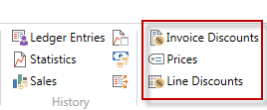
Basic Blocks
Customer
Discount Group
Window used
for Invoice Discount
Customer
Allow Line
Discount
Window used
for Price Discount sestup
Sales
header
Sales line
Window used
for Line Discounts setup
ITEM
Item Discount
Group
Unit Price
Allow Invoice
Discount
Can be accessed either from
Customer Card or Item Card

Slide 4
Window used for Line Discounts Setup (%)
Sales Type | Sales Code | Type | Code | Unit of Measure | Minimum | Line discount % | Starting date | Ending date
Customer | 10000 | 70102 (Item number) |  | PCS | 10 | 2
Customer Discount Group | Large Account | Item Discount Group | RESALE |  | 20 | 4
All Customers |  |  |  |  | 5 | 1
Campaign | Spring Campaign | Item Discount Group | BOOKS |  | 3 | 7

Slide 5
Window used for Line Discounts Setup (%)
Customer ->Navigate ->Sales section->Line discounts

Slide 6
Window used for Sales Line Discounts Setup
Customer ->Navigate ->Sales section->Prices
Original Unit price on the Item card is 293
In this model (in the seminar) enter
only two lines for one customer –
-meaning not Sale type =All customer

Slide 7
Discount combination-example
Price reduced from 100 to 90
Discount % =10
Final price after discounts were applied = 90*0,9=81,0

Slide 8
Sales lines of the SO

Slide 9
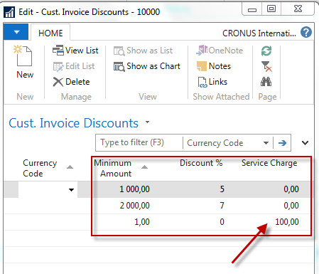
Invoice discount
Invoice discount must be allowed and manually confirmed before
you start to calculate it

Slide 10
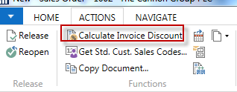
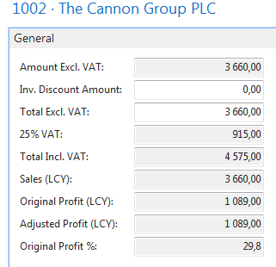
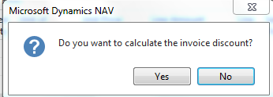
Invoice Discount calculation
Sales line
F7
(Statistics)

Slide 11
Statistics F7

Slide 12
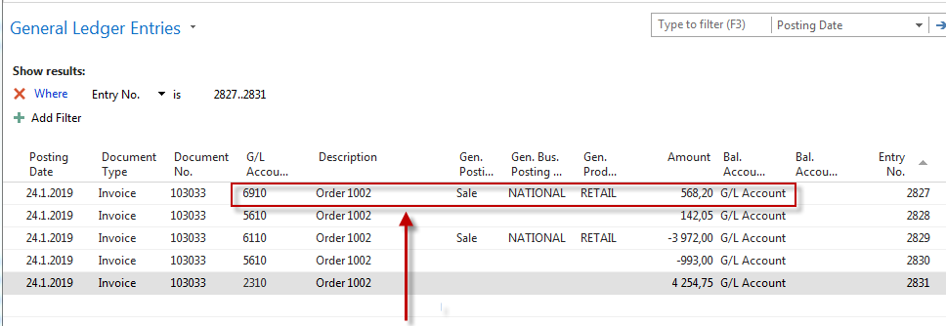
G/L Entries after posting F9
Departments->Financial Management ->General Ledger ->Archive->History->G/L Registers
Discount granted

Slide 13
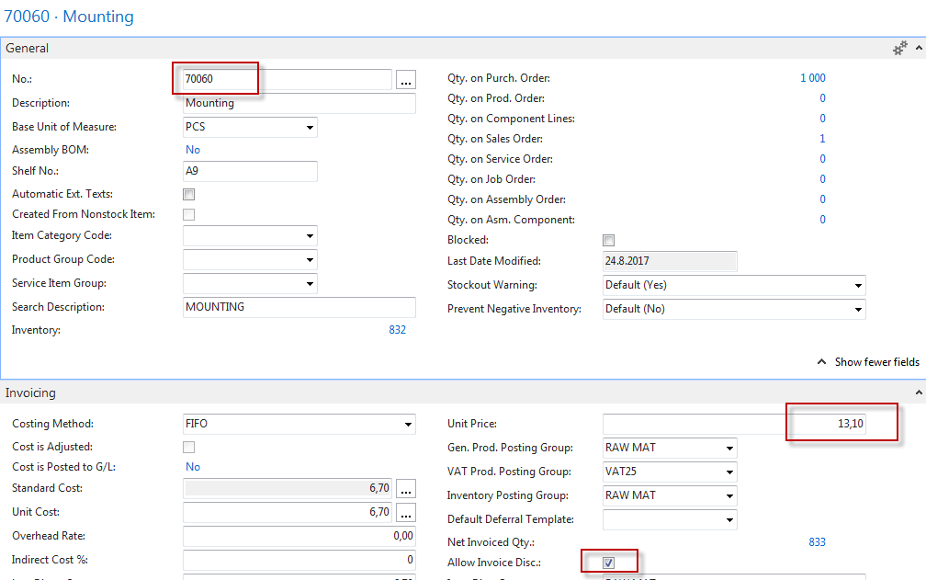
Item card used in modeling charges

Slide 14
Sales order with low unit price
Customer =10000

Slide 15
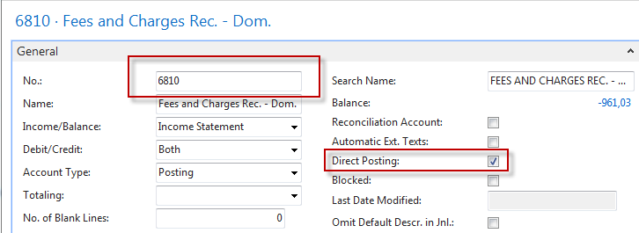
Sales order with low unit price
Customer =10000
Header

Slide 16
G/L Entries after posting F9
141,38 | 100,00
 | 25,00
 | 3,28
 | 13,10
141,38 | 141,38

Slide 17
End of the section (Discounts)
This is the end Beautiful friend This is the end My only friend, the end…
So why worry now ……

