Slide 1
Introduction to MS Dynamics NAV
(Accounting Schedule)
Ing.J.Skorkovský,CSc.
MASARYK UNIVERSITY BRNO, Czech Republic
Faculty of economics and business administration
Department of corporate economy

Slide 2
Accounting Schedules
Benefits
  User defined templates used to get reports
  Programming services necessary to create required specific reports are not used – lower costs and faster access to important data
  You can use Account schedules to analyse figures in G/L accounts or to compare G/L entries with G/L budget entries
  By employing user-defined rows and columns, you can decide exactly which figures you wish to compare and how !!
  This means that you can create as many customized financial statements as you want without using the Report Designer.

Slide 3
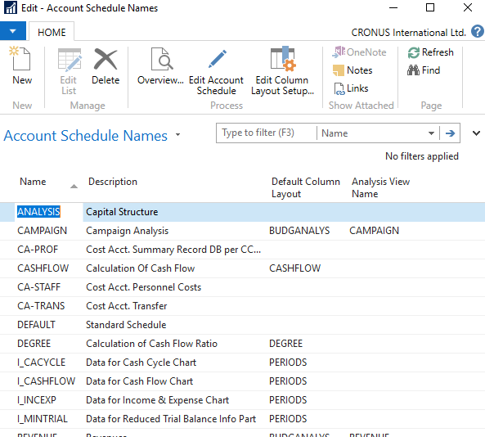
Accounting Schedules-already created - access from searching window

Slide 4

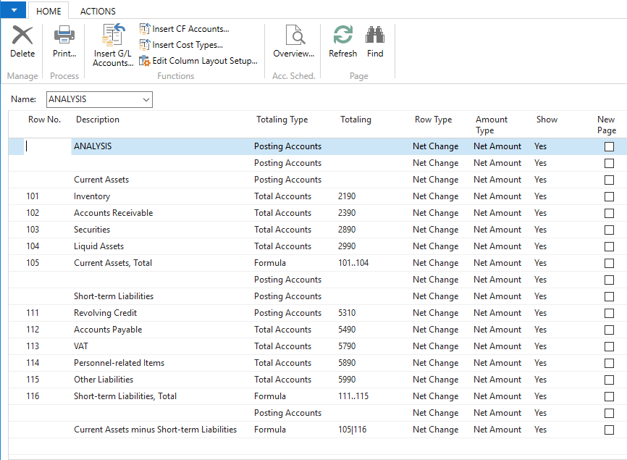
Accounting Schedules (AS) -already created - access from searching window
To see layout of the AS
Larger picture

Slide 5
Accounting Schedules (AS) -already created - access from searching window

Slide 6
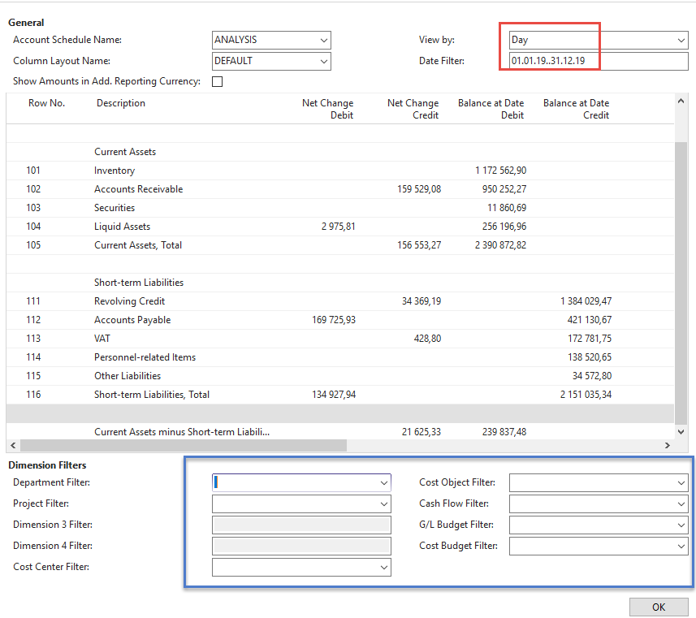
AS - overview
Modify Date filter From - To

Slide 7
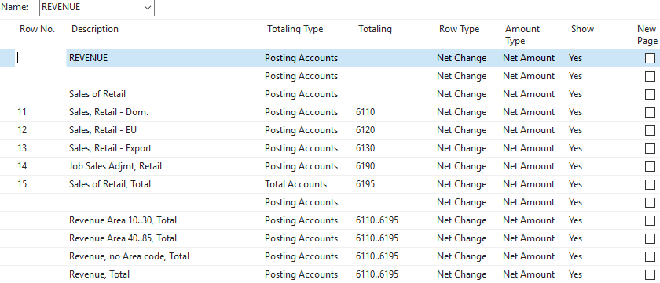
AS-different way of data display
Use button Account Schedule Name = Revenue
Use Column Layout Name = BudgAnalys
Layout

Slide 8
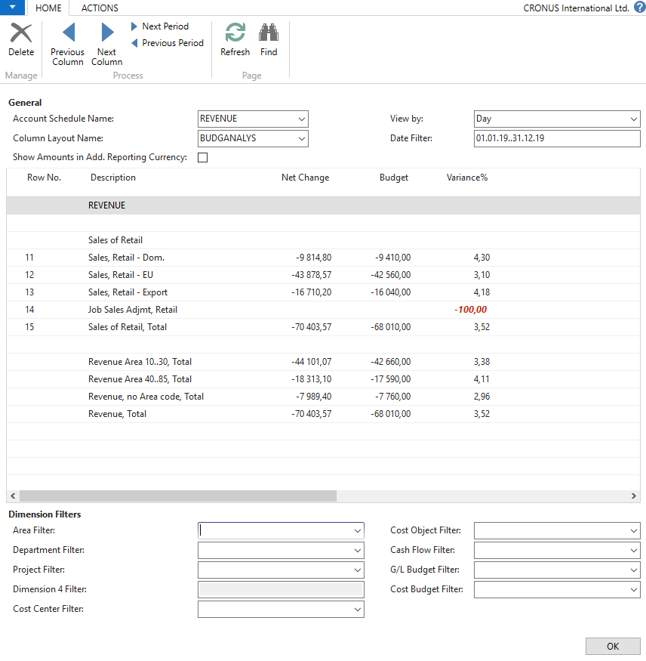
AS-different way of data display - overview icon
Modify Date filter From - To

Slide 9
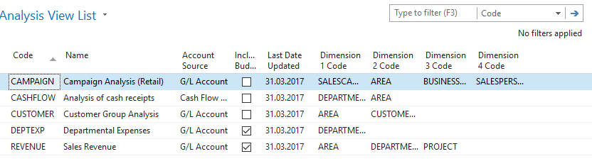
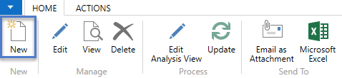
Create a simple report - access from searching window
Existing Analysis views
See next slide

Slide 10
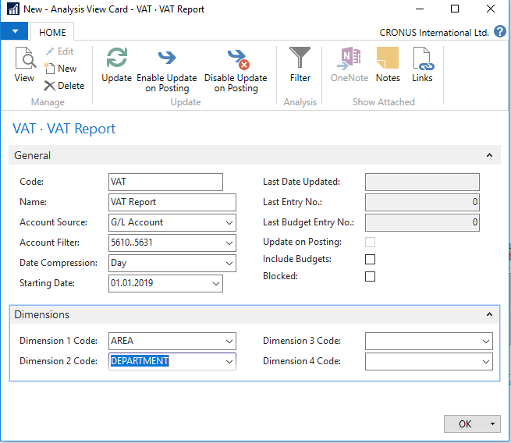
Create a simple report

Slide 11
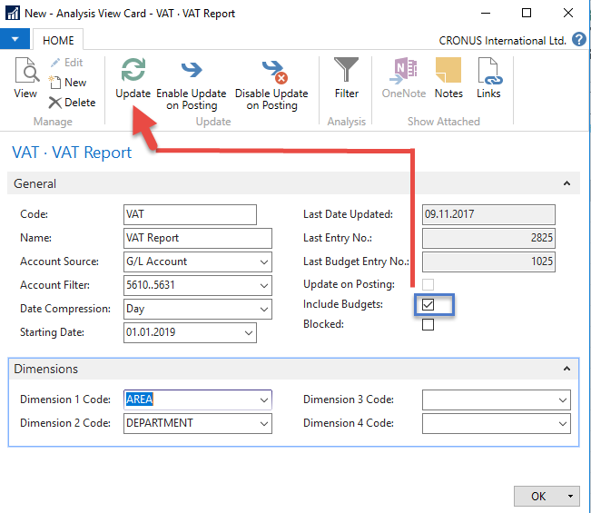
Create a simple report
Check Include Budgets and then use icon Update
ESC

Slide 12
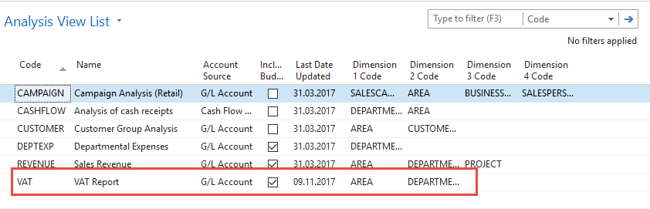
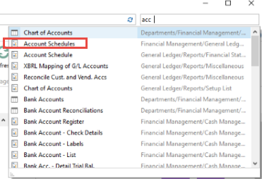
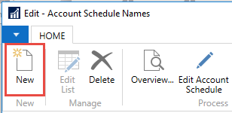
Create a simple report
Next slide

Slide 13
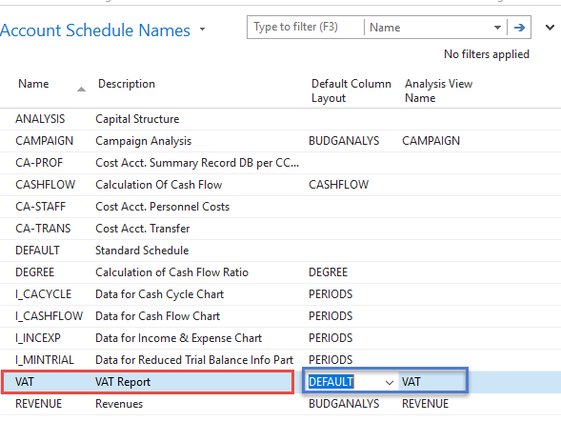
Create a simple report
Red marked enter manually, blue ones by use of F4 or mouse

Slide 14
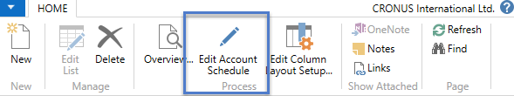
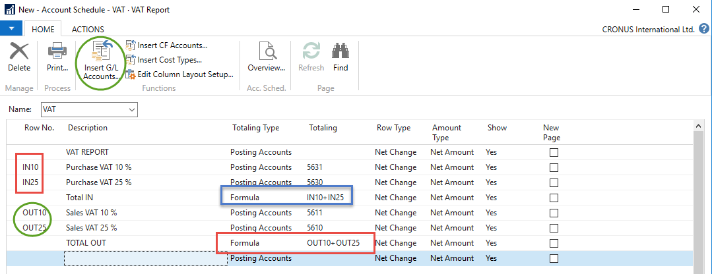
Create a simple report
Enter Accounts by use of Function from Chart of accounts and rewrite account . In the row columns enter your own variables (e.g. IN10 and IN25 for VAT10% and VAT 25% and so on). Add line formula to calculate total for purchase and sales VAT accounts.
Larger picture

Slide 15
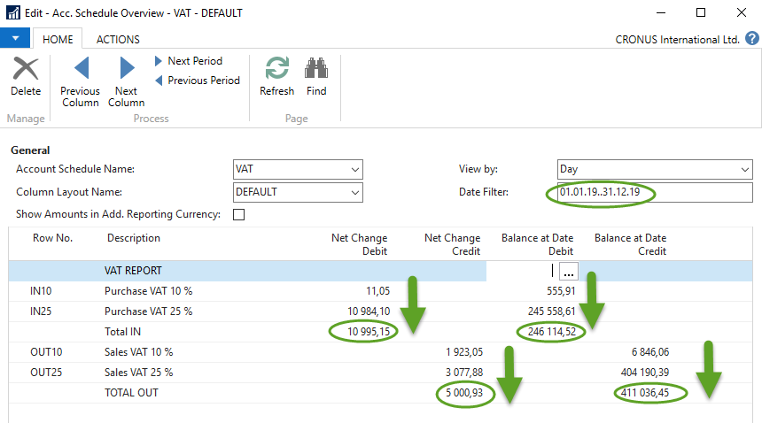
Create a simple report

Slide 16
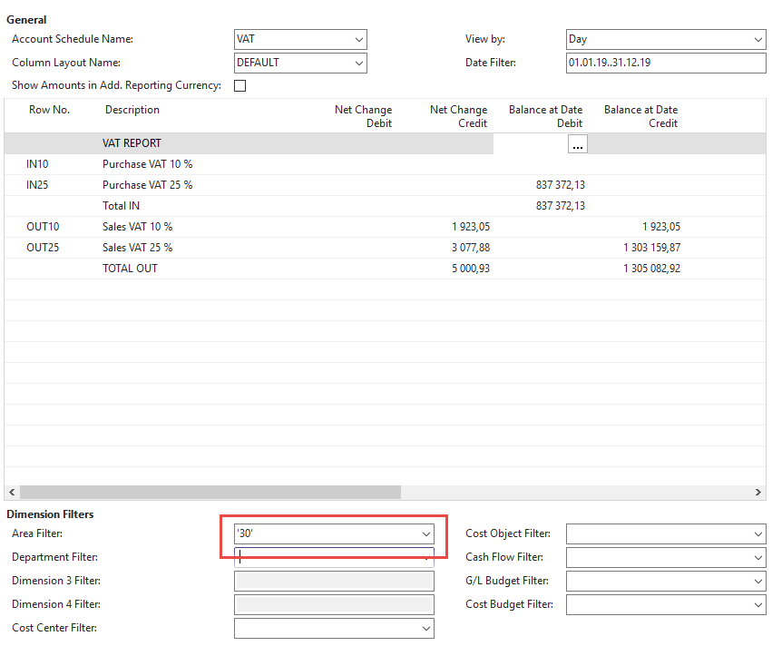
Use of dimensions

Slide 17
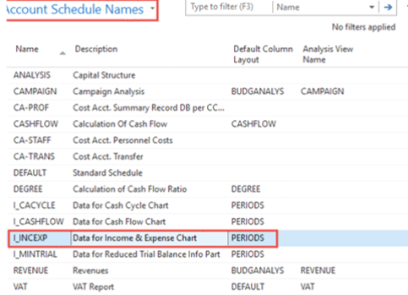
Another Account schedule
Access from searching window …
EDIT
Chosen Account
schedule template

Slide 18
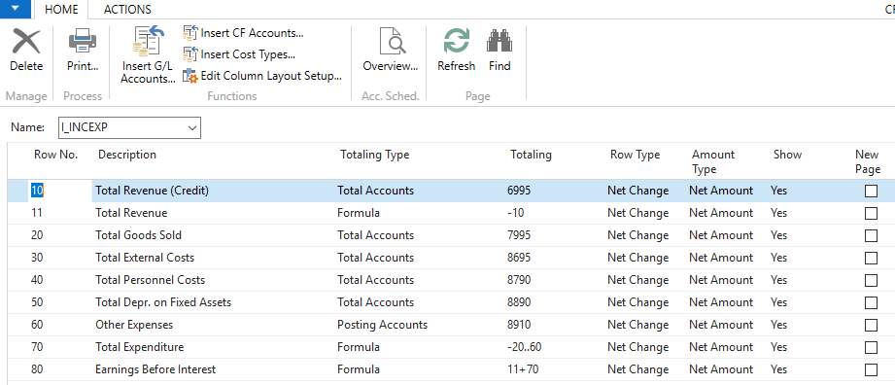
Another Account schedule
Layout

Slide 19
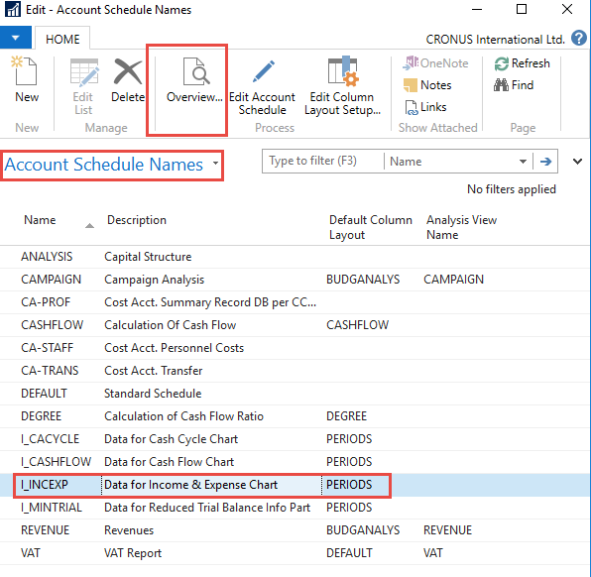
Chosen Account
schedule template

Slide 20
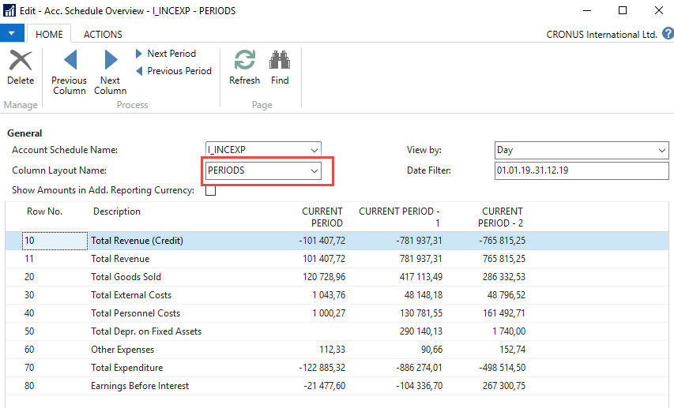

Slide 21
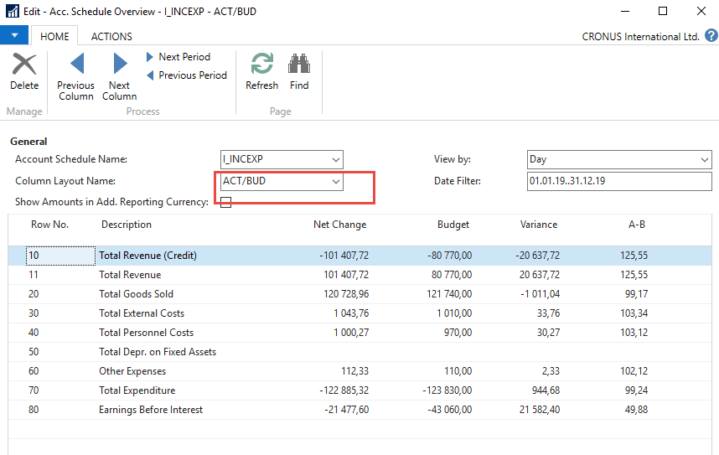
Change of column layout name

Slide 22
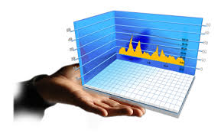
End of the section
(Accounting schedules)

