Slide 1
Linear programming-introduction
Ing.J.Skorkovský,CSc.

Slide 2
USE
Slitting and Levelling of material (coils, bars, sheets)-Cutting material, trimming,…
Blending - blending, diet, feeding rations for animals, ..
Transport problems - material flow from stock to the destination and route planning - shortest route
Assignment of resources with limited capacities - CCR
Sources : Operation Management, Quality and Competitiveness in a global environment, Russel and Taylor (can be found easily in ESF library)
CCR=Capacity Constraint Resource

Slide 3
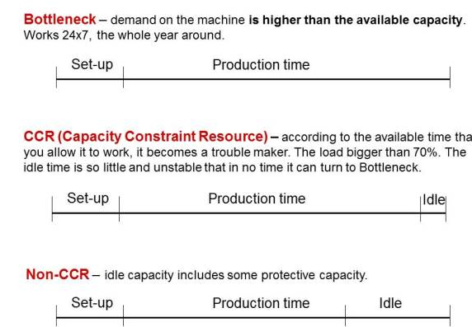
CCR –additional information
There are 3 categories of resources from the point of view of capacity:
Bottleneck
CCR – Capacity Constraint Resource
Non-CCR

Slide 4
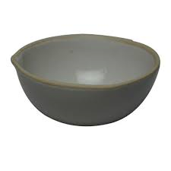

Formulation of the simple model
Product | Description | Work /hour | Material/pcs | Return/pcs
Dish | x1 | 1 | 4 | 40
Mug | x2 | 2 | 3 | 50
Which combination of products will have the greatest return
at the limits of maximum production capacity type = 40 hours
moreover, the amount of material that is limited to 120 kg of clay?
Note: A similar task in terms of flow was solved in the P&Q example
(only valid for Czech student), where the limitation in resource
B and with a maximum capacity of 2400 minutes)
Description x1 and x2 stands for variables, Material means e.g. 4 kg for one piece

Slide 5
Basic structures and used terminology
Target function
Z=Cx
We minimize our target function in the form of:
Z = c1*x1+c2*x2+…..+cn*xn with respect to the matrix of restrictive conditions:
(in our case c1=40 and c2=50 which means return/pc)
A11*x1 + A12*x2+ …+ A1n*xn (<>=) B1
A22*x1 + A22*x2+ …+ A2n*xn (<>=) B2
Am1*x1 + Am2*x2+ …+ Amn*xn (<>=)Bm
It is a classical system of linear equations is Ax=B
The solving of such a linear equation system, e.g. By use of GAUSS-JORDAN algorithm is not required if we will use Excel Solver.
xij : decision variable= level of operation activity specified by this variable
Bi : restrictive conditions , allowed deviations from the norm (in time and material)
cj : coefficient of the target function (in our case returns, meaning return 40 and 50 )
Aij : restrictive coefficients: work and material for one unit (pcs) of the product

Slide 6
Example I (introduction to the problem – practical demonstration )
Product | Description | Work /hour | Material/pcs | Return/pcs
Dish | x1 | 1 | 4 | 40
Mug | x2 | 2 | 3 | 50
Z = c1*x1+c2*x2+…..+cn*xn (classical equation from)
Target function: Z= 40*x1+50*x2, which we must maximize
Maximal production capacity = 40 hours and Maximal quantity of material =120 kg
(B1 and B2 in our mathematical expression)
Specifications of task restrictions by use of 2x2 matrix:
1*x1 + 2*x2 =40 (work- no more than 40 hours)
4*x1 + 3*x2 =120 (material=kg of clay in our case)->x1=(40-2x2)+3x2=120….
Manual solving : -> x1=24 a x2=8 and after substitution od variables (24 pcs of Dish and 8 pcs of Mug)
in target function we will get
Z=40*24+50*8=1360
(optimal Return meets the point B – see next slide)

Slide 7
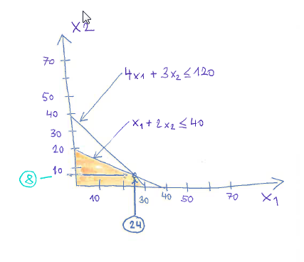
Graphical solution
B
I apologize for the inappropriate graphic expression….

Slide 8
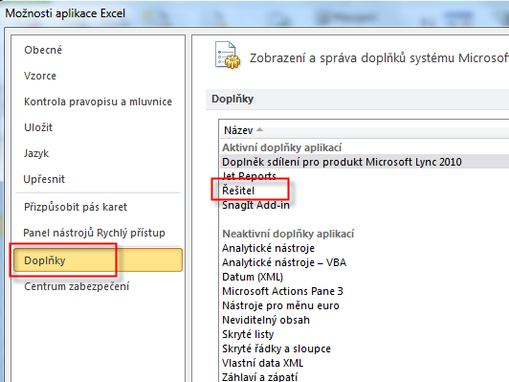
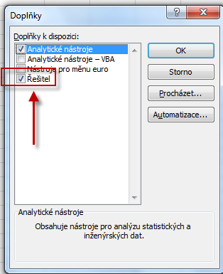
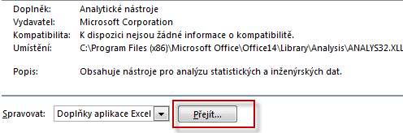

Use of Solver (Czech EXCEL)
Solver
Excel setup
Comlements
Supplement
Solver
Solver

Slide 9

Use o solver (see actual Excel formulas on one of the next slides)
x1
x2
 | Dish | Mug | Total | Capacity
Variables (x1, x2) | 0 | 0
Return | 40 | 50 | 0
Material | 4 | 3 | 0 | 120
Work | 1 | 2 | 0 | 40
Assignment
entered in table
Z
x1=Dish , x2=Mug, max 40 hour (B1), max 120 kg (B2)
Assignment
Target function Z = x1*c1 + x2*c2 = 40*x1+50*x2
4 * x1 + 3 *x2 =120 - capacity restrictions= max quantity of material =B1
1 * x1 + 2 *x2 = 40 -capacity restrictions by max work capacity=B2
Product | Description | Work /hour | Material/pcs | Return/pcs
Dish | x1 | 1 | 4 | 40
Mug | x2 | 2 | 3 | 50

Slide 10
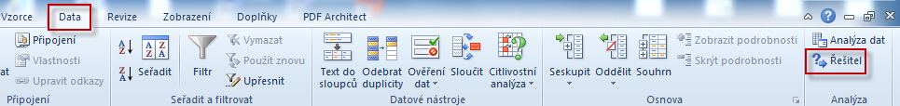
Solver start

Slide 11
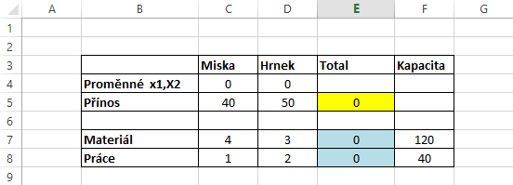
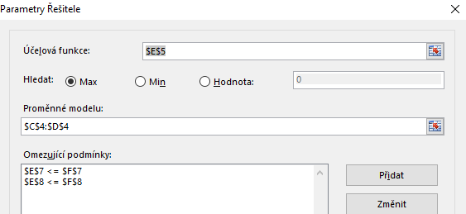
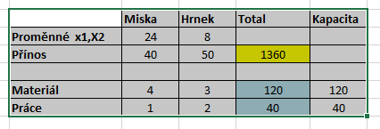
Use of Solver (Czech- not for MHP_AOPR )
E5 =
Z = x1*c1 + x2*c2 = 40*x1+30*x2
E7=C7*C4+D7*D4=4*x1+3*x2=120
E8=C8*C4+D8*D4=x1+2*x2=40

Slide 12
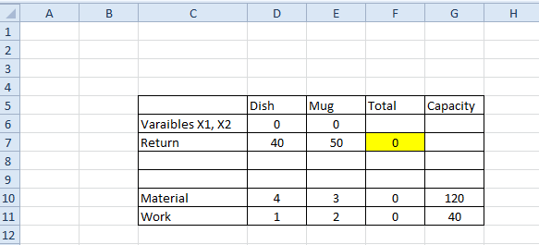
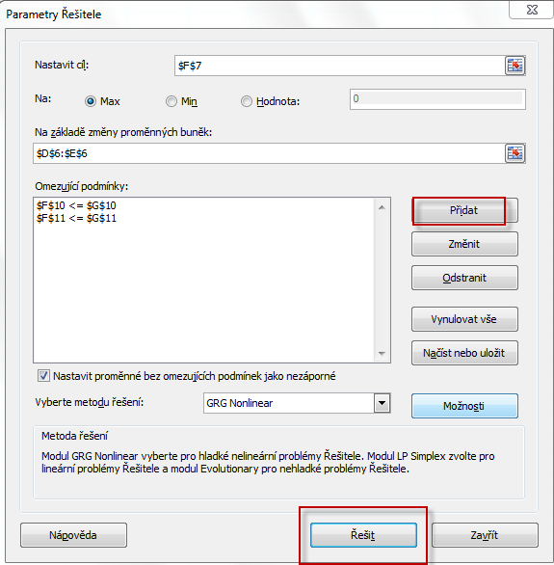
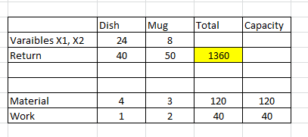
Use of solver (for MPH_AOPR)
F7 =
Z = x1*c1 + x2*c2 = 40*x1+30*x2
F10=D10*D6+E10*E6=4*x1+3*x2=120
F11=D11*D6+E11*D6=x1+2*x2=40
Target
Variables
Restrictions
Solve it

Slide 13
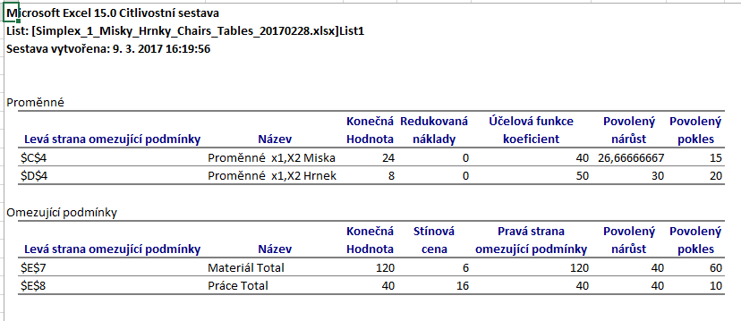
Využití Řešitele (use of Solver)

Slide 14
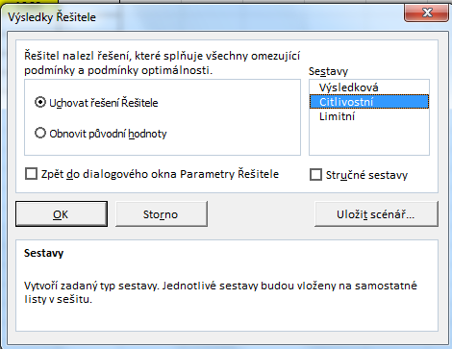
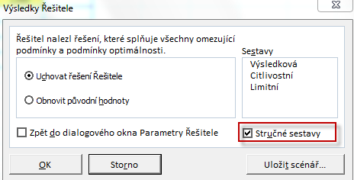
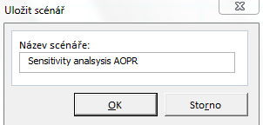
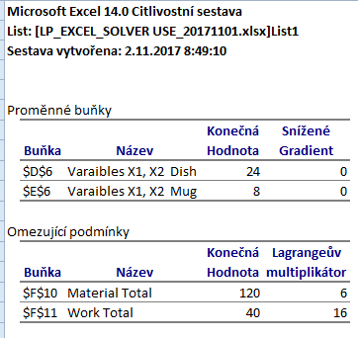
Use of Solver (English)
New Excel List

Slide 15
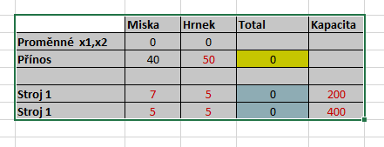
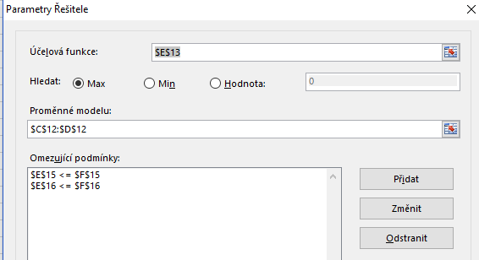
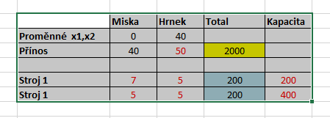
Změna úlohy- jiné výnosy jiná omezení typu práce na dvou strojích a jejich kapacitní omezení
(Change of parameters- not necessary for MPH_AOPR !!!!!)

Slide 16

OK ?

