Slide 1
Multiple Regression Analyses: Statistical Inference
October 18, 2020
Dali Laxton

Slide 2
Today’s Lecture
We are going to discuss how hypotheses about coefficients can be tested in regression models
We will explain what significance of coefficients mean
We will learn how to read regression output
  Wooldridge Chapter 4;
  Studenmund Chapter 5.1-5.4

Slide 3
Multiple Regression Analyses: Inference
Statistical inference in the regression model
  Hypothesis tests about population parameters
  Construction of confidence intervals
Sampling distributions of the OLS estimators
  The OLS estimators are random variables
  We already know their expected values and their variances
  For hypothesis testing we need to know their distribution

Slide 4


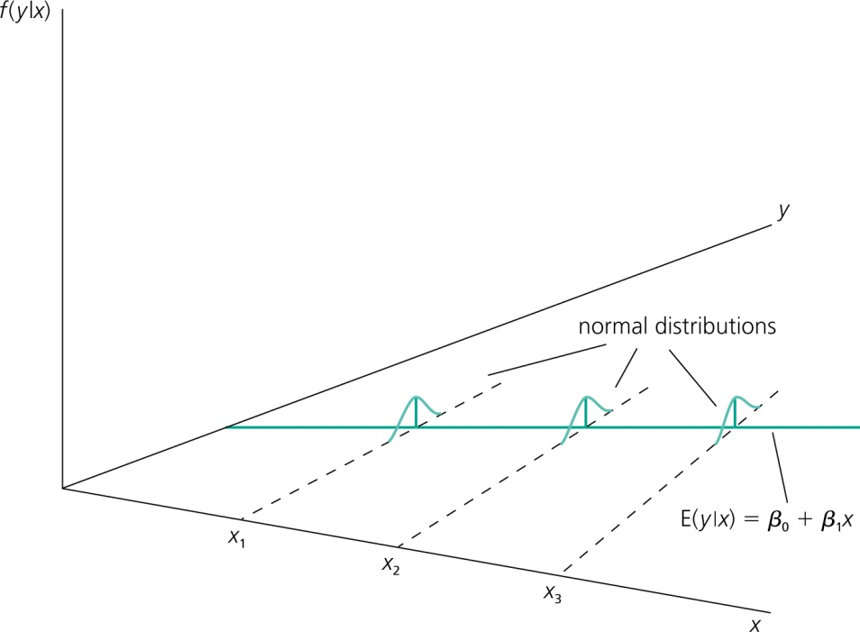
Inference: Sampling distributions of the OLS Estimators
Assumption 6 (Normality of error terms)
independently of
It is assumed that the unobserved
factors are normally distributed around the population regression function.
The form and the variance of the distribution does not depend on
any of the explanatory variables.
Notes:
Give example of impact of age on fighters’ performance

Slide 5
Show normality of the error terms in GRETL
Open GRETL load sample data “Engel”
Run regression Ols foodexp income
Generate residuals:
genr resid =foodexp-( $coeff(const) + $coeff(income)*income)
Display distribution of residuals:
freq resid --plot=display

Slide 6
Inference: Sampling distributions of the OLS Estimators
Discussion of the normality assumption
  The error term is the sum of „many“ different unobserved factors
  Sums of independent factors are normally distributed (CLT)
  Problems:
    How many different factors? Observations large enough?
    Possibly very heterogenuous distributions of individual factors
    How independent are the different factors?
  The normality of the error term is an empirical question
  At least the error distribution should be „close“ to normal
  In many cases, normality is questionable or impossible by definition
Notes:
Show in gretl normality of residuals. The central limit theorem states that if you have a population with mean μ and standard deviation σ and take sufficiently large random samples from the population with replacement (>30), then the distribution of the sample means will be approximately normally distributedwith mean equal to the population mean, regardless of the fact whether the original population distribution was normal or not.

Slide 7
Inference: Sampling distributions of the OLS Estimators
Discussion of the normality assumption (cont.)
  Examples where normality cannot hold:
    Wages (nonnegative; also: minimum wage)
    Unemployment (indicator variable, takes on only 1 or 0)
  In some cases, normality can be achieved through transformations of the dependent variable
  Under normality, OLS is the best (even nonlinear) unbiased estimator
  Important: For the purposes of statistical inference, the assumption of normality can be replaced by a large sample size (CLT)

Slide 8
Multiple Regression Analyses: Hypothesis Testing
We cannot prove that a given hypothesis is “correct” using hypothesis testing
All we can do is to state that a particular sample conforms to a particular hypothesis
We can often reject a given hypothesis with a certain degree of confidence
In such a case, we conclude that it is very unlikely the sample result would have been observed if the hypothesized theory were correct

Slide 9
Multiple Regression Analyses: Hypothesis Testing
Step 1: state explicitly the hypothesis to be tested
Null hypothesis: statement of the range of values of the regression coefficient that would be expected to occur if the researcher‘s theory were not correct
Alternative hypothesis: specification of the range of values of the coefficient that would be expected to occur if the researcher‘s theory were correct
In other words, we define the null hypothesis as the result we do not expect

Slide 10
Type I and Type II Errors
It would be unrealistic to think that conclusions drawn from regression analysis will always be right
There are two types of errors we can make:
  Type I: we reject a true null hypothesis
  Type II: We fail to reject a false null hypothesis

Slide 11
Type I and Type II Errors
Example:
H₀: The defendant is innocent
H_{A}: The defendant is guilty
  Type I error: sending an innocent person to jail
  Type II error: freeing a guilty person
Lowering the probability of Type I error means increasing the probability of Type II error;
In hypothesis testing, we focus on Type I error and we ensure that its probability is not unreasonably large

Slide 12
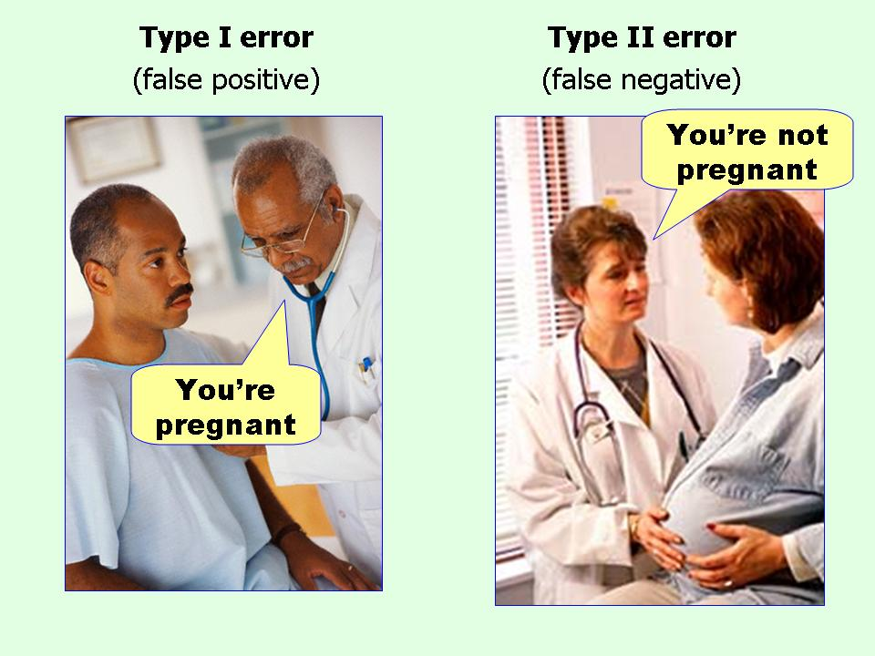
Type I and Type II Errors

Slide 13
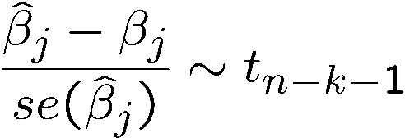

Inference: The t Test
Testing hypotheses about a single population parameter
Theorem (t-distribution for standardized estimators)
Null hypothesis (for more general hypotheses, see below)
Under assumptions 1 – 6:
If the standardization is done using the estimated standard deviation (= standard error), the normal distribution is replaced by a t-distribution
Note: The t-distribution is close to the standard normal distribution if n-k-1 is large.
The population parameter is equal to zero, i.e. after controlling for the other independent variables, there is no effect of x_{j} on y

Slide 14
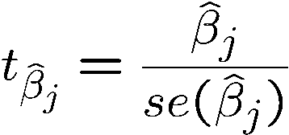
Inference: The t Test
t-statistic (or t-ratio)
Distribution of the t-statistic if the null hypothesis is true
Goal: Define a rejection rule so that, if it is true, H₀ is rejected only with a small probability (= significance level, e.g. 5%)
The t-statistic will be used to test the above null hypothesis. The farther the estimated coefficient is away from zero, the less likely it is that the null hypothesis holds true. But what does „far“ away from zero mean?
This depends on the variability of the estimated coefficient, i.e. its standard deviation. The t-statistic measures how many estimated standard deviations the estimated coefficient is away from zero.

Slide 15
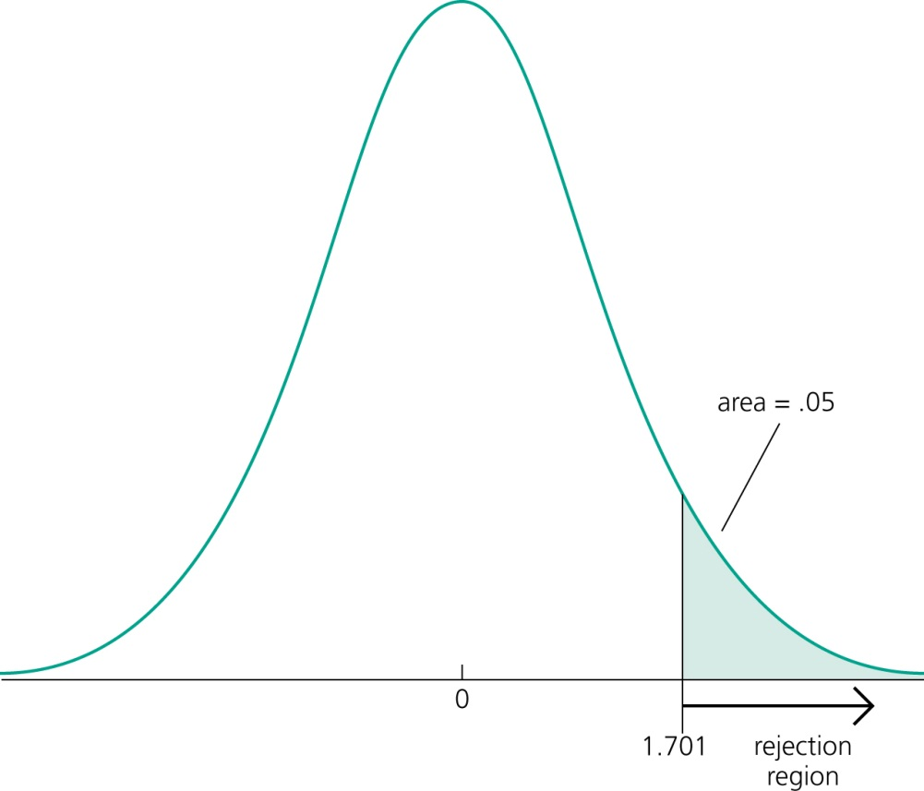


Inference: The t Test
Testing against one-sided alternatives (greater than zero)
Test ag against .
Reject the null hypothesis in favour of the alternative hypothesis if the estimated coef-
ficient is „too large“ (i.e. larger than a criti-
cal value).
Construct the critical value so that, if the
null hypothesis is true, it is rejected in,
for example, 5% of the cases.
In the given example, this is the point of the t-distribution with 28 degrees of freedom that is exceeded in 5% of the cases.
! Reject if t-statistic greater than 1.701

Slide 16



Inference: The t Test
Example: Wage equation
  Test whether, after controlling for education and tenure, higher work experience leads to higher hourly wages
Standard errors
Test against .
One would either expect a positive effect of experience on hourly wage or no effect at all.

Slide 17


Inference: The t Test
Example: Wage equation (cont.)
t-statistic
Degrees of freedom;
here the standard normal
approximation applies
Critical values for the 5% and the 1% significance level (these are conventional significance levels).
The null hypothesis is rejected because the t-statistic exceeds the critical value.
„The effect of experience on hourly wage is statistically greater than zero at the 5% (and even at the 1%) significance level.“

Slide 18
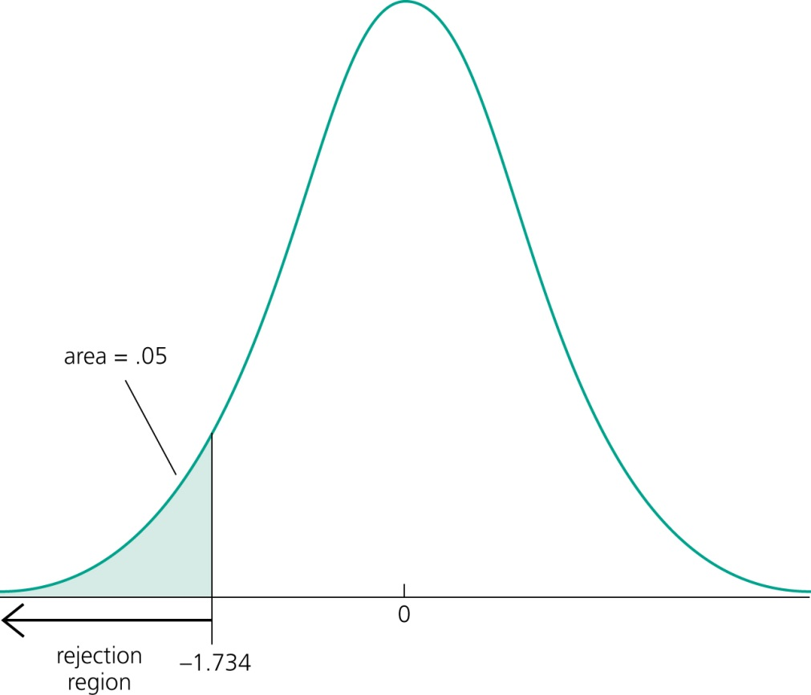

Inference: The t Test
Testing against one-sided alternatives (less than zero)
Test a against .
Reject the null hypothesis in favour of the alternative hypothesis if the estimated coef-
ficient is „too small“ (i.e. smaller than a criti-
cal value).
Construct the critical value so that, if the
null hypothesis is true, it is rejected in,
for example, 5% of the cases.
In the given example, this is the point of the t-distribution with 18 degrees of freedom so that
5% of the cases are below the point.
! Reject if t-statistic less than -1.734

Slide 19



Inference: The t Test
Example: Student performance and school size
  Test whether smaller school size leads to better student performance
Percentage of students
passing maths test
Average annual tea-
cher compensation
Staff per one thou-sand students
School enrollment
(= school size)
Test against .
Do larger schools hamper student performance or is there no such effect?

Slide 20


Inference: The t Test
Example: Student performance and school size (cont.)
t-statistic
Degrees of freedom;
here the standard normal
approximation applies
Critical values for the 5% and the 15% significance level.
The null hypothesis is not rejected because the t-statistic is not smaller than the critical value.
One cannot reject the hypothesis that there is no effect of school size on student performance (not even for a larger significance level of 15%).

Slide 21
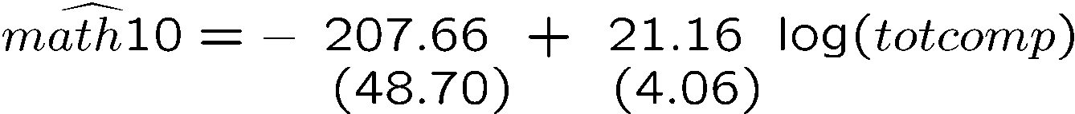
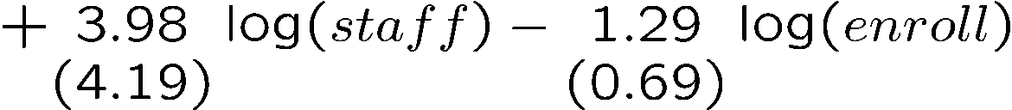



Inference: The t Test
Example: Student performance and school size (cont.)
  Alternative specification of functional form:
R-squared slightly higher
Test against .

Slide 22
Inference: The t Test
Example: Student performance and school size (cont.)
t-statistic
Critical value for the 5% significance level ! reject null hypothesis
The hypothesis that there is no effect of school size on student performance can be rejected in favor of the hypothesis that the effect is negative.
How large is the effect?
+ 10% enrollment ! -0.129 percentage points students pass test
$\frac{∂(math10)}{∂(enroll)}$= $\frac{∂(math10)}{∂log(enroll)}∗\frac{∂\log\left(enroll\right)}{∂\left(enroll\right)}=\frac{−1.29}{enroll}$
(small effect)
Notes:
Interpretation is different with linear-log -> if we increase x by 1%, y increases by Beta/100 units. log-linear -> if we increase x by 1, y increases by 100%*Beta

Slide 23
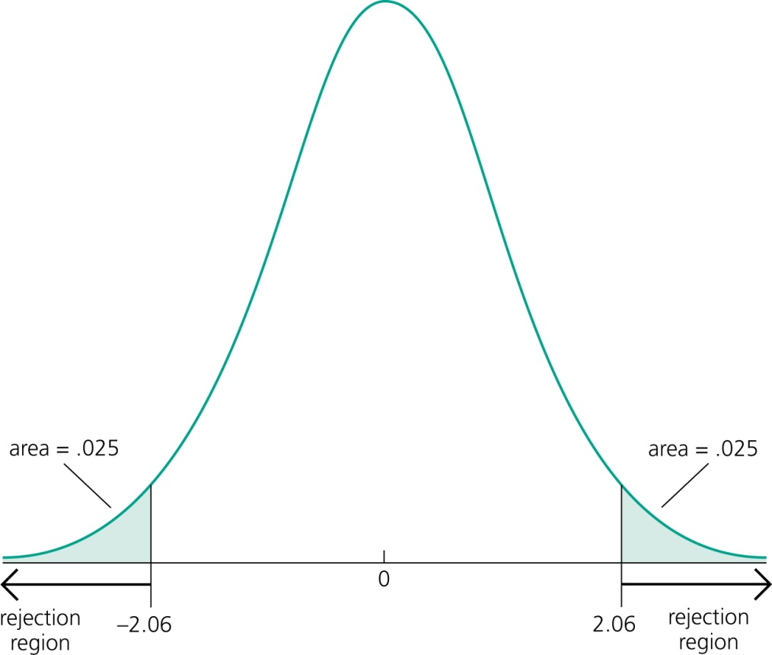

Inference: The t Test
Testing against two-sided alternatives
Test against .
Reject the null hypothesis in favour of the alternative hypothesis if the absolute value
of the estimated coefficient is too large.
Construct the critical value so that, if the
null hypothesis is true, it is rejected in,
for example, 5% of the cases.
In the given example, these are the points
of the t-distribution so that 5% of the cases
lie in the two tails.
! Reject if absolute value of t-statistic is less than -2.06 or greater than 2.06

Slide 24

Inference: The t Test
Example: Determinants of college GPA
Lectures missed per week
For critical values, use standard normal distribution
The effects of hsGPA and skipped are significantly different from zero at the 1% significance level. The effect of ACT is not significantly different from zero, not even at the 10% significance level.

Slide 25



Inference: The t Test
„Statistically significant“ variables in a regression
  If a regression coefficient is different from zero in a two-sided test, the corresponding variable is said to be „statistically significant“
  If the number of degrees of freedom is large enough so that the normal approximation applies, the following rules of thumb apply:
„statistically significant at 10 % level“
„statistically significant at 5 % level“
„statistically significant at 1 % level“

Slide 26
Inference: The t Test
Guidelines for discussing economic and statistical significance
  If a variable is statistically significant, discuss the magnitude of the coefficient to get an idea of its economic or practical importance
  The fact that a coefficient is statistically significant does not necessarily mean it is economically or practically significant!
  If a variable is statistically and economically important but has the „wrong“ sign, the regression model might be misspecified
  If a variable is statistically insignificant at the usual levels (10%, 5%, 1%), one may think of dropping it from the regression
  If the sample size is small, effects might be imprecisely estimated so that the case for dropping insignificant variables is less strong

Slide 27

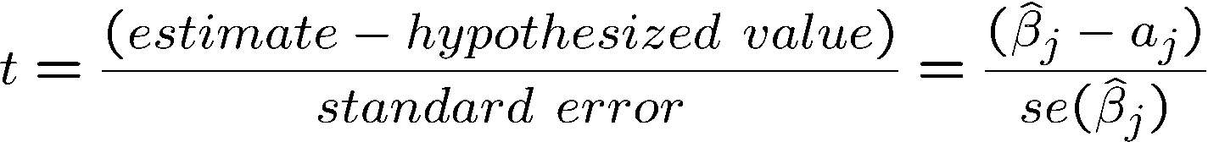
Inference: The t Test
Testing more general hypotheses about a regression coefficient
Null hypothesis
t-statistic
The test works exactly as before, except that the hypothesized value is substracted from the estimate when forming the statistic
Hypothesized value of the coefficient

Slide 28
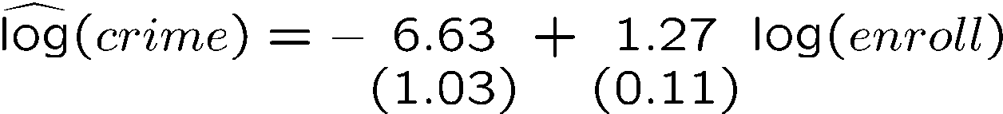

Inference: The t Test
Example: Campus crime and enrollment
  An interesting hypothesis is whether crime increases by one percent if enrollment is increased by one percent
Estimate is different from one but is this difference statistically significant?
The hypothesis is rejected at the 5% level

Slide 29
Inference: The t Test
Computing p-values for t-tests
  If the significance level is made smaller and smaller, there will be a point where the null hypothesis cannot be rejected anymore
  The reason is that, by lowering the significance level, one wants to avoid more and more to make the error of rejecting a correct H₀
  The smallest significance level at which the null hypothesis is still rejected, is called the p-value of the hypothesis test
  A small p-value is evidence against the null hypothesis because one would reject the null hypothesis even at small significance levels
  A large p-value is evidence in favor of the null hypothesis
  P-values are more informative than tests at fixed significance levels

Slide 30
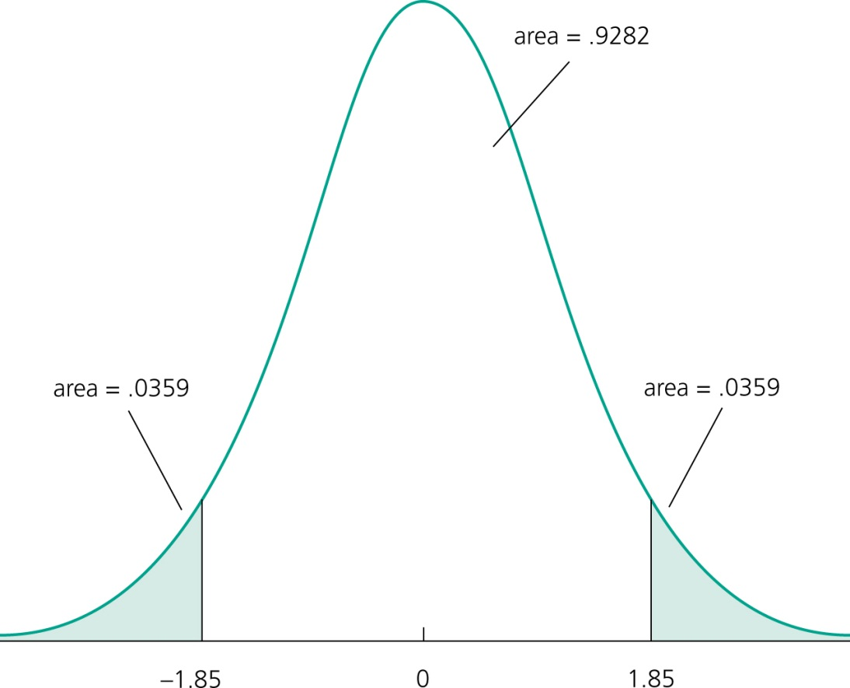
Inference: The t Test
How the p-value is computed (here: two-sided test)
The p-value is the significance level at which one is indifferent between rejecting and not rejecting the null hypothesis.
In the two-sided case, the p-value is thus the probability that the t-distributed variable takes on a larger absolute value than the realized value of the test statistic, e.g.:
From this, it is clear that a null hypothesis is rejected if and only if the corresponding p-value is smaller than the significance level.
For example, for a significance level of 5% the t-statistic would not lie in the rejection region.
These would be the critical values for a 5% significance level
value of test statistic

Slide 31
Inference: Confidence Intervals
Critical value of
two-sided test
Confidence intervals
Simple manipulation of the result in Theorem 4.2 implies that
Interpretation of the confidence interval
  The bounds of the interval are random
  In repeated samples, the interval that is constructed in the above way will cover the population regression coefficient in 95% of the cases
Lower bound of the
Confidence interval
Upper bound of the
Confidence interval
Confidence level

Slide 32



Inference: Confidence Intervals
Confidence intervals for typical confidence levels
Relationship between confidence intervals and hypotheses tests
Use rules of thumb
reject in favor of

Slide 33



Inference: Confidence Intervals
Example: Model of firms‘ R&D expenditures
Spending on R&D
Annual sales
Profits as percentage of sales
0.0217
(0.0128 )
(0.0128 )
The effect of sales on R&D is relatively precisely estimated as the interval is narrow. Moreover, the effect is significantly different from zero because zero is outside the interval.
This effect is imprecisely estimated as the in-
terval is very wide. It is not even statistically
significant because zero lies in the interval.

Slide 34


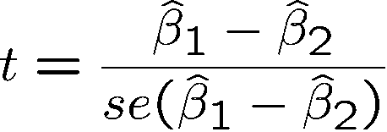
Inference: Testing hypotheses about a linear combination of parameters
Example: Return to education at 2 year vs. at 4 year colleges
Years of education at 2 year colleges
Years of education at 4 year colleges
Test against .
A possible test statistic would be:
The difference between the estimates is normalized by the estimated standard deviation of the difference. The null hypothesis would have to be rejected if the statistic is „too negative“ to believe that the true difference between the parameters is equal to zero.

Slide 35



Inference: Testing hypotheses about a linear combination of parameters
Impossible to compute with standard regression output because
Alternative method
Usually not available in regression output
Define and test against .
Insert into original regression
a new regressor (= total years of college)

Slide 36

Inference: Testing hypotheses about a linear combination of parameters
Total years of college
Estimation results
This method works always for single linear hypotheses
Hypothesis is rejected at 10% level but not at 5% level

Slide 37

Inference: The F Test
Testing multiple linear restrictions: The F-test
Testing exclusion restrictions
Salary of major lea-
gue baseball player
Years in
the league
Average number of
games per year
Batting average
Home runs per year
Runs batted in per year
against
Test whether performance measures have no effect/can be exluded from regression.

Slide 38
Inference: The F Test
Estimation of the unrestricted model
None of these variabels are statistically significant when tested individually
Idea: How would the model fit be if these variables were dropped from the regression?

Slide 39
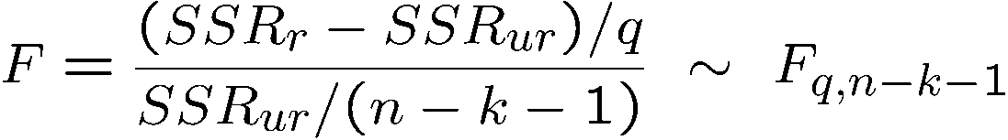
Inference: The F Test
Estimation of the restricted model
Test statistic
The sum of squared residuals necessarily increases, but is the increase statistically significant?
Number of restrictions
The relative increase of the sum of squared residuals when going from
H₁ to H₀ follows a F-distribution (if
the null hypothesis H₀ is correct)

Slide 40
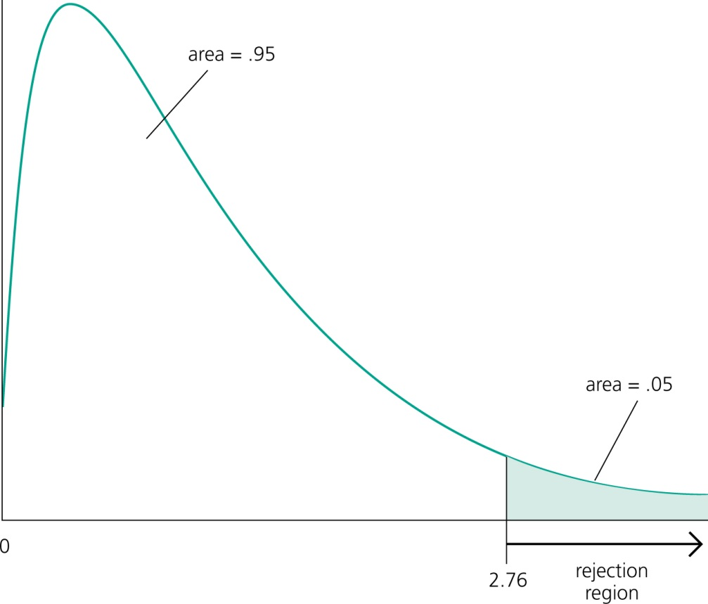
Inference: The F Test
Rejection rule
A F-distributed variable only takes on positive values. This corresponds to the fact that the sum of squared residuals can only increase if one moves from H₁ to H₀.
Choose the critical value so that the null hypo-thesis is rejected in, for example, 5% of the cases, although it is true.

Slide 41
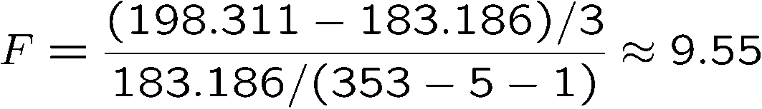
Inference: The F Test
Test decision in example
Discussion
  The three variables are „jointly significant“
  They were not significant when tested individually
  The likely reason is multicollinearity between them
Number of restrictions to be tested
Degrees of freedom in
the unrestricted model
The null hypothesis is overwhel-mingly rejected (even at very small significance levels).

Slide 42

Inference: The F Test
Test of overall significance of a regression
The test of overall significance is reported in most regression packages; the null hypothesis is usually overwhelmingly rejected
The null hypothesis states that the explanatory variables are not useful at all in explaining the dependent variable
Restricted model
(regression on constant)

