Slide 1
Economic Policy
Limits of Economic Policy

Slide 2
Economic Policy
the actions that states (governments, central banks) take in the economic field
Policymaker
Objectives
Instruments
Limits
Political context
Institutions

Slide 3
The expansion of the role of the public sector
The 20th century saw a gradual but large expansion in the role of the state in the economy because:
  Political and ideological factors
  Marxist and socialistic thinking (government should play significant role in redistributing income, shift toward and „mixed“ economy)
  Keynesian thinking (countries with large public sector were believed to be less subject to business cycles)

Slide 4
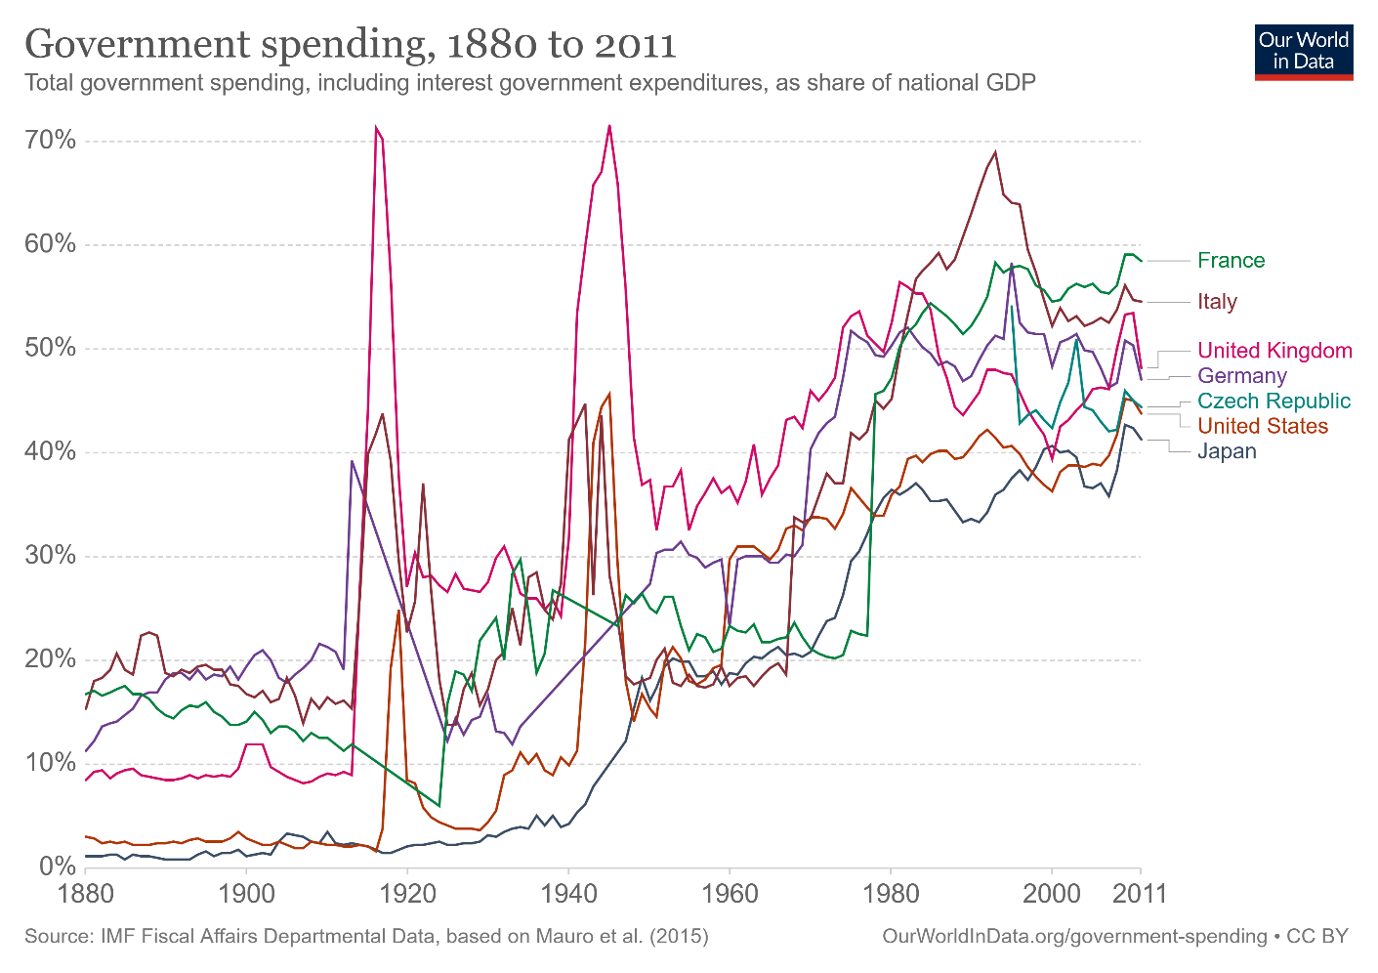

Slide 5
The expansion of the role of the public sector
It was implicitly (if not explicitly) assumed that:
  The governments had abilities lacking in the private sector (better managerial skills, higher level of expertise, sufficient amounts of capital)
  The actions of the public sector were driven by the objective of promoting social welfare
  Economic decisions were made in rational and transparent way
  Policymakers have all relevant info and full control over the policy instruments

Slide 6
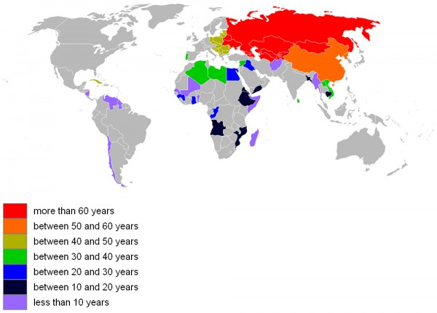
Socialist economy at some point

Slide 7
Nationalization in Western Europe
France
  1945: Crédit lyonnais, Société générale, Renault
  1946: Electricite de France, Gaz de France
Spain
  1944: Iberia
  1945: 79 % of Telefónica
Sweden
  1939-1948: private railway companies
  1957: the mining company LKAB
United Kingdom
  1946: Coal industry
  1947: Central Electricity Generating Board
  1948: National rail and inland water transport
  1967: British Steel Corporation

Slide 8
The end of naive picture
Governments are not as omniscient and omnipotent as was implicitly assumed after WWII till 1970s.
There are five main limits to the “traditional” approach to EP:
  Governments have imperfect knowledge about the structure of economy and of future risks
  Firms and households devise they own strategies and they react to (and anticipate) economic policy measures
  Governments may not be able to convince private agents that they will actually do what they have announced
  Policymakers may not have the information they need to take decisions
  Policymakers may not pursue the general interest

Slide 9
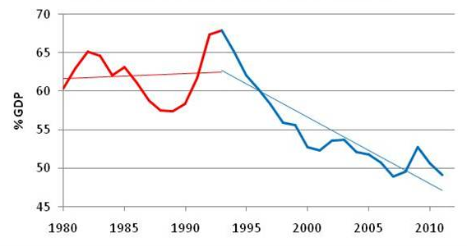
Sweden´s governemnt spending

Slide 10
The limits of knowledge: uncertainty and risk
The government does not have all the information to take action, but it cannot wait until it has all the information.
Government is not able to predict the consequences of some action exactly
  => uncertainty about adequate choice of policy tools
Many policy decisions have irreversible consequences
  => e.g., joining Eurozone

Slide 11
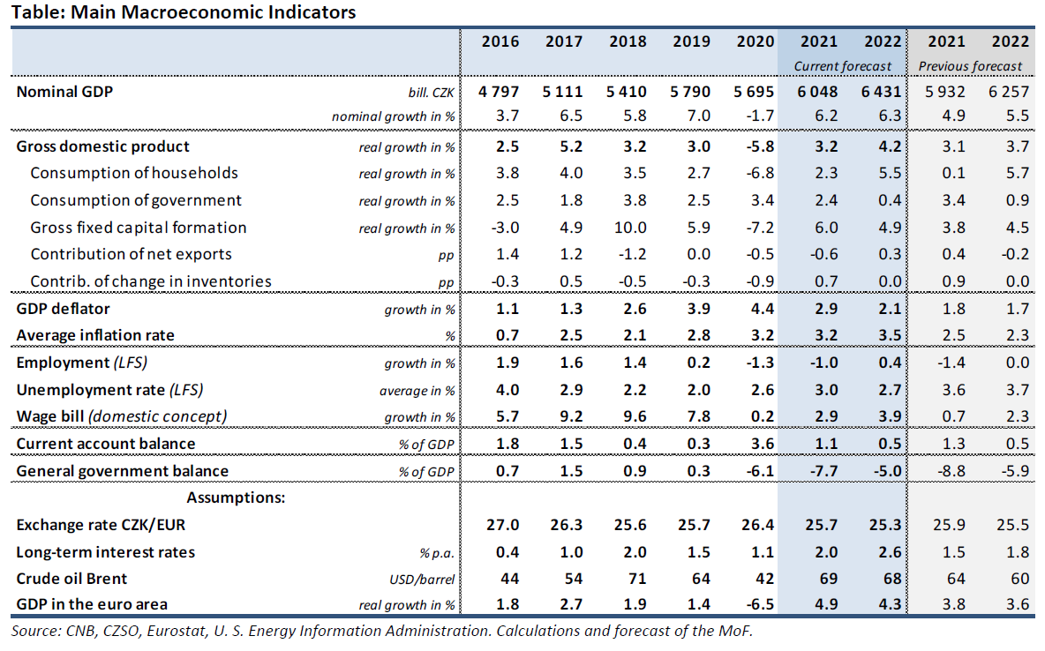
Uncertainty and risk
Exchange rate: 25,3
Crude oil Brent: 83 USD

Slide 12
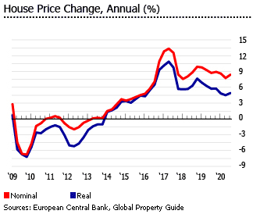
Current forecast risks and uncertainty
epidemic situation
global supply chains
structural changes in the economy (Green Deal)
deferred consumption
overvaluation of property prices

Slide 13
Time lags
Cognitive delay
Planning delay
Administrative delay
Implementation delay
Efficiency delay
Monetary Policy – 18 months time lag
Fiscal Policy 6 – 24 months time lag

Slide 14
CS: Next Generation EU
EU's recovery plan from the pandemic
over €800 billion
The aim is to mitigate the economic and social impact of the coronavirus pandemic, to make European economies and societies more sustainable and resilient, and to prepare them for the challenges and opportunities of the green and digital transformation.
The first money will arrive in the 2nd half of 2021
Do economies need fiscal expansion?

Slide 15
CS: Next Generation EU
 | GDP
Country | 2020 | 2021 | 2022
Belgium | -6,30% | 5,40% | 3,70%
Germany | -4,80% | 3,60% | 4,60%
Estonia | -2,90% | 4,90% | 3,80%
Ireland | -3,40% | 7,20% | 5,10%
Greece | -8,20% | 4,30% | 6,00%
Spain | -10,80% | 6,20% | 6,30%
France | -7,90% | 6,00% | 4,20%
Italy | -8,90% | 5,00% | 4,20%
Netherlands | -3,70% | 3,30% | 3,30%
Austria | -6,30% | 3,80% | 4,50%
Slovakia | -4,80% | 4,90% | 5,30%
Czech Republic | -5,60% | 3,90% | 4,50%
Sweeden | -2,80% | 4,60% | 3,90%
EU | -6,00% | 4,80% | 4,50%

Slide 16
The limits of confidence: credibility problems
Credibility problems arise from intertemporal inconsistency (time inconsistency)
time inconsistency: temptation for government to mislead private agents in the name of general interest => ex post and ex ante optimal policies do not coincide.

Slide 17
The limits of confidence: credibility problems
Example: Government announces it will scarp taxes on fixed capital to encourage investment. Then forgive on its promise because it is socially optimal ex post to finance public goods by taxing capital. What will be the result?
Another application to monetary policy, exchange-rate policy, management of the public debt
Unfulfilled promises undermine confidence in EP and hamper its effectiveness.
How can the credibility problem be solved?

Slide 18
The limits of confidence: credibility problems
Solutions:
  Delegation to independent agencies: central banks, regulatory agencies,…
  Banish discretionary policies and follow fixed policy rules: inflation targeting, fiscal rules, agreements for the promotion and protection of investments
  Transparency

Slide 19
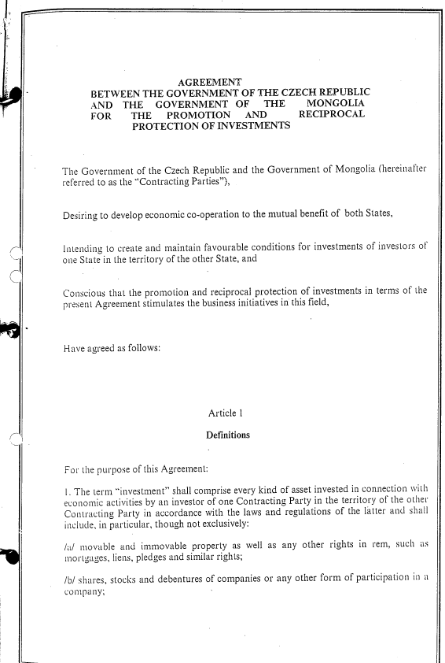
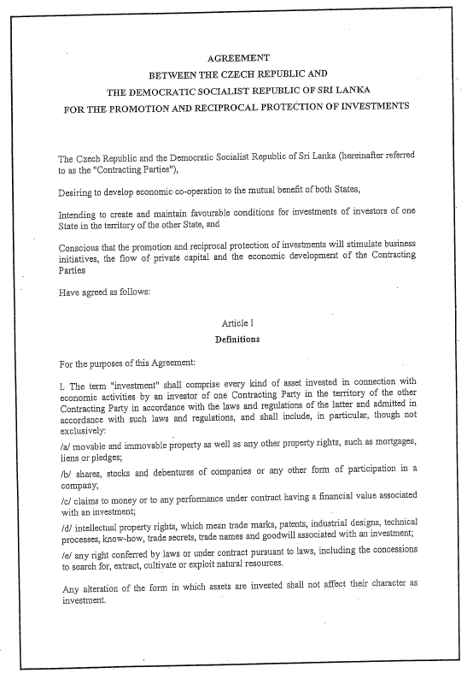
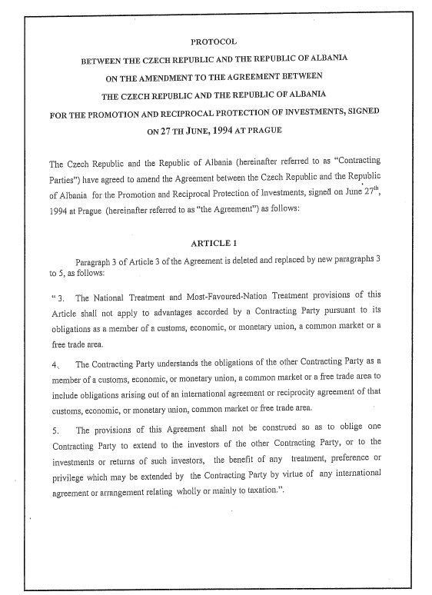
Examples of Agreement for the promotion and protection of investments

Slide 20
The limits of confidence: moral hazard
Moral hazard problems arise when probability of government intervention changes private behavior and induces more risk taking
Examples: IMF interventions in emerging countries, role of lender of last resort of the central bank, public insurance schemes…
How can the credibility problem be solved?

Slide 21
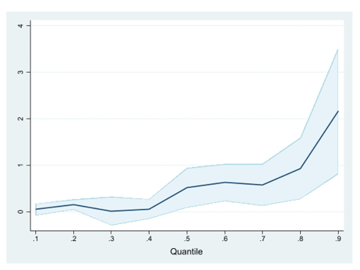
The limits of confidence: moral hazard
The impact of supplementary health insurance on doctors' visits
Solution:
  make public intervention rare and costly
Hansoo Ko 2020

Slide 22
The limits of information
Policymakers do not have full access to all information
Information is used strategically by those with access to it
Risk of regulatory capture (regulatory agencies may come to be dominated by the interests they regulate and not by the public interest)
Major issue for:
  regulation and supervision in technical areas (telecom, energy, finance…)
  contracts (e.g., for provision of government-financed services such as health care)
  Internal organization of government

Slide 23
The limits of information: example
Gosplan – central planning commission in Soviet Union
Information had companies:
  Over-estimated their need for inputs
  Under-estimated their productivity
Friedrich A. Hayek: The Use of Knowledge in Society

Slide 24
The limits of information: example
Principal-agent model
Relationship between landers and borrowers, producers and consumers,…

Slide 25
The limits of information
Theory:
  principal-agent model: the principal, who delegates a task to the agent, does not have full info about agent’s capabilities and performance => suboptimal results
Solution:
  Incentive contracts (such as performance-related compensation and promotion, e.g., Walsh contract for central bankers – wage negatively dependent on the difference between the actual and the target inflation rate.)

Slide 26
Conflict of interests
Why may politicians deviate from general interest?
  short-sightedness (electoral cycles)
  pressures from interest groups
  re-election motivation (political business cycles)
  partisan behaviour (favour the majority that supports political parties in government)

Slide 27
Conflict of interests
Solutions:
  Incentive contracts for politicians
  Procurement rules
  Anti-bribery laws
  Delegation to independent agencies

Slide 28
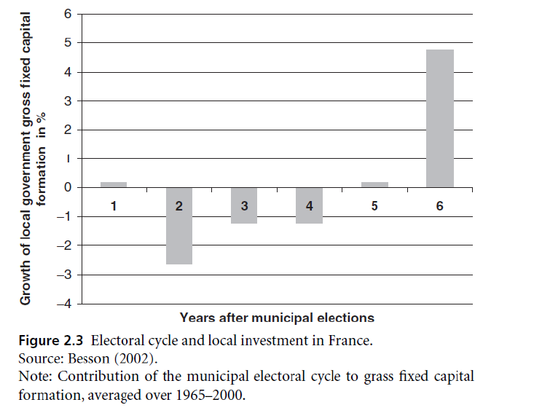
Evidence of politically‐motivated decisions

Slide 29
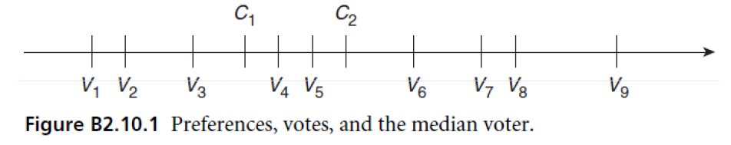
The median voter theory
Voter chooses the party whose preferences are close to his or her own: voters V1 to V4 will for example vote for candidate C1 and voters V5 to V9 to candidate C2.
If there are only two parties (left‐wing and right‐wing), they will converge on the preference of the median voter V5 => limited program differentiation

Slide 30
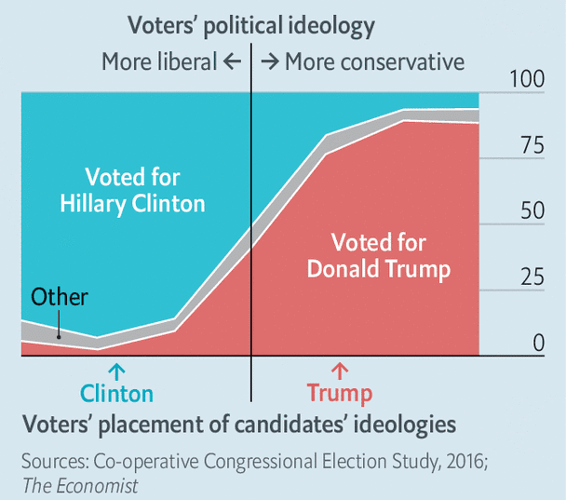
The median voter

Slide 31
Should policymaking be delegated?
Technocrats are better in presence of:
  technical complexity (e.g., financial/safety regulation)
  stable social preferences
  the decisions in question and their effects are not easily observable by voters (merger control)
  the decision with vulnerable to time inconsistency
  the decision affect the distribution of income between generations

Slide 32
Should policymaking be delegated?
But decision needs to remain political when:
  Social preferences are unstable
  Policy involves unavoidable trade‐offs
  Policy involves significant redistributions within generations
=> Today’s hot topics: balanced budget rules, fiscal councils

Slide 33
Reference textbook
Benassy-Quéré, A. et al. Economic Policy: Theory and practise. Oxford University Press, 2010. Chap. 2.1

