Slide 1
Economic Policy
Fiscal Policy

Slide 2
Fiscal Policy
Stabilization policy
Concepts of fiscal policy
Theories: Keynesian vs. neo-classical view
FP during crisis
Public debt
measurement
debt and deficit dynamics
how to reduce the debt burden
Fiscal rules

Slide 3
Stabilization Policy
aim: maintain a healthy level of economic growth and minimal price changes; to smooth the economic cycle
Stabilization Policy
Monetary Policy
Fiscal Policy

Slide 4
Stabilization Policy

Slide 5
Stabilization Policy

Slide 6
Stabilization Policy

Slide 7
Three key facts about economic fluctuations
Fact 1: Economic fluctuations are irregular and unpredictable
Fact 2: Most macroeconomic quantities fluctuate together
e.g., investment, unemployment, consumption
Fact 3: As output falls, unemployment rises

Slide 8
Concepts and measurements
Fiscal policy (FP) – set of decisions and rules regarding taxes and public expenditures for purposes of smoothing the fluctuations of economic cycle in order to keep unemployment close to its equilibrium value and avoid the build-up of deflationary and inflationary pressures (Samuelson, 1948)
Theoretically inspired by J.M. Keynes
Now in many countries the key point of FP is public debt sustainability.

Slide 9
Fluctuations in output and the size of government in the US (1870–2015)

Slide 10
Public expenditures in various countries (% of GDP)

Slide 11
Keynesian view: AS – AD model
macroeconomic model that explains price level and output through the relationship between AD and AS
aggregate demand
total amount of demand for goods and services produced in the economy
combinations of price level and level of output (GDP)
AD slopes downward
The Wealth Effect (when prices fall consumers are wealthier which encourages to spend more)
The Interest-Rate Effect (lower price level reduces the interest rate which encourages greater spending on investment goods)
The Exchange-Rate Effect (lower interest-rate depreciate the real exchange rate which stimulates exports)

Slide 12
Keynesian view: AS – AD model
long-run aggregate supply
determines the quantity of goods and services supplied in the long run
in the long run it depends on labour, capital, natural resources and technology
short-run aggregate supply
combination of price level and level of goods and services supplied in the short run
SRAS slopes upward
The Sticky-Wage Theory (nominal wages are slow to adjust, or are „rigid“ in the short run)
The Sticky-Price Theory (prices of some goods and services are slow to adjust in the short run)
The Misperceptions Theory (lower price level causes misperceptions about relative prices; these misperceptions induce suppliers to respond to the lower price level by decreasing the quantity of goods and services supplied)

Slide 13
Keynesian view: AS – AD model

Slide 14
Economic Fluctuations in AS – AD model
suppose a wave of pessimism in the economy
people lose confidence in the future
households cut back on their spending
firms put off buying new equipment
fall in AD
decrease of output
decrease in prices

Slide 15
Economic Fluctuations in AS – AD model

Slide 16
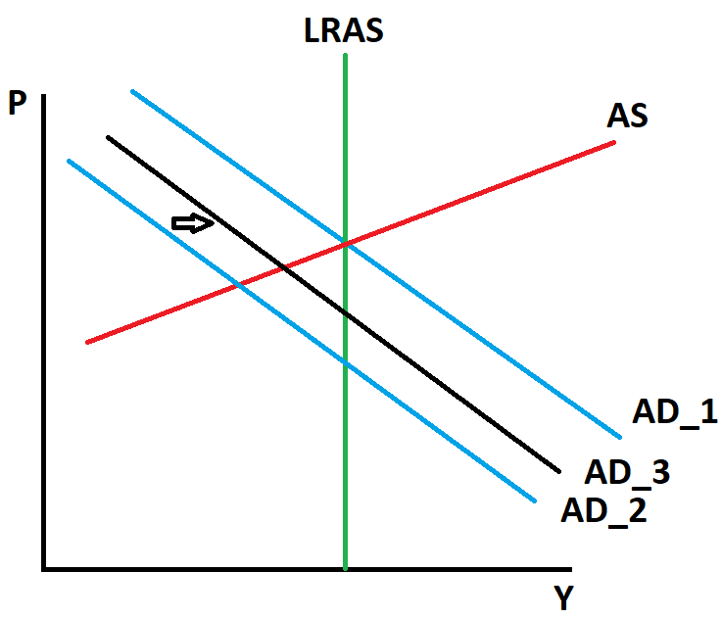
The role of government in AS – AD model

Slide 17
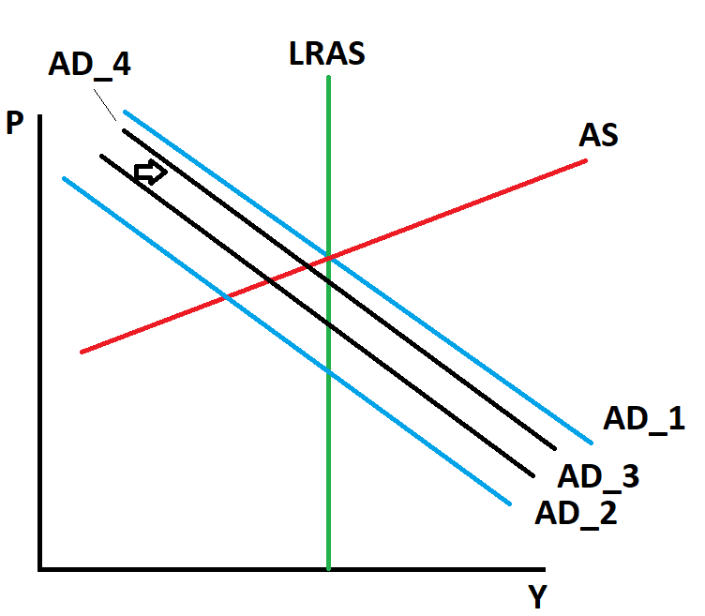
Multiplier
The US government buys $20 billion of goods from Boeing => increase in employment and profits of Boeing.
Workers and firm owners see higher profits, they respond to this increase in income by raising their own spending.
Increase in government spending => increase the demand for the products of many firms in the economy.
Multiplier = „The additional shifts in aggregate demand that result when expansionary fiscal policy increases consumer spending“.

Slide 18
The Crowding-Out Effect
increase in government spending => increase in government deficit => increase in interest rate => decrease in private investment
The crowding-out effect = the offset in aggregate demand that results when expansionary fiscal policy raises the interest rate and thereby reduces investment spending

Slide 19
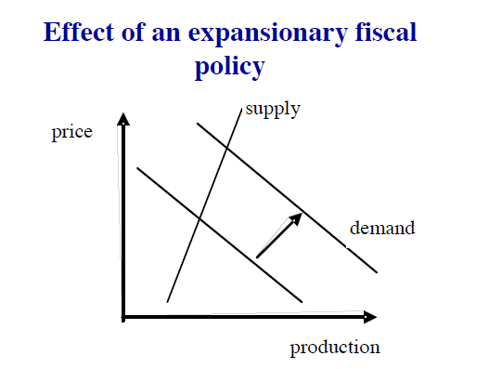
The neoclassical critique
Critique of the multiplier
Full financial crowding-out
Supply rigidity
Fiscal expansion
Rise in the interest rate => penalizes private investment
Fiscal policy effectiveness is limited in time (data shows that multiplier is close to zero after one year)

Slide 20
Public budget
Public budget is a document that specifies the origin and volume of both income (“receipts”) and intended spending over a certain horizon (usually a year)
Public budget
Budget of central government
Budgets of local governments
Functions: allocation, redistribution and stabilization

Slide 21
Public budget
Revenue: income from direct and indirect taxation, social contributions, income from public assets, income from provision of public services and, possibly, income from disposal of public assets
Spending: defence, police, justice, education, research, support to the economy, social policy, health, foreign policy, development assistance, etc.
Budgets for different level of government, cities to central government

Slide 22
Public budget
The fiscal (budgetary) balance – difference between income and expenditure
Fiscal (budget) surplus
Can be used to pay down public debt or invested
Fiscal (budget) deficit

Slide 23
Various degrees of public finance centralization

Slide 24
Budget imbalance
Budget balance = income – expenditures: surplus (+) or deficit (-)
Central or general government balance
Financial (overall) balance (= net lending); includes net interest payment
Primary balance: excluding net interest payments
Cyclically-adjusted (structural) balance: excluding cyclical balance => FP stance
FP stance
expansionary
contractionary

Slide 25
Budget balance in the Czech Republic

Slide 27
Discretionary FP vs. automatic stabilizers
Discretionary FP includes changes in government spending and taxation that need specific approval (usually requires legislative action) => risk of time lags
Automatic stabilizers increase (decrease) budget deficits during times of recession (booms) without specific new legislation => no time lags: e.g., unemployment insurance program, progressive income taxes

Slide 28
Automatic stabilizer (Czech Republic)
 | 2008 | 2009
GDP (y/y change) | 2,5% | -4,1%
Unemployment | 5,4% | 8,7%
Expenditure | 2008 (bil. euro) | 2009 (bil. euro) | y/y change
The state budget | 43 | 47 | 8%
Pensions | 13 | 13,6 | 9%
Unemployment benefit | 0,3 | 0,6 | 112%

Slide 29
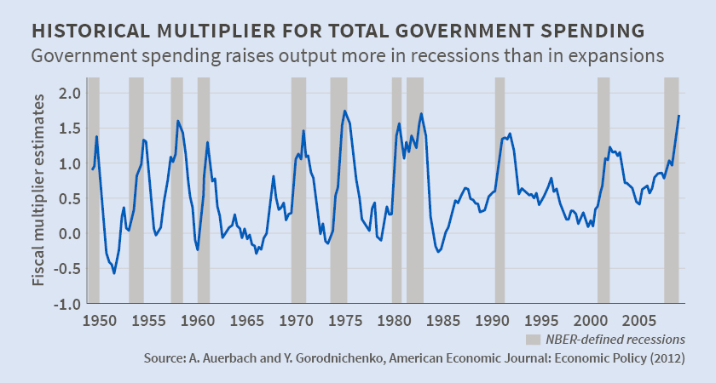
Empirical assessment of fiscal multipliers
Effectiveness of fiscal policy depends on the amount of fiscal multiplier
Studies lead to wide range of estimates for fiscal multipliers from less than zero to more than four

Slide 30
FP during the 2008-2009 crisis
Arguments in favor of 2009 stimulus:
Risk of depression (recession with a decline of GDP more than 10 %)
Ineffectiveness of monetary policy (transmission through financial system clogged, in addition to zero band)
Exceptional effectiveness of fiscal policy because of:
General excess supply
Excess savings and flight to safety resulting in ultra-low bond rates
Focus of agents on short-term horizon, credit constraints
Symmetric character of shocks, therefore, gains from coordinated action

Slide 31
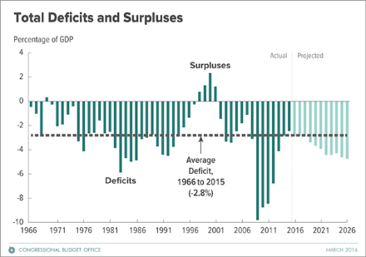
FP during the 2008-2009 crisis - USA

Slide 32
FP during the 2008-2009 crisis

Slide 33
CS: Trade constrains the use of fiscal policy
trade with other countries constrains the ability of FP
France
1980: weak economic growth
1981: François Mitterrand won the presidential election
program to stimulate aggregate demand through increased government spending and tax cuts

Slide 34
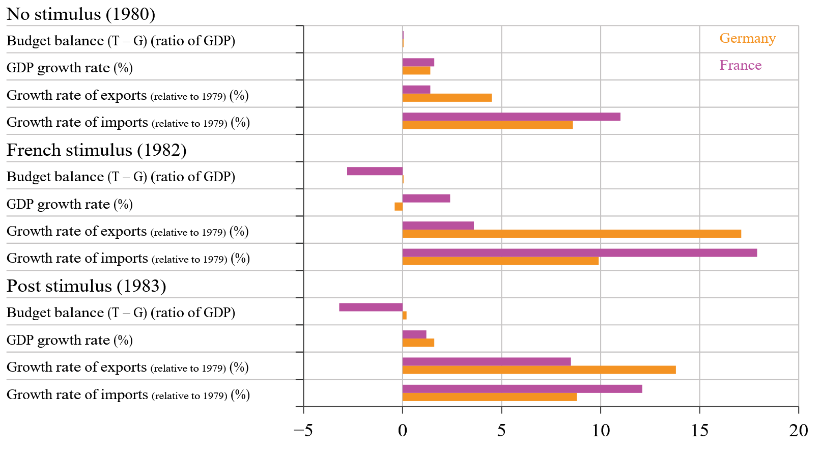
CS: Trade constrains the use of fiscal policy
The French budget balance negative
German budget balance remained close to balance
The French stimulus spilled over to other countries (imports were higher)
The French stimulus increased German export => German GDP

Slide 35
Fiscal policy in 1960s in the USA
1958 – recession
GDP -0,7 %
U 6,8 %
1960 – slowdown
GDP 2,6 %
U 6,6 %
New Economics
Kennedy, L. Johnson => decrease in taxes (20% reduction in personal tax; 10% reduction in corporate tax)
GDP, employment growth; U decline
taxes remained reduced, increase in G => inflation

Slide 36
Reference textbook
Benassy-Quéré, A. et al. Economic Policy: Theory and practise. Oxford University Press, 2010. Chap. 3 – 3.2.1

