Slide 1
Economic Policy
Fiscal Policy 2

Slide 2
Fiscal policy
Fiscal policy (FP) – set of decisions and rules regarding taxes and public expenditures for purposes of smoothing the fluctuations of economic cycle in order to keep unemployment close to its equilibrium value and avoid the build-up of deflationary and inflationary pressures (Samuelson, 1948)

Slide 3
Fiscal policy
Concepts and measurements
Theories: Keynesian vs. neo-classical view
FP during crisis
Public debt
measurement
debt and deficit dynamics
how to reduce the debt burden
Fiscal rules
Case studies

Slide 4
Public debt
Public debt = the total of all bonds and other debt owed by a government. Usually, cumulated deﬁcits.
Absolute level x debt-to-GDP ratio
Net public debt = gross public debt – value of public assets
Problem of oﬀ-balance-sheet liabilities (ageing, too-big-to fail banks)

Slide 5
Gross vs. net debt
Country | Net debt | Gross debt
Brazil | 35,2 | 68
Canada | 34,7 | 85,3
France | 84 | 90,2
Germany | 57,4 | 81,9
Great Britain | 81,6 | 88,8
Italy | 106,1 | 127
Japan | 133,5 | 238
Norway | -167 | 34,1
Saudi Arabia | -53,9 | 3,7
South Africa | 35,6 | 42,3
USA | 84,1 | 102,7
IMF 2013

Slide 6
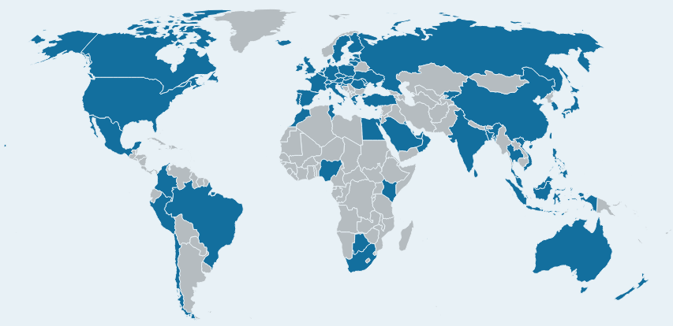
CS: Government Pension Fund of Norway
established in 1990 (first money transfer to the fund in 1996)
invests surplus revenues of the Norwegian petroleum sector
is invested in international financial markets (2021):
equity 73 %
bonds 25 %
real estate 2 %
9 123 companies in 73 countries are invested in the fund
aim: ensure responsible and long-term management of revenue from Norway’s oil and gas resources, so that this wealth benefits both current and future generations

Slide 7
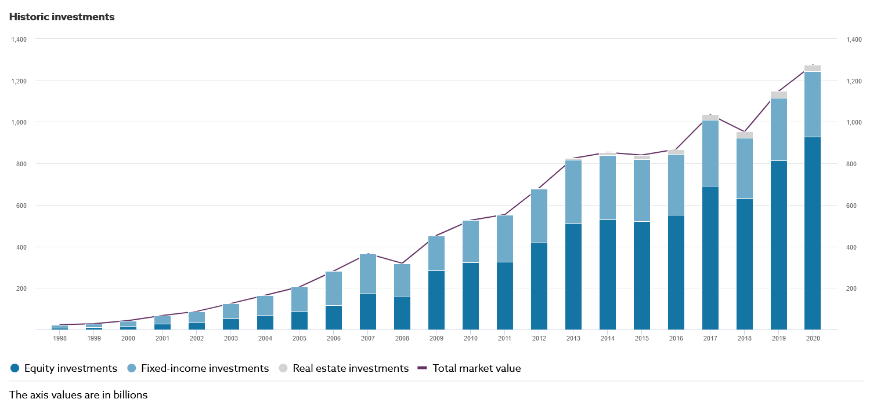
CS: Government Pension Fund of Norway
total market value 1,274 billion USD (320% GDP)
average annual return: 6.6%

Slide 8
Large deﬁcits were mostly the results of wars (e.g., USA)

Slide 9
Public debt ratios have reached very high levels in the past

Slide 10
Advanced countries have been in deﬁcit since 1970

Slide 11
Debt sustainability
Solvency: borrower’s ability to face its commitments (situation in the time)
Sustainability: policy course compatible with solvency at all times in the future
Sustainability is forward-­looking by nature and relies on assumptions on future policy and on the ability of the government to collect/increase taxes

Slide 12
Debt sustainability
„Debt can almost always be serviced in some abstract sense, through additional taxation and through the diversion of yet more domestic production to exports to generate the revenue and foreign exchange needed to service the debt. But there is a political and social, and perhaps moral, threshold beyond which policies to force these results become unacceptable.“
J. Boorman (2002)

Slide 13
Debt and deﬁcit dynamics
Stock-­ﬂow equation: $B=\left(1+i\right)B_{−1}+D,$
Where $D$ is primary deficit, $B$ is the public debt and $i$ is the nominal interest rate of government bonds
We can rewrite to percentage of nominal GDP:$\frac{B}{GDP}=\left(1+i\right)\frac{B_{−1}}{GDP_{−1}}\frac{GDP_{−1}}{GDP}+\frac{D}{GDP}$
We denote $n$ as nominal GDP growth $\frac{GDP}{GDP_{−1}}$, $b= \frac{B}{GDP} and$ $d=\frac{D}{GDP}$
$b=b_{−1}\left(\frac{1+i}{1+n}\right)+d\tilde{=}\left(1+i−n\right)b_{−1}+d$
If $i<n$, public debt can be stabilized by GDP growth.
If $i>n$, debt stabilization requires a primary surplus (d > 0)

Slide 14
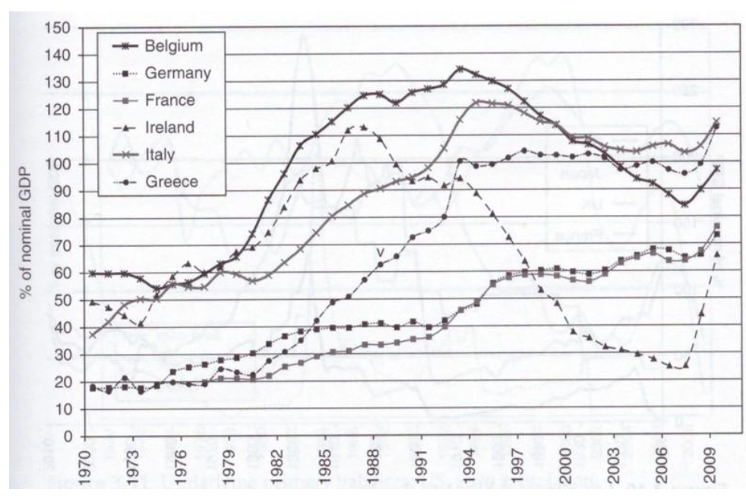
Public debt developments in selected countries

Slide 15
Net government indebtedness and primary budget balances, 2010 (% of GDP)
 | Net debt in 2010 | Primary budget surplus in 2010 | Required primary surplus to stabilize the public debt | Required primary surplus to stabilize the debt/GDP ratio
Belgium | 80,8 | -0,9 | 4 | 2
Germany | 50,1 | -1,3 | 2,5 | 1,3
Ireland | 59,9 | -30 | 3 | 1,5
Italy | 99,1 | -0,3 | 5 | 2,5
Netherlands | 34,6 | -4,1 | 1,7 | 0,9
Required primary surplus to stabilize the public debt: how the surplus should look like to not growing public debt
Required primary surplus to stabilize the debt/GDP ratio: how the surplus should look like to stabilize debt/GDP ratio.
=> reality and figures needs to stabilize public debt differs a lot

Slide 16
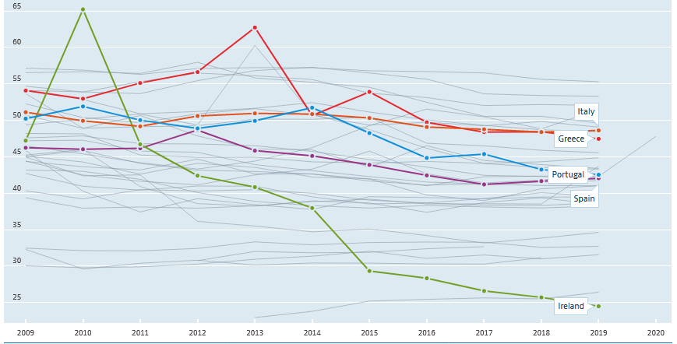
How to reduce the debt burden?
1. Fiscal adjustment: cut spending, raise taxes
the most direct but also most diﬃcult way
As diﬃcult as it is, deﬁcit reduction had been successfully implemented in many European countries
General government spending (% GDP)

Slide 17
How to reduce the debt burden?
2. Raising economic growth
is possible in medium to long-run
factors influencing the rate of growth in the long run will be spelt out later (Growth policy)

Slide 18
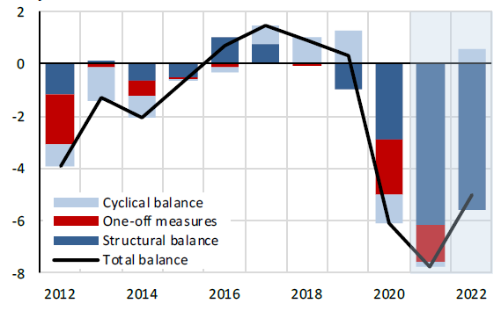
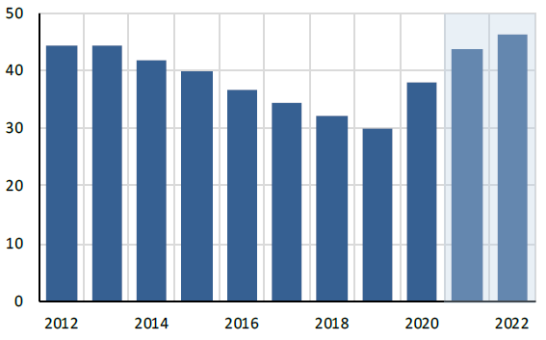
CS: reduce the debt burden in the Czech Republic
General government balance | 2015 | 2016 | 2017 | 2018 | 2019
General government balance | -0.6 | 0.7 | 1.5 | 0.9 | 0.3
General government debt | 39.7 | 36.6 | 34.2 | 32.1 | 30.0
Change in debt-to-GDP ratio | -2.2 | -3.1 | -2.3 | -2.2 | -2.0
GDP growth | 4.6 | 2.5 | 5.2 | 3.2 | 3.0
Balance
Debt

Slide 19
How to reduce the debt burden?
3. Monetization (inﬂation tax)
reducing the value of the money base (the central bank’s liability) and of the public debt (the Treasury’s liability) => tax on money and bondholders.
inﬂation must rise unexpectedly and quickly enough
temporary solution: lenders will demand higher interest rates and will be less willing to agree to long-term loans
risk of hyperinﬂation if the government will be forced to create more money to pay back maturing debt

Slide 20
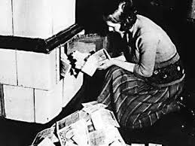
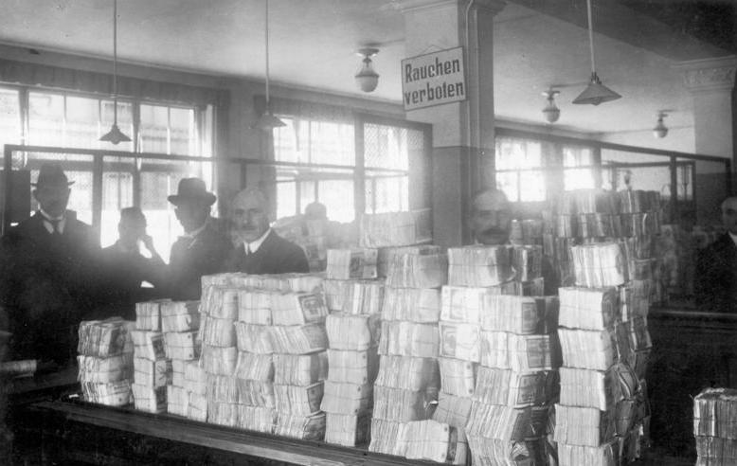
How to reduce the debt burden?
3. Monetization (inﬂation tax)

Slide 21
How to reduce the debt burden?
4. Default
not rare in Europe before 20th century
restructuring: rescheduling, write-downs, interest reductions...
coordination: Paris club (public creditors); London club (private creditors); IMF, World Bank.

Slide 22
How to reduce the debt burden?
In practice
Assistance from financial institution
Implementation of an adjustment program aimed at restoring debt sustainability
Debt reduction

Slide 23
CS: Greek government debt crisis (simplified)
2009: increase in government deficit
2010:
increased in government bond yields => credit rating agencies downgraded Greek bonds to junk status
European Commission, ECB, IMF launched a €110 billion bailout loan to rescue Greece from sovereign default and cover its financial needs
condition: implementation of austerity measures, structural reforms and privatization of government assets
2011:
debt reduction, lower interest rates
bank recapitalization
sale of some state-owned assets
2012: second bailout programme
2015: third bailout programme
2019: Greece sold 10-year bonds for the first time since before the bailout

Slide 24
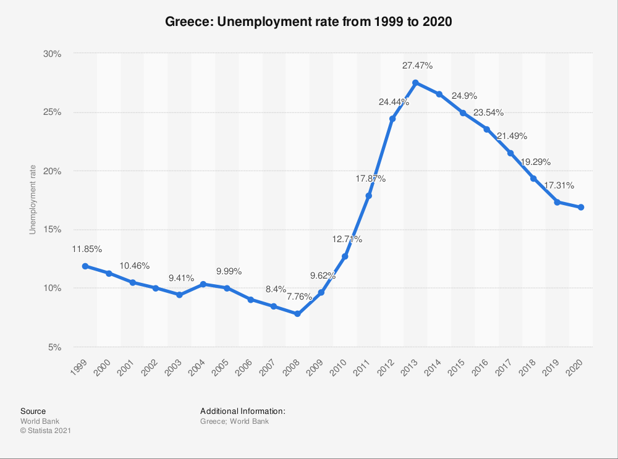
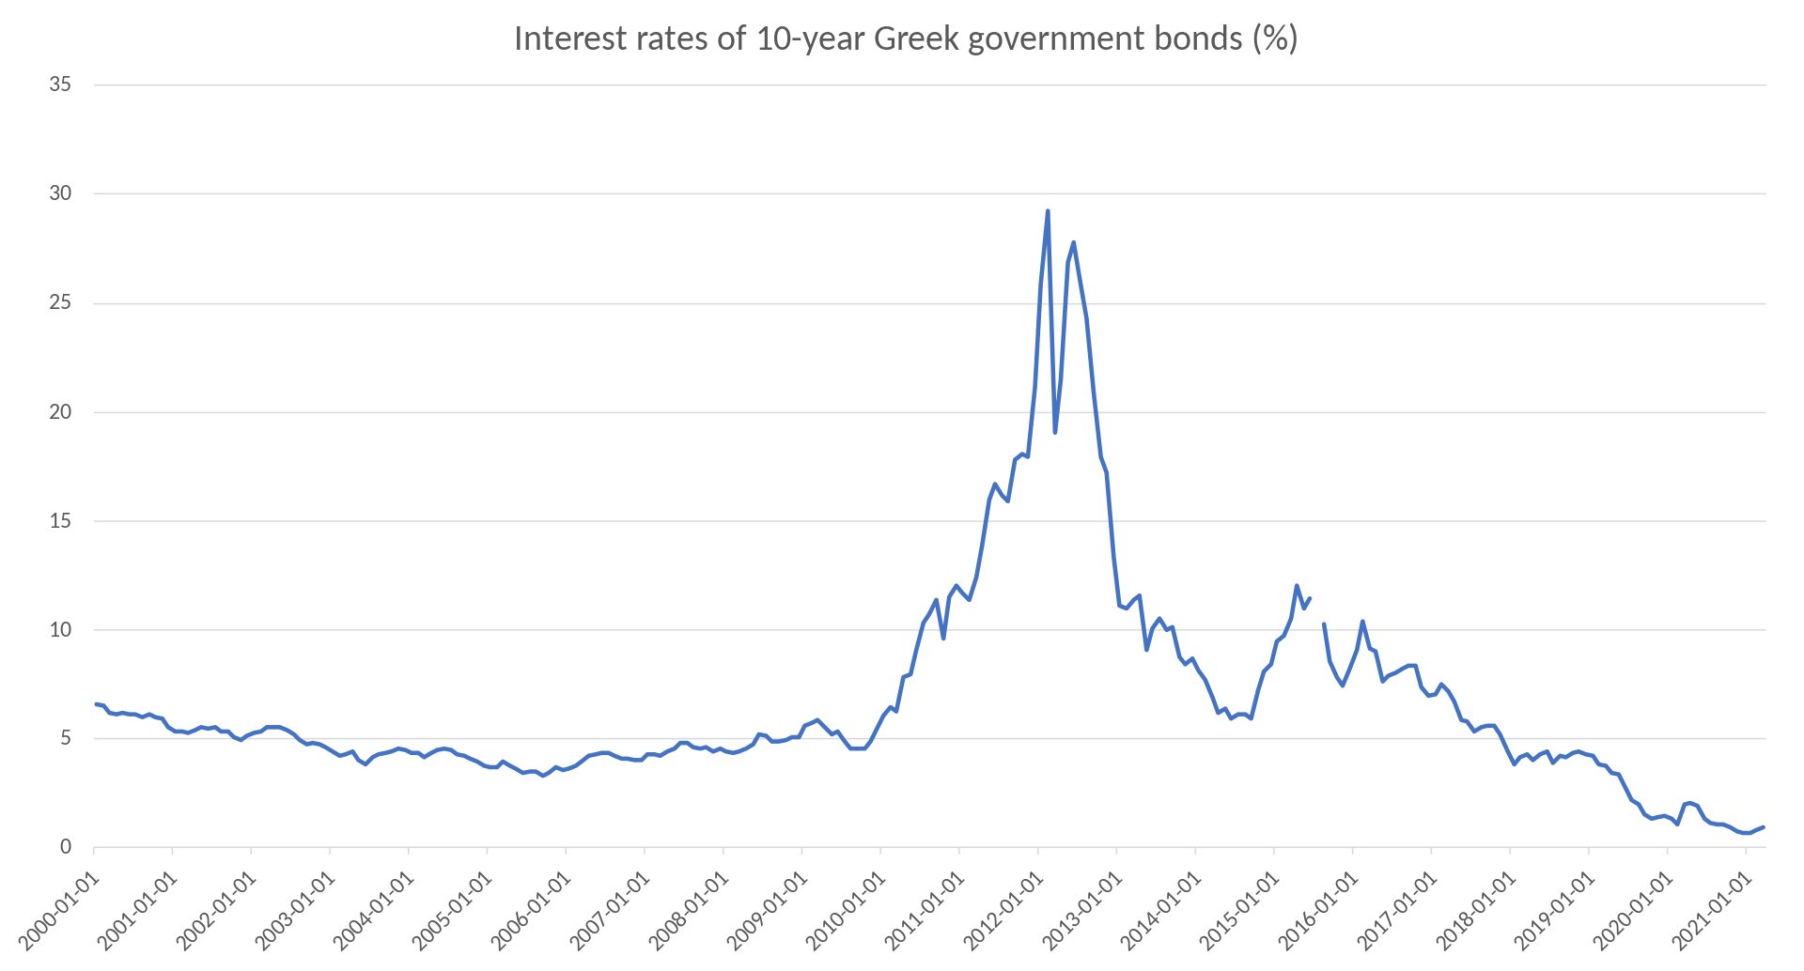
CS: Greek government debt crisis (simplified)

Slide 25
Political theory of debt
The choice of who should pay for the reduction of a high debt is a problem of redistribution.
Suppose that society can be divided into three groups: rentiers, entrepreneurs and workers.
Each of these interest groups will seek to avoid the burden of adjustment and shift onto someone else.
rentiers are opposed to default and inﬂation tax
entrepreneurs are opposed to taxes on capital
workers prefer taxes on wealth and capital and the repudiation of debt
=> solution depends on political decision

Slide 26
Rules and principles
Concerns about recurrent deficits and the public debt sustainability led many government to adopt budgetary rules; however, fiscal policy is traditionally discretionary
Increasing reliance on rules to:
improve predictability
address political failures
improve credibility
enforce coordination (e. g. between government and central bank)
Example: European Stability and Growth Pact (1997)
Current discussions in Europe:
strengthening ﬁscal discipline
national ﬁscal rules and institutions

Slide 27
More and more rules in EU

Slide 28
What is a good rule?
The ‘good rule’ according to Kopits and Symansky (1998):
clear deﬁnition,
transparent public accounts,
simplicity,
ﬂexibility – in particular regarding the capacity to react to exogenous shocks,
rule with possibility of sanctioning non-observance,
consistency with the other objectives and rules of public policies,
accompanied by other eﬀective policies

Slide 29
Many rules in practice
Deﬁcit rules (Stability and Growth Pact)
Structural deﬁcit rules (Germany after reform)
Golden rule (Germany before reform, UK 1998)
over the economic cycle, the Government will borrow only to invest and not to fund current spending.
Debt rules (UK under Blair/Brown)
Spending /receipts rules
=> Enforcement is very uneven and diﬃcult to check

Slide 30
Example 1: The UK
1998-2008
Golden rule (structural deficit only on public investments)
Sustainable investment rule (debt ratio 40% over the cycle)
Public investment shall be implemented only if the present value of expected returns covers the expenditure.
Two problems:
Who determines what is the cycle?
How to evaluate the net return on public investment?

Slide 31
Example 1: The UK
2010
structural deﬁcit < 1 % of GDP over 5 years
Oﬃce for budget responsibility: independent ﬁscal council in charge of forecasts and assessment

Slide 32
Example 2: Germany
Since late 1960s
Golden rule of public ﬁnances ‘except macroeconomic disturbance’
Three problems:
extensive notion of ‘macroeconomic disturbance’
no correction mechanism
inconsistency with SGP (that does not distinguish between current and investment spending)

Slide 33
Example 2: Germany
2009 ­(Debt brake)
Fiscal rule: structural deﬁcit < 0.35 % (for Federal government) and < 0 % (for länder)
Control account: deﬁcit < 1 % at any time.
Exceptional circumstances
natural disaster

Slide 34
The Stability and Growth Pact
Two elements:
A preventive arm
Medium term objective for its budgetary position
‘Stability’ (Eurozone) and ‘convergence’ (non-Eurozone) programs
Dissuasive arm (‘Excessive Deﬁcit Procedure’) allows for:
Advance warning
Recommendation to correct excessive deﬁcit within given timeframe
Eventual sanctions

Slide 35
The Stability and Growth Pact
Recent reforms (six-pack, ﬁscal compact)
Earlier sanctions
Debt rule

Slide 36
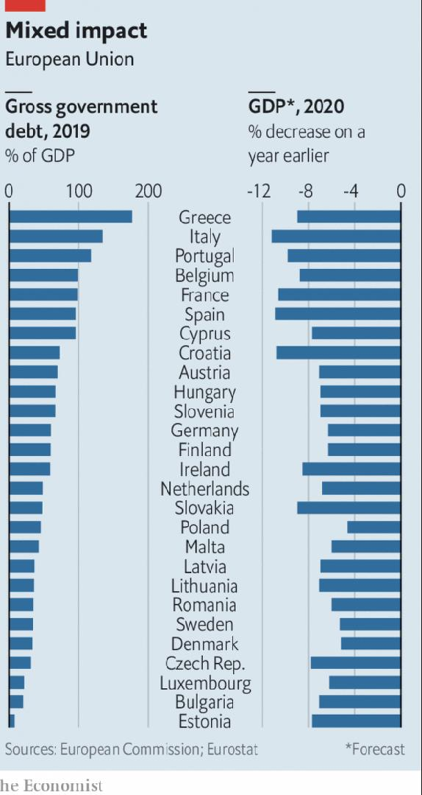
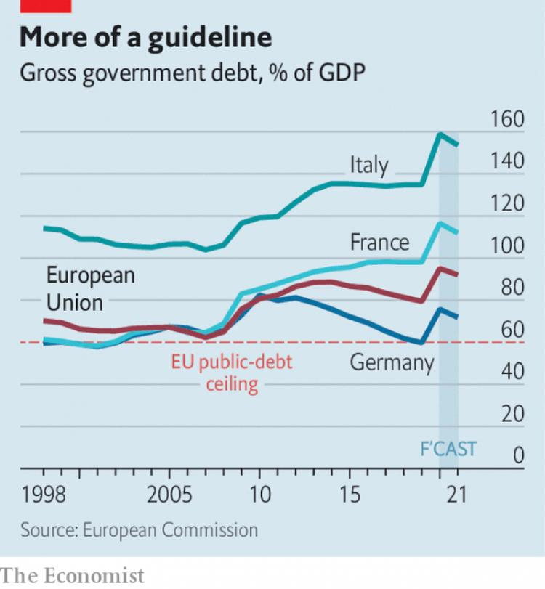

Slide 37
CS: The US: Fiscal activism
emerged in 1960s
1970s first oil shock with fiscal expansion => increase in inflation
1980s Ronald Reagan: tax cuts and additional military spending
1993 Clinton administration embarked on a fiscal adjustment policy based on a strict control on spending => structural primary surpluses 1994-2000
2001-02 cyclical downturn – fiscal expansion
2008/09 Great Recession – fiscal expansion (government deficit in 2009: -7 % of GDP)

Slide 38
CS: The US: Fiscal activism

Slide 39
CS: Japan: Low-return stimulus efforts
Japan used fiscal policy massively in the 1990s in an attempt to restore economic growth
public debt reached the highest level within the OECD
effectiveness of fiscal stimulus have been weak

Slide 40
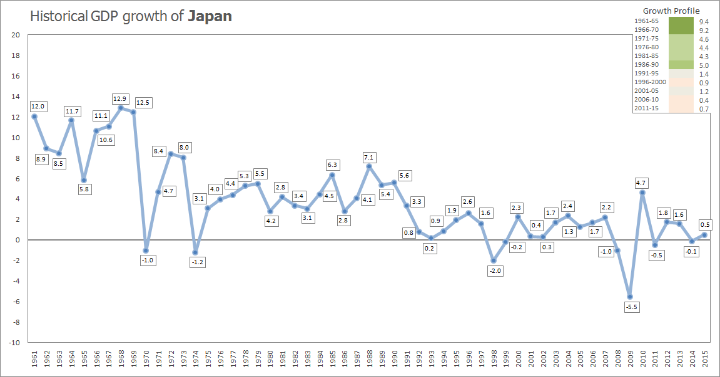
CS: Japan: Low-return stimulus efforts

Slide 41
Reference textbook
Benassy-Quéré, A. et al. Economic Policy: Theory and practise. Oxford University Press, 2010. Chap. 3.

