Slide 1
Economic Policy
Foreign-Exchange Policy + Growth Policies

Slide 2
Content
Foreign-Exchange Policy
  History of monetary system
  Convertibility and exchange-rate regimes
  Theory of optimum currency areas
  Balance of payments
Growth Policies
  Measuring growth
  Stylized facts about growth
  Growth enhancing policies

Slide 3
Monetary policy x exchange-rate policy
MP – internal value of currency (the purchasing power of money in terms of goods and services produced locally)
E-RP – external value of currency (the purchasing power of money in terms of goods and services produced abroad).
+ Exchange rate is important transmission channel
=> there cannot be long-term divergence between the internal and external purchasing power of a currency

Slide 4
Brief history of the international monetary system
System of Gold Standard was extended to all major economies in the 1880s and lasted until WWI: value of national currency was determined by a given gold weight
=> fixed exchange rates between national currencies
Pound sterling developed as an international currency parallel to gold (reserves of Bank of England did not cover the whole currency issue)

Slide 5
Brief history of the international monetary system
1920 – 1924 – Exchange rates between major currencies were left to market forces
Gold Standard was temporarily restored in the end of 1920s but finally abandoned during 1930s as the countries turned to protectionist measures and competitive devaluations in response to the Great Depression.

Slide 6
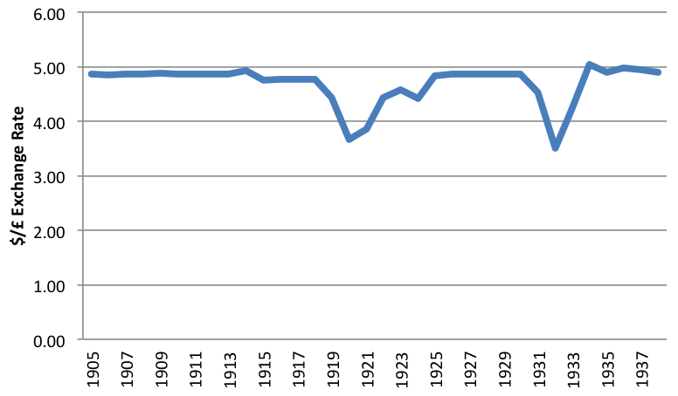
Golda standard – exchange rate
$ = 23.22 grains of pure gold
£ = 113 grains of pure gold
=> $4.8665 per pound sterling

Slide 7
Brief history of the international monetary system
After WWII Bretton Woods Conference: Gold Exchange Standard
  all currencies were convertible to US dollar which were convertible into gold at a fixed rate of $35 per ounce
  IMF – monitors world payments and helps countries that experience temporary balance-of-payments difficulties to avoid a crisis.
Contradiction between the need to supply a rapidly growing world economy with enough liquidity and the need to maintain confidence in dollar, which implied keeping its issuance in line with the gold reserves.
This system broke down in 1972.

Slide 8
Brief history of the international monetary system
1972: European countries: „European Snake“ (sets the fluctuation margins between European currencies and between these currencies and the US dollar)
1979: European Monetary System (EMS)
  all cross exchange rates had to fluctuate within margins of +/- 2.25 % (in some cases +/- 6 %) around a central rate
1993: Maastricht Treaty
  Economic and Monetary Union
1999: European monetary union was initiated
US dollar is still core currency for international monetary system.

Slide 9
Currency convertibility and exchange rate regimes
Governments need to make two crucial decisions:
on the conditions for exchanging the domestic currency for foreign currencies => currency convertibility
on the extent of exchange rate flexibility => exchange rate regime

Slide 10
Currency convertibility
Currency is nonconvertible if the government set the value of the exchange-rate and submit foreign-exchange transactions to prior authorization (e.g., Soviet bloc before 1990).
In all other cases, the currency is convertible.
  current account convertibility: the currency can be exchanged freely for the purpose of importing good and services, current transfers and factor income
  financial account convertibility: direct investments, portfolio investments and bank loans without restriction (=> capital mobility)
    Capital is actually never fully mobile, because there are valid reasons for control (e.g., fight against money laundering and terrorist finance)

Slide 11
Financial openness
While advanced economies have liberalized capital flows in the 1980s, this movement is still incomplete in developing countries.

Slide 12
The pros and cons of capital openness
Theoretical advantages:
enables the capital to flow to the most efficient places – helping both investors as well as all stakeholders
allows emerging economies to grow faster
capital flows from capital rich to capital poor countries as they should have higher returns
  reduce cost of capital
  enable investments
  increase growth

Slide 13
The pros and cons of capital openness
Potential problems:
Capital inflow is connected with appreciation of domestic currency. It can make domestic manufacturers less competitive in global markets
Fear of hot money; inflows and consequently sudden outflows of funds can cause huge economic crisis
Fear of large capital inflows, that can cause price bubbles
Fear of loss of monetary autonomy; see impossible trinity

Slide 14
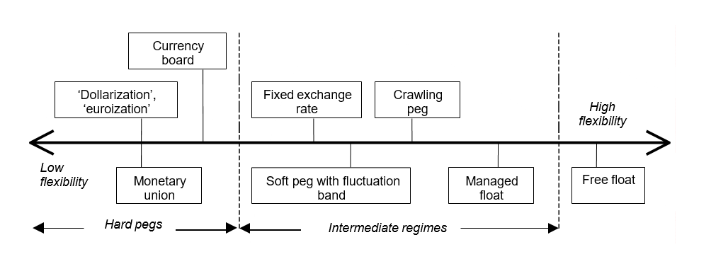
Exchange-rate regimes
Large exchange-rate fluctuations are source of uncertainty for the economy
In developing countries, foreign liabilities are denominated in key foreign currencies => depreciation of the domestic currency raises the value of the external debt.
=> governments may to wish to reduce the extent of exchange-rate fluctuations.

Slide 15
Exchange-rate regimes
Dollarization, euroization: the currency of another country circulates as the sole legal tender: dollar (e.g., Panama, Ecuador), euro (e.g., Montenegro and San Marino).
  Countries are unable to control the domestic money supply and its central bank is left with the sole mission of performing technical tasks.
Currency board: explicit legislative commitment to exchange domestic currency at a fixed rate, issuance of domestic currency is backed by foreign assets only (e.g., Bosnia and Hercegovina, Bulgaria).
Fixed exchange rates: the country pegs its currency within margins of +/-­ 1 % or less vis-­à-vis another currency or basket of currencies (e.g., Mali, Niger).

Slide 16
Exchange-rate regimes
Soft pegs with fluctuation band: the value of the currency is maintained within certain margins of fluctuation of more than +/- 1 % around a fixed central rate (e.g., Denmark).
Managed floating: The CB attempts to influence the exchange rate without having a specific exchange rate path or target (e.g., Albania, Chile, Hungary, Moldova, Ukraine)
Free floating: the exchange rate is fully market-determined (e.g., Czech Republic, eurozone, USA, United Kingdom, Poland)

Slide 17

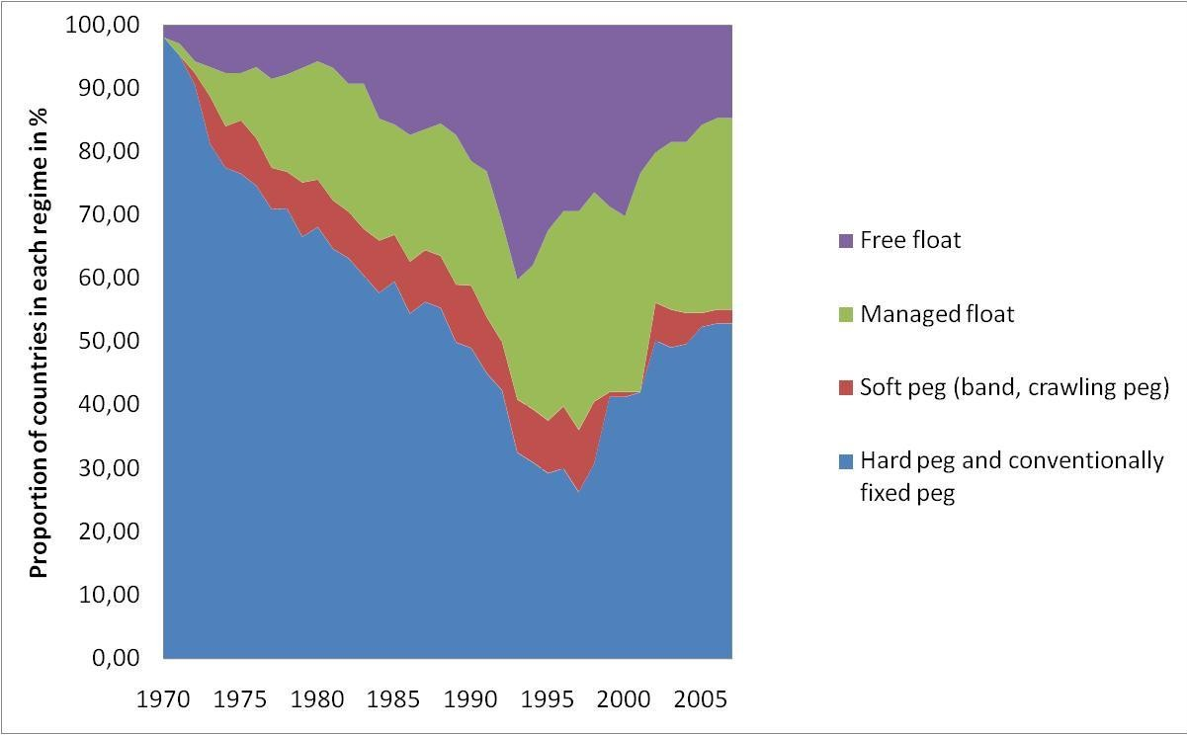
Exchange-rate regimes

Slide 18
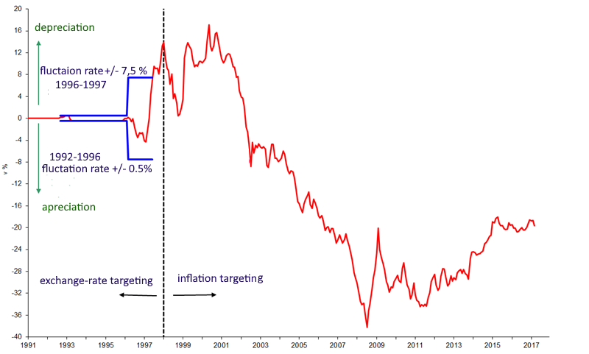
Exchange-rate regimes – Czech Republic

Slide 19
The Exchange Rate Regime Dilemma: the pros and cons of fixed regime
The risk of speculative attacks when the firmness of the commitment is being questioned that can lead to currency crisis.
A country must keep large quantities of foreign currency.
By committing to a fixed rate a country commits itself not to engage in inflationary policies.
CB must give up independent monetary policy.

Slide 20
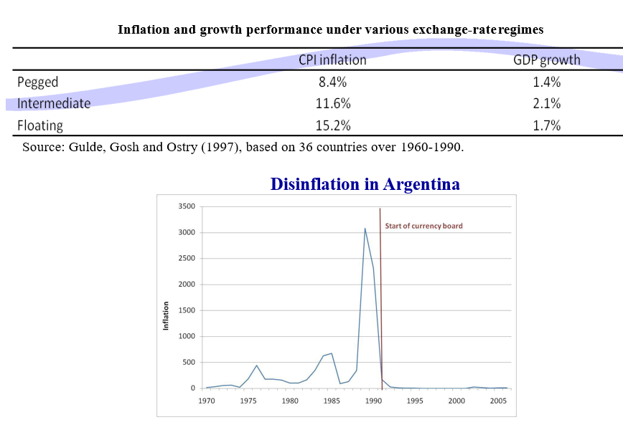
The benefits of pegs: credibility

Slide 21
The Exchange Rate Regime Dilemma: the pros and cons of floating
Large exchange rate fluctuations are a major source of uncertainty.
Exchange rate fluctuations affect the relative value of assets and liabilities => depreciation raises the value of the external debt.
Monetary independence of the CB is sustained.
Countries are better able to absorb economic shocks

Slide 22
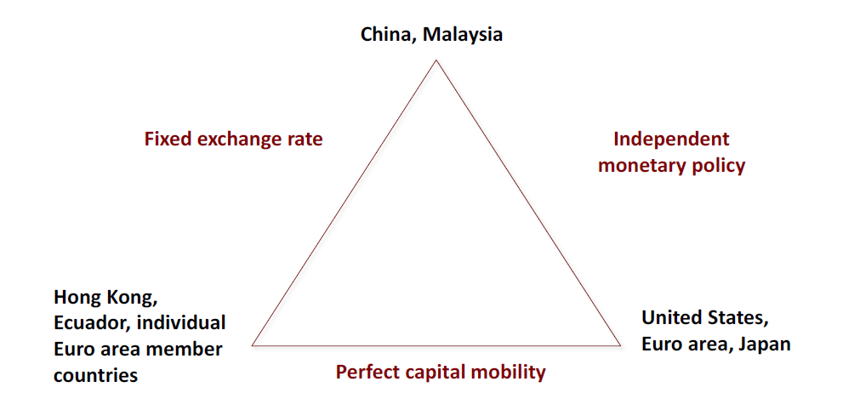
Convertibility and exchange-­rate regime: a joint choice
A country cannot simultaneously enjoy an independent MP, a stable exchange rate and a perfectly mobile capital (Mundell’s impossible trinity)

Slide 23
Regime choice: the optimum currency area theory (OCA)
The OCA theory predicts that fixed exchange rates are most appropriate for areas closely integrated through international trade and factor movements.

Slide 24
The optimum currency area theory – benefits
saving from avoiding the uncertainty, confusion, and calculation and transaction costs that arise when exchange rates float
are higher, the higher the degree of economic integration between the joining country and the fixed exchange rate area

Slide 25
The optimum currency area theory – costs
arise because a country that joins an exchange rate area gives up its ability to use the exchange rate and monetary policy for the purpose of stabilizing output and employment
are lower, the higher the degree of economic integration between a country and the fixed exchange rate area that it joins

Slide 26
The optimum currency area theory – criteria
Degree of trade openness and integration
Product diversification
Labour mobility
Wage flexibility
Level of debt
Fiscal transfer possible
Homogenous policy preferences
High degree of solidarity with other nations

Slide 27
Is the euro area an optimal currency area?
Degree of trade openness and integration – high
Product diversification – high
Labour mobility – low
Wage flexibility – low

Slide 28
Is the euro area an optimal currency area?
Level of debt – varies from low to high
Fiscal transfer possible – limited
Homogenous policy preferences – regional/limited
High degree of solidarity with other nations – regional/limited

Slide 29
Is the euro area an optimal currency area?
The eurozone does not come close to an OCA by most criteria, because
  The core group of EU countries are broadly similar (Germany + France + Netherlands + Belgium) but peripheral countries have big structural differences
  There are barriers to the mobility of labour
  Price and wage flexibility is rather low
  The role of fiscal transfers is limited
Euro is more political than economic project

Slide 30
Economic Policy
Growth Policies

Slide 31
Growth vs. stabilization policies
Stabilization policy seeks to mitigate short-term cyclical fluctuations whereas growth policies aim at raising potential level of production in the long run.
But, there are interrelations between long-term trends and short-term fluctuations because of:
  precautionary behaviour: excessive inflation is bad for long-term growth
  unemployment hysteresis: skills of unemployed workers deteriorate and they become less employable even in boom

Slide 32
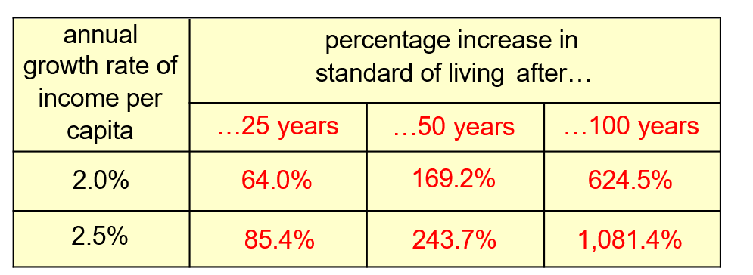
Why growth matters?
Anything that effects the long-run rate of economic growth – even by a tiny amount – will have huge effects on living standards in the long run.

Slide 33
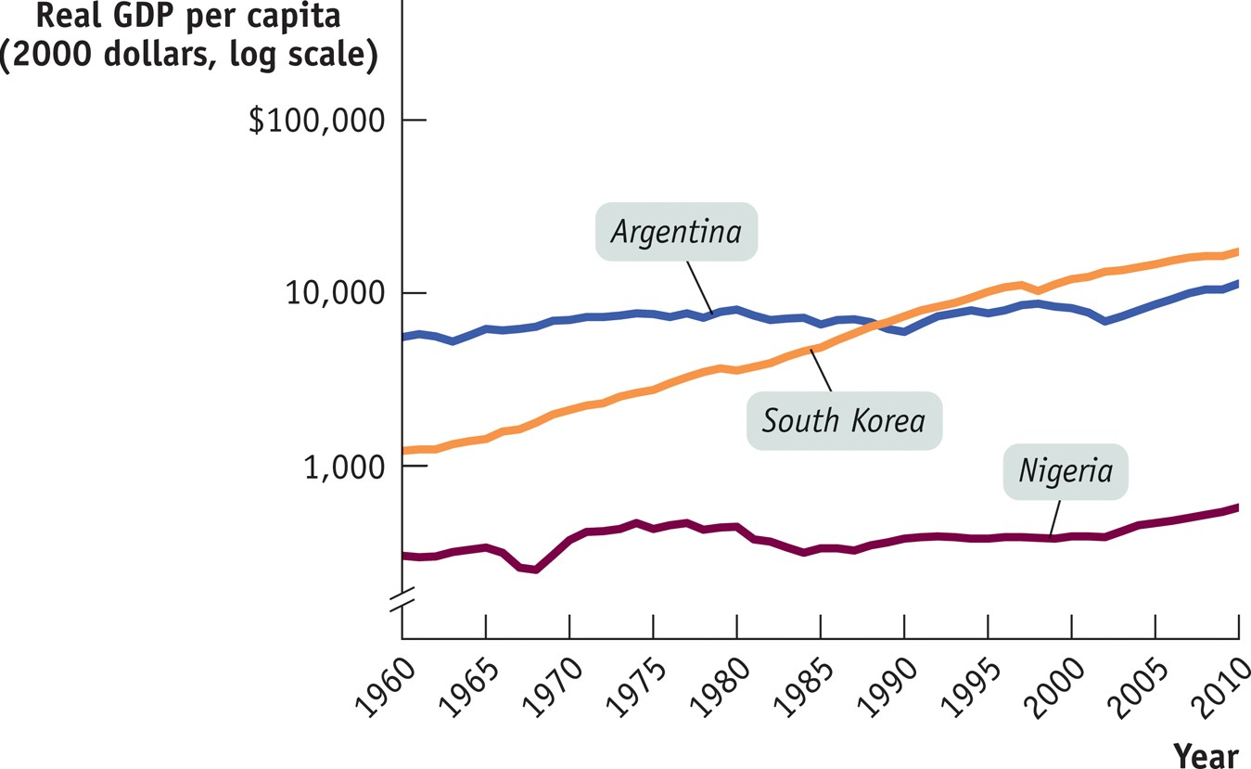
Three stories of economic growth: success, disappointment and failure

Slide 34
Measuring economic growth
GDP per person (per capita) corresponds to the average standard of living (GDP (nominal) x GDP (PPP))
GNP, HDI (GNP, life expectancy, access to public, education)
GDP per person is not well-being
  correction for: pollution, working time, life expectancy, precariousness, inequality, sustainability

Slide 35
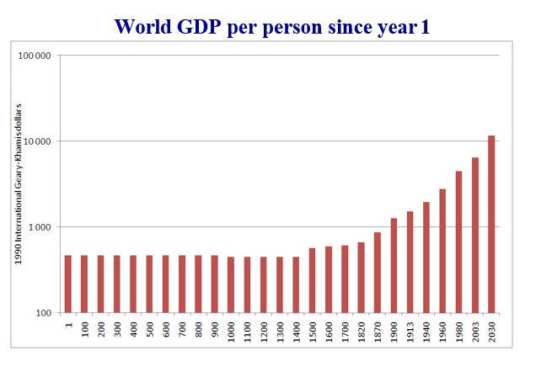
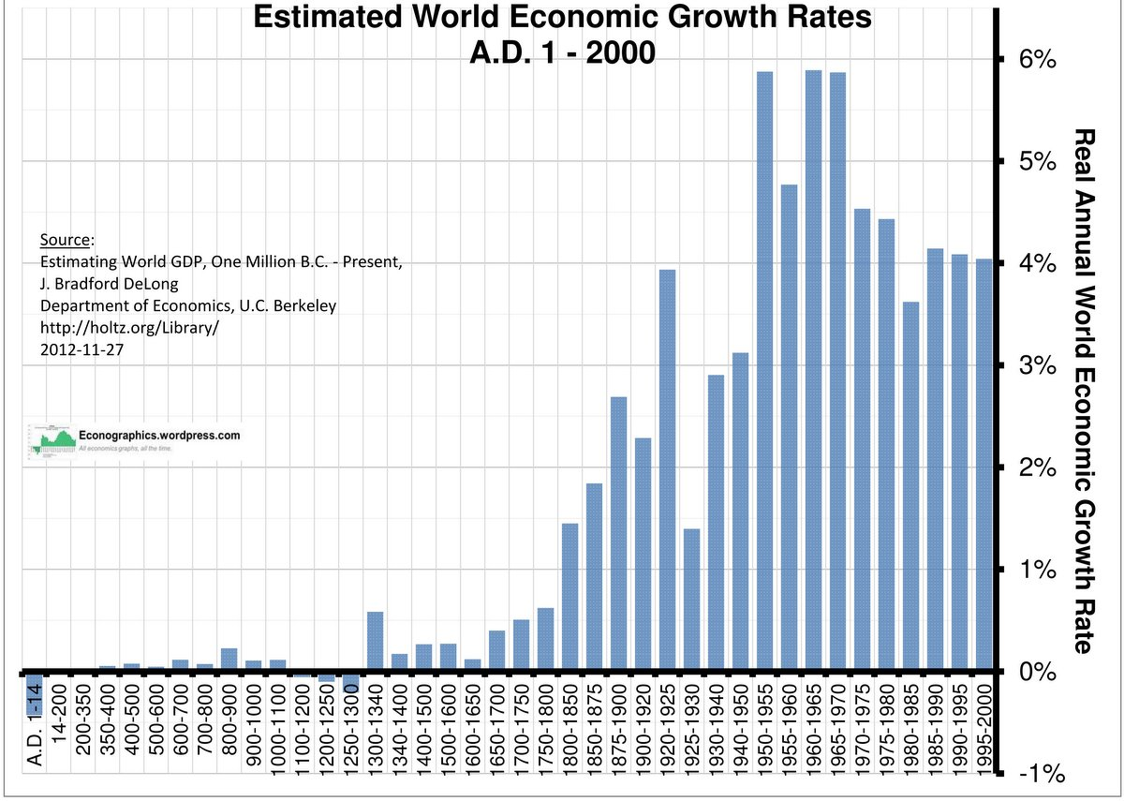
Some stylized facts about growth
Growth is a recent phenomenon by historical standards.

Slide 36
Convergence and inequality
Who benefits from the increase of world income and wealth?
No stable relationship between inequality and growth, but growth tends to increase inequality within rich countries.
Among advanced economies, technological change and growth may increase income inequalities.

Slide 37
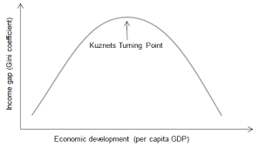
Growth and income distribution: a two way relationship
Growth → inequality
  Kuznets (1955): U-shaped relationship between development level and income inequality
  Unequal access to finance, education
Inequality → growth
  Inequality → inequality of opportunities
  Risk of political instability/deadlock
  Demand for redistributive taxation (Alesina and Rodrik, 1994)

Slide 38
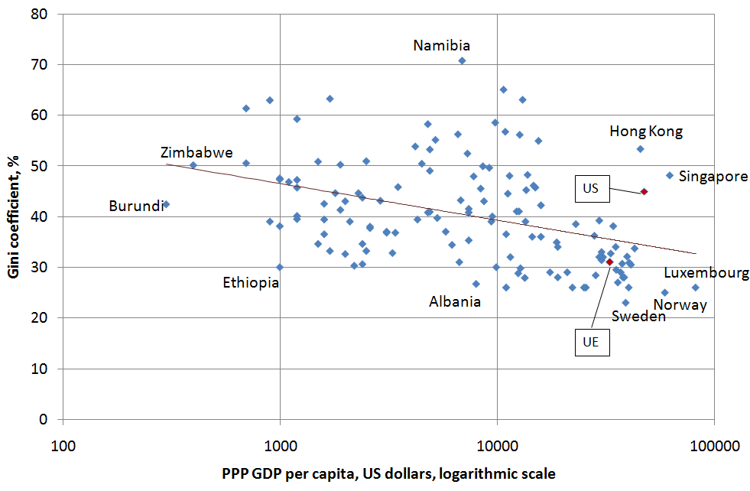
Growth and income distribution

Slide 39
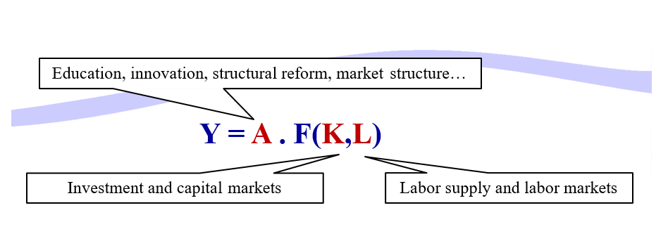
Theoretical background – growth accounting
Solow (1956)

Slide 40
Theoretical background
In the short run (a few months to a few years), potential output is exogenous; growth is dominated by cyclical fluctuations and by stabilization policies
In the medium run (a few years), governments can influence potential output through investment and labour supply
In the long run (many years), GDP and the labour/capital mix are determined by demography, technology, institutions and market structures

Slide 41
Policies
  Education
  Research
  Infrastructure
Externalities

Slide 42
Policies – Education
Public financing is justified by credit constraints and unequal access to knowledge. It is difficult to assess private and social return to human capital
Discrepancy between Europe and US in total expenditures on tertiary education

Slide 43
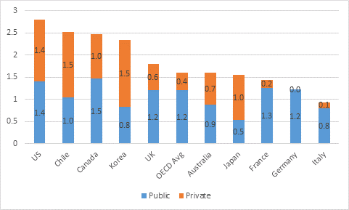
Spending on tertiary education (% GDP)

Slide 44
R&D and innovation
Social return on research spending generally exceeds its private return
Market imperfection: investments to R&D are constrained by the unavailability of funds
Public funding of fundamental research and university clusters
Incentives to private funding of applied research
  Intellectual protection
  Innovation-friendly competition regime
  Tax rebates

Slide 45
Unequal R&D effort
R&D expenditures:
  Discrepancy among countries (see next slide)
Different dynamics:
  US: new innovating SMEs
  EU: firms already in place
In the US, innovating firm creation encouraged by:
  risk capital and initial public offerings
  lower entry cost

Slide 46
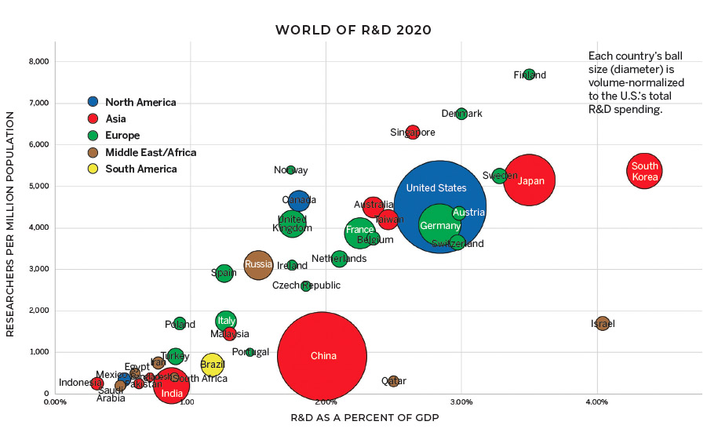

Slide 47
Public infrastructures
Government intervention is needed, because:
  many infrastructures are natural monopolies
  infrastructure involves externalities
  market cannot finance infrastructures by itself
=> European networks program, public-private partnerships

Slide 48
Labour supply
How to increase labour supply?
Through family-oriented policies
Immigration
Welfare-to-work:
  In-work benefits
  pension reforms

Slide 49
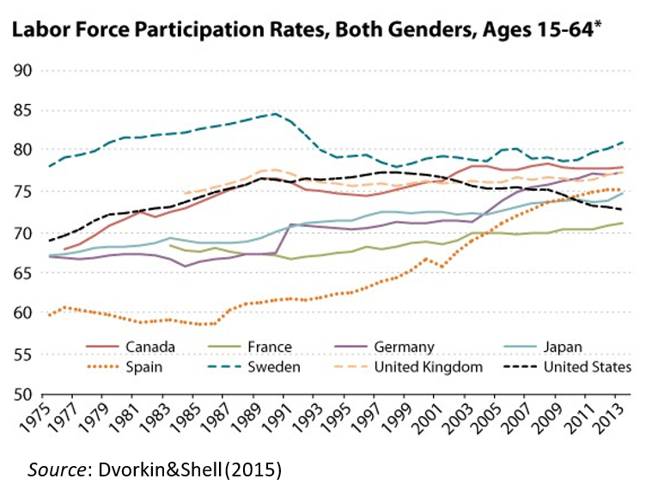

Slide 50
Developing financial markets
Often neglected in growth strategies
Channels on influence on long-term growth:
  Lower cost of capital
  Higher savings
    => increase in GDP per capita
  Better allocation of capital
    Information
    Risk diversification
    Finance innovation

Slide 51
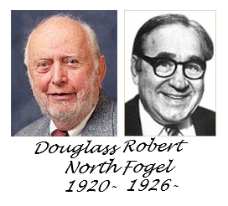
Growth and institutions
Institutions: “The humanly devised constraints that structure human interaction. They are made up of formal constraints (rules, laws, constitutions), informal constraints (norms of behaviour, conventions, and self-imposed codes of conduct), and their enforcement characteristics.”
D. North and R. Fogel (1990)

Slide 52
Improving institutions
General recommendations:
  create legal framework which is conducive to private initiative
  put in place effective market regulation
  achieve macroeconomic stability
It is difficult to identify a set of specific recommendations because of different institutional set-ups (e.g., the role of the state in the economy).

Slide 53
Reference textbook
Foreign-Exchange Policy: Benassy-Quéré, A. et al. Economic Policy: Theory and practise. Oxford University Press, 2010. Chap. 5.
Growth Policies: Benassy-Quéré, A. et al. Economic Policy: Theory and practise. Oxford University Press, 2010. Chap. 6.

