Slide 1
Economic Policy
Redistribution, social policy and welfare state

Slide 2
Content
Distribution and justice
theoretical approaches
issues in distribution
The welfare state
the concept of welfare state
worlds of welfare states
recent challenges to welfare state

Slide 3
Distribution and justice
Distribution of income and wealth has been a major concern throughout the history of economics
Positive and normative economics is difficult to separate in this area.
Two main views of justice in distribution:
commutative justice: each person should receive income in proportion to his contribution to the productive process
distributive justice: implies approximate equality in income distribution

Slide 4
Issues in distribution
The are several specific areas of concern in the debate about distribution:
the distribution of income between persons irrespective of the source of income
the distribution of income between factors of production, in particular between labour and capital
the distribution of earnings between different types of labour
the distribution of wealth
poverty

Slide 5
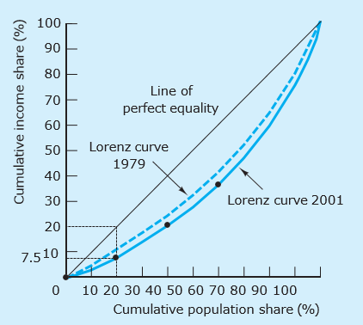
Income distribution between people
The conventional mean of illustrating income distribution is the Lorenz curve
Lorenz curves in UK (1979, 2001)

Slide 6
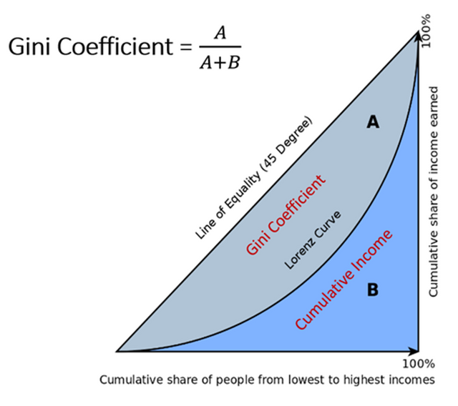
Income distribution between people
and the Gini coefficient.

Slide 7
Gini coefficient

Slide 8
The distribution of wealth
Percentage of wealth owned by: | 1971 | 1986 | 2006
Most wealthy 1 % of population | 31 | 18 | 21
Most wealthy 5 % of population | 52 | 36 | 40
Most wealthy 10 % of population | 65 | 50 | 54
Most wealthy 25 % of population | 87 | 73 | 77
Most wealthy 50 % of population | 97 | 90 | 94
Table: Ownership of marketable wealth (UK)

Slide 9
Poverty

Slide 10
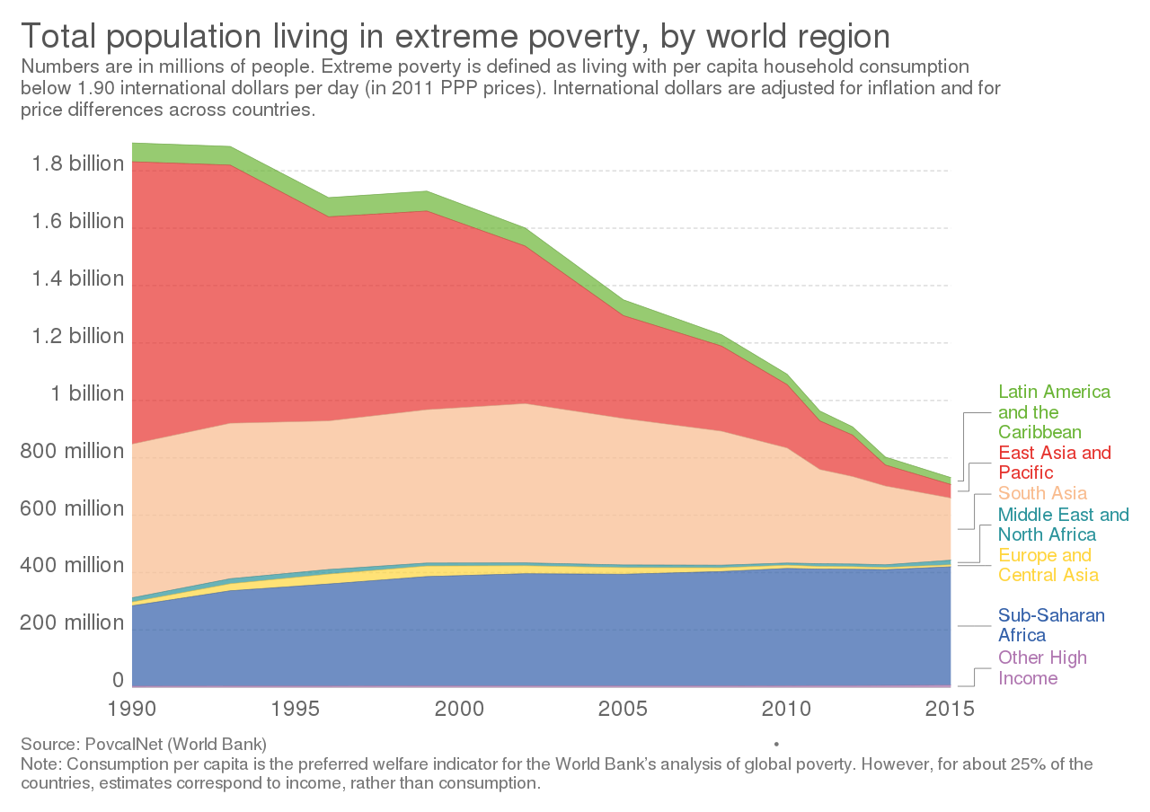
Extreme poverty (people living on less than $1.90 a day)

Slide 11
Extreme poverty (people living on less than $1.90 a day)

Slide 12
Why is income inequality rising?
globalisation
a key role for technology => replacement low-skilled workers by machines
labour vs. capital: a shifting balance
larger share of income belongs to capital owners
change in the workplace:
increase in part-time working
decline in trade union membership
changing in societies:
growing tendency to marry people very similar social and educational backgrounds

Slide 13
Labour share of national income in OECD countries, 1990 and 2009

Slide 14
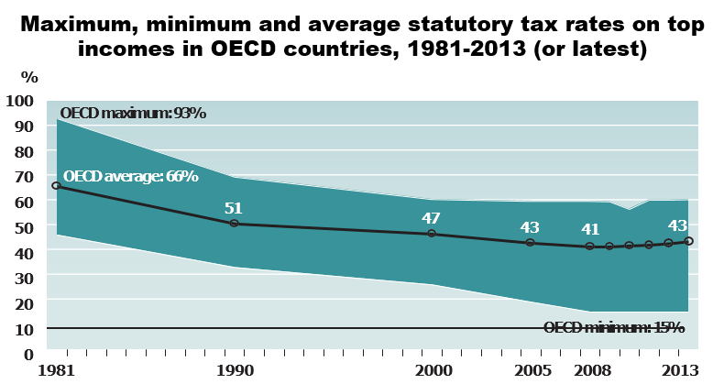
Why is income inequality rising?

Slide 15
Welfare state (WS)
The WS is a concept of government in which the state plays a key role in the protection and promotion of the social and economic well-being of its citizens
WS is funded through taxes and provides cash or in-kind transfers.
In kind transfers consist of goods or services, not money

Slide 16
Social protection expenditure and GDP per capita (US$)

Slide 17
Diversity of welfare states
Differing welfare models evolved after WWII.
Esping-Andersen (The Three Worlds of Welfare Capitalism, 1990) identified models of welfare state according to stratification and the different providers of welfare
Social-democratic (Scandinavian) model
Corporatist (continental) model
Liberal (Anglo-Saxon) model
Southern model

Slide 18
Social-democratic (Scandinavian) model
prevalent in Denmark, Sweden, Norway
generous replacement of market earnings through the state (e.g. for unemployed)
social welfare is an universal right
state as a main provider of social welfare
characterized by high social expenditure, active labour market policies and increased public-sector employment

Slide 19
Corporatist (continental) model
typified by Germany and France
main provider of welfare is the family, but contributory principle ties many benefits to employment history
basic security supplemented with contributory benefits (pensions, unemployment, etc.)

Slide 20
Liberal (Anglo-Saxon) model
United Kingdom, Ireland
seeks to increase demand for labour through liberalization and wage flexibility
mostly private forms of insurance
benefits comparatively low and linked to means-testing
poverty relief through minimum wages, but less of a focus on equality.

Slide 21
Southern model
Spain, Italy, Greece, Portugal
extended family as core unit
income maintenance
strong jobs protection – favouring, for example, full-time over temporary workers

Slide 22
Challenges for welfare states
demographic change: population ageing and living longer increases financial burden
globalization: reducing governments’ ability to sustain or reform welfare institutions
changes in the family structure (societal change): e.g. increase the participation rate of women, the shift away from the male-breadwinner model affects certain aspects of the welfare model
problem of welfare state and efficiency: especially administrative costs and the disincentive effects on the labour supply
new technologies and the changing mix of jobs

Slide 23
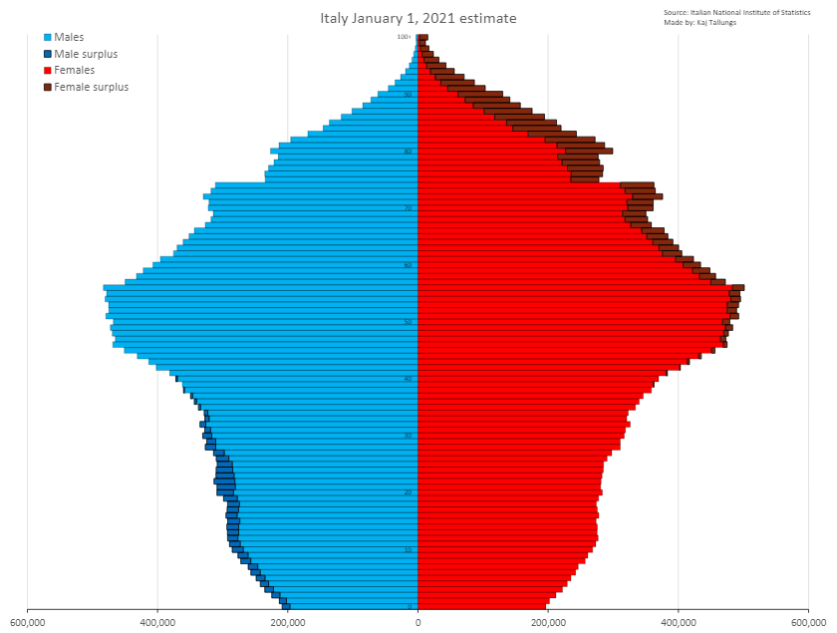
Challenges for welfare states

