Slide 1
(Un)equal access to education
Content
Cross-country overview
The case of the Czech Republic
Laura Fónadová

Slide 2
Introduction
Equal access to education - currently one of the key challenges of educational policy on the wider international level.
Pupils enter the education system with certain inborn dispositions and with assumptions resulting from the social background of the family in which they grow up.
Equal access/opportunities ≠ full equality (that everyone should reach the same level)
Equal access = fair distribution of education.

Slide 3
Theoretical background
- concept of unequal chances -
Macro-sociological concept:
How members of certain social group are favoured /disfavoured compared to the members of other social group?
Empirically measured as differences between the attainments of people belonging to different social groups.
We focus on educational inequalities conditioned by social origin/background.

Slide 4
Social stratification
Contemporary European societies are socially stratified societies
What is social stratification?
  Systematic inequality between groups of people
Why social?
  SS concerns the groups of people
  Systems of inequality are organized around groups with a shared characteristic.
Criteria delimiting the inequality
  wealth, income, prestige, power, gender, education, age
  social origin vs. social destination (O vs. D: ascription vs. achievement)
Rankings of groups change only very slowly

Slide 5
Basic Social Stratification Cube:
3 dimensions
education/prestige
. . .
. .
. . . . .
… ..
. . . .. …
… … … ……..
. . …….
…. . . . …
power/occupation
time
economic capital/income
Notes:
Historically speaking, there are three major types of systems of social stratification: slavery, caste, and class.
3. Class systems are the stratification system we are familiar with. People are divided according to economic markers such as income, wealth, ownership, and so on.
Three main dimensions of stratification: power, economic capital, prestige

Slide 6
Why is social class important?
social classes are part of modern labour markets.
they explain human behaviour in modern society
social class position is an important determinant of human behaviour
social class constraints human behaviour as well as makes conditions for it

Slide 7
Results of social class divisions
Inequality of conditions
  unequal distribution of income according to class positions
  result: differences in wealth and material conditions
  different incomes means different chances to get different goods
Inequality of opportunity
  unequal start positions
  different start positions means different chances to get different levels of education, jobs and incomes
Inequality of conditions and inequality of opportunity are connected in empirical reality
Analytically they are two concepts that describe social class differences among people
7

Slide 8
OED triangle as a core of social mobility process
E
a b
O D
c
OD connection via E, indirect
OD connection, direct (via ownership, property, aspirations, access to occupations
What can we expect in European states? Links a? b? c?
a) transition to school from family →
b) transition to labour market from educational system
c) transition to labour market from family
Notes:
How to measure

Slide 9
Reproduction of social classes
reproduction of social classes means their stability
in time
social classes are maintained intergenerationally, between parents and their children
social or cultural reproduction of class divisions
opposite to social reproduction is social mobility
  change of social class position in time between parents and children
educational systems play important role in reproduction/mobility of social classes

Slide 10
Equity in educational attainment
Equity means when the person´s educational D can not be predicted by the educational O.
By contrast inequity (less equity) – when educational O and D are strongly related.
The school performance of children and chances for further education in the Czech Republic are/is determined by early school choice to a greater extent than in OECD countries (OECD, 2018).
The school choice is based on socio-economic background.

Slide 11

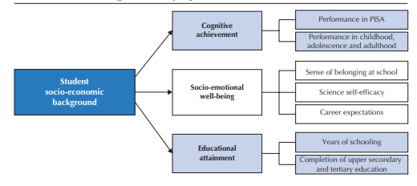
Equity in education outcome
OECD, 2018

Slide 12
Discussion:
To reduce socially conditioned educational inequalities or
To exclude the elit/unprivileged pupils in a special educational stream?

Slide 13
Do you know examples of policies for
improving equity in education?

Slide 14
Basic features of Czech public educational system (basic level)
Decentralization of education - majority of standard basic schools are maintained by local municipalities
Free syllabus and output regulation
From 2020 there has been a change: funding based on the number of hours taught/number of pupils (previously normative funding – based only on the number of pupils).
Free school choice
Diversified school structure – especially in larger cities
The Czech educational system continues in maintaining segregational tendencies. See the report (2019) of the Office of the Government of the CR:
http://www.romea.cz/en/news/czech/czech-government-agency-for-social-inclusion-publishes-analysis-of-segregation-in-primary-schools?fbclid=IwAR2CXIjF4s0iIgxLKolSBv4tnro_DOEW8ALHWrR9SG2BuFogJeV0ADD7QeQ#.XeIH8o-0Nbg.facebook

Slide 15
Equal access to education
Czech educational system makes reference to disadvantaged children (Education Act, 2004):
  with disabilities, physical handicap or socially disadvantaged.
These categories of children have the right to adequate education, school counseling and school counseling facilities.
Notes:
Although, at first glance it might seem obvious that there are no barriers in the access to education or discriminatory behavior against selected groups of pupils in the Czech educational system, the opposite is true.

Slide 16
Measures to combat unequal chances – in the CR
the abolishment of special schools (in 2005 in the CR)
removing formal barriers to continuing education at high school of any type for pupils coming from any type of primary school institution
the establishment of new positions of pedagogical teaching assistants;
the establishment of preparatory classes and courses necessary to even up or complement education
the policy of inclusion (in the CR from 2016)
compulsory preschool for five-year-olds (in the CR 2017)
Do you know other examples of policies for
improving equity in education?

Slide 17
IEO and educational expansion
IEO: chances to attain certain level of education by social origin (SO) - family background
Educational expansion (EE) is seen as a social-political provision for change of IEO (inequality of educational opportunity)
EE via IEO helps to increase social justice, equality and meritocracy
The relationship between IEO and EE has higher relevance for academic research as well as for social policy and it is the source of legitimization of social systems.

Slide 18
Expansion of tertiary education
Notes:
Tertiary education has expanded significantly over recent decades.

Slide 19
Educational expansion in European countries 2000+
Bologna process, declaration of European countries and the beginning of educational expansion in a year 2000
EE is defined as: the growth of the educational system. It means the increase of places in the educational system that is connected with increased rates of enrolment (Craig, 1981).
Notes:
In 1999, the Bologna declaration was signed. This can be seen as the beginning of the most recent wave of educational expansion in Europe. All these changes were encouraged by the need for highly educated people on the European labour markets and by further economic developments (Kogan, 2012).
The X axis shows the proportion of people with tertiary education in 2000 in each country. The Y axis shows how much this proportion increased between 2000 and 2018 (all year trends cf. Table A1, in the Appendix). The average proportion of people with tertiary education across countries was 24.1% in 2000 and 42.0% in 2018.
The educational expansion between 2000 and 2018 is negatively path dependent. The increase is lower in countries where the proportion with tertiary education was already high in 2000, and vice versa (the Pearson correlation is -0.64)

Slide 20
Social chances of the Roma in the Czech Republic
Notes:
According to what we know from the analysis and studies about the situation of the Roma in the CR, be a Roma (or to born into the Roma family) likely means social handicap for future life. Mentioned researches and studies show that Roma population in the Czech Republic faces systematic disadvantages in several areas. The most serious disadvantage is the one in the labor market. One of the main reasons leading to this situation is the low educational level Roma people attain.
Several reports of EU institutions and organizations refer to the continuing discrimination against Roma children in the Czech Republic’s education system.

Slide 21
Number of the Roma in CR and SR comparison between Cenzus and estimates
 | Data from Cenzus | Share of population | Qualified estimates | Share of population
Czech Republic | 33 000 (1991) 11 746 (2001) 5 135 (2011) | 0.3 % 0.1 % | 140 000 - 300 000 | 1.41 % - 2.9 %
Slovakia | 80 627 (1991) 89 920 (2001) 105 700 (2011) | 1.7 % - 2% | 480 000 - 520 000 | 9-10 %
Who states two mother tongues in the last Czech cenzus (2011):
33 351 (Czech and Romani); 2100 (Slovak and Romani)
Notes:
Qualified estimates, however, show that there are many more Roma people than reported in the Czech population, and the data from the census therefore do not represent the overal Roma population. This table shows that the estimates of the number of Roma in comparison with census data considerably differ. Such a phenomenon can be observed across most European countries.
However, these estimates typically focus on areas with higher spatial concentration of the Roma population, which means that only the Roma people living in concentrated areas are accounted for. But it is known that a considerable fraction of the Roma population includes those who have assimilated, whose number is even more difficult to estimate.
It is known that the current Roma population in the Czech Republic shows a remarkable diversity. The difference can be seen from several aspects: the language, the customs, the econocmic activities and lifestyles.
This demonstrates the problem of defining who is Roma and who is not. A concept of an ethnic group.
21

Slide 22
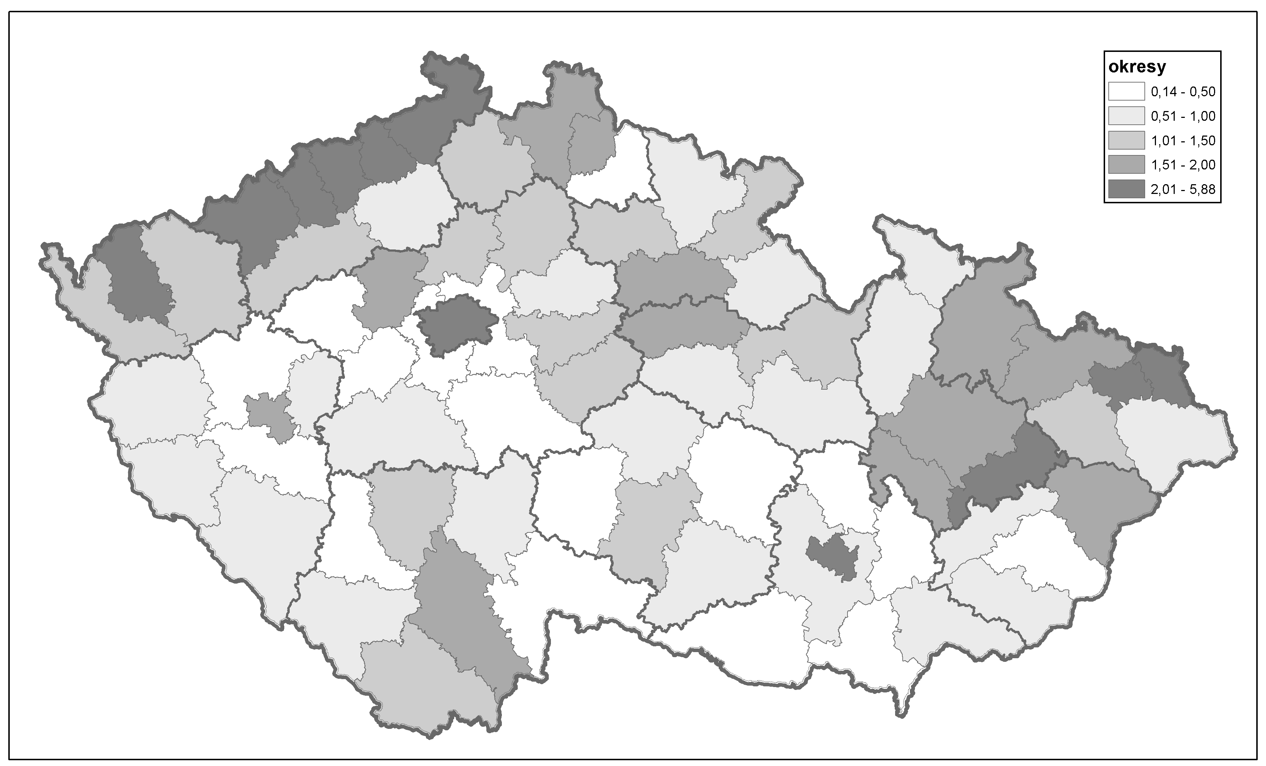
Distribution of the Roma population in the CR by districts – Cenzus 11
districts
Source: CZSO

Slide 23
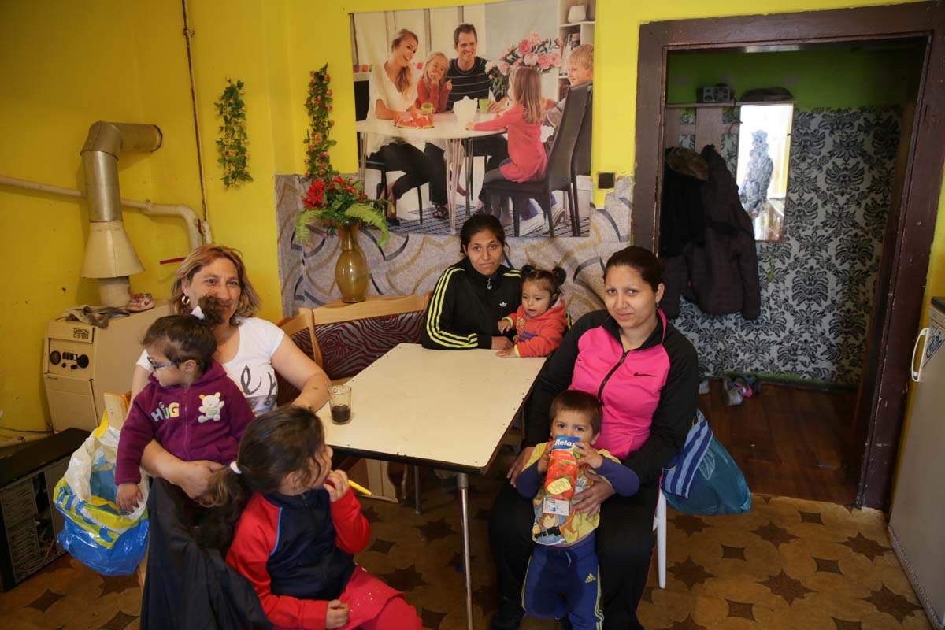
© Jindřich Štreit

Slide 24
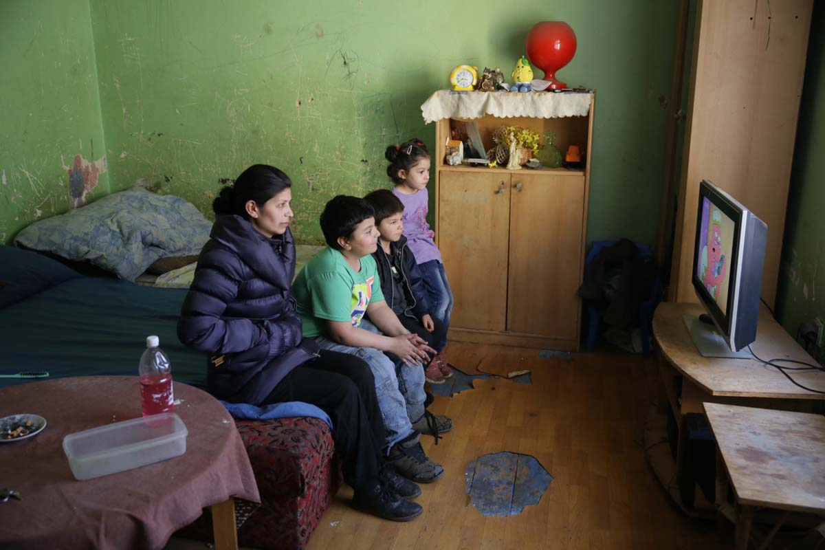
© Jindřich Štreit

Slide 25
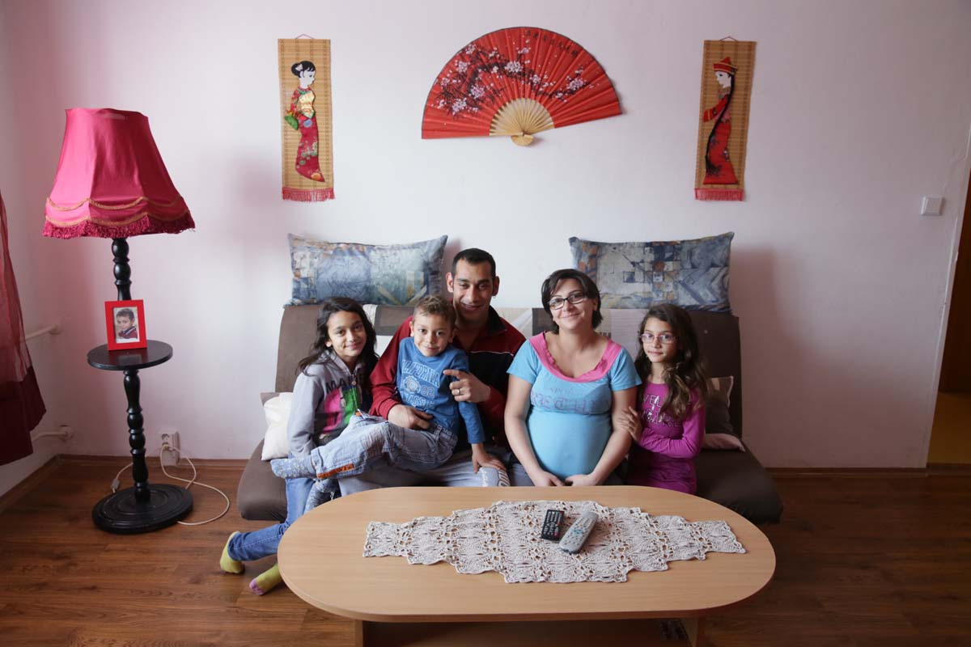
© Jindřich Štreit

Slide 26
The question of ethnic identification:
The discrepancy between:
Those who consider themselves to be Roma
Those who are considered as Roma by others.
The boundary of ethnicity is fuzzy,
the classification depends on who does it.
Notes:
Various authors and expert estimates point out against the cenzus data that they not represent the total Roma population or that the official demographic data underestimate the size of the Roma population. Thus, we see that people who do not identify themselves as Roma, are still classified as by others (experts or researchers).
Problems with the definition of who and based on what criteria identify as Roma.
3. Groupness – „býti skupinou“: „This means thinking of ethnicity,race, and nation not in terms of substantial groups or entities,
but in terms of practical categories, cultural idioms, cognitive schemas, discursive frames,
organizational routines, institutional forms, political projects, and contingent events.“

Slide 27
In the CR we clearly identify
Lower economic activity rate of Roma population
The Czech Roma often live concentrated – such areas labelled as ghettos
Low socio-economic status of the Roma – extent of dependency on social allowances/benefits.
The overall inferior social status of the Roma in Czech society.
Significantly lower school success of the Roma (especially from socially excluded localities) than that of the whole Czech population.
  In Czech society, the topic of ethnicity and educational inequality is relevant almost exclusively to the Roma. Other ethnic minorities, such as Slovaks, Ukrainians, Vietnamese, and Russians, show a much smaller ethnicity effect as a determinant of educational inequalities compared to the Roma.
Notes:
The situation of a person in the labor market is immediately reflected in the quality of life or the living standard of his family. Regarding the standard of living of the Roma, one of its key indicators is the rate of dependency on social allowances/benefits. This rate varies around one fifth of all households in localities with lower proportion of Roma population up to two-thirds of all households dependent on social benefits in areas with a higher proportion of Roma population.
Low socio-economic status of Roma people reinforces the negative stereotypes majority population holds towards Roma people and that mass media significantly boost up (for example, recent media discourse on “inadaptable members”).
27

Slide 28
Inequalities in public education
Free choice of school – mutual choice of schools and parents - results in cases in ethnic segregation of classess or schools.
An example of „The Nestlings“ (Ptáčata) 2010, 2013. http://www.ceskatelevize.cz/porady/10267754387-ptacata-aneb-nejsme-zadna-becka/4238-ptacata/
The school performance of children and chances for further education are/is determined by early school choice to a greater extent than in OECD countries – the effect is multiplied in the case of children from Roma family background.
Notes:
It is an example of the class at an elementary school here in Brno which was created after the non-Roma parents signed a petition in which they demanded that their children should not be put into the same class with the Roma children.
Afterwards based on this real case the document was created.
Intro from 0:40.
http://www.ceskatelevize.cz/porady/10267754387-ptacata-aneb-nejsme-zadna-becka/bonus/990-trailer/
http://www.ceskatelevize.cz/porady/10719503009-trida-8-a/video/ 1:30

Slide 29
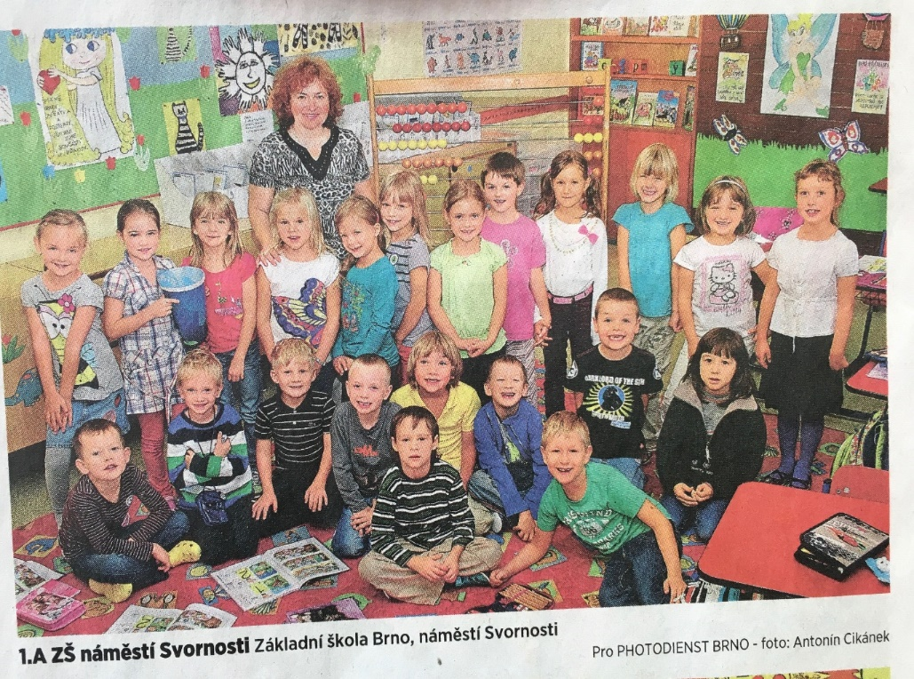
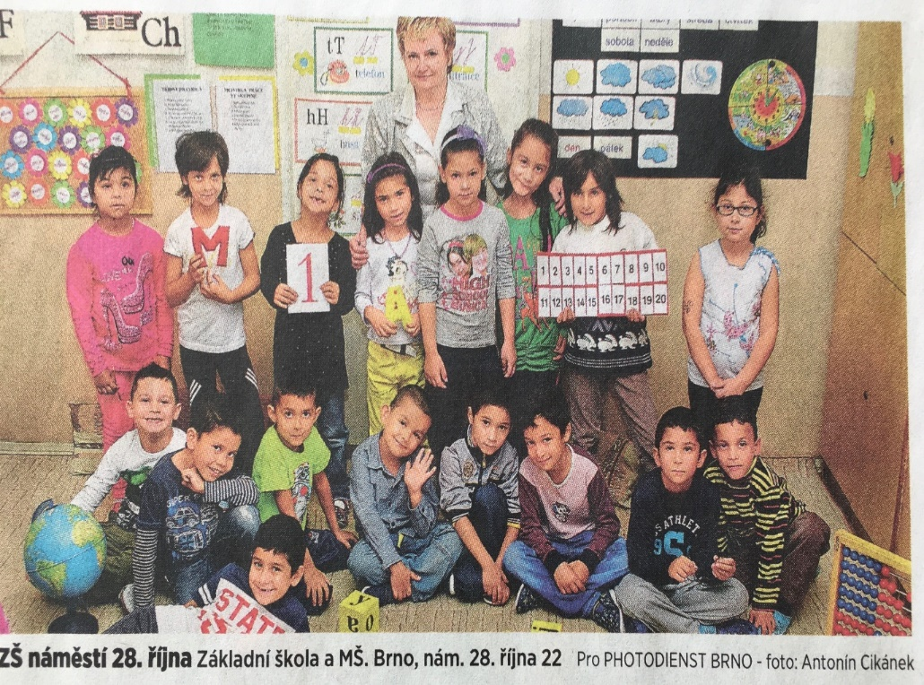
Example of ethnic differentiation among primary schools (in Brno)

Slide 30
Conclusions
- Ethnic differentiation can be observed among Brno primary schools.
- This trend is especially strengthening in the ethnically mixed districts of Center and North of the city.
→ Double differentiation of Roma children at the city level:
One is structurally conditioned (residential segregation)
The other can be explained by social action (parental strategies).

Slide 31
Causes – institutional level
The Czech Republic belongs in European milieu to those countries, where social origin of an individual strongly influences his/her educational attainment (OECD, 2018).
Consequently, the issue of relationship between ethnicity and educational inequalities (chances) is almost exclusively relevant to Roma minority and it can be already found at the level of primary education.
The segregation tendencies of the Czech educational system are pointed out even in some official (government-issued) documents ⇒ According to these official estimates in the school year 2016/17 a quarter of all Roma pupils were educated in primary schools with 50% or more enrolled Roma pupils, (Report on the Status of the Roma Minority…, 2017: 30).

Slide 32
The main problems on the side of actors
the transition between the pre-primary and the 1st level of elementary (primary/basic) education;
the transition between primary and lower secondary levels of education (the second stage is accompanied by a major outflow of Roma pupils); which influences
limited chances of attainment upper secondary/tertiary education

Slide 33
Inequalities in public education
The main factors influencing the educational path of Roma children:
poor pupils’ adaptation to school,
the relationship to school,
lower career aspirations
the climate in the school
Questions at the end:
How to eliminate disadvanteges in education?
How can be the results (success) of the implementation of inclusive measures reliably demonstrated?
How to stopping or reversing the negative trend of growing school segregation?
Notes:
Some research studies point to the fact that the Czech school system can not adequately compensate for the different skills that stem from different social backgrounds (Matějů, Straková, 2006). If we also take into account the fact that the free choice for a school forms - especially in larger cities - an ethnically segmented educational market where local hierarchy of schools exists and leads to pupils’ selection, we are faced to a deeper dilemma regarding the possibility to find general effective tools of inclusive policies. It points to the real key players who are the parents and their rational learning/educational strategies.

Slide 34
General conclusions
The concept of equal opportunities/access to education is related to the issue of educational inequalities; those inequalities which we consider unfair = are not caused only by the ability or effort of the individual.
One of the key challenges of current educational policies.
Main references:
OECD (2018). Equity in Education: Breaking Down Barriers to Social Mobility, PISA, OECD Publishing, Paris.

Slide 35
Thank you for your attention!
Contact: laura @econ.muni.cz
35

