Slide 1
10. PRICING

Slide 2
Readings for Lecture 10
Alexandersson, G., & Hultén, S. (2006). Predatory bidding in competitive tenders: A Swedish case study. European Journal of Law and Economics, 22(1), 73-94.

Slide 3
Learning Outcomes
Price discrimination and its importance in transport applications
Predatory bidding and its dangers in rail tendering
Determination of airport charges

Slide 4
Introduction
Pricing is a vital component in the economics of transport
The price determine who gets and who doesn’t get a particular service, but also determines the distribution of rewards between the provider and the user
The imperfect market structures are characterized by higher rewards for the providers

Slide 5
The principles of pricing
In most cases, transport services are subsidised and/or regulated, however a basic understanding of pricing principles is needed
In order to achieve economic efficiency, the price should equal the marginal cost
In imperfect competition markets, it is possible to observe price discrimination, predatory pricing, price fixing and congestion pricing

Slide 6
Price fixing
Firms in oligopolistic markets such as the airline sector often face a dilemma as to whether to compete with each other or to collude
Price fixing is a situation when oligopoly firms agree on the price they are going to sell their goods or services in order to remov price competitiveness and thus increase their profits

Slide 7
10.1 Price discrimination

Slide 8
Price discrimination
Price discrimination refers to a situation where a company charges particular consumers a higher price than others for the same product for reasons unrelated to cost.
The seller must possess a degree of market power, must be able to divide the market and market segments must have differing elasticities of demand.

Slide 9
Perfect price discrimination
To sell each unit (or ticket) seperately, charging the highest price that each consumer is prepared to pay
If this was achievable, the seller would obtain the entire consumer surplus from the consumer
The seller must know the exact shape of each consumer’s demand and charge each consumer the maximum price they are prepared to pay

Slide 10
Case: Sale of airline tickets
On a typical airline flight there are three classes, namely First, Business and Economy.
Figure on the next slide refers to travel in a particular class and the assumption is made that the marginal cost of one extra passenger is constant up to the point where the aircraft reaches full capacity
At this point the MC curve becomes perfectly inelastic

Slide 11
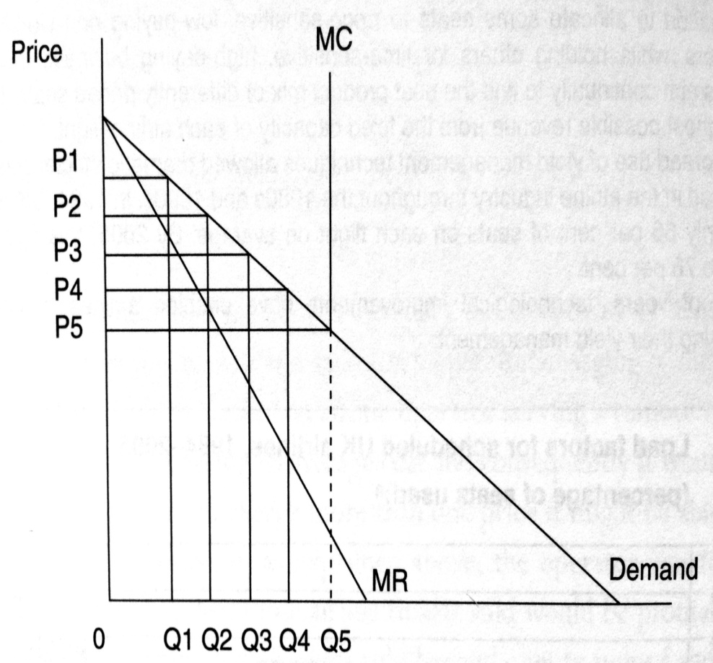
Airline price discrimination

Slide 12
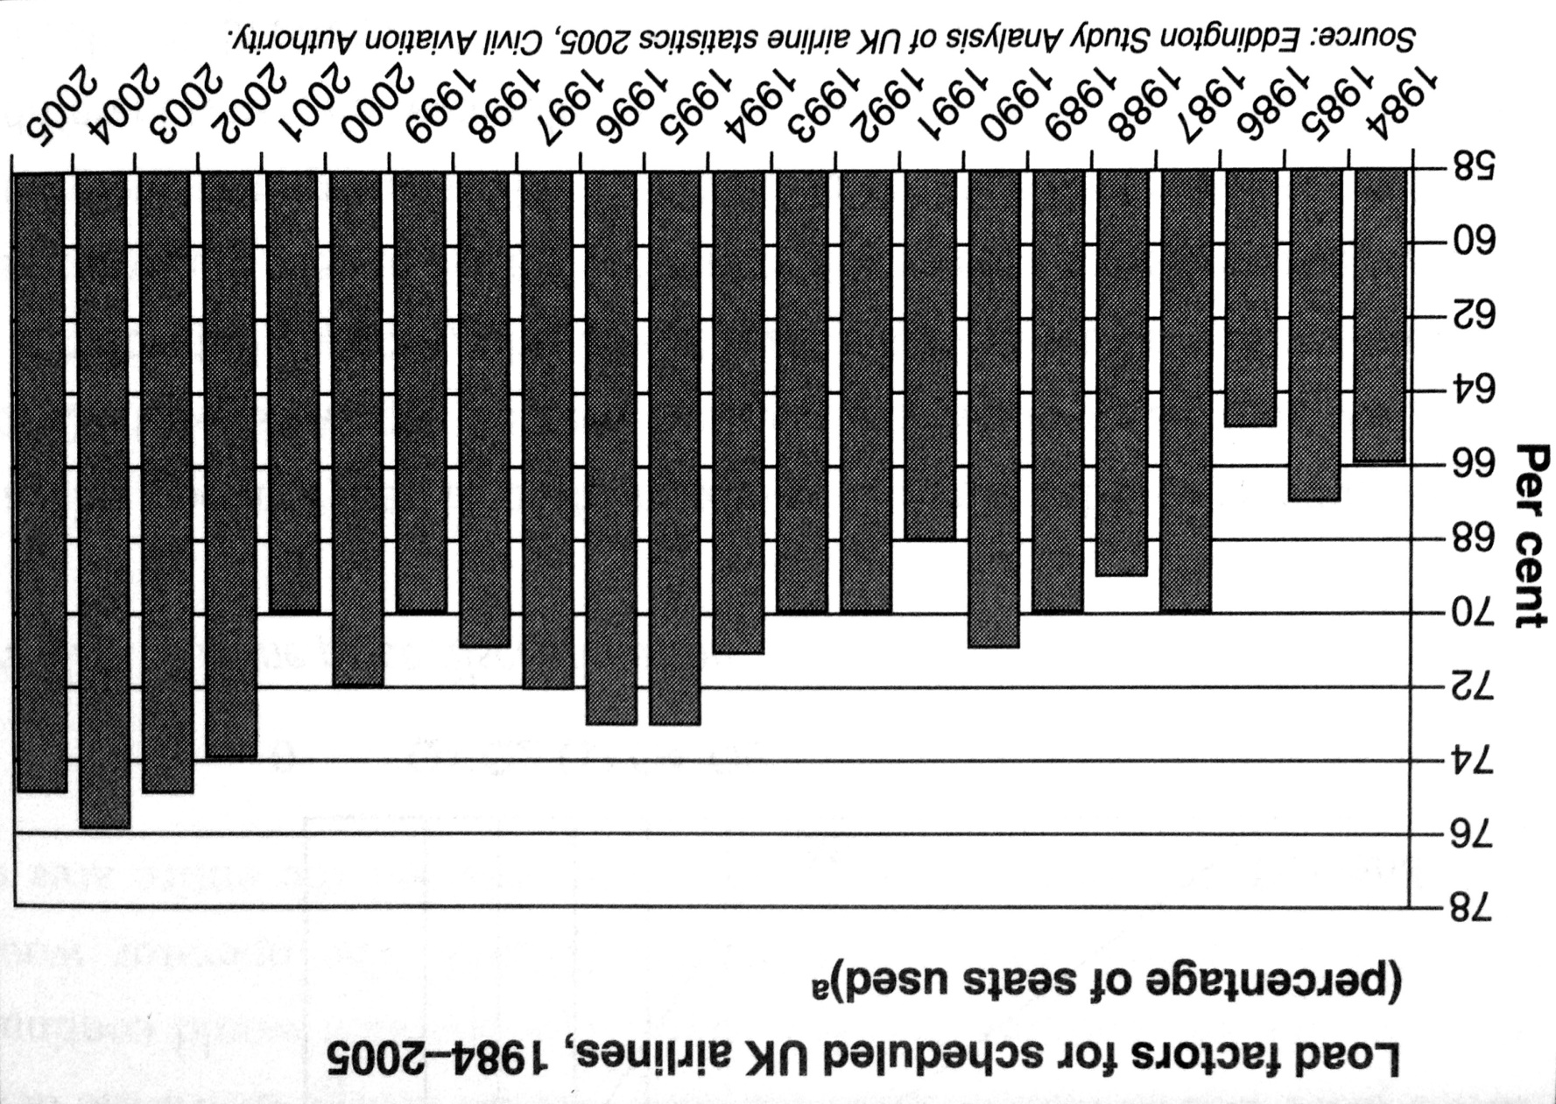
Yield management in the aviation

Slide 13
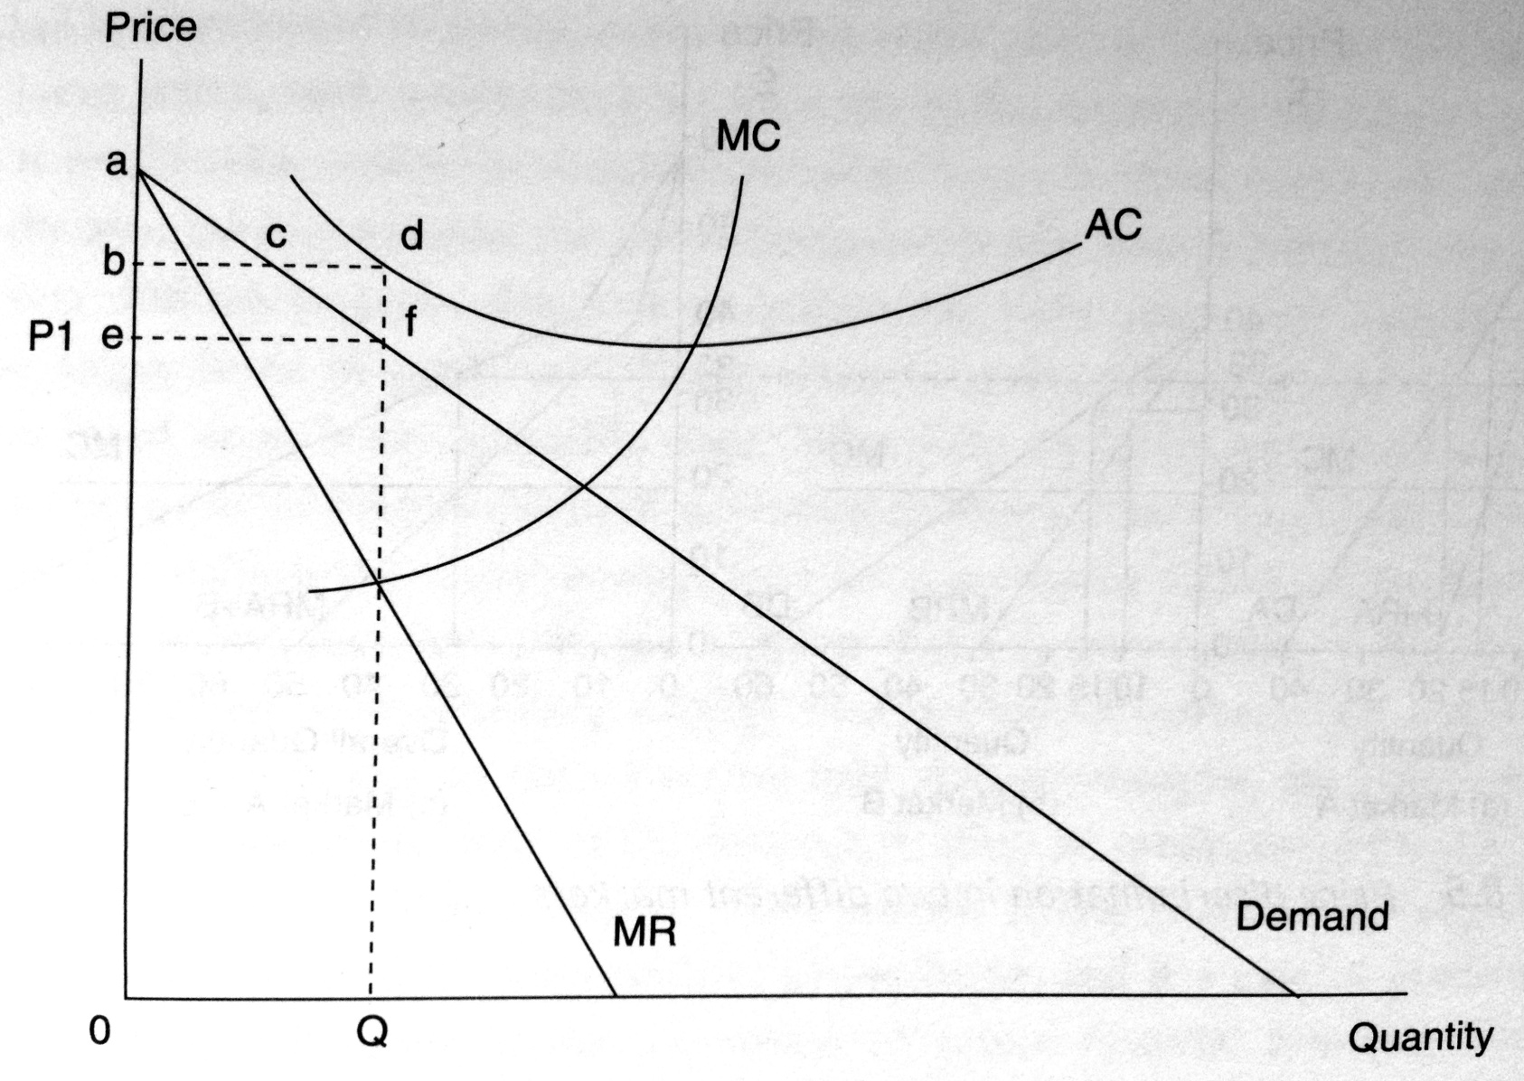
Loss making operator and perfect price discrimination

Slide 14
Exercise (1)
1. Transport operators in oligopolistic markets practise predatory pricing and price fixing from time to time. Outline what you perceive to be the benefits to transport operators of such practices and the reasons why they are illegal in many countries world-wide.
2. You are the manager of the Airline and unable to determine whether any given passenger is a business or leisure traveller. Can you think of a self-correction mechanism that would permit you identify business and leisure?

Slide 15
Exercise (2)
Suppose that a transport carrier is accused of price discriminating in two separate markets. The carrier replies that he can’t be price discriminating, since he is charging the same price in each of the markets. Do you agree or disagree with the carrier’s response?

Slide 16
Exercise (3)
Business travellers have more inelastic demands for air services in comparison with vacation travellers. If an airline charges business and vacations travellers the same route fare between Chicago and Los Angeles, does this necessarily imply that the airline is not price discriminating? Under what conditions would this be consistent with price discrimination?

Slide 17
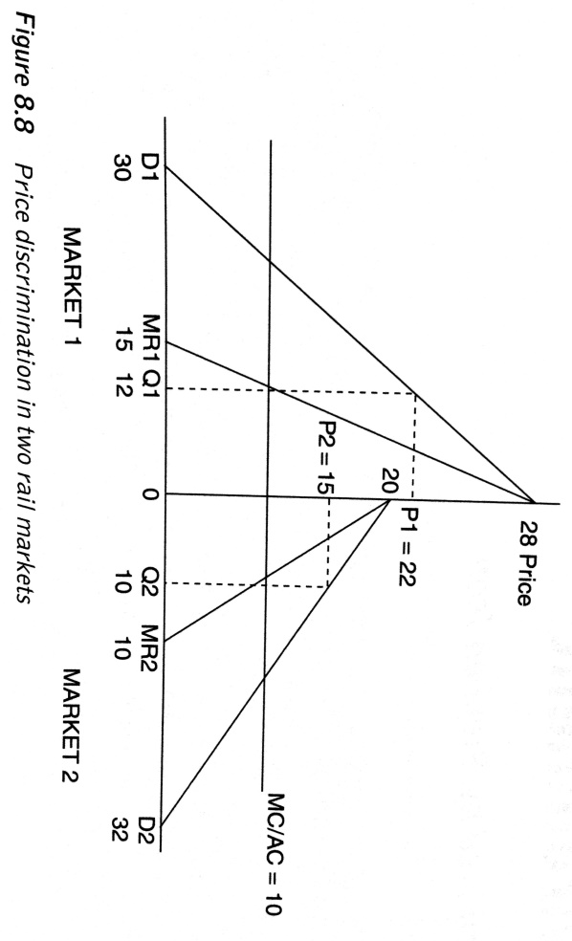
Exercise (4)
Figure refers to a rail operator that is practising price discrimination, charging a different price to the passengers in market 1 compared to those in market 2. It is assumed that costs are constant, therefore MC = AC.
What does Figure reveal about the type of passengers using the service and their relative elasticities?
Calculate the abnormal profit earned by the rail operator by price discriminating.
Based on the information presented in Figure sketch out the diagram for the rail operator if it were not to price discrimination.
Are there any beneficiaries from price discrimination and what happens to consumer surplus when price discrimination is practised?

Slide 18
10.2 Predatory bidding

Slide 19
Predatory pricing
Predatory pricing occurs when a firm with maket power reduces its price below cost in the short run so as to obtain abnormal profit in the long run.
Predatory pricing is aimed at either achieving or maintaining a monopoly situation, with the price set so as to bankrupt competitors, „encourage“ them to merge or in fact collude.

Slide 20
Predatory pricing
The consumer may benefit in the short run from lower prices, due lower competition such activity may not be in the public interest in the long run.
In practise it can be very difficult to prove that such activity has taken place
Predatory pricing is an appealing strategy in a segmented market

Slide 21
Predatory bidding
A similar practise to predatory pricing is a predatory bidding that relates to predatory pricing in competitive tenders. The competitive tendering occurs when firms bid for right to run service or gain a certain contract. The competitive tender is often utilized to choose the provider of subsidized rail passenger services. Why?
Do you think it is a good idea to choose the operator in such tender on the base of only one parameter – lowest price? Do you think that predatory pricing (bidding) or price fixing may be a problem here? Do you think a moral hazard is a relevant issue?

Slide 22
Case
Alexandersson, G., & Hultén, S. (2006). Predatory bidding in competitive tenders: A Swedish case study. European Journal of Law and Economics, 22(1), 73-94.

Slide 23
Abstract
Public procurement by competitive tendering is an important part of European policies to encourage competition in network industries previously dominated by public companies.
In recent years, the appearance of very low bids has become an issue in several countries. We discuss predatory bidding from a theoretical, practical and legislative point of view.
A case of tendering for train services in Sweden is used to illustrate the possibilities to detect an abnormally low bid. An analysis of projected costs and revenues is complemented with a method using historical data on previous tenders.

Slide 24
Introduction
One of liberalization problems in rail sector → the appearance of very low bids in tenders
Sometimes linked to later failures of winning firms to deliver the contracted train services
May contribute to a growing concern for negative effects of competitive tendering at the national and regional level

Slide 25
Why do firms place very low bids in tenders?
To push out or at least weaken competitors/new entrants
The role of market position and cross-subsidization
Is this a rational strategy?
Chicago School of Economics
The role of signalling and strategic behaviour

Slide 26
Legislators view on predatory bids
EU legislation does not consider predatory pricing as such
Instead, it focuses on price reductions as one of several practices related to abuse of dominant position

Slide 27
Tendering in northern Sweden
In 2002 Connex won tender for operating train services to northern Sweden
Connex, originating from France, is Europe biggest private passenger tranportation company (55.000 employees and 3.4 bn EUR turnover (2003))
Tagkompaniet – small competitor (this contract 80% of its turnover) bitterly complained that Connex bid was „totally unrealistic“
Swedish Competition Authority decided not to take action, after failing to find sufficient support to investigate any possible viaolation of the Competition Act

Slide 28
Comparison of the bids

Slide 29
The assesment of Connex bid
Conservative in revenue projections
Very ambitious in cost reductions
Connex publicly declared that it will not cut down on staff or change the working conditions
No allowance for expanded vehilce maintanance
Summary: Connex bid has been „extremely low“

Slide 30
Subsequent development
2004 – Connex were criticized for running old and very run-down trains, lacking the comfort passengers expected.
Connex appeared not to be willing or able to keep the interior of trains in good shape
Patronage plummeted and in late 2004 the management of Connex was facing massive criticism from staff and union.
The head of the services was replaced

Slide 31
Subsequent development
Worsening conditions for travelling by train between Stockholm and Northern Sweden, causing a political debate that soon reached the national level
The end result was a decision in Parliament to direct an extra 100 million SEK per year to imporve the quality of services
It is pretty clear that the bid of Connex was not possible to fulfill

Slide 32
Discussion question
What are lessons out of this case study?

Slide 33
Case
Predatory bidding in Czech rail tender (2006)

Slide 34
Introduction
In 2006 Czech Ministry of Transport opened two competitive tenders for rail lines Pardubice – Liberec and Plzeň – Most.
The tenders' results caused great controversy and did not open the market to competition.
This was because České dráhy won the tenders with a price that aroused suspicion that it was set under the level of the incumbent costs.

Slide 35
Data
The anger of other operators was caused by the incumbent's winning price, which was as low as 18.28 CZK/train kilometre for Plzeň-Most and 41.39 CZK/train kilometre for Pardubice - Liberec.
To assess whether the accusation of predatory pricing was valid is not easy because there were no competitive tenders in long-distance transport and only a handful of competitive tenders in regional transport at the time.

Slide 36
Former tenders
ČD used to claim much higher subsidies for directly awarded long-distance transport, usually as high as 80 CZK per train kilometre.
It is also worth noting the results for a small regional tender in 2005 in western Bohemia for a route connecting the spa towns of Carlsbad, Marienbad and Bečov, when Viamont was declared the winner with a price of 64.60 per train kilometre. ČD was second with an offer of 80.40 CZK per train kilometre, and Railtrans finished in last with an offer of 85.20 CZK (Tomeš, Kvizda, Nigrin, Seidenglanz, 2014).

Slide 37
Discussion questions
Do you think predatory bidding took place?
What is the motivation of České dráhy to resort to predatory pricing?
What are the possibilities of Ministry of Transport to limit predatory pricing or price fixing in competitive tenders?

Slide 38
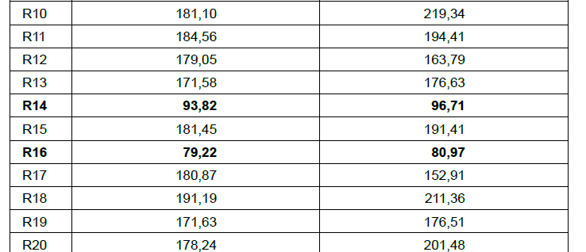
Empirical evidence
Table: Train km costs of the incumbent
Source: Rakova 2014

Slide 39
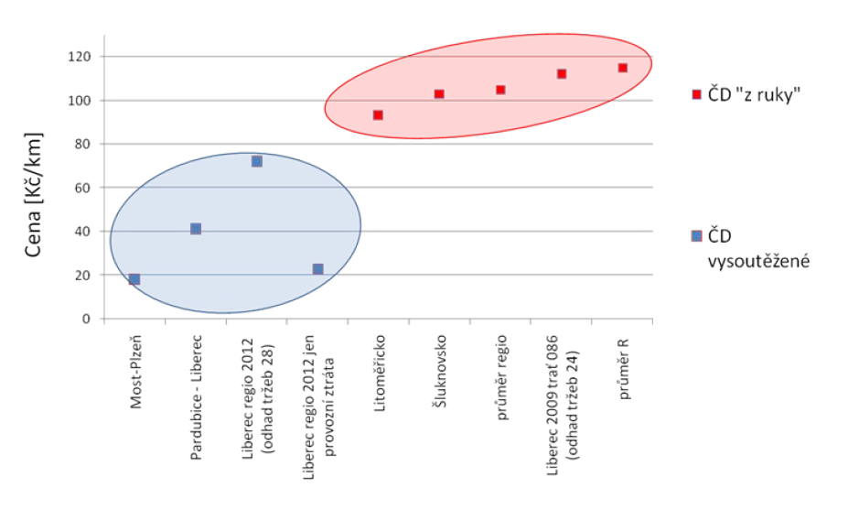
Empirical evidence
Schmidt (2009)

Slide 40
10.3 Airport charges
Bel, G., & Fageda, X. (2010). Privatization, regulation and airport pricing: an empirical analysis for Europe. Journal of Regulatory Economics, 37(2), 142-161.

Slide 41
Introduction
Both airports and major airline operators have significant market power
What are factors that determine the level of airport charges?
Volume of traffic?
Public/private ownership?
Regulation?

Slide 42
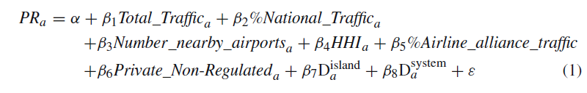
Airport pricing
Bel – Fageda (2010) examined factors determining airport charges. Their empirical model was formulated as:

Slide 43
Variables
PR is he price charged by the airports to airlines fo traffic within EU.
Total_Traffic is the airport‘s total volume of traffic.
%National_Traffic is the domestic traffic as a percentage of the airport’s total traffic.
Number_nearby_airports is the number of airports that lie fewer than 100 km away.
HHI is the the Hirschman-Herfindhal index of concentration at the airport in the terms of the number of flights offered by the airlines operating out of it.
%Airline_alliance_traffic is the percentage of traffic channelled by the airlines integrated within international alliances.
Private_Non_Regulated is the dummy for private and non regulated airports.
D^{island} is a dummy for airports with an island location.
D^{system} is a dummy for airports in countries that operate a price fixing system.

Slide 44
Questions
What signs do you expect for the explanatory variables?
Which estimation method would you use?
Do you think endogeneity may be a problem here?

Slide 45
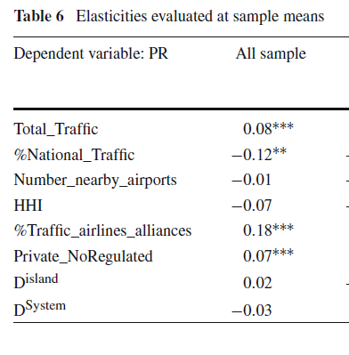
Results

Slide 46
Conclusions
Using data for 100 large airports in Europe, we find that they charge higher prices when they move more passengers.
Additionally, competition from other transport modes and nearby airports imposes some discipline on the pricing behavior of airports. Low-cost carriers and airlines with a high market share seem to have a stronger countervailing power.
We also find that private airports not regulated charge higher prices than public or regulated airports.
Finally, the regulation mechanism does not seem to influence substantially the level of airport charges.

Slide 47
10.4 Summary

Slide 48
Summary (1)
Price discrimination refers to a situation where a company charges particular consumers a higher price than others for the same product for reasons unrelated to cost.
Predatory pricing occurs when a firm with maket power reduces its price below cost in the short run so as to obtain abnormal profit in the long run.

Slide 49
Summary (2)
A similar practise to predatory pricing is a predatory bidding that relates to predatory pricing in competitive tenders.
Bel-Fageda (2010), using data for 100 large airports in Europe, found that they charge higher prices when they move more passengers.

Slide 50
Readings for Lecture 11
Nash, C. (2015). When to invest in high speed rail. Journal of Rail Transport Planning & Management, 5(1), 12-22.
Preston (2013): The economics of investment in HSR

