Slide 1
6. COMPETITION (2)

Slide 2
Readings for Lecture 6
Tomeš, Z., Kvizda, M., Jandová, M., & Rederer, V. (2016). Open access passenger rail competition in the Czech Republic. Transport Policy, 47, 203-211.
Hunold, M., & Wolf, C. (2013). Competitive procurement design: Evidence from regional passenger railway services in Germany.
Preston, J., & Almutairi, T. (2013). Evaluating the long term impacts of transport policy: An initial assessment of bus deregulation. Research in transportation economics, 39(1), 208-214.

Slide 3
Learning Objectives
Advantages and disadvantages of open access rail competition x competitive tendering
Open access rail services in Central Europe
Competitive tendering of regional rail services in Germany
Competition on the market x competition for the market in British bus industry

Slide 4
6.1 Competition in the market – Railways, Czech Republic

Slide 5
Czech railway passenger market
 | 1995 | 2000 | 2005 | 2010 | 2015
Passenger- Kilometers (billions) | 8.0 | 7.3 | 6.7 | 6.6 | 8.3
Modal Share of Railways (%) | 10.8 | 8.3 | 7.3 | 7.5 | 8.6
Private Operator’s Market Share (%) | 0.0 | 0.0 | 0.1 | 0.2 | 5.0
Source: Eurostat

Slide 6
Public and commercial services
All regional services are PSO; financed by regions;
2009 – 2019 direct awarding of all services to ČD
Long distance services
- semi-fast trains – PSO; direct awarding to ČD
- IC trains – commercial services of ČD
- open access on two mainlines
2011: Prague – Ostrava – (Slovakia/Poland)
2016: Prague – Brno – (Vienna/Bratislava/Budapest)

Slide 7
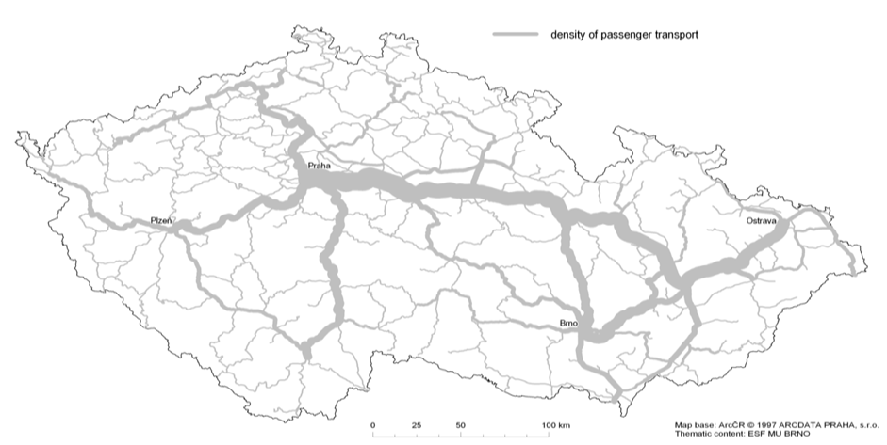
Geography
Prague
Plzeň
Pardubice
Ostrava
Olomouc
Brno
* densiiy of rail passenger flows; year 2009
Source: ČD

Slide 8
Open access on Prague - Ostrava
Before September 2011 → high density of traffic, low intermodal competition, two brands of ČD services – SC (Pendolino), IC (standard), high fares, subsidies, no competition
September 2011 → withdrawal of public subsidies; the open access entrance of the first private competitor RegioJet
January 2013 → the entrance of the second private competitor LeoExpress
2011 - 2018 → intensive price and non-price competition of the operators

Slide 9
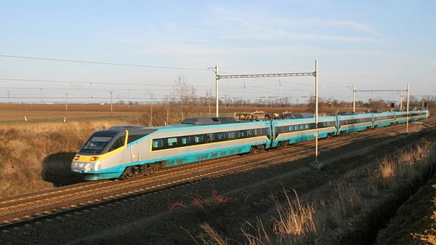
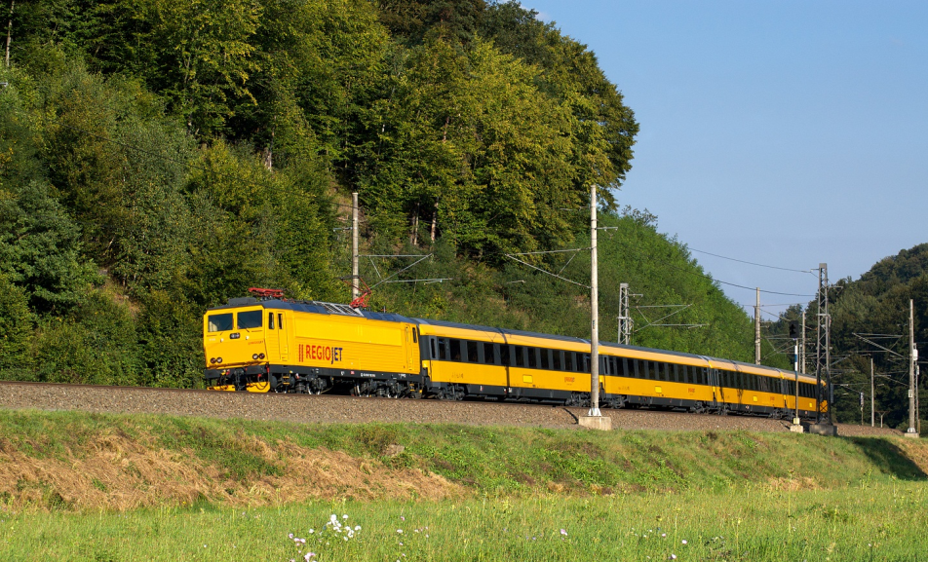
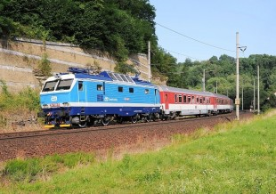
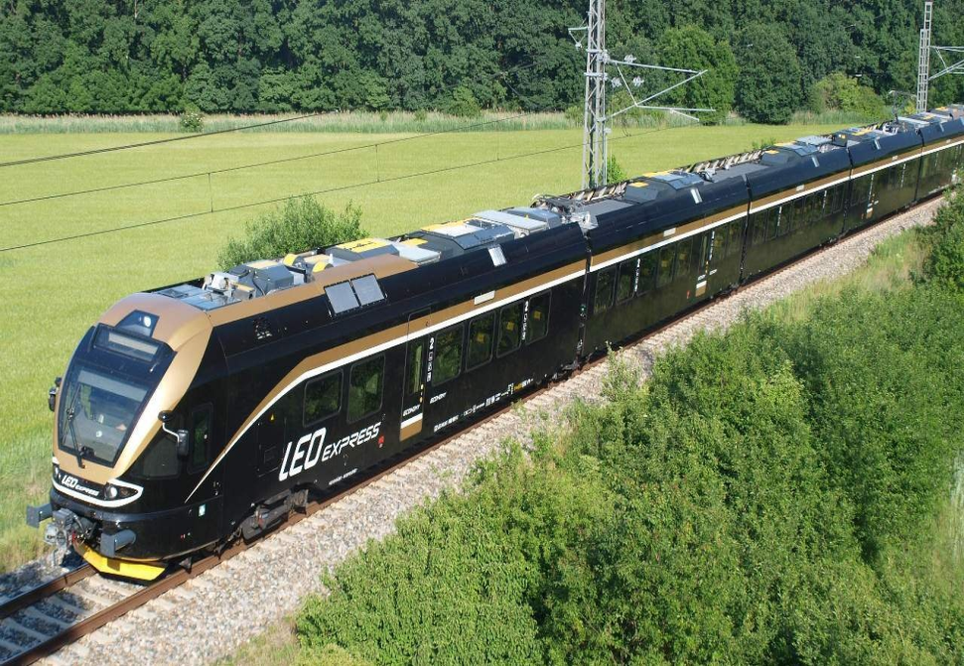
Service differentiation

Slide 10
Frequency
* daily, one-way

Slide 11
Prices
* CZK per one way ticket

Slide 12
Interurban fares above 300 km: peak single (PPP-adjusted fare EUR per km); 2015
Source: EC (2016)

Slide 13
Passengers
 | ČD SC | ČD IC | Regiojet | LeoEx | TOTAL
2010 | 1,3 | 2,3 |  |  | 3,6
2011 | 1,3 | 2,3 | 0,1 |  | 3,7
2012 | 1,1 | 2,1 | 1,1 |  | 4,3
2013 | 1,0 | 1,8 | 1,5 | 0,7 | 5,0
2014 | 1,2 | 1,5 | 2,4 | 0,9 | 6,0
2015 | 1,3 | 1,5 | 3,0 | 1,1 | 6,9
2016 | 1,3 | 1,6 | 3,1 | 1,1 | 7,1
2017 | 1,4 | 1,7 | 3,3 | 1,1 | 7,5
* millions; own estimation

Slide 14
Propensity to travel by rail (2014) and its average annual change since 2009
(p-km per year per inhabitant)
Source: RMSS 2016

Slide 15
Market shares
 | ČD SC | ČD IC | RegioJet | LeoExpr | TOTAL
2010 | 36% | 64% |  |  | 100%
2011 | 35% | 62% | 3% |  | 100%
2012 | 26% | 48% | 26% |  | 100%
2013 | 20% | 36% | 30% | 14% | 100%
2014 | 20% | 25% | 40% | 15% | 100%
2015 | 19% | 22% | 43% | 16% | 100%
2016 | 18% | 23% | 44% | 15% | 100%
2017 | 18% | 23% | 44% | 15% | 100%

Slide 16
Revenues and profits
 | 2012 |  | 2013 |  | 2014 |  | 2015
 | Rev | Profit | Rev | Profit | Rev | Profit | Rev | Profit
Regio | 246 | -76 | 318 | -93 | 523 | -42 | 718 | +41
Leo | 11 | -78 | 193 | -159 | 178 | -137 | 258 | -84
ČD | 19 500 | -517 | 19 900 | -1 795 | 20 723 | -865 | 21 075 | -1 395
mil. CZK
RegioJet and LeoExpress - data for Prague-Ostrava;
ČD – data for all Czech passenger rail network

Slide 17
Rolling stock
 | 2010 | 2011 | 2012 | 2013 | 2014 | 2015 | 2016
Average Number of Coaches per Train | 8.9 | 7.2 | 7.3 | 7.0 | 6.7 | 7.6 | 7.5
Average Number of Seats per Train | 465 | 408 | 353 | 336 | 333 | 373 | 384
Total Daily Capacity (Number of Seats) | 10 687 | 12 649 | 11 282 | 13 437 | 11 650 | 14 186 | 14 594

Slide 18
Timetable
Number of Passenger Trains Departing from Ostrava to Prague on Weekdays (number of trains per hour)

Slide 19
Regulation challenges
Infrastructure capacity (charges, priority rights)
Anticompetitive behaviour (predatory pricing)
Conflicts with PSO operations (priorities, financing)
Weak regulation
Tariff integration

Slide 20
Assessment
+ better quality of services
+ higher frequency of trains
+ lower prices for customers
strains on infrastructure capacity
- conflicts with PSO operations
tariff disintegration

Slide 21
References
Tomeš, Z., Kvizda, M., Jandová, M., & Rederer, V. (2016). Open access passenger rail competition in the Czech Republic. Transport Policy, 47, 203-211.
Tomeš, Z., Kvizda, M., Nigrin, T., & Seidenglanz, D. (2014). Competition in the railway passenger market in the Czech Republic. Research in Transportation Economics, 48, 270-276.

Slide 22
6.2 Competition in the market – Railways, Central Europe

Slide 23
Introduction
Open access passenger rail services in Central Europe:
1) Austria on the Vienna–Salzburg line from 2011
2) the Czech Republic on the Prague–Ostrava line from 2011
3) Slovakia on the Žilina–Košice line from 2014.
The paper compares the impacts of open access entries on the development of national railway markets. The comparison consists of:
entry barriers
business model
market developments
regulatory challenges

Slide 24
Railway passenger market
 | Austria | Czech Republic | Slovakia
Area (1000 km²) | 84 | 79 | 49
Population (million) | 8.5 | 10.5 | 5.4
Length of railway lines (th. km) | 5.1 | 9.5 | 3.6
Share of electrified lines (%) | 70 | 34 | 44
Passenger-killometres (billion) | 12.0 | 7.6 | 2.6
Fare box revenue as % of TR | 56 | 50 | 33
PSO as % of total services | 71 | 93 | 91

Slide 25
Open access services in CE (2018)

Slide 26
Access charges
 | InterCity | Suburban | Freight
Austria | 4.2 | 2.0 | 3.4
Czech Rep. | 1.2 | 0.6 | 3.4
Slovakia | 1.8 | 1.6 | 2.8
EUR/trainkm

Slide 27
Frequency
 | 2010 | 2012 | 2014 | 2016 | 2018
Austria (Vienna–Salzburg) | ÖBB 37 | ÖBB 37 WB 13 | ÖBB 35 WB 14 | ÖBB 35 WB 15 | ÖBB 35 WB 29
Czech Republic (Prague–Ostrava) | ČD 23 | ČD 22 RJ 10 | ČD 19 RJ 9 LE 7 | ČD 21 RJ 10 LE 7 | ČD 19 RJ 11 LE 6
Slovakia (Žilina–Košice) | ŽSSK 20 | ŽSSK 18 | ŽSSK 16 RJ 2 LE 0 | ŽSSK 16 RJ 8 LE 1 | ŽSSK 19 RJ 3 LE 2
Daily train departures; one-way

Slide 28
Market effects
 | ∆ Prices | ∆ Ridership | ∆ Revenues | ∆ Frequency (proxy for ∆ Costs)
Austria 2010–2016 Vienna–Salzburg | −(20..25)% | +(20..25)% | -10%..0% | +35%
Czech Rep. 2010–2016 Prague–Ostrava | −42% | +97% | +14% | +65%

Slide 29
Profits
 | 2012 | 2013 | 2014 | 2015 | 2016
WESTbahn | −23.5 | −14.5 | −10.3 | −5.4 | -8.7
RegioJet | −2.8 | −3.4 | −1.6 | +1.5 | n.a.
LEO Express | −2.9 | −5.9 | −5.1 | −3.1 | -4.2
mil. EUR

Slide 30
Regulatory challenges
The need for dedicated regulator
Predatory pricing
Conflicts between OA and PSO services
No tariff integration
Infrastructure capacity around big cities

Slide 31
Conclusions
Demand → undoubtely positive impact of open access services (innovations, marketing, frequency, quality, prices, ridership)
Supply → questionable/negative impact of open access services (rising unit costs, stagnating revenues, financial losses, cherry-picking, long term sustainability)
Regulation → significant challenges (vertical structure, infra capacity, priority rights, operators disputes, predatory pricing, anticompetitive behaviour)

Slide 32
References
Tomeš, Z. – Jandová M. (2018): Open access passenger rail services in Central Europe. Research in Transportation Economics. 2018. In print

Slide 33
6.3 Competition for the market
Hunold, M., & Wolf, C. (2013). Competitive procurement design: Evidence from regional passenger railway services in Germany.

Slide 34
Introduction
We study competitive awarding procedures of short haul railway passenger services in Germany from 1995 to 2011 by means of a newly collected data set. In particular, we use regression techniques to investigate:
the determinants of the number of bidders,
the identity of the winning bidder,
the subsidy level.

Slide 35
Germany regional tendering
Competitive tendering of regional railroad passenger services in Germany has developed since the liberalization of the railroad sector in 1994.
The central goal is to implement a decent level of service quality, while keeping public subsidies at a low level.
Towards this, an intermediate goal is to induce entry of new operators that provide alternatives to the still dominant operator DB Regio.
This operator is not only the incumbent of most transport services, but is additionally integrated with the network operator in the publicly owned holding Deutsche Bahn AG (DB).
Reinforced by substantial asymmetries between the incumbent and the entrants, designing awarding procedures that attract an adequate number of bidders and select the most capable one remains a challenge.

Slide 36
Development of the awarding procedures

Slide 37
Hypotheses
The identity of the winning bidder
The number of bidders in competitive awarding procedures
The subsidy levels

Slide 38
The identity of the winning bidder
Hypothesis 1. DB is more likely to win when profit risks are high.
Hypothesis 2. DB is more likely to win if used vehicles are admitted.
Hypothesis 3. DB is more likely to win if no financial support for new vehicles is offered.
Hypothesis 4. DB is more likely to win a contract if the contract volume is large.
Hypothesis 5. DB is more likely to win a contract if it is the incumbent.
Hypothesis 6. DB is more likely to win a contract if the number of bidders is low.

Slide 39
The number of bidders
Hypothesis 7. The number of bidders is higher if less other awarding procedures take place at the same time.
Hypothesis 8. The number of bidders is higher if a) DB has fewer competitive advantages and b) the contract duration is higher.

Slide 40
The subsidy level
Hypothesis 10. The resulting subsidy level is lower if the number of bidders is higher.
Hypothesis 11. The resulting subsidy level is lower for net contracts.
Hypothesis 12. The required subsidy level is lower if the network length and frequency of service increase.
Hypothesis 13. The required subsidy level is lower if a) used vehicles are admitted and b) financial support for new vehicles is offered.

Slide 41
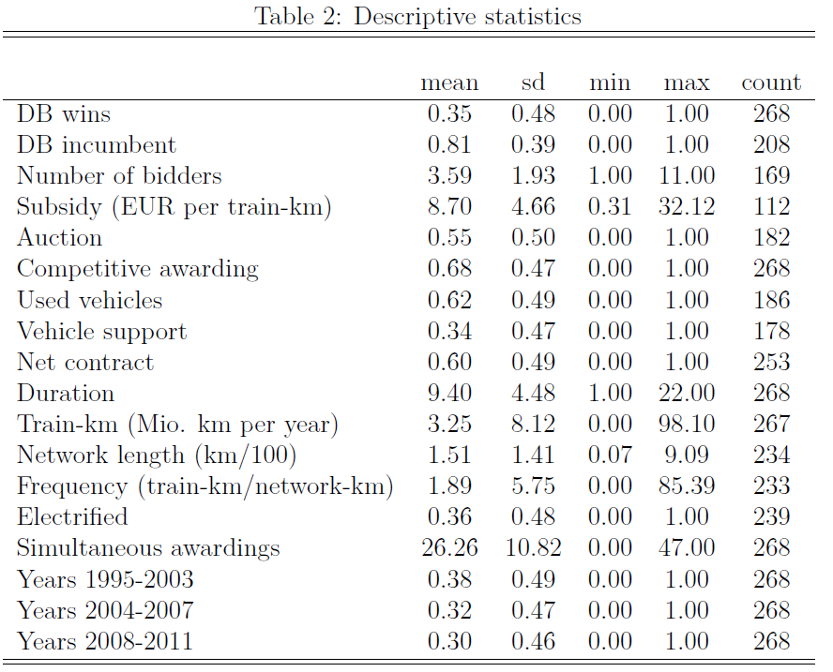
Data

Slide 42
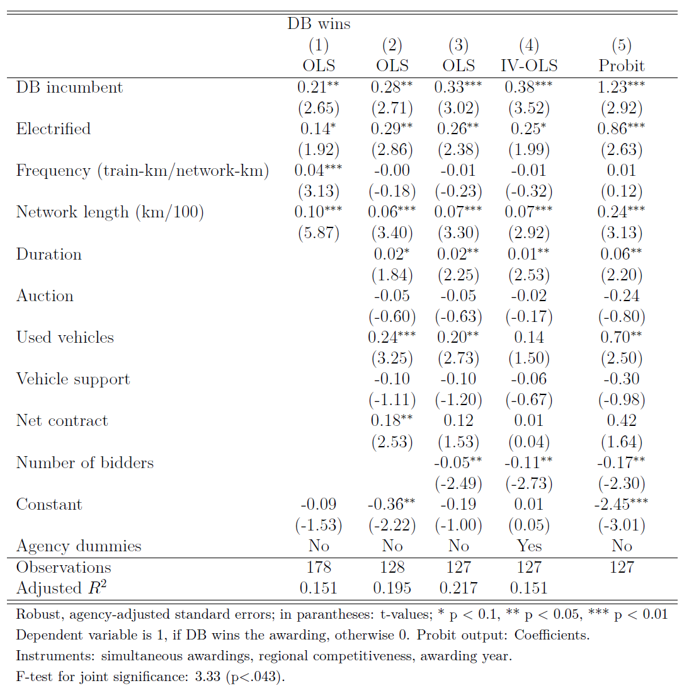
The identity of the winner

Slide 43
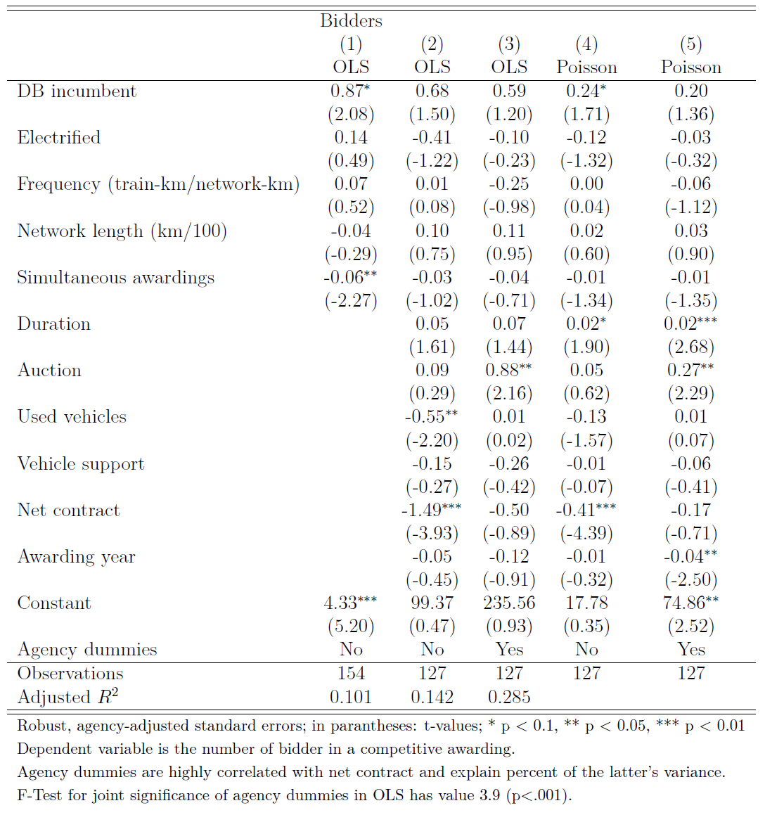
The number of bidders

Slide 44
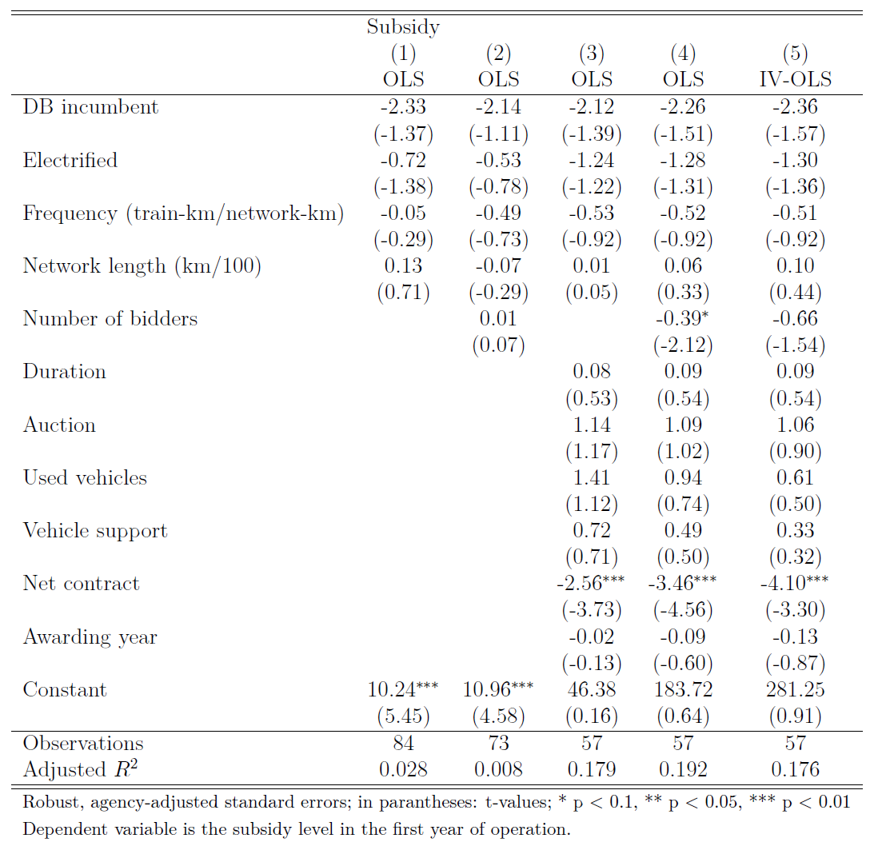
The subsidy level

Slide 45
Differences between competitive and direct awarding (mean comparison)

Slide 46
Summary
We find that there are more bidders when the contract duration is high and the revenue risk low. The dominant operator is more likely to win contracts if it is the incumbent, the network is large, the contract duration is high, when used rolling stock is admitted and when there are few other bidders.

Slide 47
6.4 British buses
Preston, J., & Almutairi, T. (2013). Evaluating the long term impacts of transport policy: An initial assessment of bus deregulation. Research in transportation economics, 39(1), 208-214.

Slide 48
British bus reform
Local buses in Britain, outside London, were ‘deregulated’ in 1986 (competition on the market)
By contrast, in London, the 1984 London Regional Transport Act introduced a system of comprehensive tendering (competition for the market)
This paper examines the long term impacts of these changes.

Slide 49
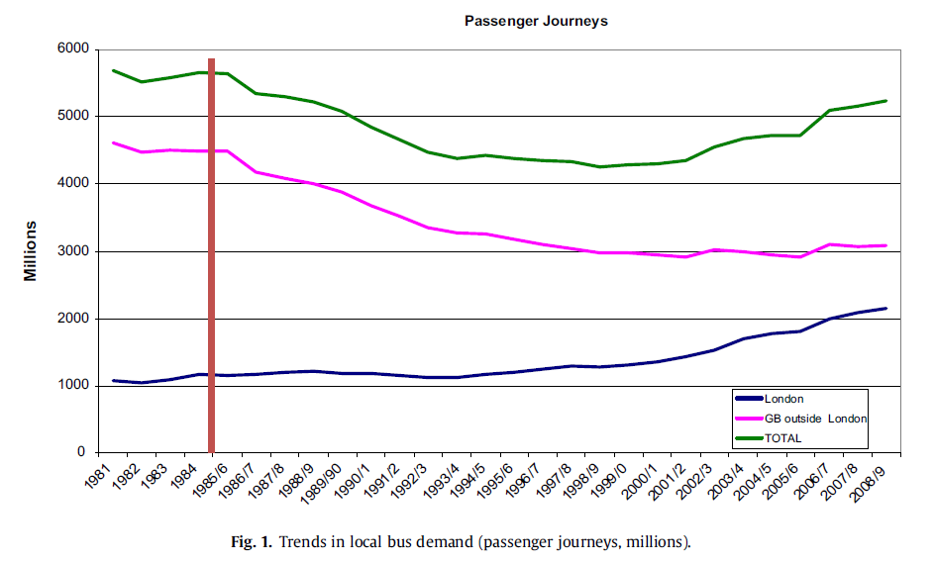
Demand

Slide 50
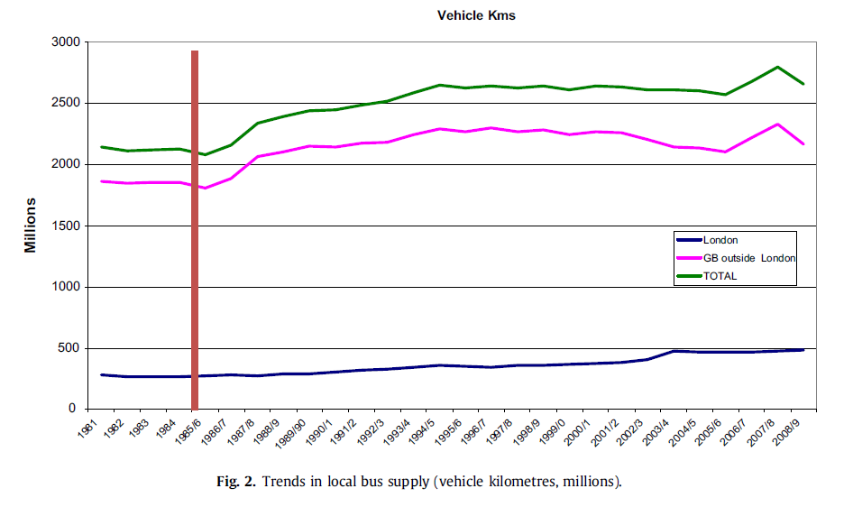
Supply

Slide 51
Fares

Slide 52
Costs

Slide 53
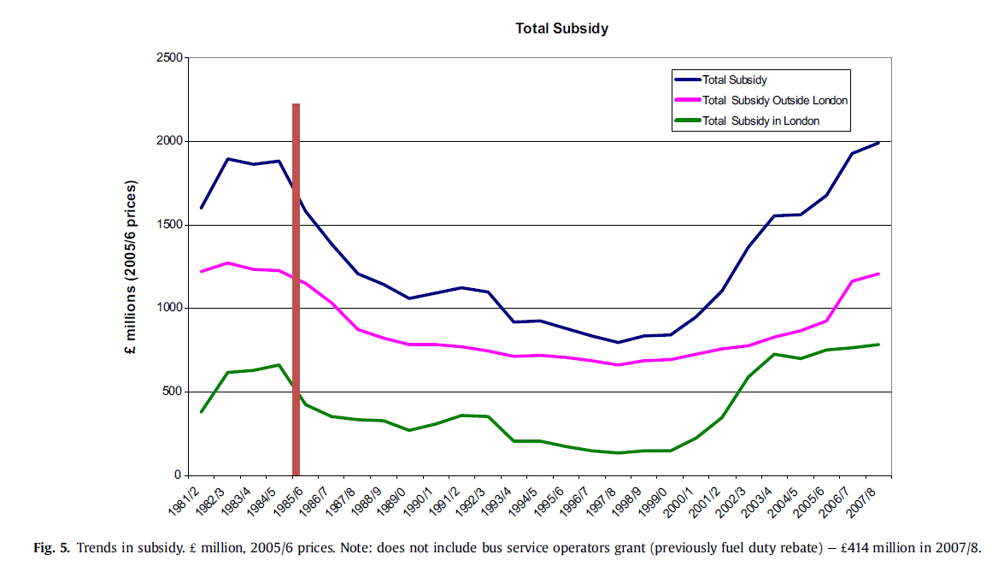
Subsidy

Slide 54
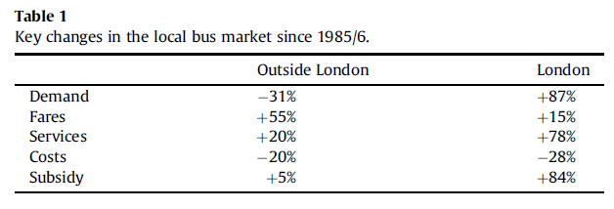
Key changes

Slide 55
Conclusion
It is found that outside London, bus demand declined strongly, at least up to the year 2000 and some of this reduction can be ascribed to deregulation. By contrast in London, demand has generally been increasing.
However, in both areas operating costs also declined strongly, again up to 2000, but since then there have been strong increases in costs and subsidy. Our initial finding is that there are net welfare increases both outside and inside London, but with welfare increases per capita being five times greater in London than elsewhere.
However, sensitivity analysis shows that our results are sensitive to the specification of the modelling system and assumptions made concerning the counterfactual, particularly for the results for London.

Slide 56
6.5 Summary

Slide 57
Summary
Open access passenger rail competition has undoubtely positive impacts on demand, however qustionable impacts on supply and creates significant regulation challenges
Competitive tendering of rail services enables to decrease total subsdies, howegver the design is critical
Competition for the market seems to work better for British buses than comeptition on the market

Slide 58
Readings for Lecture 7
Reform of the Railway Sector and its Achievements - Network Industries Quarterly - Vol 18 - No 4 (December 2016)
Preston, J., & Robins, D. (2013). Evaluating the long term impacts of transport policy: The case of passenger rail privatisation. Research in Transportation Economics, 39(1), 14-20.

