Slide 1
Addressing Extremism and Populism: Impact of the Populist Radical Right

Slide 2
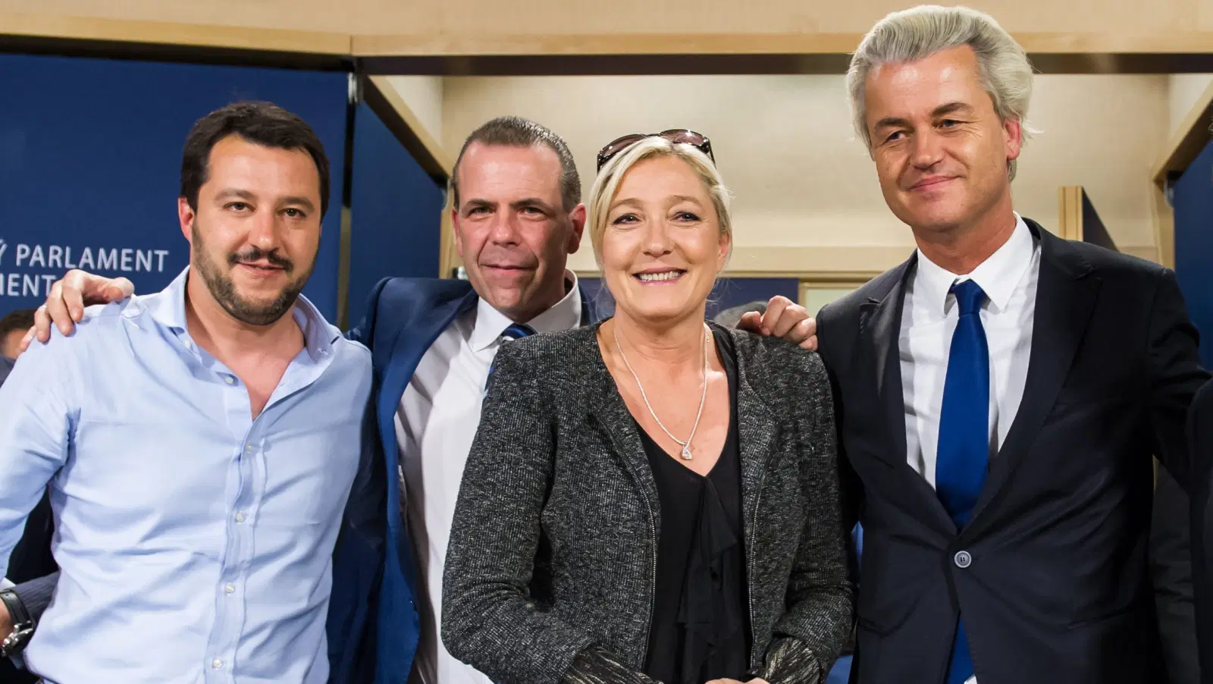

Slide 4
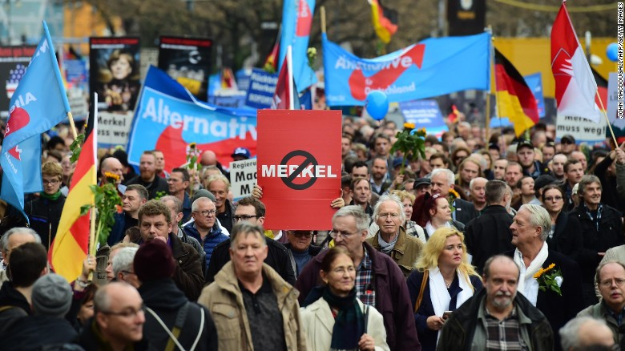

Slide 5
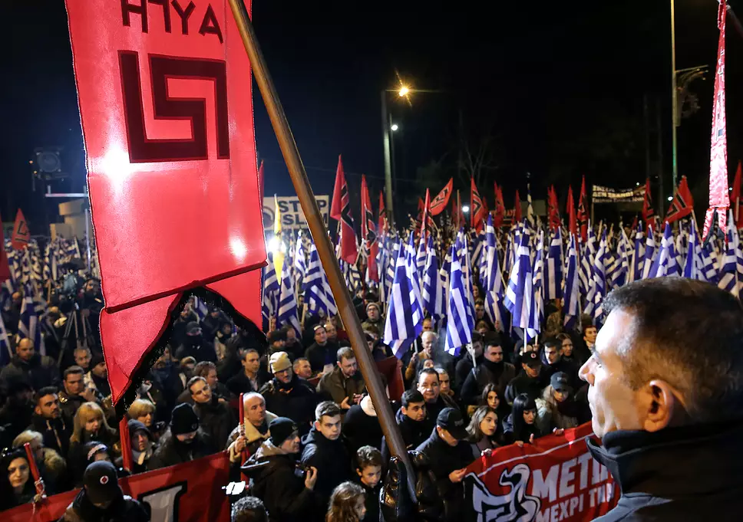

Slide 6
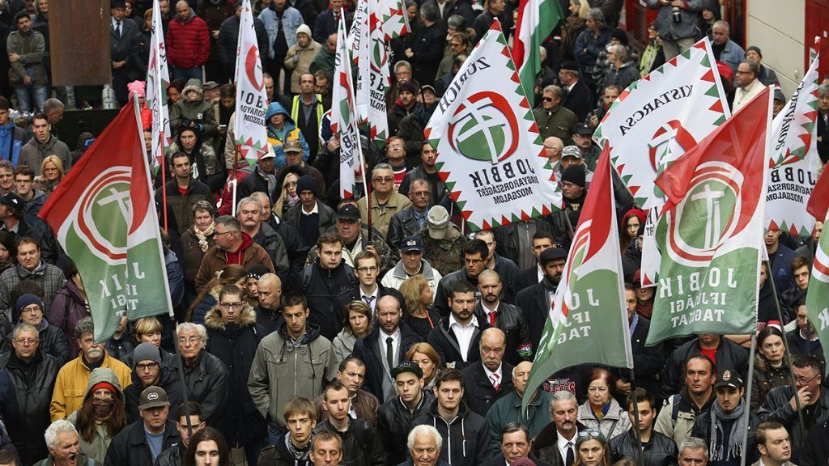
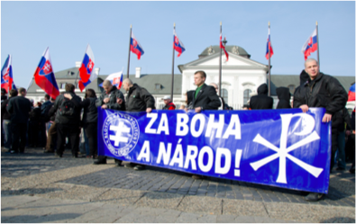

Slide 7
Populist radical right
The “new right” (Ignazi 1992): links to xenophobia and anti-political establishment populism
Electoral and mobilizing growth
Increasing challenge in Europe (and the West in general)
Mostly abiding by the democratic rules (not trying to overturn democracy): defenders of „true democracy“ (Betz, 1994)
Terminology: extreme right, radical right, far right, populist radical right, …

Slide 8
Ideology of PRR parties
Ideology: nativism, populism, authoritarianism (Mudde, 2007)
Nativism: nationalism and xenophobia
Authoritarianism: the belief in a strictly ordered society
Populism: wisdom of a ‘little man’ - considers society to be ultimately separated into two homogeneous and antagonistic groups, “the pure people” versus “the corrupt elite,” and which argues that politics should be an expression of the general will of the people
Who are “the people”?
“The heartland”, the “common sense” of the people (Taggart (2000) - a place ‘in which, in the populist imagination, a virtuous and unified population resides’ - a mythical and constructed sub-set of the whole population
Enemy-building/making: “us”-“them” (friend-enemy) dichotomy

Slide 9
Research on extreme right (parties)
Issues and ideologies
Reasons (the causes) for electoral gains
Demand for radical politics
Consequences (impact, influence of PRR politics)
Responses: how to deal with PRR parties and movements

Slide 10
What is in the impact?
Consequences and responses = different influences
Impact OF PRR parties:
How ERP influence the political agenda and policies?
How ERP influence public opinion?
What is their influence when in power?
Impact ON PRR parties:
How the government or established political parties respond to PRR parties
What strategies mainstream parties employ against PRR parties

Slide 11
Impact OF populist radical right
Policy impact
Party impact
Social impact

Slide 12
Policy impact
Direct impact: PRR adopting policies (immigration, minority rights, law and order) - FPÖ and LN instumental in introducing more restrictive immigration policy (Austria and Italy) (Zaslove 2004)
Introduction of new agenda or radicalization of an older agenda
Local level
symbolic policies, cultural policies (e.g., street names)
Junior coalition partners (often lacking experience)

Slide 13
What is (in) the party impact?

Slide 14
Party impact
Influence on other political actors: Established actors competing with PRR
Language , issues
„Contamination“: adopting arguments, language, rhetoric, style of leadership, type of political discourse, relationship between leaders and followers
Re-politization of some issues (immigration, Europe and the EU)
Legitimation of PRR: no need for „copy“, when original is available – increase in support for PRR

Slide 15
Populist effect?
Use of populism by other political parties
Strongest effect: discourse (populist Zeitgeist) – most political parties express some elements of populism
Programmatic adaptation
Has populism become mainstream in WE?
Mixed evidence or even not supported (Rooduijn, de Lange, van der Brug 2011)
Populist parties change their own discourse after being successful: Their initial success makes them more moderate

Slide 16
Party impact: policy
Impact on policy positions of other parties
Direct effect of the party competition
Reacting to same cues from the media and society
Effect of real-world developments, e.g., crises
Contagion effect (Van Spanje, 2010):
Opposition parties are more vulnerable to the contagion effect than parties in the government
Implication: anti-immigration parties are able to influence policy output in their political systems without entering government

Slide 17
Social impact
Public atttitudes: On immigration, integration, minority issues, citizenship laws, or national identity; increase in tolerance of intolerance (PRR success correlates with ethnic prejudice)
Media – friend and foe: PRR seeks to be perceived as effective and legitimate through media representations; media hostility and negative campaigns (accusations) - effect on support for journalism
Often not changes in attitudes‘ direction, but increase in its salience
Violence: Level of nativist or racist violence - the xenophobic rhetoric often spilling over into violence

Slide 18
Responses from established parties
Can non-radical (mainstream) parties do anything to counter PRR?

Slide 19
Responses from established parties
„Adaptation dilemma“: to function fully within a liberal democratic context the PRR must moderate, but to keep its unique position and ensue the lyoalty of its hardcore support it must remain radical
Different legal, political, social contexts leading to different dilemmas
Two poles of reactions:
coalition (the most accomodative)
cordon sanitaire (the most adversarial)

Slide 20
Constraining and contesting the ER I
The impact of restrictive policies is mixed
Some PRR successful despite (FN, VB), some because of cordon sanitaire
Ostracism (van Spanje and Weber, 2017):
A strategic problem for established actors: Immediate policy impact of PRR can be averted by ostracizing them (i.e., refusing any cooperation), but this strategy may sway public opinion further in their favor

Slide 21
Constraining and contesting the ER II
Hate speech prosecution (van Spanje and de Vreese, 2013)
Does hate speech prosecution of politicians affect the electoral support for their party?
Dutch voters interviewed before and after the unexpected court decision to prosecute MP Geert Wilders: The decision substantially enhanced his party’s appeal (seen as a victim)
The role of the ERP itself:
Issue ownership: voters hold conceptions of which party is best at handling a given issue - PRR as established, credible political actor that owns certain salient issue (e.g., immigration), it is immune to counter-strategies of other political actors (including media, social movements)

Slide 22
Strategies III
Along two dimensions – 1. between engagement and disengagement, 2. between militancy and accommodation (Downs 2012)
4 strategies:
Ban/isolate
Co-opt
Ignore
Collaborate
Policies “of isolation, ostracism and demonization prove surprisingly ineffective at rolling back or even containing threats to the democratic order from party-based extremism“

Slide 23
Italian elections 2018
John Oliver on Italian elections
https://www.youtube.com/watch?v=LdhQzXHYLZ4
Five star movement: 32.68%
Democratic party: 18.76%
League: 17.35%
Forza Italia: 14.00%

Slide 24
John Oliver on European far right in 2016 EP elections
https://www.youtube.com/watch?v=hjShnTFpRs4

Slide 25
Thank you for listening and participating!

