Slide 1

Fiscal Policy
III.

Slide 2
Stabilisation Policy
̶ Aim: to maintain a healthy level of economic growth and minimal price changes; to smooth the economic cycle
Stabilisation Policy
Monetary Policy
Fiscal Policy
3 Fiscal Policy

Slide 3
Three key facts about economic fluctuations
̶ Fact 1: Economic fluctuations are irregular and unpredictable
̶ Fact 2: Most macroeconomic quantities fluctuate together
̶ e.g., investment, unemployment, consumption
̶ Fact 3: As output falls, unemployment rises

Slide 4
Fiscal policy - concepts and measurements
Fiscal policy (FP) = set of decisions and rules regarding taxes and public expenditures for purposes of smoothing the fluctuations of economic cycle in order to keep unemployment close to its equilibrium value and avoid the build-up of deflationary and inflationary pressures (Samuelson, 1948)
Theoretically inspired by J.M. Keynes.
In the end of 20th century theoretical and empirical doubts surfaced about the effectiveness of FP.
̶ Now in many countries the key point of FP is public debt sustainability.

Slide 5
Keynesian view: AS – AD model
̶ A macroeconomic model that explains price level and output through the relationship between AD and AS
̶ Aggregate demand (AD)
= Total amount of demand for goods and services produced in the economy
̶ Combinations of price level and level of output (GDP)
̶ AD slopes downward:
The Wealth Effect (when prices fall, consumers are wealthier which encourages to spend more)
The Interest-Rate Effect (lower price level reduces the interest rate which encourages greater spending on investment goods)
The Exchange-Rate Effect (lower interest-rate depreciate the real exchange rate which stimulates exports)

Slide 6
Keynesian view: AS – AD model
̶ Long-run aggregate supply (LRAS) - Determines the quantity of goods and services supplied in the long run. In the long run it depends on labour, capital, natural resources and technology.
̶ Short-run aggregate supply (SRAS) = A combination of price level and level of goods and services supplied in the short run.
̶ SRAS slopes upward:
The Sticky-Wage Theory (nominal wages are slow to adjust, or are „rigid“ in the short run).
The Sticky-Price Theory (prices of some goods and services are slow to adjust in the short run).
The Misperceptions Theory (lower price level causes misperceptions about relative prices; these misperceptions induce suppliers to respond to the lower price level by decreasing the quantity of goods and services supplied).

Slide 7
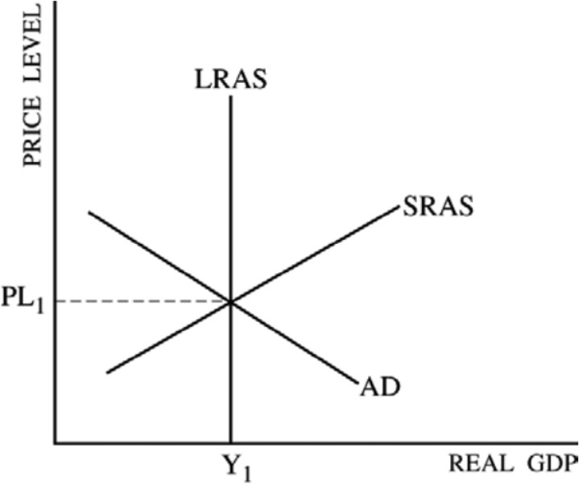
Keynesian view: AS – AD model

Slide 8
Economic Fluctuations in AS – AD model
̶ Suppose a wave of pessimism in the economy = people lose confidence in the future:
Households cut back on their spending
Firms put off buying new equipment
̶ Fall in AD
A decrease of output
A decrease in prices

Slide 9
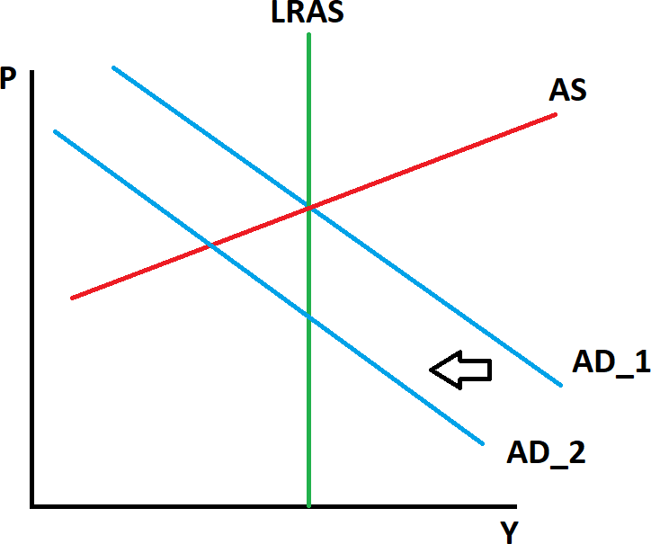
Economic Fluctuations in AS – AD model

Slide 10
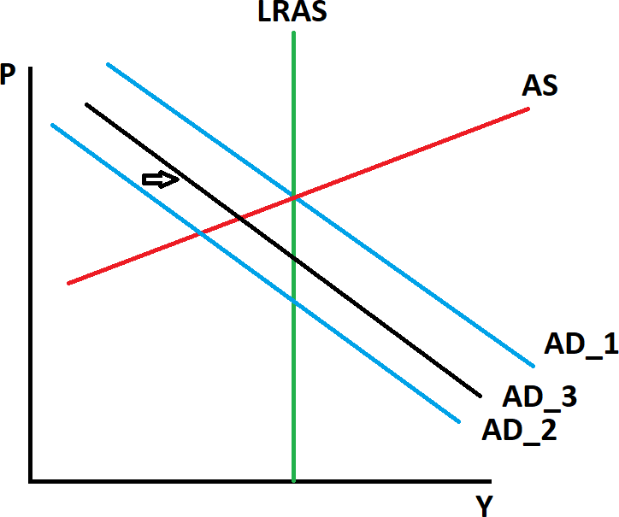
The role of government in AS – AD model

Slide 11
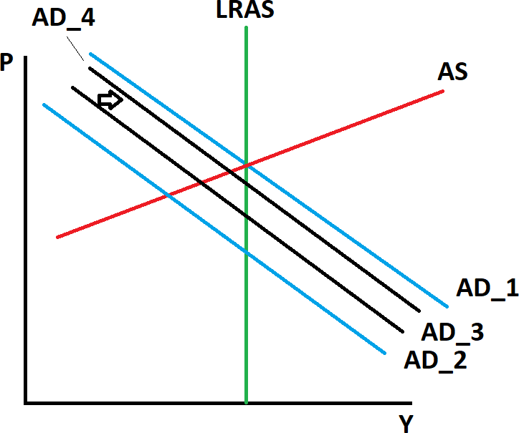
a) Multiplier
̶ The US government buys $20 billion of goods
from Boeing an increase in employment
and profits of Boeing.
̶ Workers and firm owners see higher profits, they respond to this increase in income by raising their own spending.
̶ Increase in government spending an increase the demand for
the products of many firms in the economy.
̶ Multiplier = the additional shifts in AD that result when expansionary
fiscal policy increases consumer spending.

Slide 12
b) Crowding-out effect
̶ An increase in government spending an increase in government deficit an increase in interest rate a decrease in private investment.
̶ The crowding-out effect = the offset in aggregate demand that results when expansionary fiscal policy raises the interest rate and thereby reduces investment spending.

Slide 13
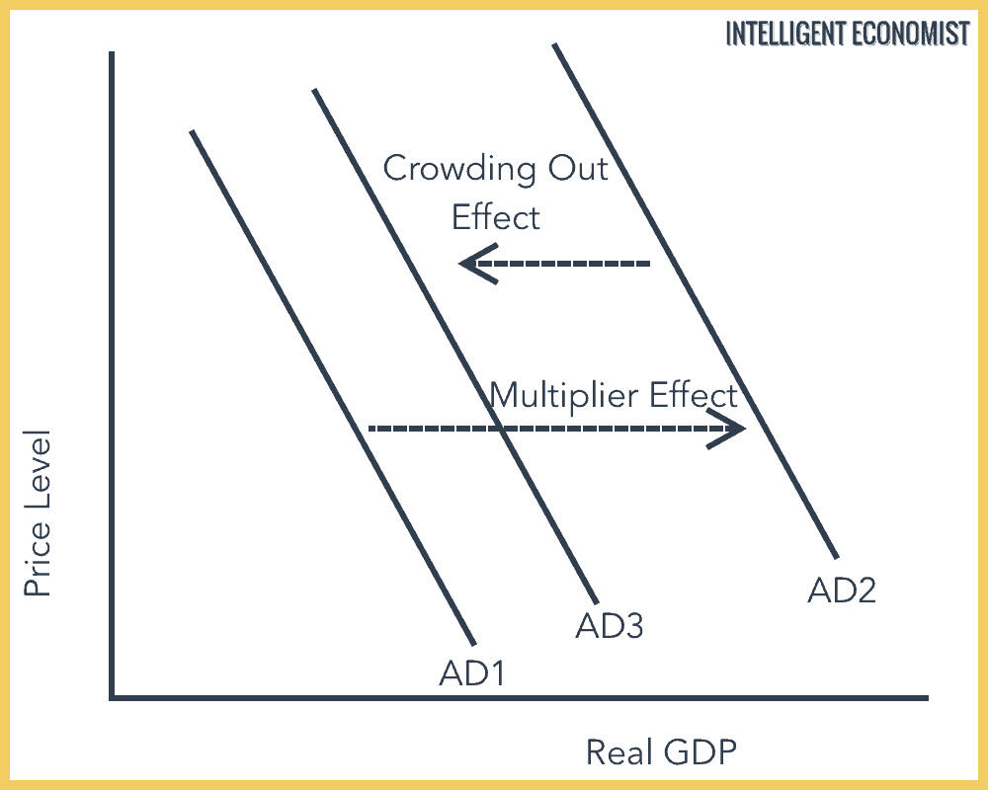
Crowding-out effect

Slide 14
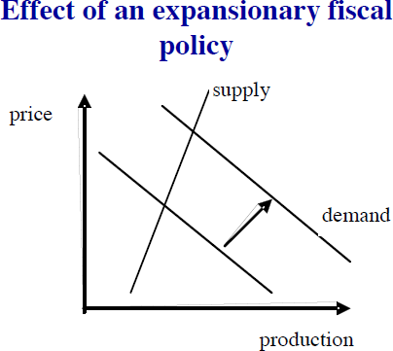
The neoclassical critique
̶ Critique of the multiplier
̶ Full financial crowding-out
̶ Supply rigidity
̶ Fiscal expansion
̶ Rise in the interest rate penalises private investment
̶ Fiscal policy effectiveness is limited in time (data shows that multiplier is close to zero after one year)

Slide 15
Public budget
̶ Public budget = a document that specifies the origin and volume of both income (“receipts”) and intended spending over a certain horizon (usually a year)
Public budget
̶ Budget of central government
̶ Budgets of local governments
̶ Functions: allocation, redistribution and stabilisation

Slide 16
Public budget
̶ Revenue: e.g. an income from direct and indirect taxation, social contributions, income from public assets, income from provision of public services and, possibly, income from disposal of public assets
̶ Spending: e.g. defence, police, justice, education, research, support to the economy, social policy, health, foreign policy, development assistance, etc.

Slide 17
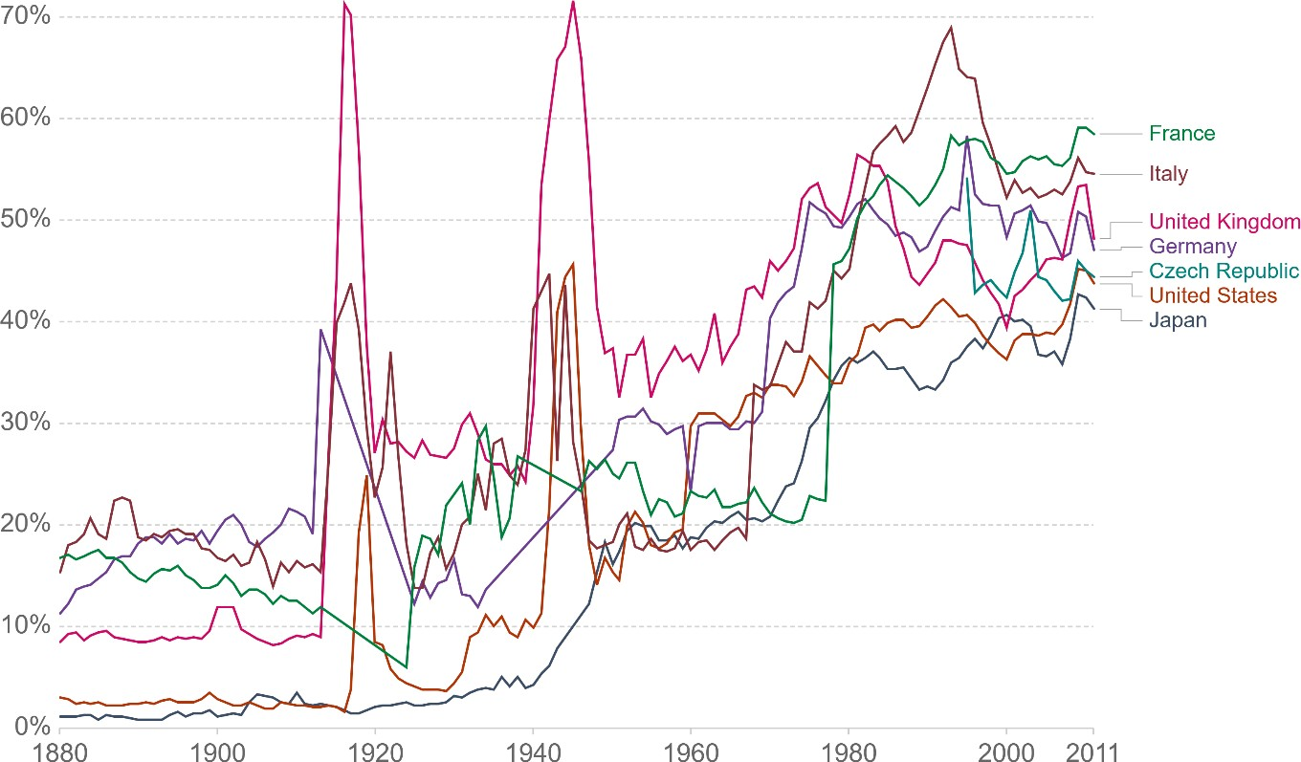
Government spending

Slide 18
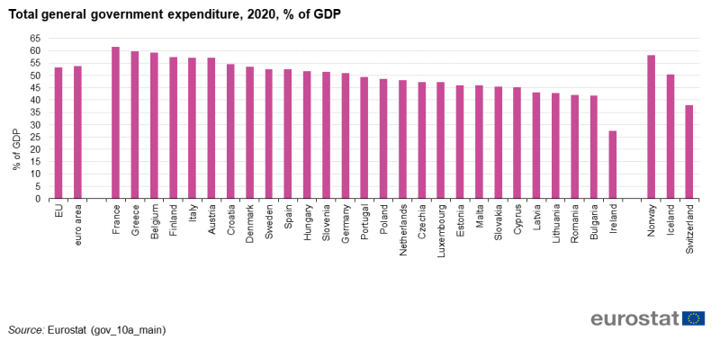
Government spending (EU countries)

Slide 19


Slide 20
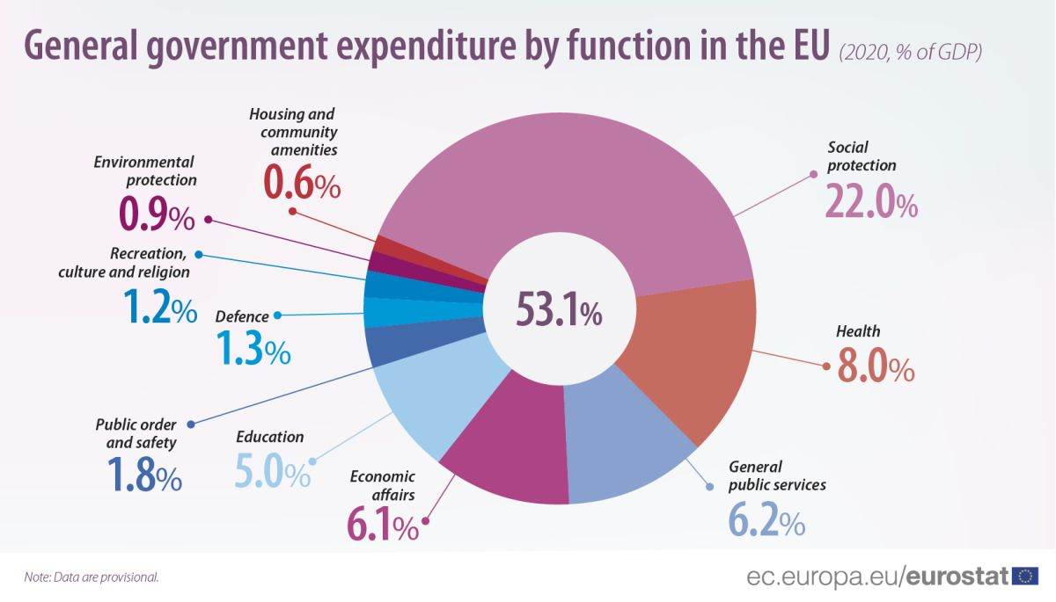

Slide 21
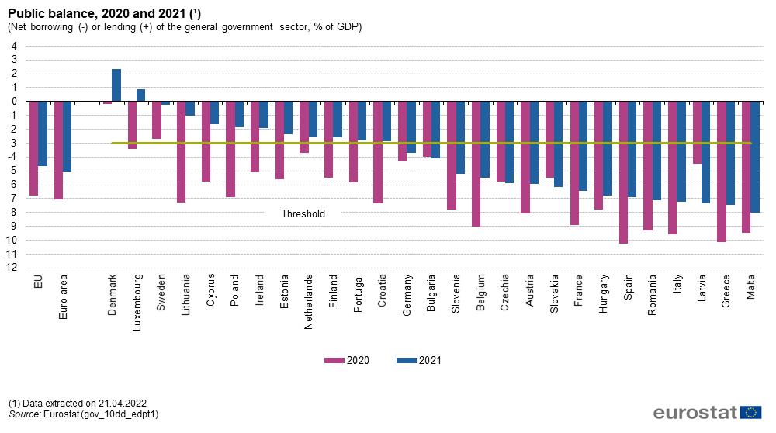
Public budget balance
̶ The fiscal (budgetary) balance = a difference between income and expenditure
̶ Fiscal (budget) surplus
- Can be used to pay down public debt or invested
̶ Fiscal (budget) deficit
22 Fiscal Policy

Slide 22
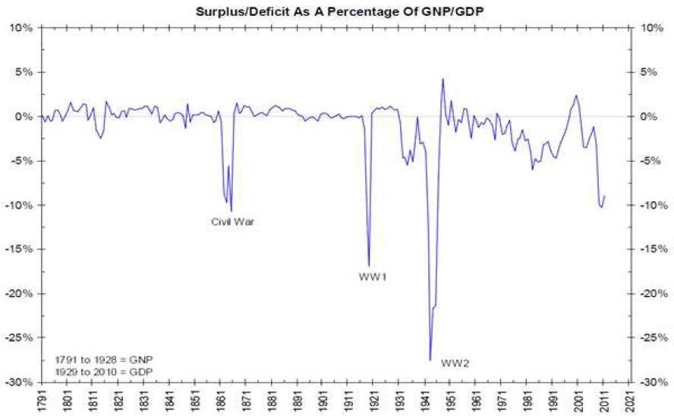
Large deﬁcits were mostly the results of wars (e.g., USA)

Slide 23
Budget imbalance
̶ Budget balance = income – expenditures: surplus (+) or deficit (-)
̶ Central or general government balance
̶ Financial (overall) balance (= net lending); includes net interest payment
̶ Primary balance: excluding net interest payments
̶ Cyclically-adjusted (structural) balance: excluding cyclical balance = FP stance

Slide 24
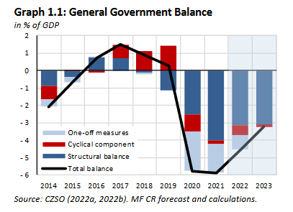
Cyclical and structural components

Slide 25
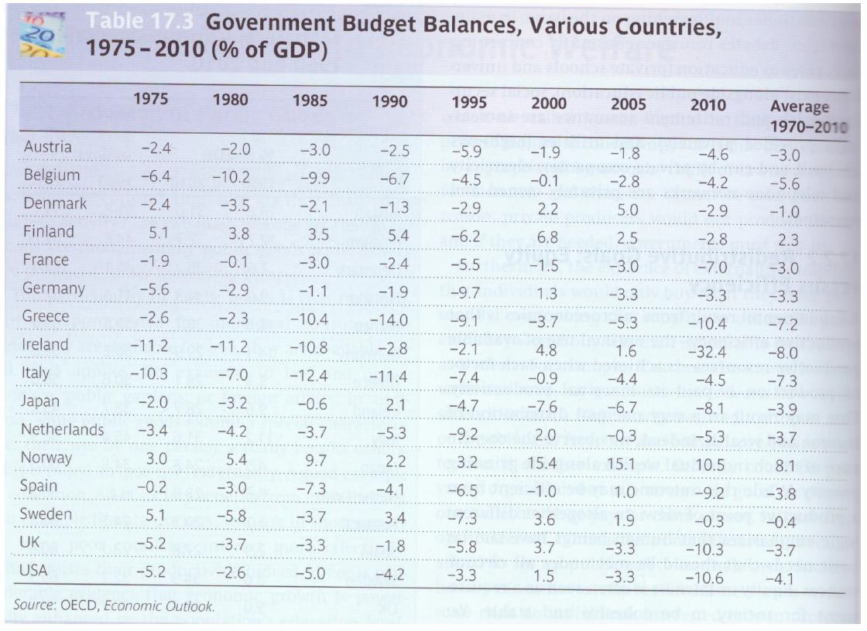

Slide 26
Discretionary FP vs. automatic stabilisers
̶ Discretionary FP includes changes in government spending and taxation that need specific approval (usually requires legislative action)
= a risk of time lags.
̶ Automatic stabilizers increase (decrease) budget deficits during times of recession (booms) without specific new legislation = no time lags: e.g., unemployment insurance program, progressive income taxes

Slide 27
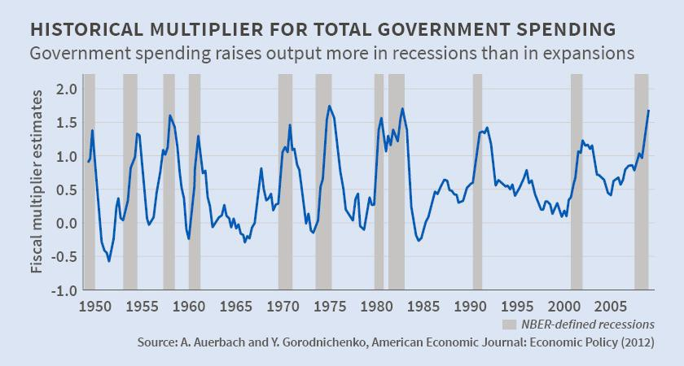
Empirical assessment of fiscal multipliers
̶ Effectiveness of fiscal policy depends on the amount of fiscal multiplier
̶ Studies lead to wide range of estimates for fiscal multipliers from less than zero to more than four

Slide 28
CS: FP during the 2008-2009 crisis
̶ Arguments in favor of 2009 stimulus:
̶ Risk of depression (recession with a decline of GDP more than 10 %)
̶ Ineffectiveness of monetary policy (transmission through financial system clogged, in addition to zero band)
̶ Exceptional effectiveness of fiscal policy because of:
̶ General excess supply
̶ Excess savings and flight to safety resulting in ultra-low bond rates
̶ Focus of agents on short-term horizon, credit constraints
̶ Symmetric character of shocks, therefore gains from coordinated action

Slide 29
Public debt
Public debt = the total of all bonds and other debt owed by a government. Usually, cumulated deﬁcits.
Debt-to-GDP ratio
Net public debt = gross public debt – value of public assets
Problem of off-balance-sheet liabilities (ageing, too-big-to fail banks)

Slide 30
Debt sustainability
Solvency = borrower’s ability to face its commitments.
Sustainability = a policy course compatible with solvency at all times in the future.
Sustainability = forward-looking by nature and relies on assumptions on future policy and on the ability of the government to collect/increase taxes.

Slide 31
Debt sustainability
— „Debt can almost always be serviced in some abstract sense, through additional taxation and through the diversion of yet more domestic production to exports to generate the revenue and foreign exchange needed to service the debt. But there is a political and social, and perhaps moral, threshold beyond which policies to force these results become unacceptable.“
J. Boorman (2002)

Slide 32
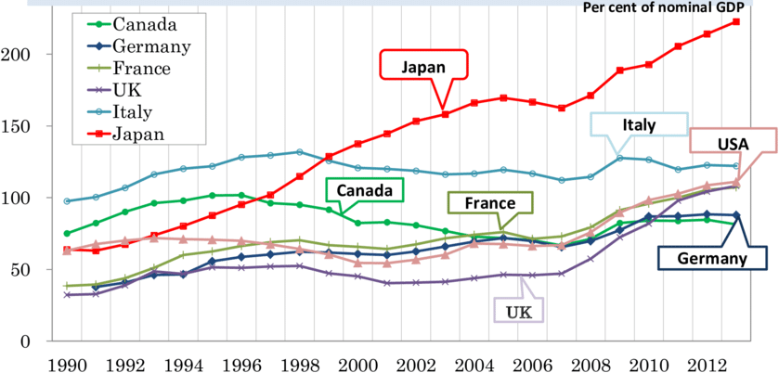
Public debt developments in selected European countries

Slide 33
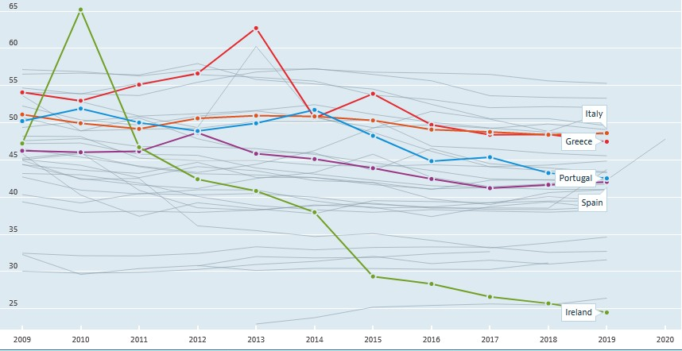
How to reduce the debt burden?
Fiscal adjustment: cut spending, raise taxes
  The most direct but also most difficult way
  As difficult as it is, deficit reduction had been successfully implemented in many European countries.
General government spending (% GDP)

Slide 34
How to reduce the debt burden?
2. Raising economic growth
It is possible in medium to long-run
Factors influencing the rate of growth will be spelt out later (Growth policy)

Slide 35
How to reduce the debt burden?
3. Monetisation (inﬂation tax)
Reducing the value of the money base (the central bank’s liability) and of the public debt (the Treasury’s liability) => tax on money and bondholders.
Inﬂation must rise unexpectedly and quickly enough.
A temporary solution: lenders will demand higher interest rates and will be less willing to agree to long-term loans.
Risk of hyperinﬂation if the government will be forced to create more money to pay back maturing debt.

Slide 36
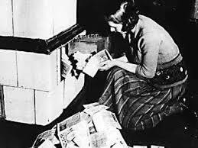
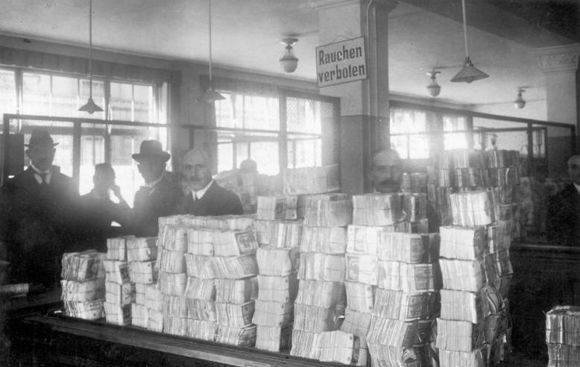
Monetisation

Slide 37
How to reduce the debt burden?
4. Default
not rare in Europe before 20th century
restructuring: rescheduling, write-downs, interest reductions...
coordination: Paris club (public creditors); London club (private creditors); IMF, World Bank.

Slide 38
How to reduce the debt burden?
In practice:
An assistance from financial institution
Implementation of an adjustment program aimed at restoring debt sustainability
Debt reduction

Slide 39
Political theory of debt
The choice of who should pay for the reduction of a high debt is a problem of redistribution.
Suppose that society can be divided into three groups: rentiers, entrepreneurs and workers.
Each of these interest groups will seek to avoid the burden of adjustment and shift onto someone else:
  Rentiers are opposed to default and inﬂation tax
  Entrepreneurs are opposed to taxes on capital
  Workers prefer taxes on wealth and capital and the repudiation of debt

Slide 40
Rules and principles
Fiscal policy is traditionally discretionary
However, increasing reliance on rules to:
  Improve predictability
  Address political failures
  Improve credibility
  Enforce coordination
European Stability and Growth Pact (1997)
Current discussions in Europe:
  Strengthening ﬁscal discipline
  National ﬁscal rules and institutions

Slide 41
More and more rules in the EU
90
80
70
60
50
40
30
20
10
0
1990
1995
2000
Debt rule
2006
Expenditure rule
2008
2011
Revenue rule
Budget balance rule

Slide 42
What is a good rule?
The ‘good rule’ according to Kopits and Symansky (1998):
  Clear deﬁnition,
  Transparent public accounts,
  Simplicity,
  Flexibility – in particular regarding the capacity to react to exogenous shocks,
  A rule with possibility of sanctioning non-observance,
  Consistency with the other objectives and rules of public policies,
  Accompanied by other effective policies.

Slide 43
CS: The Stability and Growth Pact
Two elements:
The preventive arm
A medium term objective
‘Stability’ (Eurozone) and ‘convergence’ (non-Eurozone) programs
the corrective arm (‘Excessive Deﬁcit Procedure’) allows for:
Advance warning
Recommendation to correct excessive deﬁcit within given timeframe
Eventual sanctions

Slide 44
CS: The Stability and Growth Pact
Recent reforms (six-pack, ﬁscal compact)
  Earlier sanctions
  Debt rule

Slide 45
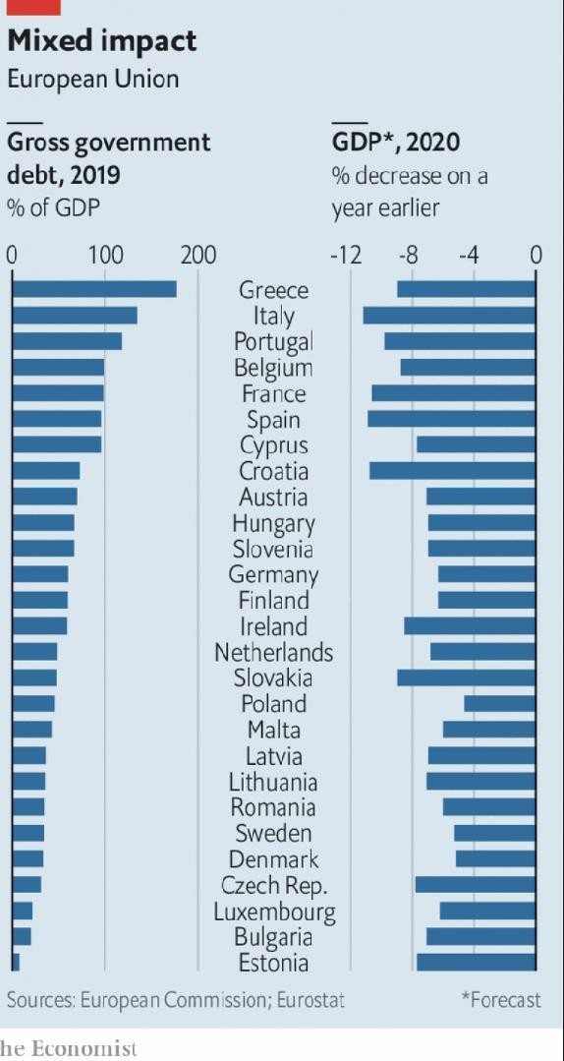
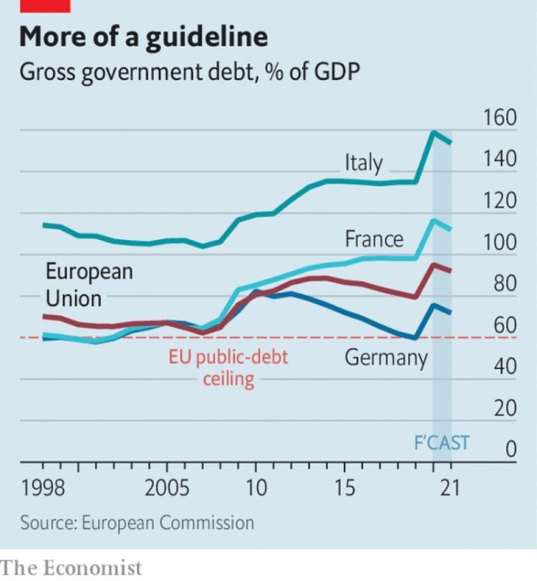

Slide 46
Reference textbook
̶ Benassy-Quéré, A. et al. Economic Policy: Theory and practise.
Oxford University Press, 2010. Chap. 3

