Slide 1
LECTURE 1
Introduction to Econometrics
Dali Laxton
September 23, 2022

Slide 2
WHAT IS ECONOMETRICS?
To beginning students, it may seem as if econometrics is an overly complex obstacle to an otherwise useful education. (. . .) To professionals in the field, econometrics is a fascinating set of techniques that allows the measurement and analysis of economic phenomena and the prediction of future economic trends.
Studenmund (Using Econometrics: A Practical Guide)

Slide 3
WHAT IS ECONOMETRICS?
Econometrics is a set of statistical tools and techniques for quantitative measurement of actual economic and business phenomena
It attempts to
^{1.} quantify economic reality
^{2.} bridge the gap between the abstract world of economic theory and the real world of human activity
It has three major uses:
describing economic reality
testing hypotheses about economic theory
forecasting future economic activity

Slide 4


Slide 5
EXAMPLE
e Consumer demand for a particular commodity can be thought of as a relationship between
quantity demanded (Q)
commodity’s price (P)
price of substitute good (P_{s})
disposable income (Y)
e Theoretical functional relationship:
Q = f (P, P_{s}, Y)
e Econometrics allows us to specify:
Q = 31.50 − 0.73P + 0.11P_{s} + 0.23Y

Slide 6
INTRODUCTORY ECONOMETRICS COURSE
e Lecturer: Dali Laxton (CERGE-EI, Prague) 245603@mail.muni.cz
e Lectures / Seminars: Friday, 9:00-11:50 room VT 105
e Office hours: Saturday by appointment 17:00-18:00

Slide 7
INTRODUCTORY ECONOMETRICS COURSE
e Course requirements:
2 quizzes and 2 home assignments (account for 40 points)
Midterm exam (account for 30 points)
Final exam/project (account for 30 points)
to pass the course, student has to get at least 50 points in total
e Recommended literature:
Studenmund, A. H., Using Econometrics: A Practical Guide
Wooldridge, J. M., Introductory Econometrics: A Modern Approach
Adkins, L., Using gretl for Principles of Econometrics

Slide 8
COURSE CONTENT
e Lectures:
Lecture 1: Introduction, repetition of statistical background, non-technical introduction to regression
Lectures 2 - 4: Linear regression models
Lectures 5 - 11: Violations of standard assumptions
e In-class exercises:
Will serve to clarify and apply concepts presented on lectures
We will use statistical software to solve the exercises

Slide 9
LECTURE 1.
e Introduction, repetition of statistical background
probability theory
statistical inference
e Readings:
Studenmund, A. H., Using Econometrics: A Practical Guide, Chapter 16
Wooldridge, J. M., Introductory Econometrics: A Modern Approach, Appendix B and C

Slide 10
RANDOM VARIABLES
e A random variable X is a variable whose numerical value is determined by chance. It is a quantification of the outcome of a random phenomenon.
e Discrete random variable: has a countable number of possible values
Example: the number of times that a coin will be flipped before a heads is obtained
e Continuous random variable: can take on any value in an interval
Example: time until the first goal is scored in a football match between Liverpool and Manchester United

Slide 11
DISCRETE RANDOM VARIABLES
e Described by listing the possible values and the associated probability that it takes on each value
e Probability distribution of a variable X that can take values x₁, x₂, x₃, . . . :
P(X = x₁) = p₁ P(X = x₂) = p₂ P(X = x₃) = p₃
.
.
e Cumulative distribution function (CDF) :
Notes:
Example, probability that heads shows up less or equal than 3 times after flipping it 5 times => need to sum all probabilities: 0 times, once, twice and three times

Slide 12
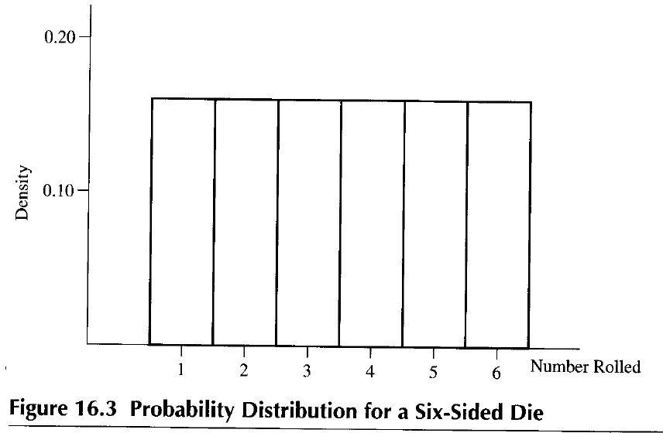
SIX-SIDED DIE: PROBABILITY DISTRIBUTION FUNCTION

Slide 13
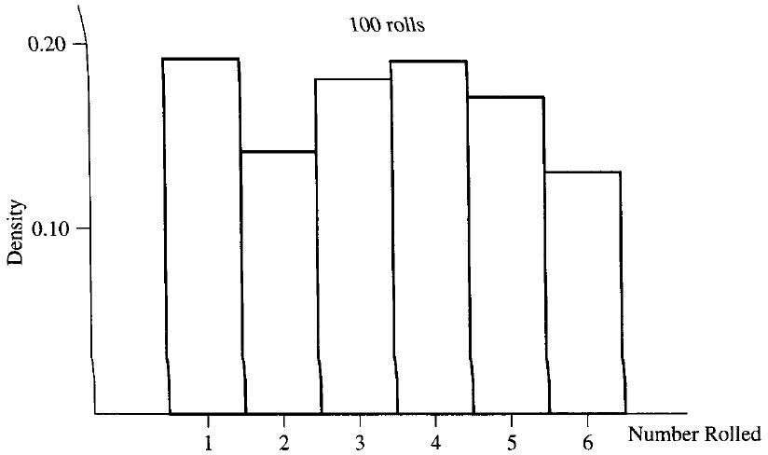
SIX-SIDED DIE: HISTOGRAM OF DATA (100 ROLLS)

Slide 14
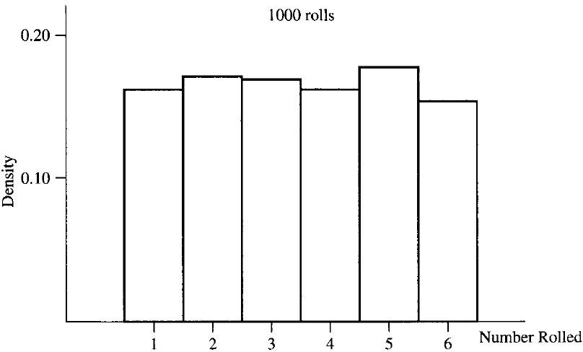
SIX-SIDED DIE: HISTOGRAM OF DATA (1000 ROLLS)
Notes:
When you increase the number of observations (100->1000) empirical distribution approaches the theoretical one

Slide 15
CONTINUOUS RANDOM VARIABLES
e Probability density function f_{X}(x) (PDF) describes the relative likelihood for the random variable X to take on a particular value x
e Cumulative distribution function (CDF) :
e Computational rule:
P(X > x) = 1 − P(X ≤ x)

Slide 16
EXPECTED VALUE AND MEDIAN
e Expected value (mean) :
Mean is the (long-run) average value of random variable
Discrete variable Continuous variable
∫
Example: calculating mean wind speed given wind speed distribution and power curve
e Median : ”the value in the middle”

Slide 17
EXERCISE 1
e A researcher is analyzing data on financial wealth of 100 professors at a small liberal arts college. The values of their wealth range from $400 to $400,000, with a mean of
$40,000, and a median of $25,000.
e However, when entering these data into a statistical software package, the researcher mistakenly enters
$4,000,000 for the person with $400,000 wealth.
e How much does this error affect the mean and median?

Slide 18
VARIANCE AND STANDARD DEVIATION
e Variance :
Measures the extent to which the values of a random variable are dispersed from the mean.
If values (outcomes) are far away from the mean, variance is high. If they are close to the mean, variance is low.
e Standard deviation :
Note: Outliers influence on variance/sd.
Notes:
Example of variance, darts

Slide 19
DANCING STATISTICS
Watch the video ”Dancing statistics: Explaining the statistical concept of variance through dance”:
https://www.youtube.com/watch?v=pGfwj4GrUlA&list= PLEzw67WWDg82xKriFiOoixGpNLXK2GNs9&index=4
Use the ’dancing’ terminology to answer these questions:
How do we define variance?
How can we tell if variance is large or small?
What does it mean to evaluate variance within a set?
What does it mean to evaluate variance between sets?
What is the homogeneity of variance?
What is the heterogeneity of variance?

Slide 20
EXERCISE 2
e Which has a higher expected value and which has a higher standard deviation:
a standard six-sided die or
a four-sided die with the numbers 1 through 4 printed on the sides?
e Explain your reasoning, without doing any calculations, then verify, doing the calculations.

Slide 21
COVARIANCE, CORRELATION, INDEPENDENCE
e Covariance :
How, on average, two random variables vary with one another.
Do the two variables move in the same or opposite direction?
Measures the amount of linear dependence between two variables.
Cov(X, Y) = E [(X − E[X]) (Y − E[Y])] = E [XY] − E[X]E[Y]
e Correlation :
Similar concept to covariance, but easier to interpret.
It has values between -1 and 1.
Corr(X, Y) = ^{Cov(X, Y)}
σ_{X}σ_{Y}

Slide 22
INDEPENDENCE OF VARIABLES
e Independence : X and Y are independent if the conditional probability distribution of X given the observed value of Y is the same as if the value of Y had not been observed.
e If X and Y are independent, then Cov(X, Y) = 0 (not the other way round in general)
e Dancing statistics: explaining the statistical concept of correlation through dance
https://www.youtube.com/watch?v=VFjaBh12C6s&index=3& list=PLEzw67WWDg82xKriFiOoixGpNLXK2GNs9

Slide 23
COMPUTATIONAL RULES
E (aX + b) | = | aE(X) + b
Var(aX + b) | = | a²Var(X)
Var(X + Y) | = | Var(X) + Var(Y) + 2Cov(X, Y)
Cov(aX, bY) | = | Cov(bY, aX) = abCov(X, Y)
Cov(X + Z, Y) | = | Cov(X, Y) + Cov(Z, Y)
Cov(X, X) | = | Var[X]

Slide 24
RANDOM VECTORS
e Sometimes, we deal with vectors of random variables
e Example:
e Expected value:
e Variance/covariance matrix:

Slide 25
STANDARDIZED RANDOM VARIABLES
e Standardization is used for better comparison of different variables
e Define Z to be the standardized variable of X:
_{Z =} X − µ_{X}
σ_{X}
e The standardized variable Z measures how many standard deviations X is below or above its mean
e No matter what are the expected value and variance of X, it always holds that
E[Z] = 0 and Var[Z] = σ_{Z}² = 1

Slide 26
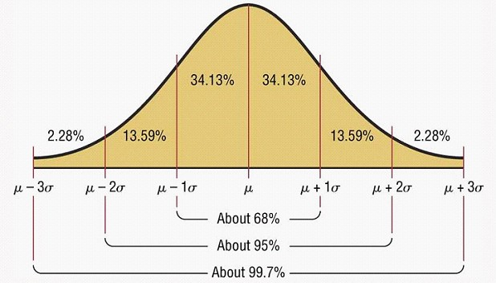
NORMAL (GAUSSIAN) DISTRIBUTION
e Notation : X ∼ N(µ, σ²)
e E[X] = µ e Var[X] = σ²
e Dancing statistics
https://www.youtube.com/watch?v=dr1DynUzjq0&index=2& list=PLEzw67WWDg82xKriFiOoixGpNLXK2GNs9

Slide 27
EXERCISE 3
e The heights of U.S. females between age 25 and 34 are approximately normally distributed with a mean of 66 inches and a standard deviation of 2.5 inches.
e What fraction of U.S. female population in this age bracket is taller than 70 inches, the height of average adult U.S. male of this age?

Slide 28
EXERCISE 4
e A woman wrote to Dear Abby, saying that she had been pregnant for 310 days before giving birth.
e Completed pregnancies are normally distributed with a mean of 266 days and a standard deviation of 16 days.
e Use statistical tables to determine the probability that a completed pregnancy lasts
⁾ at least 270 days
⁾ at least 310 days

Slide 29
SUMMARY
e Today, we revised some concepts from statistics that we will use throughout our econometrics classes
e It was a very brief overview, serving only for information what students are expected to know already
e The focus was on properties of statistical distributions and on work with normal distribution tables

Slide 30
NEXT LECTURE
e We will go through terminology of sampling and estimation
e We will start with regression analysis and introduce the Ordinary Least Squares estimator

