Slide 1

Microeconomics 1
Lecturer: Dali Laxton, Junior Researcher at CERGE-EI, Prague (245603@mail.muni.cz)
Text-book: Mankiw, Principles of Economics, 4th edition (available at the library).
Lectures / Seminars : Friday 13:00-16:50, room P312
Office hours: Online Saturday 4:00-5:00 pm by appointment

Slide 2
Agenda
2 Quizzes (10 points): 1 multiple choice, 1 conceptual question and 1 problem
First Quiz: 07.10.2022 (3rd week)
2 homeworks (10 points)
Midterm Exam (40 points): 11.11.2022
Final Exam (40 points): 16.12.2022

Slide 3
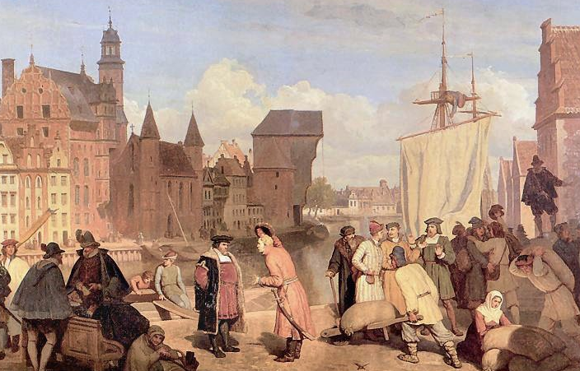
Masaryk University
Microeconomics 1
Dali Laxton
Wojciech Gerson (1831-1901)
Ten Principles
of Economics
Lecture
1

Slide 4

Why Economics?
Newspapers and websites are filled with articles related to economics—either directly or indirectly. News headlines may cover topics such as unemployment, deficits, financial markets, health care, Social Security, energy issues, war, global warming, and so on.
Photo by Robert Sexton

Slide 5

Why Economics?
At the professional level:
How can my firm minimize costs and maximize profits?
How much price should I charge and how much should I produce?

Slide 6

Why Economics?
At the personal level:
How can I maximize my average GPA given time constraints?
Should I quit my job and pursue university education?
What is a marginal benefit of calling my girlfriend compared to the cost of spent time?

Slide 7
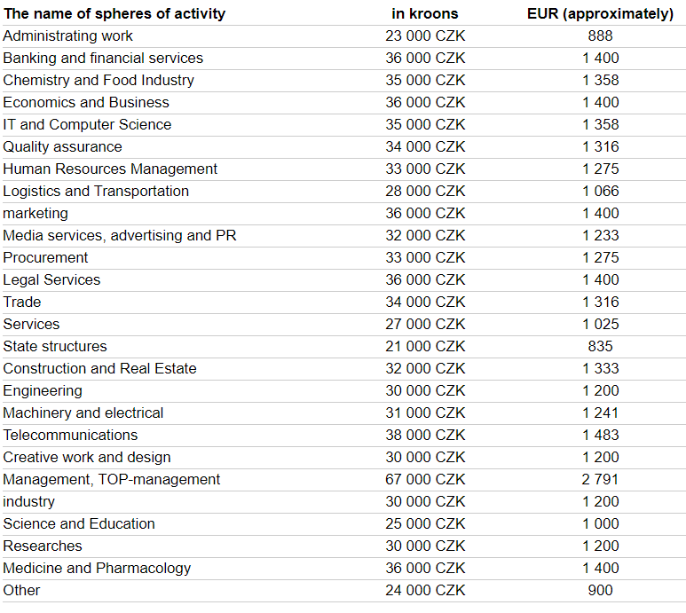
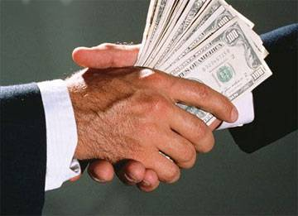
Why Economics?
It pays off ☺
The table shows gross wages in the Czech Republic before paying pension and insurance outlets. The data is retrieved from https://www.euroeducation.cz/en/content/36/20.

Slide 8
Lecture Today
Introduction/revision of fundamental principles of economics
What kinds of questions does economics address?
What are the principles of how people make decisions?
What are the principles of how people interact?
How do Economists think?

Slide 9
Readings
Mankiw, Principles of Economics, Chapter 1

Slide 10
What Economics Is All About
0
Scarcity: the limited nature of society’s resources
Economics: the study of how society manages its scarce resources, e.g.
  how people decide what to buy,
  how much to work, save, and spend
  how firms decide how much to produce,
  how many workers to hire
  how society decides how to divide its resources between national defense, consumer goods, protecting the environment, and other needs
Notes:
9

Slide 11

The principles of
HOW PEOPLE
MAKE DECISIONS
0
©lithian/Shutterstock.com
Notes:
10

Slide 12
PRINCIPLE 1
People Face Tradeoffs
0
All decisions involve tradeoffs. Examples:
Going to a party the night before your midterm leaves less time for studying.
Having more money to buy stuff requires working longer hours, which leaves less time
for leisure.
Protecting the environment requires resources
that could otherwise be used to produce
consumer goods.
Notes:
11

Slide 13
PRINCIPLE 1
People Face Tradeoffs
0
Society faces an important tradeoff:
efficiency vs. equality
Efficiency: when society gets the most from its scarce resources
Equality: when prosperity is distributed uniformly among society’s members
Tradeoff: To achieve greater equality,
could redistribute income from wealthy to poor.
But this reduces incentive to work and produce, shrinks the size of the economic “pie.”
Notes:
12

Slide 14
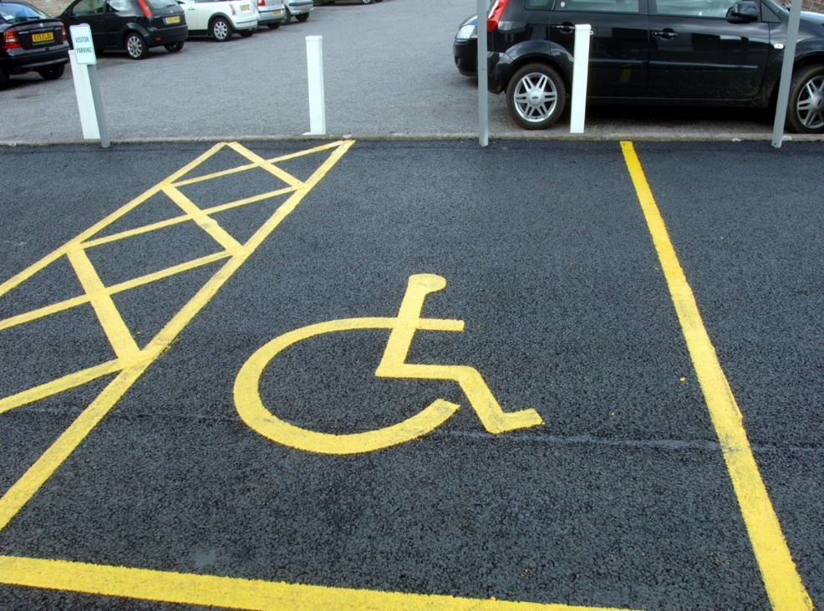
Even though designating these parking spaces for disabled drivers may not be an efficient use of scarce parking spaces (because they are often not used), many believe it is fair to give these drivers a convenient spot. The debate between efficiency and equality is often heated.

Slide 15
PRINCIPLE 2
The Cost of Something Is
What You Give Up to Get It
Making decisions requires comparing the costs and benefits of alternative choices.
The opportunity cost of any item is
whatever must be given up to obtain it.
It is the relevant cost for decision making.
Notes:
14

Slide 16

PRINCIPLE 2
The Cost of Something Is
What You Give Up to Get It
Examples:
The opportunity cost of…
  …waiting in line for “free” event.
  …studying at university – not only tuition fee and living costs but also foregone wages.
  Question:
  What are “best things” that are “free”? Are they really free?
Notes:
15

Slide 17
PRINCIPLE 3
Rational People Think at the Margin
Rational people
  systematically and purposefully do the best they can to achieve their objectives.
  make decisions by evaluating costs and benefits of marginal changes, incremental adjustments to an existing plan.
Notes:
16

Slide 18
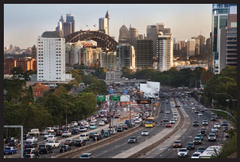
During rush hour some drivers will switch into and out of lanes if they perceive one lane is moving faster than another. This is a marginal adjustment. The same is true of lines in a supermarket. People are constantly weighing the marginal benefits and marginal costs of changing lanes and/or lines.
Vyshnya/Shutterstock.com

Slide 19


PRINCIPLE 3
Rational People Think at the Margin
Other Examples:
When a student considers whether to go to college for an additional year, he compares the fees & foregone wages to the extra income
he could earn with the extra year of education.
When a manager considers whether to increase output, she compares the cost of the needed labor and materials to the extra revenue.
VS.
Notes:
18

Slide 20
PRINCIPLE 4
People Respond to Incentives
Incentive: something that induces a person to act, i.e. the prospect of a reward or punishment.
Rational people respond to incentives.
Examples:
  When gas prices rise, consumers buy more hybrid cars.
  When cigarette taxes increase,
  teen smoking falls.
Notes:
19

Slide 21
ACTIVE LEARNING ₁
Applying the principles
Work in pairs for 3 minutes!

Slide 22
ACTIVE LEARNING ₁
Applying the principles
You are selling your old car. You have already spent 15,000 CZK on repairs.
At the last minute, the transmission dies.
You can pay 10,000 CZK to have it repaired, or sell the car “as is.”
In each of the following scenarios, should you have the transmission repaired? Explain.
  A. The value of the car is 40,000 CZK if the transmission works and 25,000 CZK if it doesn’t
  B. The value of the car is 45,000 CZK if the transmission works and 38,000 CZK if it doesn’t

Slide 23
ACTIVE LEARNING ₁
Answers
Cost of fixing transmission = 10,000 CZK
  A. If transmission works, the value of the car is 40,000 CZK and is 25,000 CZK if it doesn’t
  Benefit of fixing transmission = 15,000 CZK
  (40,000 – 25,000).
  Get the transmission fixed.
  B. If transmission works, the value of the car is 45,000 CZK and is 38,000 CZK if it doesn’t
  Benefit of fixing the transmission is only 7,000 CZK.
  Do not pay 10,000 CZK to fix it.

Slide 24
ACTIVE LEARNING ₁
Observations
The 15,000 CZK you previously spent on repairs is irrelevant. What matters is the cost and benefit
of the marginal repair (the transmission).
The change in incentives from scenario A
to scenario B caused your decision to change.

Slide 25

The principles of
HOW PEOPLE
INTERACT
0
©Pressmaster/Shutterstock.com
Notes:
24

Slide 26
PRINCIPLE 5
Trade Can Make Everyone Better Off
Rather than being self-sufficient,
people can specialize in producing one good or service and exchange it for other goods.
Countries also benefit from trade and specialization:
  Get a better price abroad for goods they produce
  Buy other goods more cheaply from abroad than could be produced at home
Notes:
25

Slide 27
PRINCIPLE 6
Markets Are Usually A Good Way to
Organize Economic Activity
Market: a group of buyers and sellers
(need not be in a single location)
“Organize economic activity” means determining
  what goods to produce
  how to produce them
  how much of each to produce
  who gets them
Notes:
26

Slide 28
PRINCIPLE 6
Markets Are Usually A Good Way to
Organize Economic Activity
A market economy allocates resources through the decentralized decisions of many households and firms as they interact in markets.
Famous insight by Adam Smith in
The Wealth of Nations (1776):
  Each of these households and firms
  acts as if “led by an invisible hand”
  to promote general economic well-being.
Notes:
27

Slide 29
PRINCIPLE 6
Markets Are Usually A Good Way to
Organize Economic Activity
The invisible hand works through the price system:
  The interaction of buyers and sellers
  determines prices.
  Each price reflects the good’s value to buyers and the cost of producing the good.
  Prices guide self-interested households and firms to make decisions that, in many cases, maximize society’s economic well-being.
  In many cases better option than centralized economy.
Notes:
28

Slide 30
PRINCIPLE 7
Governments Can Sometimes
Improve Market Outcomes
Important role for government: enforce property rights
(with police, courts)
People are less inclined to work, produce, invest, or purchase if large risk of their property being stolen.
Notes:
29

Slide 31
PRINCIPLE 7
Governments Can Sometimes
Improve Market Outcomes
Market failure: when the market fails to allocate society’s resources efficiently
Causes of market failure:
  Externalities, when the production or consumption
  of a good affects bystanders (e.g. pollution)
  Market power, a single buyer or seller has substantial influence on market price
  (e.g. monopoly)
Public policy may promote efficiency.
Notes:
30

Slide 32
PRINCIPLE 7
Governments Can Sometimes
Improve Market Outcomes
Govt may alter market outcome to
promote equity.
If the market’s distribution of economic well-being is not desirable, tax or welfare policies can change how the economic “pie” is divided.
Notes:
31

Slide 33

The principles of
HOW THE ECONOMY
AS A WHOLE WORKS
0
©nopporn/Shutterstock.com
Notes:
32

Slide 34
PRINCIPLE 8
A Country’s Standard of Living Depends on Its Ability to Produce Goods & Services
Huge variation in living standards across countries and over time:
  Average income in rich countries is more than ten times average income in poor countries.
  The U.S. standard of living today is about
  eight times larger than 100 years ago.
Notes:
33

Slide 35
PRINCIPLE 8
A Country’s Standard of Living Depends on Its Ability to Produce Goods & Services
The most important determinant of living standards: productivity, the amount of goods and services produced per unit of labor.
Productivity depends on the equipment, skills, and technology available to workers.
Other factors (e.g., labor unions, competition from abroad) have far less impact on living standards.
Notes:
34

Slide 36
PRINCIPLE 9
Prices Rise When the Government Prints Too Much Money
Inflation: increases in the general level of prices.
In the long run, inflation is almost always caused by excessive growth in the quantity of money, which causes the value of money to fall.
The faster the govt creates money,
the greater the inflation rate.
Notes:
35

Slide 37
PRINCIPLE 10
Society Faces a Short-run Tradeoff Between Inflation and Unemployment
In the short-run (1–2 years),
many economic policies push inflation and unemployment in opposite directions.
Other factors can make this tradeoff more or less favorable, but the tradeoff is always present.
Notes:
36

Slide 38
The Economist as Scientist
Economists play two roles:
  1. Scientists: try to explain the world
  2. Policy advisors: try to improve it
In the first, economists employ the
scientific method,
the dispassionate development and testing of theories about how the world works.
Notes:
37

Slide 39
The Economist as Scientist
Working with data
Notes:
38

Slide 40

The Economist as Scientist
Providing explanations by building up models.
Not these ones ☺
Notes:
39

Slide 41
Assumptions & Models
Model: a highly simplified representation of
a more complicated reality.
Economists use models to study economic issues.
Assumptions simplify the complex world,
make it easier to understand.
Example: To study international trade,
assume two countries and two goods.
Unrealistic, but simple to learn and
gives useful insights about the real world.
Notes:
40

Slide 42
The Role of Assumptions
Assumptions
  Can simplify the complex world
    Make it easier to understand
  The art in scientific thinking: deciding which assumptions to make
Different assumptions
  To answer different questions

Slide 43

Some Familiar Models
A road map
©wavebreakmedia/Shutterstock.com
Notes:
42

Slide 44
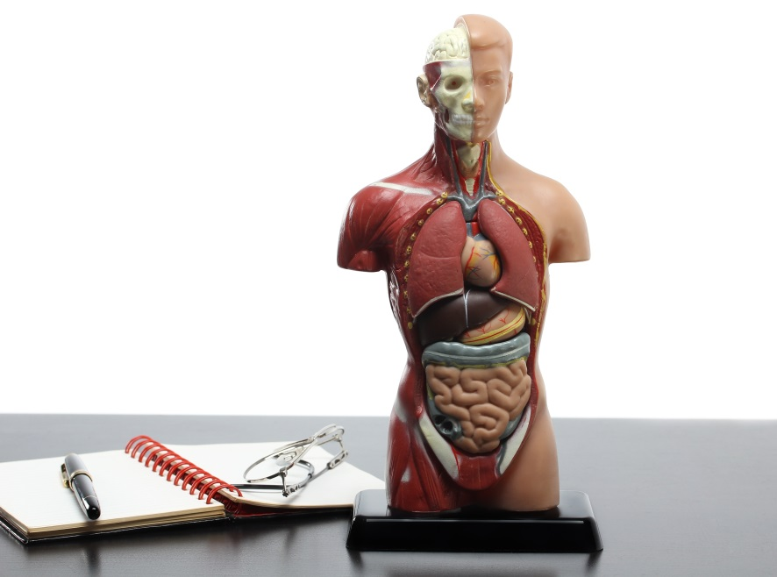
Some Familiar Models
A model of human
anatomy from high
school biology class
©Accord/Shutterstock.com
Notes:
43

Slide 45

Some Familiar Models
A model airplane
©Olga Rosi/Shutterstock.com
Notes:
44

Slide 46

Some Familiar Models
The model teeth at the dentist’s office
Don’t forget to floss!
©ittipon/Shutterstock.com
Notes:
45

Slide 47
Effective Models
Includes characteristics that are essential to explore research question.
Simplifies reality to increase our understanding – neglects redundant dimensions of reality.
Most economic models
Diagrams and equation
Ceteris Paribus analysis – concentrating in change only one variable fixing all others.

Slide 48
Summary
The principles of decision making are:
People face tradeoffs.
The cost of any action is measured in terms of foregone opportunities.
Rational people make decisions by comparing marginal costs and marginal benefits.
People respond to incentives.
© 2015 Cengage Learning. All Rights Reserved. May not be copied, scanned, or duplicated, in whole or in part, except for use as permitted in a license distributed with a certain product or service or otherwise on a password-protected website for classroom use.

Slide 49
Summary
The principles of interactions among people are:
Trade can be mutually beneficial.
Markets are usually a good way of coordinating trade.
Govt can potentially improve market outcomes if there is a market failure or if the market outcome is inequitable.
© 2015 Cengage Learning. All Rights Reserved. May not be copied, scanned, or duplicated, in whole or in part, except for use as permitted in a license distributed with a certain product or service or otherwise on a password-protected website for classroom use.

Slide 50
Summary
The principles of the economy as a whole are:
Productivity is the ultimate source of living standards.
Money growth is the ultimate source of inflation.
Society faces a short-run tradeoff between inflation and unemployment.
© 2015 Cengage Learning. All Rights Reserved. May not be copied, scanned, or duplicated, in whole or in part, except for use as permitted in a license distributed with a certain product or service or otherwise on a password-protected website for classroom use.

Slide 51
Next Lecture
Demand and Supply Analysis
Readings: Mankiw, Chapter 1; Production Possibility Frontier part and Appendix from Chapter 2

Slide 52
The PPF
Production possibilities frontier
  A graph: combinations of output that the economy can possibly produce
  Given the available
    Factors of production and technology
  Example:
    Two goods: computers and wheat
    One resource: labor (measured in hours)
    Economy has 50,000 labor hours per month available for production

Slide 53
PPF Example
Producing one computer requires 100 hours labor.
Producing one ton of wheat requires 10 hours labor.
Employment of
labor hours
Production
Computers
Wheat
Computers
Wheat
A
50,000
0
500
0
B
40,000
10,000
400
1,000
C
25,000
25,000
250
2,500
D
10,000
40,000
100
4,000
E
0
50,000
0
5,000

Slide 54
PPF Example
Point on graph | Production
 | Com-puters | Wheat
A | 500 | 0
B | 400 | 1,000
C | 250 | 2,500
D | 100 | 4,000
E | 0 | 5,000
E
D
C
B
A

Slide 55
Active Learning 1 Points off the PPF
On the graph above, find the point that represents (100 computers, 3000 tons of wheat), label it F.
  Would it be possible for the economy to produce this combination of the two goods?
  Why or why not?
Next, find the point that represents (300 computers, 3500 tons of wheat), label it G.
  Would it be possible for the economy to produce this combination of the two goods?

Slide 56
Active Learning 1 Answers
Point F: 100 computers, 3000 tons wheat
Requires 40,000 hours of labor
Possible but not efficient: could get more
of either good without sacrificing any of the other
F

Slide 57
Active Learning 1 Answers
Point G: 300 computers, 3500 tons wheat
Requires 65,000 hours of labor.
Not possible because the economy only has 50,000 hours
G

Slide 58
The PPF: What We Know So Far
Points on the PPF (like A – E): possible
  Efficient: all resources are fully utilized
Points under the PPF (like F): possible
  Not efficient: some resources are underutilized (e.g., workers unemployed, factories idle)
Points above the PPF (like G)
  Not possible

Slide 59
The PPF
Moving along a PPF
  Involves shifting resources from the production of one good to the other
Society faces a tradeoff
  Getting more of one good requires sacrificing some of the other
The slope of the PPF
  The opportunity cost of one good in terms of the other

Slide 60
The PPF and Opportunity Cost
The slope of a line equals the “rise over the run.”
Opportunity cost of 1 computer =
10 tons of wheat.
–1000
slope =
= –10
100

Slide 61
Active Learning 2 PPF and Opportunity Cost
In which country is the opportunity cost of cloth lower?
FRANCE
ENGLAND

Slide 62
Active Learning 2 Answers
England, because its PPF is not as steep as France’s
FRANCE
ENGLAND

Slide 63
Economic Growth and the PPF
With additional resources or an improvement in technology,
the economy can produce more computers,
more wheat,
or any combination in between.
Economic growth shifts the PPF outward.

Slide 64
The Shape of the PPF
Shape of the PPF
  Straight line: constant opportunity cost
    Previous example: the opportunity cost of 1 computer is 10 tons of wheat
  Bowed outward: increasing opportunity cost
    As more units of a good are produced, we need to give up increasing amounts of the other good produced

Slide 65
Why the PPF Might Be Bowed Outward
As the economy shifts resources from beer to mountain bikes:
PPF becomes steeper
and the opportunity cost of mountain bikes increases.
Beer
Mountain Bikes

Slide 66
Why the PPF Might Be Bowed Outward
At A, opportunity cost of mountain bikes is low.
At point A, most workers are producing beer, even those who are better suited to building bikes.
So, do not have to give up much beer to get more bikes.
A
Beer
Mountain Bikes

Slide 67
Why the PPF Might Be Bowed Outward
At B, most workers are producing bikes.
The few left in beer production are the best brewers.
Producing more bikes would require shifting some of the best brewers away from beer production
causing a big drop in beer output.
A
Beer
B
At B, opportunity cost of mountain bikes is high.
Mountain Bikes

Slide 68
Why the PPF Might Be Bowed Outward
The PPF is bowed outward when:
  Different workers have different skills
  Different opportunity costs of producing one good in terms of the other
  There is some other resource, or mix of resources with varying opportunity costs
    E.g., different types of land suited for different uses

Slide 69
The Economist as Policy Adviser
Positive statements: descriptive
  Attempt to describe the world as it is
  Confirm or refute by examining evidence: “Minimum-wage laws cause unemployment”
Normative statements: prescriptive
  Attempt to prescribe how the world should be: “The government should raise the minimum wage”

Slide 70
Active Learning 3 Positive vs. Normative
Which of these statements are “positive” and which are “normative”? How can you tell the difference?
  Prices rise when the government increases the quantity of money.
  The government should print less money.
  A tax cut is needed to stimulate the economy.
  An increase in the price of burritos will cause an increase in consumer demand for music downloads.

Slide 71
Active Learning 3 Answers
Prices rise when the government increases the quantity of money.
Positive – describes a relationship, could use data to confirm or refute.
The government should print less money.
  Normative – this is a value judgment, cannot be confirmed or refuted.

Slide 72
Active Learning 3 Answers
A tax cut is needed to stimulate the economy.
Normative – another value judgment.
An increase in the price of burritos will cause an increase in consumer demand for music downloads
Positive – describes a relationship.
Note that a statement need not be true to be positive.

