Slide 1
Transport Investment Appraisal Case Studies
Crossrail and High Speed Rail
Chris Nash
C.A.Nash@its.leeds.ac.uk

Slide 2
Crossrail Background
Problem
Cluster of main line termini around central London require many passengers to change on to the Underground to complete their journey
This leads to major overcrowding on the central section of Underground Lines
Solution
A new cross London tunnel connecting existing lines
First proposed in 1940s
Revived by SSRA in 2000
First

Slide 3
Key questions
Which terminals to link?
What sort of services
- metro?
Outer suburban (Thameslink?)
Long distance

Slide 4
Crossrail options(SSRA (2000))
Option | Variant | Capital Cost (£b) |  | NPV (£b) | B/C ratio
Paddington - Liv St | Metro Express | 2.8 2.3 |  | 4.4 4.5 | 2.6 3.0
Wimbledon – Liv St | Metro Express | 4.4 4.2 |  | 5.5 5.3 | 2.3 2.3
Wimbledon – Hackney | Metro Express | 5.3 5.3 |  | 3.5 4.1 | 1.7 1.8

Slide 5
Which option to choose?
- Paddington – Liv St has highest BCR and lowest capital cost
- Wimbledon – Liv St has highest NPV but incremental BCR
well below 2
- Paddington –Liv St leaves option of Wimbledon-Hackney at a later date
(Wimbledon – Liv St blocks both other routes)

Slide 6
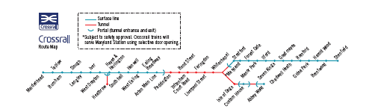
Crossrail route map

Slide 7
Advantages of the Metro option
Benefits poorer inner London suburbs rather than wealthier commuter areas
High density rolling stock maximises capacity
Simpler service pattern aids reliability
(Cf Thameslink)
BUT a longer distance option may generate more revenue

Slide 8
Objections
BCR on the basis of conventional CBA marginal (1.8)
Very expensive if all it did was to make journeys of commuters a bit more comfortable and convenient
Benefits would go to property owners (Cf Jubilee Line extension to Docklands) – not a good use of taxpayers money
So
Were there wider economic benefits? (Venables report)
Could the beneficiaries be made to pay for it?

Slide 9
Crossrail wider economic benefits (£mPV2002)
Moves to more productive jobs 3232
Agglomeration economies 3094
Labour force participation 349
Imperfect competition 486
Total 7161

Slide 10
Crossrail CBA (£mPV2002)
Time savings 12832
Crowding 2889
Other transport benefits 372
Wider economic benefits 7161
Total benefits 23254
Total costs 13902
Less revenues -6149
Plus tax loss 1207
Cost to government 8960
BCR 2.6 (1.8 excl Wider economic benefits)

Slide 11
Finance
Further studies suggested
Voluntary contributions limited – free rider problems
Scope for specific value capture limited
Property values would rise generally throughout the area
So a general supplementary business rate would be a reasonable way of getting beneficiaries to pay

Slide 12
Funding of Crossrail
Transport for London direct funding £1.9bn
Department for Transport direct funding £4.8bn
Business Rate Supplement/borrowing £4.1bn
Sale of surplus land and property £500m
Private sector/Developer contributions £880m
Community Infrastructure Levy £300m
Network Rail £2.3b
Total £14.8b

Slide 13
National Audit Office (2014)
Latest update of business case showed that growth of London had strengthened the case (BCR excluding WEIs 1.97; including WEIs 3).
On the whole and to date, the Department together with its co-sponsor Transport for London and its delivery body, Crossrail Limited, have done well to protect taxpayers’ interests in the Crossrail programme. Overall, if progress to date can be maintained, and risks managed, Crossrail is on track to achieve value for money.
But by the time NAO looked at it again in in 2019, it was running late and above budget.

Slide 14
Appraisal of High Speed Rail
Chris Nash
C.A.Nash@its.leeds.ac.uk

Slide 15
Outline
1. Introduction
2. Costs and demand
3. British case studies
-HS1 (London-Channel Tunnel)
-HS2 London-Birmingham-Manchester/Leeds
4. Conclusions

Slide 16
High Speed Rail (HSR)
A high-speed train is a train capable of reaching speeds of over 200 km/h on upgraded conventional lines and of over 250 km/h on new lines designed specifically for high speeds
(European Commission)
I will talk largely about new lines

Slide 17
Cost per route km of HSR projects
Mean £31m
Range £11m – 79m
Simple rural routes £11-20m
Urban routes £43-61m
High proportion of tunnel up to £79m
Source: PWC (2016) High speed rail international benchmarking study. HS2 Ltd

Slide 18
Costs and capacity
So HSR inevitably very expensive
But enormous capacity
If all trains identical, capacity of up to 18 trains per hour with 1000 seats per train.

Slide 19
HSR operating costs
Depend mainly on
Rolling stock requirements
Staff requirements
Energy consumption
Maintenance costs
Very high utilisation of assets and staff may more than offset high energy and maintenance costs (Civity, 2013)

Slide 20
Source of High Speed Rail Traffic (%)
(Preston, 2017)
 | Paris- Paris- Lyons Brussels |  | Madrid- London- Barcelona Paris/ Brussels
Plane | 20 | 8 | 60 | 49
Train | 40 | 47 | 10 | 12
Road Induced | 11 29 | 34 11 | 10 20 | 19 20

Slide 21
Rail Share of the rail/air market and rail station to station journey times (source Nash, 2015)
Corridor | Year | Travel time | Rail share (%)
Paris–Brussels | 2006 | 1 h 25 min | 100
Paris–Lyons | 1985 | 2 h 15 min | 91
Madrid–Seville | 2003 | 2 h 20 min | 83
Brussels–London | 2005 | 2 h 20 min | 60
Tokyo–Osaka | 2005 | 2 h 30 min | 81
Madrid–Barcelona | 2009 | 2 h 38 min | 47
Paris–London | 2005 | 2 h 40 min | 66
Tokyo–Okayama | 2005 | 3 h 16 min | 57
Paris–Geneva | 2003 | 3 h 30 min | 35
Tokyo–Hiroshima | 2005 | 3 h 51 min | 47
Paris–Amsterdam | 2004 | 4 h 10 min | 45
Paris–Marseilles | 2000 | 4 h 20 min | 45
London–Edinburgh | 1999 | 4 h 25 min | 29
London–Edinburgh | 2004 | 4 h 30 min | 18
Tokyo–Fukuoka | 2005 | 4 h 59 min | 9

Slide 22
Ex post appraisal of French high speed line construction
 | Sud Est | Atlant-ique | Nord | Inter Connec-tion | Alpes | Mediter-ranean
Passengers in first year (m) | 15.8 | 26.7 | 19.2 | 16.6 | 18.6 | 19.2
Social rate of return (%), IRR | 30 | 12 | 5 | 13.8 | 10.6 | 8.1
Source: Conseil Général des Pont et Chaussées (2006) Annex 1 updated from Crozet (2013)

Slide 23
Ex post appraisal of Spanish high speed line construction (Betancor and Llobet, 2017)
 | Madrid-Andalusia | Madrid-Barcelona
Passengers in 2013 (m) | 5.5 | 8.0
Social return % (50 year life) | 0.15 | 2.55

Slide 24
Determinants of demand for HSR
Population
Density
Corridors (‘string of pearls’ in Japan generates over 200m trips p.a.)
Competitive position with air and car

Slide 25
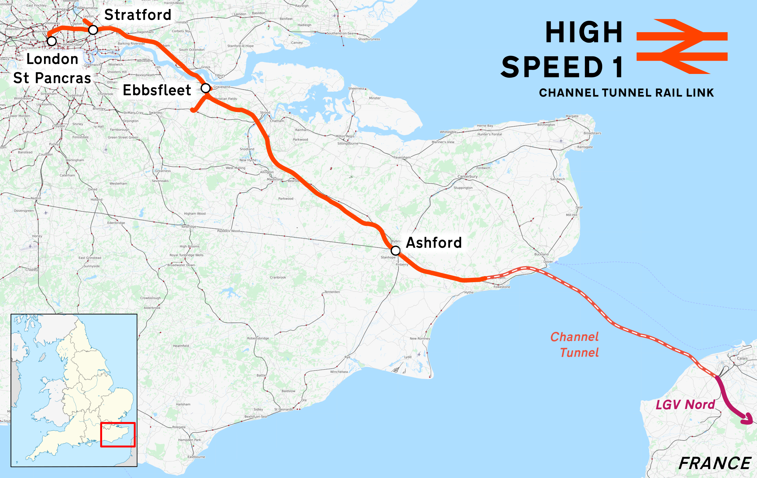
High Speed 1

Slide 26
High speed 1
Passenger traffic on HS1 2018 (m passenger trips)
Eurostar (London –Paris/Brussels) 11m
Javelin domestic services 10m
Total 21m

Slide 27
Ex ante appraisal of HS1
(London to Channel Tunnel) (£millionPV)
 | 1998 Appraisal
Benefits
User benefits - International Services | 1,800
User benefits - Domestic Services | 1,000
Road Congestion | 30
Environmental benefits | 90
Regeneration | 500
Total Benefit | 3,420
Costs | 1,990
NPV | 1,430
BCR | 1.72
(BCR excluding regeneration benefits) | 1.5

Slide 28
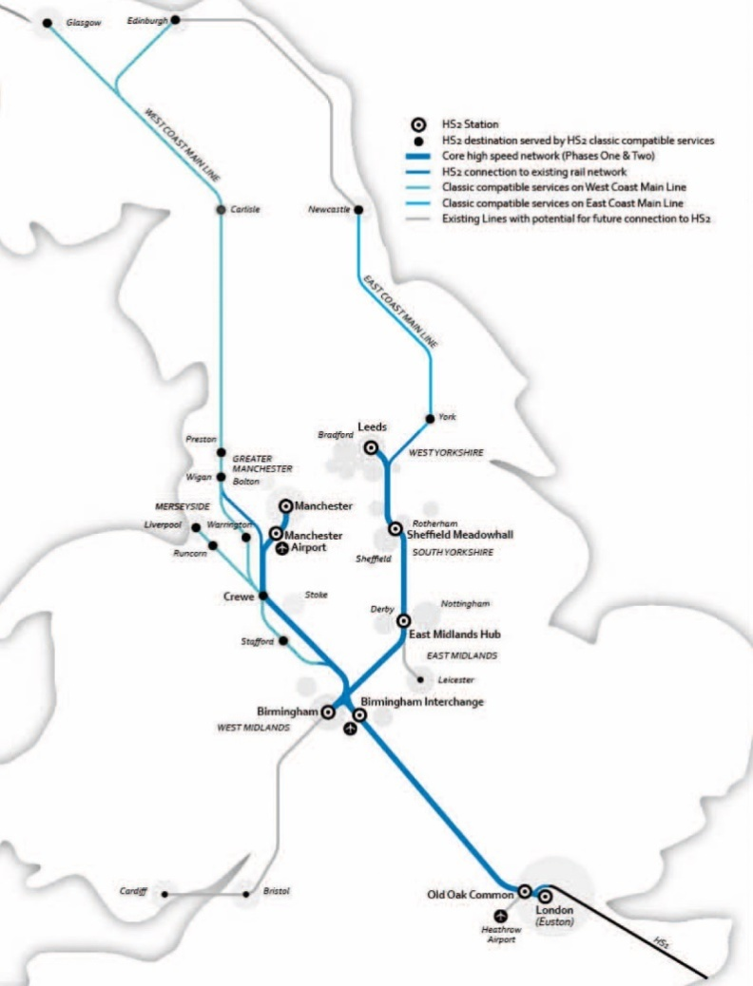
HS2 Proposal – phases 1 and 2

Slide 29
Options examined
East, West, Both or Y shaped network
Sifting process looked at 60 London termini and 6 routes
Stations included Old Oak Common (severe loss of user benefits compared with Central London)
Routes including M1 corridor (closer to built up area so involved a lot of demolition and/or tunnelling)
New orthodox line (200km p.a.)
Upgrading existing lines

Slide 30
Journey times from London
now with HS2
Birmingham 1:21 0:49
Leeds 2.12 1:23
Manchester 2.08 1.08
Newcastle 2.52 2.19
Edinburgh 4.23 3.38
Glasgow 4.08 3.38

Slide 31
Passengers forecast to use HS2
(>40m p.a.)
Switch from classic rail | 69%
New Trips | 26%
Modal Shift from Air | 1%
Modal Shift from Car | 4%
Rail already dominant except for London-Scotland
So not much scope to reduce CO₂ by modal shift.

Slide 32
Pricing Policy assumed in the appraisal
Rail fares rise by RPI +1% from 2020
HS2 fares same as conventional rail
Air fares continue to decline
Motoring costs decline as efficiency improves but no rise in fuel tax or further use of road pricing
So by 2036 in real terms:
Rail +25%
Air −30%
Car −40%
(HS2 forecasts)

Slide 33
Capacity benefits
HSR route has huge capacity
Relief of capacity problems on parallel routes leading to:
  Reduced overcrowding
  Improved reliability
  More capacity for freight
  Particularly important between London and Rugby, but also approaches to Birmingham, Leeds and Manchester (part of Northern Powerhouse Rail?
  How best to use capacity on the Northern part of the route?
  What would happen without HS2?

Slide 34
Wider economic benefits
Current appraisal method considers these only for major conurbations on the assumption of unchanged land-use :
Agglomeration benefits
Labour market benefits
Imperfect competition
The figure of £14billion is on this basis.
Graham examined whether there were further agglomeration benefits from improving inter city rail business travel? Concluded very small (£0.1bn?) due to low share of all journeys in the course of work.

Slide 35
Wider economic benefits (cont’d)
Additional mechanisms (Venables, Laird and Overman, 2014).
Increases in density and city size leading to further agglomeration effects
Specialisation and economies of scale
Attraction of additional private investment
KPMG estimate £15b p.a.; but much criticism of how they separate out rail accessibility from other factors.

Slide 36
Benefits and Costs of the full “Y” network PV, 2015 prices, £bn |  | (DfT, 2020)
1 | Net transport benefits |  | 74.2
2 | Wider Economic Impacts (WEIs) |  | 20.5
3 | Net benefits including WEIs |  | 94.7
4 | Capital costs |  | 78.2
5 | Renewals |  | 5.4
6 | Operating costs |  | 25.2
7 | Total costs = (4) + (5) + (6) |  | 108.9
8 | Revenues |  | 45.4
9 | Net costs to Government = (7) – (8) |  | 63.5
10 | BCR without WEIs (ratio) = (1) / (9) |  | 1.2
11 | BCR with WEIs (ratio) = (3) / (9) |  | 1.5

Slide 37
Breakdown of benefits for HS2 (full Y network)
(PV, 2015 prices, £m) (DfT, 2020)
Rail user benefits |  | 76670
Road user benefits |  | 820
Wider Economic Impacts |  | 20500
Reduced External Costs |  | 810
Loss of indirect Tax |  | -4140
Net Benefits |  | 94660

Slide 38
National Infrastructure Commission Report on rail needs in the Midlands and the North 2020
Northern part of HS2 plus other aspirations (new line Leeds-Manchester; upgrading Sheffield-Manchester etc) not affordable
Should examine the possibility of terminating the Eastern leg of HS2 in the East Midlands and upgrading the existing line from there north
This has been adopted as part of the Integrated Rail Plan

Slide 39
General Conclusions
Rail project appraisal is complex because of the number of options to be considered (including route, rolling stock, price, quality of service)
May be able to modify distributive consequences by revising the scheme and how it is financed
Interactions between schemes complicated
Major uncertainties are:
-future demand (esp post Covid 19)
-wider economic benefits

Slide 40
References
See:
National Audit Office (2014) Crossrail, London
National Audit Office (2019) Completing Crossrail, London
T. Worsley (2011) The Evolution of London’s Crossrail Scheme and the Development of the Department for Transport’s Economic Appraisal
Discussion Paper 27, ITF, Paris
More information about Cross Rail may be found at www.crossrail.co.uk

Slide 41
References
On high speed rail in general see:
  Nash, Chris (2013) When to invest in high-speed rail? OECD/ITF joint transport research centre discussion paper 2013/25 (www.oecd.org)
National Audit Office report on HS1:
  NAO (2012) The completion and sale of High Speed 1. Report by the Comptroller and Auditor General, HC1834, 28 March 2012. https://www.nao.org.uk/wp-content/uploads/2012/03/10121834.pdf
HS2 Strategic Case (2013)
https://www.gov.uk/government/publications/hs2-strategic-case
Oakervee Review (2019)
https://www.gov.uk/government/publications/oakervee-review-of-hs2

Slide 42
References CTD
DfT (2020) Full Business Case. High Speed 2 Phase One (https://www.gov.uk/government/publications/hs2-phase-one-full-business-case)
National Infrastructure Commission (2020) Rail Needs Assessment for the Midlands and the North
Rail Needs Assessment for the Midlands and the North - NIC

