Slide 1
Corporate Culture
Ondrej Castek
castek@econ.muni.cz

Slide 2
What can you expect
What is corporate culture
Cultural typology
Culture and corporate performance
Cultural change
2

Slide 3
What is corporate culture
Organizational culture can be understood as:
set of basic assumptions, beliefs, values, attitudes and norms of behavior
which are shared in an organization
which show itself in thinking, feeling and behavior of members of organization and in material and non-material artifacts.

Slide 4
Basic assumptions, beliefs
Basic assumptions are our long-learnt, automatic responses and established opinions. We are, ourselves, almost always unaware of the nature of our own basic assumptions, but they are enacted through our behavior - what we say and do. Basic assumptions are usually rooted in our infancy, early family life and social context. More widely, assumptions shaping our behavior relate to cultural context.
Beliefs are the assumptions we make about ourselves, about others in the world and about how we expect things to be. Beliefs are about how we think things really are, what we think is really true and what therefore expect as likely consequences that will follow from our behavior.
Notes:
It is normal to smile at people you do not know (x it is normal to keep neutral face)
It is normal to answer the customer ASAP (x answering the customer right away might look like you are not busy enough)

Slide 5
Values
Values are about how we have learnt to think things ought to be or people ought to behave, especially in terms of qualities such as honesty, integrity and openness.
Notes:
What is important for us.
i. e. customer satisfaction, employees satisfaction.

Slide 6
Attitudes
Attitudes are the established ways of responding to people and situations that we have learned, based on the beliefs, values and assumptions we hold. Attitude become manifest through our behavior.
Notes:
The relation to a certain person, thing, event or problem. Results in an behavior or behavioral intention.

Slide 7
Norms of behavior
Non-written informal rules of behavior in varying situations. Not formal rules officially set by the organization. Failing to abide these rules results in punishment, abiding them results in rewards. Punishment can have a form of unfriendly behavior of others, reward would be friendly and cooperative behavior of others.

Slide 8
Artifacts
Architecture
Equipment
Products
Annual reports
Advertisement materials
Language
Stories
Heroes
Habits
Rituals
Ceremonies

Slide 9
Elements of culture (Lukášová, 2010)
Basic assumptions | Values | Norms of behavior | Artifacts
Customer satisfaction influences the firm’s success | Customer satisfaction | Accommodate customers` needs Quickly respond to customers` demands Actively solve customers` problems Team work in customer benefit | Pleasant meeting rooms Christmas cards for customers Regular meetings with customers
9

Slide 10
Elements of culture (Lukášová, 2010)
Basic assumptions | Values | Norms of behavior | Artifacts
Customer satisfaction is possible to reach through quality | High-quality products or services | Assess quality from the customer` viewpoint Accept responsibility for customer satisfaction Care about customer needs Monitor customer satisfaction Continuously improve processes Keep eye on details and perfection | Regular information about customer satisfaction measurement Regular information about problems with reaching customer satisfaction Stories about distinct achievements with customer satisfaction
10

Slide 11
Schein’s model of organizational culture
Artifacts
Espoused values
Basic Underlying Assumptions
11
Notes:
1. Artifacts – evident, most visible layer.
2. Values and norms – partially conscious and partially visible layer. Strategies, goals, philosophies
3. Unconscious, taken for granted beliefs, perceptions, thoughts and feelings – sources of value and action.

Slide 12
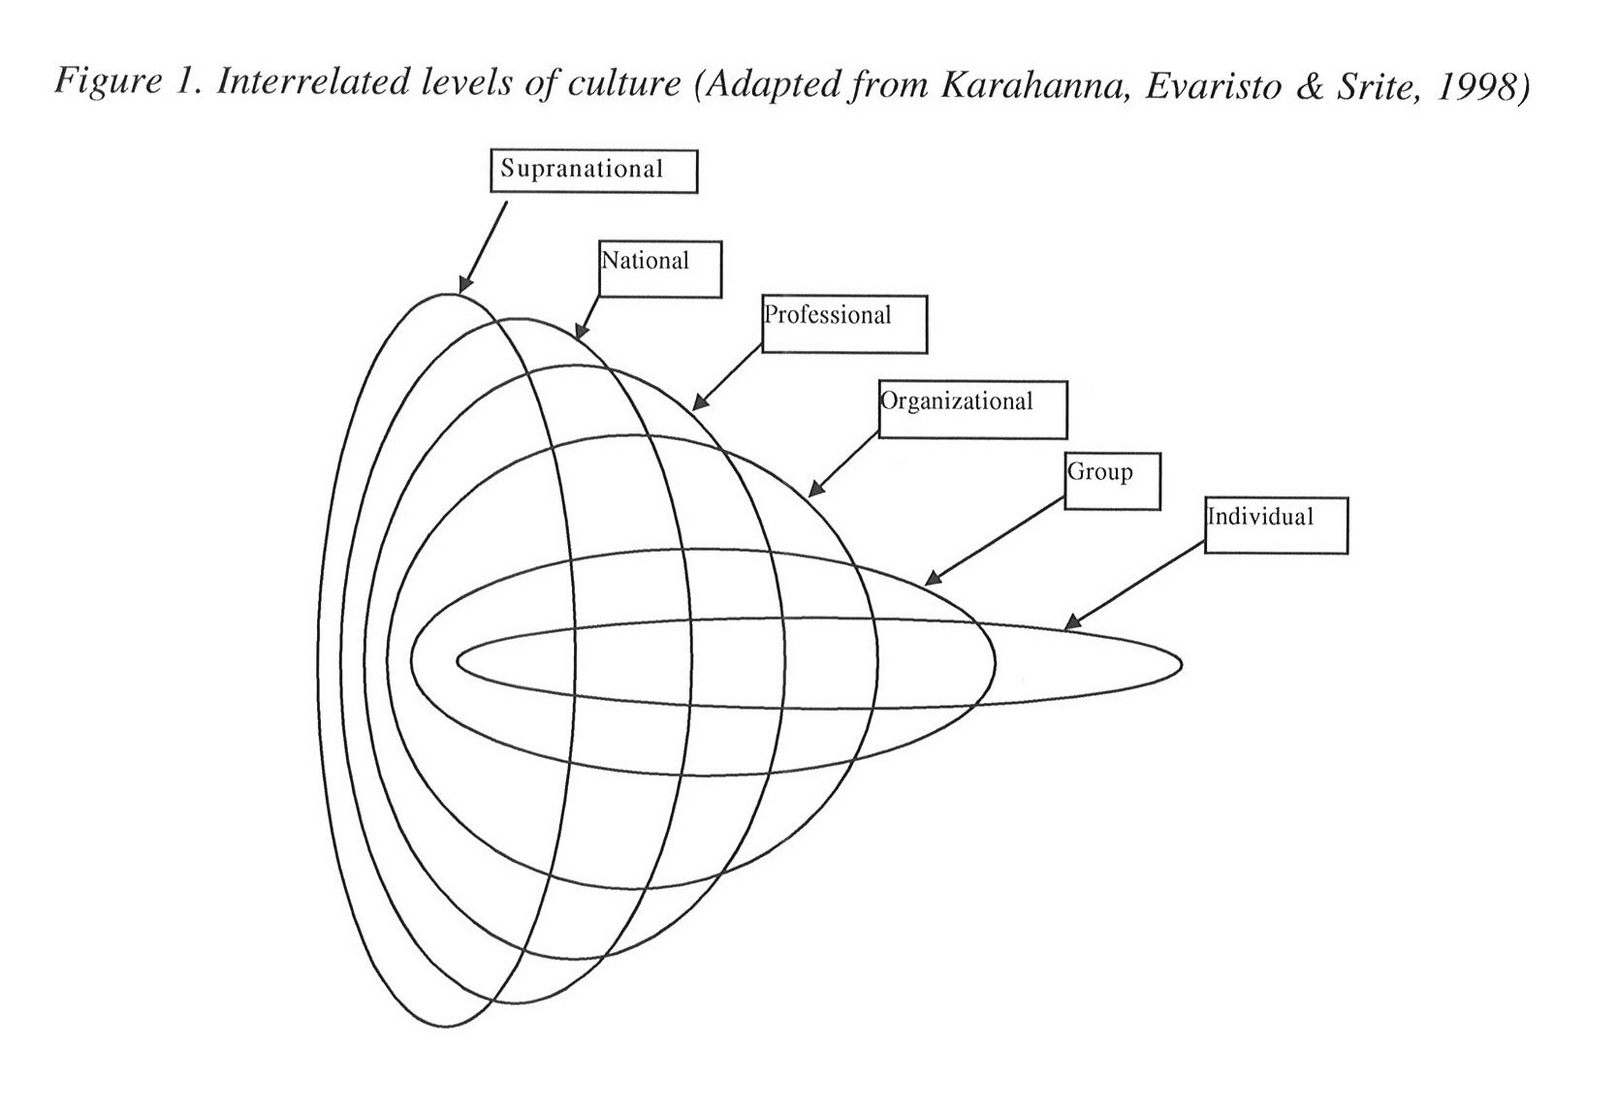
Levels of Culture

Slide 13
Other approaches to organizational culture
Hall (1995):
1. Level A: Artifacts and etiquette
2. Level B: Behaviors and actions
3. Level C: Core morals, beliefs, values
Denison (1982, 1990):
1. values and beliefs (preconditions)
2. patterns of behavior, reflecting and strenghtening the values
3. sets of conditions (artifacts and the environment in which members of organization work)
13

Slide 14
Content and Strength of the Organizational Culture
Content:
What particular basic assumptions, beliefs, values, attitudes and norms of behavior are shared.
Strength:
To what extent are these elements of culture shared.
Subcultures:
Distinct different cultures in one organization.
14
Notes:
Strength: if the culture is weak, the individual beliefs, values etc. prevail over the organizational beliefs, values, etc.
Subcultures: reasons might be geografic location, size of the company, different functions (marketing x controlling), hierarchical differences. More likely where the overall organizational culture is weak.

Slide 15
Sources of Organizational Culture
Influence of:
the environment: national culture, type of market, culture of profession, customer demands and bargaining power, type of industry,
the founder, dominant leader, owner or manager,
size and maturity of the organization,
technologies used.
15
Notes:
Type of market: free price system x central planned economy, very competitive market (automotive) x not much competitive market (utilities)…
Profession: marketing or accounting
Industry: agriculture x automotive
Size and maturity: identity crisis
Technologies: state-of-the-art or obsolete (both can be found in retailing…)

Slide 16
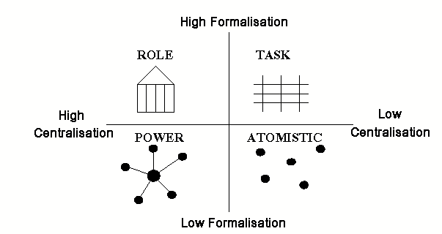
Harrison, 1972 and Handy, 1976
One of the first typologies, still very known.
16
Notes:
Power culture – power concentrates with individual or individuals, they are in the middle of the net, this cannot grow much, otherwise it tears off, only possibility is to start up another net (subcompany). Common in family businesses, small trade or financial firms and in criminal organizations.
Role culture – rational, formal, rules creating and abiding, high degree of job formalization. Usually public administration, army and very large companies.
Task culture – task oriented, matrix or net structure. Flexible. Typically advertising agency.
Person culture – couple of independent people, all very and equally important, relationships are horizontal, no one dominates. Lawyers, doctors.

Slide 17
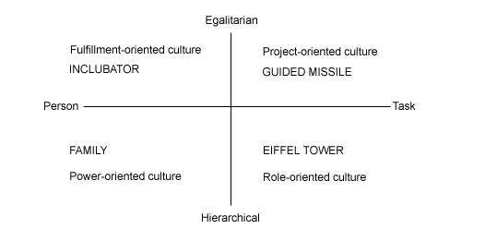
Trompenaars, 1993
17

Slide 18
Deal and Kennedy, 1982
 |  | Risk
 |  | Low | High
Feedback and reward | Rapid | Work-hard, play-hard culture | Tough-guy macho culture
 | Slow | Process culture | Bet-the- company culture
18

Slide 19
Deal and Kennedy, 1982
Work-hard, play-hard culture
This has rapid feedback/reward and low risk, leading to:
Stress coming from quantity of work rather than uncertainty.
High-speed action leading to high-speed recreation.
Eg. Restaurants, software companies.
Tough-guy macho culture
This has rapid feedback/reward and high risk, leading to:
Stress coming from high risk and potential loss/gain of reward.
Focus on the present rather than the longer-term future.
Eg. police, surgeons, sports.
Process culture
This has slow feedback/reward and low risk, leading to:
Low stress, plodding work, comfort and security. Stress may come from internal politics and stupidity of the system.
Development of bureaucracies and other ways of maintaining the status quo.
Focus on security of the past and of the future.
Eg. banks, insurance companies.
Bet-the-company culture
This has slow feedback/reward and high risk, leading to:
Stress coming from high risk and delay before knowing if actions have paid off.
The long view is taken, but then much work is put into making sure things happen as planned.
Eg. aircraft manufacturers, oil companies.
19

Slide 20
Corporate Culture and Corporate Performance
Most authors tried to verify the influence on corporate performance of:
strong cultures
participative/involved cultures
contextual and strategically suitable cultures
adaptive/flexible cultures
20

Slide 21
Strong Corporate Culture (Denison, 1990)
Strong corporate culture has these positive consequences:
creates harmony in perception of reality and thinking of workers,
guides their behavior,
means sharing of values and goals.
The minuses:
binds organization to past experience,
stops thinking in alternatives,
is resistant to changes.
21

Slide 22
Content of Corporate Culture – participative and involved culture (Denison, 1990, 2001)
The signs of participative and involved cultures are:
active, initiative, involved behavior,
autonomous decision making and problem solving,
loyalty.
To create such culture, this contributes:
continuous knowledge and skill development,
empowering,
cooperative and team environment,
customer orientation, which is manifested each day,
creating and communicating misions and visions.
22
Notes:
https://www.muni.cz/en/about-us/official-notice-board/mission-values-and-vision

Slide 23
Adaptibility and Flexibility (Denison, 1990, Kotter and heskett, 1992)
Main characteristics of adaptive culture:
ability to perceive signals from external environment, interpret them and react to them = ability to learn,
ability to understand the needs of internal and external customers, react to them and foresee them = customer focus,
ability to change processes and behavior in order to adjust = readiness for change.
23

Slide 24
Contextual and Strategic Adequacy (Scholz, 1987, Cameron and Quinn, 1999)
Contextual adequacy – the content of the culture is aligned with the environment`s needs.
Strategic adequacy – the content of the culture is aligned to the strategy.
Strategy vs. culture – if in confict, then:
ignore the culture,
bypass the culture,
change strategy,
change culture.
24
Notes:
contextual adequacy i.e.: only the companies with adeqate culture will survive.
1. risky
2. choosing ways, which are not in contradiction with the culture, but still leads to the desired goal. Case of promising, but not profitable (at present) customers.
3. might not be possible.
4. the most difficult way.

Slide 25
How to change culture?
Change the artifacts (easiest, but not sufficient)
Change the values: use symbols, slogans, emotions, motivation system,
Change the norms: use motivation system
For all goes: walk the talk.
Also, choose new employees to fit the desired culture (person-organization fit), do the same with promotions.
Provide education and training.
25
Notes:
organizational culture profile
training: both for current and new employees

Slide 26
Mergers - How can be culture important
Daimler-Benz – German, strong in Europe
Chrysler – most profitable american carmaker
In 1998 merger DaimlerChrysler announced as „merger of equals“
In 2001 Chrysler 3 bilion $ loss, loss of 9 % of market share
Cause: gradual replacement of Chrysler`s culture by Daimler`s culture
26

Slide 27
Mergers - How can be culture important
One year after the merger only 1/3 of Chrysler`s original managers still in place.
Board of directors shrank to 13 members – 8 Germans and 5 Americans.
2 years after the merger no top manager from original Chrysler, CEO of Chrysler division was a German.
27

Slide 28
Mergers - How can be culture important
Daimler:
formal and strict hierarchy
top management had more function staff and higher spending
suit compulsory, used titles
smoking, wine and beer allowed
common overtimes
Chrysler:
project structure, middle management took decision from its own initiative
management had greater responsibility and salaries
casual dressing, non formal communication
smoking and alcohol forbidden
overtimes rarely
Results: key employees quit from managerial posts, R&D and others; lower employees satisfaction of the remaining employees, therefore lower productivity.
How do you pronounce Daimler Chrysler? Daimler – Chrysler is silent.
28

Slide 29
Sources
DEAL, T. E., KENNEDY, A. A. Corporate Cultures. Reading : Addison Wesley Publishing Company, 1982. ISBN 0-201-10277-3.
DENISON, D. R. Corporate Culture and Organizational Effectiveness. New York : Wiley and Sons, 1990. ISBN 0-471-80021-X.
DRENNAN, D. Transforming Company Culture. London : McGraw-Hill Book Company, 1992. ISBN 0-07-707660-5.
HALL, W. Managing Cultures: Making Strategic Relationships Work. Chichester : Wiley and Sons, 1995. ISBN 0-471-95571-X.
HOFSTEDE, G. Cultures and Organizations: Software of the Mind. London : McGraw-Hill book Company, 1991. ISBN 0-07-707474-2.

Slide 30
Sources
KOTTER, J. P., HESKETT, J. L. Corporate Culture and Performance. New York : Maxwell Macmillan, 1992. ISBN 0-02-928467-3.
LUKÁŠOVÁ, R. Organizační kultura a její změna. Praha : Grada Publishing, 2010. ISBN 978-80-247-2951-0.
LUKÁŠOVÁ, R.; NOVÝ, I. Organizační kultura: Od sdílených hodnot a cílů k vyšší výkonnosti podniku. 1. vyd. Praha : Grada Publishing, 2004. 176 s. ISBN 80-247-0648-2.
NOVÝ, I. Interkulturální management: Lidé, kultura a management. 1. vyd. Praha : Grada Publishing, 1996. 143 s. ISBN 80-7169-260-3.
SCHEIN, E. Organizational culture and Leadership. San Francisco : Jossey Bass Publishers, 1992. ISBN 1-55542-487-2.
TROMPENAARS, F. Riding the Waves of Culture: Understanding Cultural Diversity in Business. London : The Economist Books, 1993. ISBN 0-85058-428-0.

Slide 31
Thanks for your attention
31

