Slide 1
Nigeria
Intercultural Communication
Jessica Amiesimaka

Slide 2
Content
Introduction
Culture
SWOT
Business tips & things to know
Discussion and questions

Slide 4
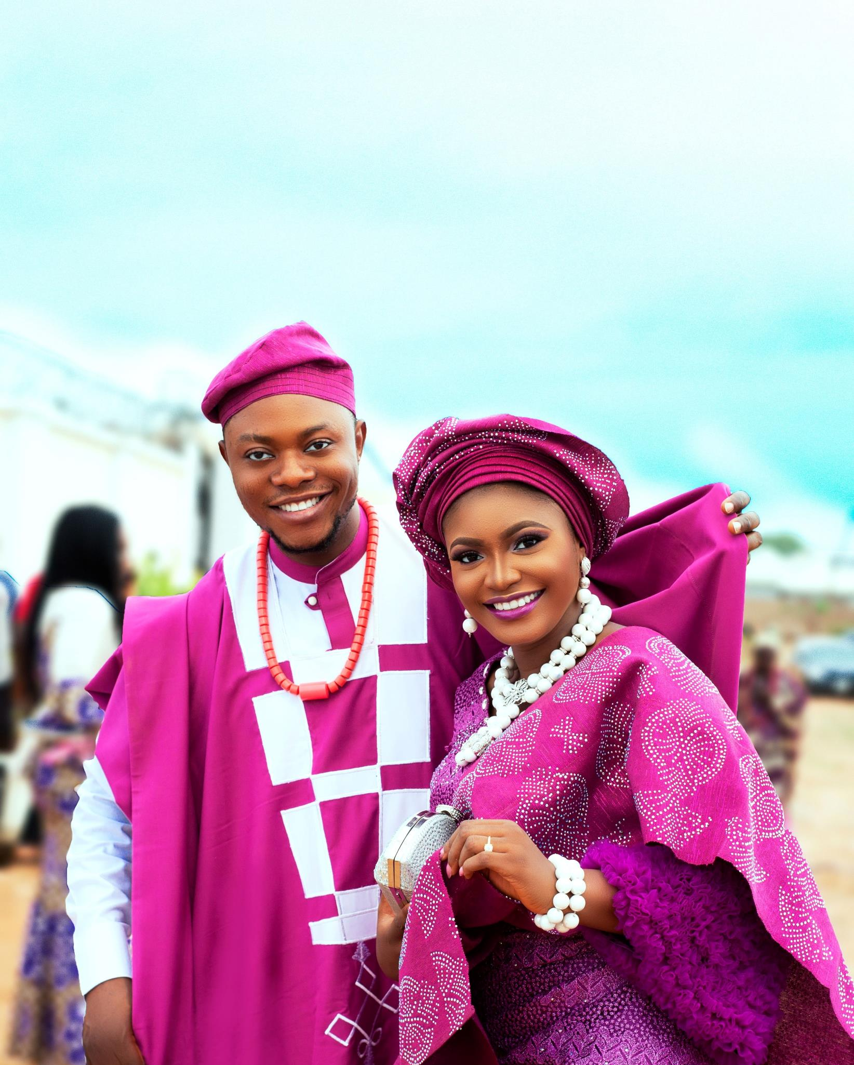
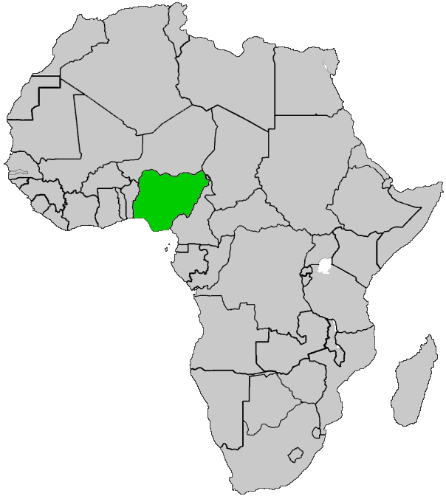
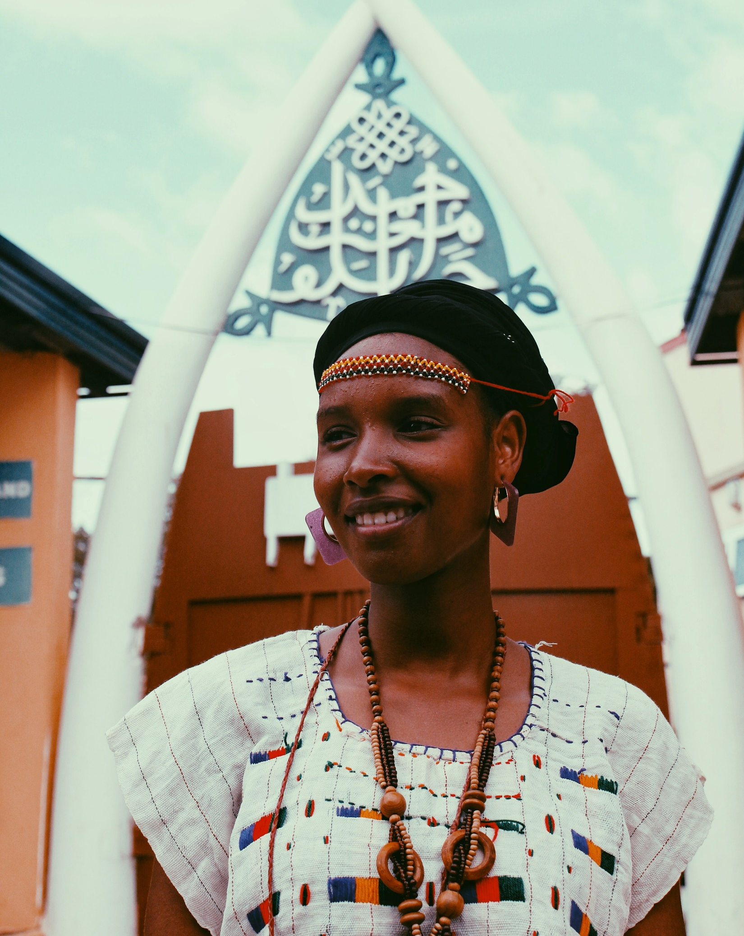
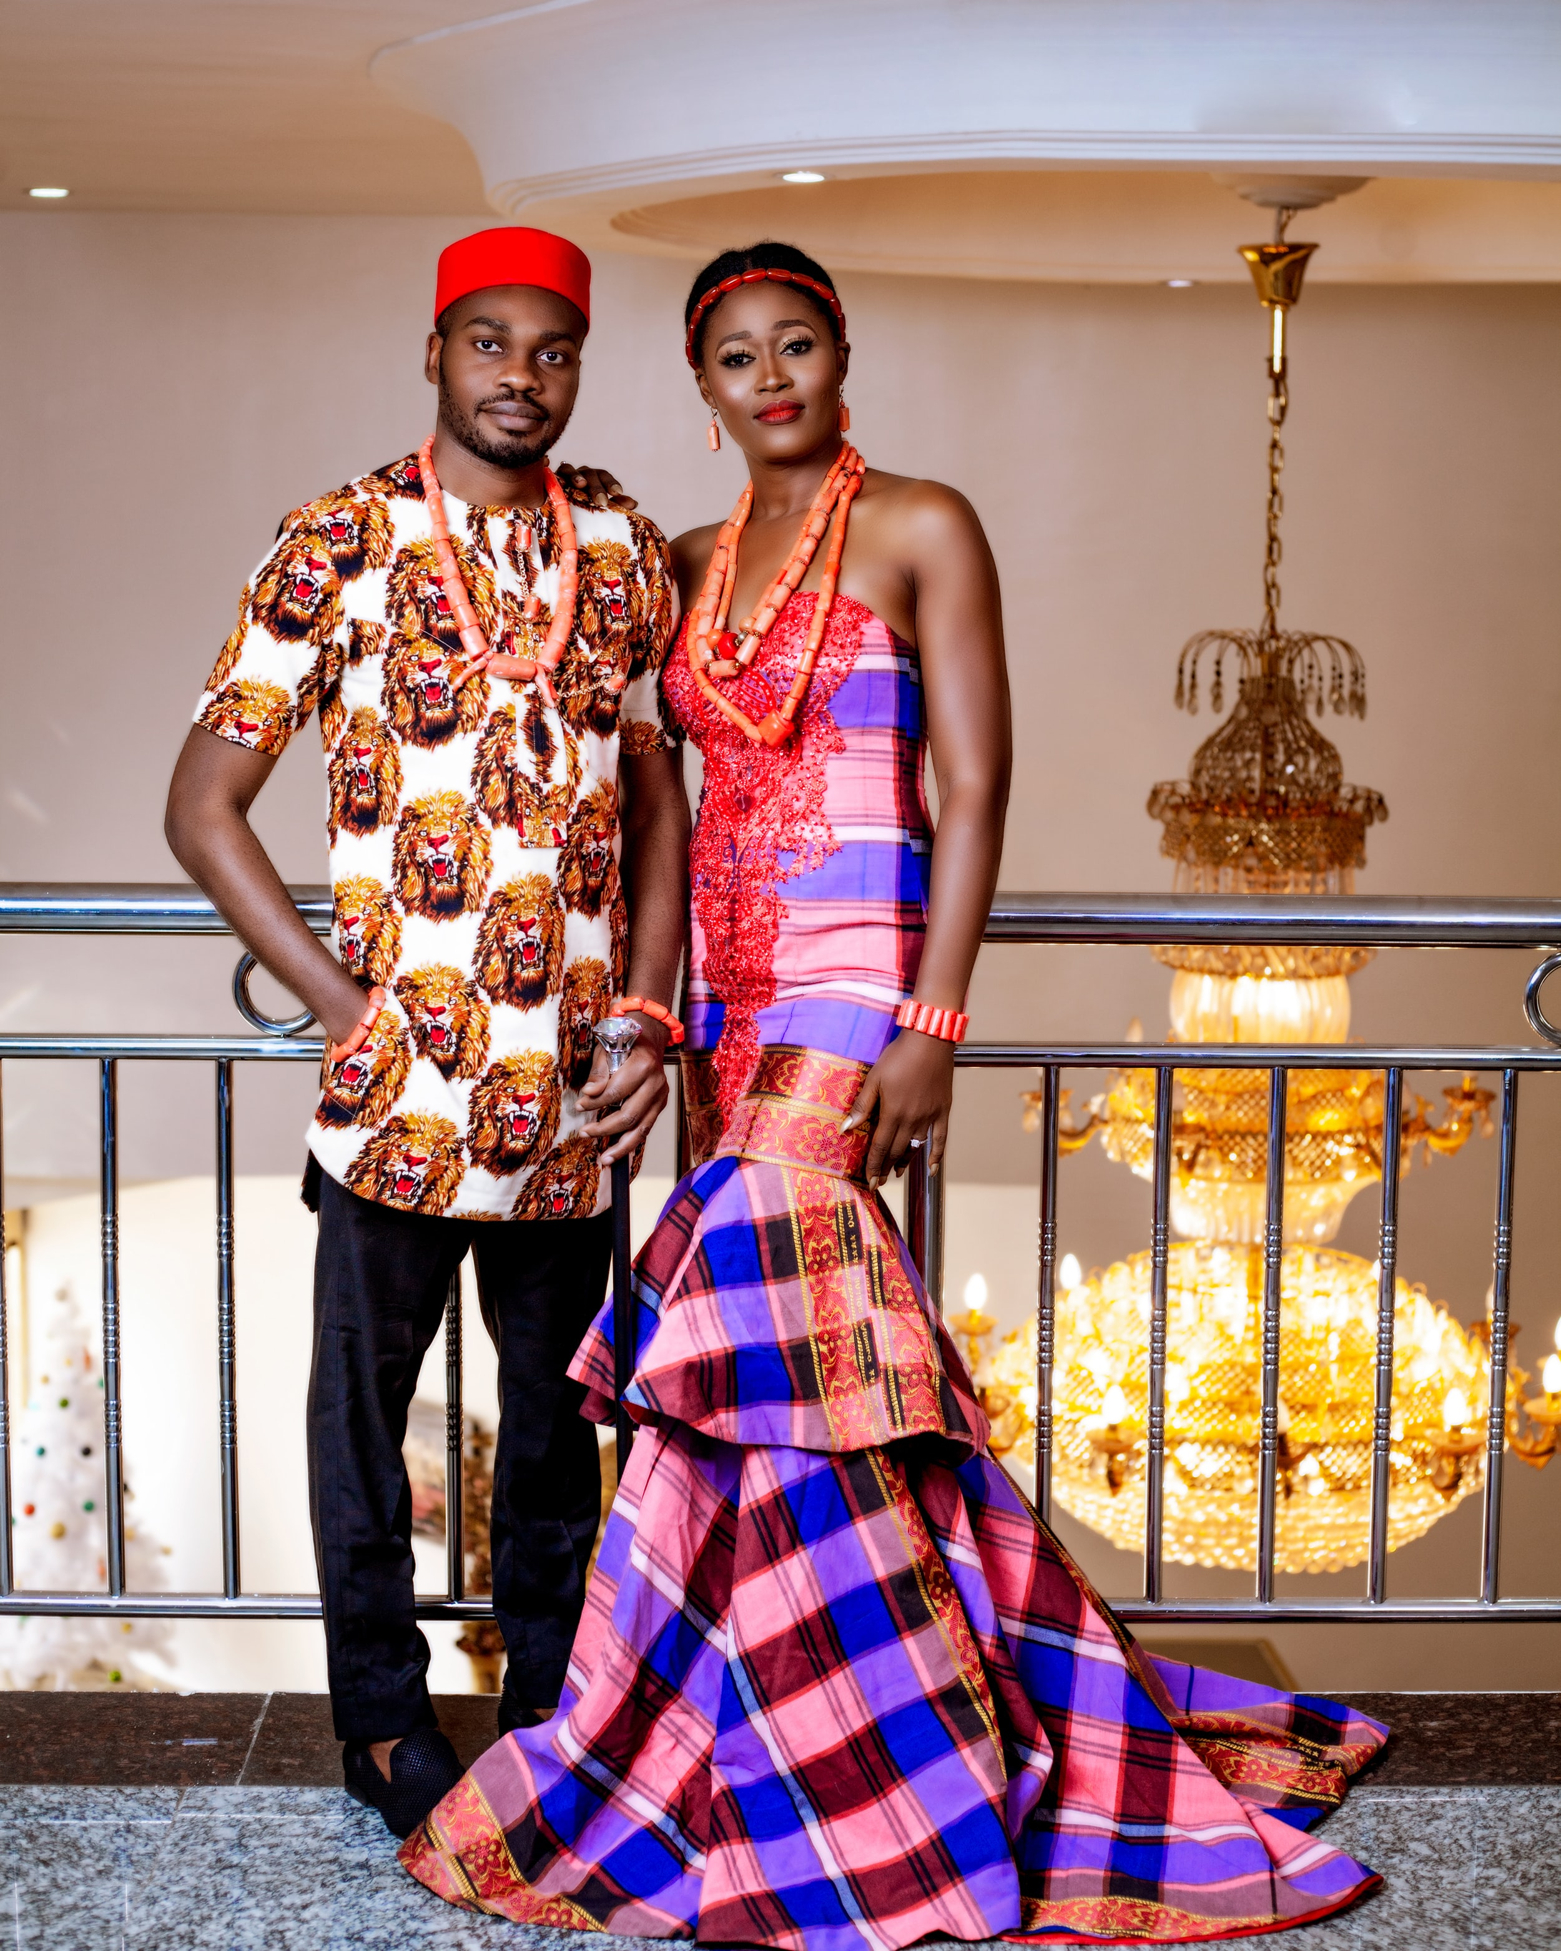
Introduction
Nigeria - West Africa
Capital – Abuja; Economic capital - Lagos
Population – 206.14million
Over 250 ethnic groups (Hausa and Fulani 29%, Yoruba 21%, Igbo (Ibo) 18%, Ijaw 10%, Kanuri 4%, Ibibio 3.5%, Tiv 2.5%)
Languages: Official – English; Major native – Ibo, Yoruba and Hausa; over 500 estimated
Religions: Muslim 50%, Christian 40%, indigenous beliefs 10%
Resources – Oil (12th largest producer), natural gas, tin, iron ore, coal, limestone, niobium, lead, zinc and arable land
Currency: Naira; 1 EUR ≈ 470 NGN
Notes:
Nigeria is about 20 times the population of Czechia
7th most populous country in the world after China, India, US, Indonesia, Pakistan, Brazil.
Most populous in Africa

Slide 5
Land size – 923,768 km²
Notes:
Nigeria is about 12 times the land size of Czech Republic

Slide 6
Culture
Nigerian society portrays hierarchy especially in terms of power relations.
Rooted in a collectivist culture.
Masculinity - competition, quality, equity and continuous improvements.
Short-term focus: Quick results and timely returns
Highly indulgent society
Notes:
Nigerian society is strongly hierarchical in terms of power relations. It is a necessity that a clear hierarchy is established where every employee is aware of this structure so that he or she may contribute to it constructively. In a certain sense, a benevolent autocrat is the preferred leadership style, and those willing to embrace this culture should experience success.
Collectivism versus individuality: Nigerian society is strongly rooted in a collectivist culture. Although this doesn’t rule out individuality, a collective effort allows for communal ownership of resources and effort. In this atmosphere, trust becomes very important.
Decisive action: Nigerian culture could perhaps be described as ‘masculine’ in the sense that emphasis is placed on action and dealing with challenges directly and quickly. There is a stress placed on competition, quality, equity and continuous improvements. Managers should be assertive and decisive because things are sorted out by fighting them out.
Short-term focus: Many Nigerian businesses are focused on achieving results quickly rather than adopting a long-term strategy. In short, people love to see results timeously and know that their monetary investment is being fruitful.
https://www.howwemadeitinafrica.com/nigerian-business-culture-and-incentives-an-inside-perspective/47005/

Slide 7
Strengths
Strong banking and financial sector
Weaknesses
Inadequate infrastructure
Threats
Crime rates, fraud, scams and corruption
Opportunities
A growing population creates high demand for products and services
Availability of young, active and mobile labour force
Investment competitiveness and profitability
Insufficient research
Lack of market diversification
Political improvements create more opportunities as markets develop
Opportunities for outsourcing and supply chain development
Threat of import effects on the local markets
Increasing competitors in the local markets
Notes:
2021 – 0-14 (43.31%), 15-64 (53.93%), 65+ (2.76%)
In Czechia – 0-14 (16.1%), 15-64 (63.5%), 65+ (20.4%)
Inadequate power supply, neglected transport (road, rail, sea/river) networks, inadequate security set up and other related

Slide 8
Things to know
National pride vs tribal pride
Family & friends - no social welfare
Trust
Religion
Respect: Age and position
Time: lateness is understood
Cash transactions & e-commerce
Short-term gains
Hard work + knowledge = success
Notes:
Time
Cash transactions – central bank new law limiting cash transactions
E-commerce/fintech
National pride
Short-term gains
Family
Religion
Hard work, knowledge, success
Recognition and attention
Respect – Age and position, bow
Small talk – family, health
Greetings – handshakes (women extend hands first, Muslims may not shake hands)
Use titles – Until invited to use others

Slide 9
Business tips
Greetings – handshakes (Muslims may not shake hands)
Use the right hand
Small talk – family, health, personal life
Use titles – Until invited to use others
Business cards are acceptable – include role and title
Gifts are appreciated
Offered to parents but provided for the children
From men to women requires diplomacy
Meetings – long discussions, involved negotiations, “beating about the bush”, generous time frames
Business dressing - formal (sometimes semi-formal)
Communication
Proverbs
Humour
Loud tones - passion, excitement
Body language is important
Bottleneck bureaucracy
“What an old man sees while lying down, a young man can never see even if he climbs a tree.”
“The bird that remembers its flockmates, never miss its way”
“Courage is the father of success.”

Slide 10
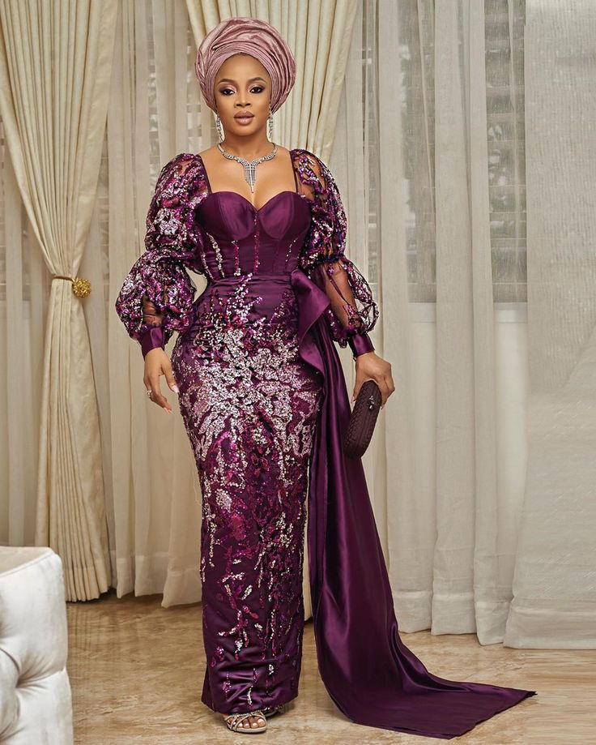
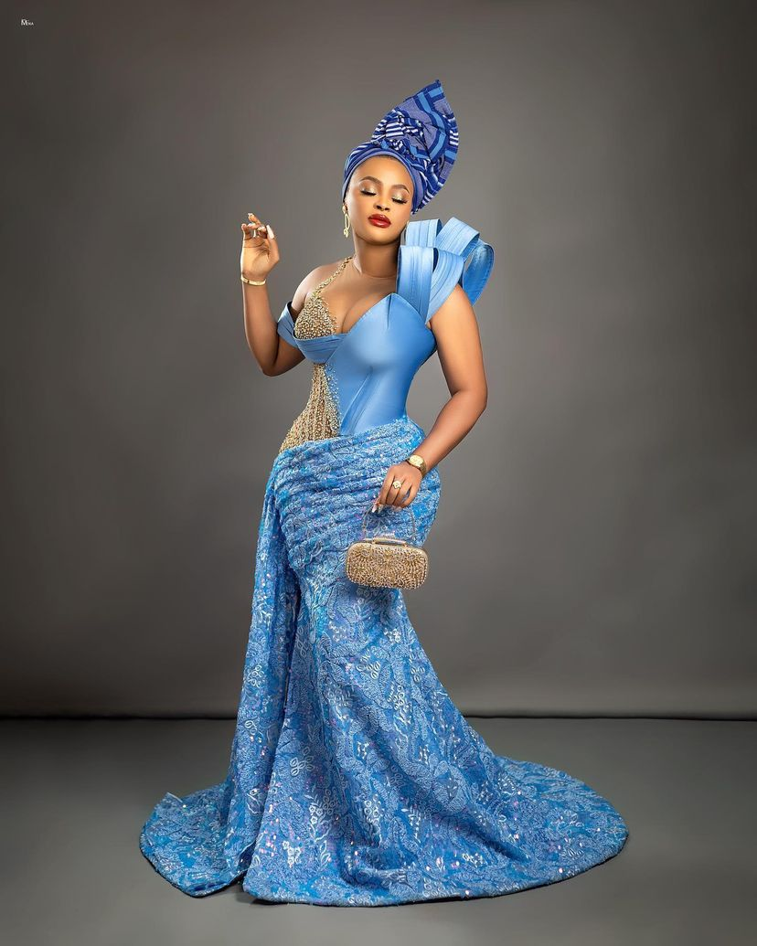
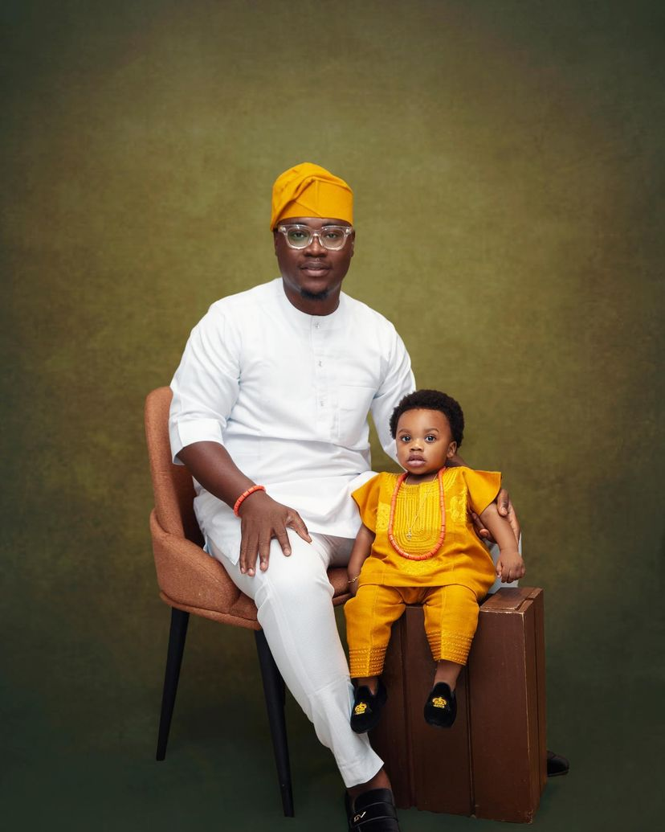
Creative industry
Movies (Nollywood/Neflix)
Music (Grammy winners)
Fashion (Lagos Fashion Week)
FinTech industry
Payment platforms (Paystack, FlutterWave, Interswitch)
Online/Mobile banking (Kuda bank)
Savings platforms (Piggyvest)
Notes:
Burna Boy won a Grammy at the 63rd Annual Grammy awards
Naomi Campbell is a world renowned model and she graced the Lagos Fashion Week

Slide 11
Notes:
Beyonce and Wizkid won a Grammy at the 63rd Annual Grammy awards

Slide 13
Thank you
Questions and Discussion

Slide 14
References
https://www.commisceo-global.com/resources/country-guides/nigeria-guide
https://www.worldatlas.com/maps/nigeria
https://databank.worldbank.org/views/reports/reportwidget.aspx?Report_Name=CountryProfile&Id=b450fd57&tbar=y&dd=y&inf=n&zm=n&country=NGA
https://worldpopulationreview.com/country-rankings/oil-production-by-country
https://www.opec.org/opec_web/en/about_us/167.htm
https://www.cbn.gov.ng/rates/exchratebycurrency.asp
https://www.hofstede-insights.com/country-comparison/czech-republic,nigeria/
https://www.howwemadeitinafrica.com/nigerian-business-culture-and-incentives-an-inside-perspective/47005/

