Slide 1
International Public Finance
Public Finance 2

Slide 2
International Public Finance
cash relations arising from the acquisition, distribution, redistribution and use of funds by international organizations and international (supranational) associations
the budgets of international and supranational organizations
provide goods international or even global character, but also national, regional and local public goods that were "recognized" by the relevant organization

Slide 3
International Public Finance
purchases of goods and services from the private and public sector (e.g. the peacekeepers and police forces, judicial and administrative staff) and transfer payments
role of international public finance will grow due to globalization - the need for international coordination of fiscal policy (Musgrave, Musgrave)
they are derived from national public finance, but gain their autonomy

Slide 4
The structure of international public finance
International Financial Relations
International Monetary Funds (budgets)
International Public Institutions
International Financial Instruments
International Budget Rules
International Authorities (e.g. independent guardian of the financial interests )

Slide 5
Revenues of international budgets
payments provided by member countries
(e. g. according to quota)
own sources
others (donations, interests, loans etc.)
direct funding of joint activities by the Member States (e. g. NATO)
debate about international taxes resulting from tax harmonization and coordination

Slide 6
Expenditures of international budgets
administrative costs
expenditures on activities of the organization (loans, subsidies, donations, etc.)

Slide 7
International Monetary Fund (IMF)
an organization of 190 countries, working to foster global monetary cooperation, secure financial stability, facilitate international trade, promote high employment and sustainable economic growth, and reduce poverty around the world
3 key functions: surveillance (monitor), financial assistance (loans) and capacity development (training)

Slide 8
IMF Finance
Special Drawing Rights (SDR) – international code XDR
The SDR is an international reserve asset, created by the IMF in 1969 to supplement its member countries’ official reserves.
SDRs can be exchanged for freely usable currencies.
The value of the SDR is based on a basket of five major currencies—the U.S. dollar, euro, the Chinese renminbi (RMB), the Japanese yen, and pound sterling—as of October 1, 2016.
Survey https://www.imf.org/external/Pubs/FT/quart/2021fy/043021.pdf

Slide 9
North Atlantic Treaty Organization (NATO)
is an intergovernmental military alliance based on the North Atlantic Treaty which was signed on 4 April 1949. The organization constitutes a system of collective defence whereby its member states agree to mutual defence in response to an attack by any external party.

Slide 10
Funding NATO
direct (are made to finance requirements of the Alliance), indirect (national contributions – main source)
More in details:
http://www.nato.int/cps/en/natohq/topics_67655.htm?selectedLocale=en

Slide 11
Funding NATO
National contributions - member countries agreed to commit a minimum of 2% of their Gross Domestic Product (GDP) to spending on defence
problem - only few countries fulfill this criteria

Slide 12
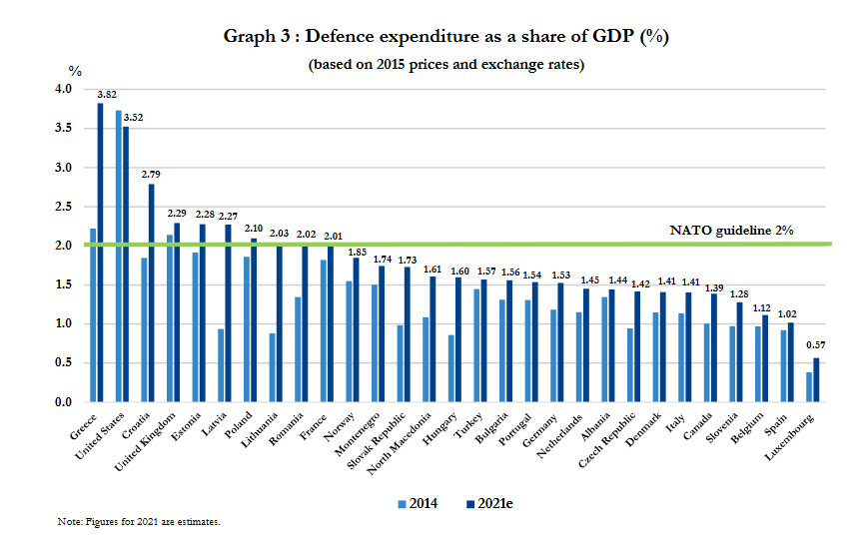
Source: Defence Expenditure of NATO Countries (2014-2021)

Slide 13
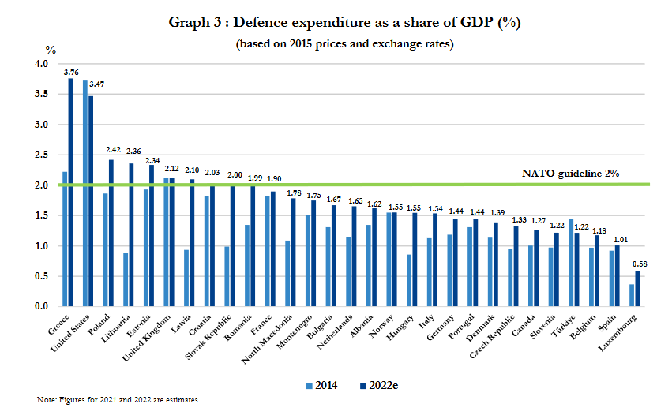
Pramen: Defence Expenditure of NATO Countries (2014-2022)

Slide 14
EU Finance
EU Budget – more in details
http://ec.europa.eu/budget/index_en.cfm
European Structural and Investment Funds
https://cohesiondata.ec.europa.eu/

Slide 15
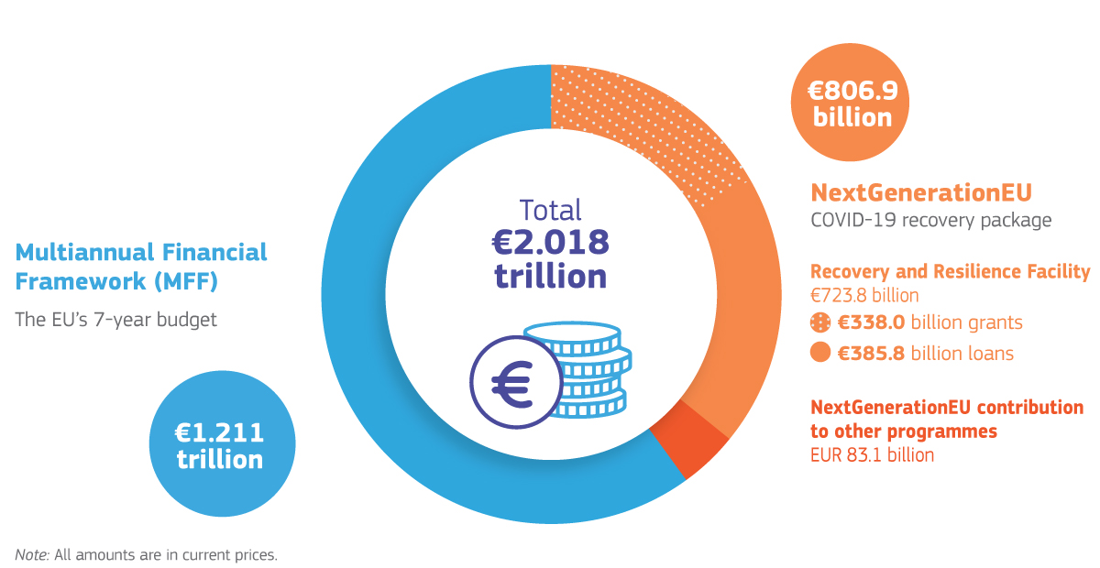
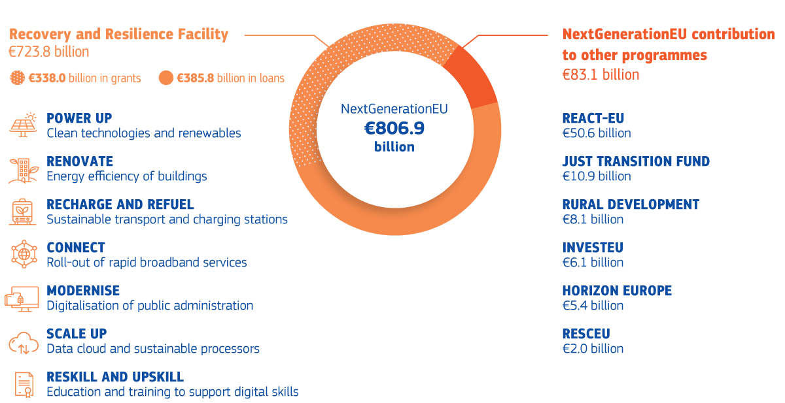
Source: European Commission: The 2021-2027 EU budget – What’s new?
Notes:
One of the EU’s long-term goals is stable economic growth with a high rate of employment. To achieve this, the Commission devised the ten-year Europe 2020 (EUROPE 2020 A strategy for smart, sustainable and inclusive growth, COM(2010) 2020, final wording of 3 March 2010) strategy, which it started to actively implement in conjunction with Member States in 2010. In addition to the goal mentioned above, this strategy should help resolve the deficiencies ensuing from the long-term economic crisis and put in place the right conditions for strengthening the three basic priorities of the strategy: smart growth, sustainable growth, inclusive growth.
Europe 2020 contained five headline targets which the EU seeks to achieve by 2020

Slide 16
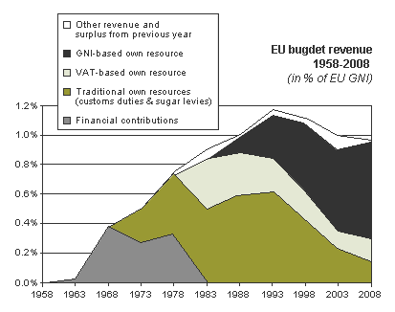
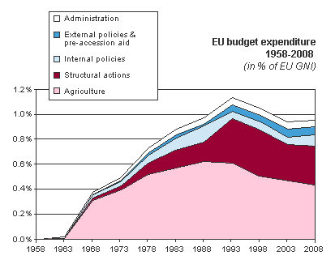
Criticism?
Bureaucratic Inefficiency
Democratic Deficit
Policy Inefficiency
Source: https://placeduluxembourg.wordpress.com/2010/11/28/evaluating-the-criticisms-against-the-eu/, 2016

Slide 17
Challenge?
discussion about new proposal – EU Financial Transaction Tax - tax would impact financial transactions between financial institutions charging 0.1% against the exchange of shares and bonds and 0.01% across derivative contracts, if just one of the financial institutions resides in a member state of the EU FTT
some countries support this proposal (e.g. GE, FR, BE, etc.), some are against (e.g. CR, UK, SWE etc.)

Slide 18
European Stability Mechanism
The European Stability Mechanism (ESM) is an important component of the comprehensive EU strategy designed to safeguard financial stability within the euro area.
The ESM provides financial assistance to euro area Member States experiencing or threatened by financing difficulties.
http://www.esm.europa.eu/about/index.htm

Slide 19
Thank you for your attention!

