Slide 1
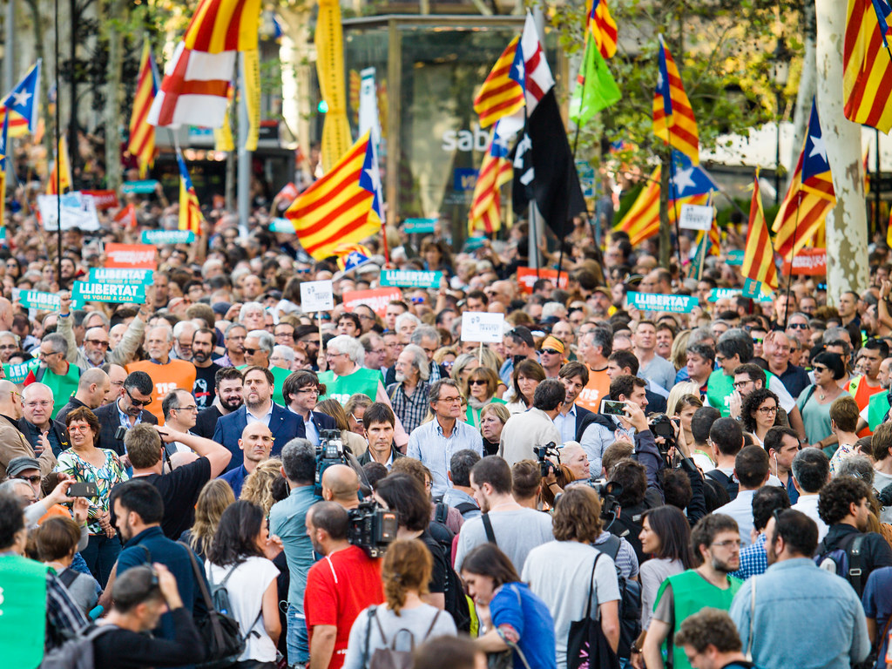
Actors of the Public Policy
Taxonomy, Influence & Interests
Tato fotka od autora Neznámý autor s licencí CC BY-SA-NC

Slide 2
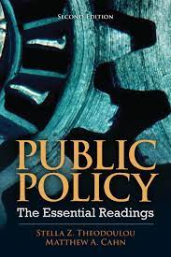
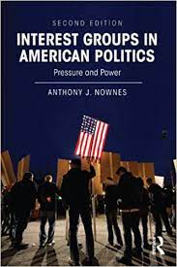
Further readings
ANTHONY J. NOWNES, author. Basic Interests: The Importance of Groups in Politics and in Political Science Frank R. Baumgartner Beth L. Leech. The Journal of Politics[online]. 1999, 61(3), 844-848 [cit. 2018-08-10]. ISSN 00223816. https://muse.jhu.edu/article/370770
CAHN, M., A. 2012. Institutional and Noninstitutional Actors in the Policy Process. Pp. 199-281 in S. Z. Theodolou, M. A. Cahn. Public Policy: The Essential Readings. 2nd Edition. Pearson.

Slide 3
Who are actors? (Howlett, Ramesh 2003)
State Actors (Parliament, Government Bureaucracy, …)
Social Actors (Employees, Professional Societies, Trade Unions)
Political Actors (Public, Specific Interest Groups, Political Parties,….)

Slide 4
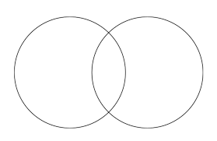
Actors to Interest Groups/Power Groups?
A = IG
A > IG
A < IG
What’s right?

Slide 5
Interest groups:
Any group that actively acts and formulates demands on government bodies at any level of government in order to satisfy its interests.
or
Any group seeking to influence the shape of public policy to satisfy its group interests.
They play an important role:
The entry of interest groups into the decision-making mechanism is a source of information about how individual and collective opinions, attitudes and values are stratified in society.

Slide 6
Relations between interest groups and political institutions
There are three theoretical scenarios:
1. Interest groups dominance (interest groups persuade or manipulate policymakers);
2. cooperation between interest groups and policymakers; The Corporatist Model
3. Authoritarian dominance (the government convinces interest groups).

Slide 7
What do actors do?
Initiate/Propose
Design/Formulate/Modify
Approve
Execute
Support
Oppose
Adopt their behaviour
Co-operate
Consult
Lobby

Slide 8
Understanding policy - what’s important to know about actors?
Prepare a set of concepts. Try to highlight the essential aspects. What could help us to understand a particular public policy better?
You may shortly discuss this with your classmates.

Slide 9
Influence
How to measure?
Ask others.
What have they achieved?
Sucessful brookers?
What matters?
Number of „members“
Cohesiveness
Others… next page

Slide 10
The strength of the coercion is a function of:
Quantity - number of ordinary and prominent members;
Wealth - measured by tangible and intangible assets;
Representation in decision-making bodies - manifested by the placement of its people in formal decision-making bodies;
Internal belonging, cohesiveness;
Level of commitment to act in a way that achieves the desired effect;
Level of prestige in local, regional, national and international environments - belonging to the decision-making system;
Ability to collaborate, negotiate, etc.

Slide 11
Interests (What do they want? What do they maximize?)
Economical
income
……….
……….
Others
professional authonomy
…..
……

