Slide 1
6. RAIL COMPETITION

Slide 2
Competition on x for the market
Competition for the market = where entry to the network is restricted, it is possible to organize competition for the exclusive right to service individual routes
Competition on the market = this occurs where there is no restriction on entry. Operators are competing directly against each other.

Slide 3
Competition for the market
Enables creation of long-term contracts between operator and public authority, including investment liabilities
Contracts may include specification of services (frequency, quality, punctuality and so on)
Competition for the market may be organized for wider regions and therefore it may internalize more network externalities than open access operators on single

Slide 4
Competition on the market
Direct impact on efficiency and costs
Entrepreneurship spirit and flexibility regarding entry and exit
No arbitrary borders of franchises

Slide 5
European rail
Competition for the market:
British franchising
Germany regional traffic
Many others
Competition on the market:
Praha – Ostrava; Praha – Brno
Wien – Salzburg; Roma – Milano
Stockholm - Goteborg

Slide 6
British buses
Competition for the market – London
Competition on the market – rest of England

Slide 7
Case study: How to liberalise passenger rail services? Lessons from European experience
Nash, C., Smith, A., Crozet, Y., Link, H., & Nilsson, J. E. (2019). How to liberalise rail passenger services? Lessons from European experience. Transport Policy, 79, 11-20.

Slide 8
Introduction
Passenger rail services may be liberalised in two ways.
The first is by means of competitive tendering for public service contracts. (competition for the market)
The second is by open access for the operation of commercial services. (competition on the market)

Slide 9
Competition for the market
Britain has adopted competitive tendering for almost all passenger services, subsidized and commercial; state-owned British Rail was not allowed to bid and ceased to exist as a train operator.
Sweden has adopted tendering for virtually all subsidized services; most are procured by the regions, and 45% of all services in Sweden are now operated by new entrants.
In Germany, the federal states are responsible for procuring all subsidized services; there is a trend toward competitive tendering and 18% of regional services are operated by new entrants

Slide 10
Competition on the market
All three countries have at least some commercial open access operation, but this is on a limited scale.
The countries that have taken open access competition furthest are:
  Italy, where an entrant NTV provides services in competition with the state-owned Trenitalia on the high-speed network,
  Czech Republic, where there RegioJet and Leo Express compete with ČD on the busiest domestic routes as well as on international routes to neighbouring countries.
  Austria with the frequent competition on the crucial Wien – Salzburg line (WESTbahn and OBB)

Slide 11
France – no competition
By contrast, France has no competitive tendering or open access competition (except on a couple of international routes).

Slide 12
Has passenger rail market liberalization been a success?
Existing evidence on:
Growth of traffic
Subsidies

Slide 13
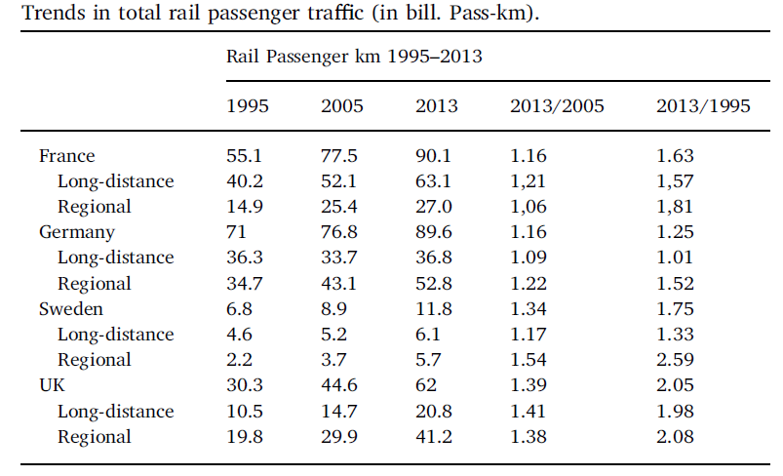
Traffic

Slide 14
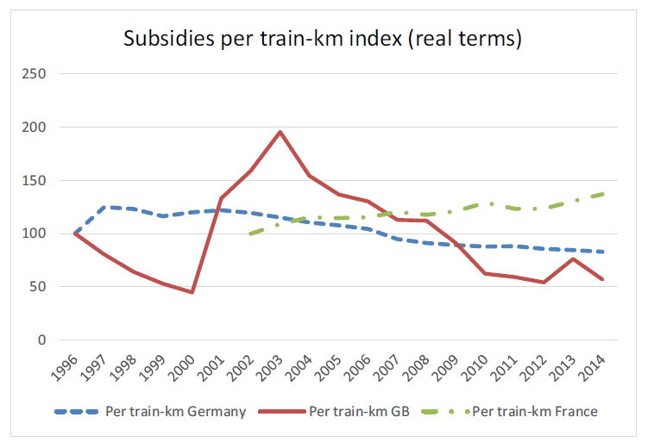
Subsidies

Slide 15
Empirical evidence
In all three countries – there has been rapid growth in demand for regional services, and subsidy per train km has generally fallen.
By contrast in France, with no competition, subsidies have risen substantially.
Whilst in Germany and Sweden costs have been reduced, in Britain train operating costs have actually risen, although this has been more than offset by increased revenue.
In Britain the winner of a tender takes over an existing company including its staff, wages and conditions. In Germany and Sweden, the winner is responsible for assembling its own staff.
For France the issue of how to handle existing staff is the biggest challenge

Slide 16
Conclusions
The evidence is that introducing competition (for the market) to date has been a success.
Tendering has contributed to the provision of improved services carrying more traffic, particularly in the regional market
At the same time, in Germany and Sweden tendering has led to stabilising or declining support per train km.
Even in Britain, a substantial increase in cost per train km has been offset by a rise in revenue, due both to increases in traffic per train km and in fares, leading to reducing support.
All this is in marked contrast to the experience of France, where under a state monopoly support per train km has increased by 60%.

Slide 17
Update: France
France introduced competition on the busiest line HSR line Paris – Lyon in 2020
Against the incumbent SNCF, the Trenitalia started to operate its services
The impact of increased competition has been 15% increase in frequency and 23% decline in prices (Source: Laroche 2022: Goodbye monopoly)

Slide 18
Greater role for open access?
In Britain, open access has been limited by a ‘not primarily abstractive’ test; only open access operations where revenue new to the rail industry is at least 30% of that abstracted from existing operators are permitted.
Germany has had very little new entry in practice, perhaps because of the relatively high track access charges and strong competition from DB, air and now intercity bus.
Open access has only applied in Sweden for a short period of time, but already there is intense competition on one key intercity route, between Stockholm and Goteborg.
For more experience of on-track competition, we have to look outside our case study countries, to Italy, Austria and the Czech Republic.

Slide 19
Open access rail services in Central Europe

Slide 20
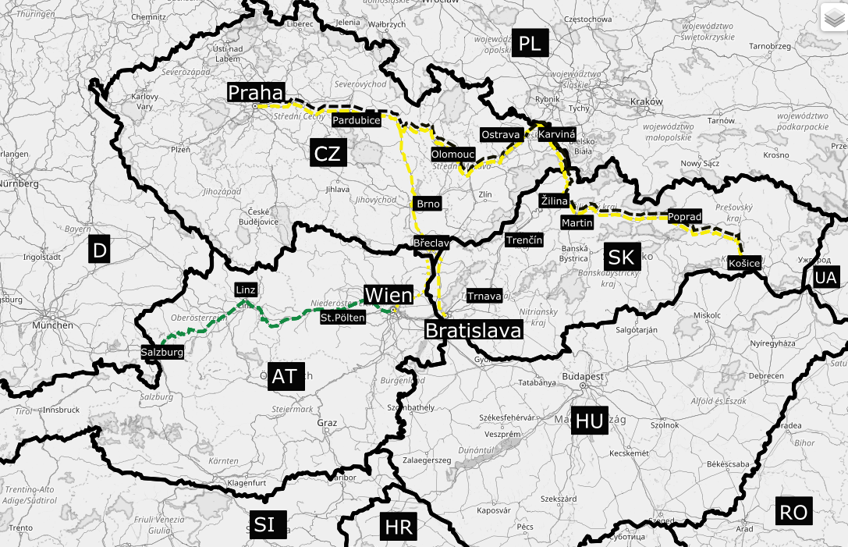
Competition on the rail market in Central Europe

Slide 21
Fares
The entries of new private operators were distinguished by the introduction of lower ticket prices.
This triggered competitive responses from the incumbents and usually a subsequent reaction by the new entrants.
This hot price war stabilized after some time, however, with prices down about 25–50% as compared to the situation before the entry of private operators.
The pressure of competition has decreased fares on competitive lines well below national averages.

Slide 22
Market shares
The share of new operator's services on the total departures in 2018 was 45% on Vienna-Salzburg, 47% on Prague-Ostrava, 26% on Prague-Brno and 21% on Žilina - Košice.
The number of connections rose between 2010 and 2018 on Vienna-Salzburg from 37 to 64, on Prague-Ostrava, from 23 to 36, on Prague-Brno from 26 to 34 and on Žilina-Košice from 20 to 24

Slide 23
Market effects
 | ∆ Prices | ∆ Ridership | ∆ Revenues | ∆ Frequency (proxy for ∆ Costs)
Austria 2010–2016 Vienna–Salzburg | −(20..25)% | +(20..25)% | -10%..0% | +35%
Czech Rep. 2010–2016 Prague–Ostrava | −42% | +97% | +14% | +65%
Tomeš, Z., & Jandová, M. (2018). Open access passenger rail services in Central Europe. Research in Transportation Economics, 72, 74-81.

Slide 24
Conclusions
Demand → undoubtedly positive impact of open access services (innovations, marketing, frequency, quality, prices, ridership)
Supply → questionable/negative impact of open access services (rising unit costs, stagnating revenues, financial losses, cherry-picking, long term sustainability)
Regulation → significant challenges (vertical structure, infra capacity, priority rights, operators' disputes, predatory pricing, anticompetitive behaviour)
Tomeš, Z., & Jandová, M. (2018). Open access passenger rail services in Central Europe. Research in Transportation Economics, 72, 74-81.

Slide 25
Open access on Prague - Ostrava
Before September 2011 → high density of traffic, low intermodal competition, two brands of ČD services – SC (Pendolino), IC (standard), high fares, subsidies, no competition
September 2011 → withdrawal of public subsidies; the open access entrance of the first private competitor RegioJet
January 2013 → the entrance of the second private competitor Leo Express
2011 - 2023 → intensive price and non-price competition of the operators

Slide 26
Czech railway passenger market
 | 2000 | 2005 | 2010 | 2015 | 2018
Passenger- Kilometers (billions) | 7.3 | 6.7 | 6.6 | 8.1 | 10.2
Modal Share of Railways (%) | 8.4 | 7.3 | 7.5 | 8.6 | 9.6
Private Operator’s Market Share (%) | 0.0 | 0.0 | 0.2 | 5.0 | 12.5
Source: Eurostat

Slide 27
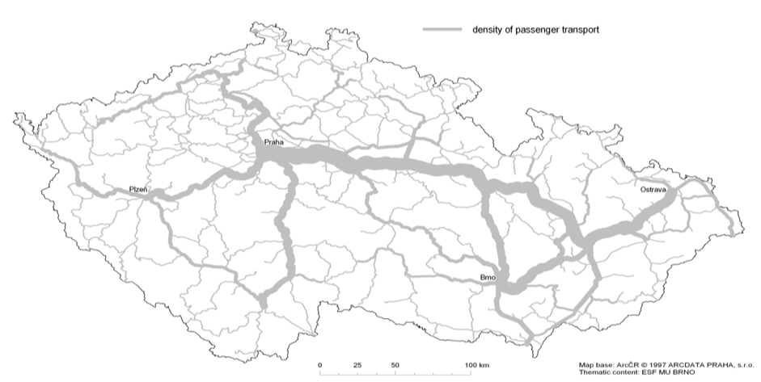

Geography
Prague
Plzeň
Pardubice
Ostrava
Olomouc
Brno
* densiiy of rail passenger flows; year 2009
Source: ČD

Slide 28
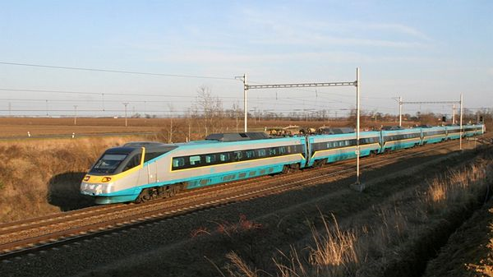
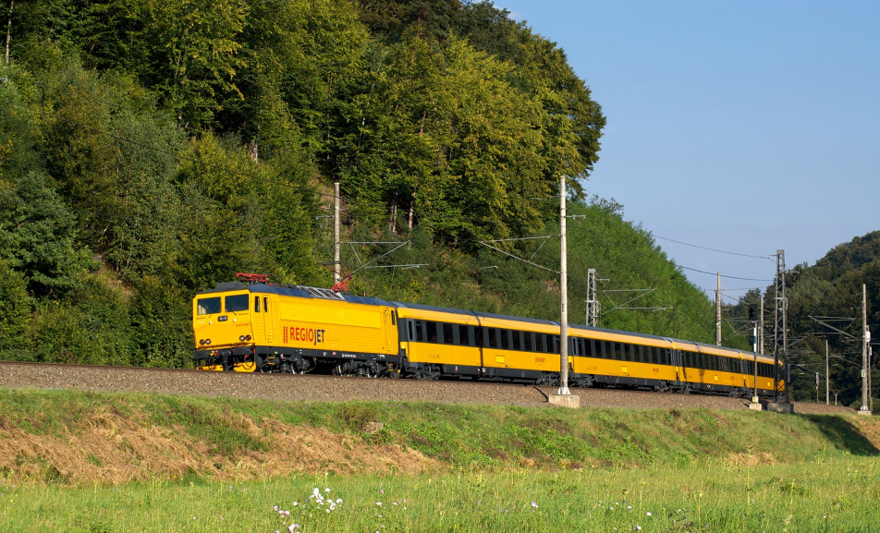
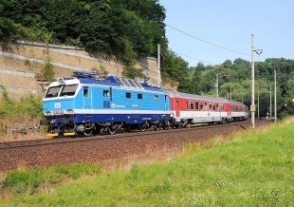
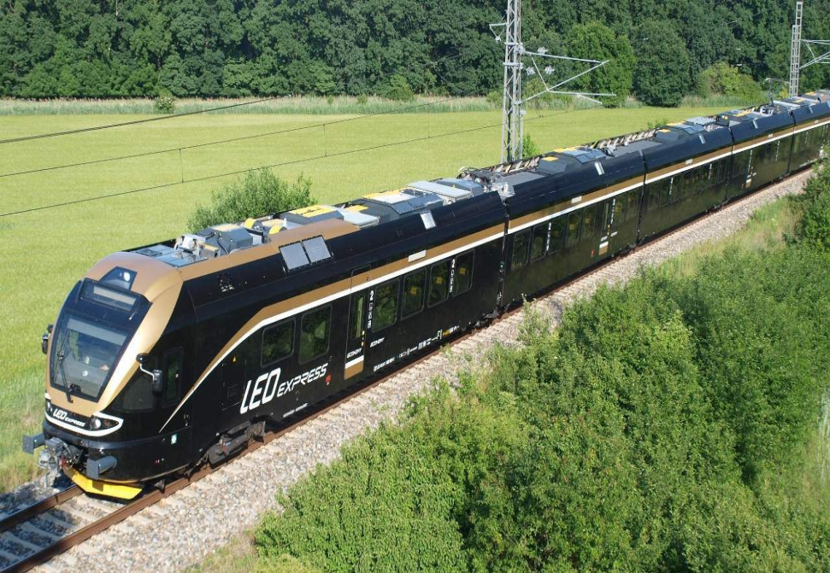
Service differentiation

Slide 29
Passengers
 | ČD SC | ČD IC | Regiojet | LeoEx | TOTAL
2010 | 1,3 | 2,3 |  |  | 3,6
2011 | 1,3 | 2,3 | 0,1 |  | 3,7
2012 | 1,1 | 2,1 | 1,1 |  | 4,3
2013 | 1,0 | 1,8 | 1,5 | 0,7 | 5,0
2014 | 1,2 | 1,5 | 2,4 | 0,9 | 6,0
2015 | 1,3 | 1,5 | 3,0 | 1,1 | 6,9
2016 | 1,3 | 1,6 | 3,1 | 1,1 | 7,1
2017 | 1,4 | 1,7 | 3,3 | 1,1 | 7,5
* millions; own estimation

Slide 30
Assessment of the Czech case
+ better quality of services
+ higher frequency of trains
+ lower prices for customers
strains on infrastructure capacity
- regulatory challenges
Tomeš, Z., Kvizda, M., Jandová, M., & Rederer, V. (2016). Open access passenger rail competition in the Czech Republic. Transport policy, 47, 203-211.

Slide 31
Open Access Passenger Rail Competition: the case of Italy
Angela Stefania Bergantino
University of Bari, Italy
Round Table On Open Access Passenger Rail Competition 2016
Masarykova Univerzita, Brno
11th November 2016

Slide 32
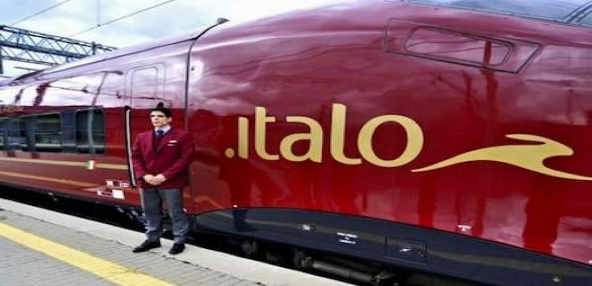
A brief history of HSR in Italy: the entry of NTV
Italy is the first country in Europe to open its HSR network to «on track competition»;
Nuovo Trasporto Viaggiatori (NTV), first private operator:
  established in December 2006, by a number of Italian private entrepreneurs (Montezemolo, Della Valle, Punzo and Sciarrone);
  The French national incumbent (SNCF) acquired NTV shares as a “technical partner”, without any involvement in the management (initially 20%; now 1.4% due to an increase in capital);
  It entered the market in regime of “Open Access” in December 2012;
  The high-speed train of NTV is called “Italo”

Slide 33
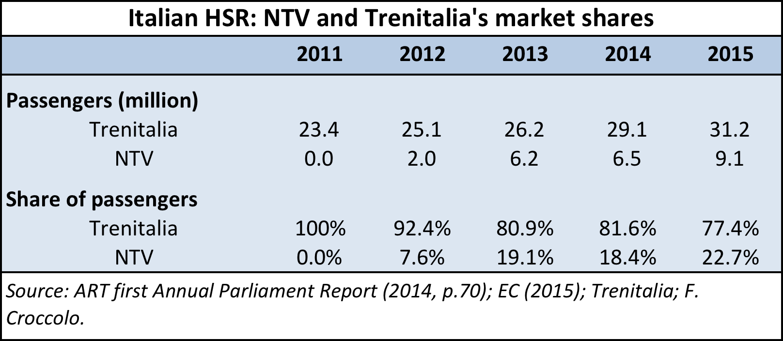
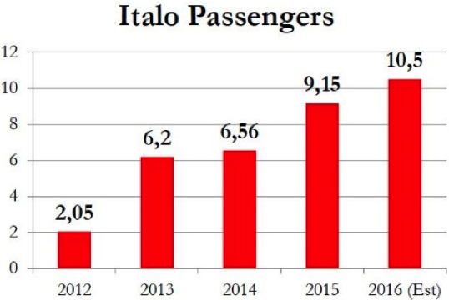
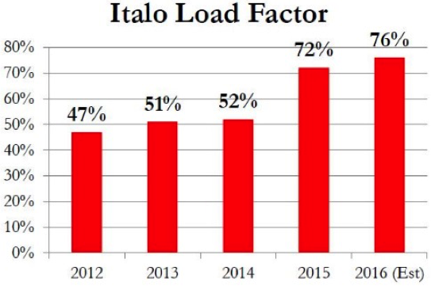
The effect of Open Access: Demand
Expo effect: in 2015 Italo’s pax increased by 2.6 million (+39.5% of growth rate) and Trenitalia by 2.1 million (7,2%) mainly on the routes directed to Milan. Ryanair left the market!
NTV continues to grow
2016
2016

Slide 34
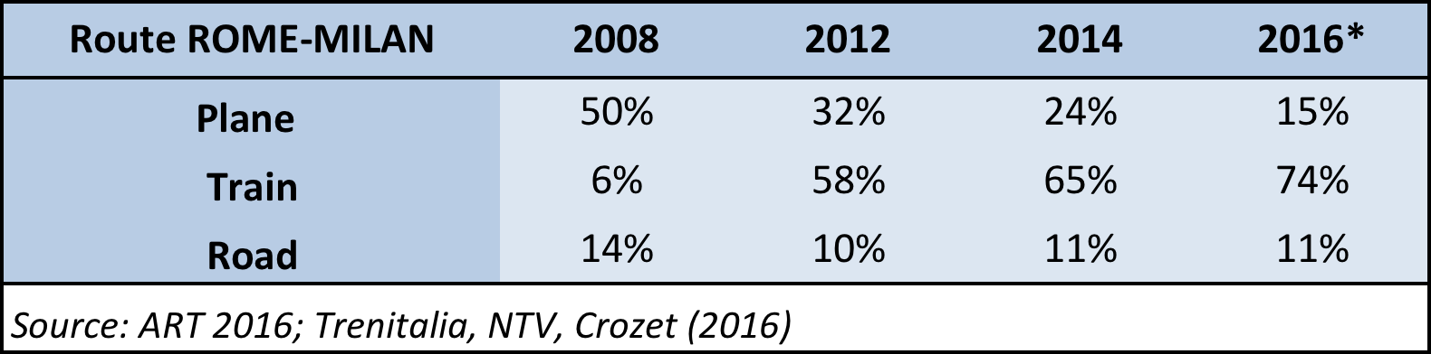
The effect of Open Access: Demand
From air to HSR. Substantial modal shift.
  In 2015, Ryanair, operating on Rome-Milan Orio al Serio moved out of the market.

Slide 35
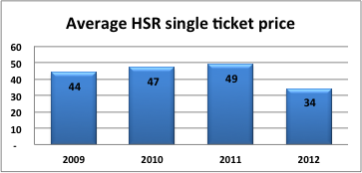
The effect of Open Access: Prices
  Competition pressured prices down…
    effect of price discrimination strategies (promotional fares and new price structures), PRE ENTRY:
      On the Milan-Rome (MI-RM) route, one-way fares reduced an average of 31% between 2011 and 2012 (the year of entry into operation of NTV; Cascetta and Coppola, 2014; p. 184)
Strategic behaviour: -31%

Slide 36
The effect of Open Access: Supply
  The main routes experienced a change in the structure of supply:
    The number of HS connections grew by 26.7% over the period 2009-2013 (from 30 daily connections in 2009 to 38 in 2013) and by 53% over the period 2009 to 2016 (with a total of 45 daily connections);
    Instead, the number of conventional rail services fall by 22% (from 9 daily connections in 2009 to 7 in 2013) by 44% to only 4 in 2016 → substitution effect (create demand for HS)!.
  It seems that Trenitalia implemented an entry-deterrence strategy by increasing its supply (as Alitalia did for the airline industry), with the purpose to pre-empt the rival about the allocation of slots.
Notes:
Aggiornato – ok tradurre

Slide 37
Competition or Privatization?
Tomeš, Z. (2017). Do European reforms increase modal shares of railways?. Transport Policy, 60, 143-151.

Slide 38
Motivation
50% of road freight over 300 km should shift to rail and water and the majority of medium distance passenger transport should go by rail by 2050 (EC, 2011)
These goals underpinned by reform initiatives (vertical separation and especially competition entry)
However, there are many factors causing long term structural decline of railways (DiPietrantonio – Pelkmans, 2004) and net benefits of vertical separation are questioned by some scholars (Pittman 2003, van de Velde et al. 2012)
Do European reforms actually increase modal share of railways? Or could be privatization more effective?

Slide 39
Railway reforms in the EU
Vertical separation = a complete institutional separation of the infrastructure manager and the incumbent operator
Competition entry = actual entry of the non-incumbent operators on the freight and passenger rail market
Horizontal separation = institutional separation between passenger and freight operations of the incumbent
Freight privatization = privatization of freight operator

Slide 40
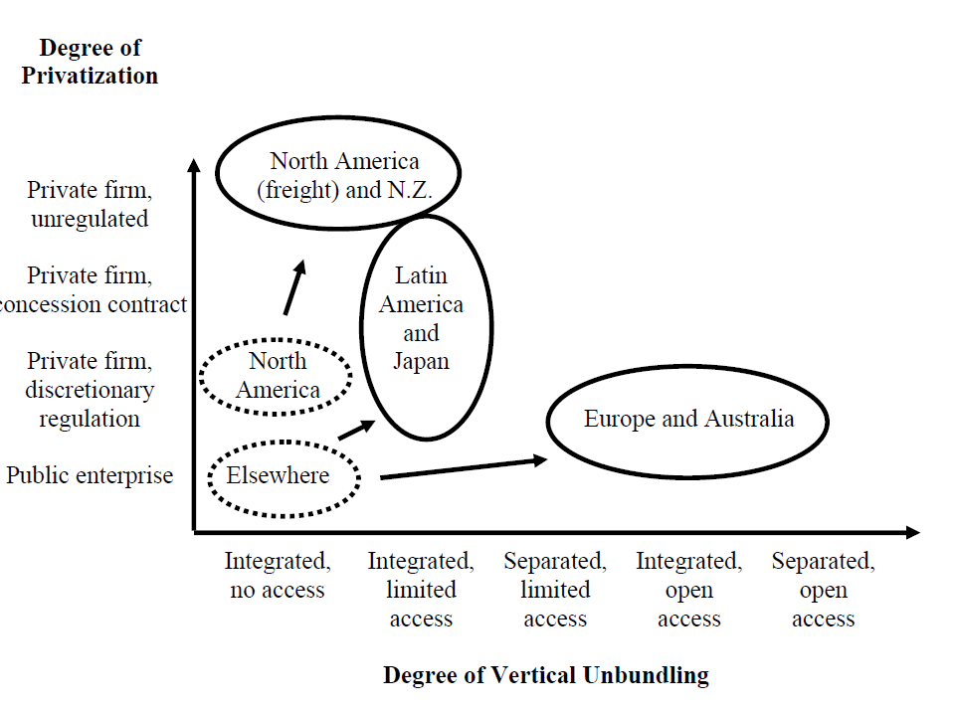
Reform options
(Gómez-Ibánez, 2006)

Slide 41
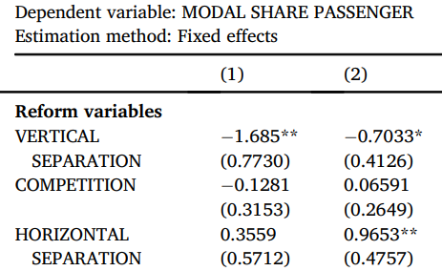
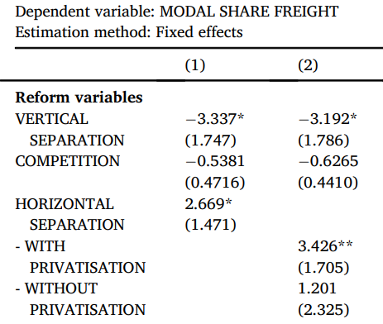
Results

Slide 42
Conclusion
There is no evidence that principal European reforms (vertical separation and competition entry) are increasing modal shares of European railways.
The more promising reform strategy seems to be horizontal separation, especially when followed by freight privatization.
There are significant differences in the long term development of railway’s modal shares between Western and Eastern Europe.

Slide 43
COMPETITION OR PRIVATIZATION?
Canadian freight railways

Slide 44
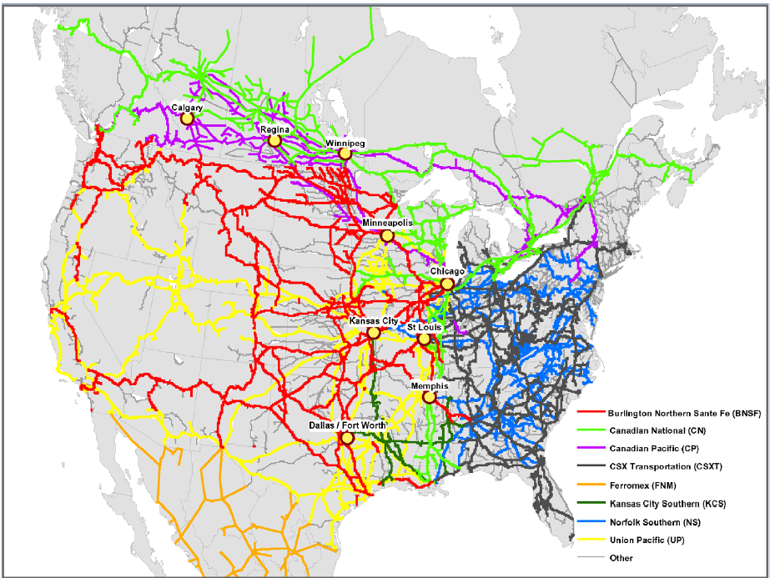
North American rail freight market
Source: Rodrigue (2008)

Slide 45
Canada rail sector
In the 20th century two big transcontinental railroads:
Canadian National (CN) – public
Canadian Pacific (CP) - private

Slide 46
Canada (1980): Public ownership does or does not matter?
The efficiency of public and private firms is usually compared in industries which have heavy regulation and limited competition.
In this paper we present a case study in which the effects of property rights can be isolated from the effects of regulation on noncompetitive markets.
We compare the postwar (1956–1975) productivity performance of the Canadian National (public) and Canadian Pacific Railroads (private).
Caves, D. W. – Christensen, L. R. (1980): The Relative Efficiency of Public and Private Firms in a Competitive Enviroment: The Case of Canadian Railroads. Journal of Political Economy

Slide 47
Estimates
Table: Average annual growth rate of productivity of CN and CP
 | CN | CP | CN relative to CP
1956-63 | 1.9 | 1.7 | 0.2
1963-74 | 4.4 | 3.3 | 1.1
1956-75 | 3.1 | 2.5 | 0.7

Slide 48
Conclusion (1980)
Contrary to the predictions of the property rights literature, we find no evidence of inferior performance by the government-owned railroad.
We conclude that any tendency toward inefficiency resulting from public ownership has been overcome by the benefits of competition.

Slide 49
Privatization of CN
In 1995 was Canadian National privatized after careful three years preparation
Can we infer any interesting information out of this privatization?
Hypothesis: If Caves and Christensen were right than we can expect no change in performance of CN due to privatization

Slide 50
Evaluation of CN privatization (2013)
This article describes and analyses the privatization of Canadian National Railway (CN), a large railroad privatization.
It uses data from 1990 to 2011 to compare CN's post-privatization operating performance with its pre-privatization performance.
Boardman, A. E., Laurin, C., Moore, M. A., & Vining, A. R. (2013). Efficiency, profitability and welfare gains from the Canadian National Railway privatization. Research in Transportation Business & Management, 6, 19-30.

Slide 51
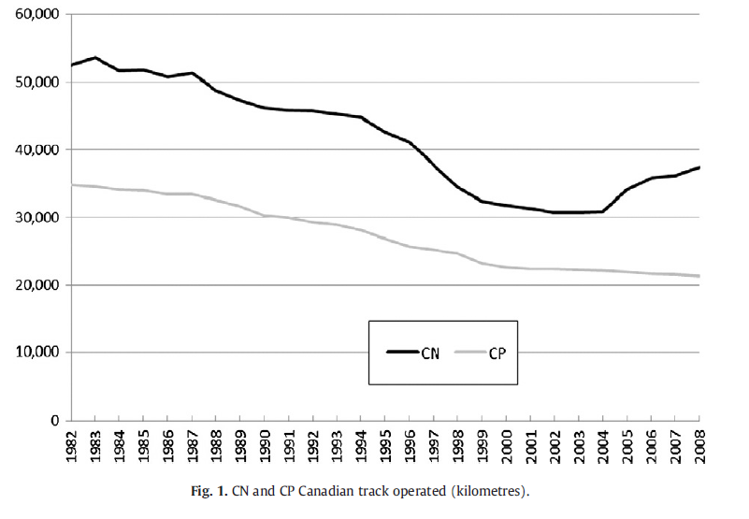
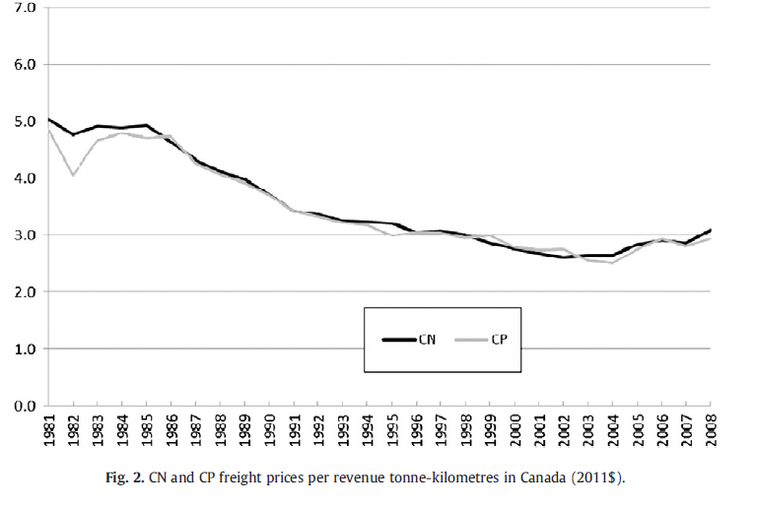
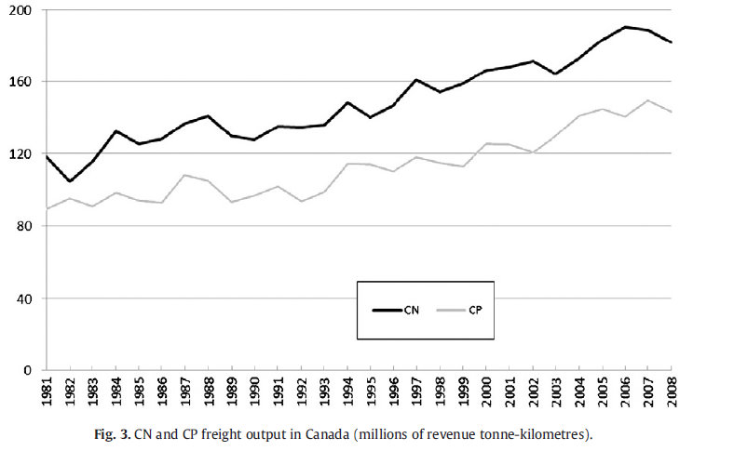
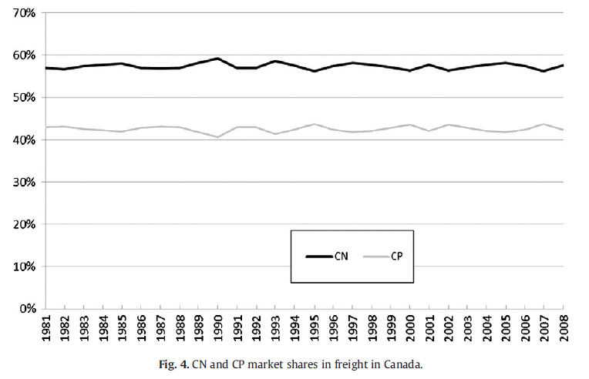
Infrastructure, prices, output and market

Slide 52
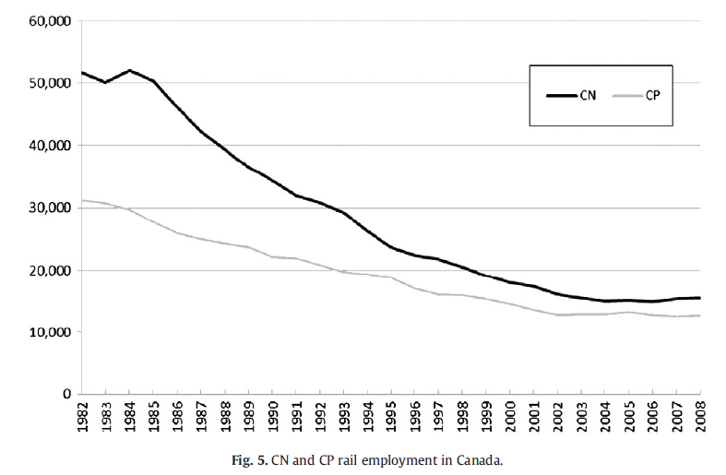
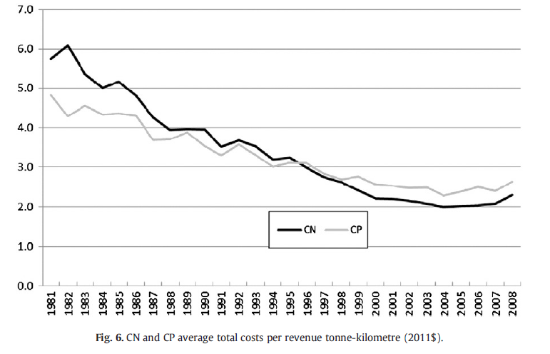
Employment and costs
Boardman, A. E., Laurin, C., Moore, M. A., & Vining, A. R. (2013). Efficiency, profitability and welfare gains from the Canadian National Railway privatization. Research in Transportation Business & Management, 6, 19-30.

Slide 53
Ownership does matter?
The results demonstrate that CN performed substantially better following privatization,
We find statistically significant increases over the long term (16 years following privatization) in sales, capital investment, assets, profit, profitability, productivity, dividends and corporate taxes paid.
There was little change in the capital structure of CN and a significant decrease in employment.
Using Canadian Pacific Railway as a basis for the counterfactual, we estimate that CN's privatization generated social welfare gains of approximately $25 billion in 2011 Canadian dollars.
The Canadian government received almost half of these gains, while CN's shareholders (most of whom were non-Canadian) captured the rest.

Slide 54
Summary
Caves - Christensen (1980): found no evidence of inferior performance by the government-owned railroad CN. They conclude that any tendency toward inefficiency resulting from public ownership has been overcome by the benefits of competition.
Boardmann et al. (2013): The overall results demonstrate that CN performed substantially better following privatization, both from an operational perspective and from a broader social welfare perspective.

