Slide 1
Consultancy project:
Customer Needs Analysis
By Jakub Čech & Andrej Šišolák
Notes:
Note: Please after inserting your picture, “Right Click” on the picture and “Send it to Back” to get the “Gradient” effect.

Slide 2
Our Agenda
Consultancy Project | Market Analysis
5 min
01
Definition & Objectives
20 min
02
B2C Needs & Analysis
20 min
03
B2B Needs & Analysis
20 min
04
Competitors Analysis

Slide 3
Customer Needs Analysis
Definition & Objectives
By Jakub Čech & Andrej Šišolák
Notes:
Note: Please after inserting your picture, “Right Click” on the picture and “Send it to Back” to get the “Gradient” effect.

Slide 4
Market Analysis Objectives
Consultancy Project | Market Potential Analysis | Definition & Objectives
Quantitative Analysis
Qualitative Analysis
Profit Levels
Own Qualities
Relevant Potential
Customer Needs
Growth Trends
Competitors Qualities

Slide 5
Terms Definition
Consultancy Project | Market Potential Analysis
Customer Need
are the psychological and physical motivations that make someone want to purchase a product of service and stay loyal to that business
Type of the business
Customer needs are significantly different in Business to Consumer and Business to Business types of entrepreneurship.
Notes:
Note: Please after inserting your picture, “Right Click” on the picture and “Send it to Back” to get the “Gradient” effect.

Slide 6
Customer Needs Analysis
B2C Needs and analysis
By Jakub Čech & Andrej Šišolák
Notes:
Note: Please after inserting your picture, “Right Click” on the picture and “Send it to Back” to get the “Gradient” effect.

Slide 7
Market Analysis Objectives
Consultancy Project | Market Potential Analysis | B2C needs and analysis
Maslow´s hierarchy of needs
Fullfilment of personal potential. Perfection, mastery, independence
Self actualization
Esteem through recognition or achievement. Success, reputation and respect of others
Esteem
Affiliation with others. Friendship, deeper relationships, love, intimacy
Love and belonging
Security through order, law and stability. Health, job, property, family
Safety needs
Basic necessities of life. Food, water, air, sleep, warmth, reproduction
Physiological needs

Slide 8
Customer Needs Analysis
Consultancy Project | Market Potential Analysis | B2C needs and analysis
The most typical product needs
Functionality
Price
Convenience.
Experience
From
A to Z
Design
Reliability
Performance
Efficiency

Slide 9
Customer Needs Analysis
Consultancy Project | Market Potential Analysis | B2C needs and analysis
The most typical service needs
Empathy
Fairness
Transparency.
Control
From
A to Z
Options
Information
Accessibility

Slide 10
Needs Analysis
Consultancy Project | Market Potential Analysis | B2C needs and analysis
Data analysis
Analyzing all available data and informations based on previous experineces or public researches. The easiest way how to get a results but is the least accurate to the topic.
Questionnare
On-line or live interaction with existing or potential customers. Set of quesions, where you get the clear answer on topics you want to know. Bigger quantity, less details.
Focus groups
Most detailed method of questioning the customers. Small group of people answering the questions within one longer meeting. Goes very deep in details. You can combine with questionnare which is than used as a confirmation the results with bigger group.
Notes:
Note: Please after inserting your picture, “Right Click” on the picture and “Send it to Back” to get the “Gradient” effect.

Slide 11
Customer Needs Analysis
B2B Needs and analysis
By Jakub Čech & Andrej Šišolák
Notes:
Note: Please after inserting your picture, “Right Click” on the picture and “Send it to Back” to get the “Gradient” effect.

Slide 12
Customer Needs Analysis
Consultancy Project | Market Potential Analysis | B2B needs and analysis
Hard facts
Business customers basically follows three main needs. Profitability, quality and time
Soft needs
Happines, desire for success, wish to be different. In many cases here are the needs which customers don´t show for the first sight. Ego, power, influence, personal benefits.
Legal topics
Everything what companies do must be alligned to the law. This can be anything mandatory for the particular area of business

Slide 13
Needs Analysis
Consultancy Project | Market Potential Analysis | B2C needs and analysis
Data analysis
Analyzing all available data and informations based on previous experineces or public researches. The easiest way how to get a results but is the least accurate to the topic.
Questionnare
On-line or live interaction with existing or potential customers. Set of quesions, where you get the clear answer on topics you want to know. Bigger quantity, less details.
Focus groups
Most detailed method of questioning the customers. Small group of people answering the questions within one longer meeting. Goes very deep in details. You can combine with questionnare which is than used as a confirmation the results with bigger group.
Notes:
Note: Please after inserting your picture, “Right Click” on the picture and “Send it to Back” to get the “Gradient” effect.

Slide 14
Customer Needs Analysis
Understanding of the needs
By Jakub Čech & Andrej Šišolák
Notes:
Note: Please after inserting your picture, “Right Click” on the picture and “Send it to Back” to get the “Gradient” effect.

Slide 15
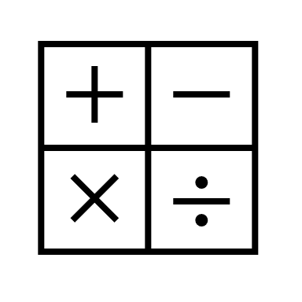
Customer Needs Analysis
Consultancy Project | Market Analysis | Understanding of the needs
01
02
03
04
Need
Core values
Features
Parametres
Specific requirements of the customers which motivate them for purchase
Everything what customer see as a direct impact or significant influence of the need fulfillment
Properties of the product or service, which has an impact how customers perceive the value of the product
Translation of the features to the measurable characteristics of the product or service

Slide 16
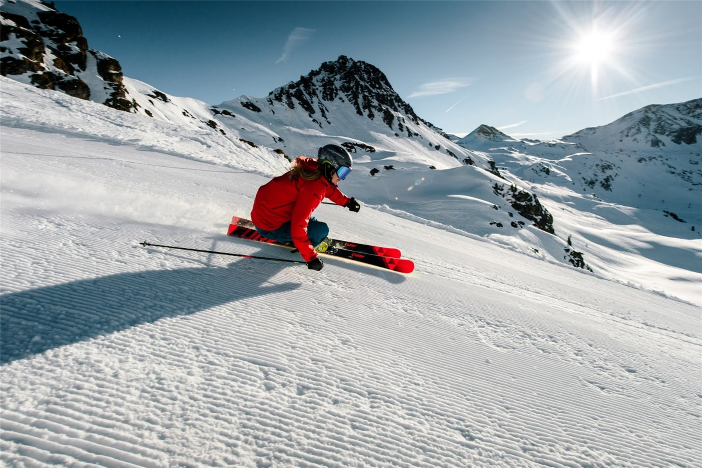
Customer Needs Analysis
Consultancy Project | Market Analysis | Understanding of the needs
Example
Need
A new ski, which allows me enjoyable and quality skiing on the perfectly prepared slopes of Austria.
Values
Durable ski, which will last min. 10 seasons, quality made with a nice and modern design to show. Secure binding to avoid the injury. Respecting the level of skier and surface I want to ski on.
Features
Type of used materials with long warranty, made for specific ski style, easy to drive on direct paths, allow hard carving, tested binding for different people, last year model latest
Parametres
Flexibility of the ski based on the used materials, lenght and radius, model year, distance in the narrowest part below the binding, color, binding test results

Slide 17
Customer Needs Analysis
Sika CZ – case study
By Jakub Čech & Andrej Šišolák
Notes:
Note: Please after inserting your picture, “Right Click” on the picture and “Send it to Back” to get the “Gradient” effect.

Slide 18
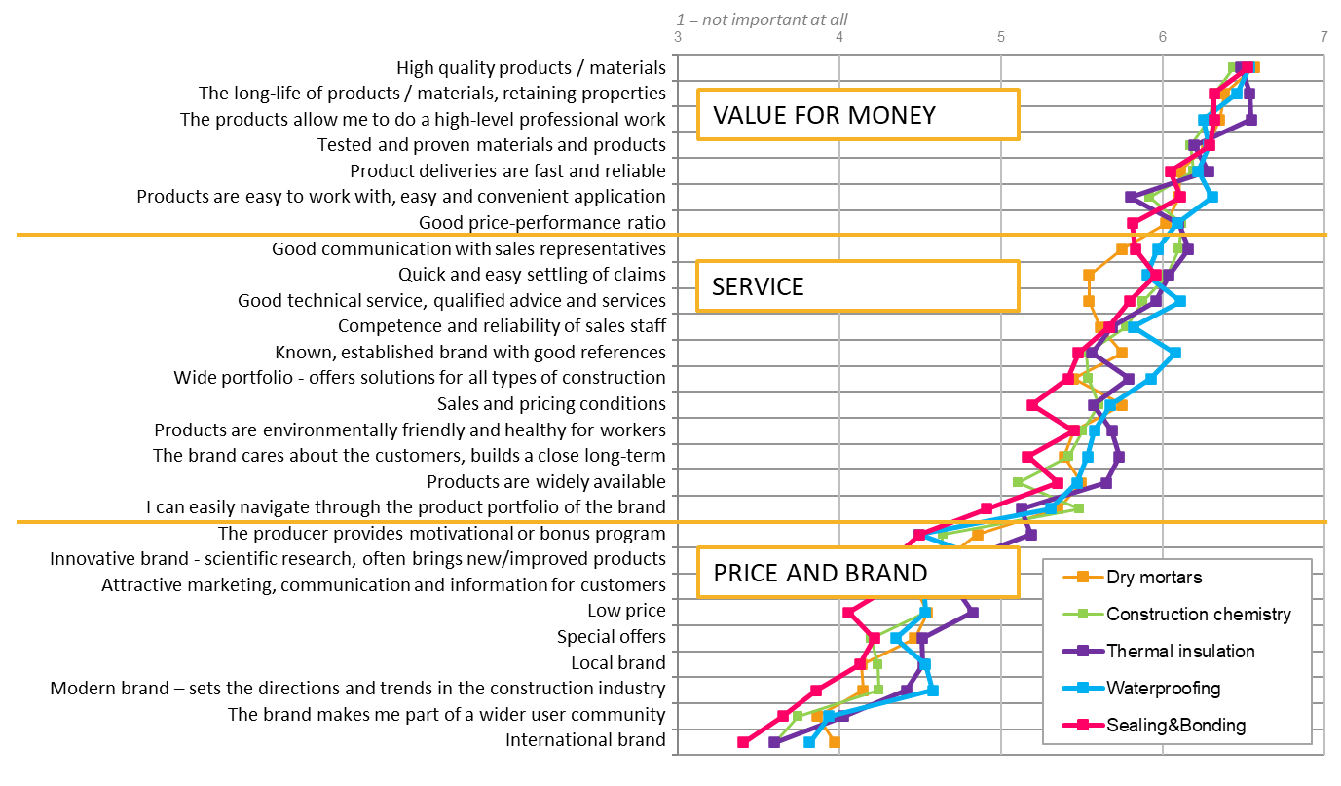
Customer Needs Case Study Sika CZ
Consultancy Project | Market Analysis | B2B Analysis
Key criteria for selection of materials supplier:

Slide 19
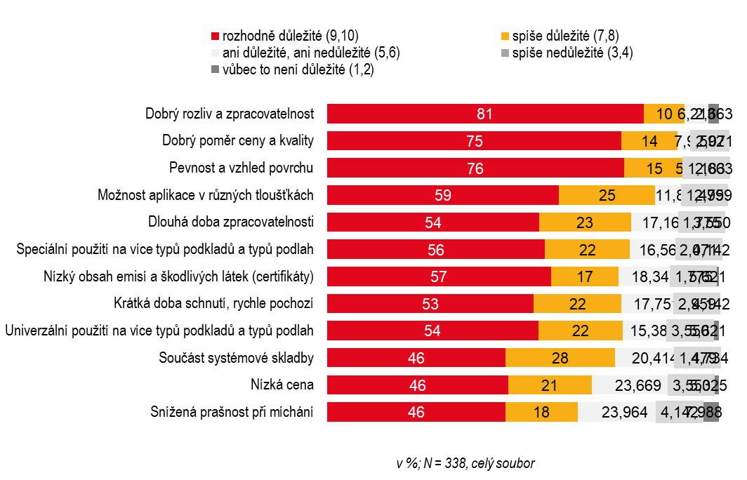
Customer Needs Case Study Sika CZ
Consultancy Project | Market Analysis | B2B Needs
Key parameters required from self-leveling compounds:

Slide 20
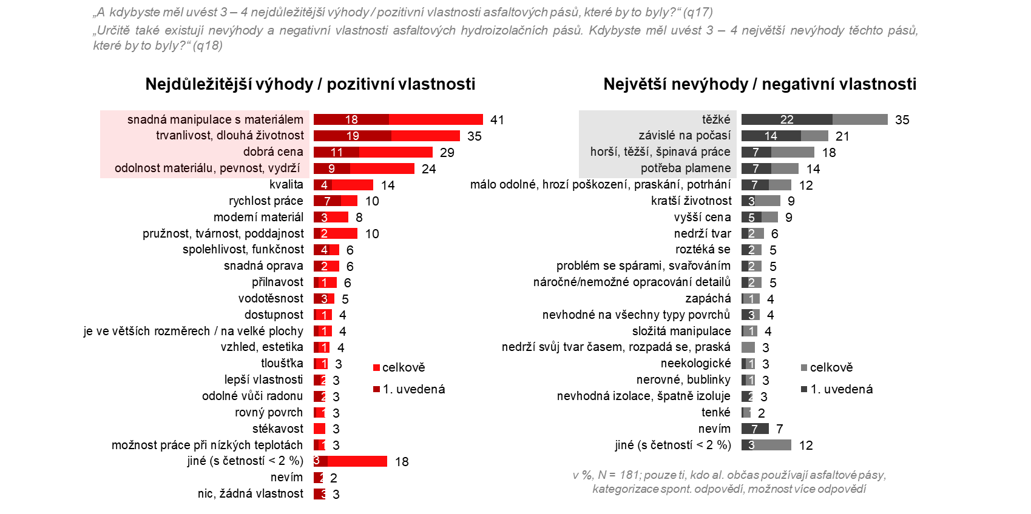
Customer Needs Case Study Sika CZ
Consultancy Project | Market Analysis | B2B Needs
Key parameters required from bituminous sheets:

Slide 21
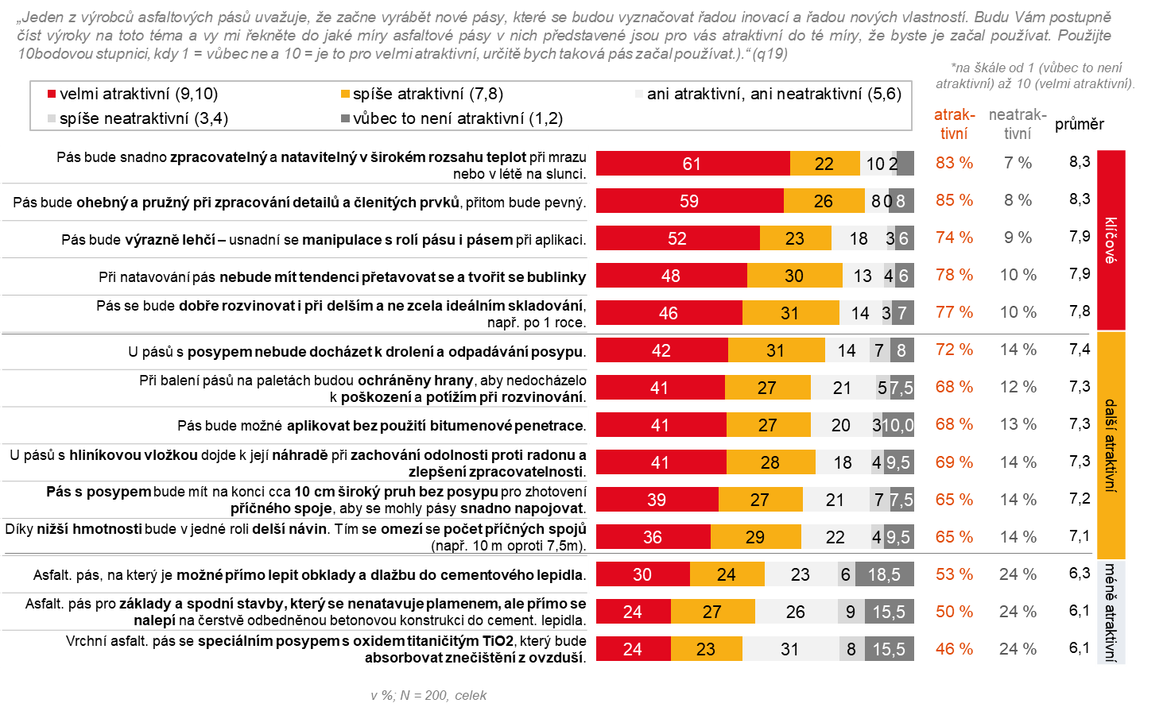
Customer Needs Case Study Sika CZ
Consultancy Project | Market Analysis | B2B Needs
Key parameters required from bituminous sheets:

Slide 22
Customer Needs Analysis
Competitors Analysis
By Jakub Čech & Andrej Šišolák
Notes:
Note: Please after inserting your picture, “Right Click” on the picture and “Send it to Back” to get the “Gradient” effect.

Slide 23
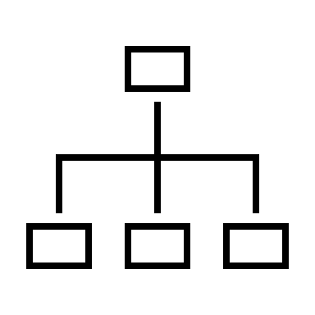
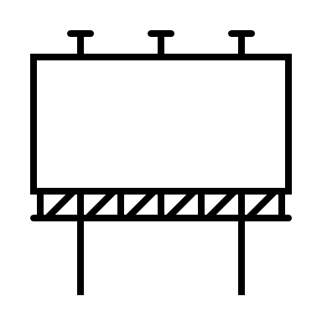
Market Potential Sika CZ Case Study
Consultancy Project | Market Analysis | Competitive Environment
People
Market approach
Organization of the competitors (sales representatives, KAM, KPM, sales support etc.)
Distribution chain (sales agents, distributors, own e-shop etc.), Logistics to the customers
Product
Additional Services
Product characteristics, main arguments used by the competitor, quality, added value
All relevant additional services (technical support, sales support, claim management etc.
Marketing
Production
QUALITATIVE ANALYSIS
Marketing investments, comunication to the customer (advertising, on-line activities, point of sales advertisement etc.)
Does the competitors own the production plants? How many and where? What benefits they gain out of that?

Slide 24
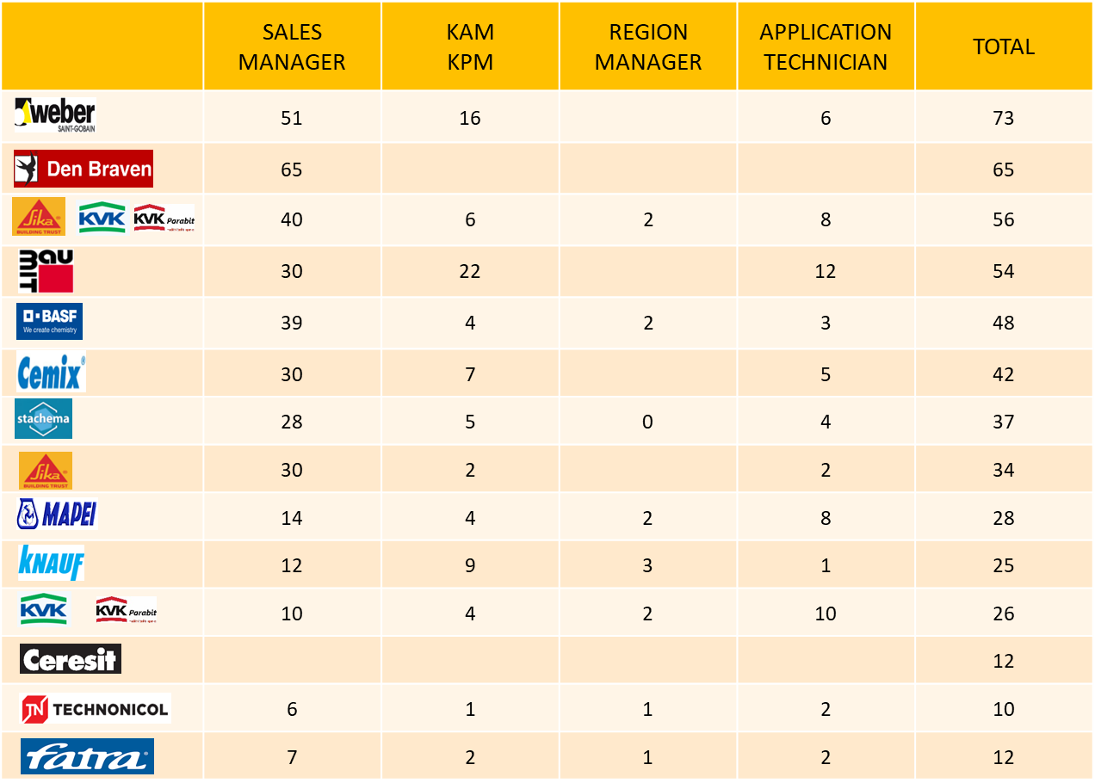
Market Potential Sika CZ Case Study
Consultancy Project | Market Analysis | Competitive Environment
People:

Slide 25
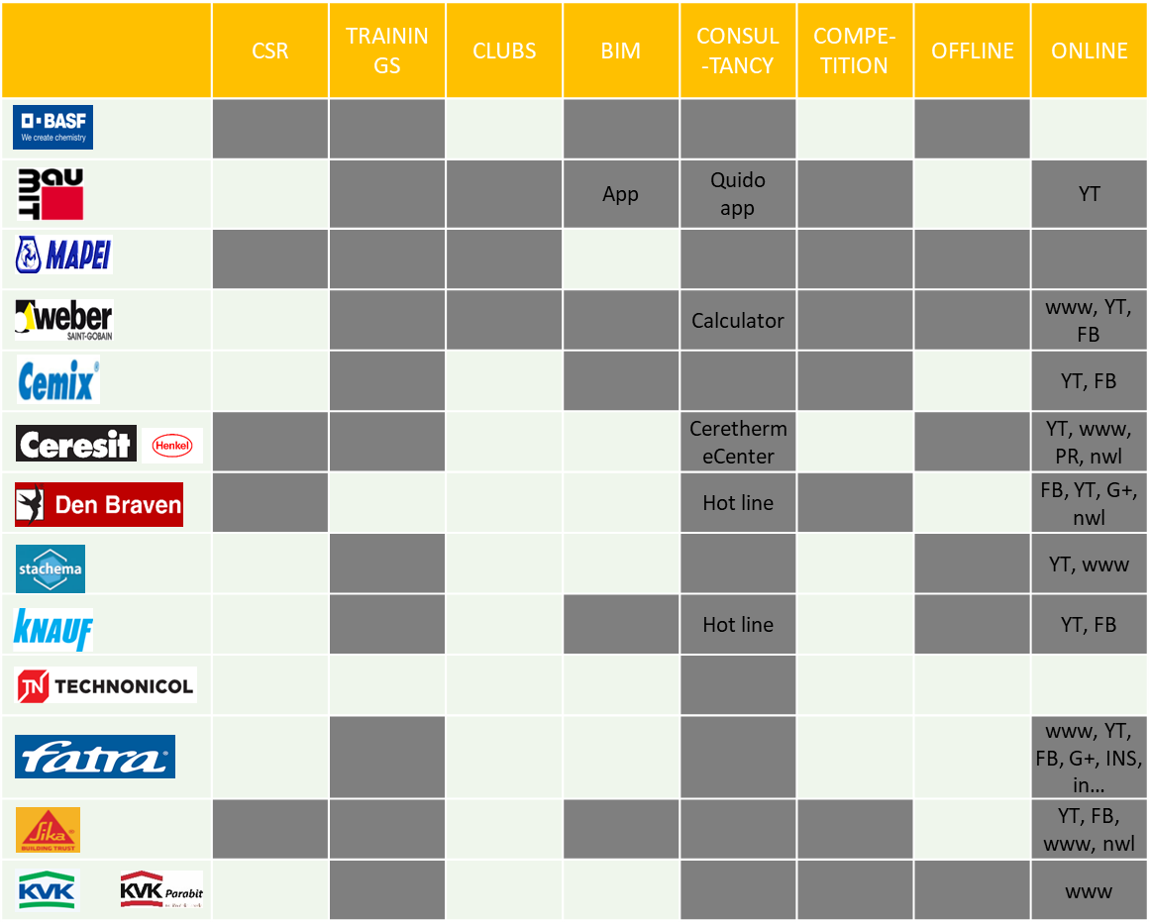
Market Potential Sika CZ Case Study
Consultancy Project | Market Analysis | Competitive Environment
Comunication | Services:

Slide 26
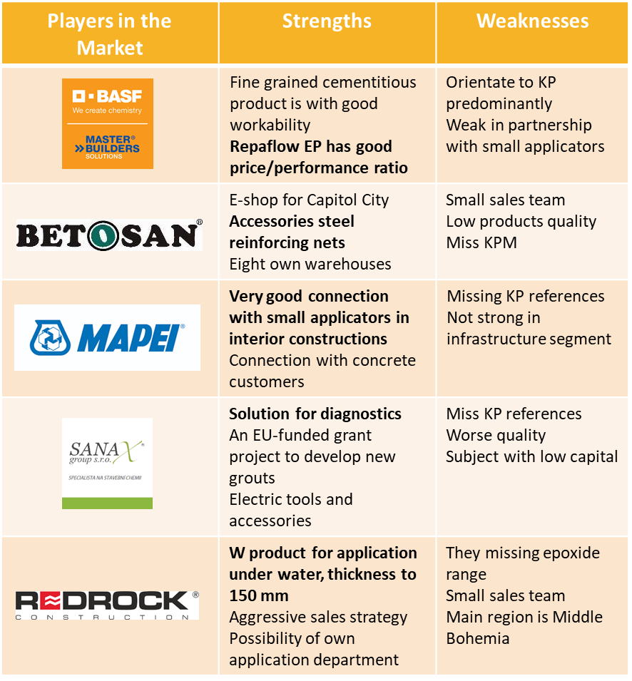
Market Potential Sika CZ Case Study
Consultancy Project | Market Analysis | Competitive Environment
Strengths & Weaknesses:

Slide 27
Consultancy project
The task for Seminars
By Jakub Čech & Andrej Šišolák
Notes:
Note: Please after inserting your picture, “Right Click” on the picture and “Send it to Back” to get the “Gradient” effect.

Slide 28
Seminar Task Assignment
Consultancy Project | Task for the seminar 2|
Vertical analysis
Top - Down
Vertical analysis
Bottom - Up
Horizontal analysis
Based on the data you gain from the databases, prepare and present completed analysis and the calculated potential for your products / services
Be ready to present completed analysis of customers and their potential for your products / services. We will work together on the qualitative part (customer needs, influencers etc.)
Prepare and present the completed analysis of competitive environment. Show us again the calcuted potential based on this part of analysis. We will work together on the qualitative part

Slide 29
Expected Outcome
Consultancy Project | Expected outcome
Format
Any of your favourite presentable format which can be presented during the seminar to the others
Number of slides
We don´t calculate the number of slides, important is to have all required informations
At the seminar
Every team will present, the rest of the teams and lecturer will than comment, ask and discuss.
Notes:
Note: Please after inserting your picture, “Right Click” on the picture and “Send it to Back” to get the “Gradient” effect.

Slide 30
Thank You
For Your Watching
Jakub & Andrej

