Slide 1
Little´s law simple application
Based on :https://www.process.st/littles-law/ - Ben Mulholland

Slide 2
Statements
Little's Law is a powerful tool in the arsenal of almost every project team. From napkin consumption calculations to system performance calculations over time, this law is one of the key building blocks for efficient business.
Verbalized : Number of customers in queue = customer arrival rate x average time spent in the queue
Formula: WIP=TH x CT

Slide 3
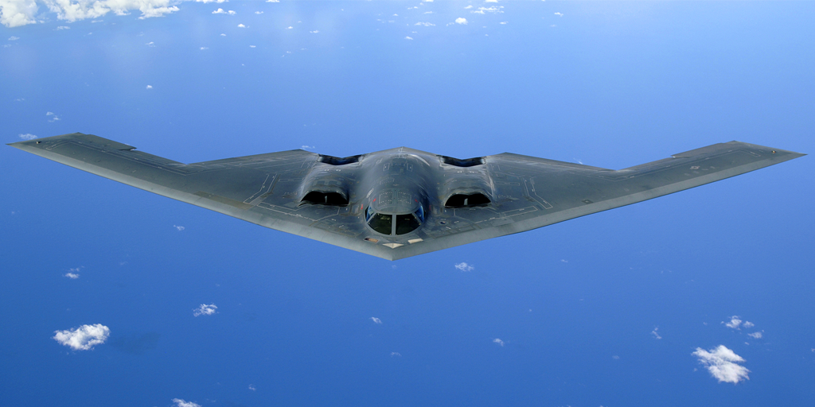
Queue and another statement related to B2 bombers
https://www.process.st/wp-content/uploads/2017/11/littles-law-queue-south-park.gif
B-2 stealth bombers cannot take off if they are in the US Air Force maintenance section due to poor queue (waiting lines) management

Slide 4

John Little
The law itself is named after John Little – an MIT professor who first mathematically proved the law in 1961. The law existed beforehand, but until Little there wasn’t a set mathematical definition of it or proof for its validity.
Little defined the law while doing operations research on traffic control signals, hence the basis of it as a way to analyze queueing systems (waiting lines).

Slide 5
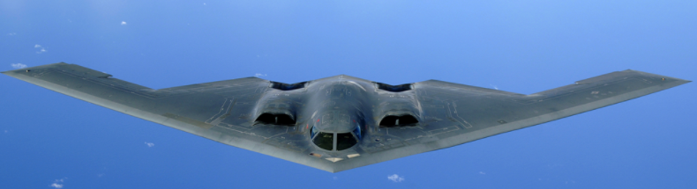
Maintenance of B2 bombers
B-2 bombers (stealth bombers) are a vital part of nuclear deterrence. While there aren’t many (20 to be exact), these need to be in prime condition and ready to use at a moment’s notice, but also log regular flight hours and be available to train pilots or run general tests.
Unfortunately, these complex aircraft have to undergo extensive maintenance after a set amount of flight hours (and, of course, after incurring damage) in order to maintain their stealth status. This maintenance could take anywhere from 18 to 45 days, and thus resulted in a delicate balancing act between use and maintenance.

Slide 6
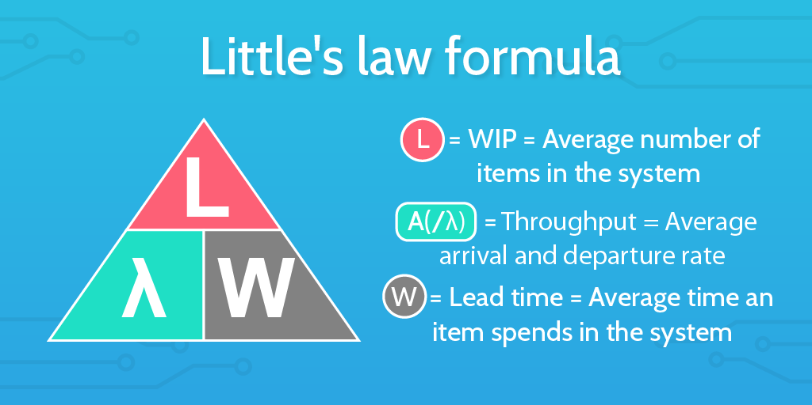
Little´s low – formula – different indication of formula variable but same meaning
WIP=TH x CT
L = WIP
A = TH
W = CT

Slide 7
Little’s law formula is incredibly simple:
L = A x W
In this formula, “L” stands for the number of items inside the queueing system (WIP) you’re examining. This is also known as “WIP”, as in, the items that are a “work in progress”, and can be pretty much any whole number.
“A” represents the arrival rate and departure rate of items in and out of the business system. This is also sometimes known as “throughput” or “the amount of an item passing into and/or out of a system”, and is sometimes represented as lambda, or “λ”.
The arrival rate is a little confusing at first, but the key to remember is that it will usually be a fraction. This is because you’re measuring the rate at which items enter/depart from the system, rather than the number of items or the time between new arrivals. As such, “A” is always expressed as a fraction showing “one item every X units of time”, or:
A = (1 item) / (unit of time) =throughput
For example, if a new item enters your queue every twenty minutes, your arrival rate is not 20, but instead 1/20.
WIP=TH x CT

Slide 8
Basic Little´s law formula in full English
Number of items in the system = (the rate items enter and leave the system) x (the average amount of time items spend in the system)

Slide 9
Little´s law application
It was obvious that the maintenance process needed to be improved and regulated, but the target time wasn’t clear enough to use to introduce process improvement just yet, and that’s where Little’s law came in.
The item they needed to calculate was the ideal lead time (the time spent in maintenance), and so the formula used was:
See next slide

Slide 10
W = L / A = > Cycle time=WIP/TH
Based on the flight schedule analysis, it was calculated that the three B-2 bombers will be maintained at that time. The rate at which the bombers entered maintenance was also calculated approximately every 7 days. So:
L = WIP – quantity of B2 bombers in maintenance = 3
A = TH=arrival/departure rate = 1 every 7 days = 1/7 days
W = CT=average time needed for maintenance of one aircraft = ?
W = L/A= 3/ (1/7) = 21 days

Slide 11
Conclusion
The target time for the maintenance of a B-2 bomber must therefore be 21 days in order to meet the requirements for the availability of aircraft to perform their scheduled (scheduled flights).
While the equation is simple, the scope of LZ utilization is considerable. LZ is one of the building blocks of the principles of lean manufacturing or production management with the help of kanban, especially showing the importance of WIP size managememt
http://www.vissinc.com/2012/09/07/littles-law-isnt-it-a-linear-relationship/

