Slide 1
Business Central Introduction
(ERP=Microsoft Dynamics 365 Business Central)
Budgets and Financial report basics
Ing.Jaromír Skorkovský,CSc.
Masaryk University Brno
Czech Republic

Slide 2
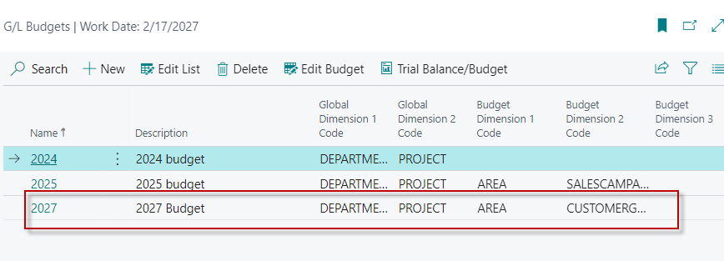
Introduction - supplement to file BC -19
Follow-up PWP with the data on 6715 (or other accounts such as group of accou 8110..8130) base on already specified budget fro year 2024 as well as the budget entries for this G/L account including the two values of the global dimensions SALES and ADM
See next slide

Slide 3
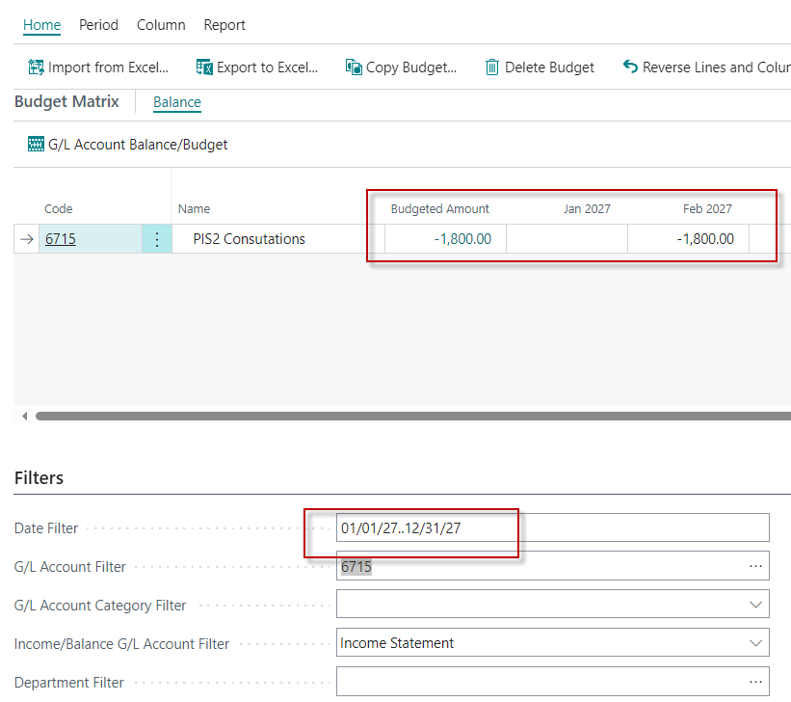
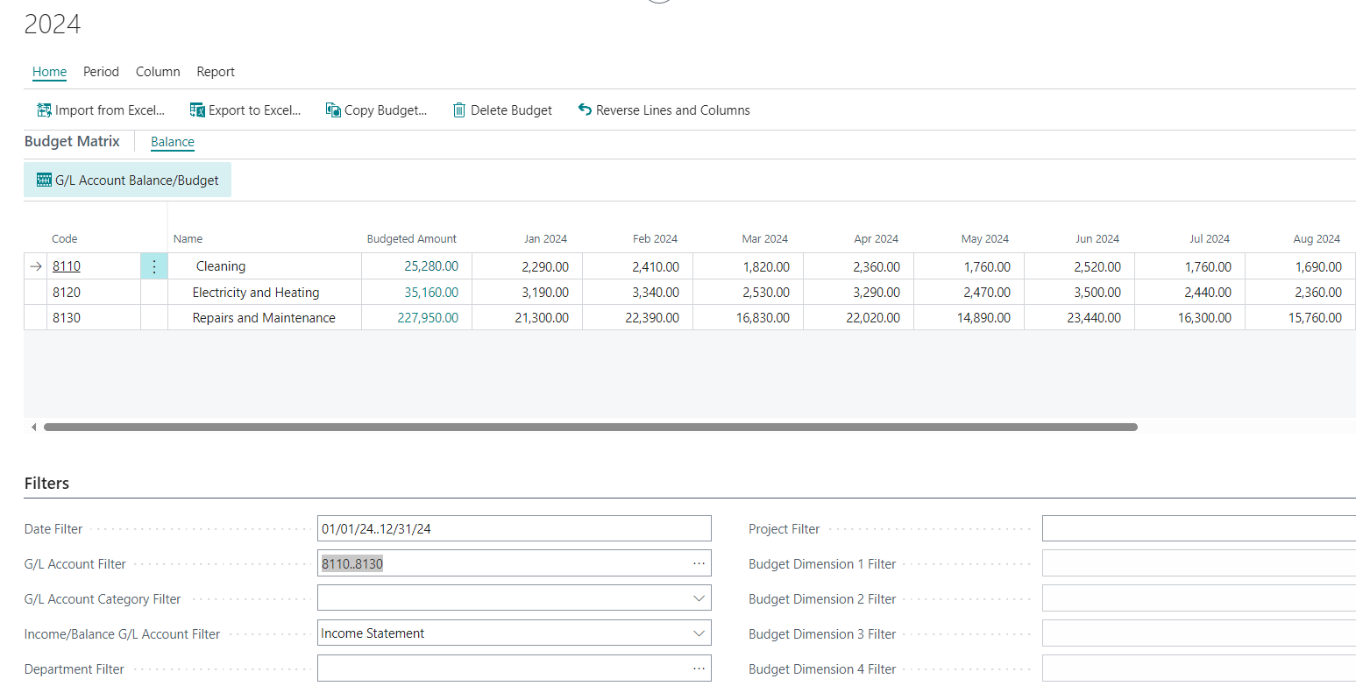
G/L Budget setup (for one account only)

Slide 4
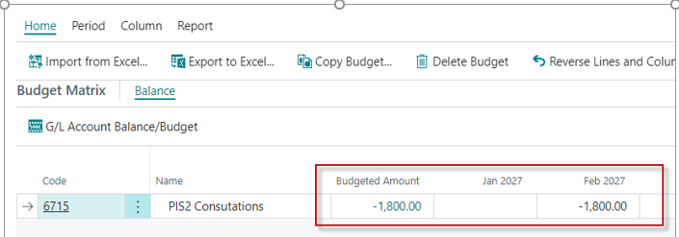
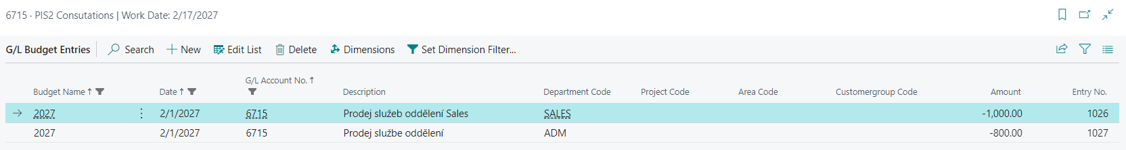
Breakdown of the budgeted amount on one account

Slide 5
Breakdown of the budgeted amount on accounts 8110..8130 (chosen month =JUIN 2024)

Slide 6
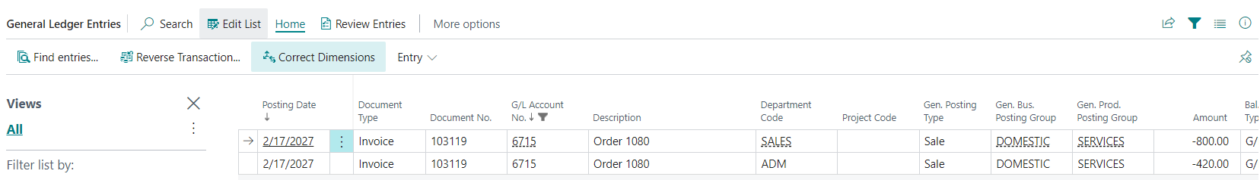
G/L Entries created by use of Sales order for chosen dimensions values (two sales lines)
The chosen values of the Department dimension were assigned to each sales order line before its posting.
The first line was marked with the SALES value and the second with the ADM value

Slide 7
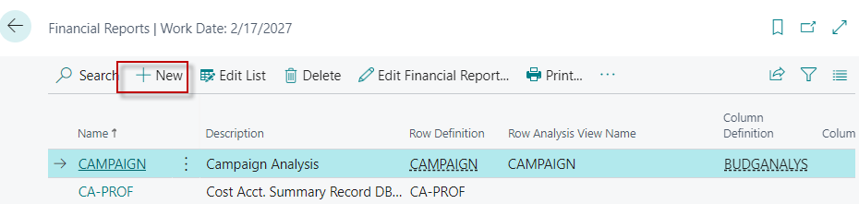
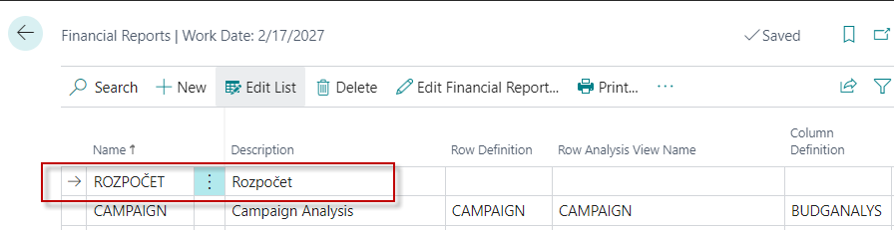
Financial report creation 1 (one account only)
Rozpočet is the Czech name for the generated financial report (budget).

Slide 8
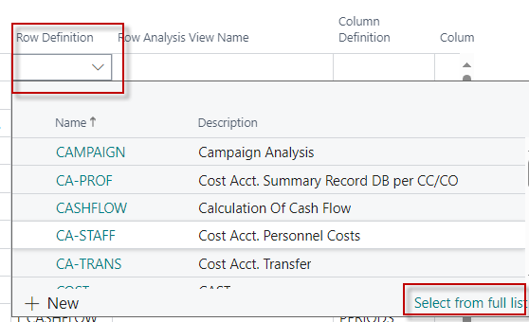
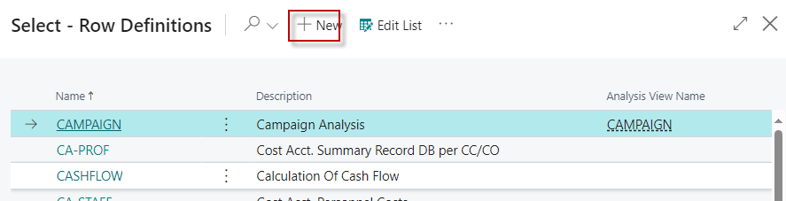
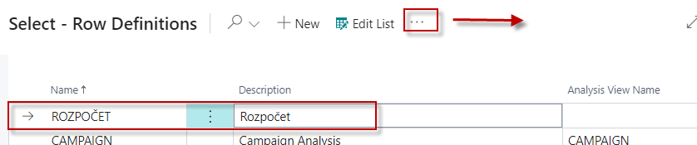
Financial report creation 2

Slide 9
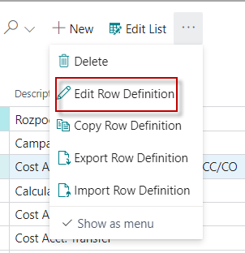
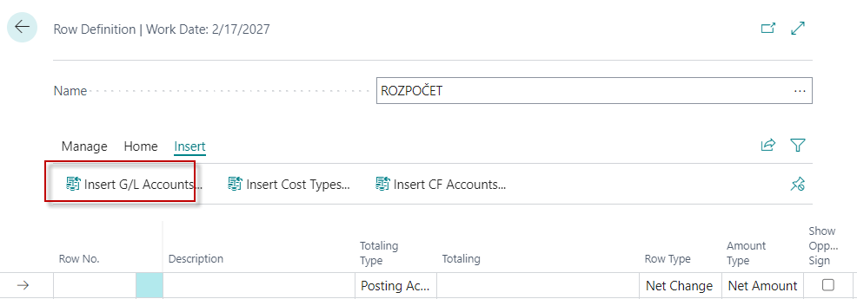
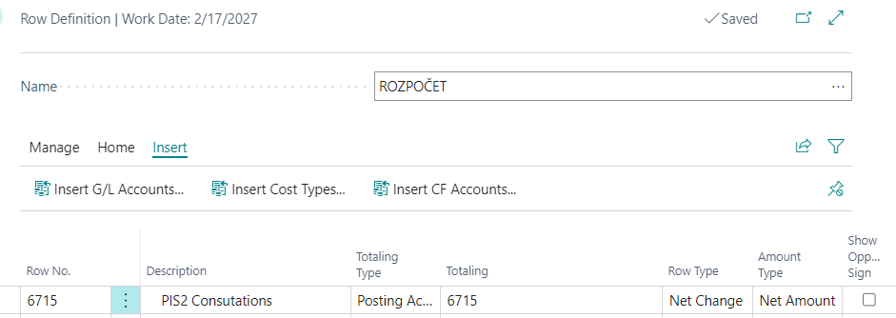
Financial report creation 3

Slide 10
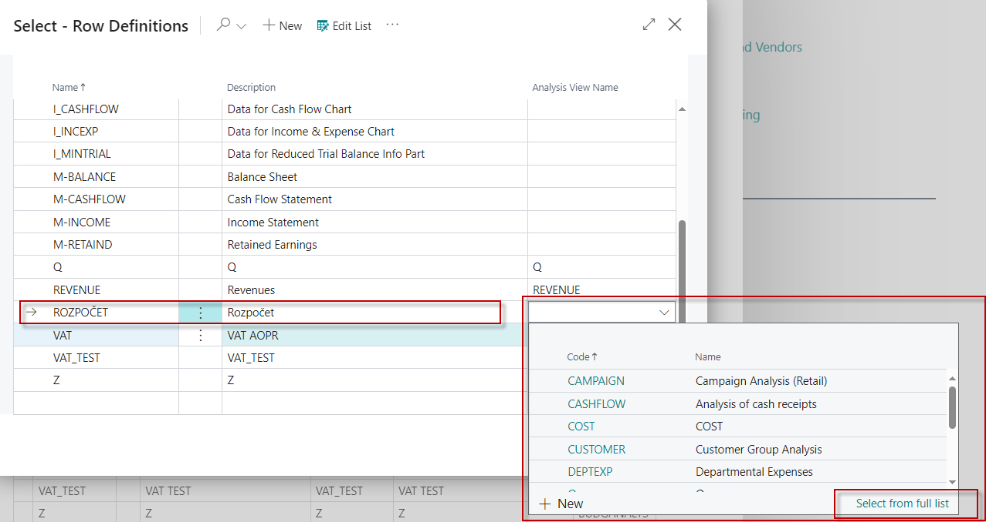
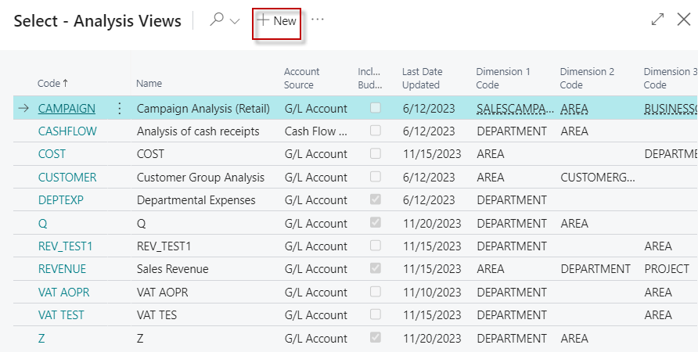
Financial report creation 4

Slide 11
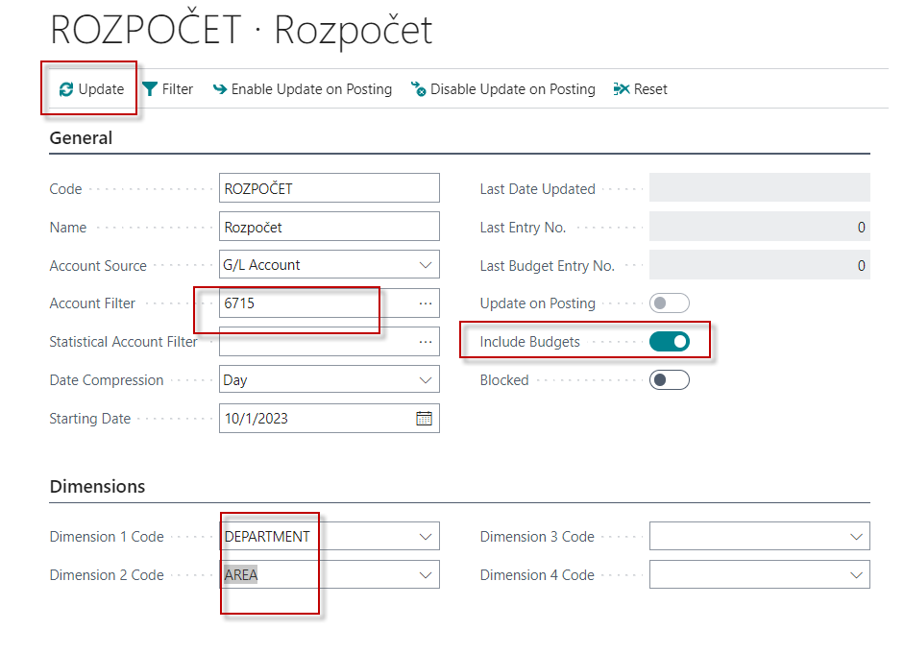
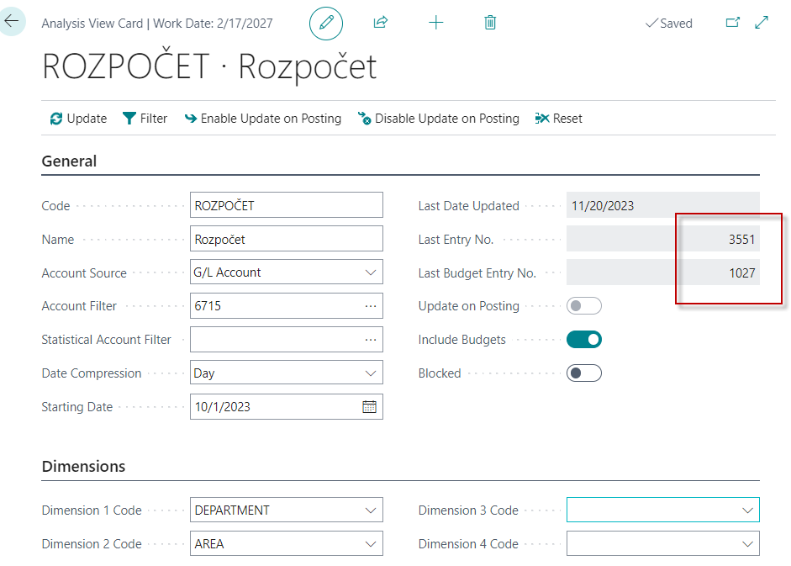
Financial report creation 5
Rozpočet is the Czech name for the generated financial report (budget).
Before update
After update

Slide 12
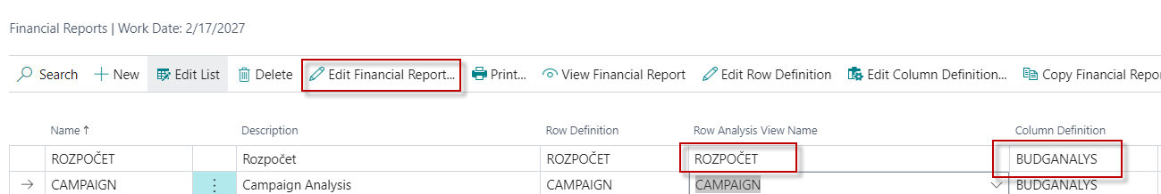
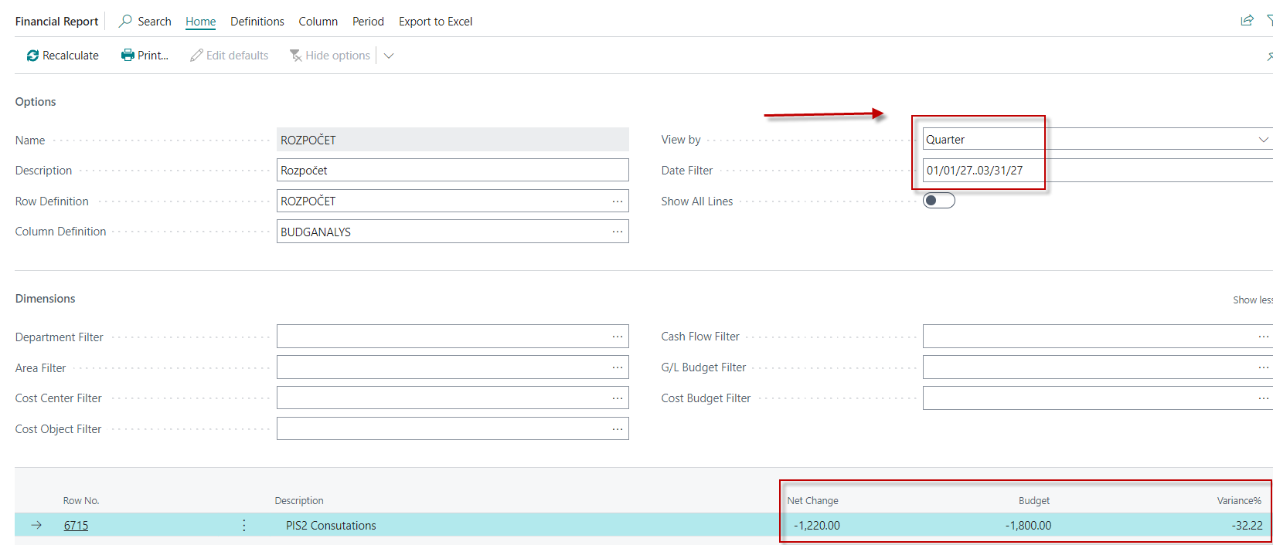
Financial report creation 6
We need to change the time scale
of View by Quarter

Slide 13
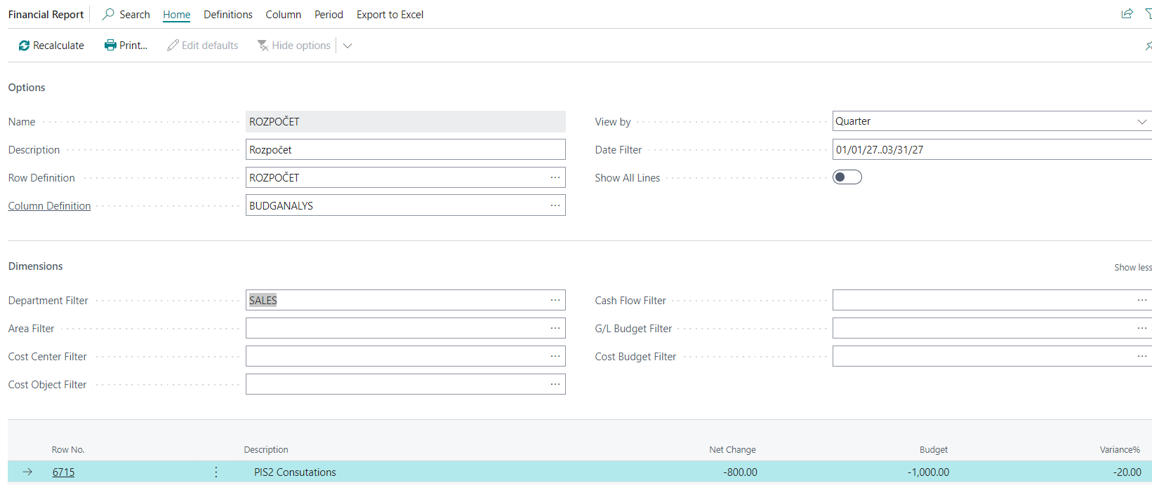
Financial report creation 7 – with filter based on dimension values (here SALES)

Slide 14
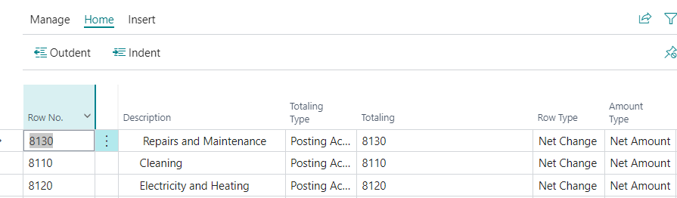
Rows for accounts 8110..8130

Slide 15
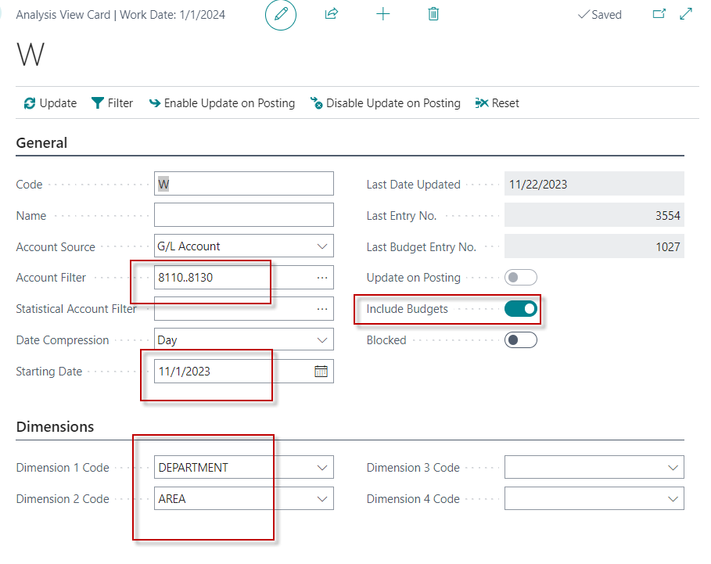
View for accounts 8110..8130

Slide 16
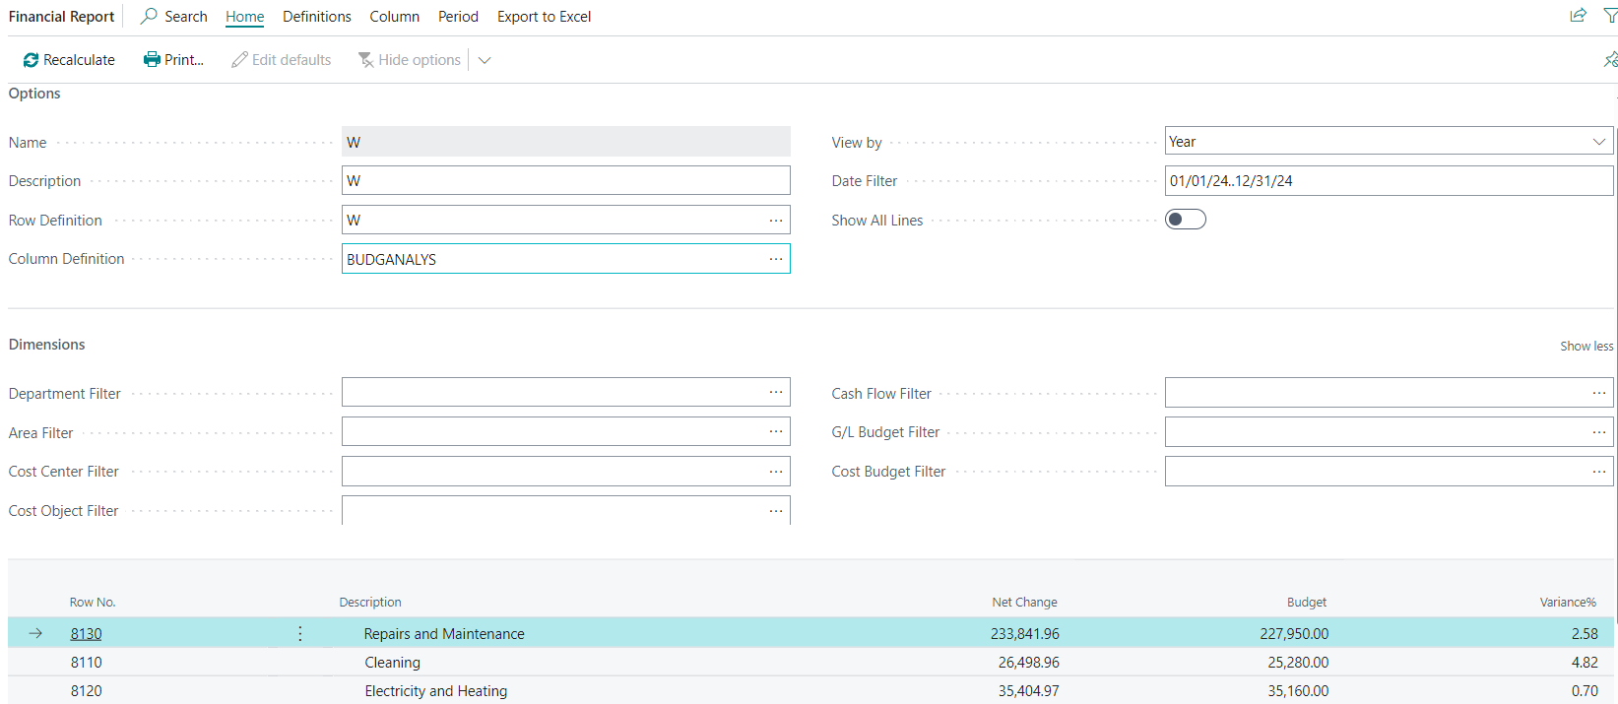
Financial report for account 8110.8130

Slide 17


