Slide 1

This is
Business Central
All-in-one business management
for small and medium-sized
businesses
Notes:
Welcome to this short presentation of what Business Central is

Slide 2
Business Central Positioning Statement
For
Who
Dynamics 365 Business Central is
That
Unlike
Dynamics 365 Business Central
small and midsized businesses
have outgrown their existing accounting or ERP software,
a comprehensive business management solution
easily and seamlessly connects systems and processes.
traditional ERP solutions,
is deeply integrated with Office 365 and includes built-in intelligence, so it’s easy to use and helps you make better business decisions.
Notes:
First here is the Position Statement for Business Central
We will try to give you a more clear feeling for what this statement means

Slide 3
A single, comprehensive solution to meet the needs of growing businesses
Financial management
Project management
Automatically pull systems and processes together to manage
financials, sales, service, and operations
Connect with 3rd party applications like payroll, banking, CRM, or industry-specific systems
Microsoft Dynamics 365
Business Central
Sales & service management
Operations management
Supply chain management
Reporting
& analytics
Notes:
Dynamics 365 Business Central connects people and processes with a single, unified solution, so data can be quickly and easily shared with key people throughout the company. Users will have access to the most current, accurate data so they’re making the most informed decisions possible.

Slide 4

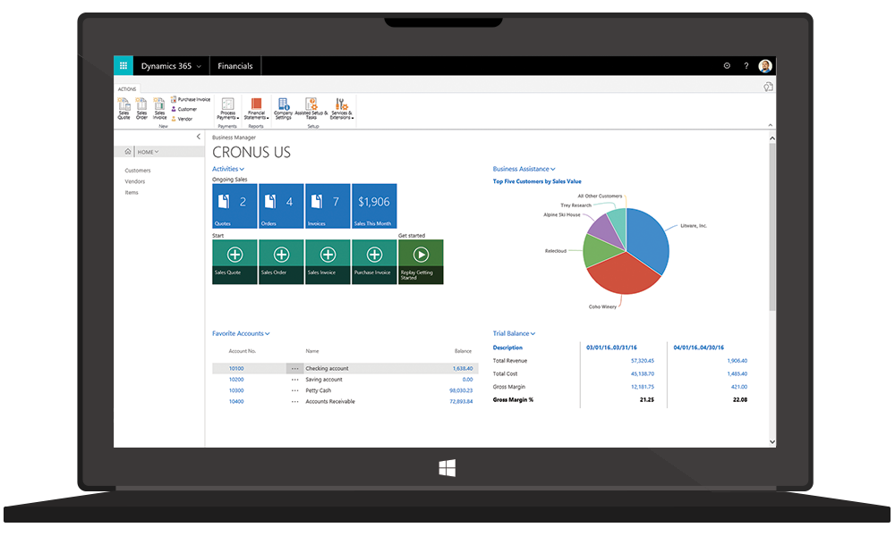
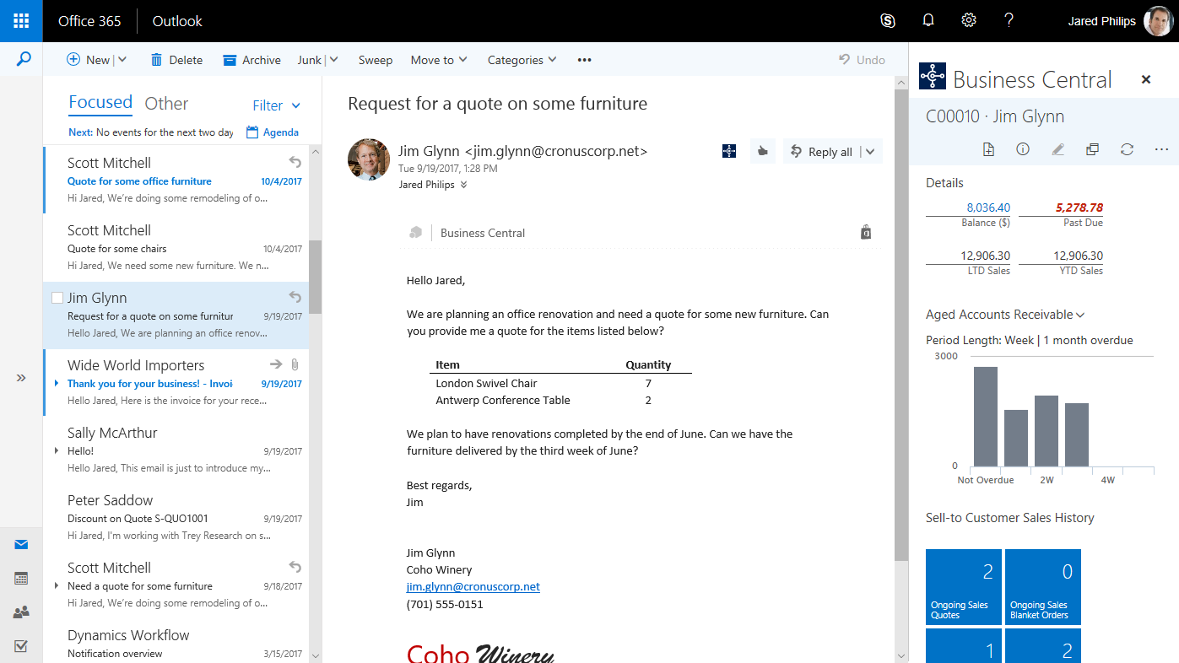
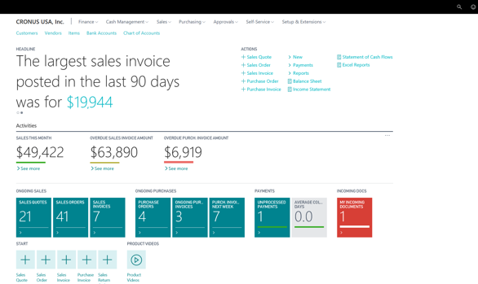
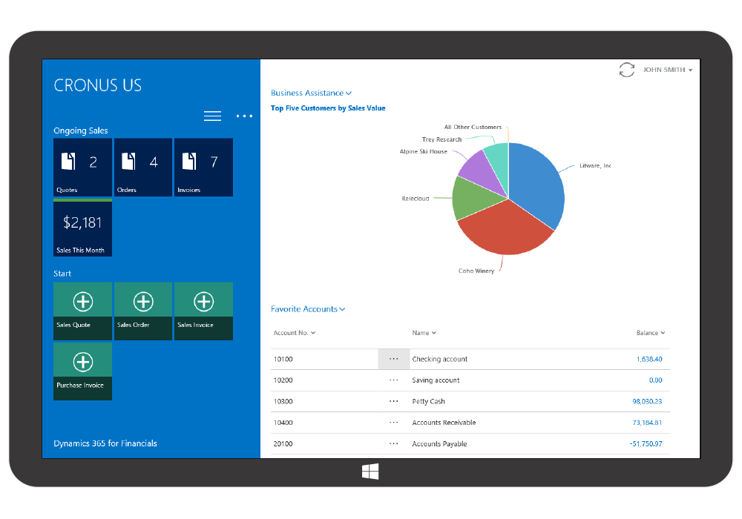
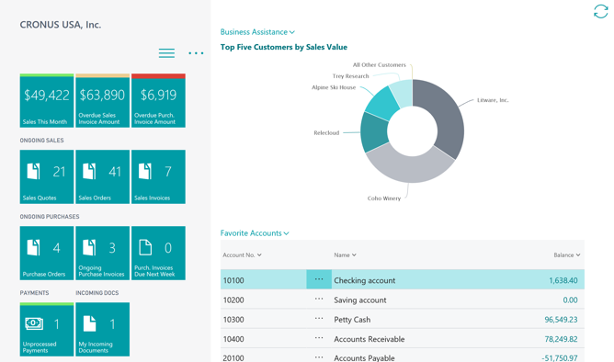

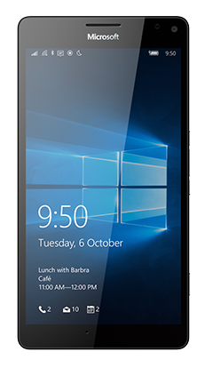

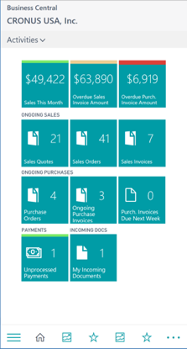
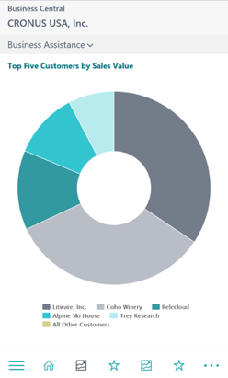
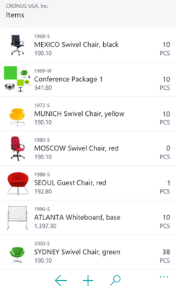




Connect your business
Project
management
Financial
management
Operations
management
Sales & service
management
Reporting
& analytics
Supply chain
management
Deploy a single,
comprehensive solution
Work where your
Business takes you
Manage quote to cash,
all within Outlook
Notes:
The All-in-one nature of Business Central removes silos and allows the customer to connect operations with financial management, reporting and all other important areas of the business
It gives full capabilities on desktop, tablet or mobile, on-prem or in the cloud
It is deeply embedded within Outlook, so business data and processes work right where users spend most of their time

Slide 5

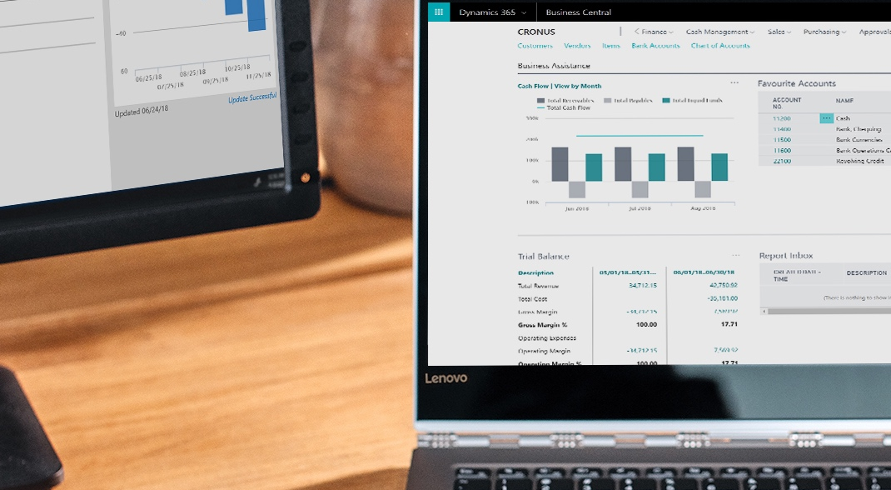
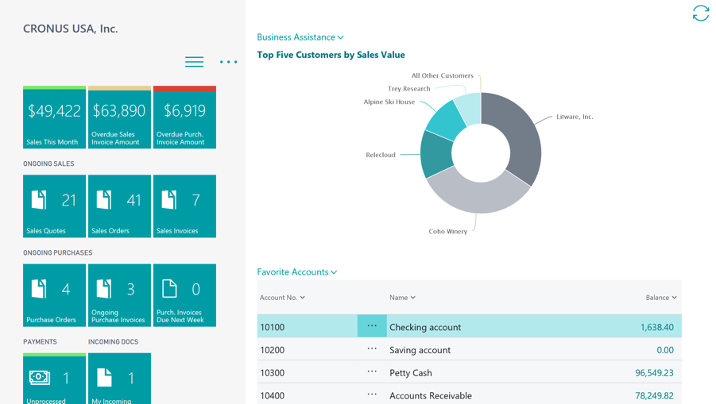
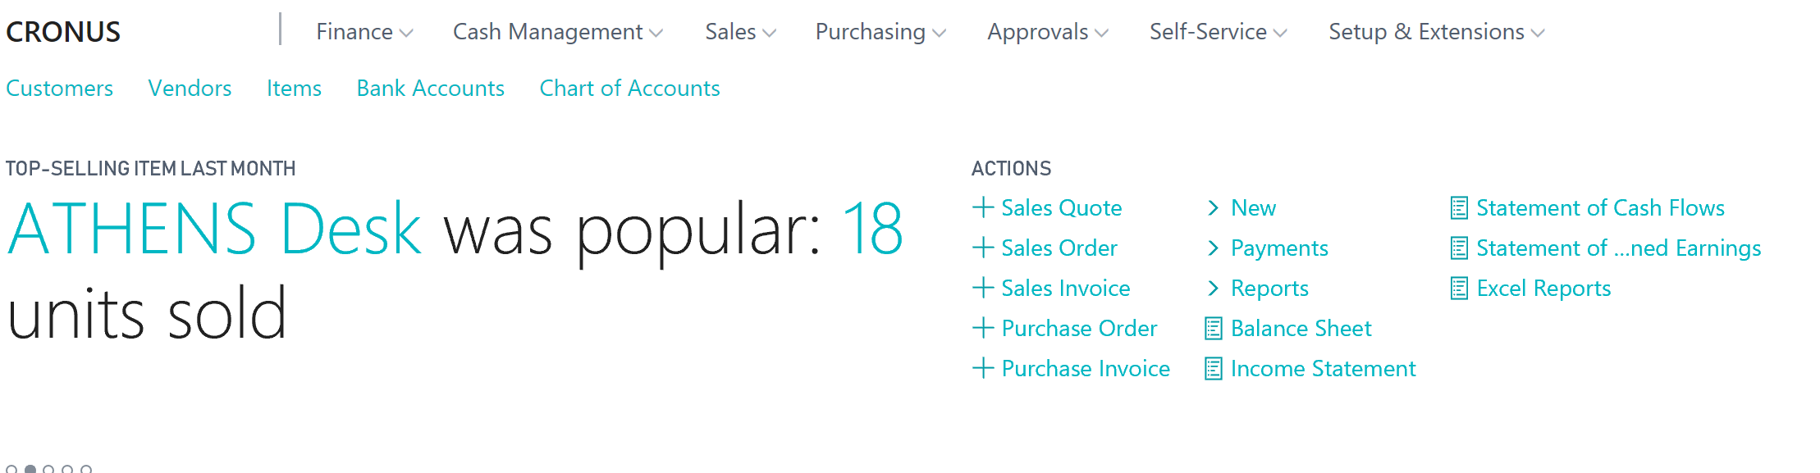
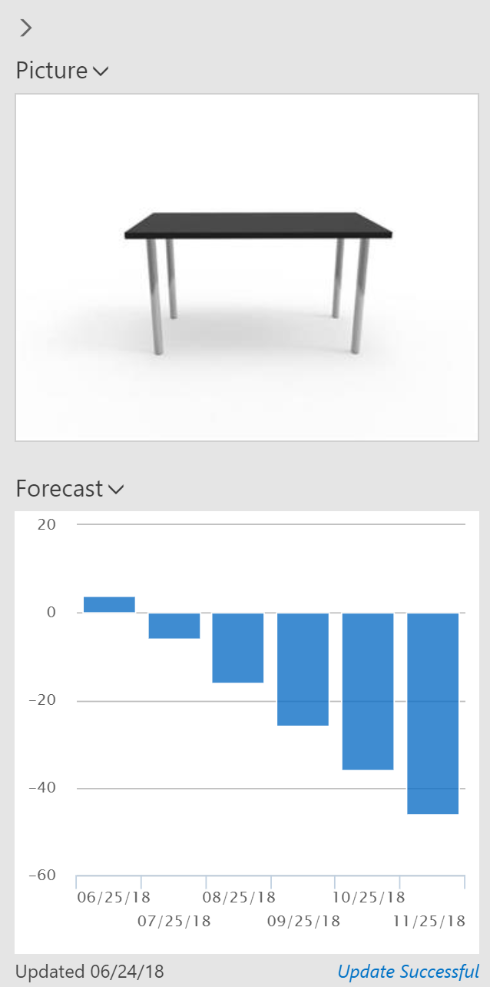
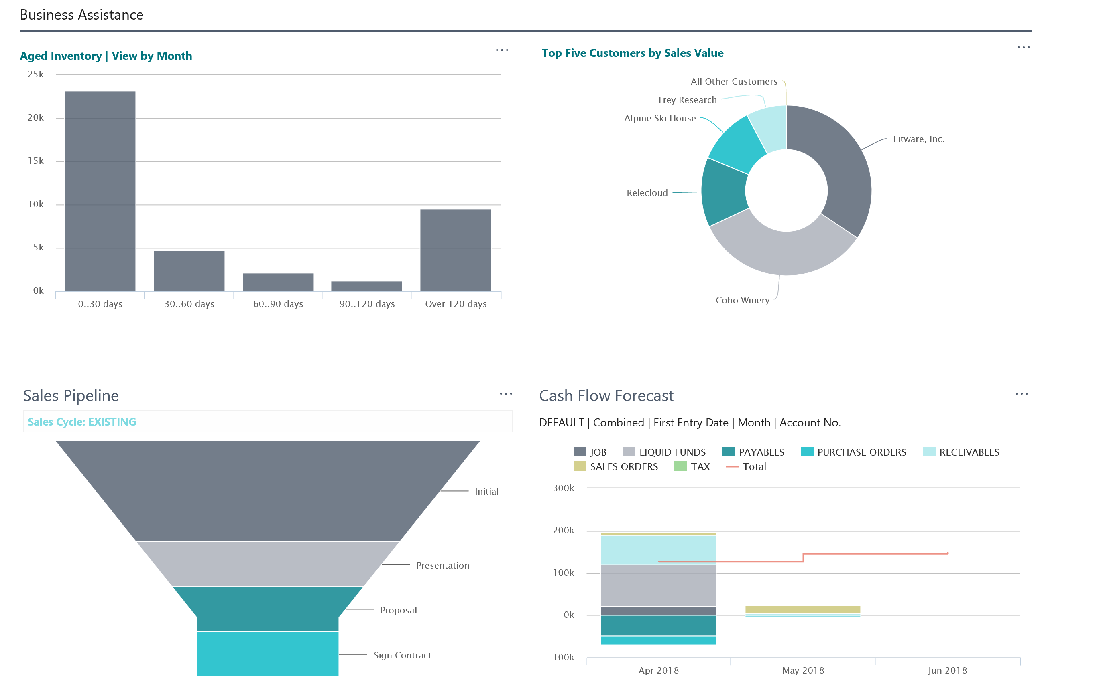
Make smarter decisions
18 units sold
Get an end-to-end view
of your business
Sell smarter and improve
customer service
Guide employees to
optimal outcomes
Notes:
The users will get all business data at their fingertips, real-time; flexible KPIs (Key Performance Indicator) and dashboards for each user role
Artificial Intelligence enables higher performance and powers an improved customer experience
System suggestions based on historical data, lead to optimized process outcomes and higher productivity

Slide 6

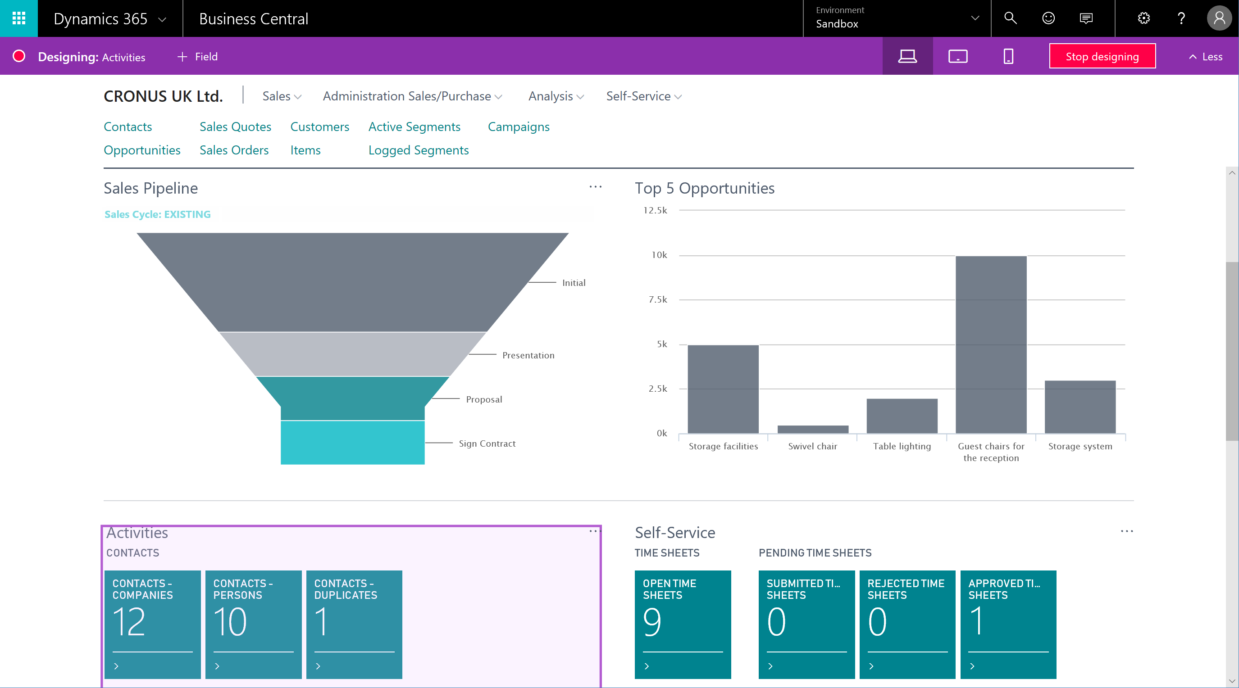
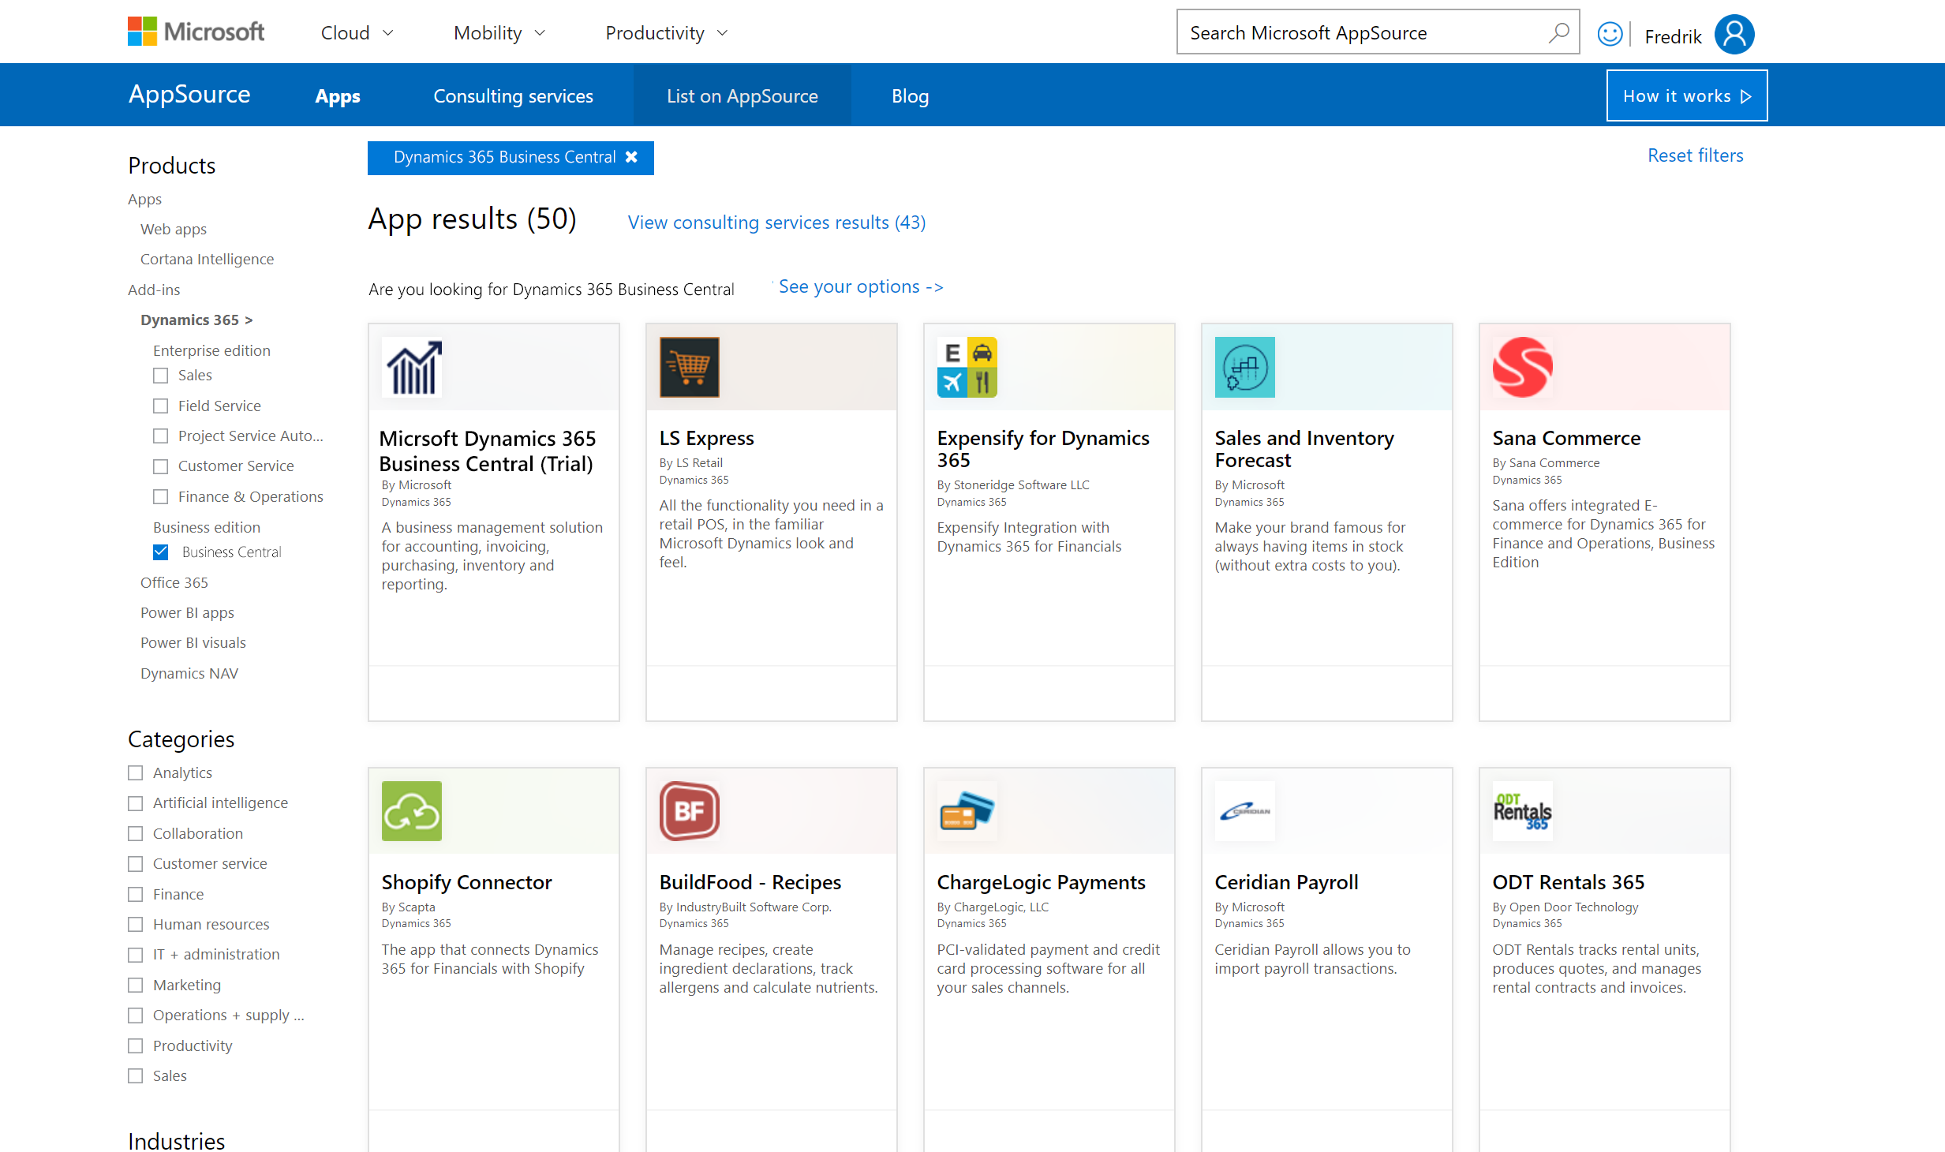
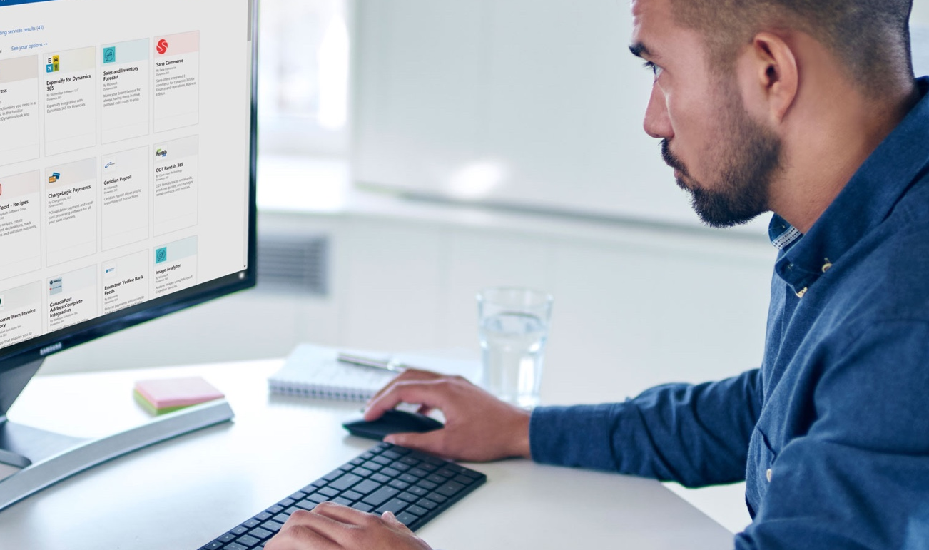
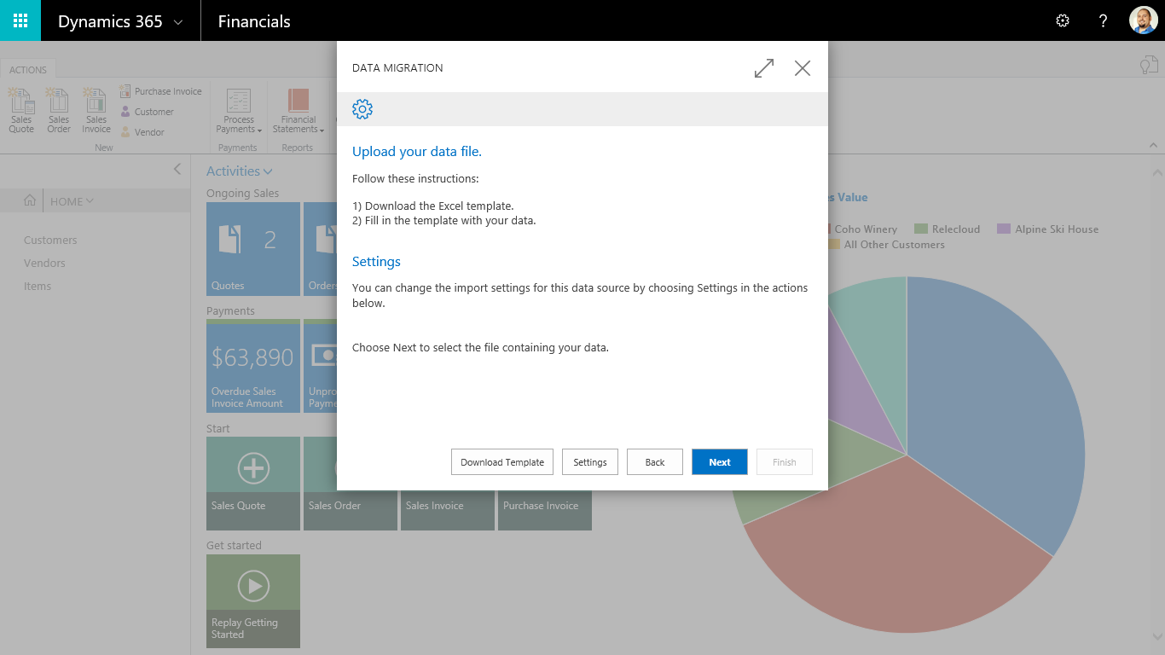
Start and grow easily
Tailor to your needs
Add industry or business extensions
Be ready for growth
Notes:
It is easy to tailor the software in a no-code environment, through the UI or with embedded PowerApps
Visit AppSource to quickly add 3rd party integrations, horizontal or vertical-specific add-on functionality designed to work seamlessly with Business Central
Start with as many (or few) users and modules as you want, and grow as your needs grow. Built on Microsoft’s Intelligent Cloud, Business Central will scale and perform as your volumes grow, with no additional cost or system tuning required.

Slide 7

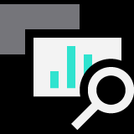
Microsoft Dynamics 365 Business Central
Core Capabilities
Financial Management
Account Receivables Payables | Bank reconciliation | Fixed asset management | Month/year end closing
Sales & Service Management
Quote generation | Contact management | Sales invoicing | Payment processing
Project Management
Capacity planning | Budgets and estimates | Job and process costing | Resource management
Supply Chain Management
Inventory and Purchasing control | Shipment and distribution | Returns and cancellations | Procurement and vendor management
Operations Management
Forecasting | Production planning | Manufacturing capacity | Warehouse management
Reporting
& Analytics
Customer insights | Self-serve reports | Interactive dashboards | Built-in intelligence
Notes:
We just did a very high level tour of the capabilities of Business Central
Here is a more comprehensive list of the core capabilities which shows that Business Central is not only easy to use and offer low cost of ownership but it is also a full-featured solution tailored specifically to the needs of small and medium businesses.

Slide 8
Development of software for company management
Operation Planning
MRP –Material Requirmenet Planning : It calculates what do I neeed to get and when
Closing loop MRP „ It is MP software extended with capacity planning
Manufacturing Resource Planning : Closing loop MRP extended with financial management
Sales & Operation Planning : Operational planning< –> Financial planning<–> Sales Planning
Just in Time systems and Lean Manufacturing
ERP – Enterprise Resource Planning
APS – Advanced Planning and Scheduling (finite capacities management)

Slide 9

Benefits arising from the use of ERP in teaching at the faculty
ERP
Subject 1
Theory of controlling processes
Resources
Methods
Tool -Excel
Data
Subject 2
Theory of controlling processes
Zdroje
Methods
Tool - UML
Data
Subject 3
Theory of controlling processes
Resources
View across all companies
Methods
Tool - MatLab
Data
Subject 4
Theory of controlling processes
Resources
Methods
Tool – none
Data
Data
Data

Slide 10
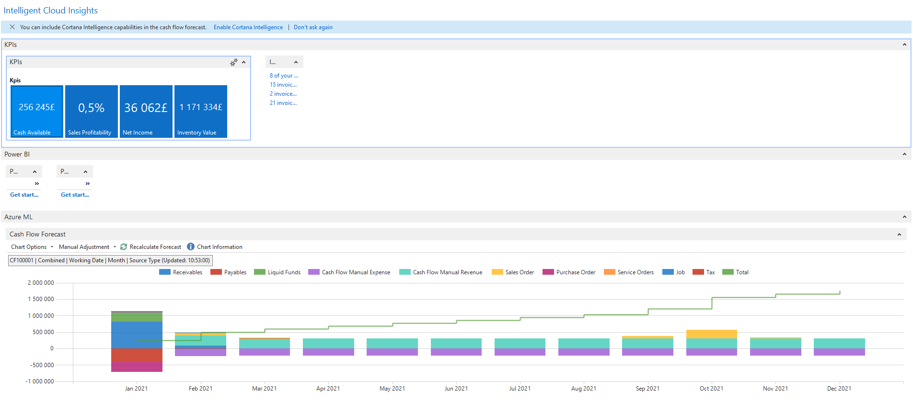
Intelligent Coud Insight (Cash Flow) in BC

Slide 11
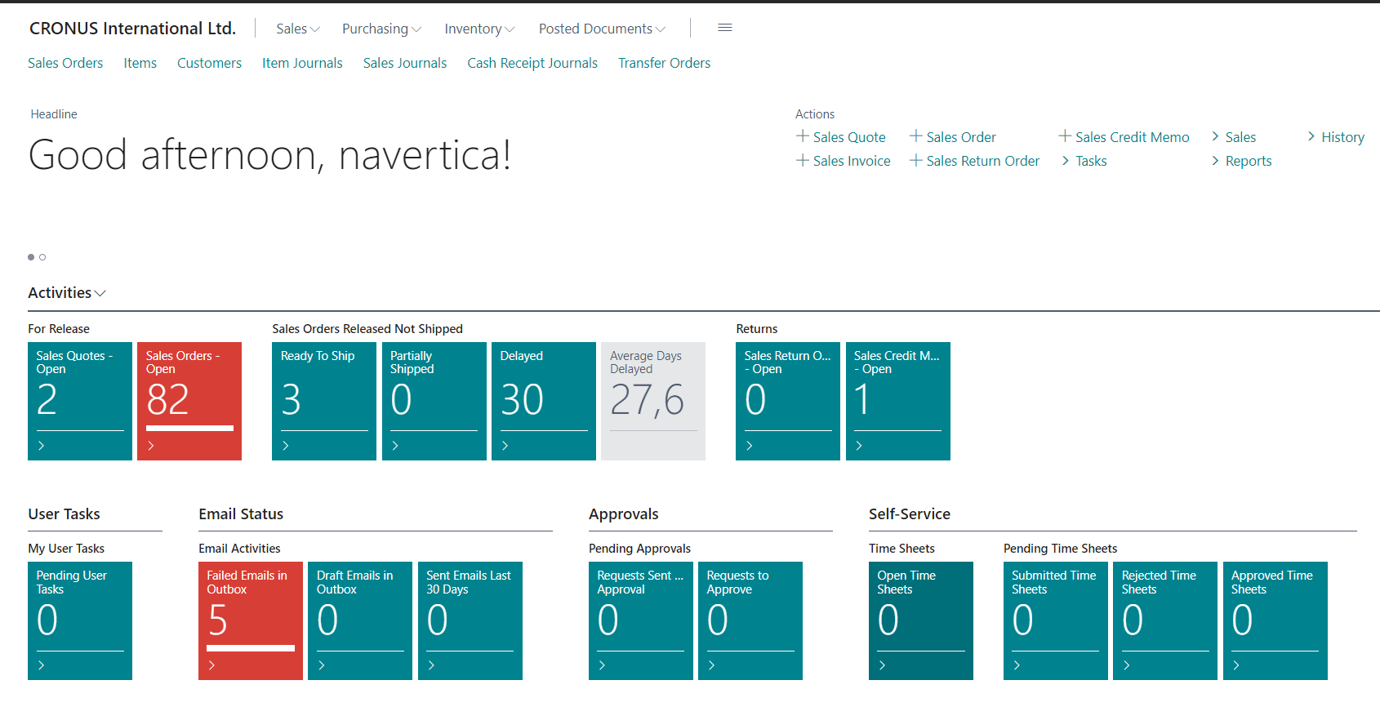
MS Dynamics 365 Business Central (Cloud i On-Prem version)

Slide 12
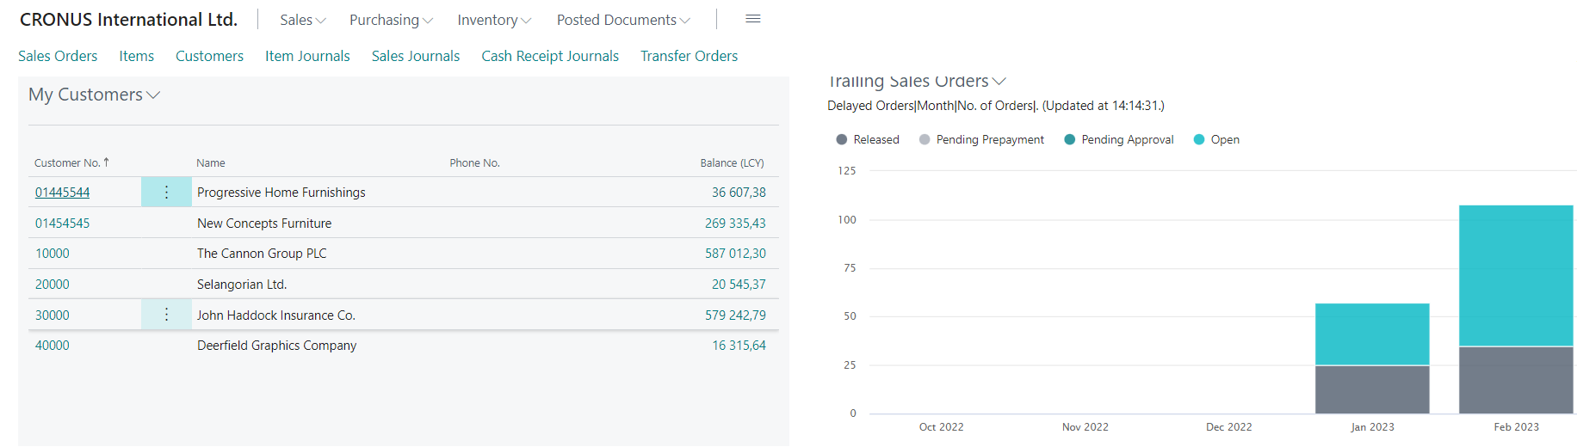
MS Dynamics 365 Business Central

Slide 13



Simplified schema of ERP usage – feedback princip
DB
MPH_AOPR
ERP
Transaction- entries- položky-data
Partners
ERP
Information
Information
(trends)
Enterprise
Reports
Trends
Decision
Knowledge of methods applied for process management
AOPR
Key decisions
Key knowledge
27.09.2023

Slide 14
ERP
The main objective of Enterprise Resource Planning, or ERP, is to integrate all departments and functions across a company into a single system by using a common database, the value of which is to be able to have only one correct set of data.

Slide 15
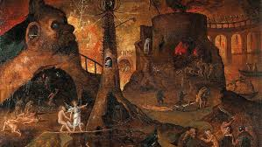
Isolated Data Islands – heterogeneous solution
Marketing
& Sales
Islands
Accounting
Island
Marketing
Management
Production
Island
Customer
Orders
Accounting
Sales Representatives
Customers
Production
Planning
Island of
Deliveries
Quality
Management
Island
Quality Management
Inventory and Production
15

Slide 16
One Solution One Database All Microsoft
Management
Marketing
Inventory and Production
Customer
support
Internal Sales
One Company
Database
Accounting
Sales Representatives
Customers
Quality
management
Production
Planning
16

Slide 17
ERP – object solution
Tables - data storage
Windows (forms) - data visualization
Reports - processed data
Programs (scripts, codes, code units) - how to process data
Menus - control user access
Data ports - link to external environment

Slide 18
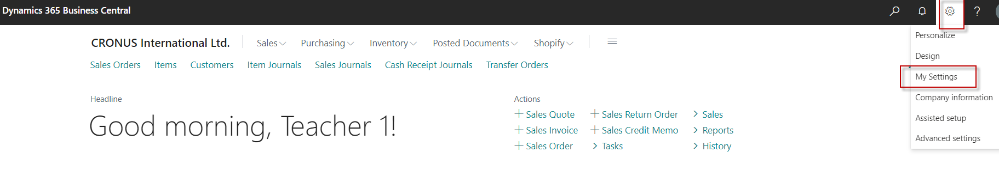
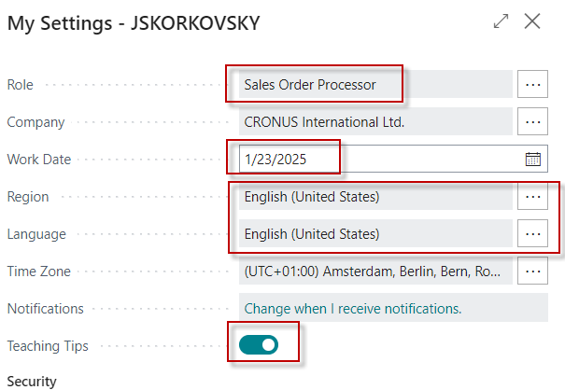
How to get to chosen objects- use of icons or Searching window
Setting up your
user profile

Slide 19
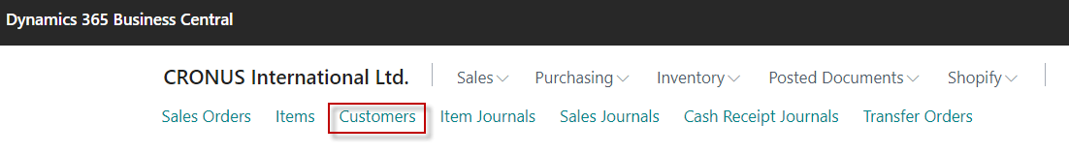

Icons used for your chosen working area

Slide 20
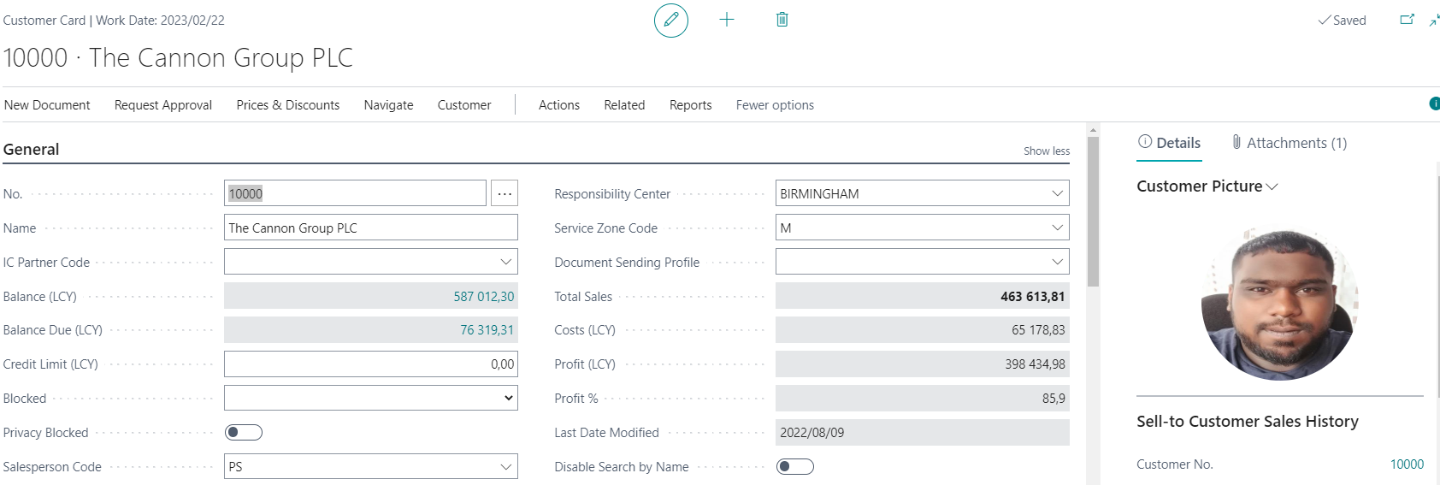
Customer card- table

Slide 21

Icons used for your chosen working area

Slide 22
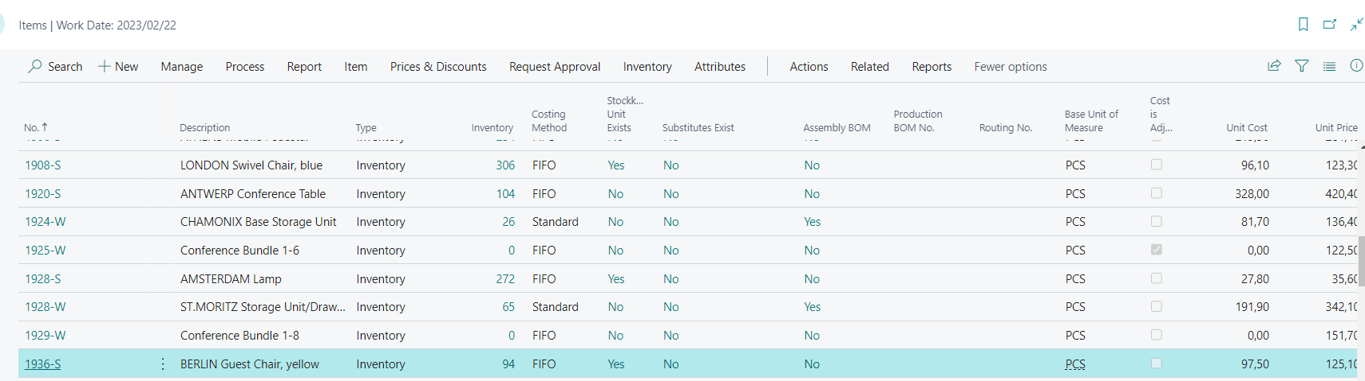
Example of window type list (items in our warehsouse)

Slide 23
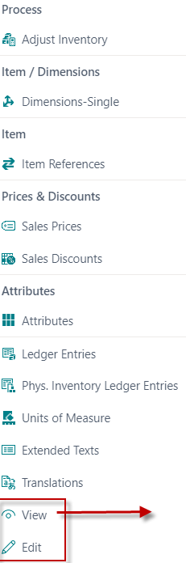
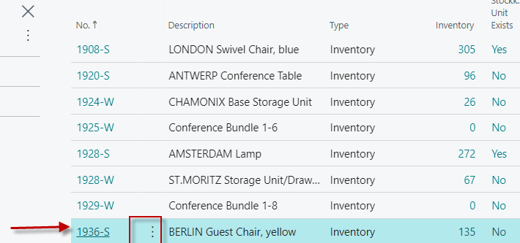
Example how to get to one item (record)

Slide 24
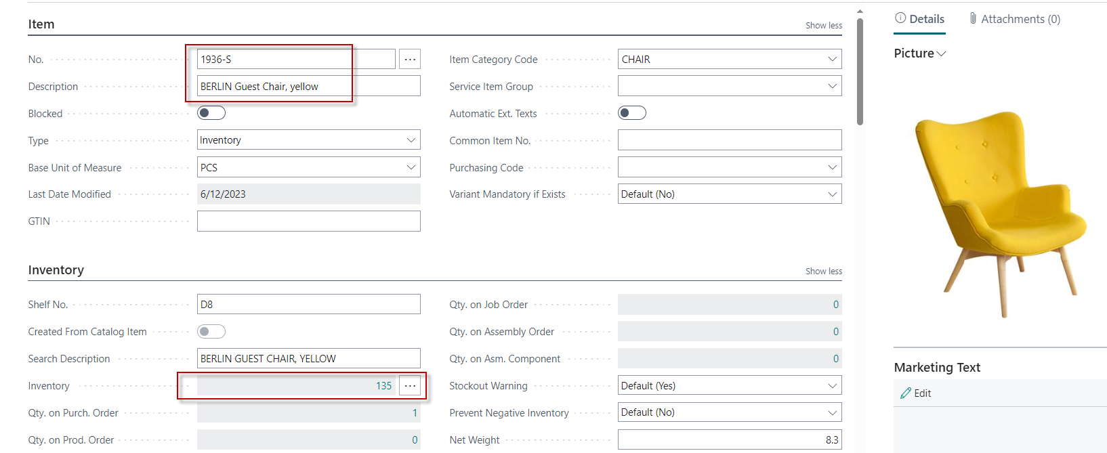
One part of chosen item card

Slide 25
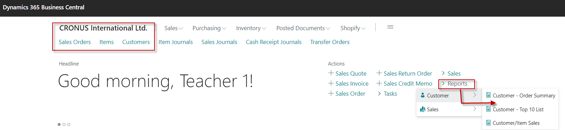
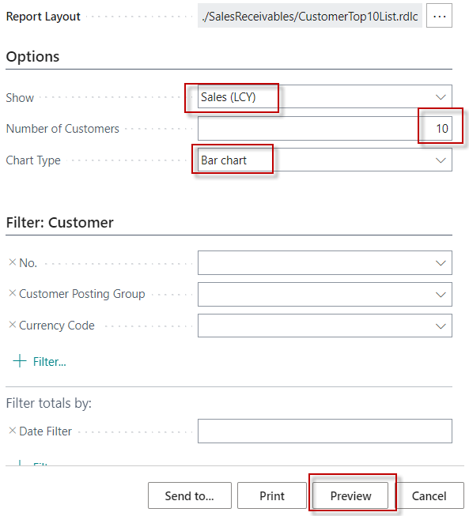
Report (our example- To 10 list) – > how to start it

Slide 26
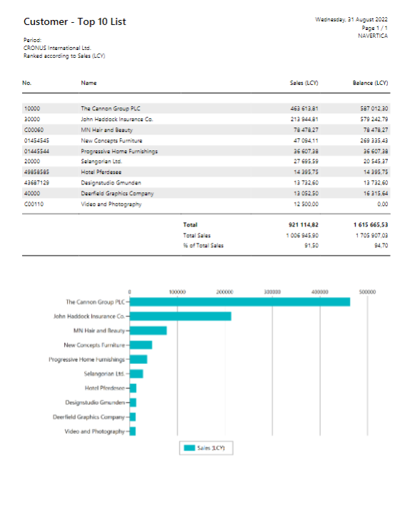
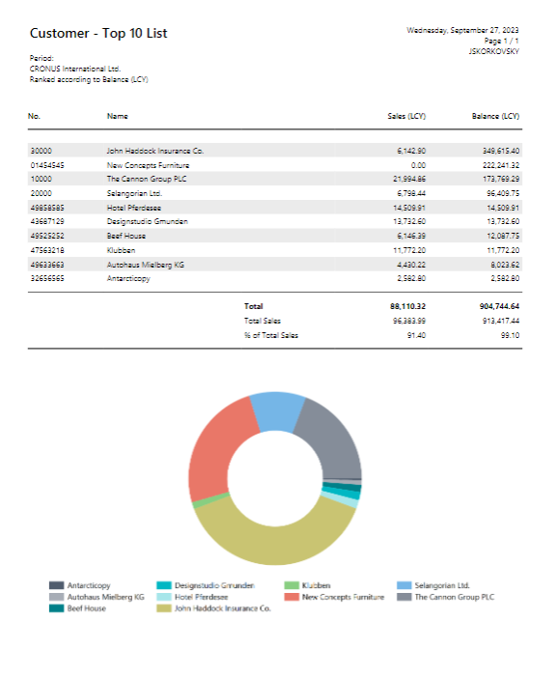
Report – examples
Sales and bar type
Balances and pie type

Slide 27
Some types of document handled by ERP Business Central
Sales orders
Sales quotations
Purchase orders
Purchase quotations
Transfer orders
Production orders
Credit memos
Service orders
Assembly orders
Demand
Replenishment

Slide 28

What happens when a selected document is posted
Customer
Header of Sales Order
Posting
Header of Sales invoice
Line of of Sales Order
Line of of Sales invoice
Item to be sold
Row data in General ledger
Row data in item ledger entries

Slide 29
ERP – I
ERP - the documents are created and subsequently accounted for (transactions are created)
ERP - after chosen document registration -> created transactions (entries) - raw data
General ledger entries such as for instance Inventory|Vendor and VAT|Vendor

Slide 30
ERP - II
Vendor entries : invoices, payments, credit notes, returns, reminders
Item entries : purchase, sale, shipment, receipt, consumption, production and transfer)
Each entry represents a data record which consists of data fields of different types (numbers, texts, etc.)

Slide 31
Thank you very much

