Slide 1
ERP Simplified BC
Ing.J.Skorkovský,CSc.
Department of Business Management
Faculty of Business and Administration
Masaryk University Brno
Czech Republic

Slide 2
This short presentation is only to refresh the memory of those who
have already attended BPH_PIS1
where they used Microsoft Dynamics NAV 2018.
For the students of the MPH_AOPR course,
this presentation serves as a supplementary explanation
of the basic functions in the initial hours of the course

Slide 3
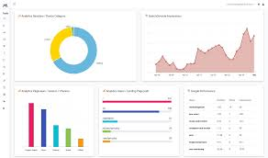
Tables (data)
Registration (posting)->transactions (entries)
Customer Ledger entry
Account Schedule
Customer
Header
Vendor Ledger entry
Vendor
Line1
Document
(style)
Item ledger entry
Reports
Item
G/L entry
BC Reports
LineN
G/L account
Reservation entry
Financial Journal
Export
Value entry
Location
Item Journal
Row data
Excel
Processes :
(sales, purchase, payments, production, service orders,..)
Power BI

Slide 4
Business Central Objects
Tables (data)
Forms (to display data)
Reports (organized data-> Valid information)
I/O ports (communication BC- > external environment)
Menus
Scripts (programs to handle data)

Slide 5
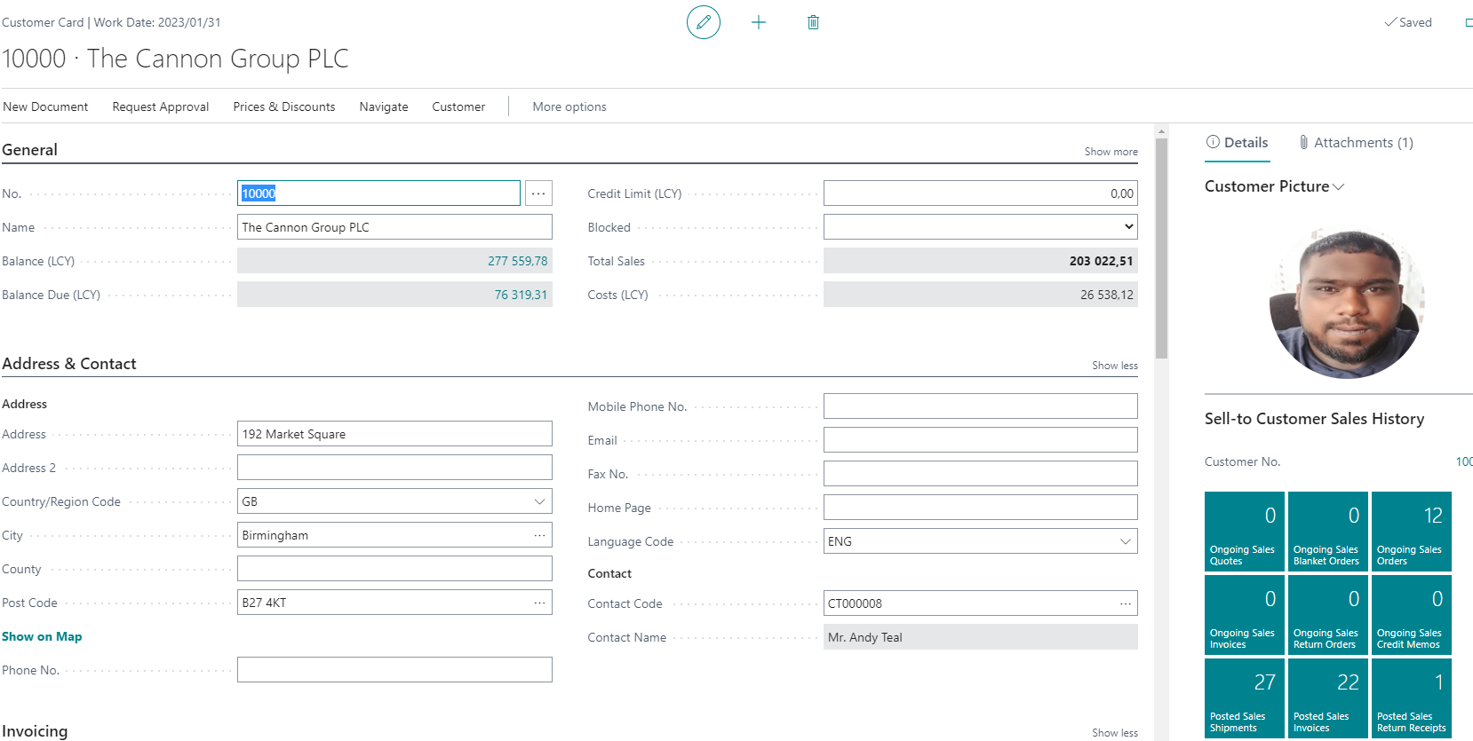
Part of table displayed by the card type screen (form)

Slide 6
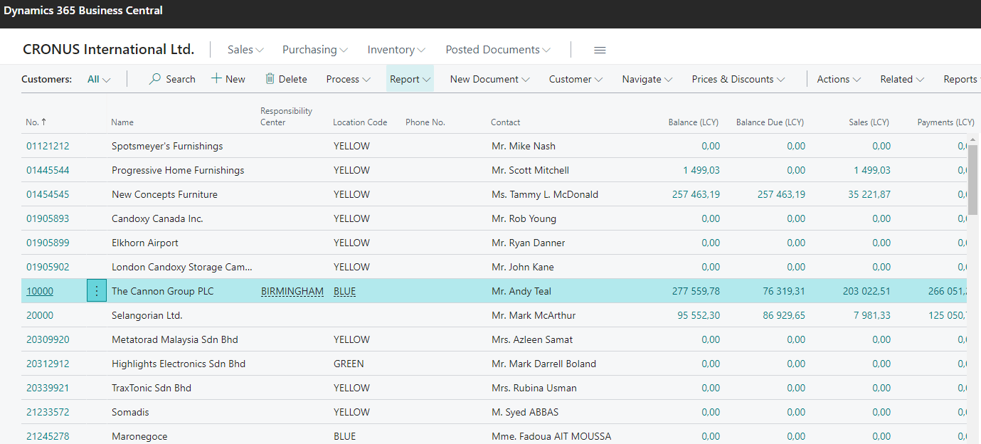
Part of table displayed as a list

Slide 7
Table (in our example one table model)
All fields in BC database
table such as for
example Customer table
The data that can be displayed
(but some can be hidden
and made visible any time )
Currently displayed data
in the selected form - before modification
(if needed)
Currently displayed data
in the selected form (window)
after modification

Slide 8
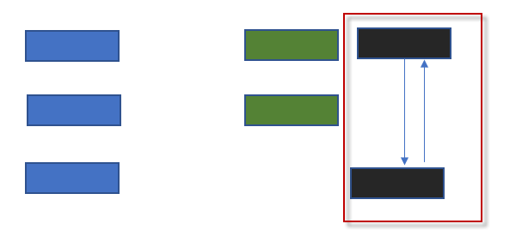
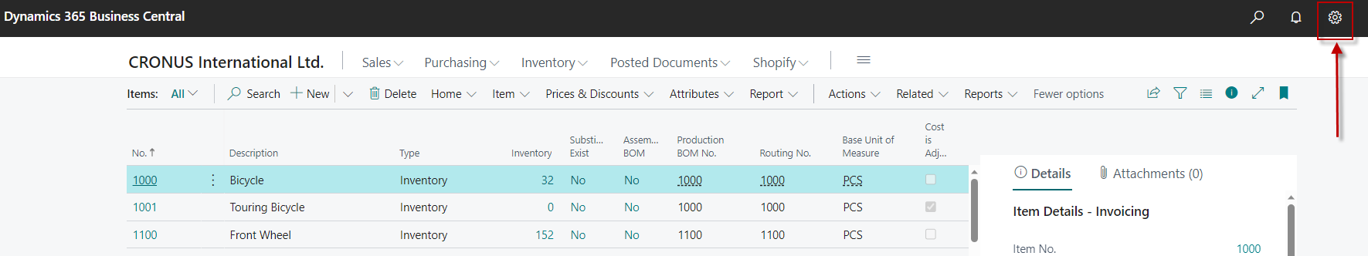
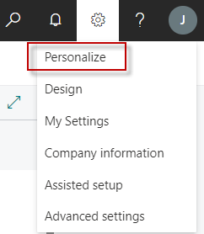
How to Display Hidden Fields 1st step

Slide 9
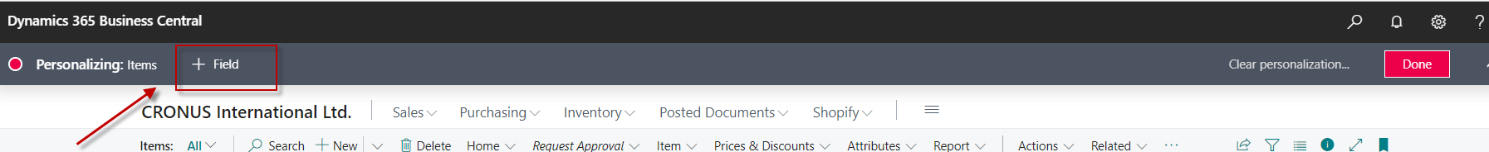
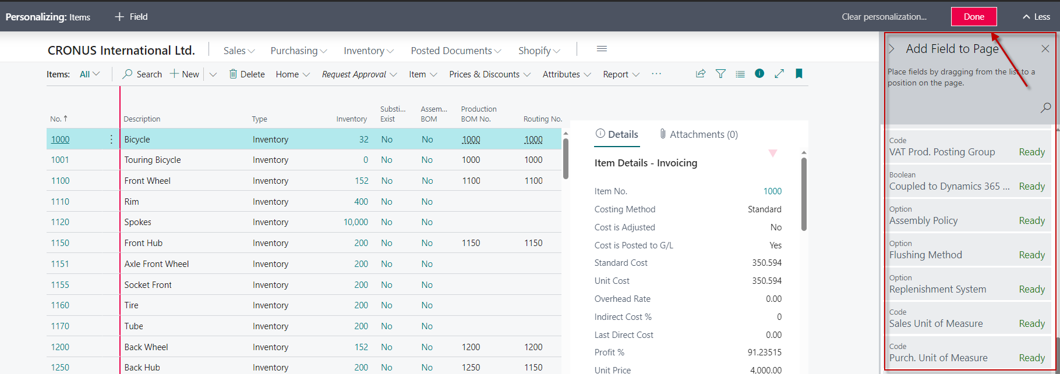
How to Display Hidden Fields 2nd step

Slide 10
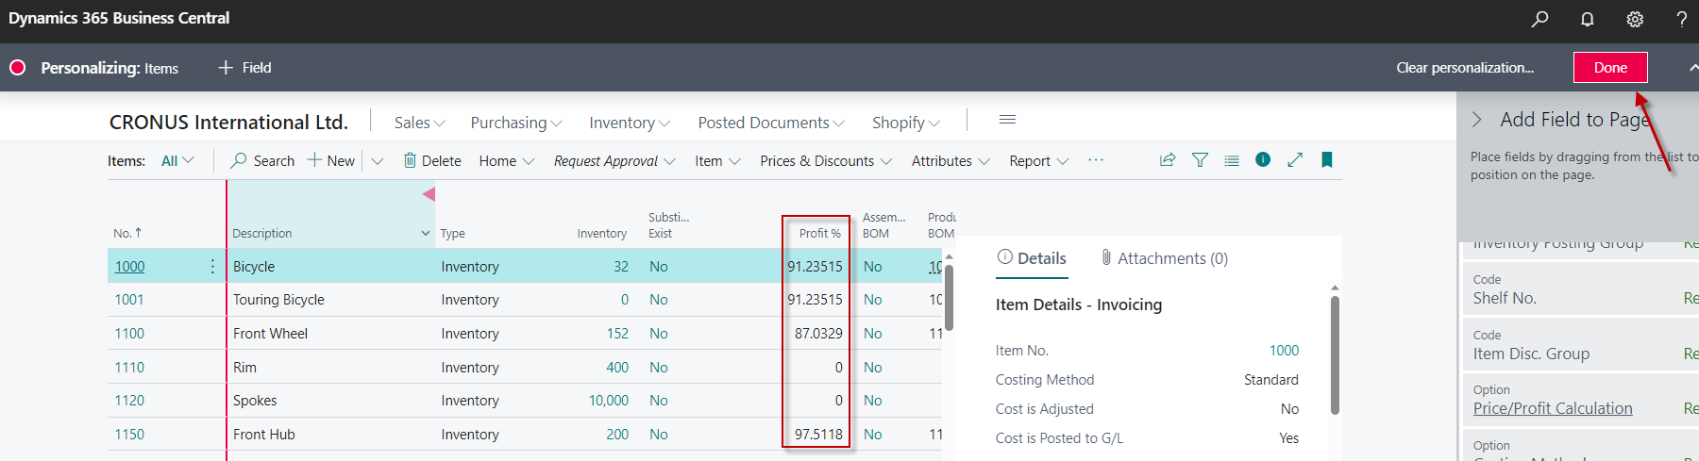
How to Display Hidden Fields 3rd step (drag & drop)
We have used drag & drop to move the Profit % field into the list where it was not displayed before. The transfer is confirmed with the Done button. Clear Personalization is used to clear either one or more modifications

Slide 11
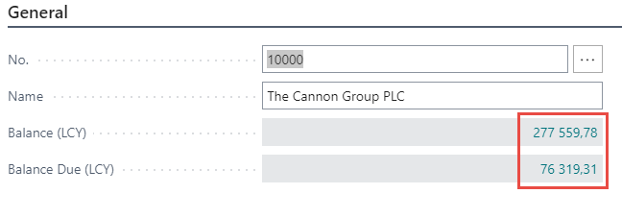
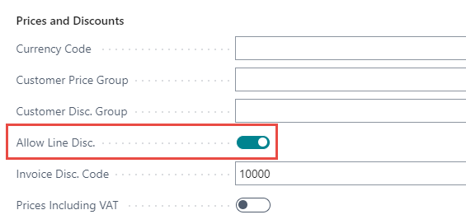
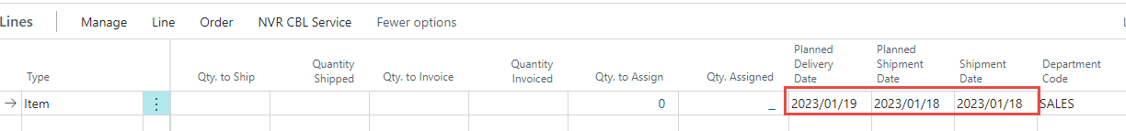
The nature of the data stored in the fields
Real numbers
Texts
Date and period (21.2.2023 or 1W)
Booelan (yes of no->Checked of not checked)
Time
Menus and so on…

Slide 12
End of story

