Slide 1
Business Central Introduction Selling and Purchasing
Ing.J.Skorkovský,CSc.
Department of Business Management
Faculty of Business and Administration
Masaryk University Brno
Czech Republic

Slide 2
The basics of double entry accounting presented
on Sales Order posting.
This was more and less shown in principles
in the previuos BC presentation

Slide 3
Double-entry booking (Selling process –> Sales Order->Sales Invoice)
Customer
Account (2310)
Revenue
Account (6110)
VAT (25%)
Account (5610)
Customer
Debit
Credit
Debit
Debit
Credit
Parameters
Credit
125
125
100
25
Invoice (1st)
Sales Order Header
Payment (2nd)
Bank (2920)
Debit
Credit
125
Sales Order Line
Balance on Customer card =
125 ->100+25
Parameters
Balance on Customer card =
0 ->125-125
Item card
Note: the amounts in total entries do not match the amounts in the animated
example. It is only an explanation that the relevant entries (transactions)
are created gradually during the business example

Slide 4
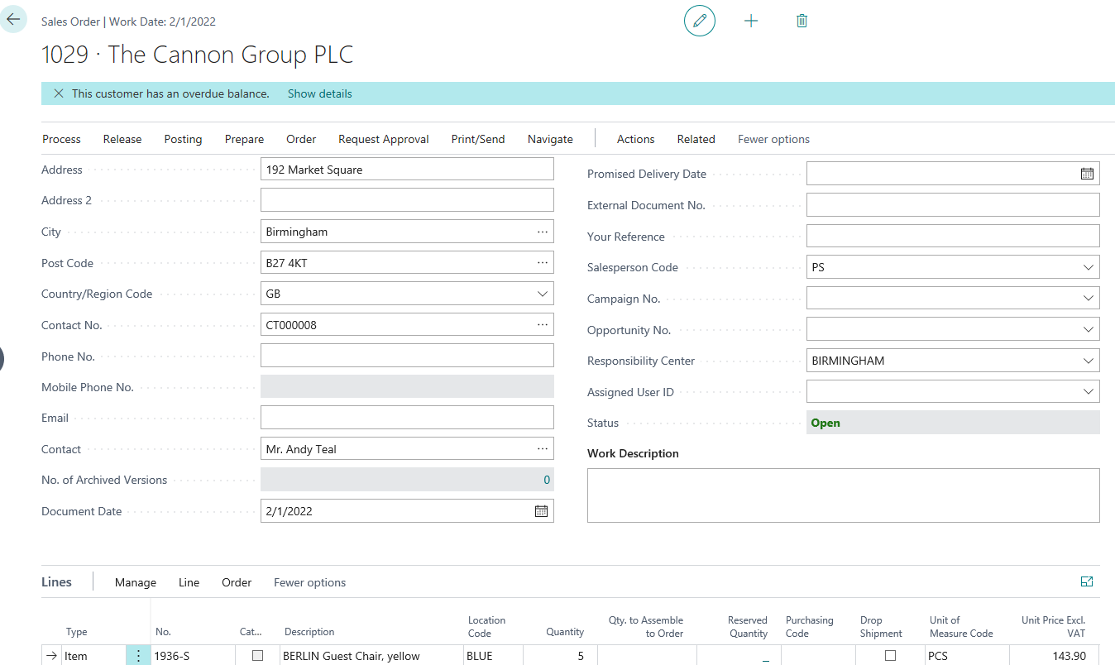
Sales Order

Slide 5
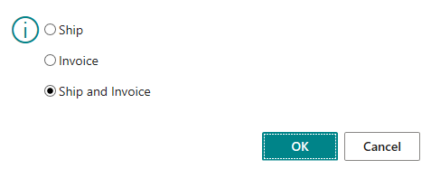
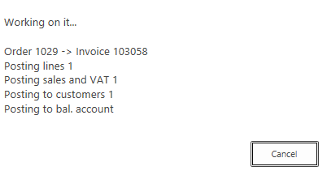
Sales Invoice (F9)
Three possible options
Either use the F9 key or find the Post icon. It is easier and therefore faster to use keyboard shortcuts.
Post Icon
BC creates all
entries
G/L Entries
Item Ledeger Entries
Customer Ledger Entries

Slide 6
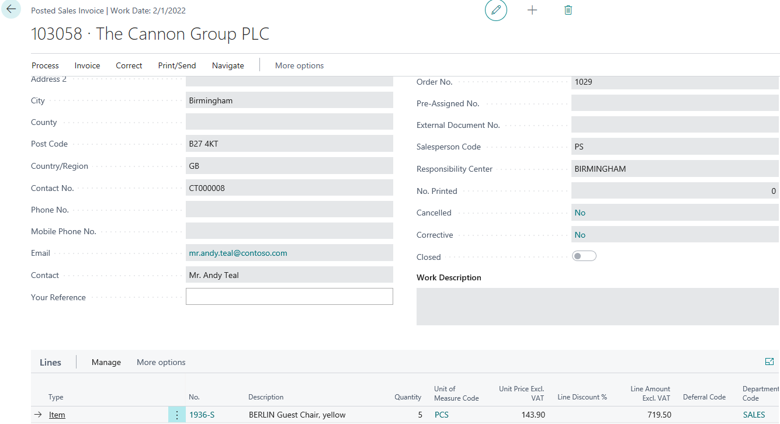
Posted Sales Invoice (after posting by F9 hot key)

Slide 7
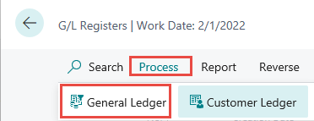
General Ledger (impacts) – One way to get at it
+ Sign -> Debit , - Sign -> Credit
719,50+179,88=899,38

Slide 8
Demand creation – Sales Order (only theory so far)
Reasons
Planning - calculation of replenishment and Creation of Purchase Order (PO)
Creation of two different PO covering demand with different costs
Posting both PO (Purchase Order documents)
Partly posting of Sales Order (For example, not everything was delivered by Vendor )
See applied Item Ledger Entries (this affects stock levels)
See important fields on the Item card
Inventory Adjustment (will be explain at the end of the course- only PIS2 course)
See the impact on item General Ledger Entries
See the impacts on Value entries (will be explain more in detail later – only PIS2 course !!!!)

Slide 9
Logic
Business Central supports supply planning for wholesale companies where the resulting supply orders can only be transfer and purchase orders.
The main interface for this planning work is the Requisition Worksheet page,
Which will be shortly described by tutor (only PIS2 coursce).
Material Requirement Planning
Netting
Vendor card
Customer card
Requisition worksheet
Proposals to replenish warehouse
Parameters
Parameters
Value entry
Sales Item ledger entry
Purchase Order Header
Sales Order Header
Purchase Item ledger entry
Purchase Item ledger entry
Value entry
Purchase Order Line
Sales Order Line
Value entry
Parameters
Item card
Parameters
Item card
Raw Data
Balancing
Replenishment
Demand

Slide 10
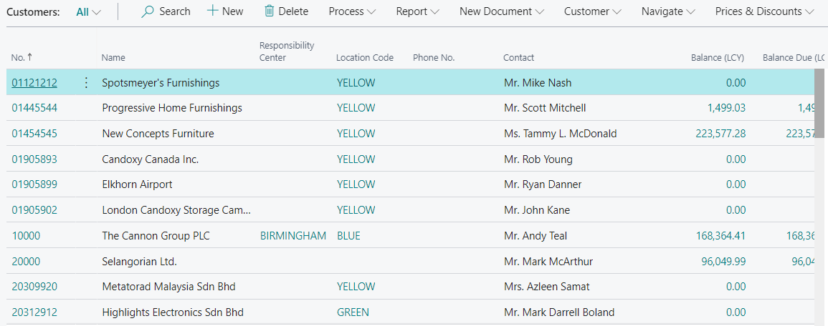
Customer card I.
Customer list

Slide 11
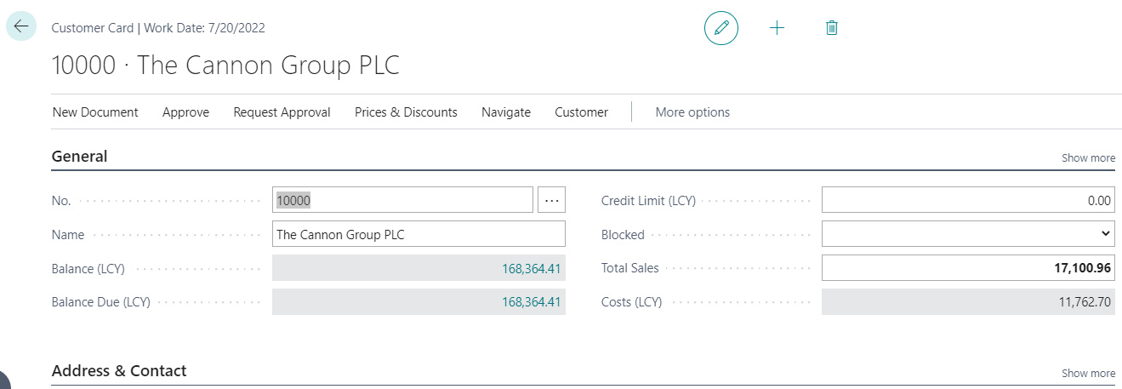
Customer card II.
Ctrl-F7
Entries

Slide 12
Customer card III.

Slide 13
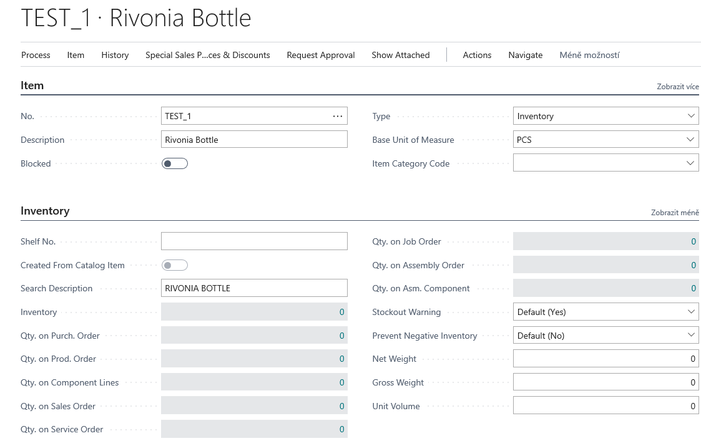
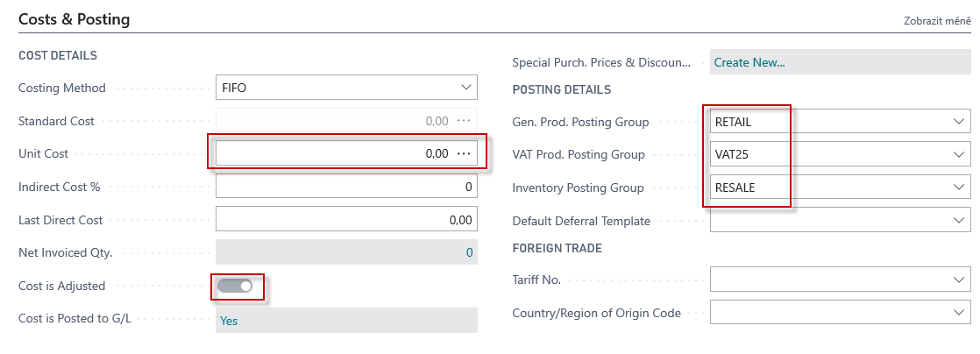
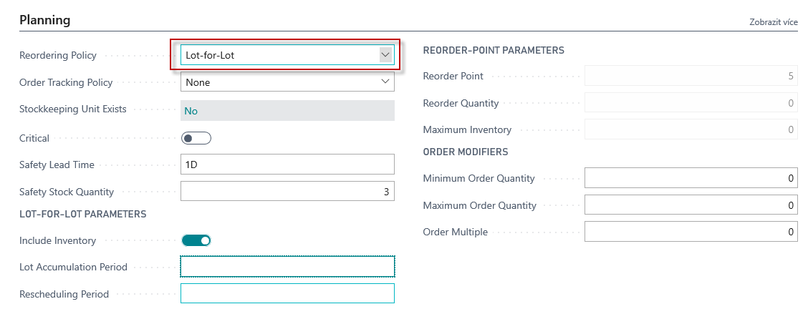
New item card (FIFO)
Lot Accumulation period explanation on the next slide
Lot-for-lot : The quantity is calculated to meet the sum of the demand that comes due in the time bucket.

Slide 14
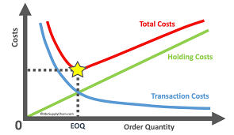
Lot- for- Lot-> Economic Order Quantity
Instead of three different purchases over time, everything is purchased only once
Quantity
Quantity
Time
Time

Slide 15
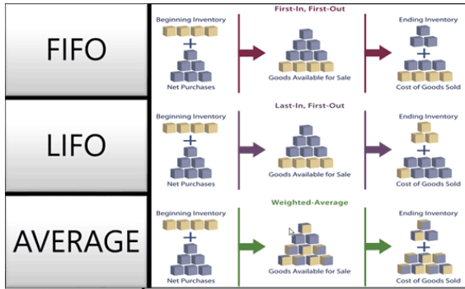
FIFO costing method (home study)
An item's unit cost is the actual value of any receipt of the item, selected by the FIFO rule. In inventory valuation, it is assumed that the first items placed in inventory are sold first.

Slide 16
New Sales Order
To find Sales orders you can use searching window !!!!
Sales Orders
already
created
but not
postet

Slide 17
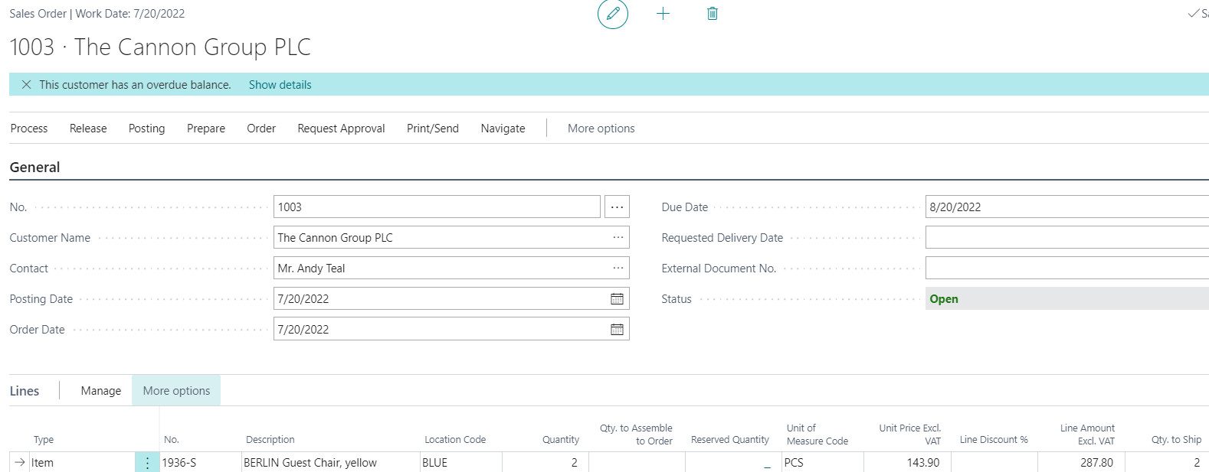
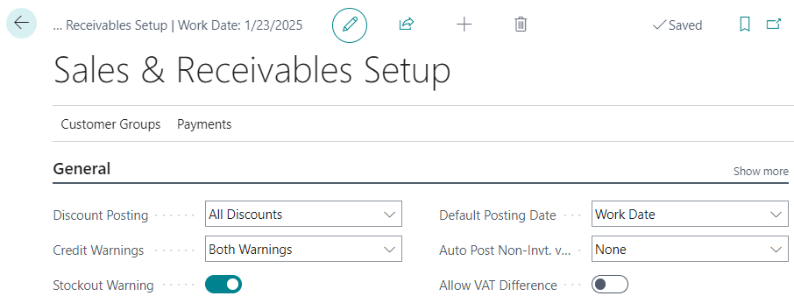
Sales Order created
It's just a warning based on Sales and

Slide 18
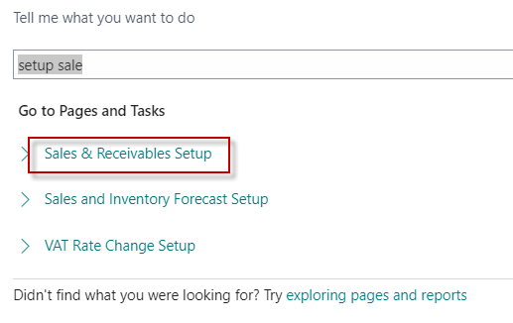
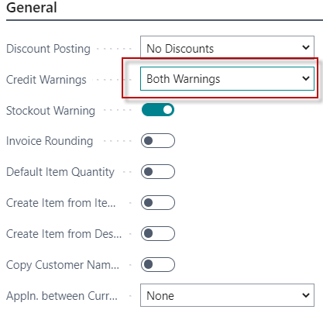
Setting warning types in BC
Credit limit (LCY)
Overdue
Both Warning
No Warning
Options
Credit Limit (LCY)
Specifies the maximum amount you allow the customer to exceed the payment balance before warnings are issued.
Learn more
Explanation : LCY=Local Currency

Slide 19
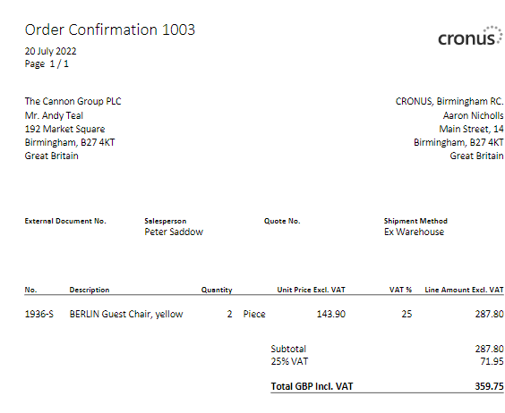
Sales Order print confirmation->Preview only
It can also be format pdf

Slide 20
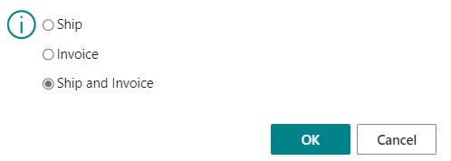
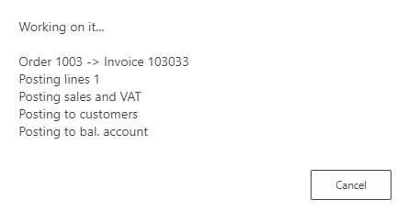
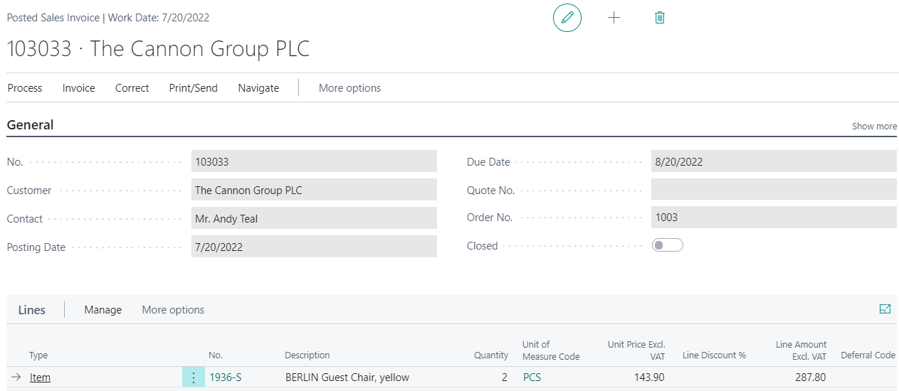
Sales Order posting (by use hot key F9)->Result->Sales invoice
You can also find it in BC
using the search window

Slide 21
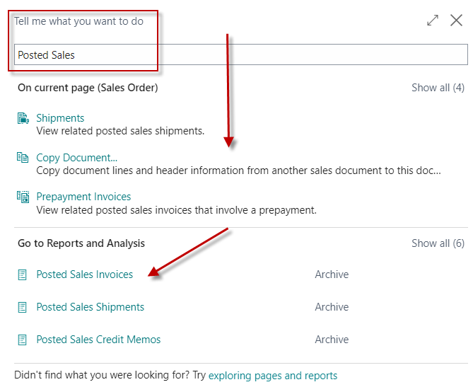
List of all Posted Sales Invoices

Slide 22
Customer Ledger Entries (raw data)
Ctrl-F7

Slide 23
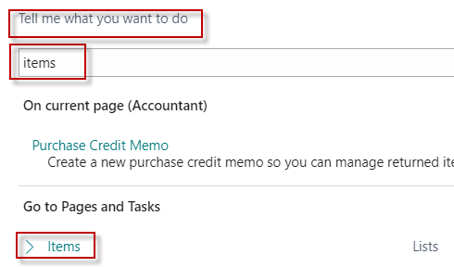
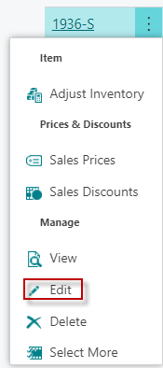
Item Ledger Entries
Edit
Item card 1936-S
Ctrl-F7
Costs, selling prices, decrease or increase in stock levels)

Slide 24
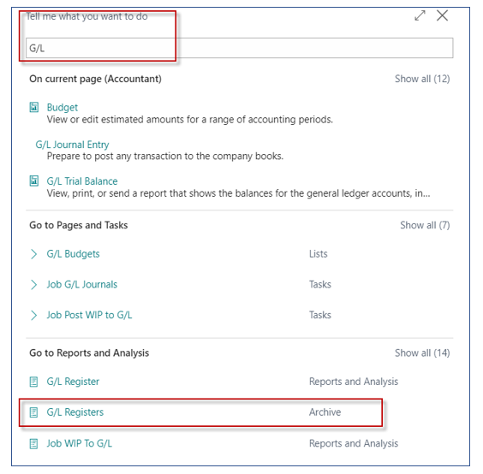
General Ledger Entries

Slide 25
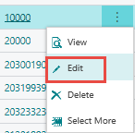
Purchase Order – List of Vendors
Vendor Card

Slide 26
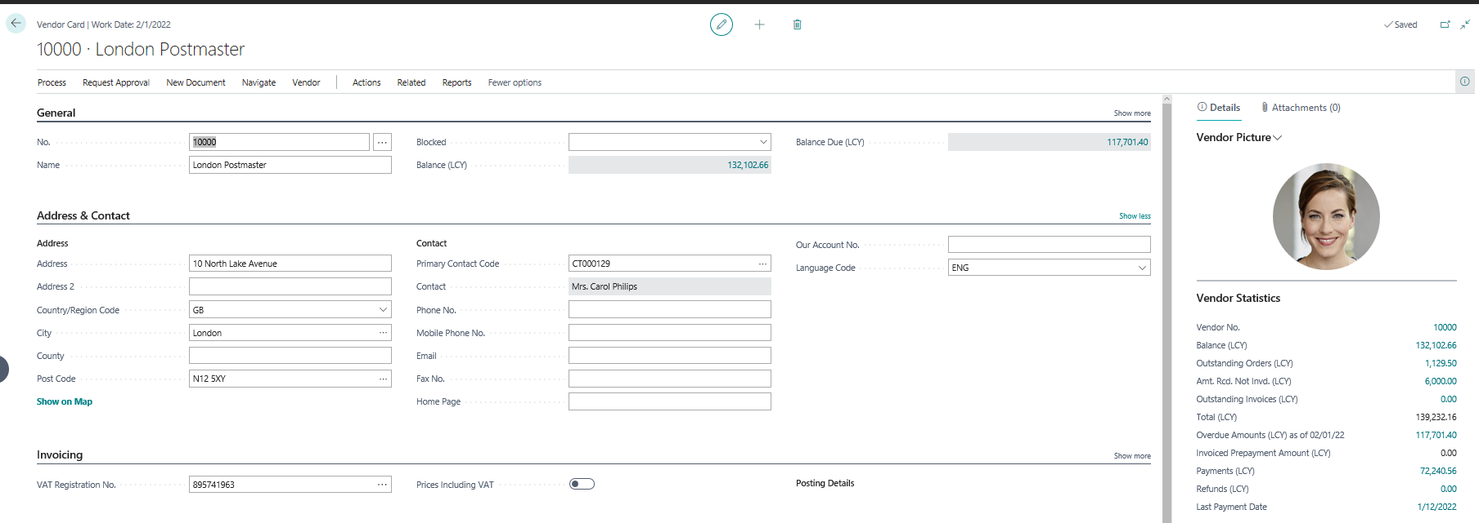
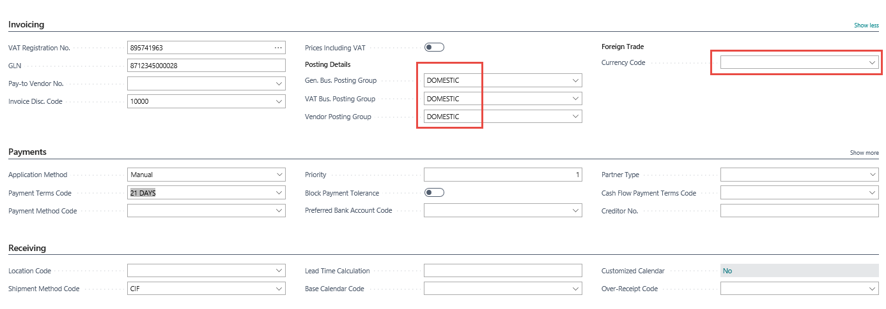
Purchase Order – Vendor Card

Slide 27
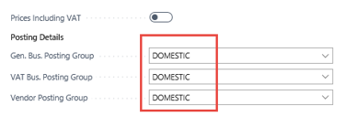
General Ledger Settings
Link to the general ledger account settings on which the purchase order that will become the purchase invoice will be posted
See tab Invoicing and options : Show more fields, Select from
full list->Edit list->Option Setup
Customer card –> one card=one chosen parameter
Item card –> one card=one chosen parameter

Slide 28
Purchase Order – document (Header and Lines)

Slide 29
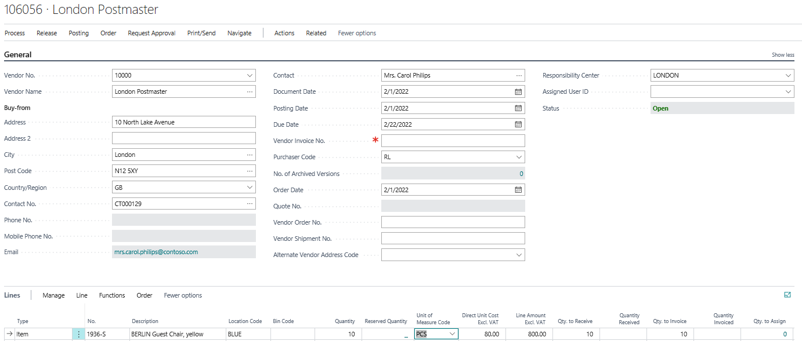
Purchase Order (PO) – document (Header and Lines)
Where there is
an orange asterisk
you need to add the data !!!!

Slide 30
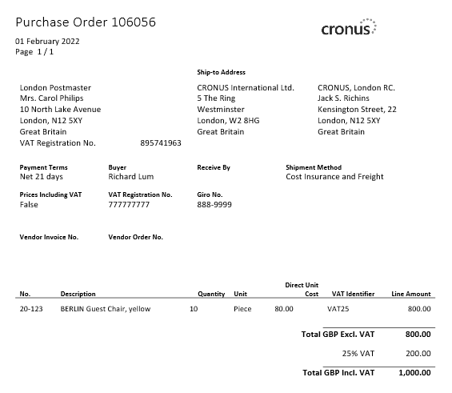
PO- Preview

Slide 31
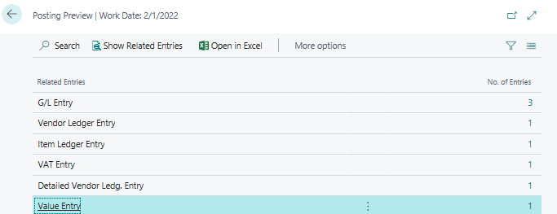
PO - preview posting by appropriate icon
G/L Entries see next slide
Invoice (could be modified by personalize feature-adding fields)
Presented in BC - 2
Inventory (could be modified by personalize feature-adding fields)

Slide 32
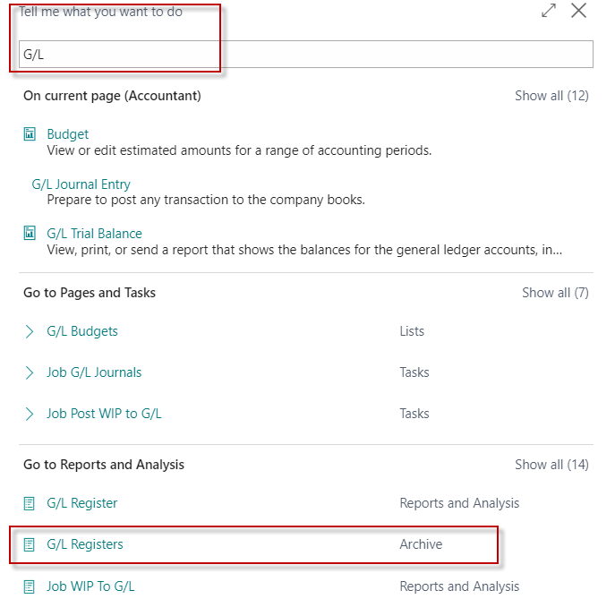
General Ledger Registers-> Archive

Slide 33
PO – General Ledger Entries - preview

Slide 34
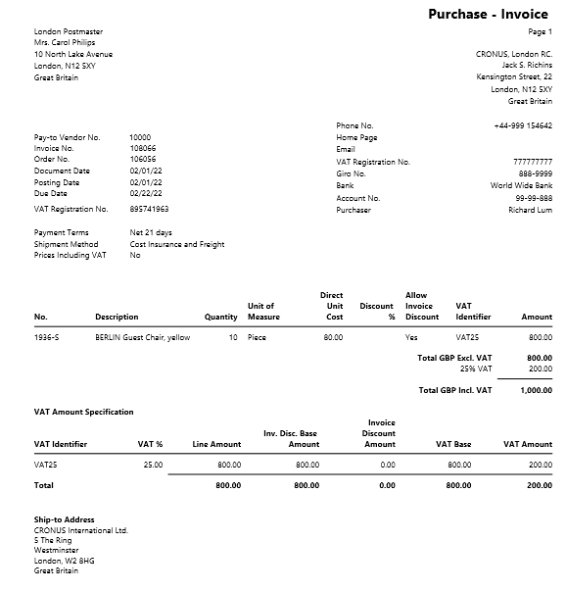
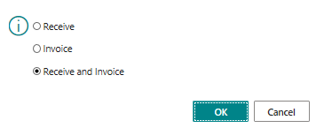
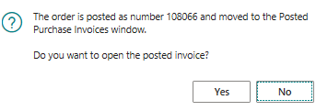
PO – F9 posting

