Slide 1
Introduction to MS Dynamics 365 Business Central Discounts
Ing.J.Skorkovský,CSc.
MASARYK UNIVERSITY BRNO, Czech Republic
Faculty of economics and business administration
Department of Business Management

Slide 2
Discounts
Use of discounts:
Support of „Sales“ actions->lower stock value and better liquidity
Support of marketing ->get new clients
Basic incentives for any client
To differentiate between clients (based on sales in the last period or other criteria)
Types :
Price ->modification of Unit Price
Line ->change the final Unit Price in %
Invoice Discount ->based on the level of invoiced amount on one document

Slide 3
Discount calculations I
Unit price=100
Price discount 10 %
New updated unit price on the cretaed document = 100*0,9=90
Line discount 10 % added
New updated unit price on the cretaed document = 90*0,9=81

Slide 4
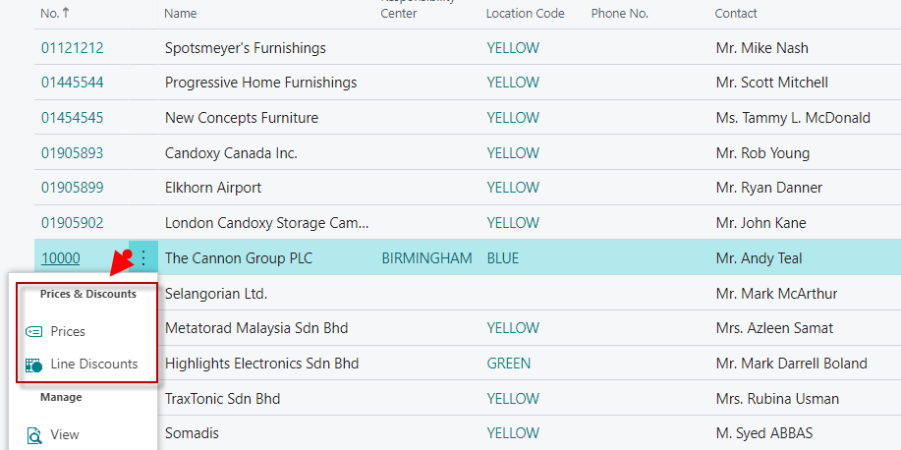
Customer card 1st possibility to access discount setup
Discounts can also be adjusted from the item card.
So either from customer card and it will be automatically
transferred to the item card or vice versa.

Slide 5
Customer card 2nd possibility to access discount setup
Here you can set the different unit prices in absolute values as well as the % discount depending on the quantity of items.

Slide 6
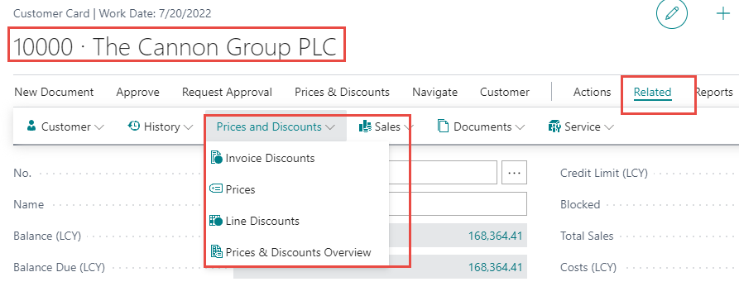
Customer card-3rd possibility to setup discounts

Slide 7
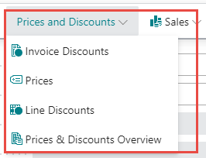
Basic Blocks
Customer
Discount Group
Customer
Window used
for Invoice Discount
setup
Allow Line
Discount
(Yes or No)
Sales
header
Window used
for Price Discount sestup
Sales line
Window used
for Line Discounts setup
ITEM
Item Discount
Group
Unit Price
Allow Invoice
Discount
(Yes or No)
Can be access either from
Customer Card or from
Item Card

Slide 8
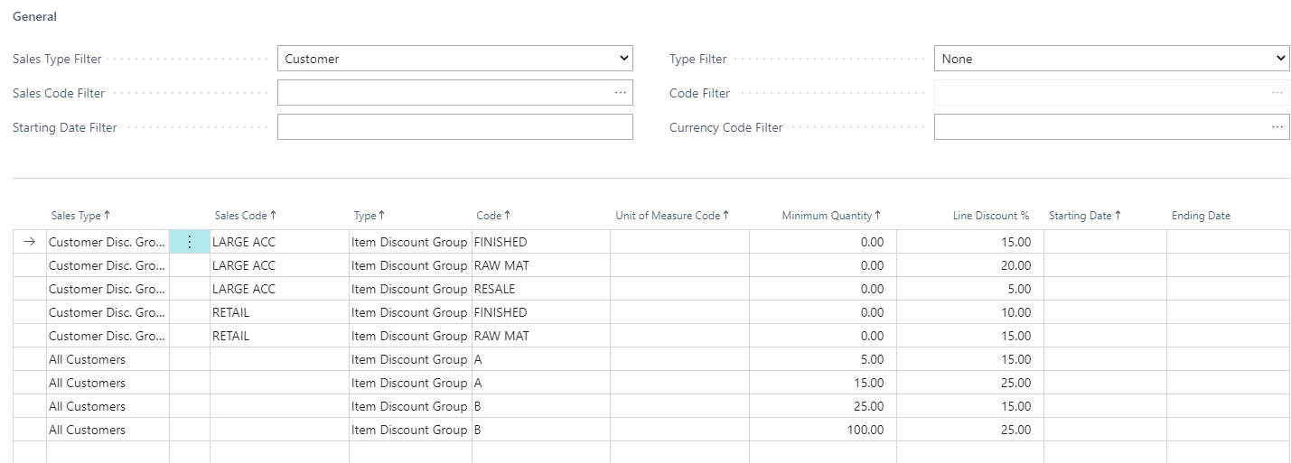
Window used for Line Discounts Setup (%)
Condition for quantity rebate
From this window you can see that some discounts are valid for
all customers
or
only for a certain group of customers (Customer Discount Group)
or
for one customer only

Slide 9
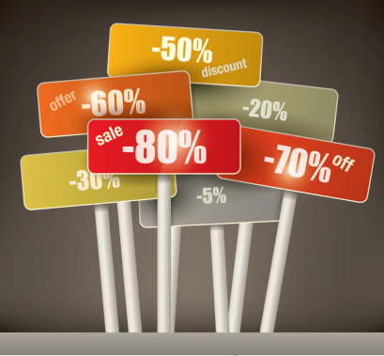
Window used for Line Discounts Setup (%)
In none of our examples here do we indicate the start or end of discounts in time !!!
With the time limitation of the validity of discounts being one of the basic requirements !!!

Slide 10
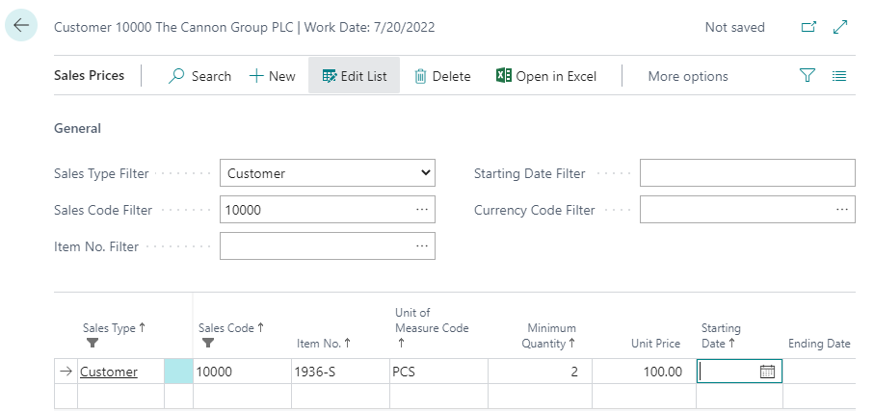
Window used for Sales Line Discounts Setup
One customer only

Slide 11
Discount combination –similar example as on slide number 3
Sales Price reduced from 100 to 90
Line Discount % =10
Final price after discounts were applied = 90*0,9=81,0

Slide 12
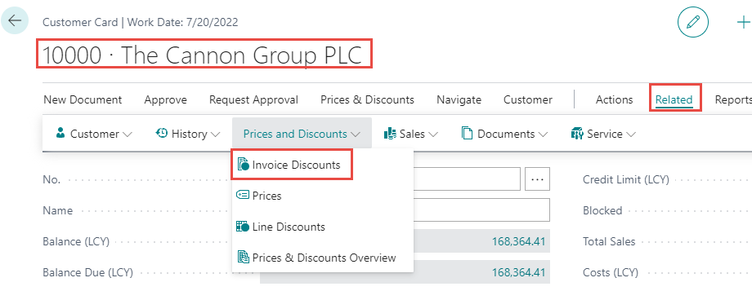
Invoice discount setup
Invoice discount must be allowed and manually confirmed before
you start to calculate it !!

Slide 13
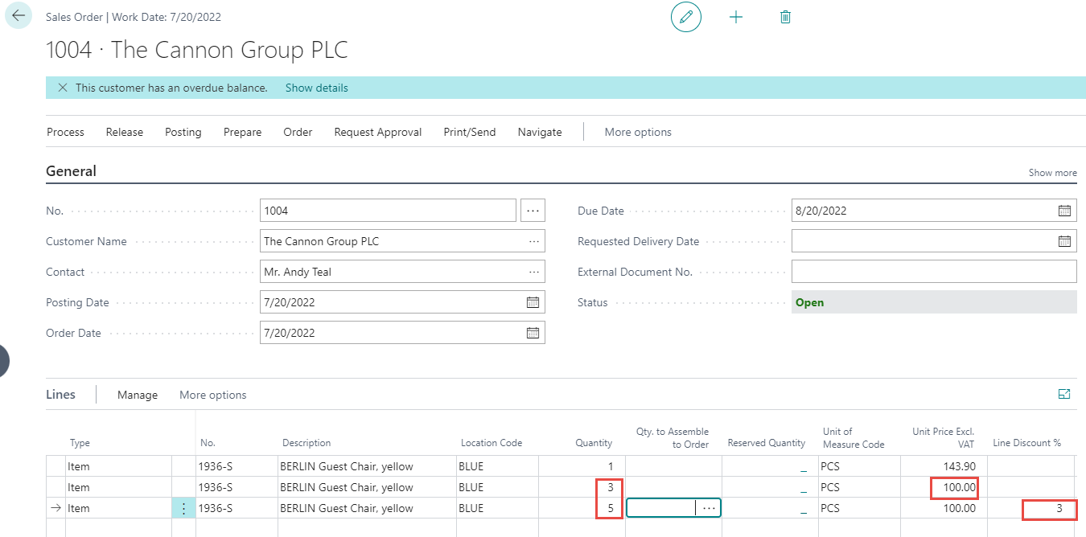
Sales Order
Sales lines of the Sales Order

Slide 14
Invoice Discount calculation
(F7= Statistics)
Sales lines before invoice discount application

Slide 15
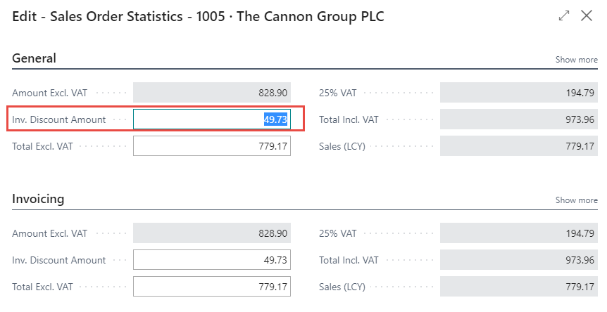
Invoice Discount calculation (acces by use of F7 key)
F7 -> Statistics

Slide 16
Sales line after applicaton of invoice discount

Slide 17
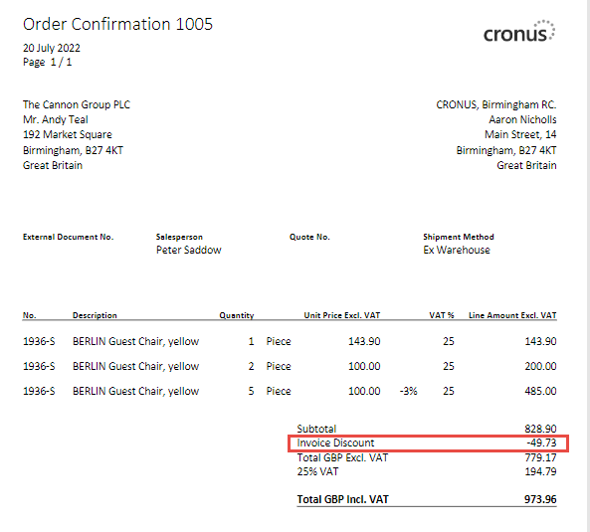
Sales order print

Slide 18
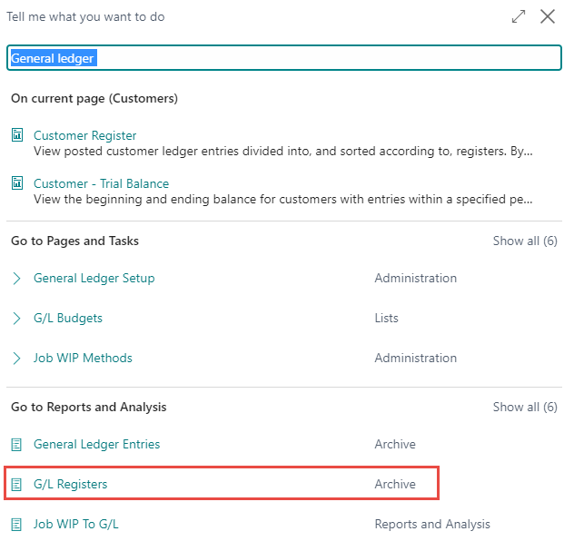
General ledger entries after posting F9

Slide 19
General ledger entries after posting F9

Slide 20
General ledger entries after posting F9
Discount granted

Slide 21
Simple seminar
example

Slide 22
Create New customer and item
Use chosen item template :
Name: your name and comany (e.g. John´s company)
Create new item – see if Allow Invoice discount is OK (switched on)
Used template: TEST_02 (1st template out of 3)

Slide 23
Customer card –control about Line discount

Slide 24
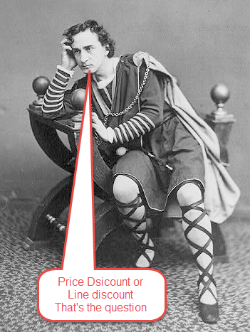
Seminar example

Slide 25
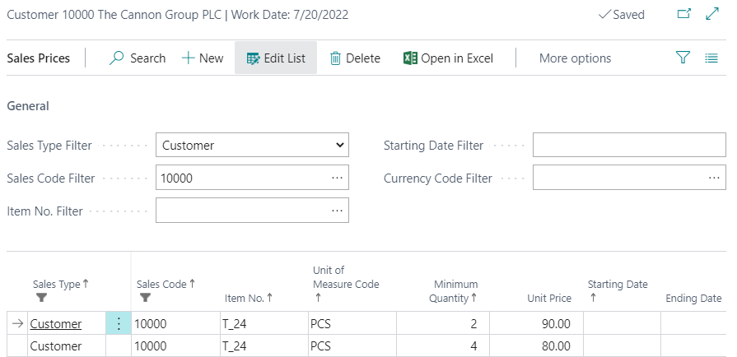
Example for training
Unit Price Discount Setup
Your customer number
Your item
Your new unit prices
Follow teacherś step´s !!!
Thresholds for quantity rebates

Slide 26
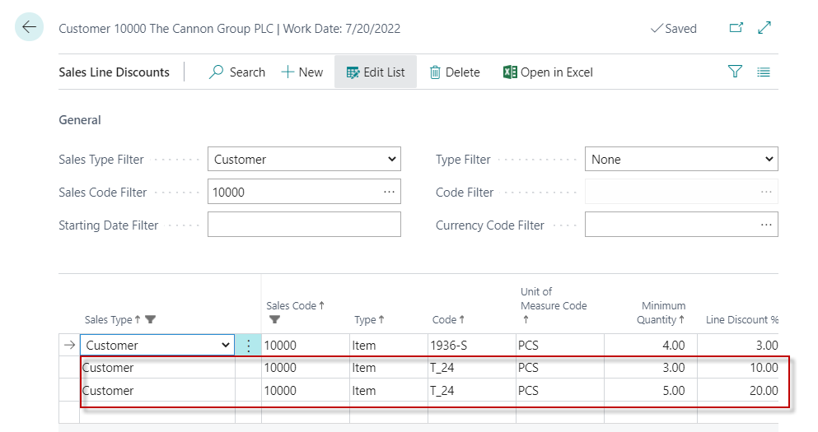
Example for seminar
% Line Discount Setup
Thresholds for quantity rebates in % discounts

Slide 27
Example for seminar
Invoice Discount Setup (acces from icone related)

Slide 28
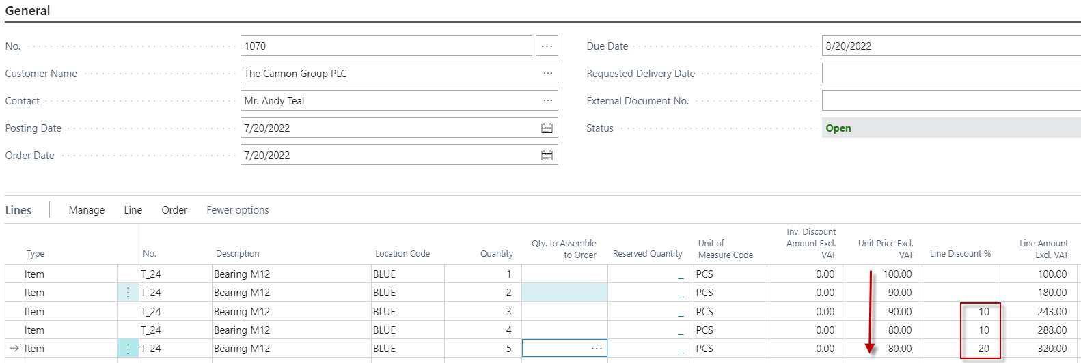
Example for seminar
Sales Order
More sales lines are listed here only so you can see the gradual changes
in the types of discounts so that these discounts change depending
on the number of pieces ordered

Slide 29
Example for seminar
Sales Line of the Sales Order (only Sales Line)-modified Sales Line from previous slides

Slide 30
Example for seminar
Invoice Discount Application : step 1
Use icon Prepare

Slide 31
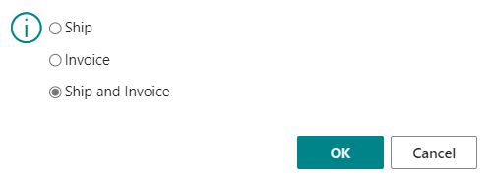
Example for seminar
Invoice Discount Application : step 2
Posting Sales Ordes by key F9

Slide 32
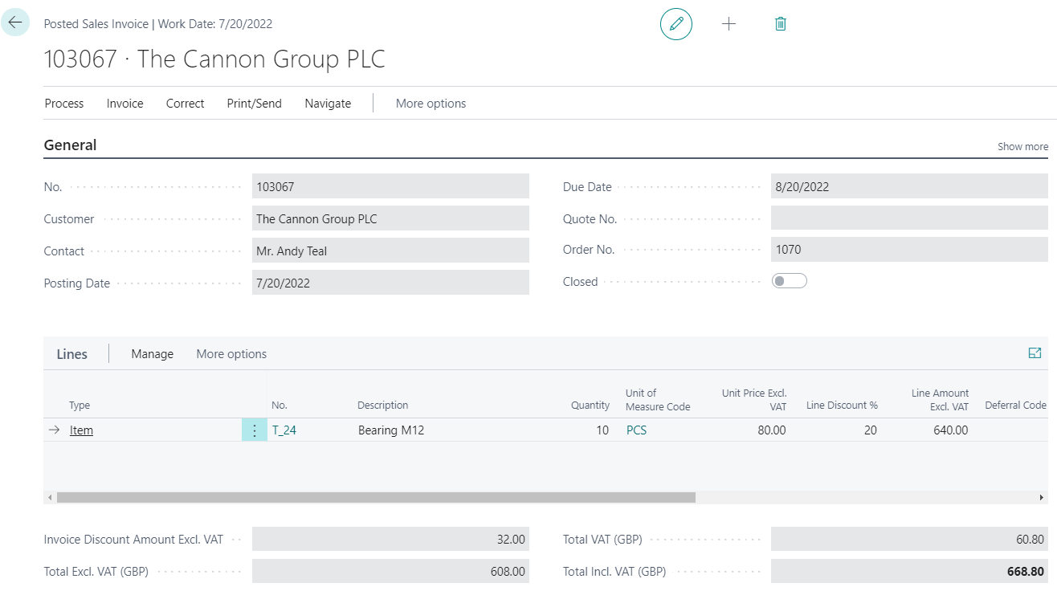
Example for seminar
Posted Sales Invoice

Slide 33
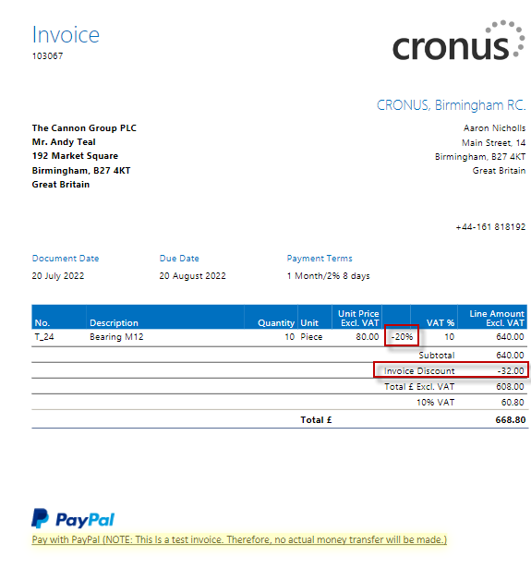
Example for seminar
Printed Posted Sales Invoice

Slide 34
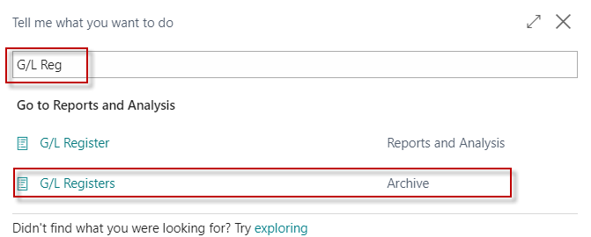
Example for seminar
General Ledger Entries

Slide 35
Example for seminar
General Ledger Entries
Account name : Discount granted
Account number : 6910

Slide 36
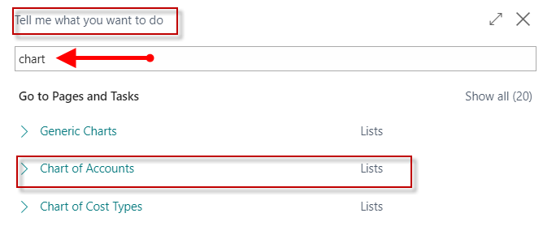
Chart of accounts I.
Or you can use access from Customer Ledger Entry (last created invoice type)
and subsequent function Find entry

Slide 37
Chart of accounts (set filtr to 6910) II.
Ctrl-F7
(G/L Entries)

Slide 38
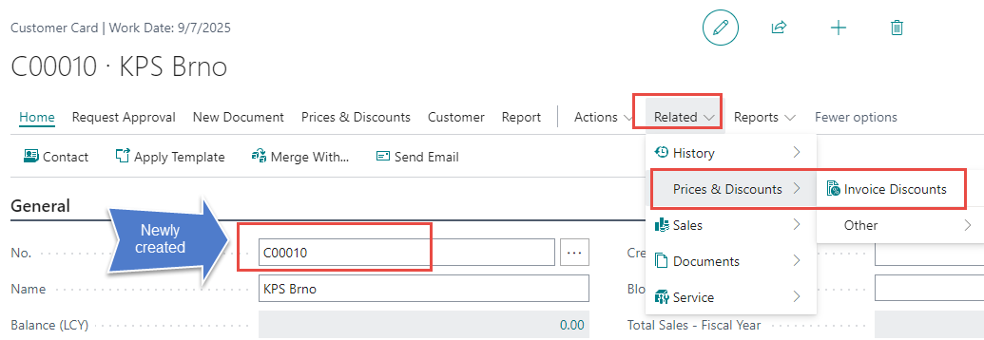
Invoice Discount and charges (more detailed explanation)
Amount <10 ->no Discount 5% or Service Charge 7,0 is calculated
Amount >10 and <500 only Service Charge 7,0 is calculated
Amount >=500 only Discount 5% is calculated

Slide 39
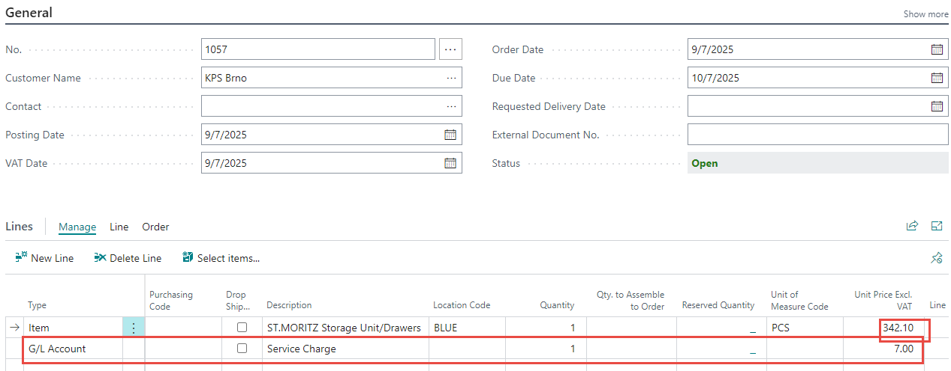
Sales order I

Slide 40
Sales order II (Unit price modified) – only line

Slide 41
End of the section (Discounts)
This is the end Beautiful friend This is the end My only friend, the end…
So why worry now ……

