Slide 1
Introduction to MS Dynamics 365 Business Central
Discounts new version in MS 365 BC
This concept described in this PWP presentation
was not used in the MPH_AOPR 2023-2024 course
DO NOT STUDY !
Ing.J.Skorkovský,CSc.
MASARYK UNIVERSITY BRNO, Czech Republic
Faculty of economics and business administration
Department of business manmagement

Slide 2
Statements
Discount system configuration may be different according to the Business Central version (ESF actual version has a number 22)
The discount system also includes the creation of price lists for various customers or groups of customers and various categories of traded items.

Slide 3
How to determine the Dynamics 365 Business Center version
Log into your Business Central software and click the ‘Help’ icon – a small question mark in the top right-hand corner
Select the ‘Help & Support’ option
In the window that opens, in the Troubleshooting section it should display your current version number with the build version, and the product release name in brackets.

Slide 4
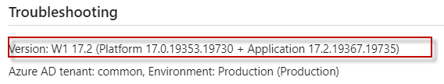
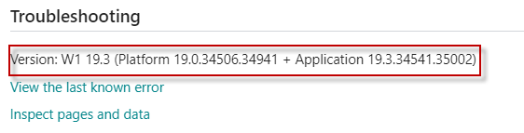
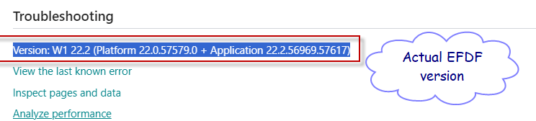
Older and more recent versions of BC on which the PWP file with serial number VIII-I (old) and VIII-II (new) is based
Old version
New version

Slide 5
Discounts -reasons for use
(already mentioned in the file BC – 8-1)
Use of discounts:
  Support of „Sales“ actions->lower stock value and better liquidity
  Support of marketing ->new clients
  Basic incentives for any client
  To differentiate between clients (based on sales in the last period or other criteria)
  Types :
  Price ->modification of Unit Price
  Line ->change the final price in %
  Invoice Discount -> based on the level of invoiced amount

Slide 6
Discount calculations I
(already mentioned in the file BC – 8-1)
Unit price=100
We can manually reduce the Unit price to a lower level, for instance, 90, so the new updated Unit price on the created document will be 90
We can assign to selling (purchasing) line discount in %, so let's use a 10 % line discount
The final Unit price will then be 90*0,9= 81

Slide 7
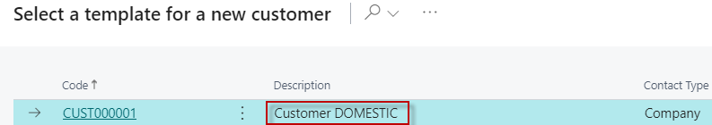
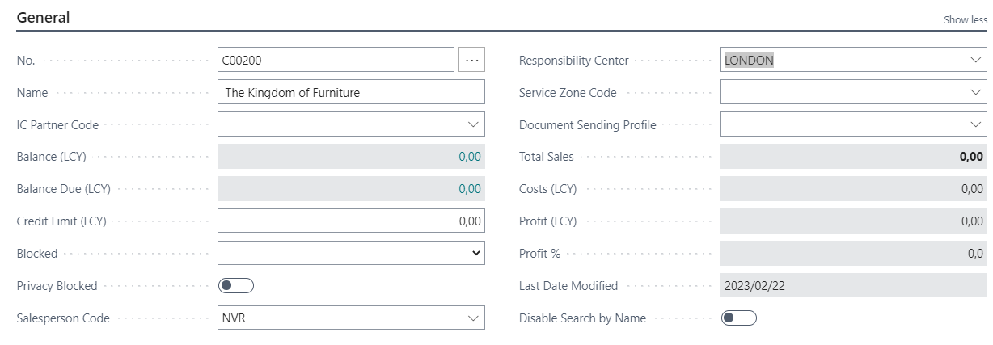
Creation of the new customer I.
Chosen role = Sales Order Processor -> Customers -> New -> Template_
OK
Other tabs on next slide

Slide 8
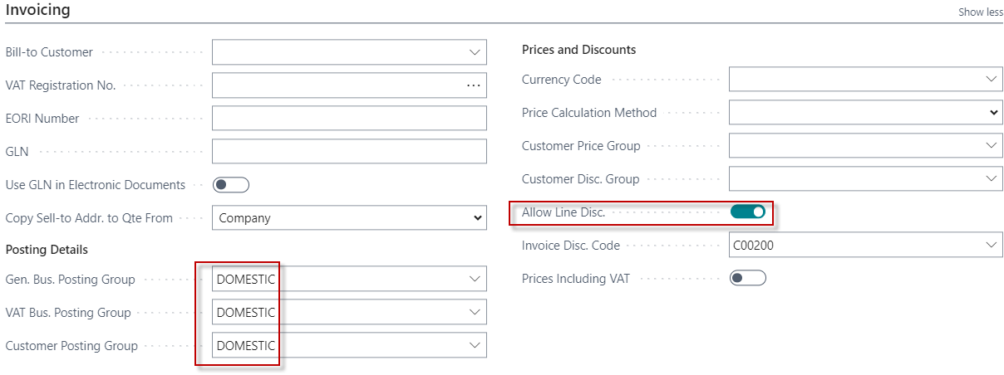
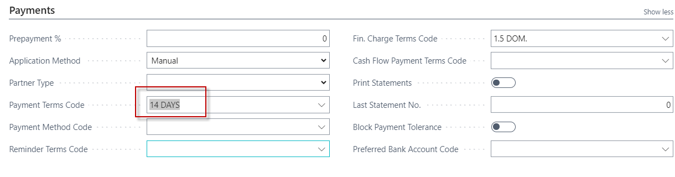
Creation of the new customer II.

Slide 9
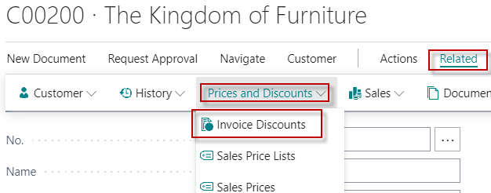
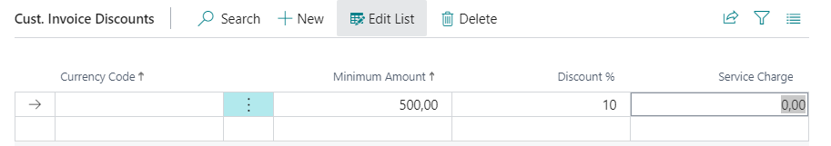
Invoice discount setup on our new customer
Customer card

Slide 10

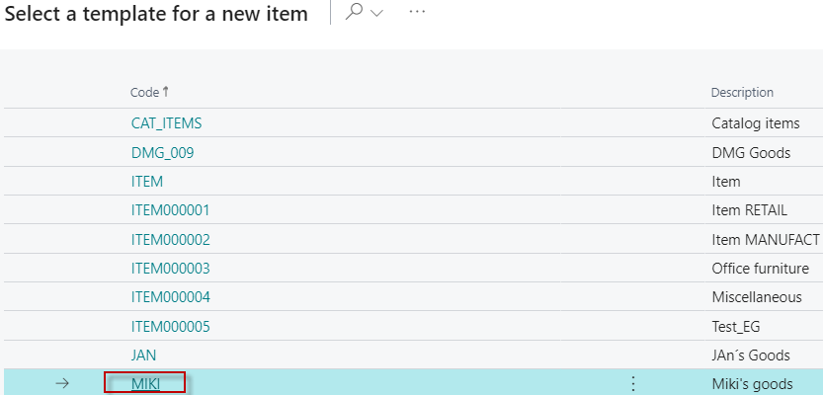
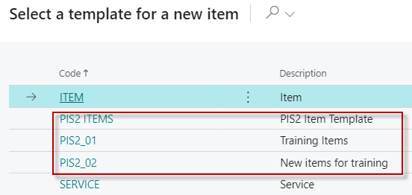
New item creation I
OK & see next slide
Use one of these item templates in your instance

Slide 11
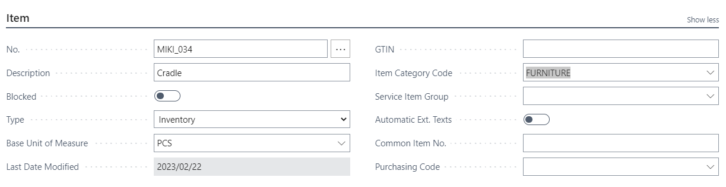
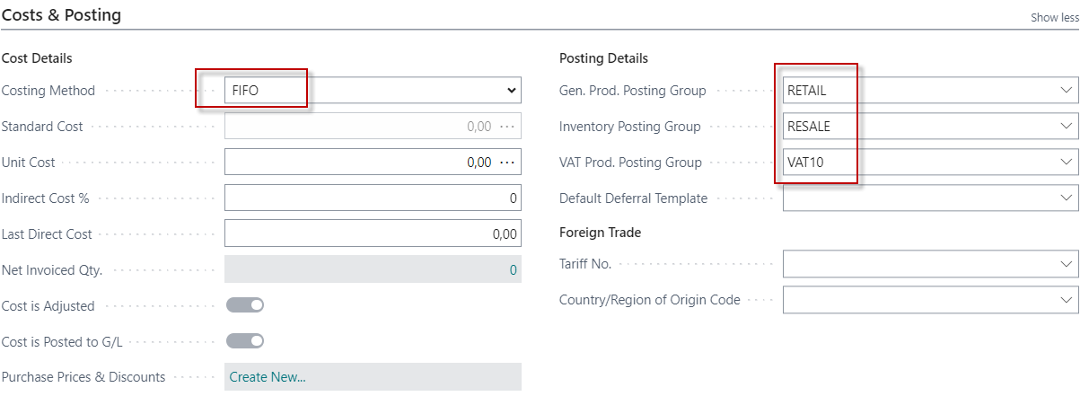
New item creation II
See other Item tabs

Slide 12
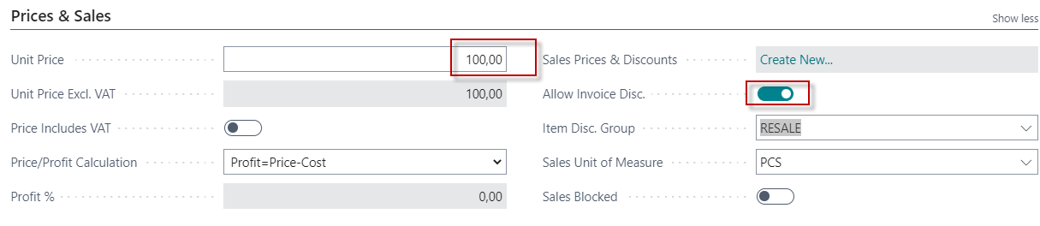
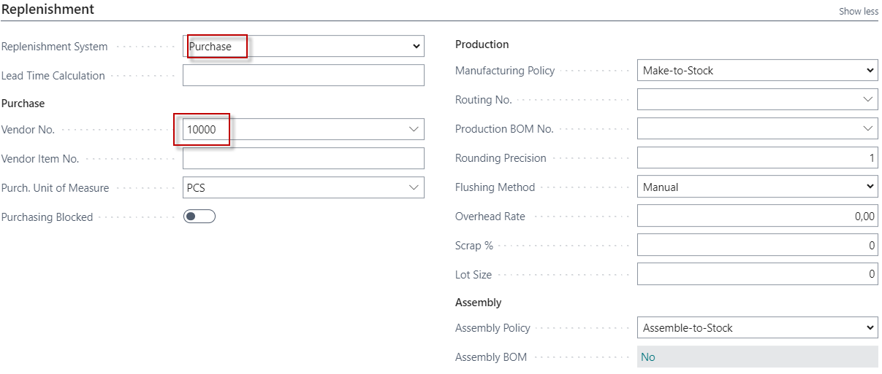
New item creation III
Values of some fields are entered manually on the card

Slide 13
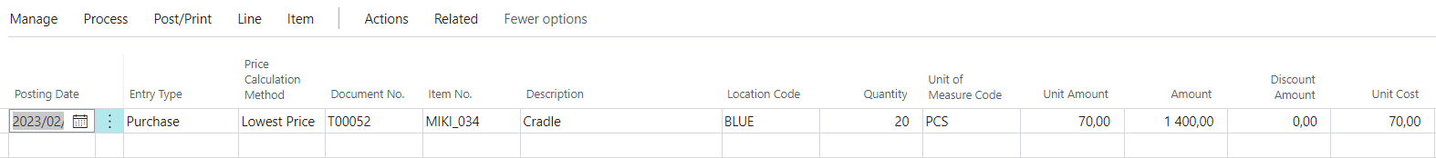
Purchasing item by use of Item journal
F9
Item ledger entries
So far we have only used Purchase orders for replenishment. Now we will use this item journal. Everything is the same except that the vendor is not included in this type of replenishment.

Slide 14
Setup of discounts from Customer card
Types of settings (combinations of discounts)
For whom | What for? | Unit price | Line discount
Customer | Item
Customer Discount Group | Item
Customer | Item Discount Group
Customer Discount Group | Item Discount Group
All Customers | Item
All Customers | Item Discount Group
Our 1st model

Slide 15
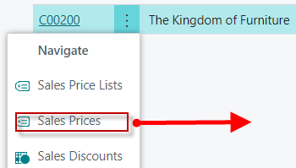
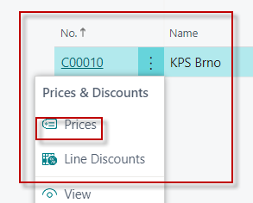
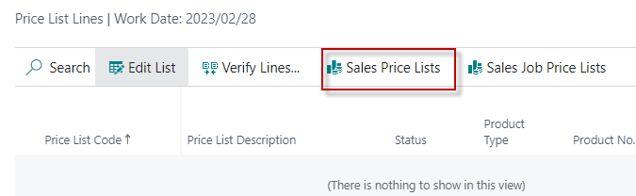
Customer (chosen Customer number C00200)
Or
In the newer version of BC, we have to access the Sales Price list through the search window

Slide 16
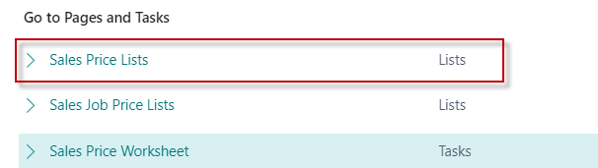
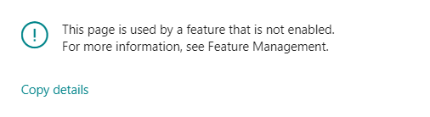
Sales Price List access (new BC)
See next slide

Slide 17
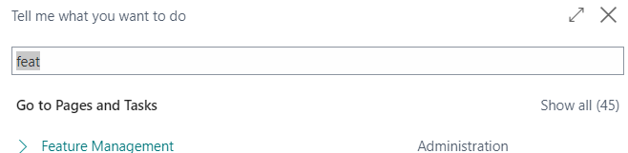
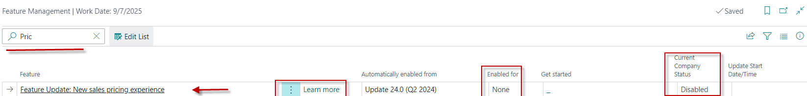
Feature Management
Use new sales pricing experience

Slide 18
Use new sales pricing experience
If you record special prices and line discounts for sales and purchases, Business Central can automatically calculate prices on sales and purchase documents, and on job and item journal lines. The price is the lowest permissible price with the highest permissible line discount on a given date. Price calculation in Business Central can fit many businesses, but there are also many that have industry or business-specific pricing needs. This improvement addresses such needs by making price calculation and its user experience easily extendable.
By default, the status of new price lists is Draft. When you're done adding lines and want the price calculation engine to include it, you can change the status to Active.
To review price lists and prices that apply for specific customers or vendors, on the Customer page, choose Sales Price Lists or, on the Vendor page, choose Purchase Price Lists. You can view price list lines set in various price lists by choosing Sales Prices or Purchase Prices from the Item and Resource pages.

Slide 19
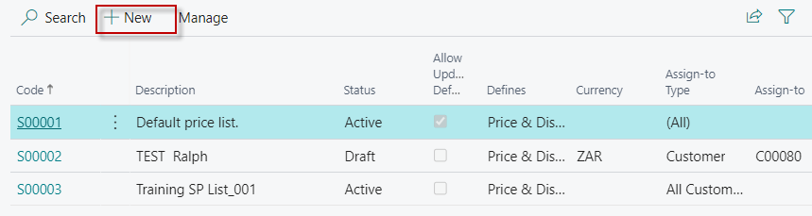
Sales Price Lists
The system opens previously created Sales Price Lists for other customers created before and other types of discounts for selected items. These Lists can have different states such as Active or Draft or Inactive
Let's create a new Sales Price List

Slide 20
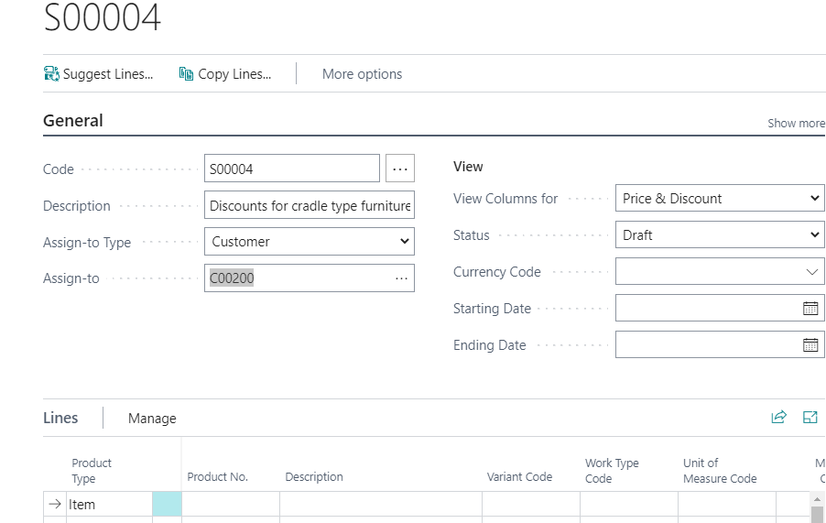
Let's create a new Sales Price List (header)

Slide 21
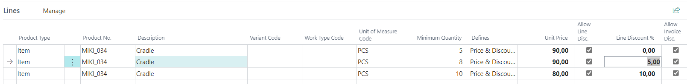
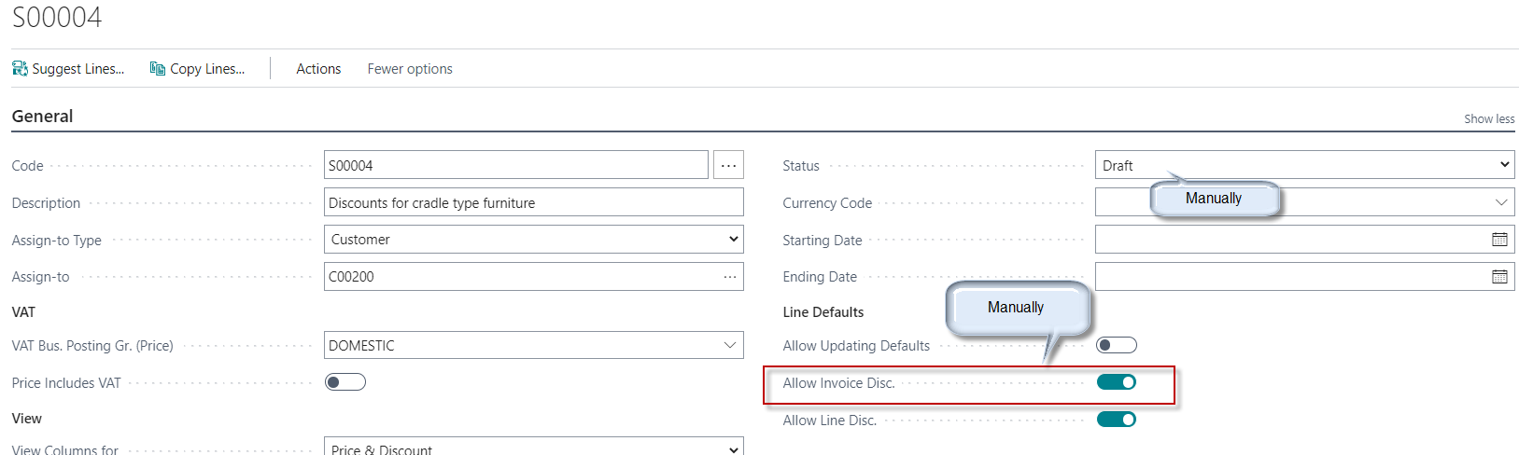
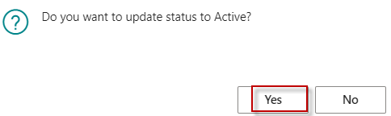
Let's create a new Sales Price List (lines)
In the rows it is necessary to set both the quantity determining
levels for activating the quantity rebates and then the modification
of Sales Price and Line Discounts in %

Slide 22
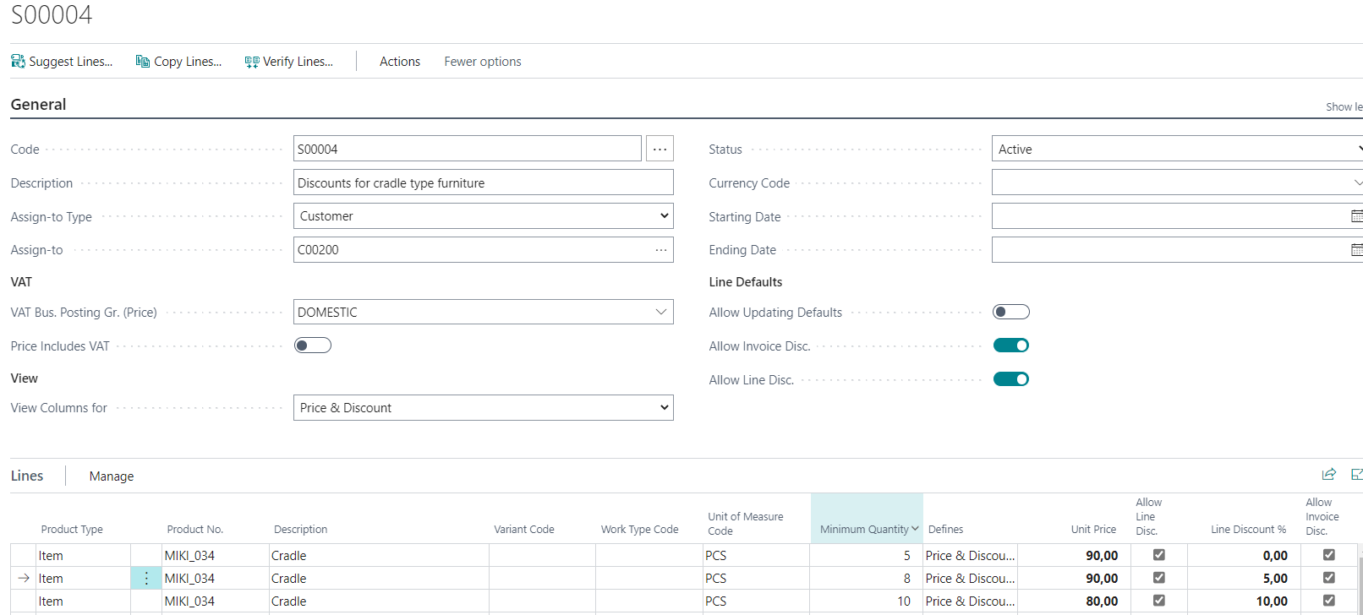
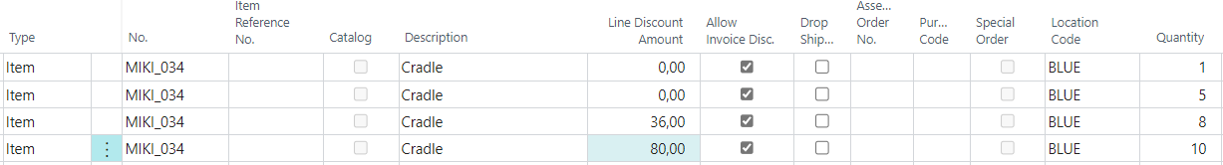
Sales Price List afer editing

Slide 23
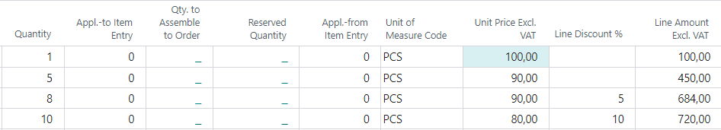
Sales Order lines (SO lines)
1st part of the line
Followed by the second part of the line
Calculation method Line discount amount presented on 3rd Sales Order line :
8 * 90 =720
720 * 0,95=684, where 0,95 represents 5 % of discount
Unit Discount Amount is calculated : 720-684=36

Slide 24
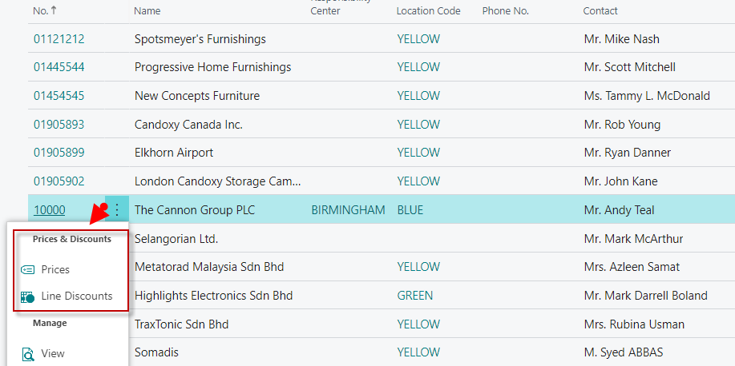
Customer card one possibility to access discount

Slide 25
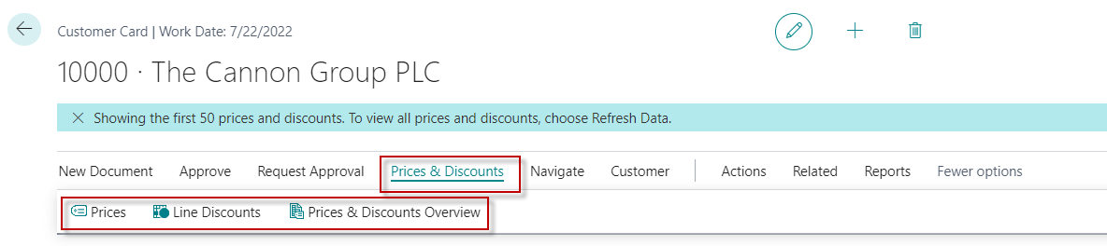
Customer card ->2nd possibility to access discount
Here you can set the different unit prices in absolute values as well as the % discount depending on the quantity of items.

Slide 26
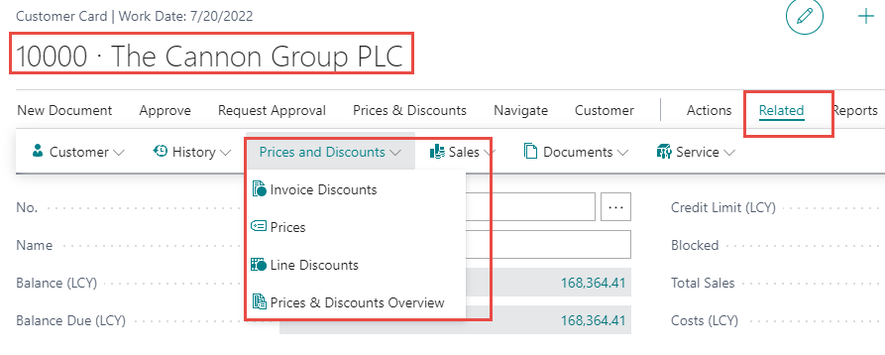
Customer card-3rd possibility to setup discounts

Slide 27
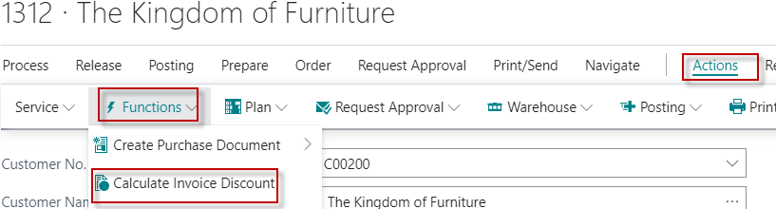
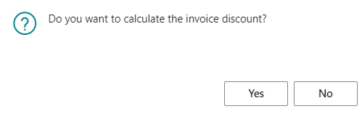
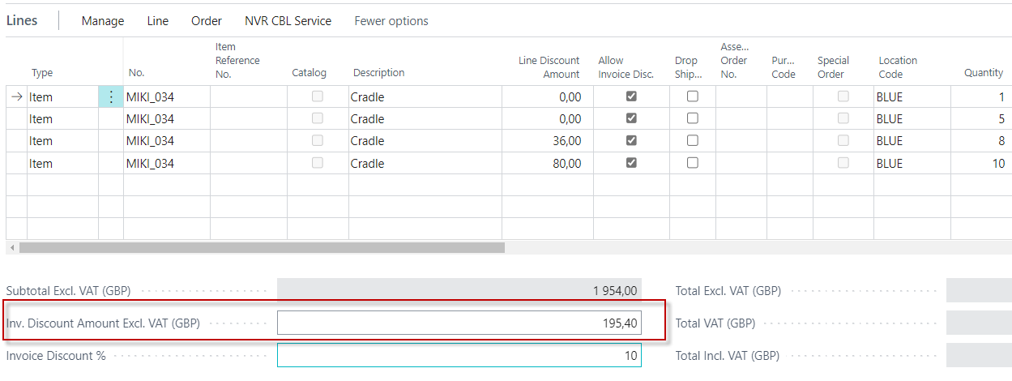
Invoice discount activation

Slide 28
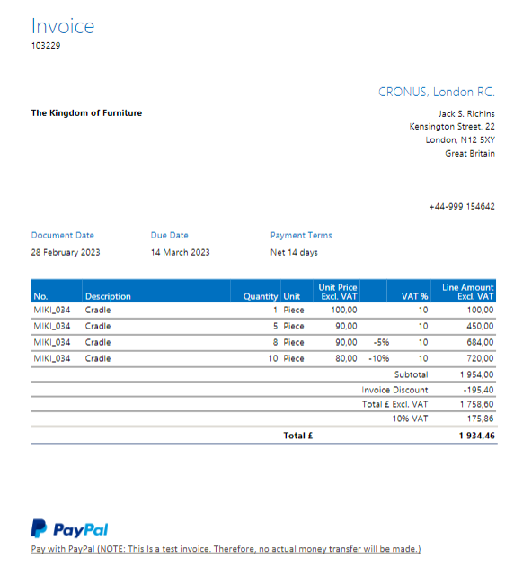
Sales Invoice

Slide 29
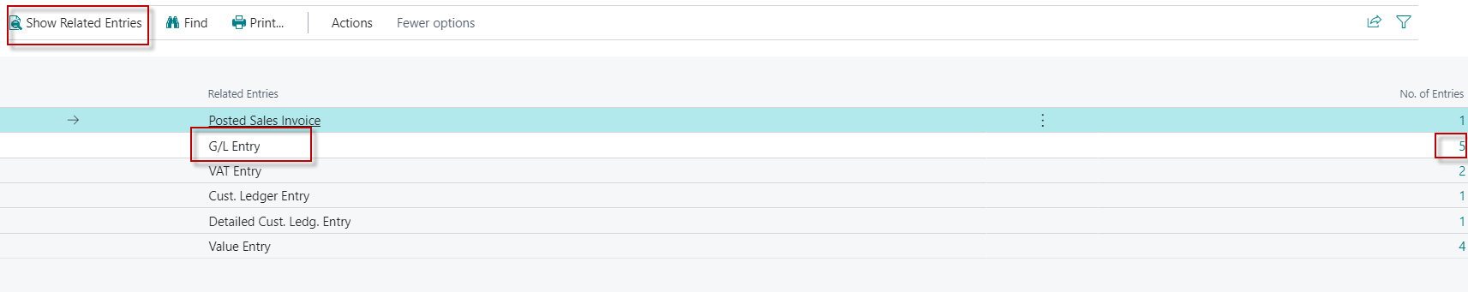
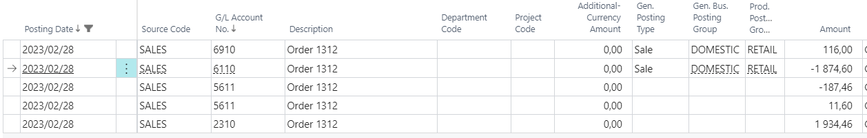
G/L Entries from Customer Ledger entries
Customer Card->Ctrl-F7->Entry->Find entries
Discount Granted G/L Account

Slide 30
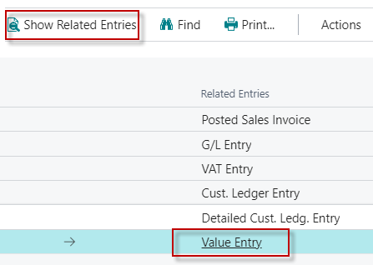
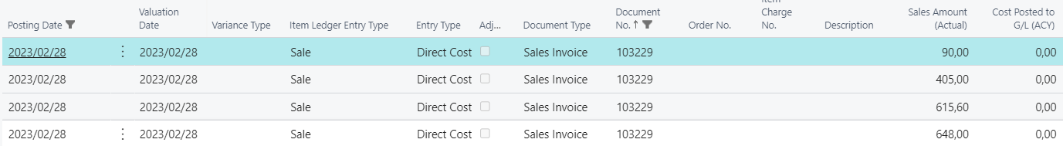
Value entries after sales
Original Unit price =684 , VAT 10% = 68,4 and
Selling price without VAT = 615,60 = 684-68,4

Slide 31
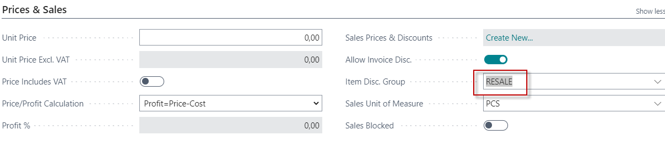
Next new item type cradle
So after buying with Item journal we will have two cradles with the same Item Discount Group = Resale. Both cradles have also dimension Furniture with Dimension Value =Cradle

Slide 32
Setup of discounts from item
Types of settings (combinations)
For whom | What for? | Unit price | Line discount
Customer | Item
Customer Discount Group | Item
Customer | Item Discount group | not allowed
Customer Discount Group | Item Discount Group
All Customers | Item
All Customers | Item Discount Group

Slide 33
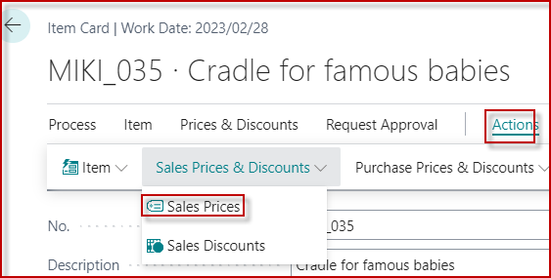
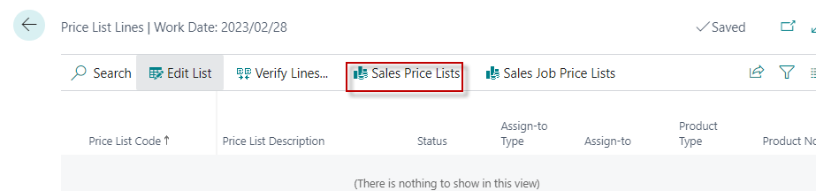
Setup of discounts from item I

Slide 34
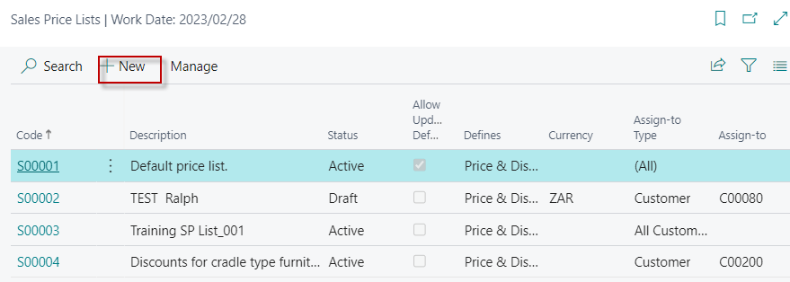

Setup of discounts from item card II

Slide 35
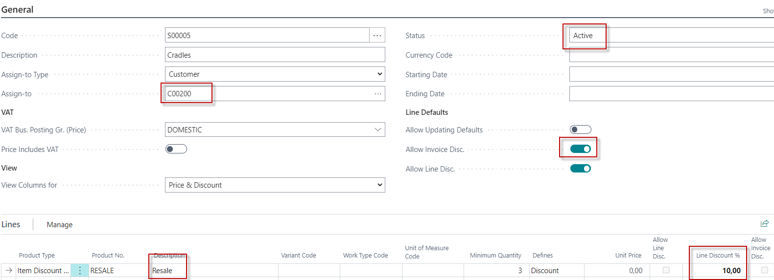
Setup of discounts from item II

Slide 36
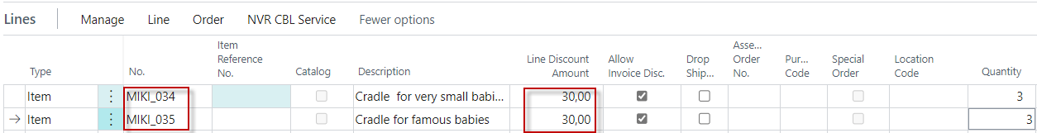
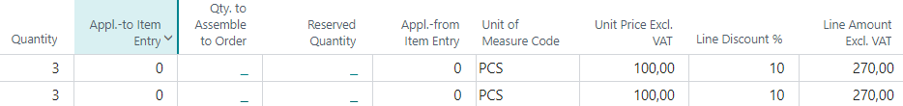
Sales Order Line (applied Item Discount Group)
1st part of the line
2nd part of the line
Best Price Calculation -> home study
After you record Special prices and line discounts for sales and purchases, Business Central calculates
the best price on sales and purchase documents, and on job and item journal lines.
The best price is the lowest price with the highest line discount allowed on a given date.
Business Central calculates best prices when it adds unit prices and the line discount percentages
on document and journal lines.

Slide 37
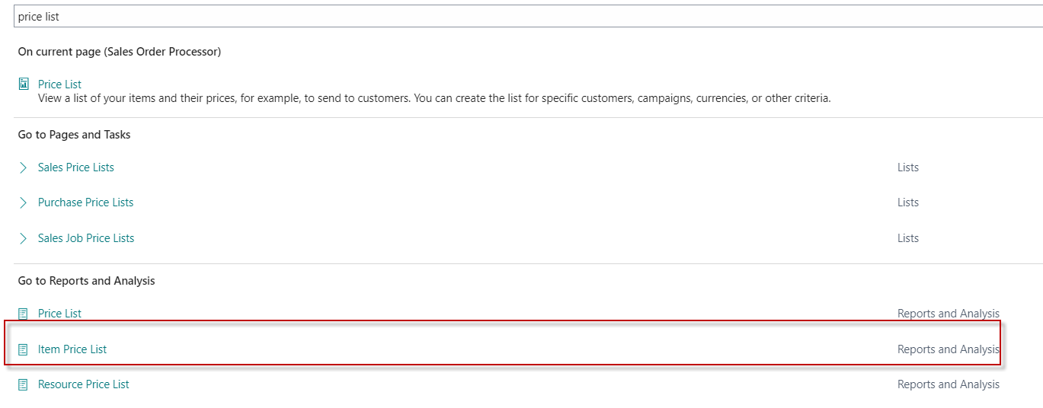
Item Price List

Slide 38

Item Price list

Slide 39

Price List
Our
model

Slide 40


Slide 41

End of the section
(Discounts new version)
This is the end
Beautiful friend
This is the end
My only friend, the end…
So why worry now ……

