Slide 1
Theory of business informatics
Seminar: Quantitative methods in the IS
(part 2)

Slide 2
Today‘s agenda
Goals:
Train QUANT mindset
Understand basic statistics in the QUANT paper (descriptives and correlations)
Do a few basic tests (comparing means of two samples, etc.)
Dataset: Jirásek and Sudzina (2020) on personality traits and (self-reported) creativity
We will work with cross-sectional data (or panel or time-series)
Something not clear? Ask (really!)

Slide 3
QUANT mindset

Slide 4
QUANT mindset
Clear (step-by-step) guidelines, many easy-to-check features of QUANT papers
The most common mindset: Correlational approach (there is a relationship between A and B)
Limitations: equifinality, asymmetry, complexity
Usually involves some kind of hypothesis testing
But! Still subjective… why?

Slide 5
QUANT mindset
Subjectivity
Choice of variables (“playing with models”/ “p-hacking”)
Choice of operationalizations (measures)
Choice of modelling techniques (specific quantitative approaches)
Treatment of data – from data collection (who, where, how, when, etc.) to data preparation (outliers, missing values, etc.)
Selective presentation of methods and results
Imprecise/vague interpretation of results
…

Slide 6
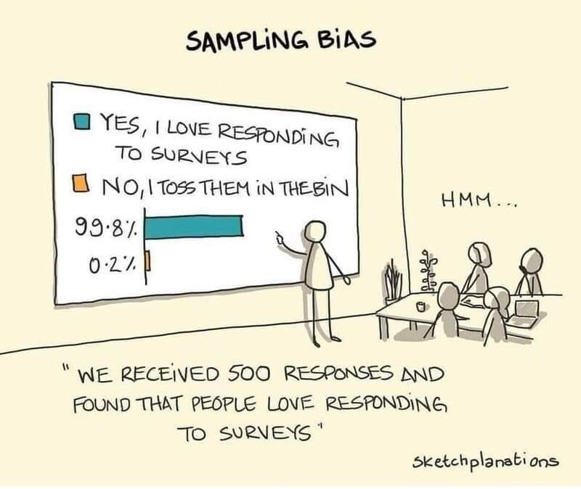
QUANT mindset
Important: QUANT mindset still requires thinking!

Slide 7
QUANT mindset
When it is good to use QUANT approach? When not?

Slide 8
QUANT mindset
Some use cases:
Clear hypotheses
Simple relationships (association between A and B)
Rich datasets (“good enough” sample size)
Some no-go cases:
Rich context
No theory to guide methodological choices
Some problematic cases:
Causality
Distant proxies (variable measurement)
Equifinality, asymmetry, complexity

Slide 9
QUANT mindset
Life of QUANT researcher
Planning (“you only get what you ask for”)
Data collection (surveys, observations, archival data, etc.)
Data cleaning (preparation for analysis)
Data analysis
Data interpretation
Communication of results (“know your audience”)
For a skilled QUANT researcher: 20% - 10% - 30% - 10% - 10% - 20%

Slide 10
Basic statistics

Slide 11
Basic statistics
In most QUANT papers you should be able to find:
Descriptives – mean, standard deviation (minimum and maximum values)
Correlations – associations between pairs of individual variables
Why to pay attention to them? What do they tell you?

Slide 12
Basic statistics
Give you basic understanding of the dataset
Can point out some problems (strange extreme value, multicollinearity, etc.)
… but are limited

Slide 13
Basic statistics: Spurious correlations

Slide 14
Basic statistics: Spurious correlations

Slide 15
Basic statistics: Spurious correlations

Slide 16
Basic statistics
Let’s try it out in gretl…
Download data for Jirásek and Sudzina (2020) from the interactive syllabus
File > Open > User file > choose .csv files, do not interpret the first column and import as cross-sectional
View > Summary statistic
View > Correlation matrix
How do you interpret them? Are there any problems?

Slide 17
Basic tests

Slide 18
Basic tests
Tools > Test statistic calculator
Mean
2 Means (comparing two samples)
Sample > Restrict, based on criterion (Gender == 1)
Nonparametric test

Slide 19
Basic tests
Usually not the main output of high-ranked QUANT papers
Not bad, but limited added value (“there is no difference between the samples” > “So what?”)
We are usually interested in explaining WHY something happens: next parts of this seminar series

Slide 20
Debrief

Slide 21
Debrief
What we covered? Pick two most important things for you and say them aloud.

