Slide 1
LECTURE 7
Introduction to Econometrics
Omitted & Irrelevant Variables
Hieu Nguyen
Fall semester, 2024

Slide 2
SPECIFICATION OF A REGRESSION
We discussed the specification of a regression equation
Specification consists of choosing:
correct independent variables
correct functional form
correct form of the stochastic error term
A specification error occurs if any of these choices is wrong
In lecture 6, we discussed the correct functional form. Now we will learn how to deal with the other two in today’s and the following two lectures.

Slide 3
ON TODAY’S LECTURE
We will talk about the problem of not adding relevant independent variables or adding irrelevant independent variables
We will learn that
Omitting a relevant variable brings bias to our estimates of the other coefficients
Including an irrelevant variable increase the variance of our estimates of the other coefficients
Since in real estimation, it is often hard to judge whether or not to include a variable, we need economic theory and statistical tools to decide

Slide 4
OMITTING RELEVANT VARIABLES
e We omit a variable when we
forget to include it
do not have data for it
e This misspecification results in
not having the coefficient for this variable
biasing estimated coefficients of other variables in the equation −→ omitted variable bias

Slide 5
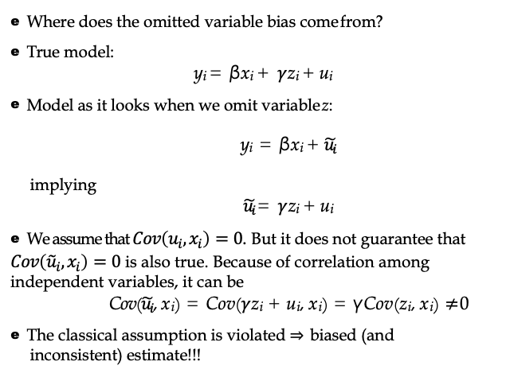
OMITTED VARIABLES
e Where does the omitted variable bias come from?
e True model:
y_{i} = βx_{i} + $γ$z_{i} + u_{i}
e Model as it looks when we omit variable z:
y_{i} = βx_{i} + $\tilde{u_{i}}$
implying
$\tilde{u_{i}}$= $γ$z_{i} + u_{i}
e We assume that $Cov\left(u_{i},x_{i}\right)=0$. But it does not guarantee that $Cov\left({\tilde{u}}_{i},x_{i}\right)=0$ is also true. Because of correlation among independent variables, it can be
Cov($\tilde{u_{i}}$, x_{i}) = Cov($γ$z_{i} + u_{i}, x_{i}) = γCov(z_{i}, x_{i}) $≠$0
e The classical assumption is violated ⇒ biased (and inconsistent) estimate!!!

Slide 6
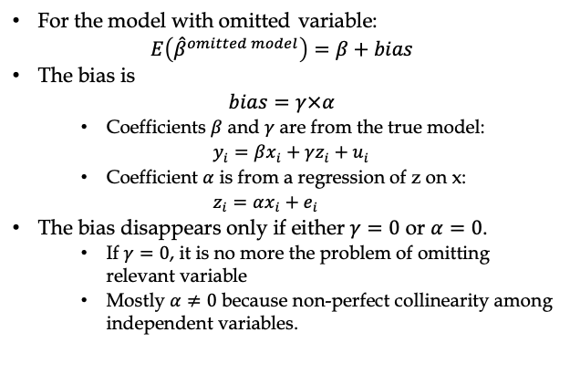
OMITTED VARIABLES
For the model with omitted variable:
$$E\left({\hat{β}}^{omitted model}\right)=β+bias$$
The bias is
$$bias=γ×α$$
Coefficients $β$ and $γ$ are from the true model:
$y_{i}=βx_{i}+γz_{i}+u_{i}$
Coefficient $α$ is from a regression of z on x:
$z_{i}=αx_{i}+e_{i}$
The bias disappears only if either $γ=0$ or $α=0$.
If $γ=0$, it is no more the problem of omitting relevant variable
Mostly $α≠0$ because non-perfect collinearity among independent variables.

Slide 7
OMITTED VARIABLES
Intuitive explanation:
if we leave out an important variable from the regression ($γ ≠$ 0), coefficients of other variables are biased unless the omitted variable is uncorrelated with all included dependent variables ($α$ $≠$0).
the included variables pick up some of the effect of the omitted variable (if they are correlated), and the coefficients of included variables thus change causing the bias.
Example: what would happen if you estimated a production function with capital only and omitted labour?

Slide 8
OMITTED VARIABLES
Example: estimating the price of chicken meat in the US
Y_{t} . . . per capita chicken consumption
PC_{t} . . . price of chicken
PB_{t} . . . price of beef
YD_{t} . . . per capita disposable income

Slide 9
OMITTED VARIABLES
When we omit price of beef:
R² = 0.895
Compare to the true model:
, n = 44
R² = 0.986 , n = 44
We observe positive bias in the coefficient of PC (was it expected?)

Slide 10
OMITTED VARIABLES
Determining the direction of bias: bias= $γ$*$α$
Where $γ$ is a correlation between the omitted variable and the dependent variable (the price of beef and chicken consumption)
$γ$ is likely to be positive
Where $α$ is a correlation between the omitted variable and the included independent variable (the price of beef and the price of chicken)
$α$ is likely to be positive
Conclusion: Bias in the coefficient of the price of chicken is likely to be positive if we omit the price of beef from the equation.

Slide 11
OMITTED VARIABLES
In reality, we usually do not have the true model to compare with
Because we do not know what the true model is
Because we do not have data for some important variable
We can often recognize the bias if we obtain some unexpected results
We can prevent omitting variables by relying on the theory
If we cannot prevent omitting variables, we can at least determine in what way this biases our estimates

Slide 12
IRRELEVANT VARIABLES
A second type of specification error is including a variable that does not belong to the model
This misspecification
does not cause bias
but it increases the variances of the estimated coefficients of the included variables
Notes:
Why variance increases on estimated coefficients when we include irrelevant variable. Explanation https://stats.stackexchange.com/questions/193229/why-does-the-parameter-variance-change-when-control-variables-are-added-to-a-reg

Slide 13
IRRELEVANT VARIABLES
True model:
y_{i} = βx_{i} + u_{i}
(1)
Model as it looks when we add irrelevant z:
y_{i} = βx_{i} + γz_{i} + $\tilde{u_{i}}$
We can represent the error term as $\tilde{u_{i}}$= u_{i} − $γ$z_{i}
(2)
but since from the true model $γ$ = 0, we have $\tilde{u_{i}}$ = u_{i} and there is no bias
But the problem:
$Var\left(β^{\left(2\right)}\right)=\frac{σ^{2}}{(1−r_{XZ}^{2})\sum_{i}{x_{i}^{2}}}>\frac{σ^{2}}{\sum_{i}{x_{i}^{2}}}=Var(β^{\left(1\right)}$)

Slide 14
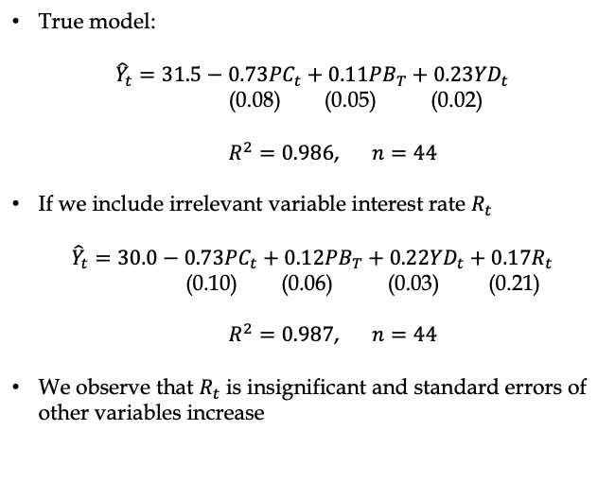
IRRELEVANT VARIABLES
True model:
$${\hat{Y}}_{t}=31.5−0.73{PC}_{t}+0.11{PB}_{T}+0.23{YD}_{t}$$
(0.08) (0.05) (0.02)
$R^{2}=0.986$, $n=44$
If we include irrelevant variable interest rate $R_{t}$
$${\hat{Y}}_{t}=30.0−0.73{PC}_{t}+0.12{PB}_{T}+0.22{YD}_{t}+0.17R_{t}$$
(0.10) (0.06) (0.03) (0.21)
$R^{2}=0.987$, $n=44$
We observe that $R_{t}$ is insignificant and standard errors of other variables increase

Slide 15
SUMMARY OF THE THEORY
Bias – efficiency trade-off:
Omitted variable
Irrelevant variable
Bias
Yes*
No
Variance
Decreases *
Increases*
* As long as we have correlation between x and z

Slide 16
FOUR IMPORTANT SPECIFICATION CRITERIA
Does a variable belong to the equation?
Theory: Is the variable’s place in the equation unambiguous and theoretically sound? Does intuition tells you it should be included?
t-test: Is the variable’s estimated coefficient significant in the expected direction?
R²: Does the overall fit of the equation improve (enough) when the variable is added to the equation?
Bias: Do other variables’ coefficients change significantly when the variable is added to the equation?

Slide 17
FOUR IMPORTANT SPECIFICATION CRITERIA
If all conditions hold, the variable belongs in the equation
If none of them holds, the variable is irrelevant and can be safely excluded
If the criteria give contradictory answers, most importance should be attributed to theoretical justification
Therefore, if theory (intuition) says that variable belongs to the equation, we include it (even though its coefficients might be insignificant!).

Slide 18
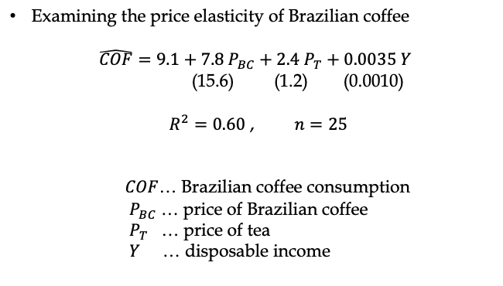
EXAMPLE FOR SPECIFICATION CRITERIA
Examining the price elasticity of Brazilian coffee
$$\hat{COF}=9.1+7.8{ P}_{BC}+2.4 P_{T}+0.0035 Y$$
(15.6) (1.2) (0.0010)
$R^{2}=0.60$ , $n=25$
$COF$… Brazilian coffee consumption
$P_{BC}$ … price of Brazilian coffee
$P_{T}$ … price of tea
$Y$ … disposable income

Slide 19
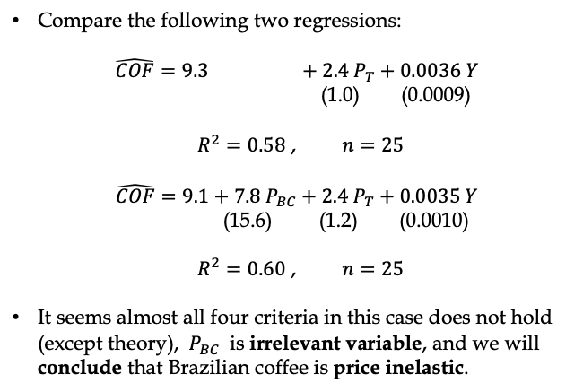
EXAMPLE FOR SPECIFICATION CRITERIA
Compare the following two regressions:
$$\hat{COF}=9.3 +2.4 P_{T}+0.0036 Y$$
(1.0) (0.0009)
$R^{2}=0.58$ , $n=25$
$$\hat{COF}=9.1+7.8{ P}_{BC}+2.4 P_{T}+0.0035 Y$$
(15.6) (1.2) (0.0010)
$R^{2}=0.60$ , $n=25$
It seems almost all four criteria in this case does not hold (except theory), ${ P}_{BC}$ is irrelevant variable, and we will conclude that Brazilian coffee is price inelastic.

Slide 20
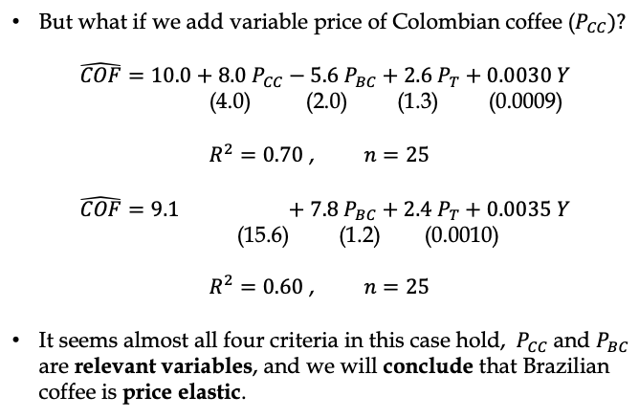
EXAMPLE FOR SPECIFICATION CRITERIA
But what if we add variable price of Colombian coffee ($P_{CC})?$
$$\hat{COF}=10.0+8.0 P_{CC}−5.6{ P}_{BC}+2.6 P_{T}+0.0030 Y$$
(4.0) (2.0) (1.3) (0.0009)
$R^{2}=0.70$ , $n=25$
$$\hat{COF}=9.1 +7.8{ P}_{BC}+2.4 P_{T}+0.0035 Y$$
(15.6) (1.2) (0.0010)
$R^{2}=0.60$ , $n=25$
It seems almost all four criteria in this case hold, ${ P}_{CC}$and $P_{BC}$ are relevant variables, and we will conclude that Brazilian coffee is price elastic.

Slide 21
THE DANGER OVERSPECIFICATION
”If you just torture the data long enough, they will confess.”
If too many specifications are tried:
The final result may have the desired properties only by chance
The statistical significance of the result is overestimated because the estimations of the previous regressions are ignored.
How to solve this issue:
Keep the number of try of regressions low
Focus on theory (very important)
Save all regression you tried

Slide 22
SPECIFICATION TEST
Ramsey’s Regression Specification Test (RESET)
Allows to detect possible misspecification
But cannot detect the source of misspecification
Two types of test based on the same intuition:
If the equation is correctly specified, nothing is missing in the equation and the residuals are white noise.
Assume we have:
$y_{i}=β_{0}$+ $β_{1}x_{i}+β_{2}z_{i}+ε_{i}$

Slide 23
RESET TYPE I
Run the regression: $y_{i}=β_{0}$+ $β_{1}x_{i}+β_{2}z_{i}+ε_{i}$
Save the predicted values: ${\hat{y}}_{i}={\hat{β}}_{0}$+ ${\hat{β}}_{1}x_{i}+{\hat{β}}_{2}z_{i}$
Run the augmented regression:
$y_{i}=β_{0}$+ $β_{1}x_{i}+β_{2}z_{i}+{γ_{1}\hat{y}}_{i}^{2}+{γ_{2}\hat{y}}_{i}^{3}+ε_{i}$
(more power can be included)
Test a standard F test with null hypothesis ${ γ}_{1}=γ_{2}=0$
If we can reject the null hypothesis, there is a misspecification problem in the model
Intuition: if the model is correct, $y$ is well explained by $x_{i}$ and $z_{i}$ and addition of the predicted values raised to higher powers should not be significant.

Slide 24
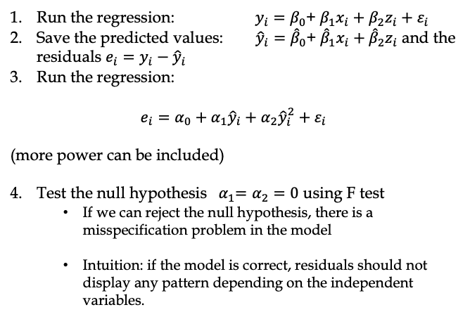
RESET TYPE II
Run the regression: $y_{i}=β_{0}$+ $β_{1}x_{i}+β_{2}z_{i}+ε_{i}$
Save the predicted values: ${\hat{y}}_{i}={\hat{β}}_{0}$+ ${\hat{β}}_{1}x_{i}+{\hat{β}}_{2}z_{i}$ and the residuals $e_{i}=y_{i}−{\hat{y}}_{i}$
Run the regression:
$$e_{i}=α_{0}+{α_{1}\hat{y}}_{i}+{α_{2}\hat{y}}_{i}^{2}+ε_{i}$$
(more power can be included)
Test the null hypothesis ${ α}_{1}=α_{2}=0$ using F test
If we can reject the null hypothesis, there is a misspecification problem in the model
Intuition: if the model is correct, residuals should not display any pattern depending on the independent variables.

Slide 25
SUMMARY
Omitting a relevant variable brings bias to our estimates of the other coefficients
Including an irrelevant variable increase the variance of our estimates of the other coefficients
Since in real estimation, it is often hard to judge whether or not to include a variable, we need economic theory and statistical tools to decide

