Slide 1
WE from Adam Smith to WWI

Slide 2
Contet of the lecture
formation of WE
development prior to Adam Smith
from Adam to WWI
  global tendencies
  development

Slide 3
Formation of WE

Slide 4
A. Formation of WE
no exact date of formation
beginning of WE at the end of the 19th century
  minimum connections among inhabited areas
  existence of international markets of goods, labour and capital
BUT increasing cooperation/connections even earlier

Slide 5
Development prior to A. Smith

Slide 6
B. Prior to Adam
Prehistory
  trade already in Neolithic - trade routs
Antiquity
  Troy
  Phoenicians
  height Greeks and Romans
  Eastern civilizations more developed than Europe (according to certain authors)
  the fall of Rome at the end of 4th century ⇨ decline in trade

Slide 7
The Middle Ages
  revival of trade only in 10th century
  regional specialization
  terrestrial transport more expensive than maritime transport
  overseas discoveries ⇨ price revolutions (prices 3x - 4x)
  considerable increase of trade - from 15th to 18th century
    importance of overseas discoveries
    the most dynamic sector
    spice and (later) ordinary things
  leadership
    China – at the beginning of 15th century technological superiority
    Portugal + Spain + North Italy
    Netherlands ⇨ (FR?)
    GB

Slide 8
Comparison of China and Western Europe (1400-1989)

Slide 9
From Adam to WWI

Slide 10
C. From Adam to WWI general trends
1776
general trends
  balance among powers –> minimum conflicts
  gold standard
  self-regulated market for a large number of products
  liberal state
  considerable technological progress
  GB as superpower - Pax Britanica

Slide 11
C1. From Adam to WWI tendencies and development
tendencies
  demographic
  technological
  political
  social
  institutional
development
  economic growth
  price stability
  foreign trade
  international flows of capital
  globalization???

Slide 12
Demographic changes
demographic transition
  ⇨ population growth
migration
  massive outflow of population from Europe to newly settled lands – USA, parts of GB Empire, Latin America ⇨
    decrease of population pressures in Europe
    newly settled lands gain necessary labour force
improvement in the quality of human capital

Slide 13
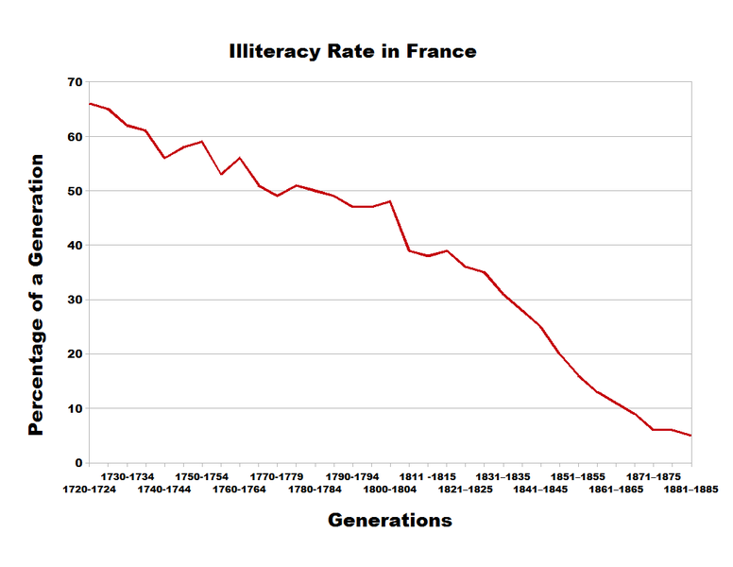
Illiteracy rate in France

Slide 14
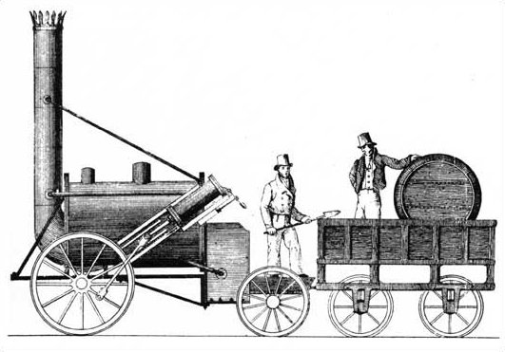
Technological changes
fundamental changes in technologies
  water – water energy as well as transport rout
  steam engine – cheaper source of energy and transport
    James Watt
    Stephenson´s steam locomotive ⇨ railways ⇨  costs
    similarly ship transport
  telecommunications – telegraph, telephone, …
  later electrical energy
industrial revolution– YES/NO
  transition from handmade manufacturing
    To machine production in factories
  GB = so called „workshop of the world“
    around 1830 ½ of world ind. production
Suez Canal (1869)
Panama Canal (1915)

Slide 15
Length of railway network, 1840-1910 (in thousand miles)

Slide 16
Political changes
military conflicts
  period delimited by Napoleonic Wars and WWI
1815 – 1914 balance among powers
  only Crimean War
  and FR X Prussia 1870-71
BUT early 20th century Weapon Races
stability thanks to the policy of GB
  so called splendid isolation = GB ouside of military alliances– abandoned at the beginning of 20th century
Notes:
kronika lidstva 0800 - 0881_2

Slide 17
BUT regional and civil wars
  Civil war in USA
+ revolution - 1848
monarchies ⇨ transition to democracies
  the role of state keep marginal - no interventions to economy BUT considerable differences among countries
⇧ colonies (Africa and Asia)
  reasons for colonialism: economic x political

Slide 18
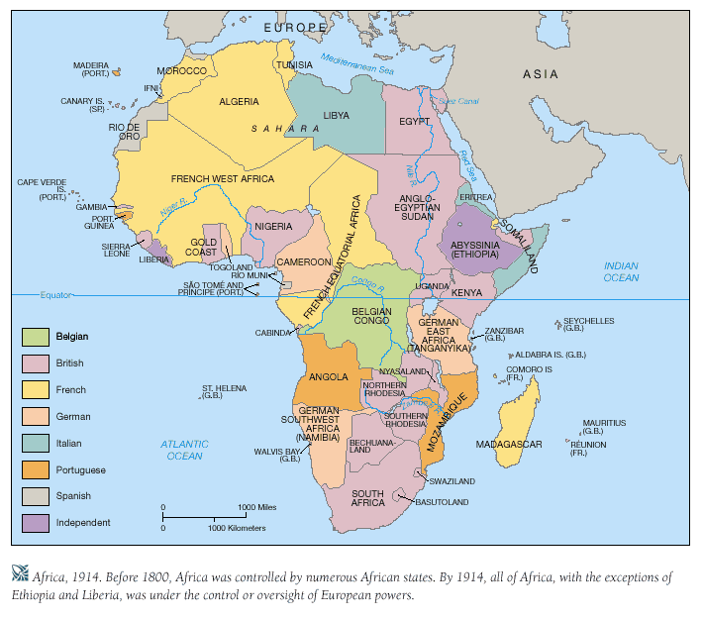
Partition of Africa in 1914

Slide 19
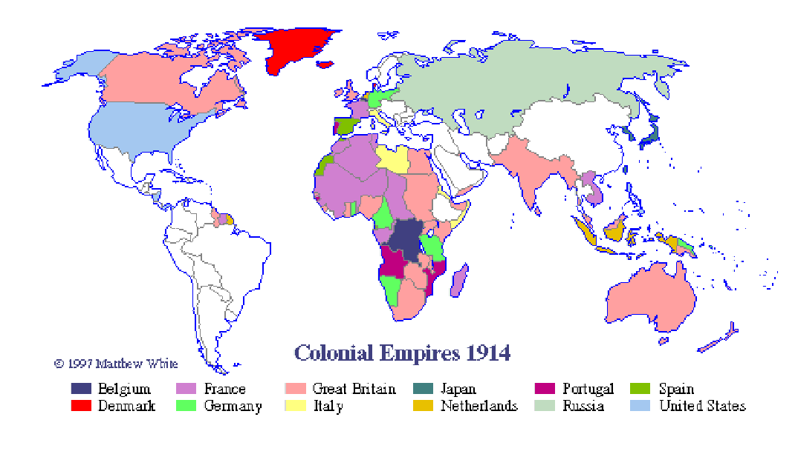
Colonial Empires 1914

Slide 20
Social conditions
very hard life in the countryside before the industrial revolution x myths about good simple life
  ñ population ⇨ workers ⇨ social claims
  + very severe situation of working force at the beginning of 19th century
  ⇧ working hours – ineffective
since 1870  working hours + holiday + sick benefit ⇨  working hours and  health and quality of LF
other factors of improvement
  economic growth
  legislation
  migration
  trade unions
  politics

Slide 21
Institutional changes
from feudalism to capitalism
  free sale and purchase of property
  private ownership
legal system
  protection of proprietary rights - Roman law
  development of accountancy
  ñ predictability of taxes = ò randomness
development of financial institutions
  better access to loans and insurances
concentration of production
  monopolistic tendencies?

Slide 22
C2. From Adam to WWI tendencies and development
tendencies
  demographic
  technological
  political
  social
  institutional
development
  economic growth
  price stability
  foreign trade
  international flows of capital
  globalization???

Slide 23
Economic growth
extensive
  demographic changes (population growth)
  increasing capital accumulation
intensive
  institutional changes
  technological changes
    cheaper energy, better communication and transport
  changes in production
    rational organization of business
    better managerial techniques
    ⇧ work discipline
  division of labour in connection with foreign trade
  ð ð ñ labour productivity

Slide 24
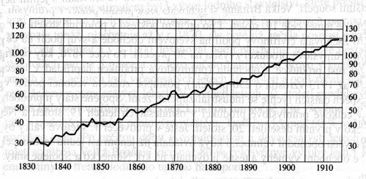
GDP of Europe 1830 –1914 (1899-1900 = 100)

Slide 25
Cyclical development
before industrialization – local crises
  bad weather ð crop failure - 1590s, 1630s, 1780s
    in most cases short-term impacts - ñ mortality (aged and young persons) ð rapidly replaced BUT considerable political consequences
    longer period of higher mortality – diseases or invasions (Mongols) ⇨ better conditions for survivors: more land ⇨ lower rents + lack of LF ⇨ high wages
industrialization + ñ international trade ð interconnected cylical fluctuations
  spread of crises through trade routes
  1825-23, 1837-38, 1846-47, 1857, 1866, 1873, 1882, 1893, 1900-01, 1907
  !!! ò output ð ò prices

Slide 26
1873 – 1st deep international depression
the most deep and widespread in the entire previous history
financial panic in Vienna and New York
spread to most of other industrial countries
in GB referred as “Great Depression”
ò prices !!!
foreign trade blamed by industry ð demand for protectionism
  same situation in agriculture

Slide 27
Stability of prices
price level reliant on the gold supply – gold standard ð stability
year

Slide 28
Foreign trade
phases
  strongly protecionistic ⇨ free ⇨ moderately protectionistic
long-term foreign trade
before WWI – unprecedented interdependence
  similar situation after WWII
  benefits for all participants

Slide 29
Average growth in the volume of trade, 1850-1913 (in %)

Slide 30
The beginning of the century
protectionism
  mercantilism
  duties as fiscal revenues (easy collection)
    both export and import duties (primarily on luxury goods)
trade with colonies
  colonies ð mother countries: raw materials
  mother countries ð colonies: final goods
    but low purchasing power

Slide 31
Napoleonic Wars
  Continental Blockade = trade embargo against GB
  Russia
  victory of GB ⇨ superpower = the largest producer, trader, investor, fleet, colonies, …
    center of trade = Europa (2/3)
GB in 40s - turnover
  abolishment of Navigation Acts and Corn Laws
  + effort for free international trade
  critics that favourable for GB

Slide 32
After 1860
Cobden – Chevalier treaty (1860) - free trade between GB and FR
  GB abolished duties except those on luxury products (fiscal function)
  FR permitted he import of British textile + duties
  Most favoured nation clause = possibility of extension to other nations
  ⇨ 60s FR with BE, DE Customs Union, IT, CH, Scandinavian c., ES, NL, AT and PT – only Russia not involved
  + nations among each other ⇨ interdependence ⇨ free trade
  disadvantage - necessity of its renewal
+ gold standard
+  transportation costs (railways, steamers)
+ GB support of free trade

Slide 33
Turnover - Prussia
Prussia X FR 1871
  Prussia: winner, requirement of enormous reparations
  ⇨  amount of AU⇨ prices +  development of factories ⇨ overproduction ⇨ crisis in 1873 worsen for DE
+ financial panic
⇨ in DE free trade blamed ⇨ ñ protectionism
+ other reasons…

Slide 34
Share in British grain market
Other reasons
agriculture
  important Prussian export commodity
  in 70s inflow of cheap grain to Europe from USA, Russia, India, …
  steam technologies - railways
  huge impact on Prussian exporters

Slide 35
World grain production, 1831/1840-1888
(in million bushels)

Slide 36
+ German Historical School
+ pressure groups
⇨ Bismarck imposed duties (1879 a 1889) ⇨  prices of grain
Average prices of grain in England and Prussia per Imperial Quarter

Slide 37
Other countries
followed DE´s example
France
  1881 new tarrif law (industry)
  more important Meline tariffs from 1892
  in 1910 additional increase of tariffs on chemicals, electric appliances and rubber products
Italy
  unification of the country
  price war with FR ⇨mutual trade by 2 times
AUS-HUN
  returne to ultraprotectionism
USA
  strong protectionism after the Civil War
Russia
  never abolished the duties
  in 1891 enactment of practically prohibitive duties

Slide 38
BUT in total only moderate  protectionism
  GB X but without considerable results
  BE, N and DK still liberal
  WE still highly interconnected
    EX/GDP
      GB, FR, DE 15 - 20%
      smaller countries such as BE, NL and Scand. higher
      + USA and Latin America also involved
    1913 the largest trader still GB (2. DE, 3. USA)
  GB no trade with modern products such as chemicals, eappliances, …
territorially – the most of trade realized in Europe

Slide 39
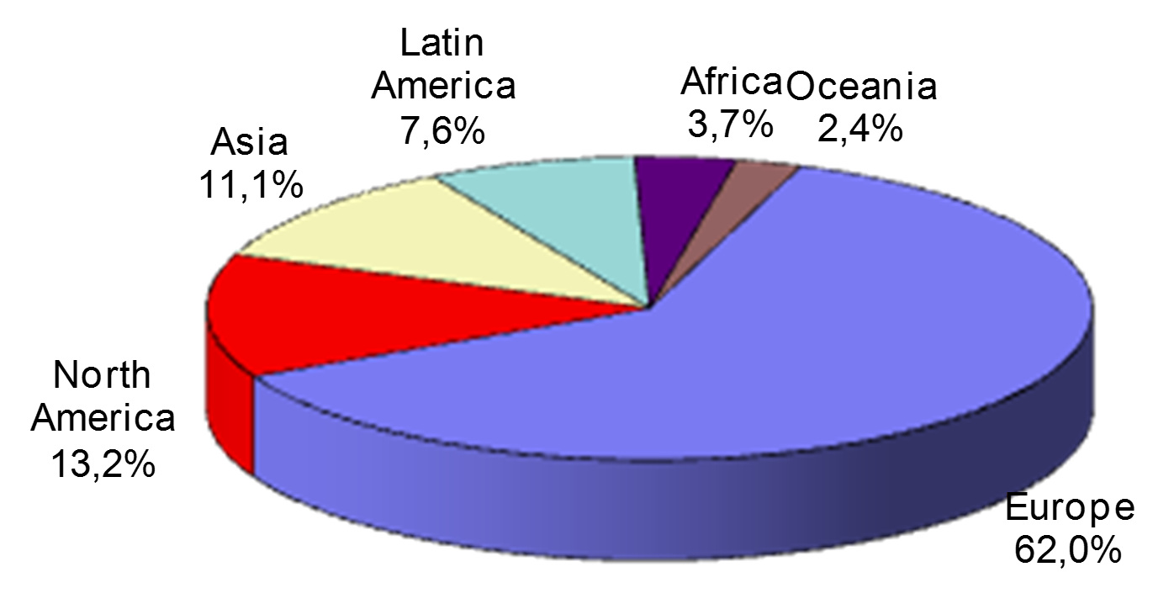
Regional distribution of international trade in 1913

Slide 40
International flow of capital
capital flows already after 1700 + ñ GB´s I after the Napoleonic Wars
huge outflow of C to abroad approx. 50 years before WWI
before WWI no restrictions on capital flows
  first globalization of the financial markets
  ð strong convergence of interest rates on bonds
international financial center in London

Slide 41
Reasons
Gold standard
  stability of the system
  credibility of economic policy
new financial institutions and instruments (investment banking)
technological progress (telegraph, transatlantic cabel – 1866, telephone)
flexibility of economies + less powerful pressure groups
+ certain regulations = requirements to spread info about companies (in GB) + e.g. accountancy

Slide 42
Structure of investments
bonds to finance railways and infrastructure + long-term government debt
  e.g. GB = 1913 foreign investments
    30% in government and municipal securities
    40% railways
    10% extraction of raw materials (mainly mining)
    5% public services
    ð 85% very transparent and tangible actives
majority under the form of obligations (not assets)
portfolio investments more important than FDI

Slide 43
Investors
principal international investor - GB
  in 1914 - 43% share in total investments (more than 4 bill. pounds) = 2 times more than FR
  1914 - GB + FR + DE =3/4 of investments

Slide 44
Foreign investment by country of origin in 1914

Slide 45
Direction of investments
GB - EU,USA + Dominium
  to ex-colonies – same language, culture, legal system and accountancy
FR X GB
  initially construction of railways in Europe
  later influence of policy = Russia as ally x DE⇨ direction of investments (1914 = 28%)
  + areas with similar culture and where its influence was high = IT, ES

Slide 46
British foreign investments into various regions, 1830-1914 (in %)

Slide 47
Globalization ??
situation before WWI similar to the current one
  ⇧ foreign trade + foreign I + migration -> interdependence of WE
  + supported by  markets + new technologies (changes in transportation and energy sources)
X differences
  number of countries not involved
  speed of transport and communication less convenient for the function of companies at global level
  contemporary financial markets – substantially larger absolute flows of capital
  before WWI – limited teritorial and structural direction of capital

Slide 48
Thank you for attention

