Slide 1
Human Resource Management
Understanding Individual Behavior
Lecture 6

Slide 2
Agenda for today
Human Resource Management
  HRM Process
  Identifying and selecting employees
  Providing employees with knowledge and skills
  Retaining competent and high-performing employees
  Current Issues in HRM
Understanding indivdual behavior
  Behavior defined
  (Psychological) factors affecting behavior
  Shaping behavior

Slide 3
Where are we?

Slide 4
Importance of Human Resource Management
As a necessary part of the organizing function of management
  Selecting, training, and evaluating the work force
As an important strategic tool
  HRM helps establish an organization’s sustainable competitive advantage.
Adds value to the firm
  High performance work practices lead to both high individual and high organizational performance.

Slide 5
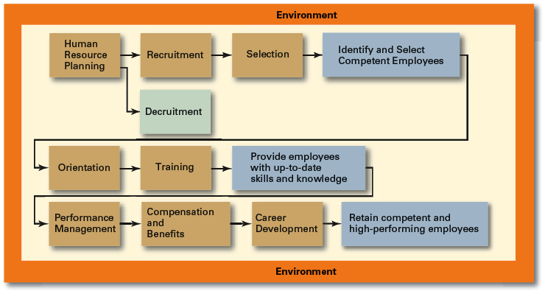
The HRM Process
Functions of the HRM Process
  Ensuring that competent employees are identified and selected.
  Providing employees with up-to-date knowledge and skills to do their jobs.
  Ensuring that the organization retains competent and high-performing employees who are capable of high performance.

Slide 6
Identifying and selecting employees (step 1)
Human Resource (HR) Planning
  The process by which managers ensure that they have the right number and kinds of people in the right places, and at the right times, who are capable of effectively and efficiently performing their tasks.
  Helps avoid sudden talent shortages and surpluses.
  Steps in HR planning:
    Assessing current human resources
    Assessing future needs for human resources
    Developing a program to meet those future needs
  Job Analysis
    An assessment that defines a job and the behaviors necessary to perform the job
      Knowledge, skills, and abilities (KSAs)
    Requires conducting interviews, engaging in direct observation, and collecting the self-reports of employees and their managers.
Job Description
  A written statement of what the job holder does, how it is done, and why it is done.
Job Specification
  A written statement of the minimum qualifications that a person must possess to perform a given job successfully.

Slide 7
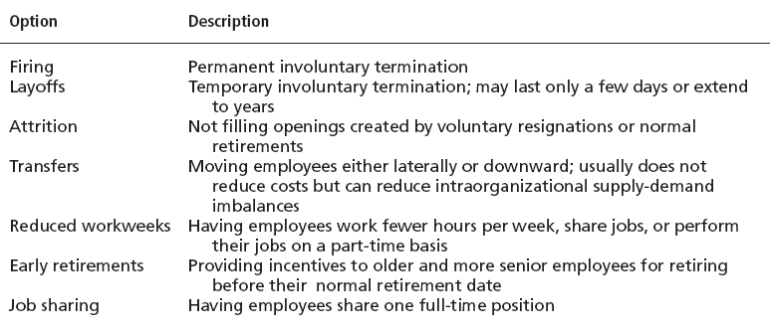
Identifying and selecting employees (step 2)
Recruitment
  The process of locating, identifying, and attracting capable applicants to an organization
E-recruiting
  Recruitment of employees through the Internet
    Organizational web sites
    Online recruiters
Decruitment
  The process of reducing a surplus of employees in the workforce of an organization

Slide 8
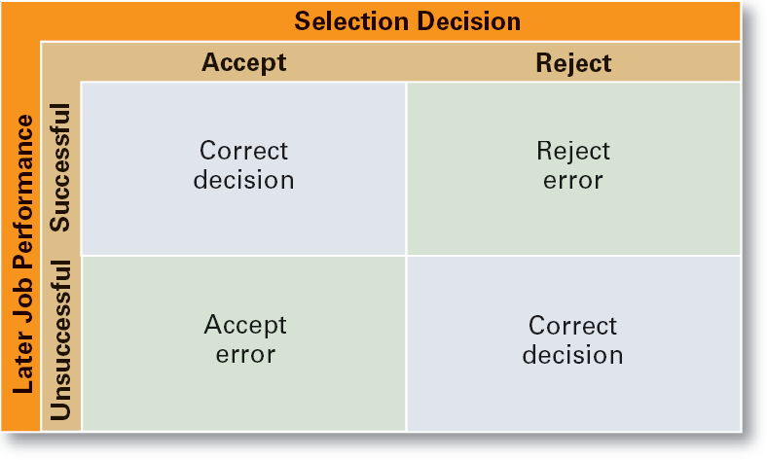
Identifying and selecting employees (step 3)
Selection Process
  The process of screening job applicants to ensure that the most appropriate candidates are hired.
What is Selection?
  An exercise in predicting which applicants, if hired, will be (or will not be) successful in performing well on the criteria the organization uses to evaluate performance.
  Selection errors:
    Reject errors for potentially successful applicants
    Accept errors for ultimately poor performers
Realistic Job Preview (RJP)
  The process of relating to an applicant both the positive and the negative aspects of the job.
    Encourages mismatched applicants to withdraw.
    Aligns successful applicants’ expectations with actual job conditions; reducing turnover.

Slide 9
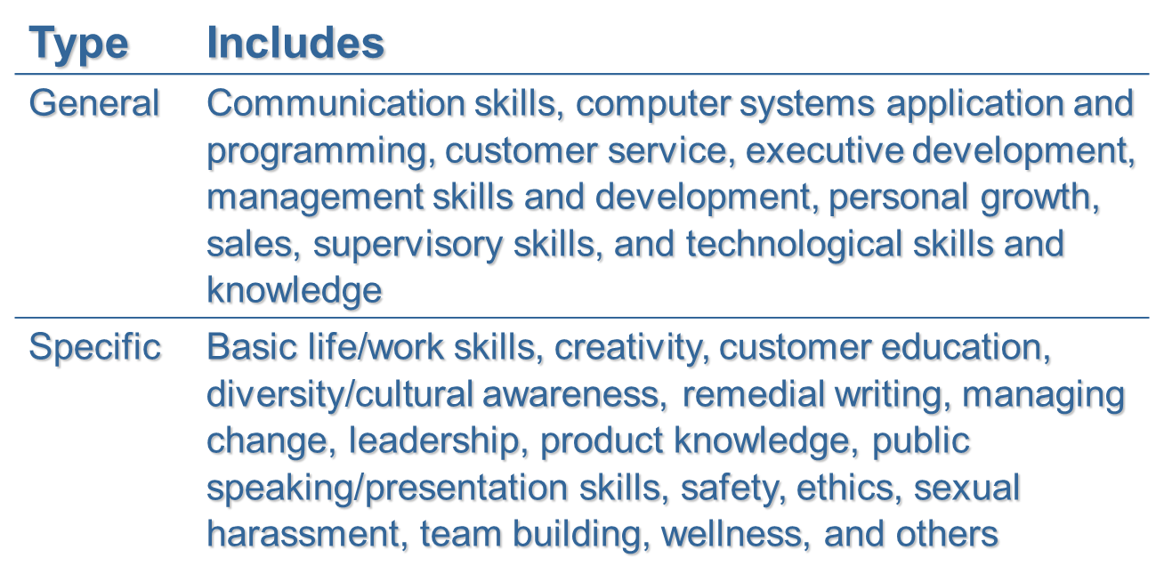
Providing employees with knowledge and skills
Orientation
Training
Transitioning a new employee into the organization.
  Work-unit orientation
    Familiarizes new employee with work-unit goals
    Clarifies how his or her job contributes to unit goals
    Introduces he or she to his or her coworkers
  Organization orientation
    Informs new employee about the organization’s objectives, history, philosophy, procedures, and rules.
    Includes a tour of the entire facility
Training Methods
  On-the-job
  Job rotation
  Mentoring and coaching
  Experiential exercises
  Workbooks/manuals
  Classroom lectures
  E-learning

Slide 10
Retaining competent and high-performing employees
Employee Performance Management
Compensation and Benefits
Performance Management System
  A process of establishing performance standards and appraising employee performance in order to arrive at objective HR decisions and to provide documentation in support of those decisions.
Fair, Effective, and Appropriate
  Helps attract and retain high-performance employees
  Impacts on the strategic performance of the firm
Types of Compensation
  Base wage or salary
  Wage and salary add-ons
  Incentive payments
  Skill-based pay
  Variable pay

Slide 11
Current Issues in HRM
Managing Downsizing
  The planned elimination of jobs in an organization
    Provide open and honest communication.
    Provide assistance to employees being downsized.
    Reassure and counseling to surviving employees.
Managing Work Force Diversity
  Widen the recruitment net for diversity
  Ensure selection without discrimination
  Provide orientation and training that is effective
Work-Life Balance
  Employees have personal lives that they don’t leave behind when they come to work.
  Organizations have become more attuned to their employees by offering family-friendly benefits:
    On-site child care
    Summer day camps
    Flextime
    Job sharing
    Leave for personal matters
    Flexible job hours

Slide 12
Why Look at Individual Behavior?
Organizational Behavior (OB)
  The actions of people at work
Focus of Organizational Behavior
  Individual behavior
    Attitudes, personality, perception, learning, and motivation
  Group behavior
    Norms, roles, team building, leadership, and conflict
Goals of Organizational Behavior (Theory)
  To explain, predict and influence behavior.

Slide 13
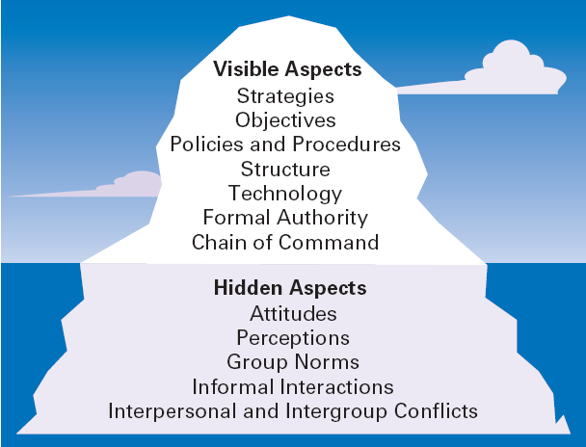
The Organization as an Iceberg

Slide 14
Important Employee Behaviors
Employee Productivity
  A performance measure of both efficiency and effectiveness
Absenteeism
  The failure to report to work when expected
Turnover
  The voluntary and involuntary permanent withdrawal from an organization
Organizational Citizenship Behavior (OCB)
  Discretionary behavior that is not a part of an employee’s formal job requirements, but which promotes the effective functioning of the organization.
Job Satisfaction
  The individual’s general attitude toward his or her job

Slide 15
Psychological Factors Affecting Employee Behavior
Employee Productivity
Absenteeism
Turnover
Organizational Citizenship
Job Satisfaction
Workplace Misbehavior
Attitudes
Personality
Perception
Learning

Slide 16
Attitudes
Attitudes
  Evaluative statements—either favorable or unfavorable—concerning objects, people, or events.
Components Of An Attitude
  Cognitive component: the beliefs, opinions, knowledge, or information held by a person.
  Affective component: the emotional or feeling part of an attitude.
  Behavioral component: the intention to behave in a certain way.

Slide 17
Job satisfaction (1/2)
Job Satisfaction
  Job satisfaction is affected by level of income earned and by the type of job a worker does.
Job Satisfaction and Productivity
  For individuals, productivity appears to lead to job satisfaction.
  For organizations, those with more satisfied employees are more effective than those with less satisfied employees.
Job Satisfaction and Absenteeism
  Satisfied employees tend to have lower levels of absenteeism.
Job Satisfaction and Turnover
  Satisfied employees have lower levels of turnover; dissatisfied employees have higher levels of turnover.
  Turnover is affected by the level of employee performance.

Slide 18
Job satisfaction (2/2)
Job Satisfaction and Customer Satisfaction
  The level of job satisfaction for frontline employees is related to increased customer satisfaction and loyalty.
  Interaction with dissatisfied customers can increase an employee’s job dissatisfaction.
  Actions to increase job satisfaction for customer service workers:
    Hire upbeat and friendly employees.
    Reward superior customer service.
    Provide a positive work climate.
    Use attitude surveys to track employee satisfaction.
Job Satisfaction and Workplace Misbehavior
  Dissatisfied employees will respond somehow
  Not easy to predict exactly how they’ll respond

Slide 19
Other psychological factors
Job Involvement
    The degree to which an employee identifies with his or her job, actively participates in it, and considers his or her performance to be important to his or her self-worth.
    High levels of commitment are related to fewer absences and lower resignation rates.
Organizational Commitment
    Is the degree to which an employee identifies with a particular organization and its goals and wishes to maintain membership in the organization.
    Leads to lower levels of both absenteeism and turnover.
Perceived Organizational Support
    Is the general belief of employees that their organization values their contribution and cares about their well-being.
    Represents the commitment of the organization to the employee.
    Providing high levels of support increases job satisfaction and lower turnover.

Slide 20
Attitudes and Consistency
People seek consistency in two ways:
    Consistency among their attitudes.
    Consistency between their attitudes and behaviors.
If an inconsistency arises, individuals:
    Alter their attitudes or alter their behavior or develop a rationalization for the inconsistency
Cognitive Dissonance Theory
    Any incompatibility or inconsistency between attitudes or between behavior and attitudes. Any form of inconsistency is uncomfortable and individuals will try to reduce the dissonance.
    The intensity of the desire to reduce the dissonance is influenced by:
    The importance of the factors creating the dissonance.
    The degree to which an individual believes that the factors causing the dissonance are controllable.
    Rewards available to compensate for the dissonance.

Slide 21
Personality
Personality
    The unique combination of psychological characteristics (measurable traits) that affect how a person reacts and interacts with others.

Slide 22
Personality insights
The Big-Five Model
Other insights
Extraversion
  Sociable, talkative, and assertive
Agreeableness
  Good-natured, cooperative, and trusting
Conscientiousness
  Responsible, dependable, persistent, and achievement oriented
Emotional Stability
  Calm, enthusiastic, and secure or tense, nervous, and insecure
Openness to Experience
  Imaginative, artistically sensitive, and intellectual
Locus of Control
  Internal locus: persons who believe that they control their own destiny.
  External locus: persons who believe that what happens to them is due to luck or chance.
Self-Esteem (SE)
  The degree to which people like or dislike themselves
  High SEs - believe in themselves and expect success.
  Low Ses - are more susceptible to external influences.
  The propensity to take risks
Self-Monitoring
  An individual’s ability to adjust his or her behavior to external, situational factors.
  High self-monitors - are sensitive to external cues and behave differently in different situations.
  Low self-monitors - do not adjust their behavior to the situation. Are behaviorally consistent in public and private.

Slide 23
Emotions
Emotions
Emotional Intelligence (EI)
  Intense feelings (reactions) that are directed at specific objects (someone or something)
  Universal emotions:
    Anger
    Fear
    Sadness
    Happiness
    Disgust
    Surprise
  An assortment of noncognitive skills, capabilities, and competencies that influence a person’s ability to succeed in coping with environmental demands and pressures.
  Dimensions of EI:
    Self-awareness: knowing what you’re feeling
    Self-management: managing emotions and impulses
    Self-motivation: persisting despite setbacks and failures
    Empathy: sensing how others are feeling
    Social skills: handling the emotions of others

Slide 24
Understanding Personality Differences
Personality-Job Fit Theory (Holland)
    An employee’s job satisfaction and likelihood of turnover depends on the compatibility of the employee’s personality and occupation.
    Key points of the theory:
    There are differences in personalities.
    There are different types of jobs.
    Job satisfaction and turnover are related to the match between personality and job for an individual.

Slide 25
Perception
  Perception
    A process by which individuals give meaning (reality) to their environment by organizing and interpreting their sensory impressions.
Factors influencing perception:
    The perceiver’s personal characteristics—interests, biases and expectations
    The target’s characteristics—distinctiveness, contrast, and similarity
    The situation (context) factors—place, time, location—draw attention or distract from the target

Slide 26
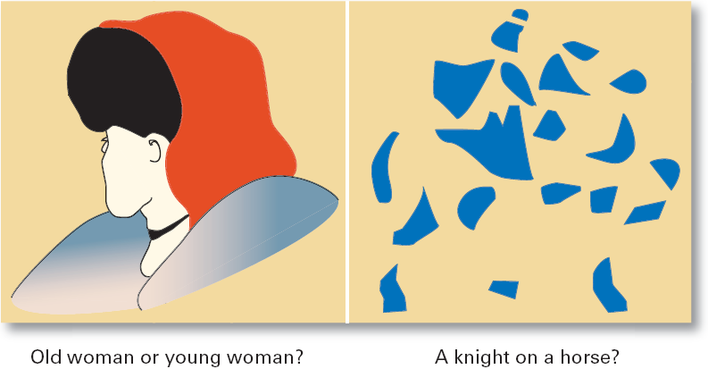
Perception Challenges: What Do You See?

Slide 27
Perception errors and biases
  Fundamental attribution error
    The tendency to underestimate the influence of external factors and to overestimate the influence of internal or personal factors.
  Self-serving bias
    The tendency of individuals to attribute their successes to internal factors while blaming personal failures on external factors.
Assumed Similarity
    Assuming that others are more like us than they actually are.
Stereotyping
    Judging someone on the basis of our perception of a group he or she is a part of.
Halo Effect
    Forming a general impression of a person on the basis of a single characteristic of that person

Slide 28
Implications for Managers
Employees react to perceptions
Pay close attention to how employees perceive their jobs and management actions

Slide 29
Shaping Behavior
  Attempting to “mold” individuals by guiding their learning in graduated steps such that they learn to behave in ways that most benefit the organization.
  Shaping methods:
    Positive reinforcement: rewarding desired behaviors.
    Negative reinforcement: removing an unpleasant consequence once the desired behavior is exhibited.
    Punishment: penalizing an undesired behavior.
    Extinction: eliminating a reinforcement for an undesired behavior.

Slide 30
Terms to Know
behavior
organizational behavior
employee productivity
absenteeism
turnover
organizational citizenship behavior
job satisfaction
workplace misbehavior
Attitudes
self-esteem
self-monitoring
impression management
emotions
emotional intelligence (EI)
perception
attribution theory
fundamental attribution error
job involvement
organizational commitment
perceived organizational support
cognitive dissonance
attitude surveys
personality
big-five model
locus of control
Machiavellianism
human resource planning
job analysis
job description
job specification
recruitment
Decruitment
stereotyping
self-serving bias
assumed similarity

