Slide 1
Introduction to Business Central Assembly Orders
Ing.Jaromír Skorkovský,CSc.
Masaryk University Brno
Faculty of Economics and Adminisration
Department of Business Management

Slide 2
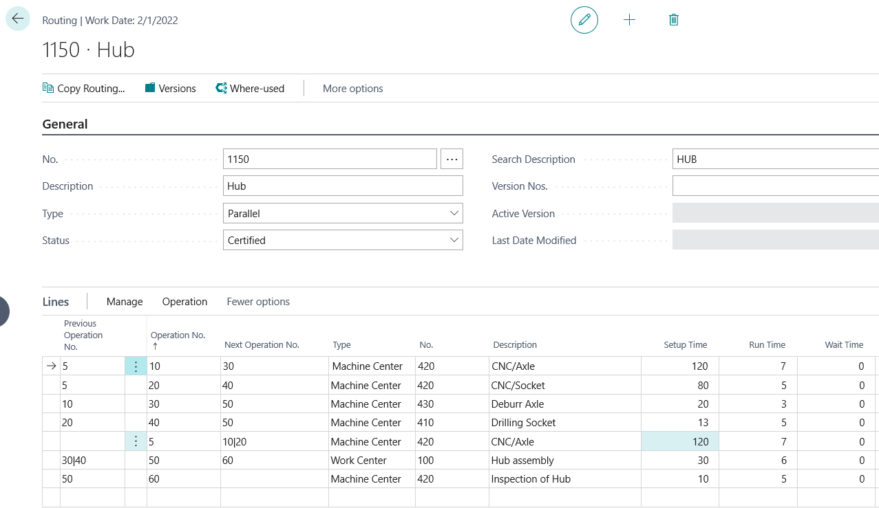
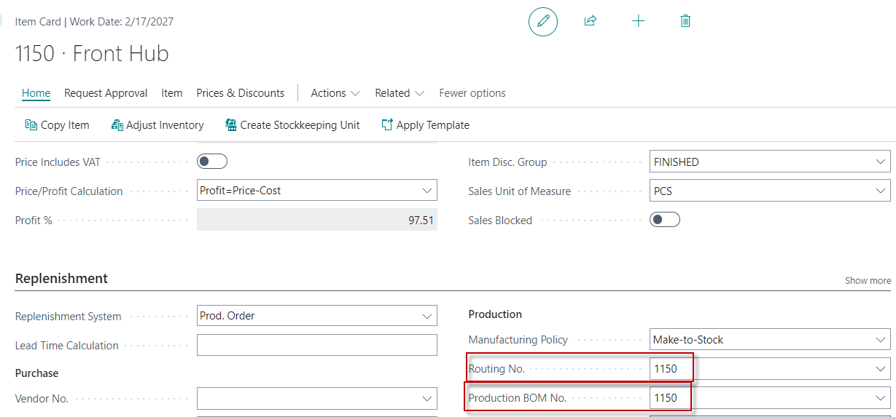
The difference between Production orders and Assembly orders I.
Routings
Product
1150
BOM
1151
1155

Slide 3
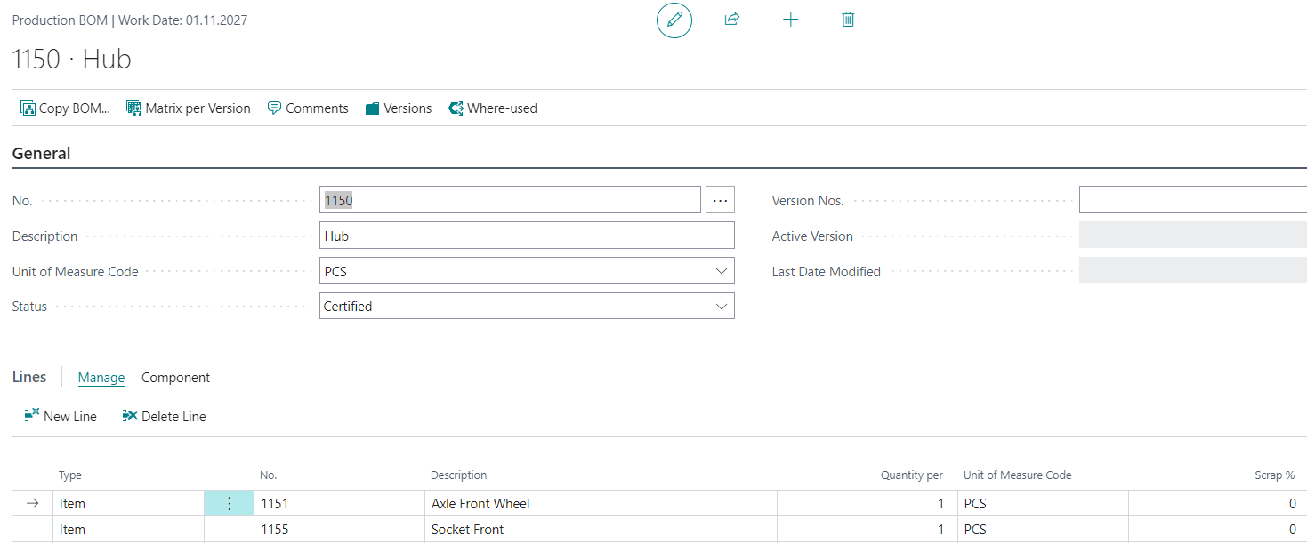
Bill of Material (BOM)

Slide 4
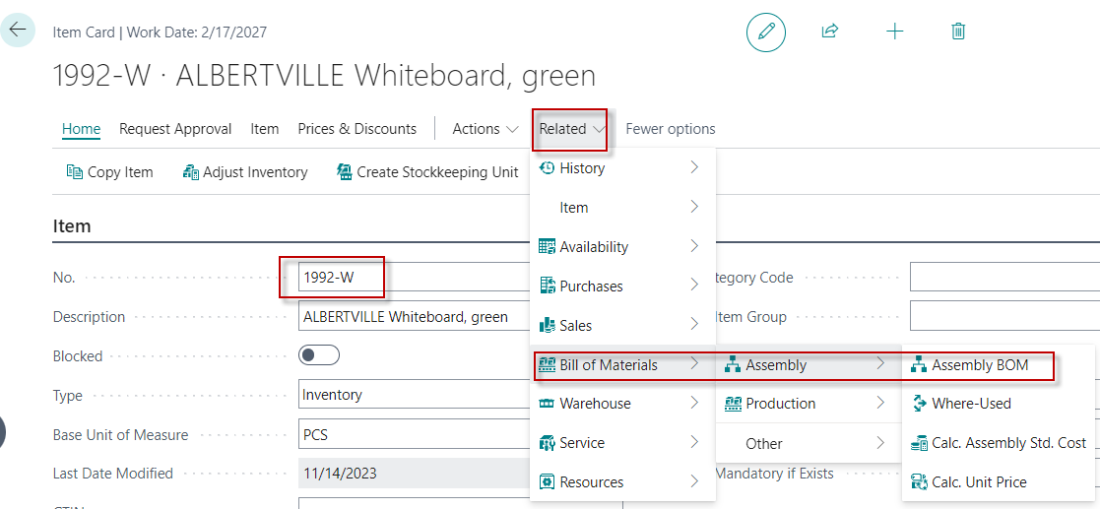
The difference between production orders and assembly orders II.
Resources are parts of the Assembly BOM

Slide 5
Assemble to Order (AtO)
Assembly orders- Skorkovský
Typically, AtO is used for items that you do not want to stock because you expect to customize them to the customer's requirements or because you want to minimize the accounting cost of the goods. Support features include:
The ability to customize assembled items when using a Sales quote
An overview of the availability of the assembly item and its components
Ability to reserve assembly components immediately to ensure order fulfillment as soon as possible
Functionality to determine profitability of customized orders
Warehouse integration to make assembly and shipping easier
Ability to Assemble to Order at point of manufacture sales quotes or bulk sales order
Ability to combine quantity of goods with quantity of assemblies per order
See next slide

Slide 6
Bulk Sales order
Bulk Sales order
A bulk sales order refers to the practice of purchasing a large quantity of products in a single transaction. This approach is commonly used in wholesale and retail industries to benefit both buyers and sellers.
Bulk sales order key points:
Cost efficiency -> discounts
Increased Sales Volume -> moving large inventory quantity at once increase Cash – Flow
Logistics -> Fewer stock movements

Slide 7
Assembly to Stock (AtS)
Assembly orders- Skorkovský
Typically, you use assemble to order for items you want to assemble ahead of time for sale, in preparation for campaigns, and keep them in the warehouse until they are ordered.
These items are usually common items like packing kits that you don't offer to customize to customer requirements
During AtS, the item is assembled with no immediate sales demand and stored in the warehouse as a stock item for later sale or consumption sub-assemblies.

Slide 8
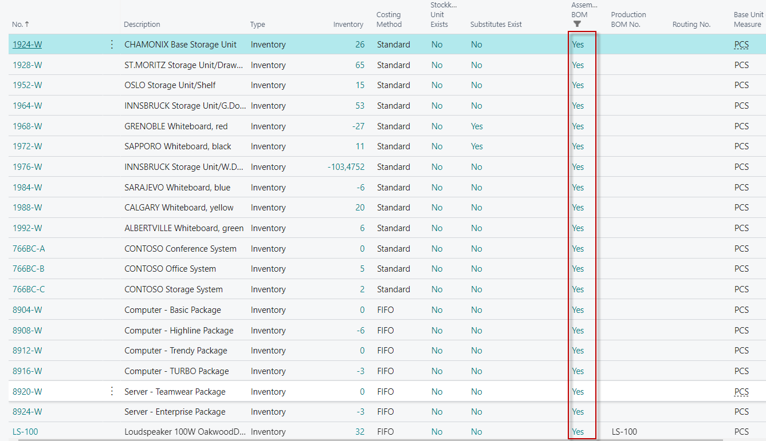
List of possible Assembly items
Assembly orders- Skorkovský

Slide 9
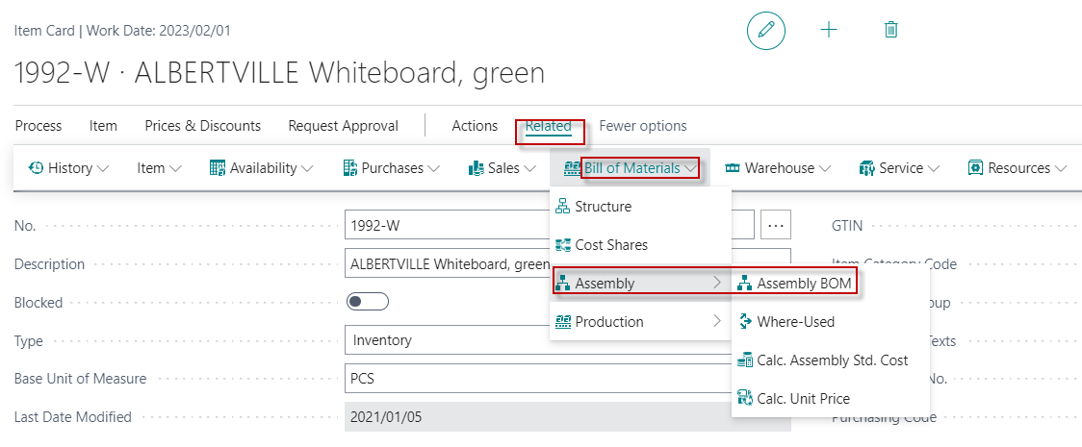
Assembly Bill of Material for chosen item 1992-W
Assembly orders- Skorkovský
BOM=Bill of Material
Components

Slide 10
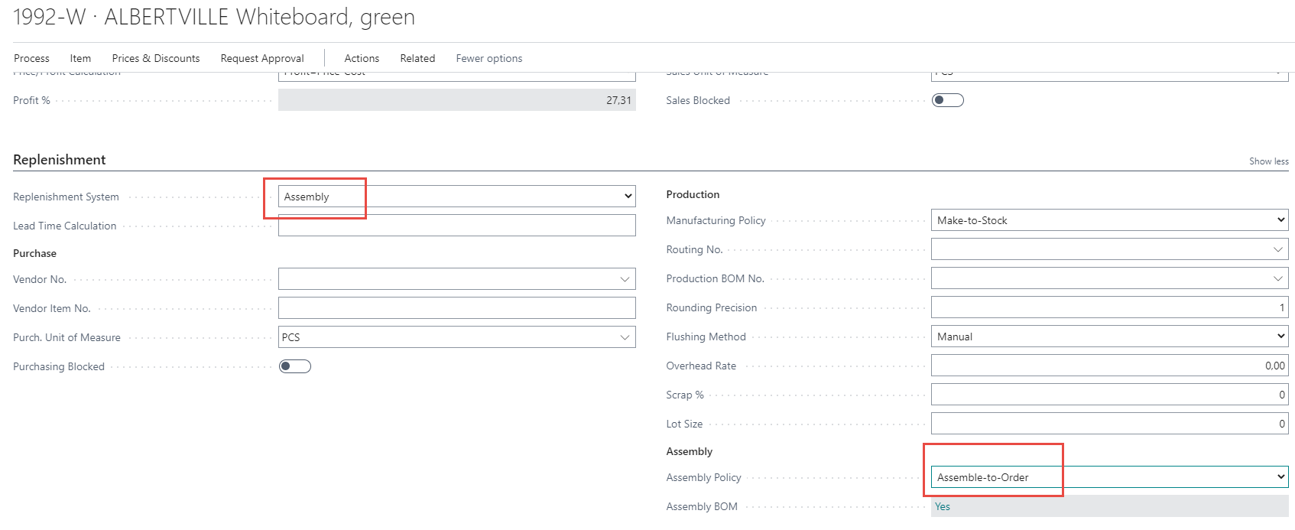
Setup of Assembly item card
Assembly orders- Skorkovský
Items that are set up for Assemble-to-Order aren't expected to be in inventory and will be assembled when it's included on a Sales order. An item is set up for Assemble-to-Order when the Assembly Policy field on the item card contains Assemble-to-Order option.
When you enter the item on a sales order line, an Assembly order is automatically created and linked to the sales order.
Use the Assemble-to-Order process (option) for items that you don't want to stock.

Slide 11
Assemble-to-Stock explanation (see slide 7)
Assembly orders basics
Assemble-to-Stock uses the assemble-to-stock process for items that you assemble and store for future sales.
Assemble-to-Stock items are standard items, such as packaged kits, that you don't customize. You can also consume these items as subassembly components.
Use the Assemble-to-Stock process for items that you assemble and store for future sales.

Slide 12
Standard Cost is a Costing method set for our model item
Standard Cost
Many manufacturing companies select a valuation base of standard cost. This also applies to companies that perform light manufacturing, such as Assembly and Kitting. A standard cost system determines inventory unit cost based on some reasonable historical or expected cost. Studies of past and estimated future cost data can then provide the basis for standard costs.
These costs are frozen until a decision is made to change them. The actual cost to produce a product may differ from the estimated standard costs. For management control, the actual cost is compared to the standard cost for a specific item and differences
Explanation fo Kitting : see next 2 slides
Standard Cost=Pevná cena

Slide 13
Explanation of the term Kitting
Kitting
Kitting is a process commonly used in manufacturing and logistics where individual items are grouped together to create a single, ready-to-ship package.
This method is particularly useful for assembling products that require multiple components.
Reasons for use of kitting :
Efficiency: By pre-assembling kits, companies can streamline their production and shipping processes, reducing the time and labor required to handle individual parts
Cost Savings: It can lower inventory costs and improve space utilization by consolidating multiple items into a single package

Slide 14
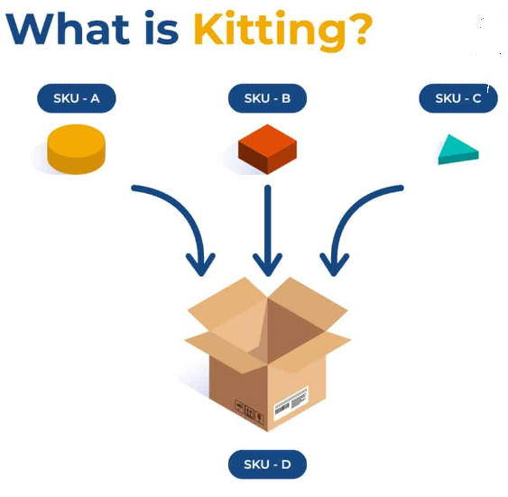
Kitting
SKU=Stock Keeping Unit

Slide 15
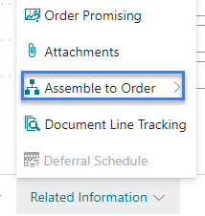
Sales Order Line -> Assemble-to-Order version
Assembly orders- Skorkovský

Slide 16
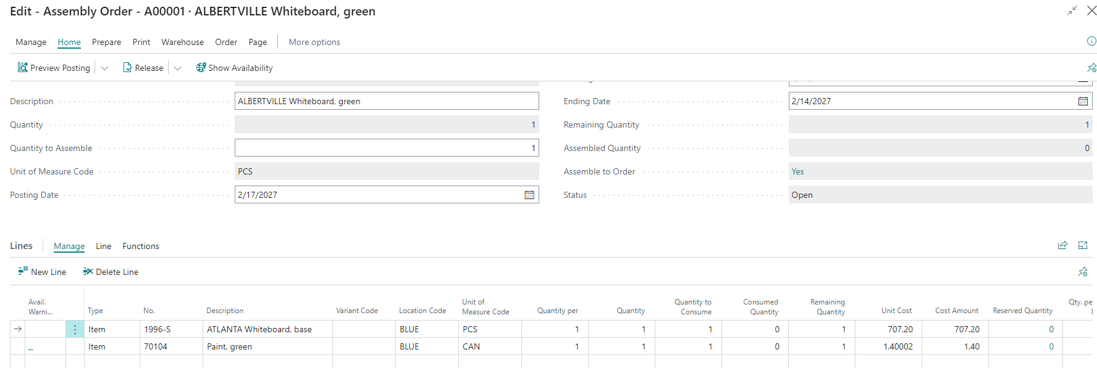
Created Assembly Order type Assemble-to-Order (AtO)
Assembly orders- Skorkovský

Slide 17
Link from AtO lines to document
OR

Slide 18
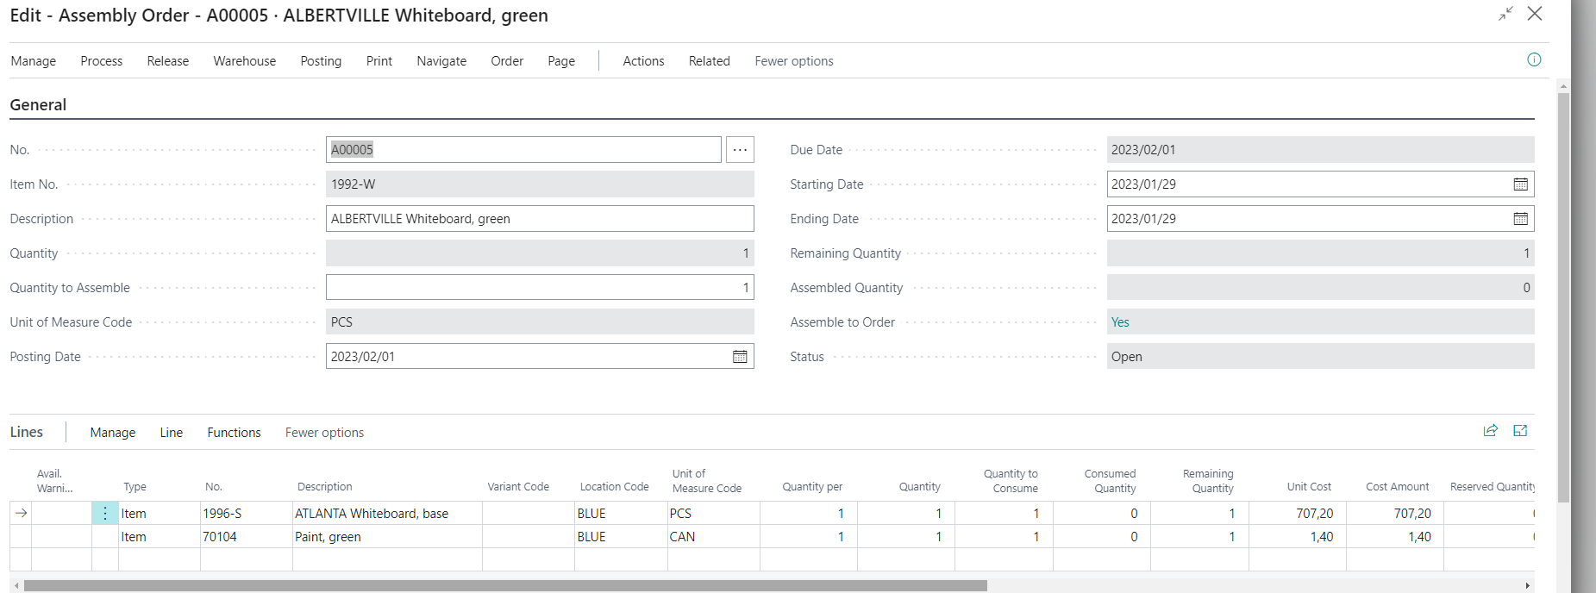
Show created document (Assembly Order) – before posting
Assembly orders- Skorkovský
This model does not consider the source, but it can be added in the teaching

Slide 19
Status change : Open -> Released
Assembly orders- Skorkovský
You need to change the status manually !

Slide 20
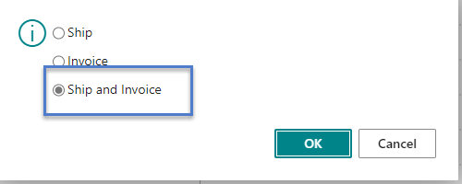
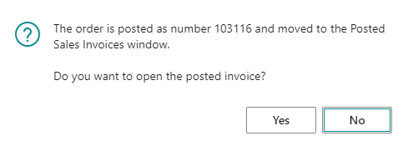
SO posting is related to Automatic posting of linked Assembly order
Assembly orders- Skorkovský
F9

Slide 21
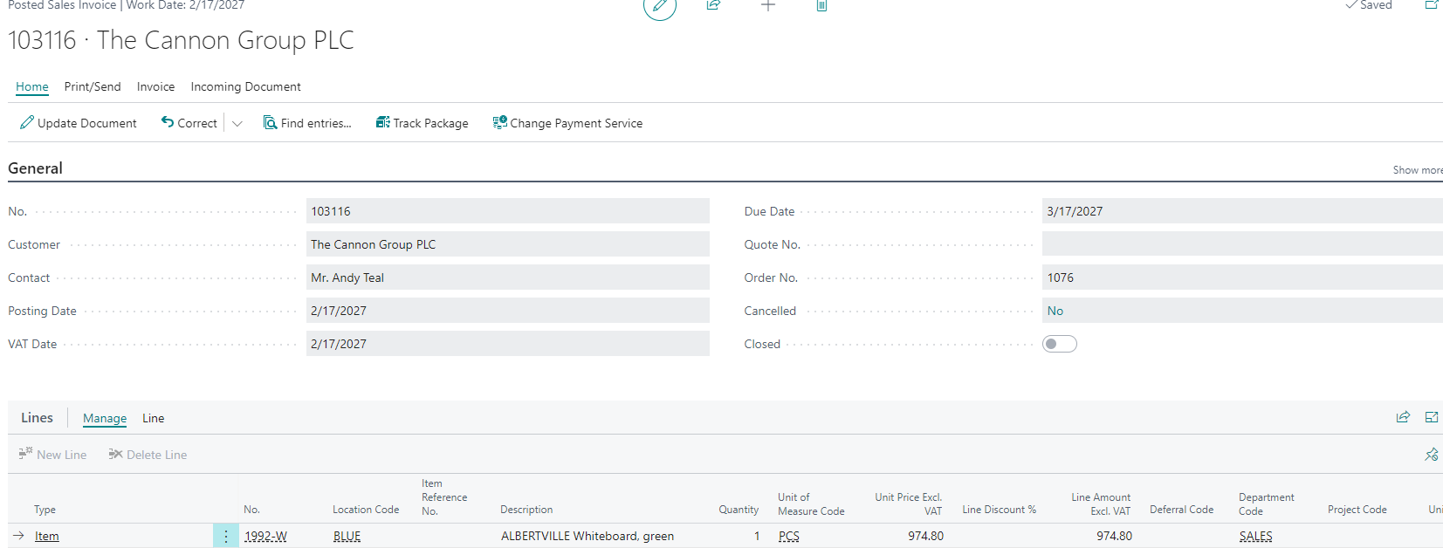
Posted Sales Invoice
Assembly orders- Skorkovský
It automatically posts both the sales order and the linked Assembly order

Slide 22
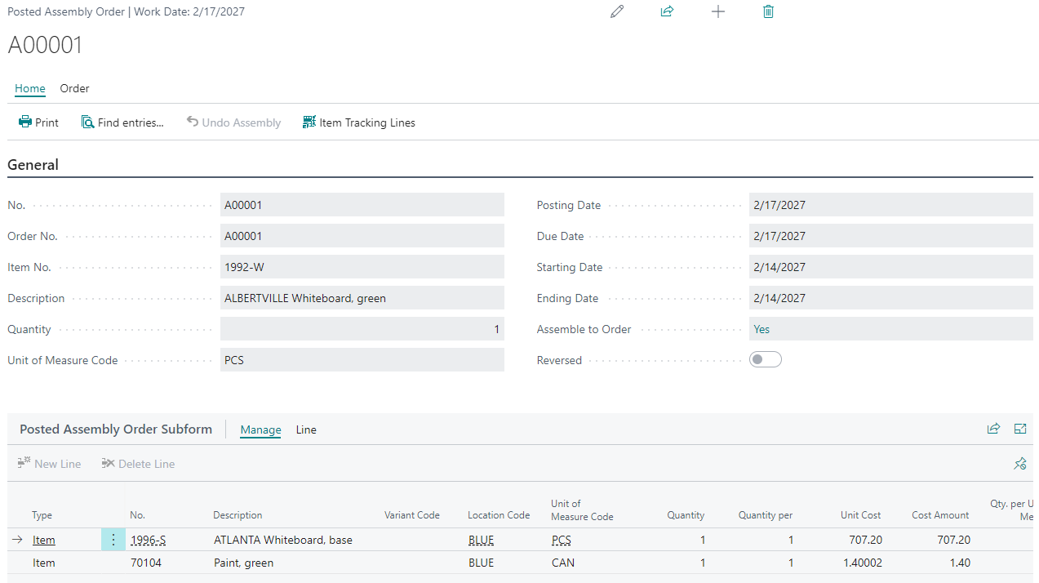
Posted Assembly order
Assembly orders- Skorkovský

Slide 23
Item Ledger Entries after posting Sales order
Assembly orders- Skorkovský

Slide 24
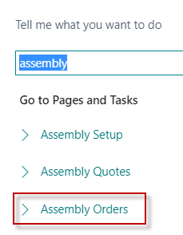
Assembly orders type Assemble-to-Stock
Assembly orders- Skorkovský
No document is yet listed in the ESF database

Slide 25
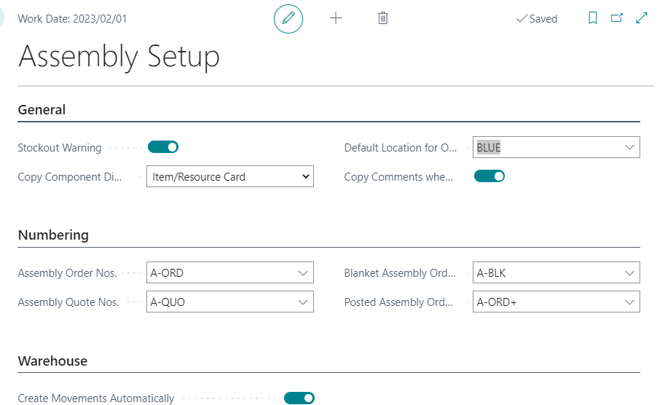
Assembly setup
Assembly orders- Skorkovský

Slide 26
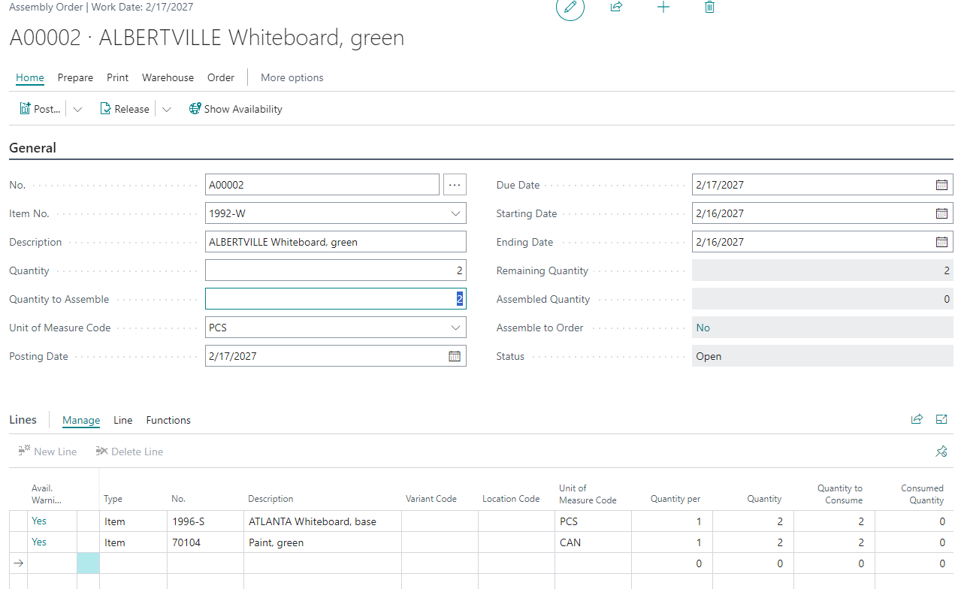
Assembly Order
Assembly orders- Skorkovský

Slide 27
Explanation Assemble-to- stock and Assemble-to-order
Assembly orders- Skorkovský
If the Assembly Method field on the Assemble Item tab contains Assemble-to-Stock, then the default Sales Order process assumes that the item is already assembled and can be removed from stock if available. Therefore, no Assembly order is automatically created and linked to the Sales Order line
However, if part (or all) of the quantity is not available, you have the option to create an Assembly order for the remaining quantity by filling in the QTY to Assemble-to- Order field on the sales order line.
In this way, you can assemble the item to order, even if it is set to be Assemble-to-Stock by default

Slide 28
Assembly order-posting
Assembly orders- Skorkovský

Slide 29
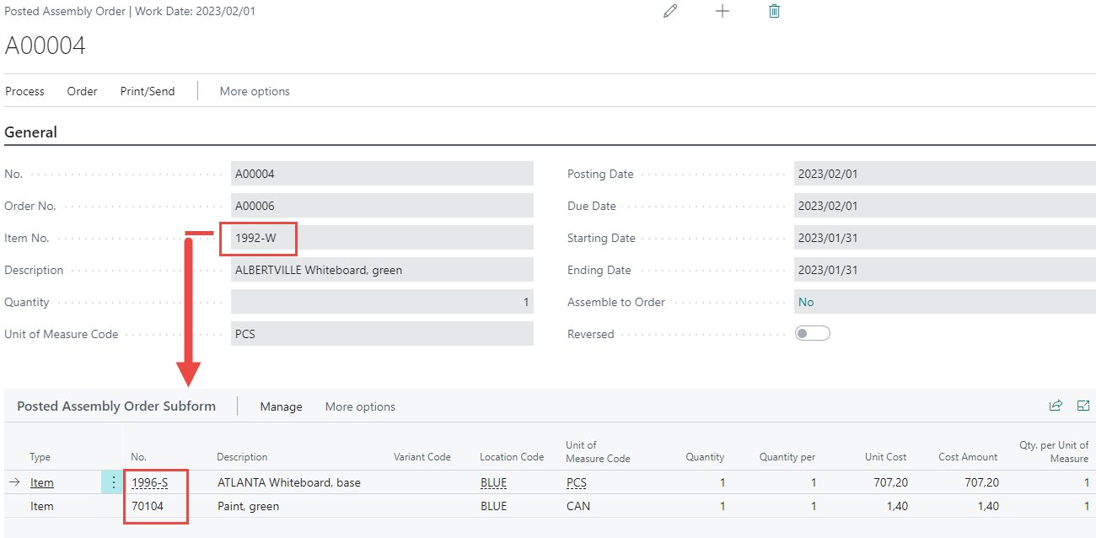
Posted assembly order
Assembly orders- Skorkovský

Slide 30
Item ledger entries
Assembly orders- Skorkovský

Slide 31
Roll-UP Cost
Roll-up Cost v Business Central je celková cena hotového výrobku, která zahrnuje náklady na všechny jeho složky, včetně surovin, práce a režie.
NA následujícím snímku jsou uvedeny kroky pro výpočet Roll-up Cost v aplikaci Business Central.

Slide 32
Roll-up-Cost
The Roll-up Cost in Business Central is the total cost of a finished product that includes the cost of all its components, including raw materials, labor, and overhead (režie). Here are the steps to calculate the Roll-up Cost in Business Central:
Identify the finished product: Determine which finished product you want to calculate the roll-up price for.
Create a Bill of Materials (BOM): Create a list of all the components required to produce the finished product. This includes raw materials, labor, and overhead costs (režie).
Assign costs to each component: Assign the cost of each component to the BOM. This includes the cost of raw materials, labor, and overhead costs.
Calculate the total cost of the BOM: Add up the cost of all the components listed in the BOM.
Add any additional costs: If there are any additional costs associated with producing the finished product, such as shipping or packaging costs, add them to the total cost of the BOM.
Determine the mark-up (přirážka, marže): Decide on the desired profit margin for the finished product and add it to the Total cost of the BOM.
Calculate the Roll-up Price: Add the total cost of the BOM to the desired profit margin to determine the Roll-up Price for the finished product.
Business Central has a built-in feature to calculate the Roll-up Price of items based on the cost of their BOM. This feature is called the "Calculate Roll-up Cost" function and it can be accessed through the "Item Card" page.

Slide 33
Cost shares on item card
View ow the cost of underlying items in the BOM roll-up to the parent item.
The information is organized according to the BOM structure
to reflect the levels at which individual costs increase.
Each item level can be collapsed or extended
to obtain an overview or detailed view.
SEE : In the class, try Cost share of item 1000 (to see Rolled-Up Costs related to Production )

Slide 34
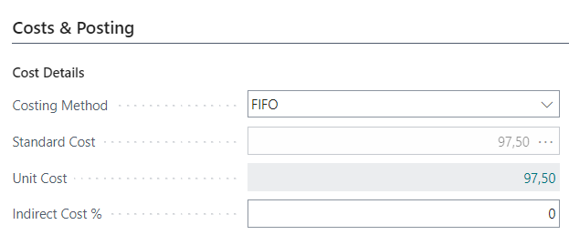
Costs on item card (overhead and item cost)
Indirect costs in absolute value
Indirect costs in absolute value

Slide 35
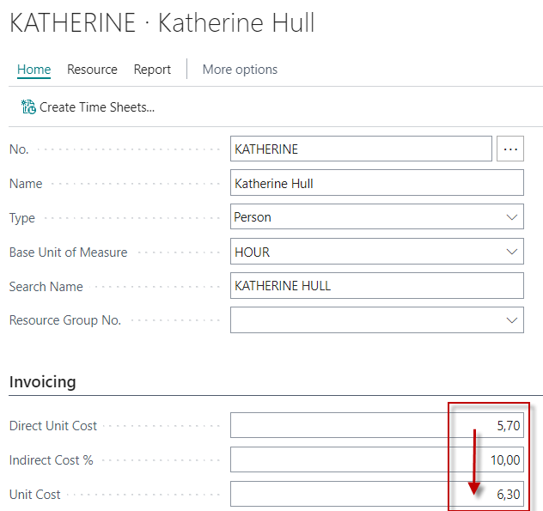
Costs on related resources (capacity cost)
After Rounding up

Slide 36
Adding capacity to Assembly BOM component
Cost Shares

Slide 37
Standard cost – sigle level
Item Material Capacity Overhead
A 24 + 5 + 6 = 35
B 10 + 3 + 3 = 16
C 5 + 2 + 1 = 8
=16+8 = 24
A
C
B

Slide 38
Standard cost – multiple level
Item Material Capacity Overhead
A 15 + 10 + 10 = 35
5 6
B 10 + 3 + 3 = 16
C 5 + 2 + 1 = 8
=16+8 = 24
A
C
B

Slide 39
Thank you for your attention

