Slide 1
Remainders in Business Central
Ing.J.Skorkovský,CSc.
MASARYK UNIVERSITY BRNO, Czech Republic
Faculty of economics and business administration
Department of Business Management

Slide 2
Reminders
Reminders – better control over Receivables
In Business Central a Reminder is similar to an Invoice. When you create a reminder, you must fill in a Reminder header and one or more Reminder lines.
You can fill in a header manually and have the program fill in the lines
OR
- you can have the program create reminders for all customers automatically.

Slide 3
Customer card setup

Slide 4
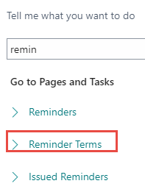
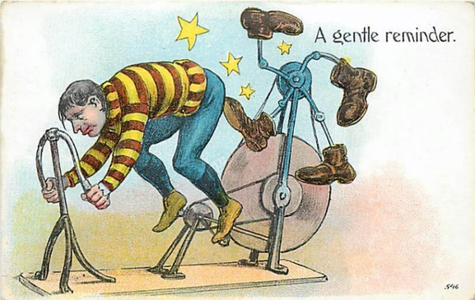
Remainder terms (conditions) and its setup
It is very important to check the box Post Additional Fee.
Otherwise, the fee amount will not appear in the reminder lines!

Slide 5
Reminder levels I.

Slide 6
Reminder levels II.
Defining Grace Periods: For each reminder level, you can specify a grace period.
This period is the number of days after the due date during which no another reminder will be sent

Slide 7
Reminder Beginning and Ending texts
Set Up Reminder Terms and Levels - Business Central | Microsoft Learn
Přístup k parametrům typu : %p

Slide 8
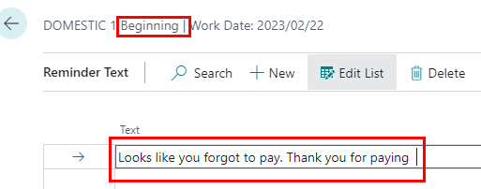
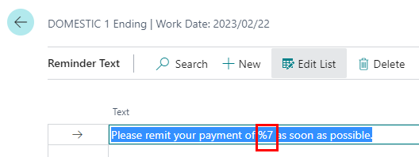
Reminder texts for every reminder level
%7 – text variable (list of all variables see later in this show – see slide 10)
In our examle: %7= Total ( Remaining amount + Charge + Fee + VAT)

Slide 9
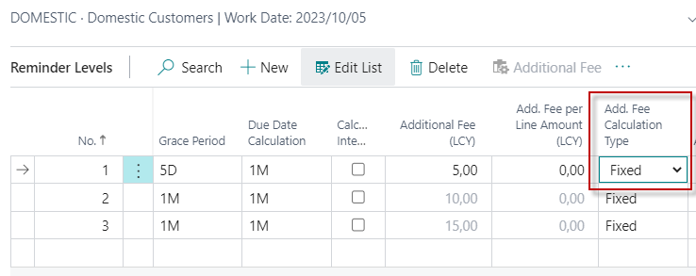
How to calculate fee (we will use Fixed option)
Resource : Help MS Dynamics 365 Business Central
Fee setup is not accessible
Nobody uses Dynamic Variants – so it is the reason why it is not mentioned in this material
Fixed
Fees are calculated based on the value of the Fee field on the row for the reminder level itself.

Slide 10
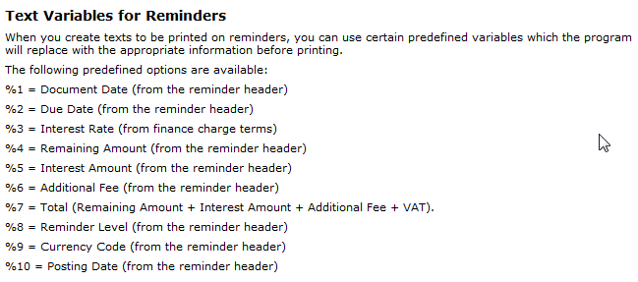
Varibles used in terms
Set Up Reminder Terms and Levels - Business Central | Microsoft Learn
Set Up Reminder Terms and Levels - Business Central | Microsoft Learn

Slide 11
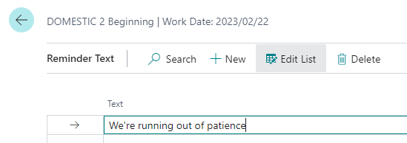
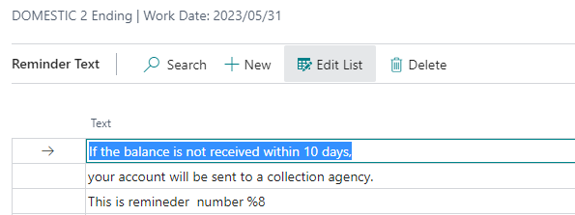
Terms – second level
Dochází nám trpělivost…
Code –Text Variable for Reminder level

Slide 12
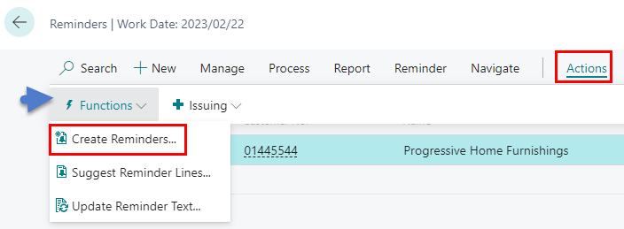
Automatic Reminder creation
Open the Reminders window (Search window -> Reminder -> New icon)
In the Reminders window, use the Create Reminder icon in the Actions area. The batch request panel appears, which creates a reminder
Set a filter per customer and/or per Document type of Customer Ledger Entries if you want to create reminders for selected customers and/or for specified type of Customer Ledger Entries (such as for example Invoice)

Slide 13
Reminder dates example (WD=9/9/2026) ->MM/DD/YYYY
VAT Date = 10/9
Invoice issue date = 9/9
Invoice due dates = 10/9
Reminder Level 1 = 10/9+5D+1D=10/15 - > Issue (in this model DDC=0 )
Reminder Level 2= 10/15+1M+1M+1D=12/16/2026 - > Issue
Reminder Level 3 = 12/16/2027+1M+1M+1D=2/17/2027 -> Issue
One (1) month from Payment Term code
Green days -> Grace periods
Red days -> Due Date Calculation (DDC)
WD=Working Day
Why 1D ? -> next day
Issue -> jde o vydání upomínky

Slide 14
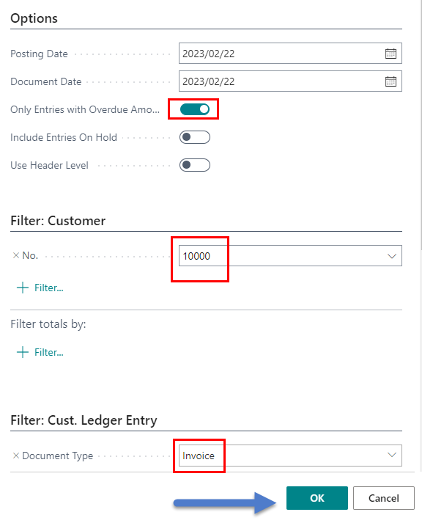
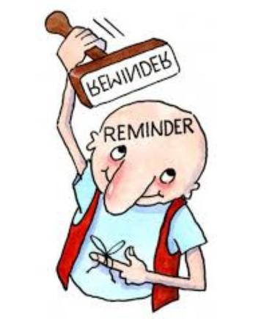
Automatic reminder creation
On the Options tab, fill in the fields with the relevant information. If you need Help, then use the Help on each field
In former student database
we used Posting date and
Document Date = 1.4.2023
In this presentation we used
2023/02/02

Slide 15
List of created reminders in database used

Slide 16
Header of created reminder in used database
Díly naší nové licenci umožňující reálná data
od 1.11.20xx do 28.2.20x(x+1)
použijeme 1.12.2027
a zákazníka 20000.
WD=1.12.2027
In this database
Used Posting date and
Document Date =1.4.2023
Date template : YYYY/MM/DD

Slide 17
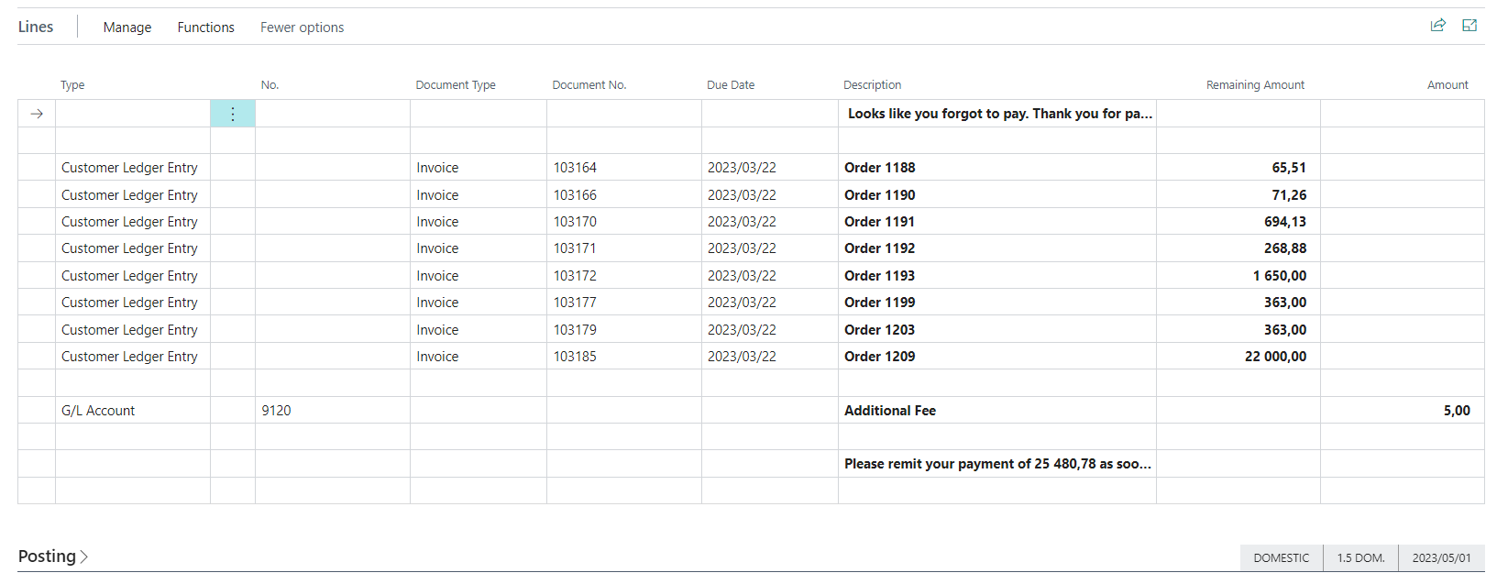
Created Reminder lines in used database
Additional Fee for remineder level 1

Slide 18
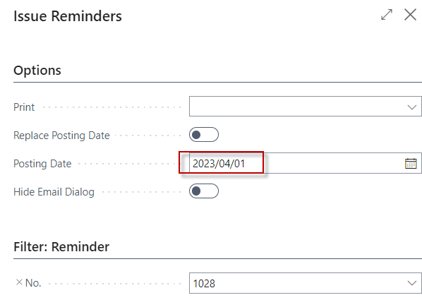
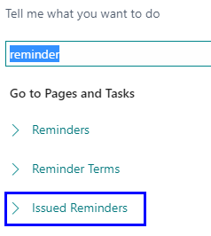
Issuing of already created reminder in database

Slide 19
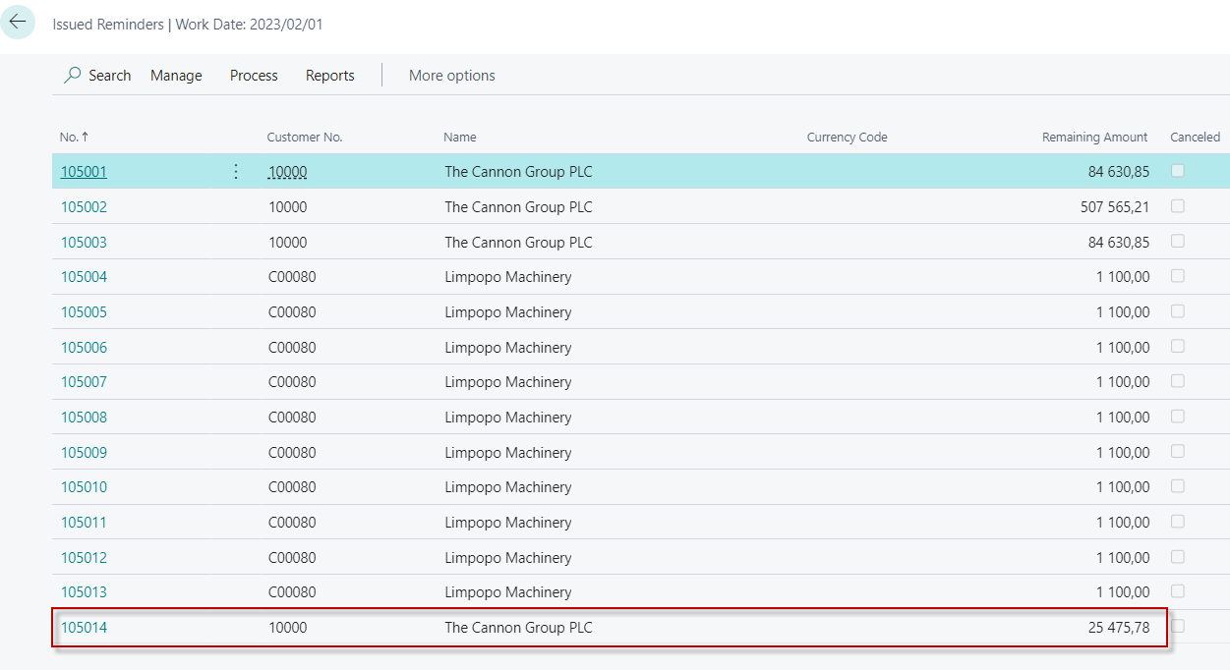
List of issued reminders in used database
Just created

Slide 20
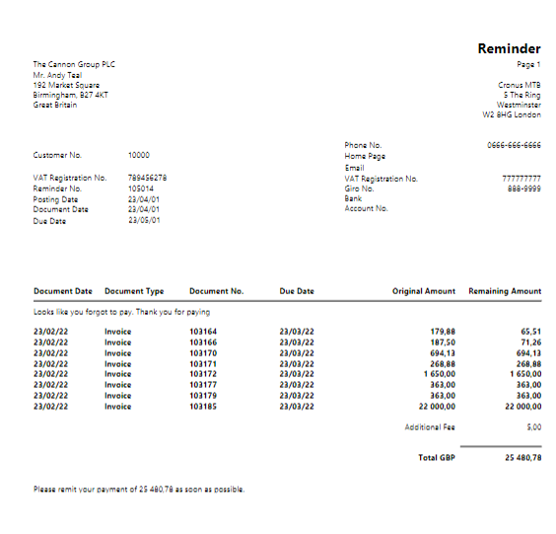
Printout of issued reminder in used database

Slide 21
Customer ledger entries
Reminder Due date

Slide 22
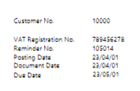
Second attempt to create reminders in used database
New date for ceration of 2nd level reminder= Due Date + 1M + 1D = 2023/06/02
Due to the grace period (1M)
Actual working date to create reminder : 2023/06/02

Slide 23
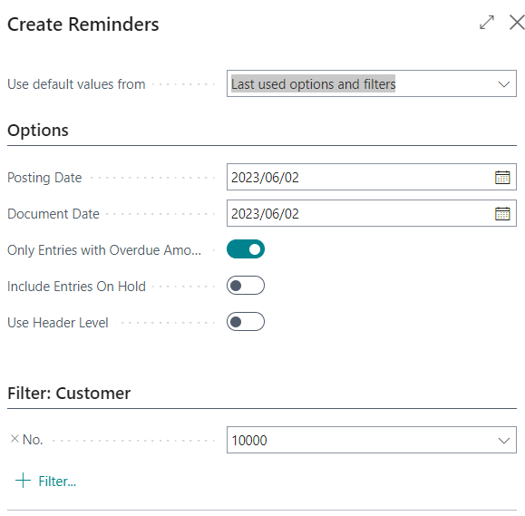
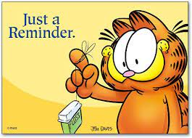
2nd level reminder creation in used database
Actual Working date
to create reminder : 2023/06/02

Slide 24
2nd level reminder created in used database
Reminder Header

Slide 25
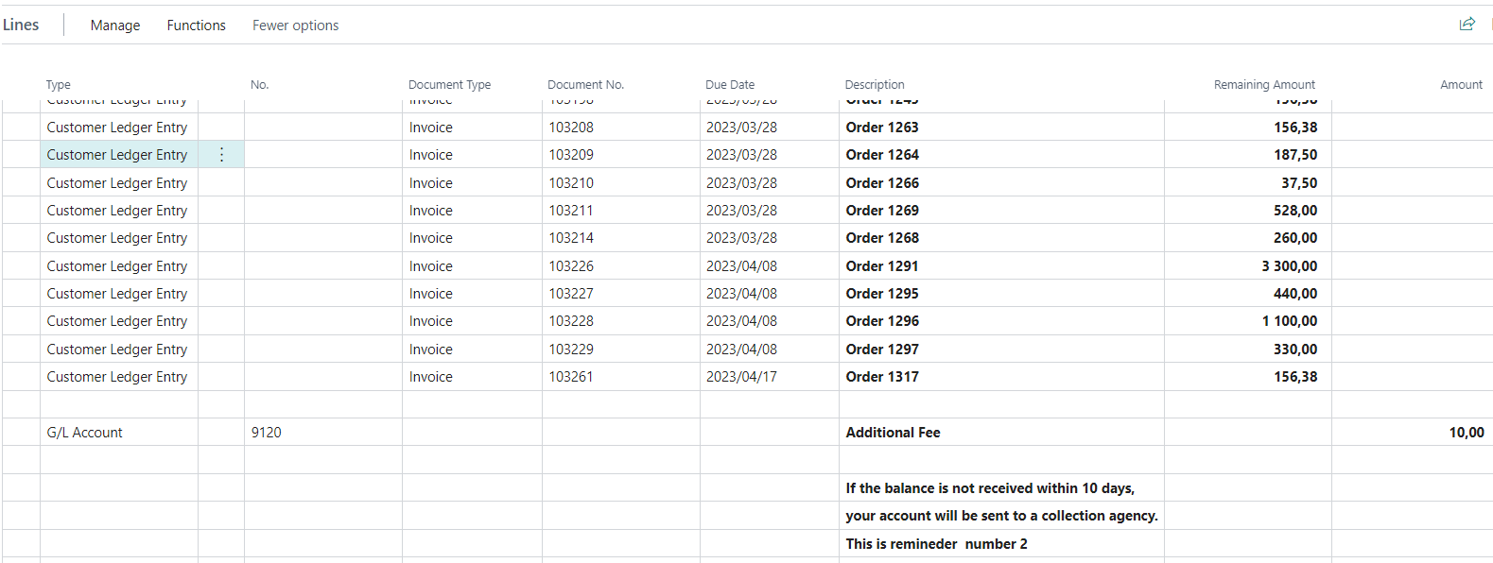
2nd level reminder created in used database
Reminder lines (only part of the lines)
Additional Fee for remineder level 1

Slide 26
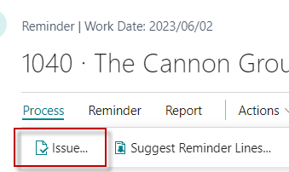
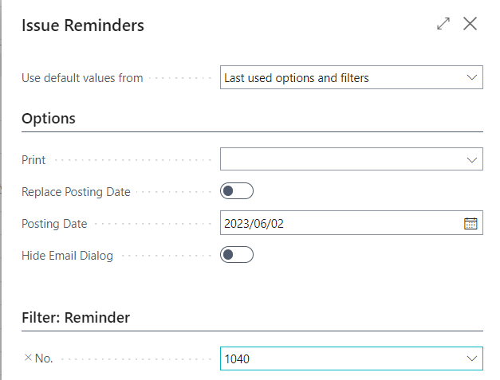
Customer Ledger entries and G/L entries after issuing reminder
Actual working date to
create reminder : 2023/06/02

Slide 27
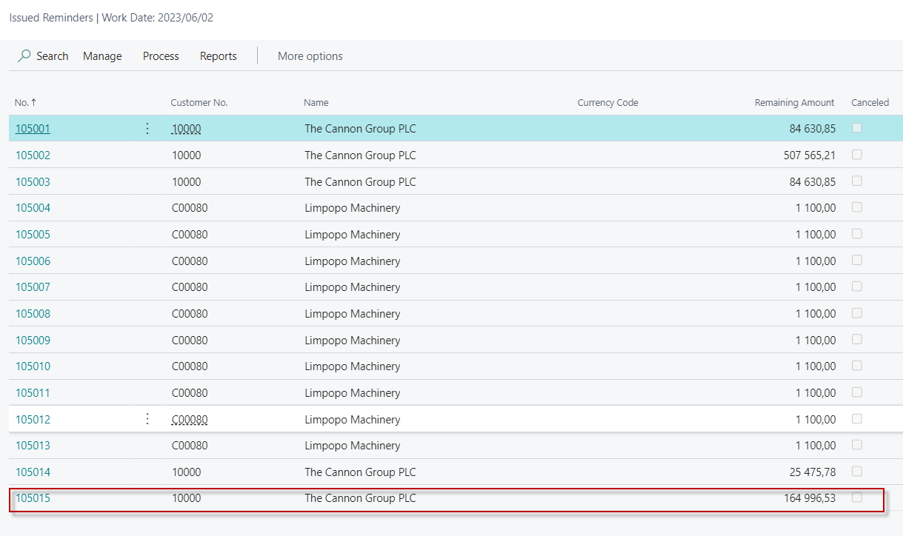
List of issued reminders

Slide 28
General ledger entries

Slide 29
Customer Ledger Entries

Slide 30
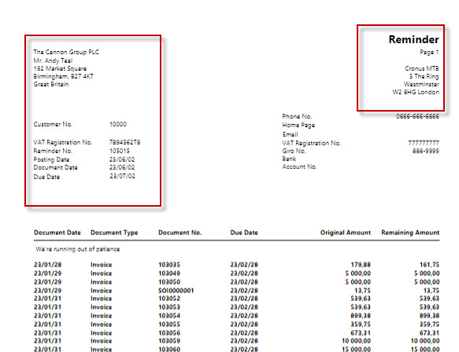
Printout of issued 2nd level reminder (part of it – there is much more lines)
Important date for 3rd lever reminder creation

Slide 31
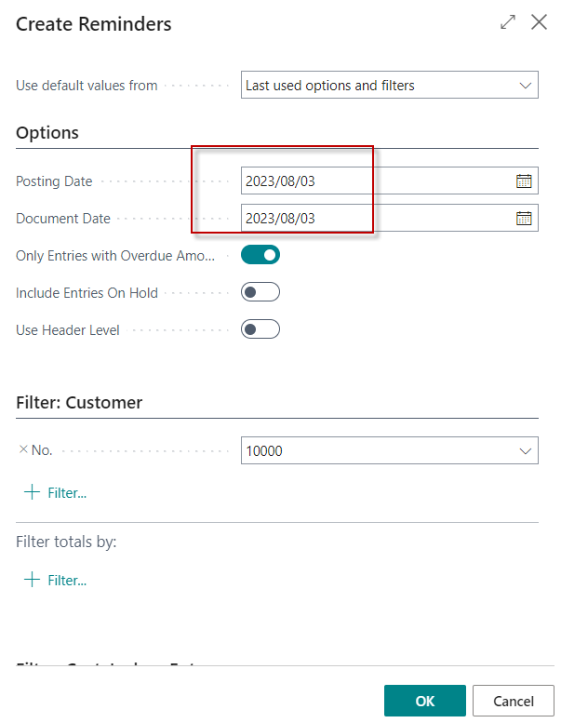
Creation of the 3rd level Reminder
Important date for 3rd level
Reminder creation (2023/07/02)
2023/07/02+1M +1D = 2023/08/03
1 month

Slide 32
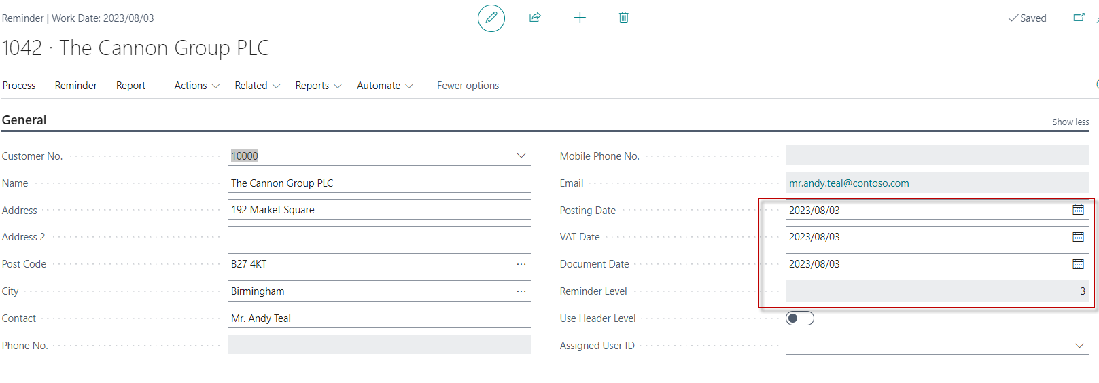
3rd level reminder header

Slide 33
3rd level reminder some lines

Slide 34
NEW MODEL-Home study

Slide 35
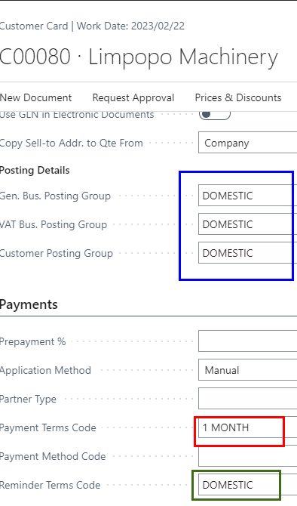
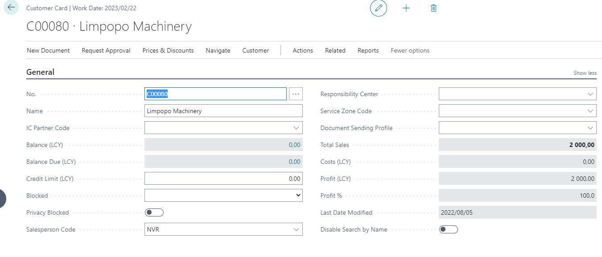
Another example
Newly created customer :

Slide 36
Customer ledger entries
All Customer Ledger entries originate from test versions of the example

Slide 37
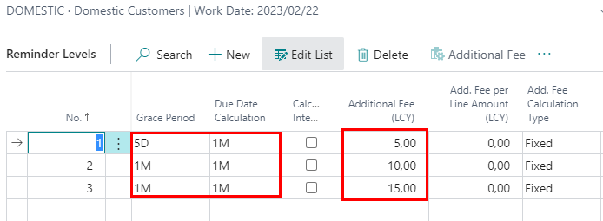
Reminder setup (Domestic)

Slide 38
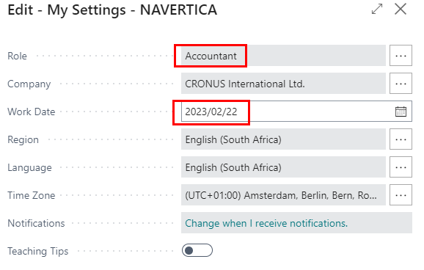
Working date

Slide 39
Data creation (invoice)
Only sales line (in Sales Header we have our Limpopo Machinery client)
First part of the line
Second part of the line
F9 to post Sales Order

Slide 40
Customer ledger entries

Slide 41
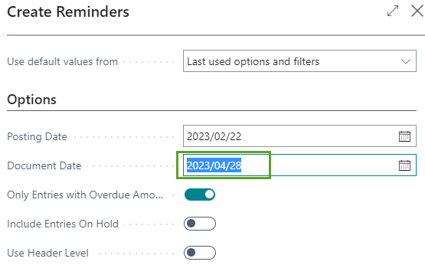
Create remainder 1st level
2023/02/22 invoice was posted
2023/03/22 – invoice due date
(payment term condition =1 month on Customer card)
Due Date calculation =1M of 1st level remineder
Grace period=5 Days
Document date=2022/04/28 (reminder 1st)
2022/04/28=2022/03/22+1M+5 Days +1 Day (1 day after calculation)
Posting date = invoice due date

Slide 42
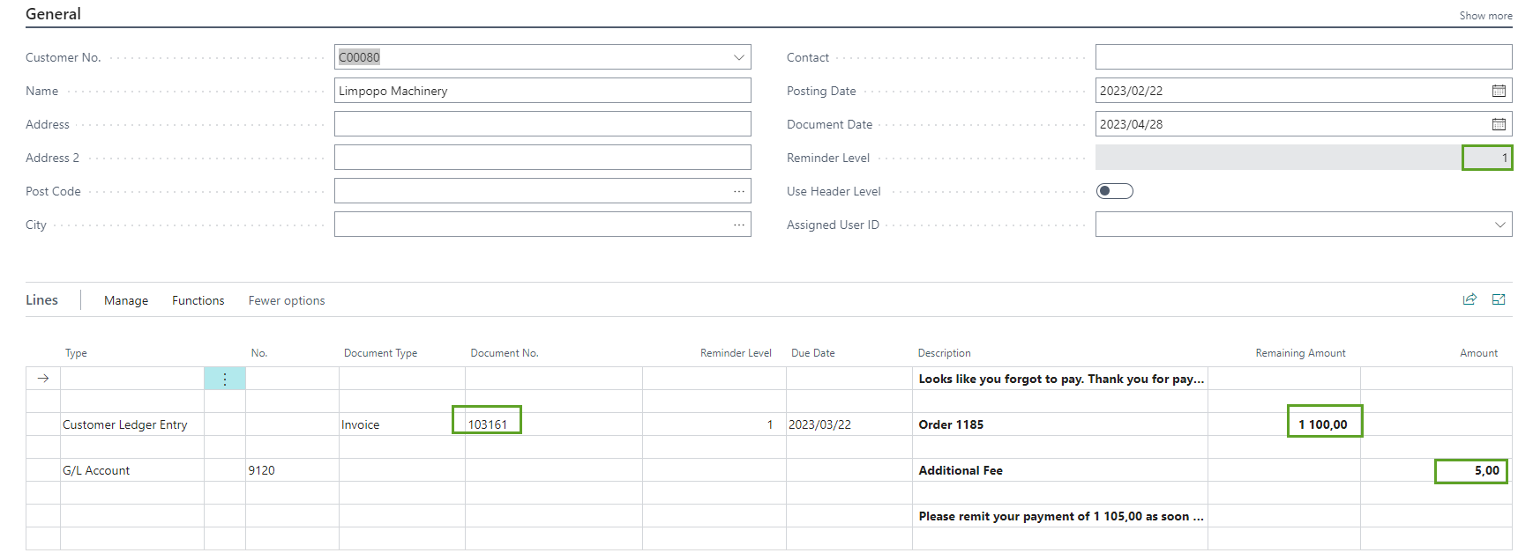
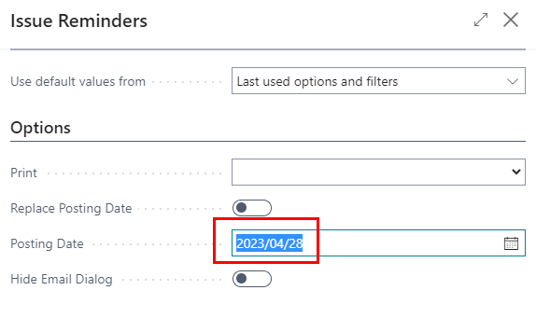
Created reminder 1st level
Document date of the Reminder =2023/04/28
Issue Reminder

Slide 43
Customer ledger entries
Due date of the 1st Reminder = 2023/05/28 = 2023/04/28+ 1M

Slide 44
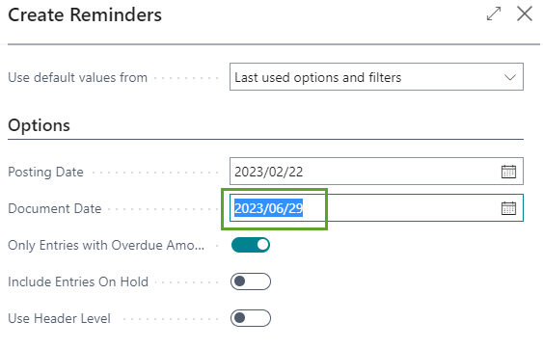
Create remainder 2nd level
2023/02/22 invoice was posted
2023/05/28 – due date of 1st level reminder
Due Date calculation =1M (see reminder 2nd level)
Grace period= 1 Month
Document date=2023/04/28 (1st level reminder)
New document date for reminder 2nd level
2023/06/29=2023/04/28 +1 M + 1 Month +1 day

Slide 45
2nd level Reminder

Slide 46
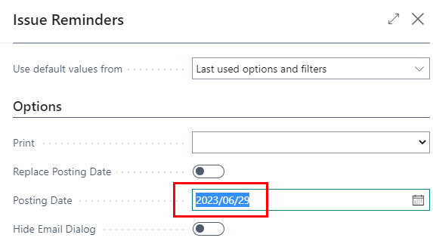
Customer ledger entries after issuing 2nd level reminder

Slide 47
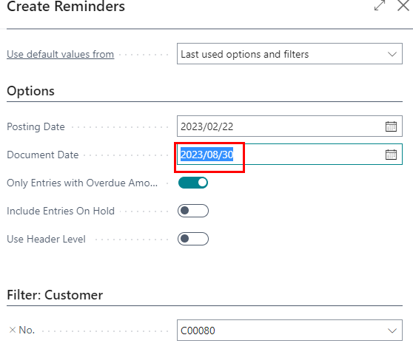
Create remainder 3rd level
2023/02/22 invoice was posted
2023/07/29 – due date of 2nd level reminder
Due Date calculation =1M (see reminder 3rd level)
Grace period= 1 Month
Document date=2023/06/29 (2nd level reminder)
New document date for reminder 3rd level
2023/08/30=2023/06/29 +1 M + 1 Moths +1day

Slide 48
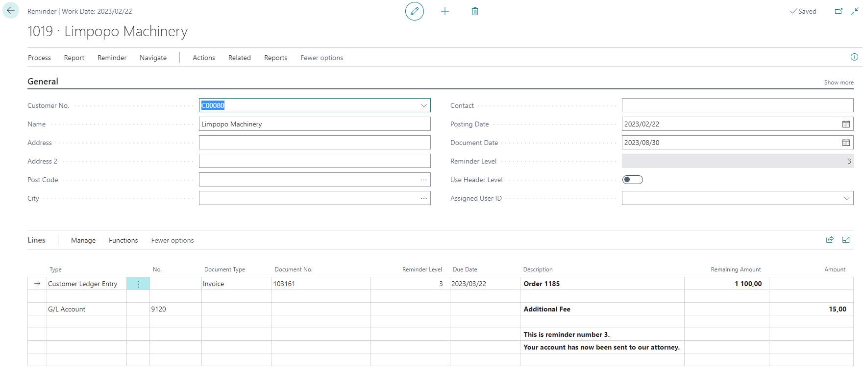
3rd level reminder

Slide 49
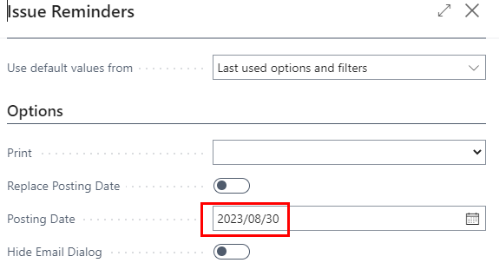
Customer ledger entries after issuing 3rd level reminder

Slide 50
Customer payment

Slide 51
Customer payment
F9

Slide 52
Customer ledger entries and GL entries

Slide 53
