Slide 1
ATP-CTP Calculation of Order Promising Dates MS Dynamics 365 Business Central
Ing.J.Skorkovský,CSc.
MASARYK UNIVERSITY BRNO, Czech Republic
Faculty of economics and business administration
Department of business management

Slide 2
ATP-CTP (CZ verze vysvětlení)
V Dynamics 365 Business Central se používají dvě hlavní metody pro slibování termínů dodání: ATP (Available to Promise) a CTP (Capable-to- Promise).
ATP (Available-to-Promise): Tato metoda vypočítává dostupnost na základě aktuálních zásob a plánovaných příjmů. Pokud máte dostatek zásob na skladě nebo jsou na cestě, ATP vám poskytne datum, kdy můžete objednávku splnit¹.
CTP (Capable-to-Promise): Tato metoda jde o krok dále a zahrnuje nejen dostupné zásoby, ale také výrobní kapacity a dodací lhůty od dodavatelů. CTP vypočítává, kdy můžete objednávku splnit, i když musíte nejprve vyrobit nebo objednat potřebné zboží¹.
Obě metody pomáhají zlepšit přesnost a spolehlivost vašich dodacích termínů, což vede k lepší spokojenosti zákazníků.

Slide 3
ATP-CTP (Eng version)
In Dynamics 365 Business Central, there are two main methods for promising delivery dates: ATP (Available-to-Promise) and CTP (Capable-to-Promise).
ATP (Available-to-Promise): This method calculates availability based on current inventory and projected revenue. If you have enough inventory in stock or on the way, ATP will give you a date when you can fulfill order 1.
This method goes one step further and includes not only available inventory CTP (Capable-to-Promise): but also production capacity and lead times from suppliers. CTP calculates when you can fulfill the order, even if you have to produce or order the item first.
Both methods help improve the accuracy and reliability of your delivery times, leading to better customer satisfaction.

Slide 4
Calculations ATP-CTP
When Business Central calculates the customer’s delivery date, it performs two tasks:
Calculates the Earliest Delivery date when the customer has not requested a specific Delivery date.
Verifies if the delivery date requested by the customer or promised to the customer is realistic.

Slide 5
Introduction I.
A company must be able to inform their customers of Order Delivery dates.
The Order Promising Lines page enables you to do this directly from a sales order.
Business Central calculates shipment (earlier) and delivery (later)dates based on an item’s known and expected availability dates, which you can promise to customers.
If you specify a Requested delivery date on a sales order line, then that date is used as the Starting point for the following calculations:
Requested Delivery Date – Shipping Time = Planned Shipment Date
Planned Shipment Date - Outbound Warehouse Handling Time = Shipment Date
Planned Shipment Date
Shipment Time
Requested Delivery Date
or
Shipment Date
Outbound
W. Handling T.
Planned Delivery Date
Planned Shipment Date
Picking

Slide 6
Introduction II.
Requested Delivery Date – Shipping Time = Planned Shipment Date
Planned Shipment Date - Outbound Warehouse Handling Time = Shipment Date
-
Requested Delivery Date
Shipment Time
Planned Shipment Date
-
Planned Shipment Date
Outbound
Handling
Shipment Date
Nebo to může být znázorněno takto
Planned Delivery
Date
Shippment Time
Planned Shipment
Date
OWHT
Shipment
Date

Slide 7
ATP-CTP
Available-to-Promise
Capable-to-Promise
ATP – based on the reservation functionality of the system, which checks availabilities (Calculation of Delivery date)
CTP – based on WHAT-IF scenarios. That is, calculating the earliest time when the requested item will be available. It calculates replenishment.
If there are no existing any Item Ledger entries, no incoming orders of the type Purchase, Transfer, Return or Production - then the system calculates the nearest date, creates order lines and reserves stock items.

Slide 8
ATP-CTP
Select Available-to-Promise if you want to calculate the Earliest date that the item will be available with respect to inventory, scheduled receipts, and Gross Requirements.
Select Capable-to-Promise if you know that the item is presently out of stock and you want to calculate the earliest date that the item can be available by issuing new replenishment requisitions.
Before an item can be included in the Order Promising calculation, it must be marked as Critical.
This setup ensures that non-critical items do not cause irrelevant order promising calculations.

Slide 9
Gross Requirements-explanation
Gross Requirements:
Gross requirements represent the total quantity of a product that is needed to satisfy the demand forecast. This includes both the demand from external customers and the demand generated by the production plan for other products within the organization.
In simple terms, gross requirements are the total demand for a particular item before considering any existing inventory.
Gross Requirement=Hrubý požadavek

Slide 10
Net Requirements-explanation
Net requirements, on the other hand, take into account the current inventory levels and the scheduled receipts (orders or production) that are already in the pipeline.
Net requirements are calculated by subtracting the current on-hand inventory and scheduled receipts from the gross requirements. This calculation helps determine the actual quantity that needs to be produced or procured to meet the demand.
Net Requirement=Čistý požadavek

Slide 11
Important equation (relation between GR and NR)
Net Requirements = Gross Requirements - (On-Hand Inventory + Scheduled Receipts – Schedule Deliveries –Safety Stock)

Slide 12
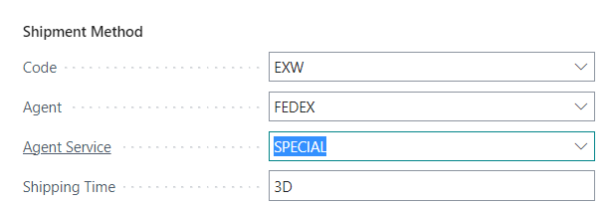
ATP –CTP
Blues Location
1D - OWHT
Shipment time
Blue Location card tab Warehouse
Customer Card
Customer

Slide 13
ATP –CTP – Order Promising Setup
The Offset Time Delay -> Compensation (Time) field contains the amount of time the program must wait before it can issue a new purchase order, production order or transfer order. It was already mentioned in the section describing reservations.
The period begins on the current date
Used Time units can be days, working days, weeks, months, quarters or years

Slide 14
Parameters used for ATP-CTP calculations
Times ATP-CTP | Numbre of days | Where it's set
OWHT | 1D | Location Blue
IWHT | 1D | Location Blue
Lead Time Calculation | 4D | Item Card
Safety Lead Time | 2D | Item Card
Shipping Time | 3D | Customer Cards
Offset | 1D | Order Promising Setup
OWHT=Outbound Warehouse Handling Time
IWHT=Inbound Warehouse Handling Time
Lead Time
Safety Lead Time
IWHT
OWHT
Shipment Time
Vendor
Customer
Locations setup

Slide 15
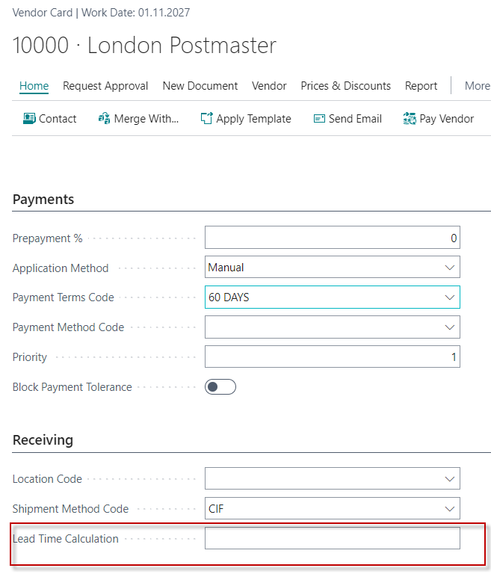
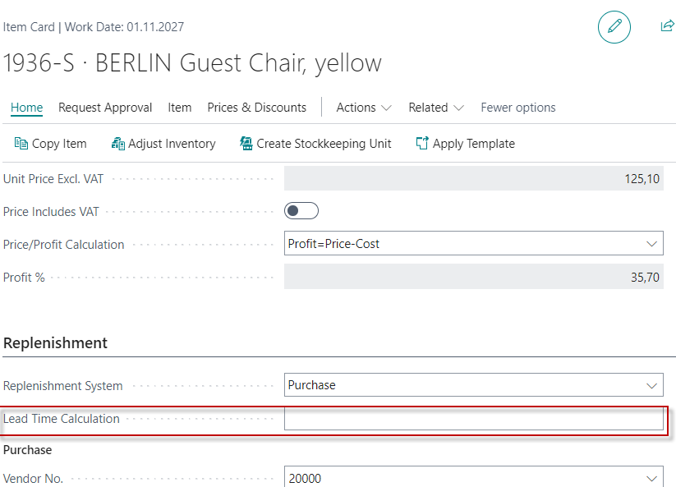
Lead time calculations Setups

Slide 16
Lead time calculations-explanation-CZ version
V Business Central hodnota pole Lead Time Calculation na kartě dodavatele a na kartě zboží ovlivňuje, kdy je třeba objednat zboží, aby bylo doručeno včas.
Lead Time Calculation na kartě dodavatele: Tato hodnota určuje dobu, kterou dodavatel potřebuje k dodání zboží od okamžiku objednání. Pokud je tato hodnota nastavena, Business Central ji použije k výpočtu data objednávky na základě požadovaného data doručení¹.
Lead Time Calculation na kartě zboží: Tato hodnota určuje dobu, kterou potřebujete k přípravě zboží na skladě, včetně času na zpracování a manipulaci. Pokud je tato hodnota nastavena, Business Central ji použije k výpočtu data, kdy bude zboží dostupné k vyzvednutí¹.
Při zadávání objednávky Business Central kombinuje tyto hodnoty, aby vypočítal optimální datum objednávky a očekávané datum doručení. Pokud například zadáte požadované datum doručení, systém automaticky vypočítá datum objednávky odečtením celkové doby dodání (dodavatel + zboží) od požadovaného data¹.
Požadované datum doručení na kartě Dodavate ->Requested Delivery date
(nebude uvažováno v našem jednoduchém modelu)
Náš model bude brát do úvahy LS and SLT POUZE na kartě zboží (viz vyjádření na snímku 18)

Slide 17
Lead time calculations-explanation-ENG version
In Business Central, the value of the Lead Time Calculation field on the Supplier tab and the Item tab affects when you need to order goods to be delivered on time.
Lead Time Calculation on the Supplier card: This value determines the amount of time it takes the supplier to deliver the item from the time of ordering. If this value is set, Business Central uses it to calculate the order date based on the requested delivery date.
Lead Time Calculation on the Item Cards. If this value is set, Business Central will use it to calculate the date the item will be available for pick-up.
When you place an order, Business Central combines these values to calculate the optimal order date and expected delivery date. For example, if you enter a desired delivery date, the system automatically calculates the order date by subtracting the total delivery time (supplier + item) from the desired date.

Slide 18
Statement
in our model we will use
only the Lead time calculation and the item card

Slide 19
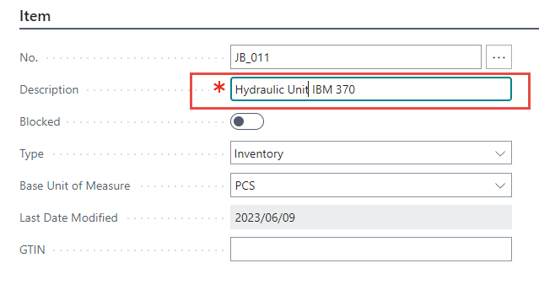
Simple model (ATP Calculation) I.
First of all, it is also necessary to create a new item card with the parameters
that will be part of the calculation, set the parameters of the model location
and the customer to whom we will deliver our model item.
Working day will be set in this PWP presentation to 3.7.2023 (2023/07/03)
Due to the type of license in our BC instances allowing to work realistically
only from 1.11. to 28.2. of that year, we set today our Working date
to 3.11.2027 for real modeling of ATP-CTP.
More Tabs

Slide 20
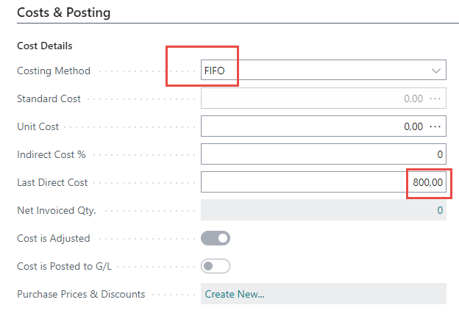
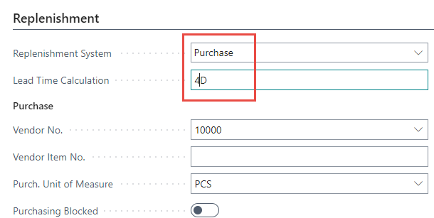
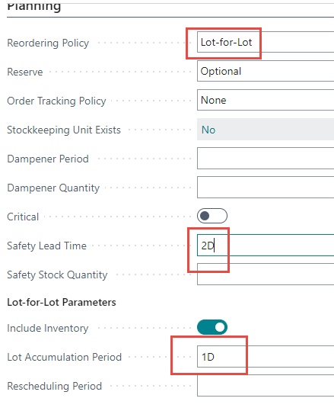
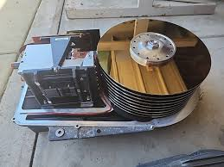
Simple model (ATP Calculation) II.

Slide 21
Simple model (ATP Calculation) III.
Customer 1000

Slide 22
Purchase of item JB_011 by use of Item Journal
F9
Important Quantity
(will be used later)
Item ledger entry
At this moment we have a total of 71 pieces of our items in stock in location Blue

Slide 23
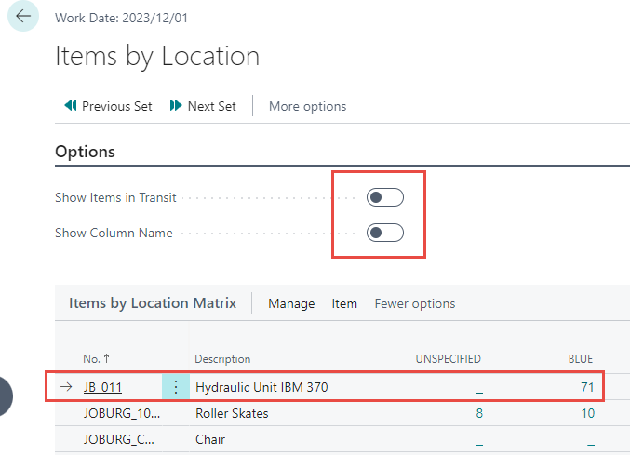
Items by Locations & Availability

Slide 24
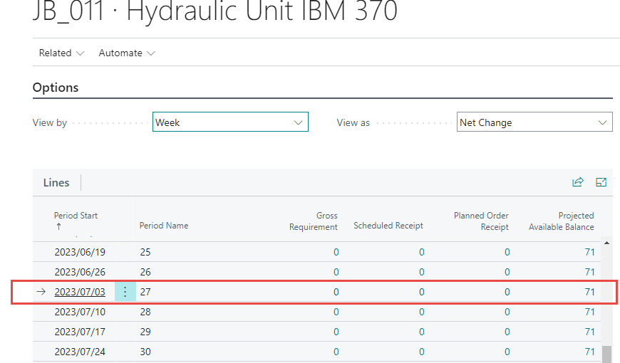
Items by Locations & Availability by period

Slide 25
Sales Order (our Customer must have set Shipping time to 3D)
Only Sales Order Line presented in this PWP presentation !
We have already purchased 71 items by use of Item Journal
and we require only 50 pcs – see a quantity field in Sales Order line.
Lead Time nor Safety Lead Time will be not used in this part of the model.
In this example, we do not consider manually entered Requested Delivery Dates (if visible)
into the Sales line (each line may have a separate Requested Delivery Date).
If we enter this date in the sales order header, where the field also exists,
this value is automatically transferred to all lines. In our example we will not consider this.
1st part of the Sales Line
2nd part of the Sales Line
3D=Shipping time
1D=OWHT

Slide 26
Sales Order (our Customer must have set Shipping time to 3D)
2nd part of the Sales Line
3D=Shipping time
1D=OWHT
Explanation of dates

Slide 27
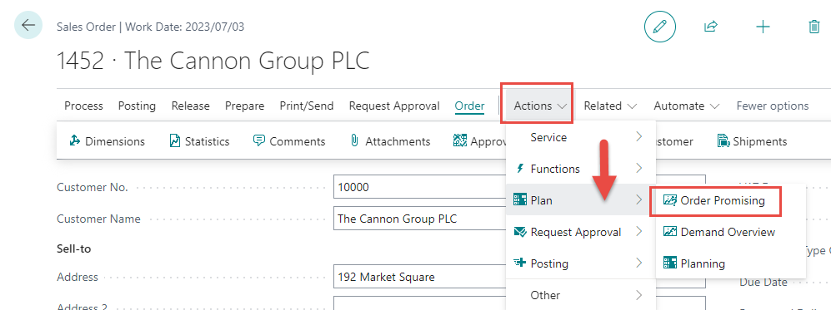
Sales Order : Order Promising function
What's left in stock (71-50=21)
Before ATP activation and ATP proposal approval
See next slide

Slide 28
ATP Calculation
Before use of
ATP
ATP
calculations
Suggestion

Slide 29
ATP Calculation
After accepting the calculation, it was not reflected in the sales line.
Manual modification of the required quantity in the sales order line 50->100
Reason for change Quantity per 100 pcs-> Purchase and related parameters
such as Lead Time Calculation ( in our Setup =4D) and IWHT (1D)

Slide 30
CTP Caluclation
We use CTP because ATP has already been used and more, we need to plan the replenishment of the stock with 29 pcs
We're 29 units short
100=71+29
Shipping time +OWHT=3D+1D
12 days=4D+8D
8 days
It will be necessary to accept
Purchase process (after the CTP calculation)
July 3 -> July 11 = 8D = 4D (Lead Time) + 2D (Safety Lead Time)+ 1D (IWHT at Location Blue) + 1D Offset)
Specifies the period of time to wait before issuing
a new purchase order, production order, or transfer order.

Slide 31
Part of Sales Line : CTP calculation Accepted calculation
3 days
1 day
4 days
Sales process
15.7.-11.7. = 4D = 3D (Shipment Time)+ 1D (OWHT from Location Blue )

Slide 32
New example
In classes

Slide 33
A realistic model in classroom teaching
Zdroj | Specifikace | Hodnota
Lokace Blue | IWHT | 1D
Lokace Blue | OWHT | 1D
Item Card | Lead Time | 4D
Item Card | Safety Lead Time | 2D
Customer | Shipping Time | 3D
OP Setup | Offset time | 1D
CTP do finálního výpočtu zahrnuje soboty a neděle!

Slide 34
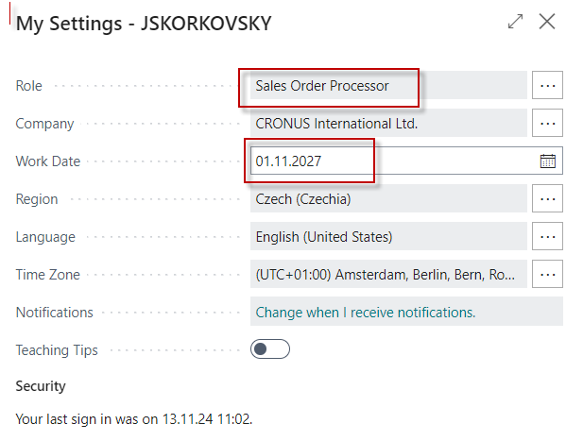
User role settings

Slide 35
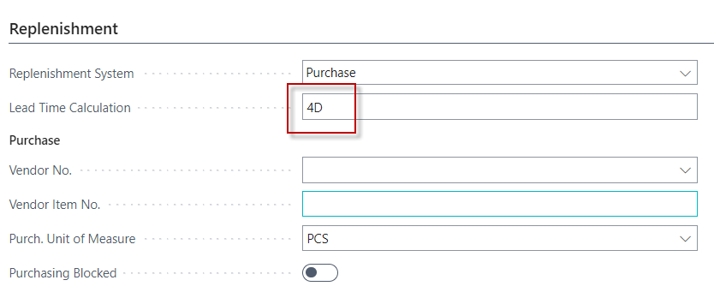
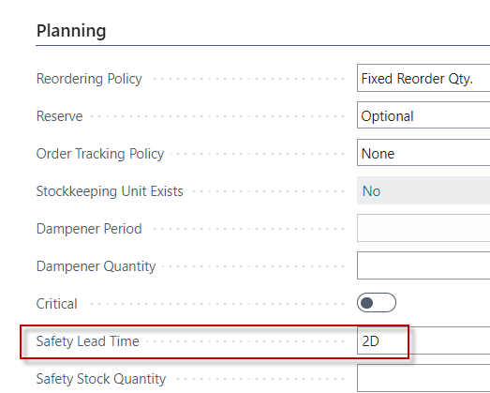
Setup LT and SLT

Slide 36
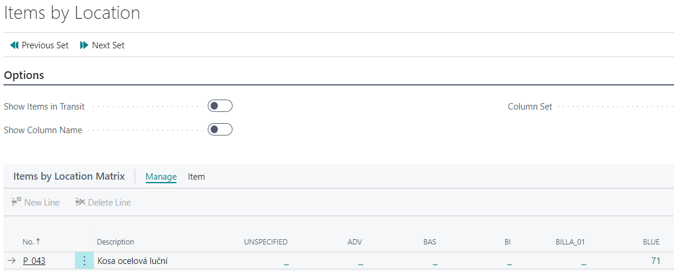
Purchase item „kosa ocelová luční“
We used Item journal ->71 pcs to location BLUE

Slide 37
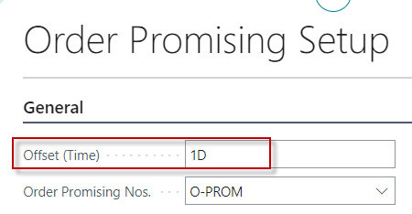
Setup Shipping time (new customer) and Order Promising Setup

Slide 38
Sales order (line only)
1st part
2nd part
1 day=OWHT
3 days-ST

Slide 39
Action- Plan-Order Promising-CTP
15.11. <-> 11.11 -> 4 Days = Shipping Time +OWHT=3D+1D
11.11.<-> 1.11.-> 10 Days = LT+SLT+IWHT+Offset+2 days (Suterday- Sunday)=
= 4D +2D +1D+1D+2D (weekend)

Slide 40
Action- Plan-Order Promising-CTP
Sales line 2nd part
1 day=OWHT
3 days-ST

Slide 41
Reservation
Add Vendor code

Slide 42
Purchase order line
F9
It was originally bought in the wrong location and corrected by transfer

Slide 43
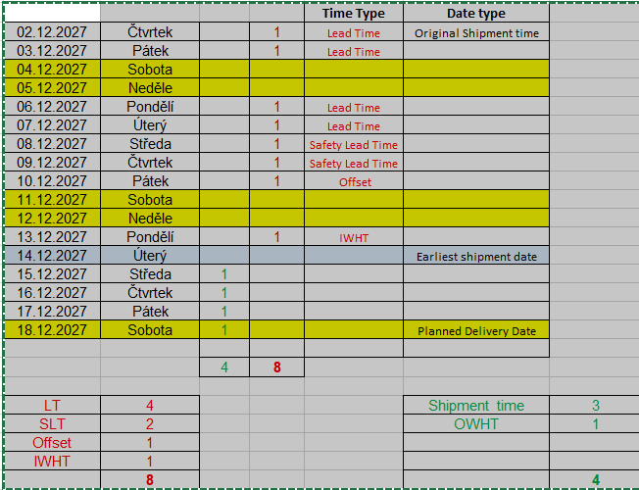
Další varianta pro stejné parametry (pouze WD=2.12.2027 místo 1.11.2027)
8 D + 2D weekend
4D

Slide 44
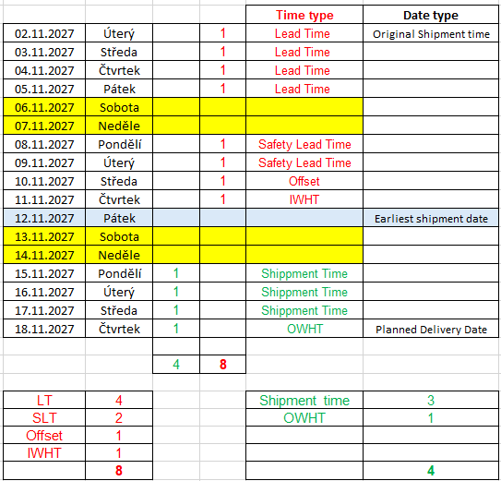
Varianta příkladu z výuky 20241125
8 D + 2D weekend
4D + 2D weekend

Slide 45
End of Basic section

Slide 46
Advanced area of ATP-CTP
Navazuje na původní příklad !!
Je už provedena v modelu, takže není potřeba
dále probírat
1. Reservation -> RQWS -> Purchase (to replenish)
2. Requested Delivery Date Options

Slide 47
Reservations I.
Proposed refill

Slide 48
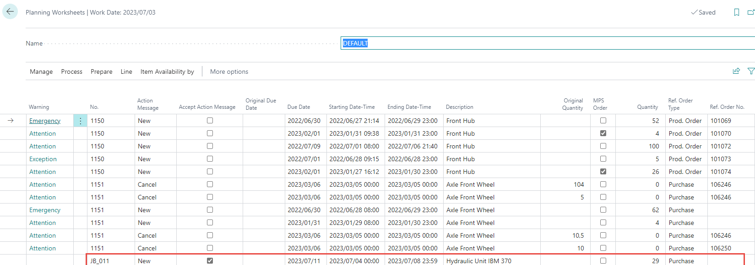
Reservations II.
Carry out action message
Purchase Order

Slide 49
Purchase Order line
1st part Purchase line
2nd part Purchase line
3 days
Sales line
See 3 days calculation

Slide 50
Calculation purchase
Planned Receipt date + Inbound warehouse handling time + Safety Lead time = Expected receipt date
7.8. +2D (Safety Lead Time) +1D (IWHT)= 11.8

Slide 51
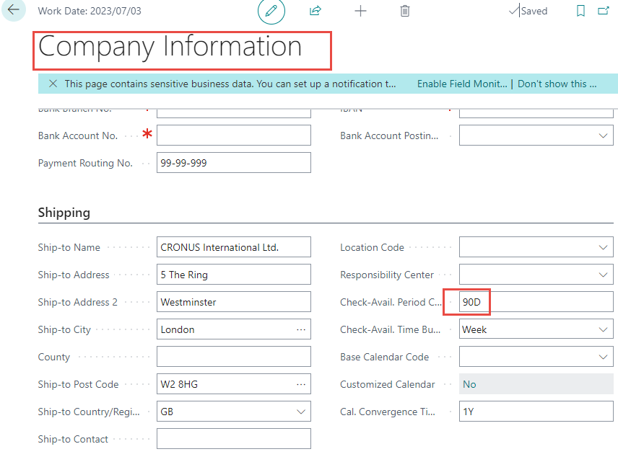
Unavailability date
Sales line
90 Days

Slide 52
Reqested Delivery date options
Requested Delivery date not specified
Shipment date + outbound whse. handling time = Planned shipment date
Planned shipment date + Shipping time = Planned delivery date
Planned Delivery Date =Shipping Time + OWHT + Shipment date
Requested Delivery date specified
Requested delivery date - Shipping Time = Planned shipment date
Planned shipment date - outbound whse. handling time = Shipment date
Requested Delivery Date =Shipping Time + OWHT + Shipment date

Slide 53
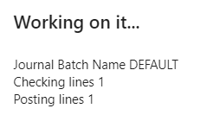
Requested Delivery Date & ATP-CTP
Working day will be set to 3.7.2023 (2023/07/03)
We will sell all item JB_011 in order to get Inventory=0
F9

Slide 54
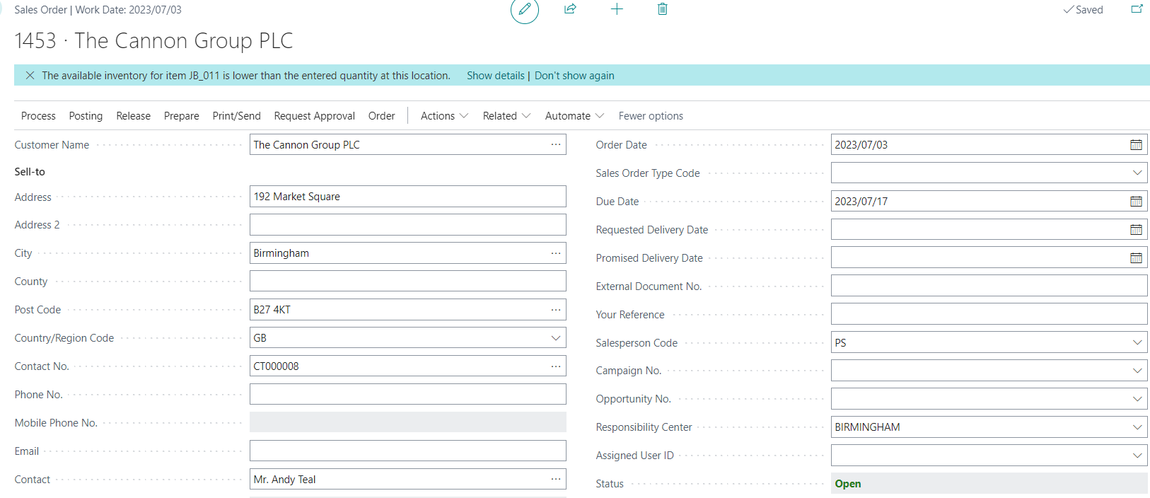
Sales order 1
1st part of the Sales Line
2nd part of the Sales Line
Shipment time
OWHT

Slide 55
Sales order 2 (Action -> Plan -> Order Promising)
4D
4D = 3D (Shipment Time)+ 1D (OWHT from Location Blue )

Slide 56
Reserved quantity
Part of the Sales Line

Slide 57
Requsition Worksheet
Carry out action message
Purchase Order
Purchase process (after the CTP calculation)
July 7 -> July 14 = 7D = 4D (Lead Time) + 2D (Safety Lead Time)+ 1D (IWHT at Location Blue)
order date + lead time calculation = planned receipt date
planned receipt date + inbound whse. handling time + safety lead time = expected receipt date
3D
Purchase line

Slide 58
Combination of CTP and reservations
1. Create a new item with the same parameters as the stock items already used (LT=4D, SLT=2D,...) – Date 03.07.2023 2. Purchase 10 pieces of this item using Item Journal 2. Moving the working date into the future - 17.7.2023 3. Creating a Purchase order (20 Ks) with the understanding that this document will not be charged and will serve as an additional source for booking in addition to the stock
3.a ->Working date to 31.7.2023 4. Sales order for 40 pcs of this item 5. Reservation with actual Item ledger entries (stock) lines 3 pcs and 7 pcs 6. Reservation with actual Purchaser Order lines 11 pcs and 9 pcs 6. CTP and accept calculations 7. See field reservation 8. See Purchase order dates 9. See Sales Order dates

Slide 59
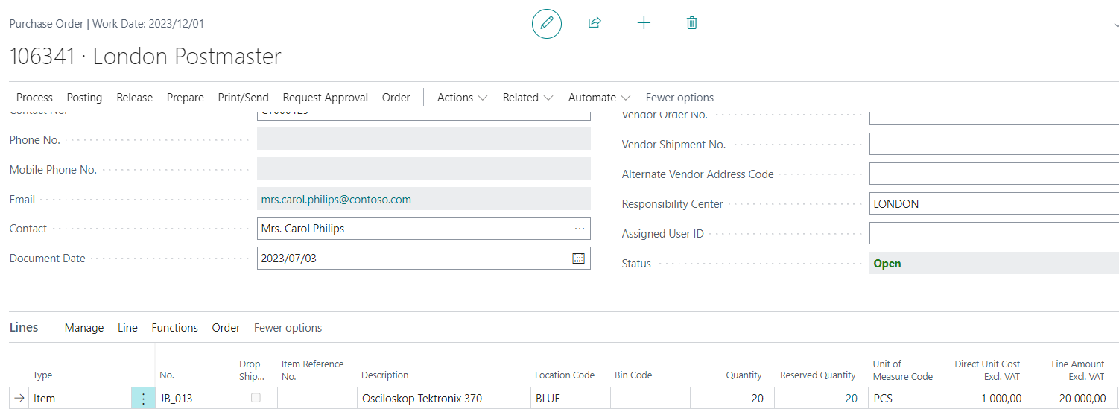
Purchase order

Slide 60
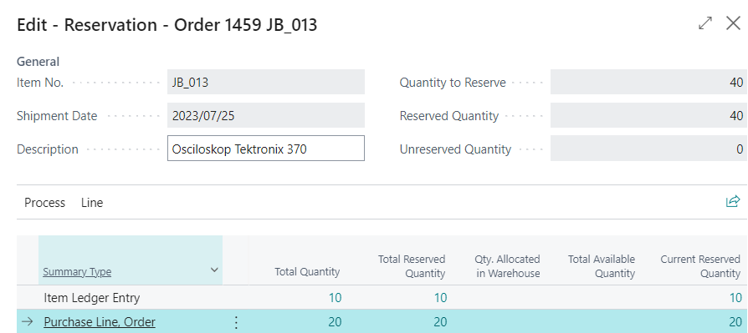
Sales order and reservation

Slide 61
Sales Order line – important part for the model
OWHT
Shippment time

Slide 62
Requisition worksheet
7D=4D (Lead Time) + 2D (Safety Lead Time)+ 1D IWHT
Sales Order Line
OWHT
Shippment time
3D= 2D Safety Lead Time + 1D IWHT

Slide 63
A Different Perspective on the Planned delivery date calculation
7D = 4D +3D
4D =Lead Time
3D = 2D Safety Lead Time + 1D IWHT
18.7.
25.7.
25.7.
25.7.
29.7.
4D = 3D Shippment Time + 1D OWHT

Slide 64
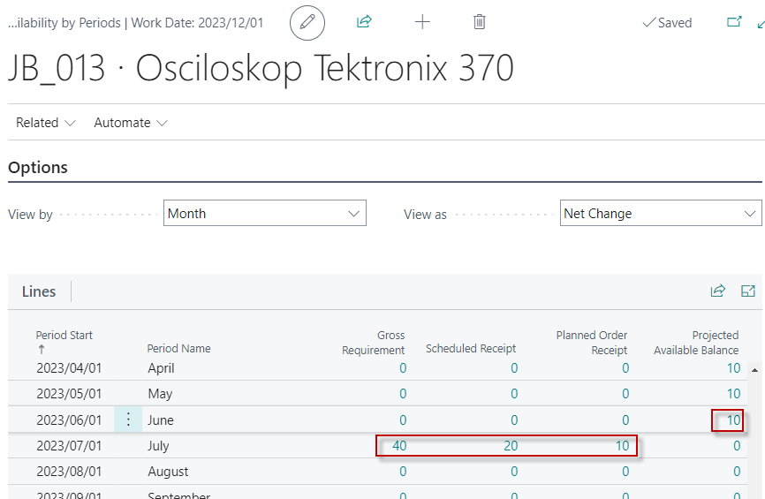
Availability by period

Slide 65
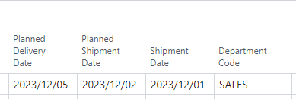
Planning by use of Requision worksheet
Completing the relationships between Order Date, Planned Receipt Date and Expected Receipt Date. ATP-CTP is not used in this model
Part of Sales Order line (Item has the same parameters already used)
Part of RQWS line (Item has the same parameters already used as well as Vendor)
Carry out
Part of Purchase Order created from RQWS line
LT=4D
SLT+IWHT =3D
Order Date + Lead Time =Planned Receipt Date = 4D
Planned Receipt Date + Safety Lead Time +IWHT= Expected Receipt Date

