Slide 1
Business Central Introduction
Dimensions
(ERP=Microsoft Dynamics 365 Business Central)
Ing.Jaromír Skorkovský,CSc.
Department of Business Management
Masaryk University Brno

Slide 2
Business Intelligence
Processing large volumes of data so that the result of this action helps managers to make decisions in process management
The result of the processing must be relevant information that managers receive at the right time
The primary source of data that is often stored in data warehouses is ERP systems (relational DB)
Information retrieval as a result of structured queries must be fast (short response time)
Used for management at the strategic, tactical, and operational level

Slide 3
Limitations of ERP as a data provider
They do not allow quick and flexible changes to the selection criteria
No immediate user access to large volumes of aggregated data
The volume of data doubles every five years in every enterprise, which of course also means that the system is overwhelmed with redundant data
Dimensions are values that categorize entries so you can track and analyze them on documents, such as sales orders. Dimensions can, for example, indicate the project or department an entry came from.
So, instead of setting up separate general ledger accounts for each department and project, you can use dimensions as a basis for analysis and avoid having to create a complicated chart of accounts.

Slide 4
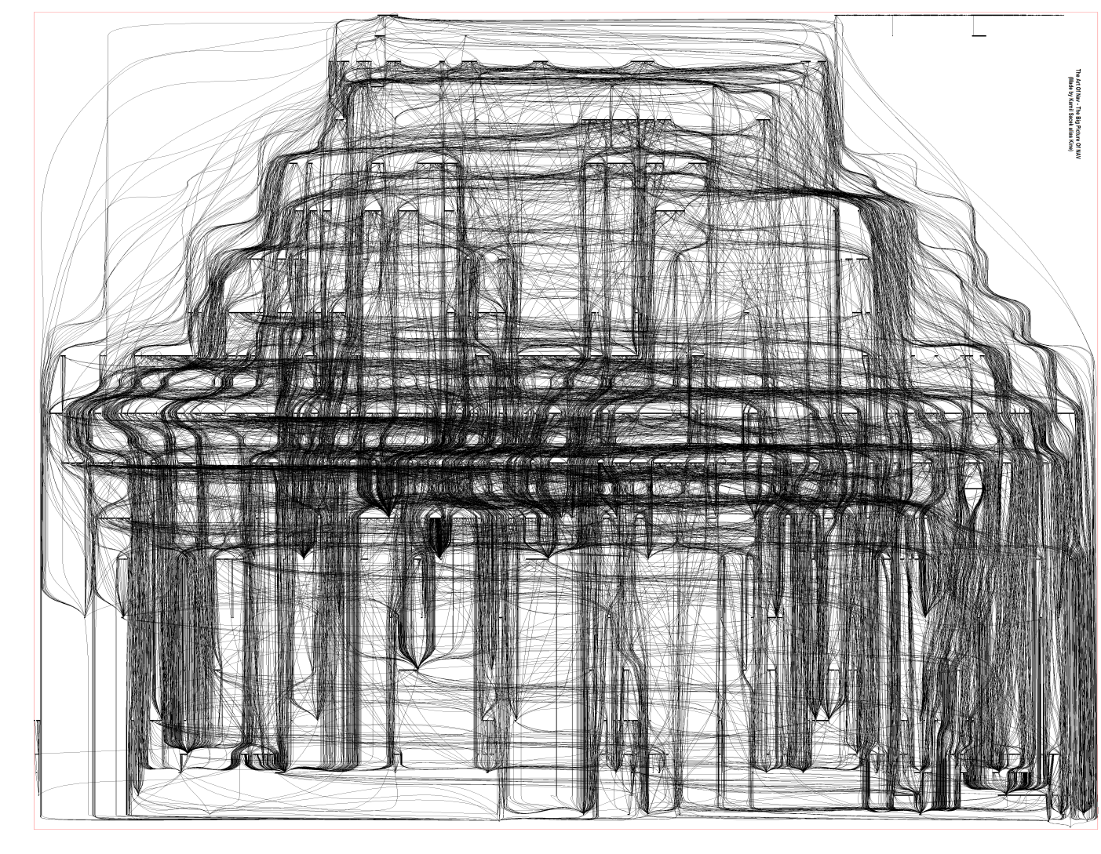
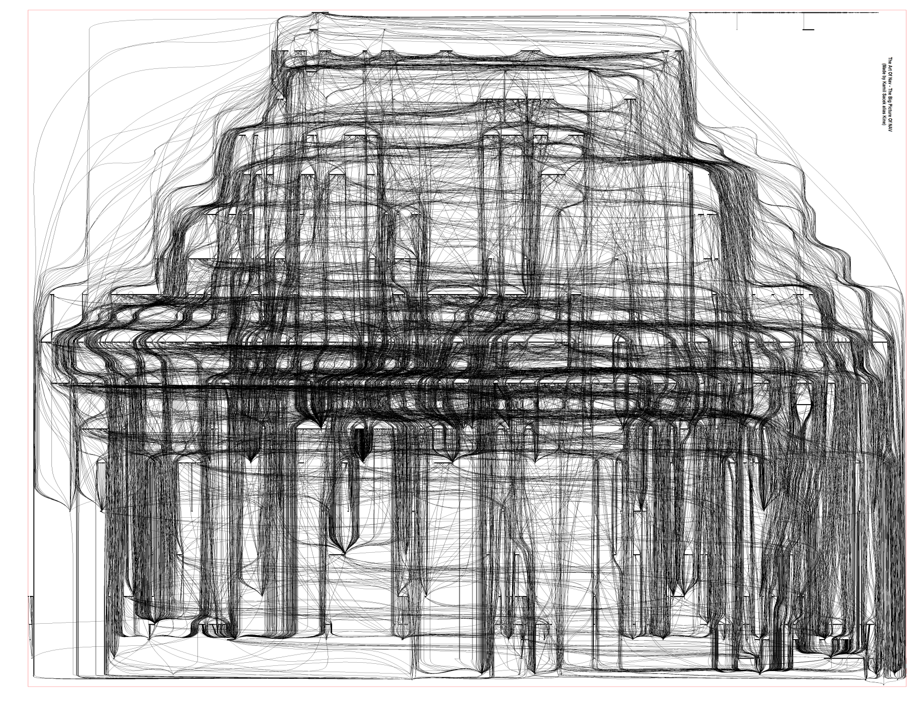
Relations among tables I

Slide 5
Relations among tables II

Slide 6
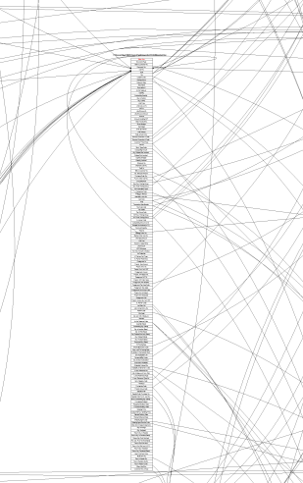
One table and its relations I

Slide 7
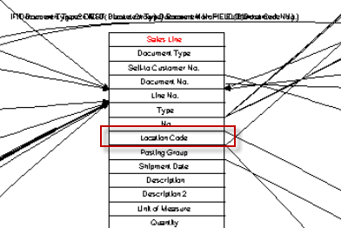
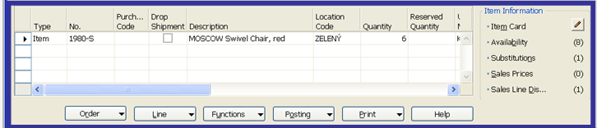
One table (Sales Line) and its relations II
ERP NAV (very similar to Business Central)

Slide 8




Main principles (source tables and their entries)
Customer
Control parameters
(time, type of products,
Costs, Revenue, Area,..)
Vendor
Item
Account
Dimensions

Slide 9
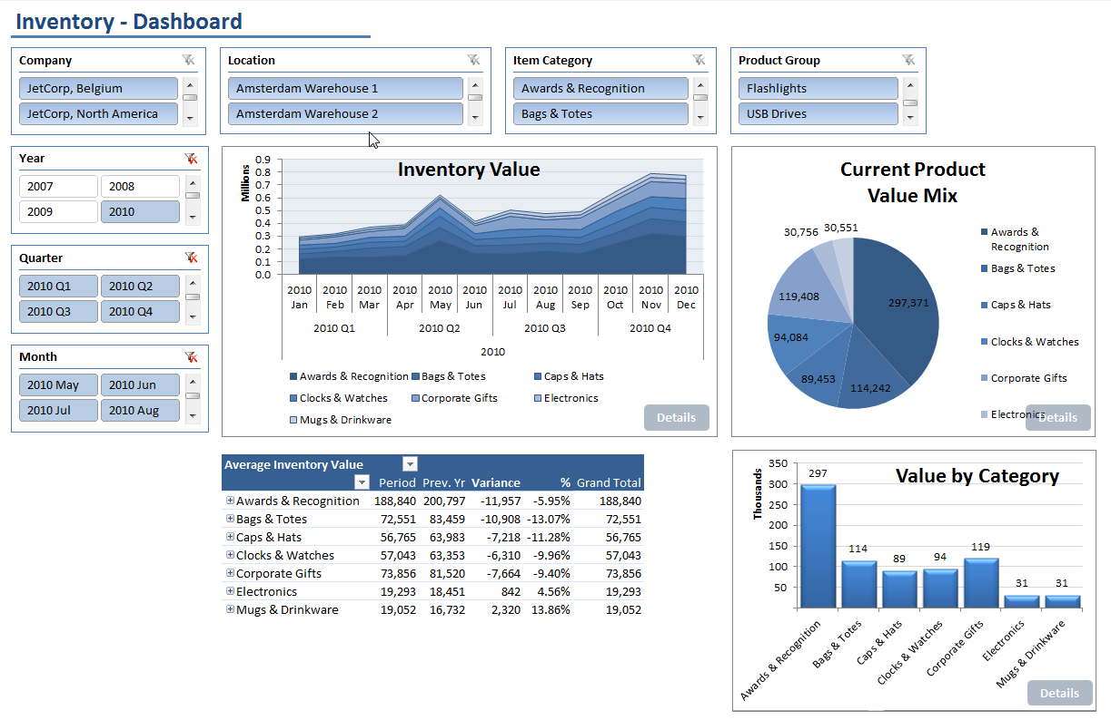
Some chosen analysis
Inventory Dashboard

Slide 10
OLAP cube -adhoc definition of queries
http://www.databaseanswers.org/designing_olap_cubes.htm
cut
Amount (Unit Price), Costs, Quantities
Cost - Revenue Centres
Time (Y,M,D)

Slide 11
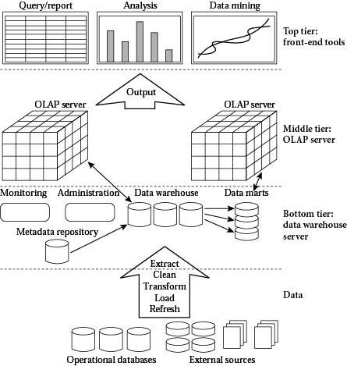
OLAP architecture
METADATA

Slide 12
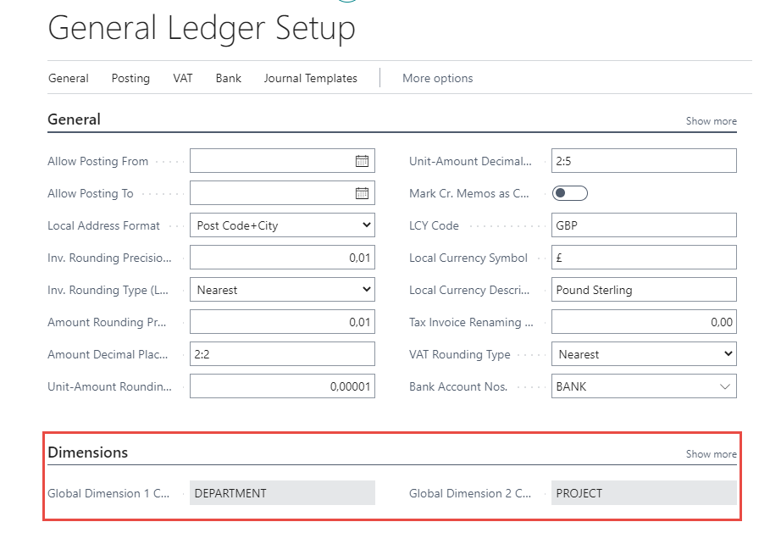
Dimensions –global and shortcut
Global dimenions codes
these are
always part of the entries

Slide 13
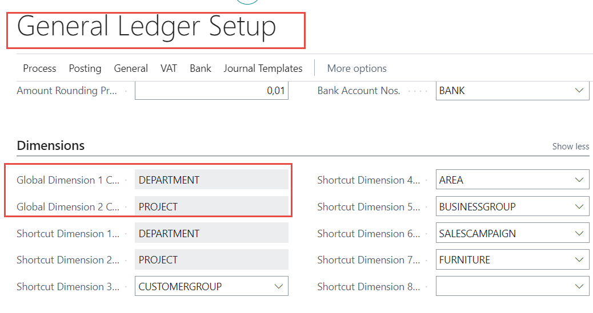
Global and Shortcut dimensions and entries

Slide 14
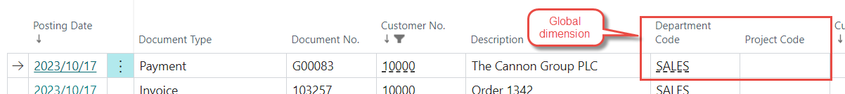
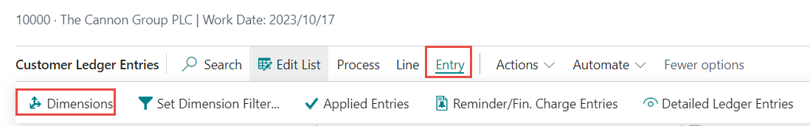
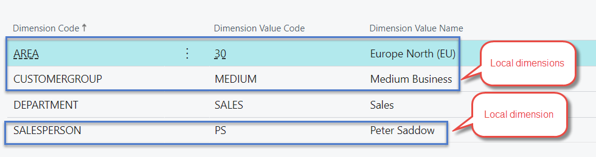
Global and Shortcut dimensions and entries

Slide 15
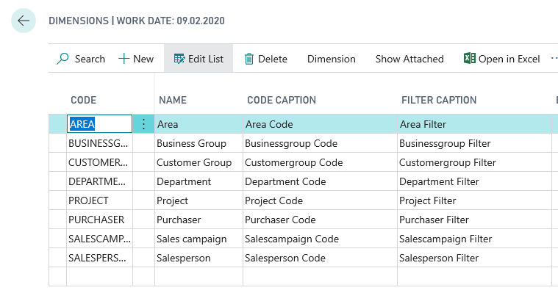

Dimensions (cost centers, income centers)

Slide 16
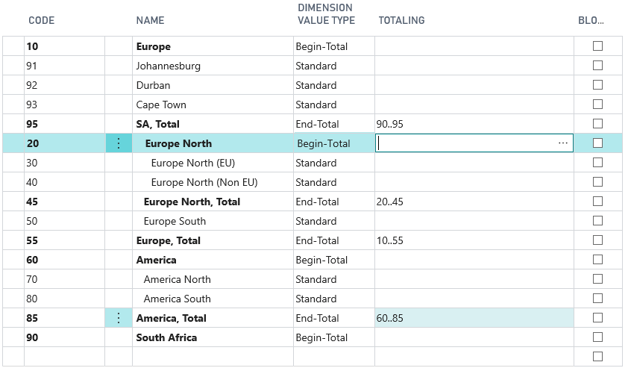

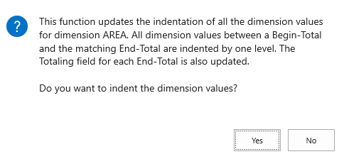
Dimension values (we created here three new areas with values 91-93)

Slide 17
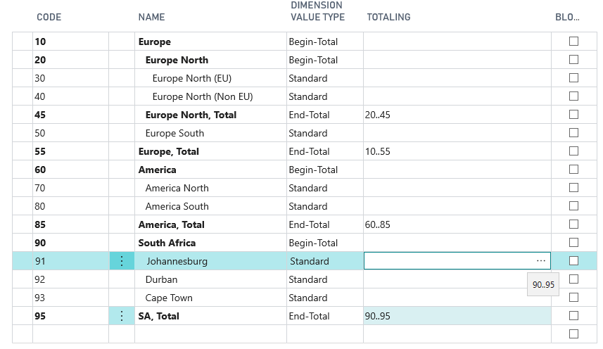
After dimension value indent-1st example
These dimensions
might be used
in our examples

Slide 18
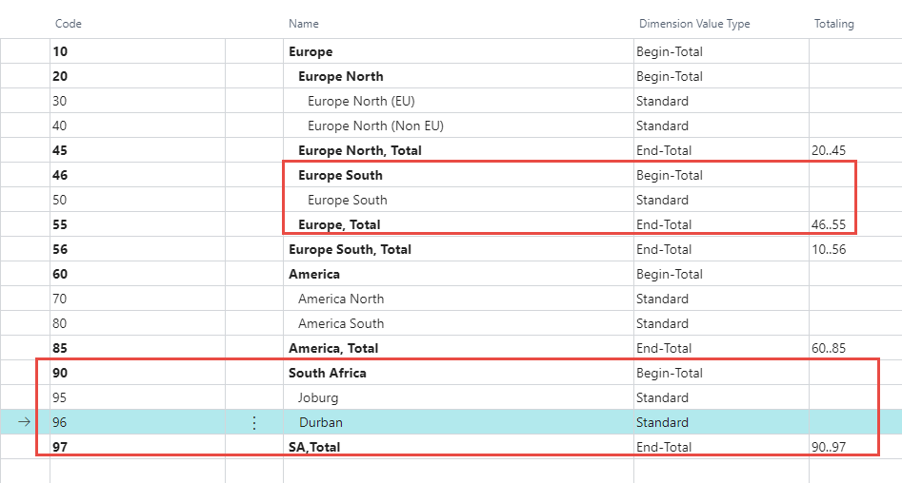
After dimension value indent-2nd example

Slide 19
Principles
Values
Global dimension
Customer
Department
Sales
Shorcut dimension
Area
30-Europe North
Shorcut dimension
Chair
Customer Ledger Entry
SO Header
Customer card
Sales
F9-post
Ctrl-F7
30-Europe North
Sales Order line
Item card
Dimension Entries
Ctrl-F7
Item
Chair
Item Ledger Entry
Furniture

Slide 20
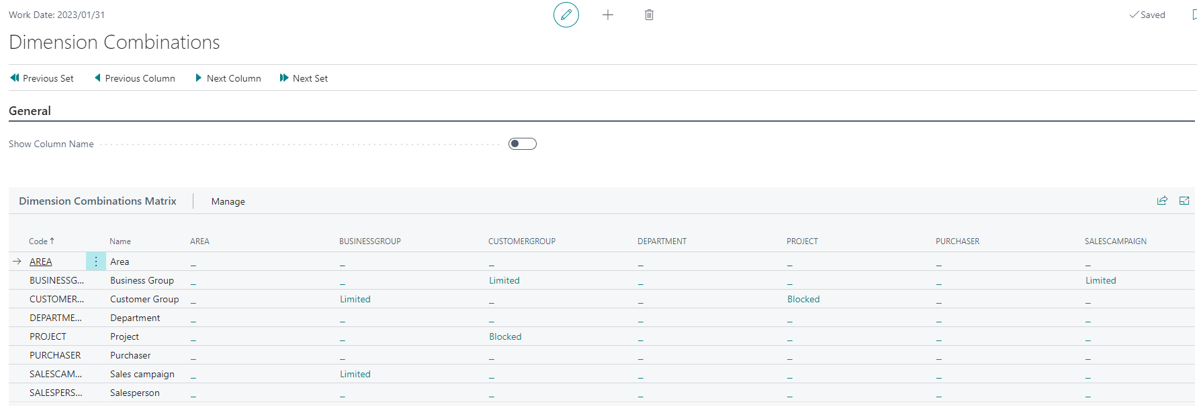
Dimension combinations
A blocked dimension combination means you cannot post both dimensions on the same entry regardless
of what the dimension values are.
In contrast, a limited dimension combination means you can post both dimensions
to the same entry, but only for certain combinations of dimension values.

Slide 21
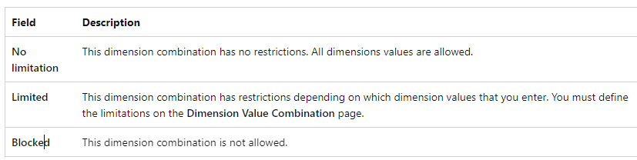
Dimension combination

Slide 22
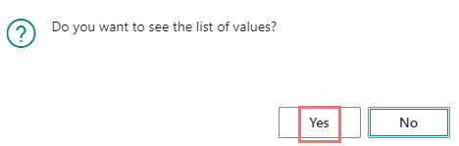
Dimension combination

Slide 23
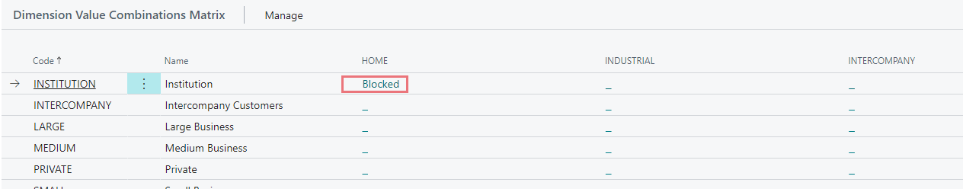
Dimension combination

Slide 24
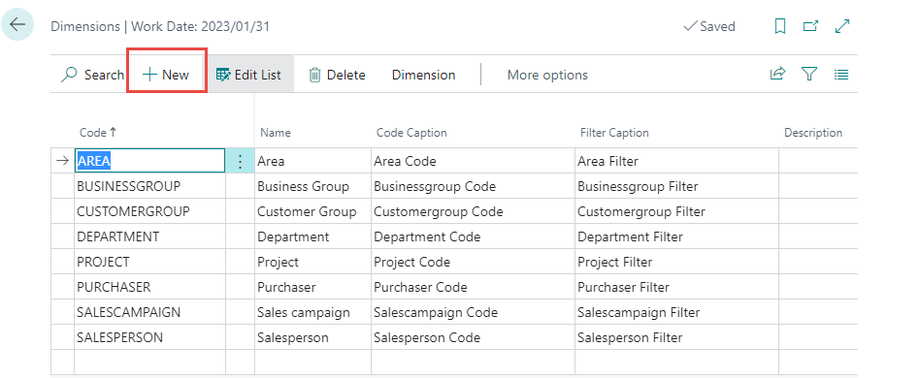
New dimensions for furniture

Slide 25
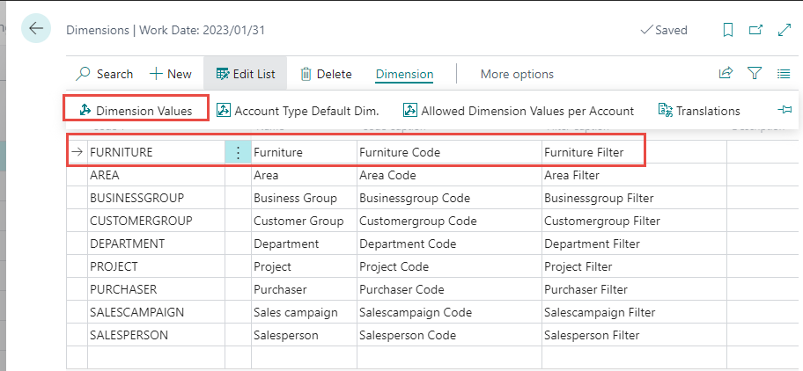
New dimensions for furniture

Slide 26
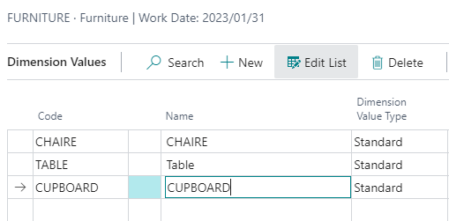
New dimensions for furniture

Slide 27
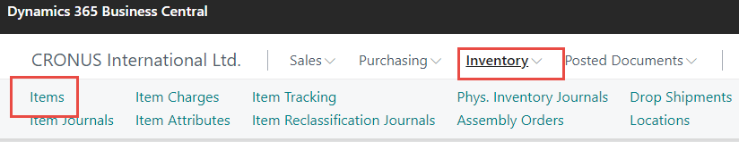
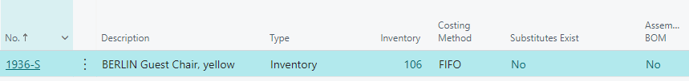
New dimensions for furniture
Item card
Dimension assignment

Slide 28
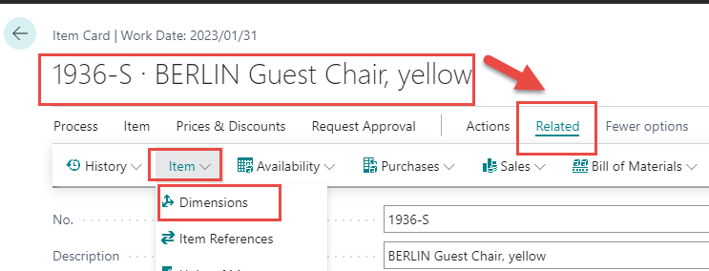
Dimension value to item card

Slide 29
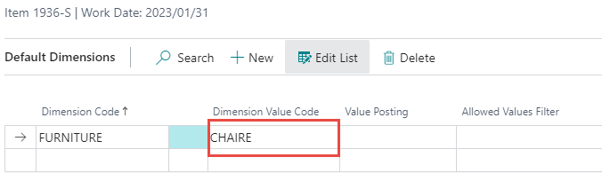
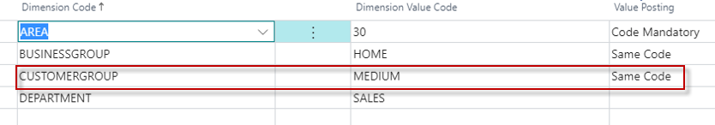
Dimension for our item card setup
Code Mandatory - when posting (before posting,) it is necessary to select a dimension value appropriate to the specific business case (e.g.when you create Sales Order)
Same Code - you must have a pre-selected preset value . This value is always the same. So, for example, CUSTOMERGROUP cannot be other than MEDIUM.

Slide 30
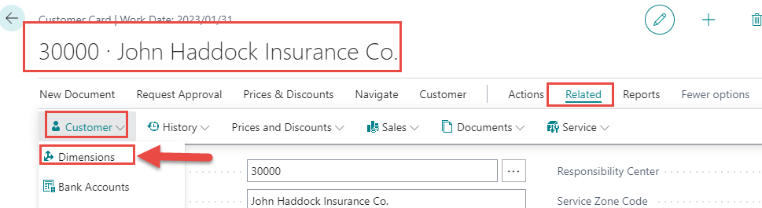
Customer card and dimensions
OR use Customer icon - > Dimensions

Slide 31
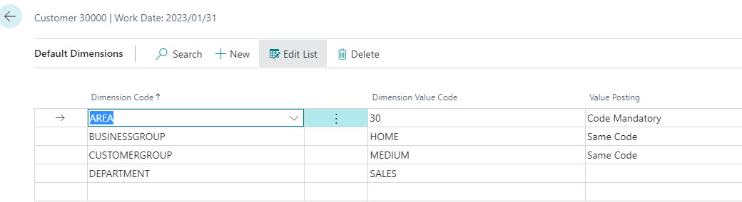
Customer card and dimensions
See slide
number 29
Explanation
If you want to make a dimension required, but you do not want to assign a default value to the dimension, leave the Dimension Value Code field blank and then select Code Mandatory in the Value Posting field. Afterwards, however, the areas must be delivered manually

Slide 32
Dimensions Value Posting statements
If you want to require a dimension but don't want to assign a default value to the dimension, leave the Dimension Value Code field blank, then select Code Mandatory in the Value Posting field.
If an account is used in an Adjust Exchange Rates or Post Inventory Cost to G/L batch job, do not select Code Mandatory or Same Code. These batch jobs cannot use dimension codes.

Slide 33
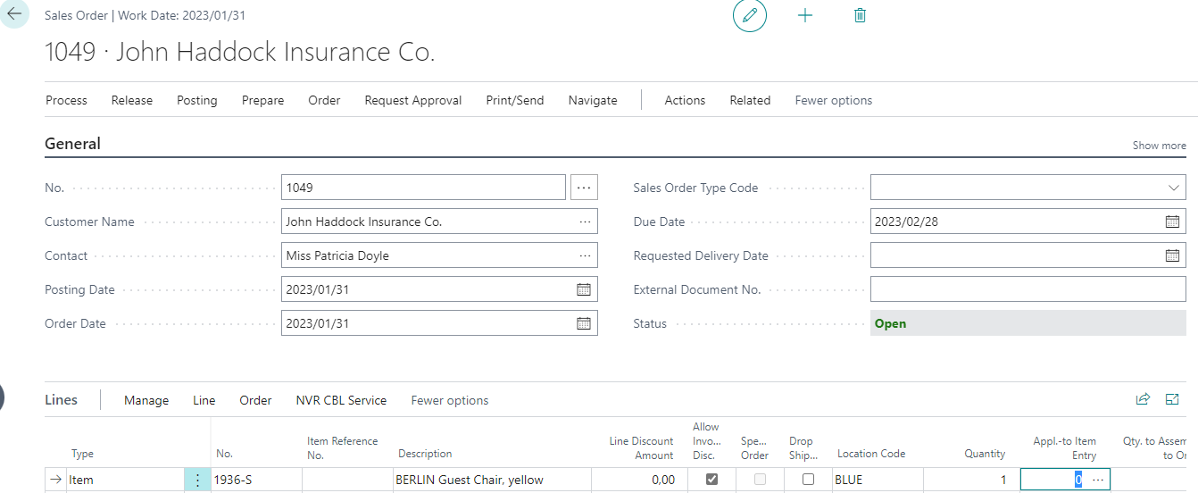
Sales Order and Dimensions

Slide 34
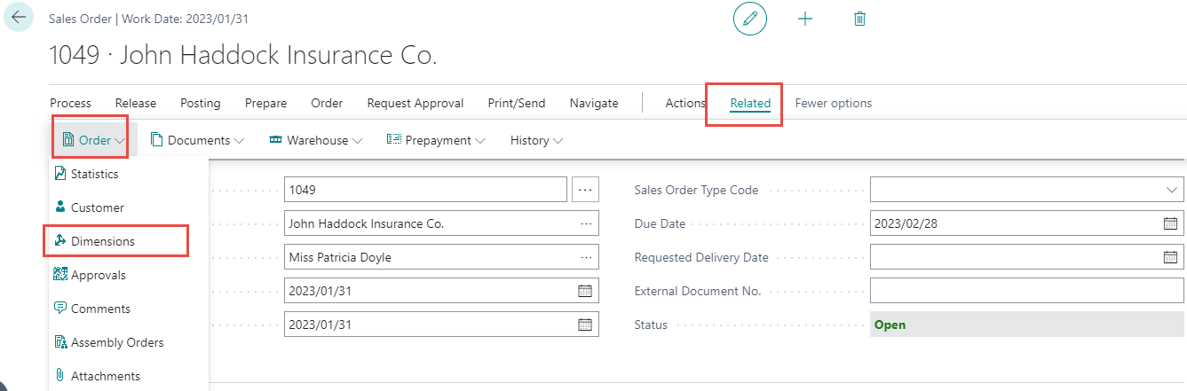
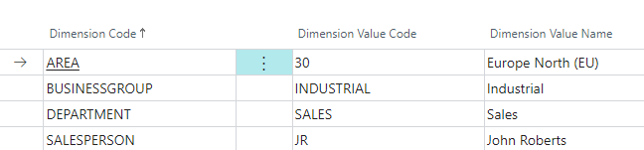
Dimensions in Sales Order Header

Slide 35
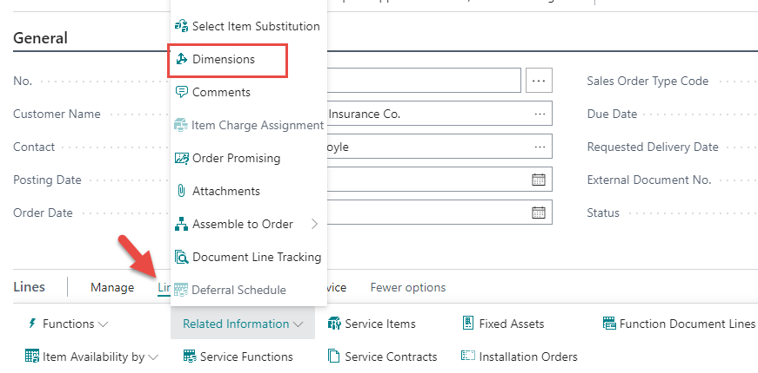
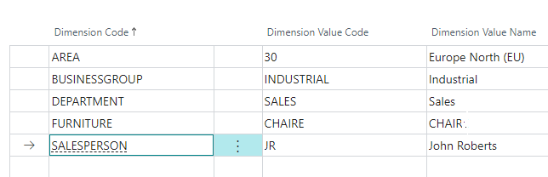
Dimensions in Sales Order Lines

Slide 36
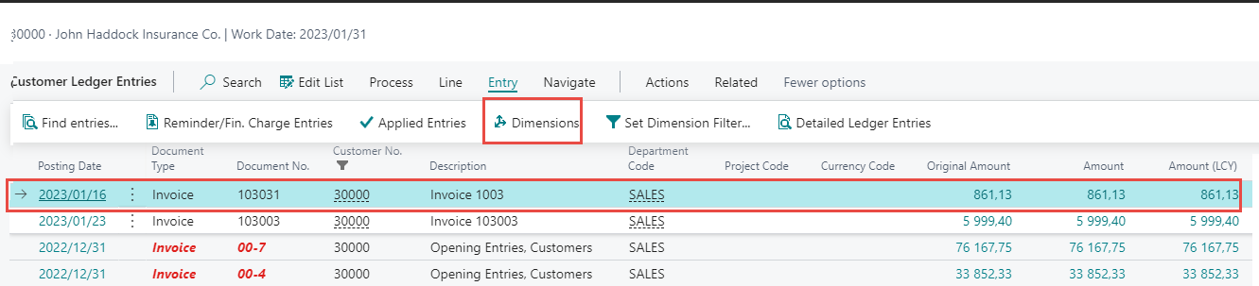
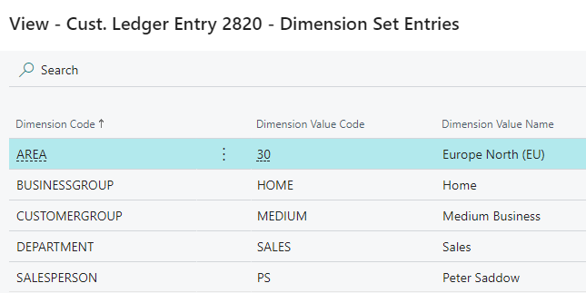
Created Customer Ledger entries

Slide 37
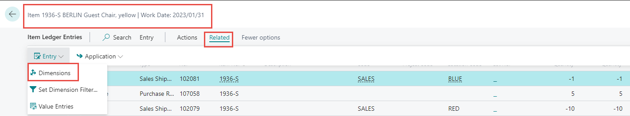
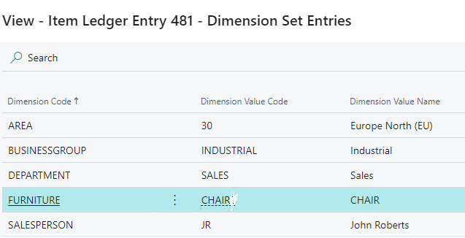
Created Item Ledger entries

Slide 38
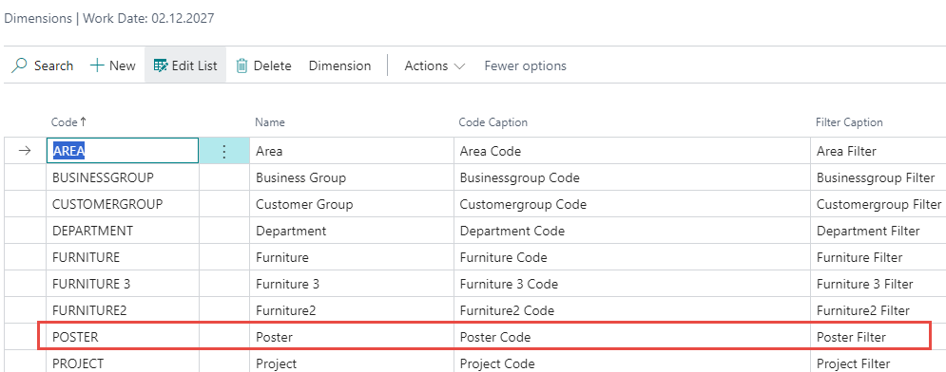
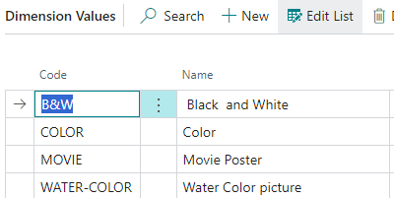
Another set of dimensions (see teacher database)
Dimension values

Slide 39
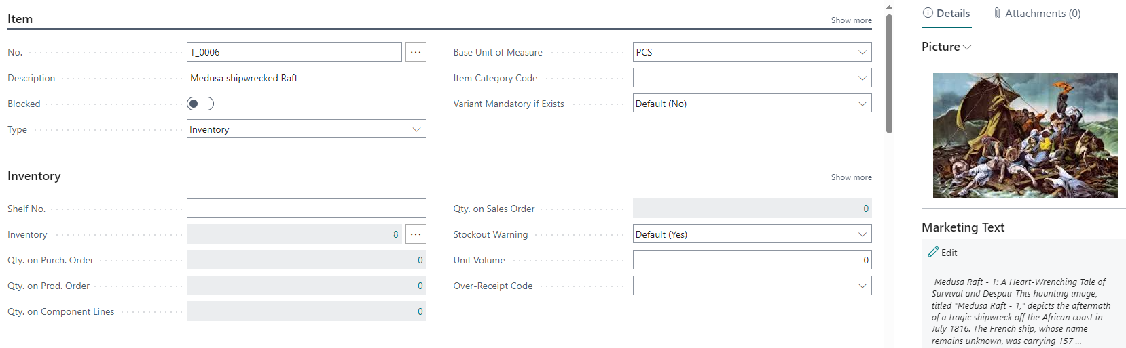
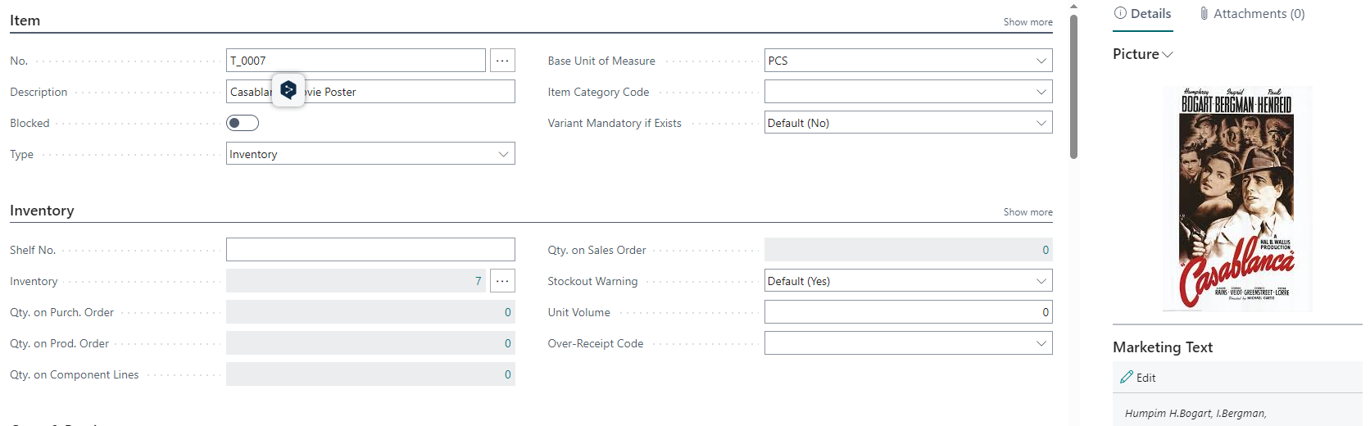
Related items

Slide 40
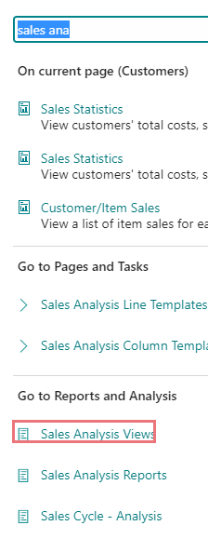
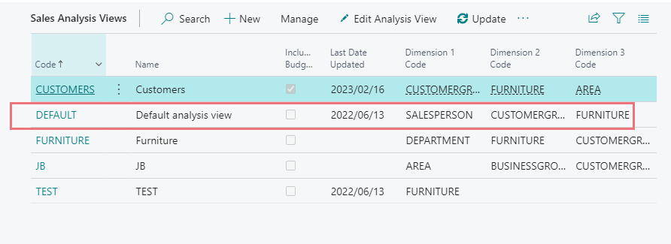
Analysis by Dimensions

Slide 41
Analysis by Dimensions
EDIT

Slide 42
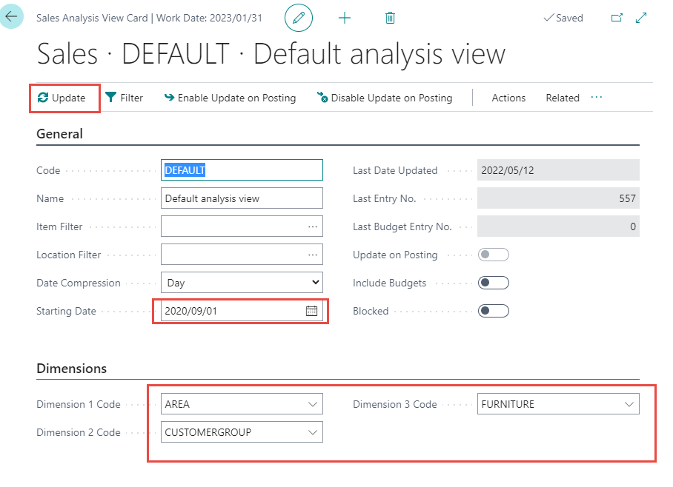
Analysis by Dimensions – view
UPDATE
Update allows all entries set in filters
to be included in the analysis view

Slide 43
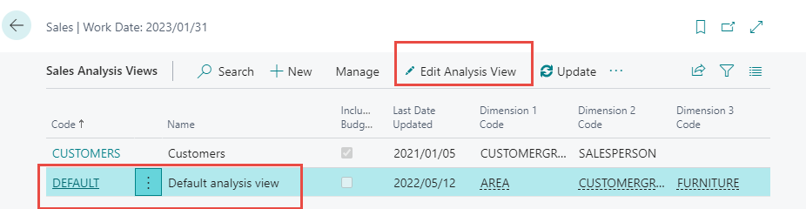
Analysis by Dimensions

Slide 44
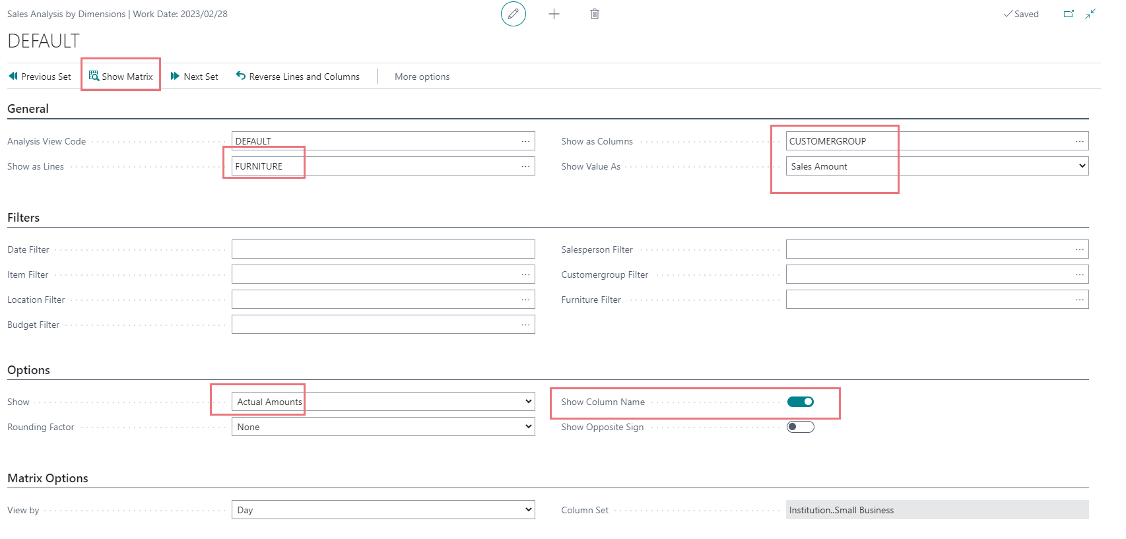
Analysis by Dimensions

Slide 45
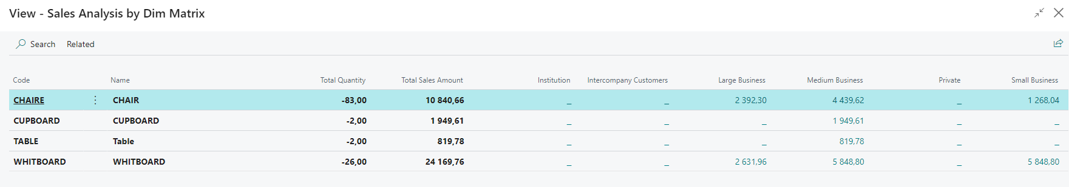
Analysis by Dimensions

Slide 46

Analysis by Dimensions

Slide 47


Analysis by Dimensions

Slide 48

Another type of analysis – Customer type

Slide 49
Analysis by Dimensions
Dimensions play an important role in business intelligence, such as when defining analysis views. For more information, see Analyze Data by Dimensions.
Analyze Data by Dimensions - Business Central | Microsoft Docs
An analysis by dimensions displays a selected combination of dimensions. You can store and retrieve
each analysis you have set up. The information for setting up an analysis is stored on an Analysis View
card to simplify future analysis.
Choose the icon Searching window, enter Analysis Views, and then choose the related link.
On the Analysis View List page, choose the New action.
Fill in the fields as necessary. Hover over a field to read a short description.
To add other dimension codes in addition to the four on the Dimensions FastTab, choose the Filter
action, fill in the fields, and then choose the OK button.
To update the view, choose the Update action.

Slide 50


Poster Analysis

Slide 51


$a^{2}+b^{2}=c^{2} →4∗4+3$*3 = 25 -> c =5

Slide 52

Au revoir
mes amis !!

