Slide 1
Expected costs in Business Central
Ing.J.Skorkovský,CSc.
MASARYK UNIVERSITY BRNO, Czech Republic
Faculty of economics and business administration
Department of Business Management

Slide 2
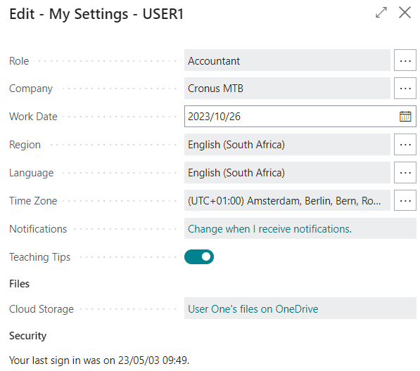
User settings

Slide 3
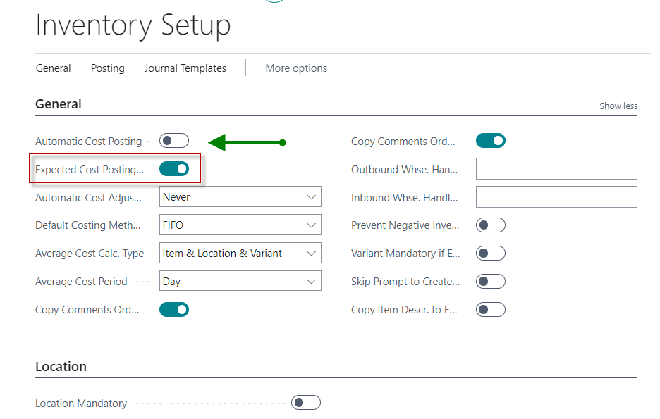
Expected cost setup
It is an estimated cost in the case of a purchase, before the actual invoice for the goods purchased is received.
You can temporarily post the expected (estimated) cost to both the Stock account and the Revenue account in the general ledger.
After posting, a value entry is also created (for goods above the item ledger entry) with the Expected value
This Expected value will affect the value of the stock but is not posted to the general ledger unless you allow the program to do so. See Inventory Setup (Expected Cost Posing=Yes).
The expected cost is posted to a temporary account. This account must be set up in the system for the appropriate accounting group (see table)
In this model we will use
manual Inventory Cost adjustment
process.
Unlike in some models provided last term.
Therefore, there is no Automatic
Cost accounting field checked

Slide 4
Expected costs setup 1st part
If the Expected cost posting is checked (ticked),
then Business Central post the expected costs to a temporary (interim) General ledger account.

Slide 5
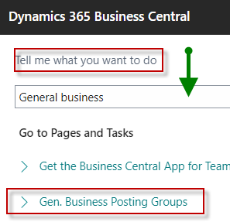
Expected costs setup 2nd

Slide 6
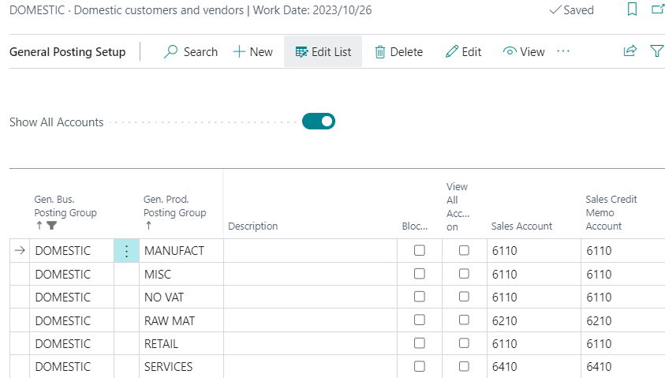
General Business Posting Groups setup
If you don't have a combination of Domestic and RESALE, use the NEW icon and Suggest Accounts
Interim = Prozatímní účty

Slide 7
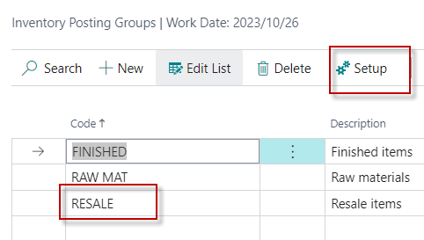
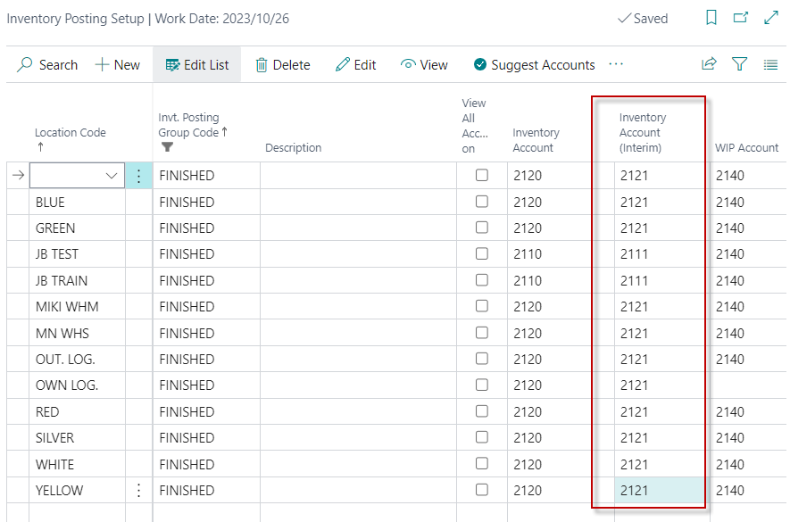
Inventory Posting Groups setup
Relations Inventory posting Group and Location
Interim = Prozatímní

Slide 8
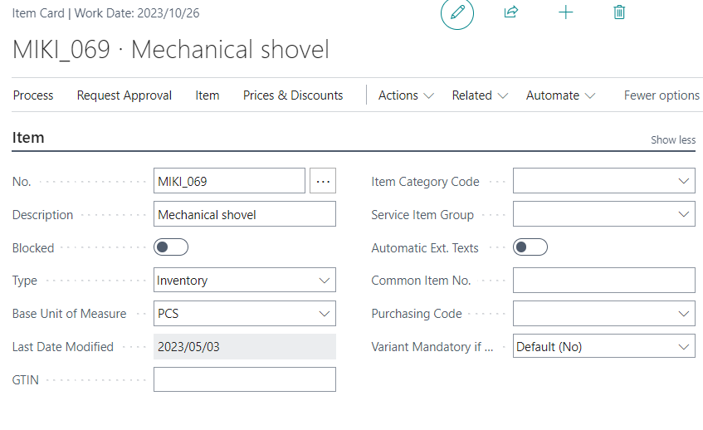
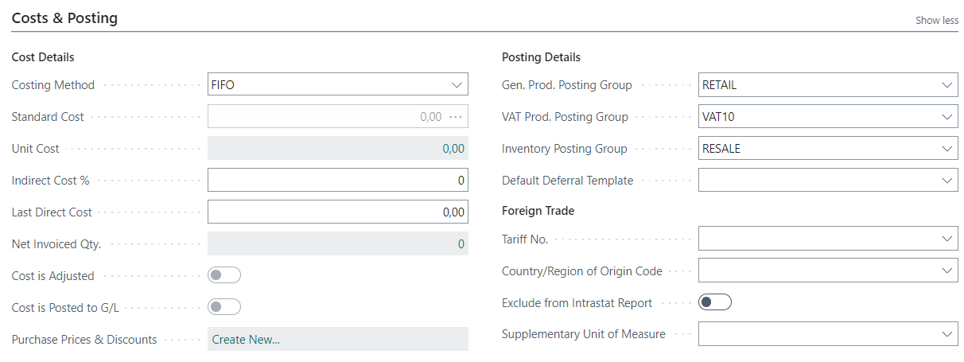
New item creation (use predefined template)

Slide 9
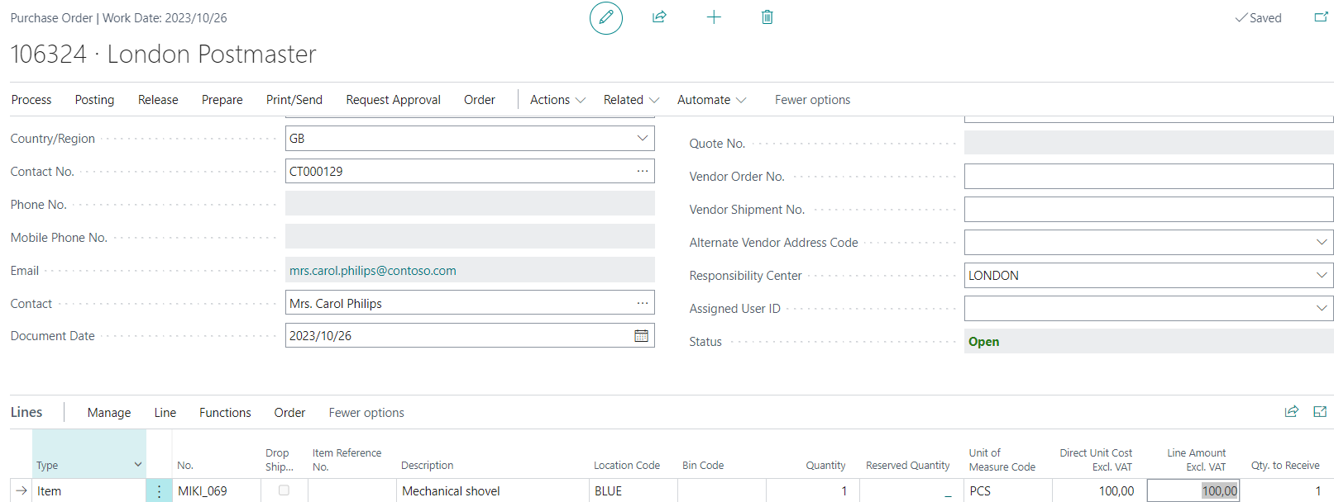
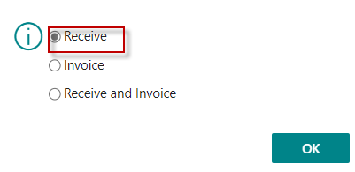
Purchase order – Expected Purchase price is 100
Only Post Receive
We don't know the actual purchase price yet
So expected cost could be 100,
but who knows for sure that !!!!

Slide 10
Purchase line after Receive posting only

Slide 11
Item ledger entries after posting
Ctrl-F7
Only the expected value is given in the entry.
The actual cost is therefore zero at that moment
Value entries (položky ocenění)
Manual Inventory adjustment process is commented on the next slides

Slide 12
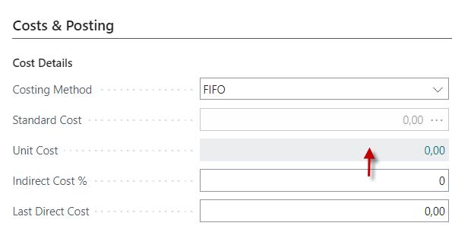
After delivery related to expected Cost
Part of the item card
Unit Cost =0 !. Before Inventory Cost Adjustment Process
Click

Slide 13
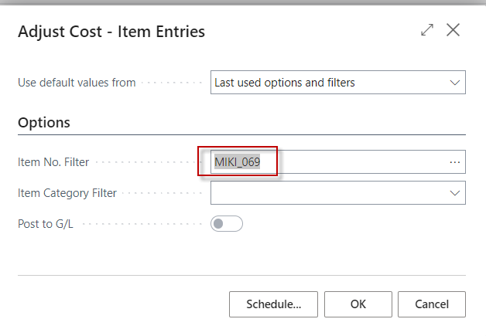
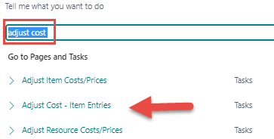
Inventory value - after 1st Inventory cost adjustment and posting Inventory value to General Ledger
In Microsoft Dynamics 365 Business Central, adjusting cost inventory refers
to the process of making changes to the recorded cost of inventory items
to reflect their actual or adjusted costs accurately.
This can be necessary for several reasons, such as changes in the purchase price,
additional costs associated with acquiring or storing inventory,
or other factors that affect the Cost of Goods Sold (COGS) – NNPZ v češtině
and the value of inventory on your balance sheet.

Slide 14
COGS (home study)
Cost of goods sold (COGS) includes all of the costs and expenses directly related to the production of goods.
COGS excludes indirect costs such as overhead and sales and marketing.
COGS is deducted from revenues (sales) in order to calculate gross profit and gross margin. Higher COGS results in lower margins.
The value of COGS will change depending on the accounting standards used in the calculation.

Slide 15
Gross Profit and Gross Margin I.
Gross Profit and Gross Margin are both essential metrics used to assess a company’s profitability, but they represent different aspects of financial performance:
Gross Profit:
Definition: Gross profit is the total revenue minus the cost of goods sold (COGS). It represents the actual profit made from producing and selling products before deducting any other expenses.
Calculation:
Gross Profit=Revenue−COGS
Example: If a company has $500,000 in revenue and $300,000 in COGS, the gross profit would be $200,000.
Will be used in next slide

Slide 16
Gross Profit and Gross Margin II.
Gross Profit and Gross Margin are both essential metrics used to assess a company’s profitability, but they represent different aspects of financial performance:
Gross Margin:
Definition: Gross margin is the percentage of revenue that exceeds the COGS. It shows how much of each dollar of revenue is retained as gross profit.
Calculation:
Gross Margin=(Gross Profit/Revenue​) × 100
Example: Using the same figures, if the gross profit is $200,000 and the Revenue is $500,000, the gross margin would be 40%.
Margin-marže
Profit = zisk
COGS=NNPN = Náklady na prodané zboží

Slide 17
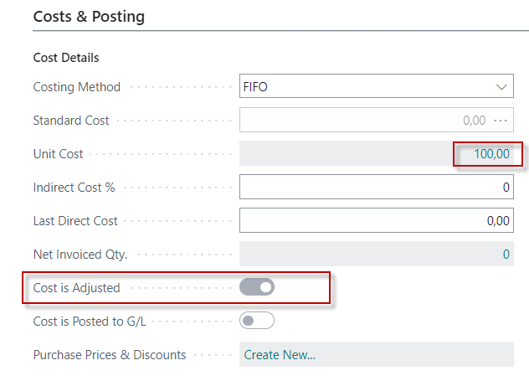
Result of manual inventory cost adjustment
This change (Inventory Cost Adjustment)
has not yet been reflected
in the General Ledger (will be)

Slide 18
Item ledger entries & Value entries
Ctrl-F7
Value entries (pložky ocenění)

Slide 19
Value entries –description I.
In Microsoft Dynamics 365 Business Central, value entries play a crucial role in tracking and managing the financial aspects of inventory transactions. Here are the key functions of value entries:
Reflect Changes in Inventory Value:
Value entries record the financial impact of inventory transactions, such as purchases, sales, adjustments, and revaluations. Each entry that affects the inventory value creates one or more value entries.
Link to Item Ledger Entries:
Each value entry is associated with an item ledger entry, which records the quantity changes in inventory. This relationship ensures that both the quantity and value aspects of inventory are accurately tracked.
Support Costing Methods:
Value entries support various costing methods (e.g., FIFO, LIFO, Average) by providing detailed cost information for each inventory transaction. It helps in the accurate calculation of the COGS.

Slide 20
Value entries –description II.
In Microsoft Dynamics 365 Business Central, value entries play a crucial role in tracking and managing the financial aspects of inventory transactions. Here are the key functions of value entries:
Enable Revaluation:
Value entries allow for the revaluation of inventory items. If the value of an item changes due to market hase to be changed, you can post revaluation entries to update inventory value accordingly
Facilitate Financial Reconciliation:
At regular intervals, value entries are posted to the general ledger to reconcile inventory transactions with financial accounts.

Slide 21
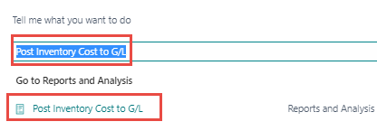
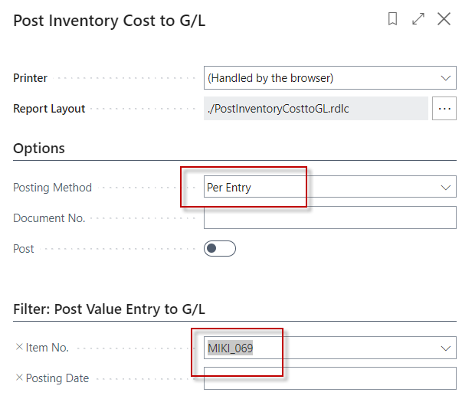
Posting inventory cost to General Ledger 1st step
It must be checked ON,
otherwise the result of
the Inventroy cost adjustment
will not appear in the General Ledger
Here it is set to OFF

Slide 22
Posting inventory cost to General Ledger 2nd step
YES
This Inventory value message is displayed automatically

Slide 23
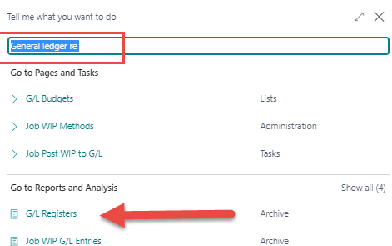
General Ledger entries display 1st part

Slide 24
General Ledger entries display 2nd part
Account 5510 -> Inventory Adjustment (Interim), Retail

Slide 25
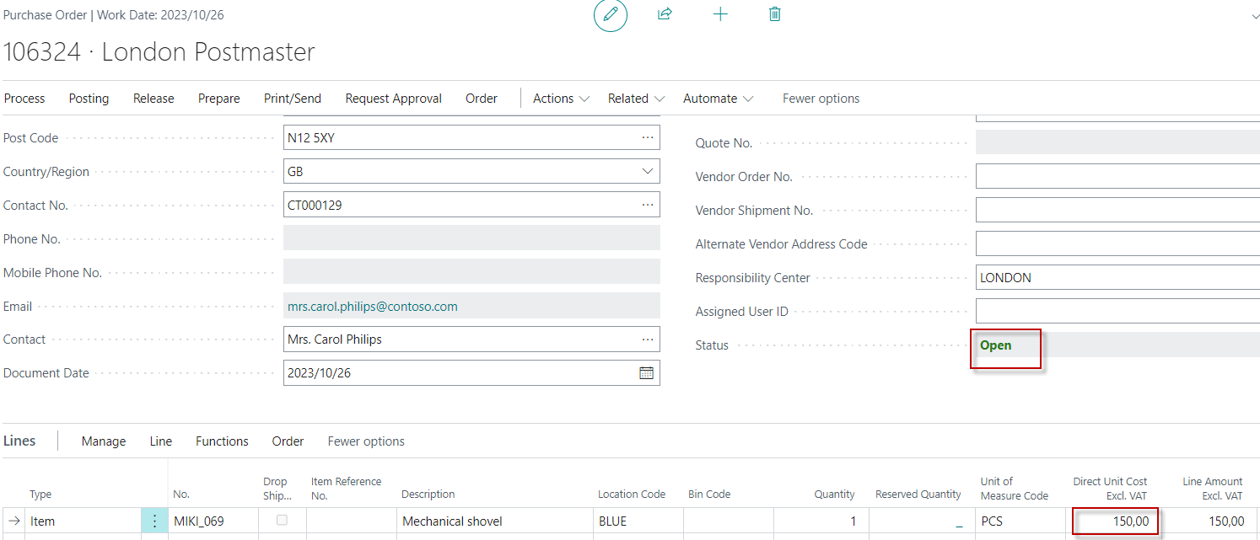
Invoicing at the actual price
The purchase price 100 is overwritten in the purchase line to the new actual price 150 and before modifying purchase line it is necessary to Reopen purchase order
100 -> 150

Slide 26
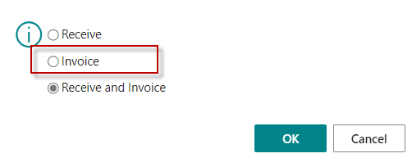
Posting Purchase order Only Invoice
The item have already been received
Attention! Here we have still checked 3rd option Receive and Invoice
Item ledger entry
Ctrl-F7
Value ledger entries

Slide 27
2nd manual inventory cost adjustment
Actual cost in Item ledger entry is updated ! Not visible here.
Instead of one Value Entry , another (additional) Value Entry was created.

Slide 28
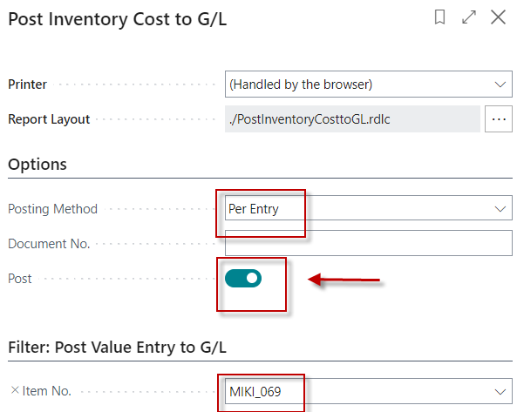
Posting Inventory Cost to General Ledger
No

Slide 29
Results : Average Cost Calculation overview

Slide 30
General Ledger entries

Slide 31
The first part of our show

Slide 32
Selling and Posting on interim accounts
It is about accounting for the Costs of Good Sold (COGS) and movements of inventory costs on interim accounts in the event of a sale before the actual invoicing process takes place.
It is therefore also a general ledger entry presented in this case.
It might be an example of a deferred sales (odložený prodej) in case of combined deliveries due an unexpected delay in the invoicing of multiple deliveries.

Slide 33
General Business Posting Groups setup
It has already been presented

Slide 34
Inventory Posting Groups setup
It has already been presented

Slide 35
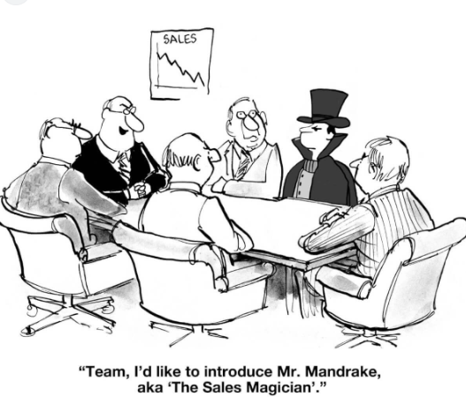
Sales Order
Unit Price does not play any role here!
We track only the Cost of Item and related movement on the inventory accounts

Slide 36
Sales Order before its modification
The value Cost = 150 is taken from the earlier example
Unit cost filed must be additionally displayed with the help of the Sales line Personalize feature

Slide 37
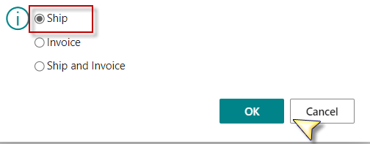
Sales order line after modification
150->180
Manually edited
In this case, original Unit Cost =150 was change to the new expected Unit Cost=180.
We posting Sales Order as Shipped only.

Slide 38
Average cost calculation from Item card
Already booked purchase order

Slide 39
Item ledger entry and value entry after shipping
1st part of ILE
2nd part of ILE
Ctrl-F7

Slide 40
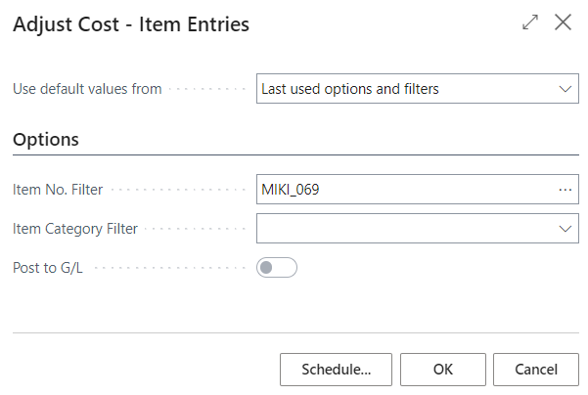
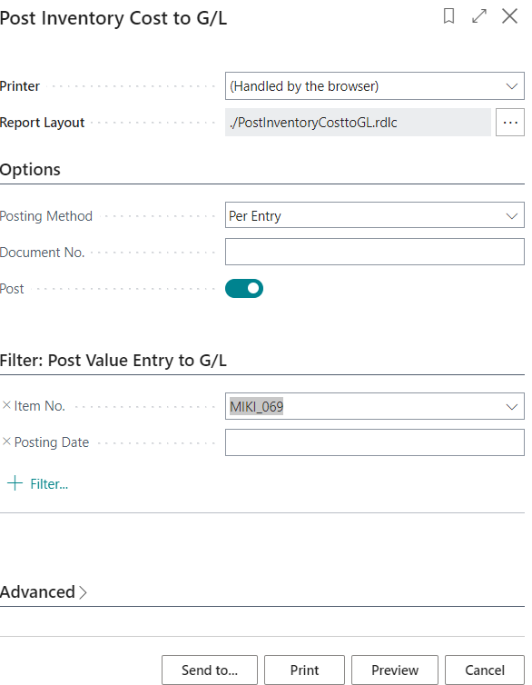
Inventory cost adjustment process
Step by step, we have to start inventory adjustment and subsequent posting costs to the general ledger
&

Slide 41
Inventory value
To provide that little bit of extra value to our fabulous company !!!!

Slide 42
Item entries before invoicing Sales order
Ctrl-F7

Slide 43
General ledger entries before Sales Order invocing
It is worth saying here, that we did not adjust the expected purchase price
of 180 before posting the Sales Order.
This cost has remained the same in this model.
In the next model we will illustrate a difference procedure.

Slide 44
All results after invoicing and inventory cost adjustments 1st part

Slide 45
All results before and after invoicing and inventory cost adjustments 2nd part
Before
After

Slide 46
End of the second part of the show

Slide 47
Second model - sale with expected price
This second part is suggested for the home study
and will not be reviewed in the classes
It is only a completion of all the options associated with the expected costs
The third part of the show is called homework

Slide 48
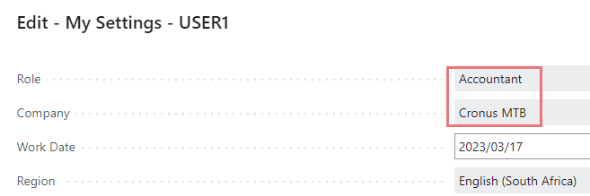
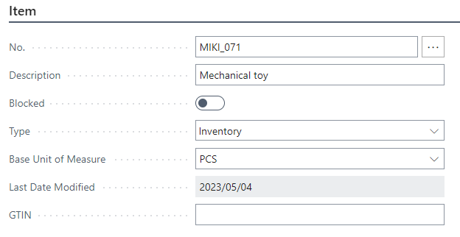
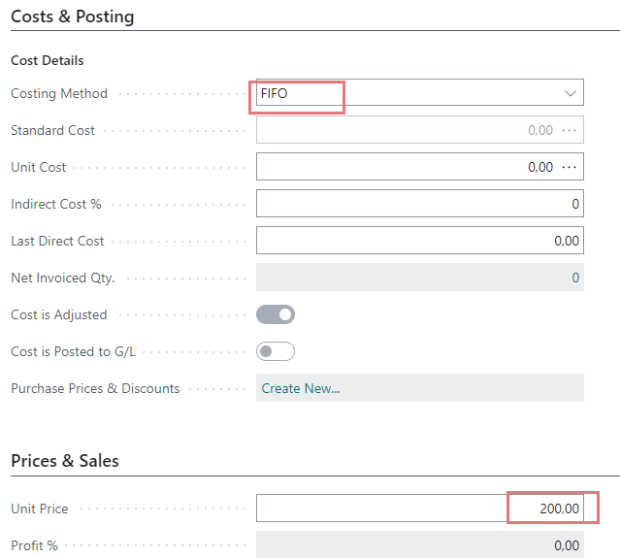
Second sales model with expected acquisition price
New item creation
User settings for this model

Slide 49
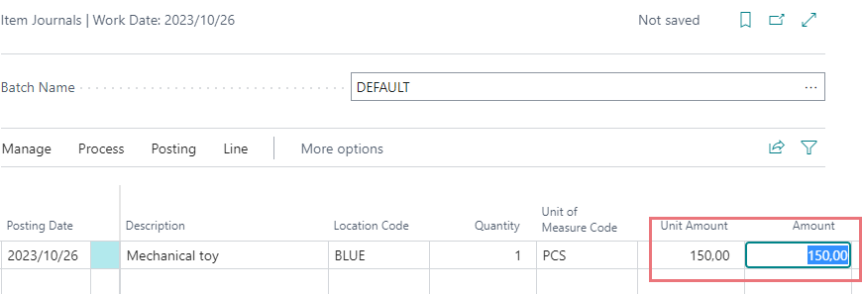
Purchase items with the Item journal
No expected cost is taken into account
F9

Slide 50
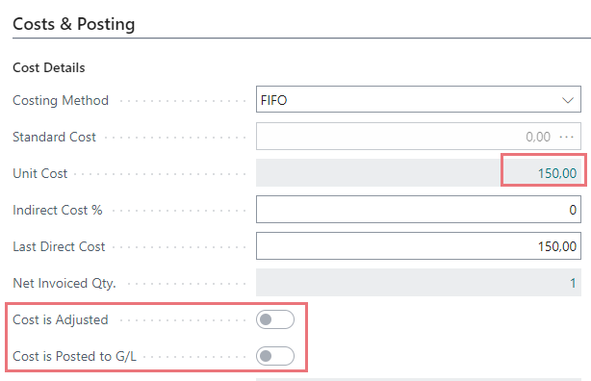
Item Ledger Entry & Average Cost Calculation

Slide 51
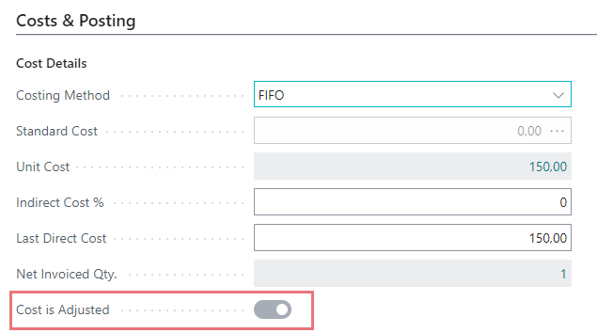
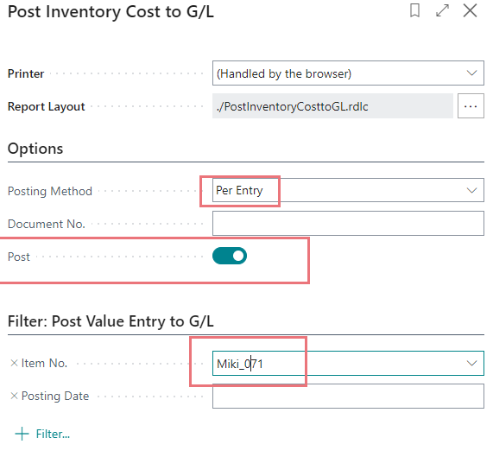
Inventory cost adjustment

Slide 52
General Ledger entry

Slide 53
Sales Order model concept
Sales line before 1st modification
Unit Cost =150 (actual cost)
Sales line after 1st manual modification (150->180 manually)
Unit Cost =180 (expected cost)
Ship only
Inventory Cost Adjustment and Post Inventory Costs to G/L
Sales line after 2nd modification (after Sales Order was re-open )
Unit Cost =111 (new actual cost instead added manually )
Invoice only
Inventory Cost Adjustment and Post Inventory Costs to G/L

Slide 54
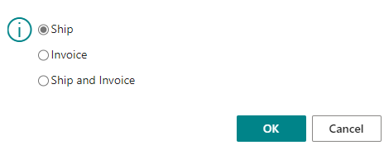
Sales Order line and Ship posting
F9
Inventory Cost Adjustment and Post Inventory Costs to G/L

Slide 55
Sales line after posting shipping (1st and 2nd part of ILE)

Slide 56
Item ledger entries and value entry
After inventory cost adjustment and Posting Invnetory Costs to General Ledger
The procedure for adjusting and booking costs is the same as in the previous examples, so it is not shown here

Slide 57
Item ledger entries and value entry
After inventory cost adjustment and posting invnetory costs to General Ledger
The procedure for adjusting and booking costs is the same
as in the previous examples, so it is not shown here

Slide 58
General Ledger entries

Slide 59
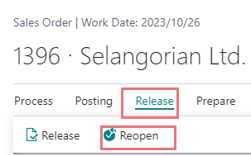
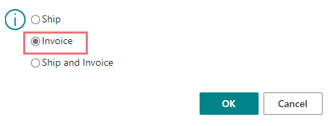
2nd Sales line Modification – new actual unit cost
Before modification it is required to Re-open the Sales Order
Another change after delivery and before posting

Slide 60
Final results 1st part
After inventory cost adjustment and posting invnetory Costs to General Ledger
The procedure for adjusting and booking costs is the same
as in the previous examples, so it is not shown here
150-39=111

Slide 61
Final results 2nd part

Slide 62
Final results 3rd part
2110
2111
2112
7190
39
150
150
39
111
111
39+111=150
Interim account
39+111=150

Slide 63
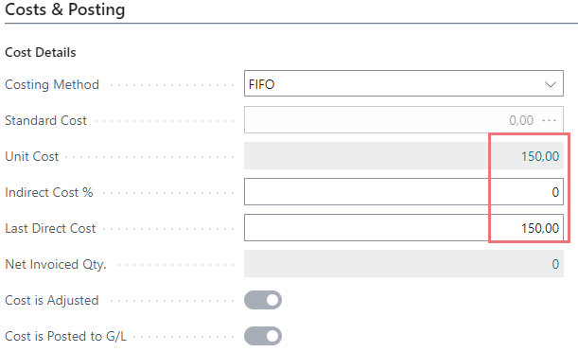
Average Cost Calculation Overview

Slide 64
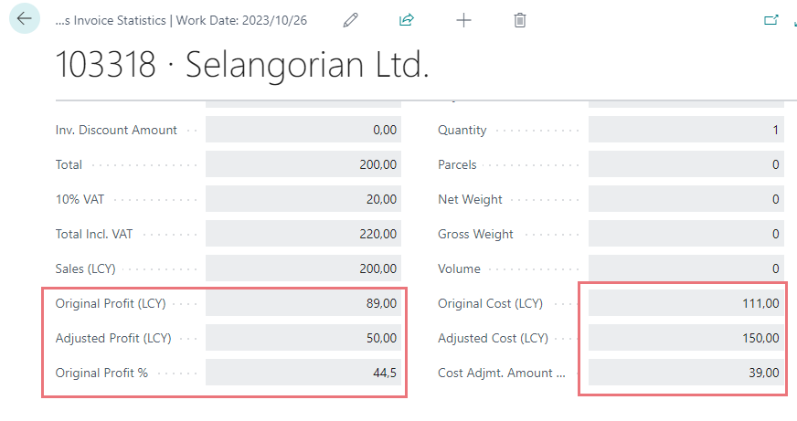
Statistics of posted invoice with different new actual unit cost (111)

Slide 65
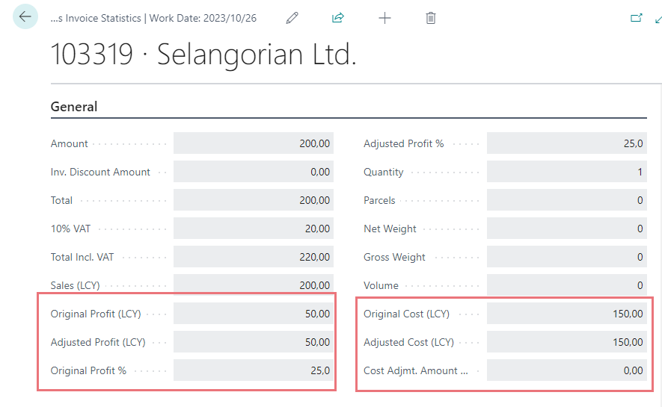
Statistics of posted invoice with former actual unit cost from item card (150)

Slide 66
Conclusion
Before the model, the same procedure was done for the same item but with a different number and the unit cost was not modified and remained at 150.
Meaning, that the modification of the unit cost affected the profit before cost adjustment only and it did not affect the unit cost on the item card

Slide 67
End of the section Expected costs

