Slide 1
Consultancy project:
Market Potential Analysis
By Jakub Čech & Andrej Šišolák
Notes:
Note: Please after inserting your picture, “Right Click” on the picture and “Send it to Back” to get the “Gradient” effect.

Slide 2
Our Agenda
Consultancy Project | Market Analysis
5 min
01
Definition & Objectives
20 min
02
Vertical – Top Down
20 min
03
Vertical – Bottom Up
20 min
04
Horizontal

Slide 3
Market Potential Analysis
Definition & Objectives
By Jakub Čech & Andrej Šišolák
Notes:
Note: Please after inserting your picture, “Right Click” on the picture and “Send it to Back” to get the “Gradient” effect.

Slide 4

Market Analysis Objectives
Consultancy Project | Market Potential Analysis | Definition & Objectives
Quantitative Analysis
Qualitative Analysis
Profit Levels
Own Qualities
Relevant Potential
Customer Needs
Growth Trends
Competitors Qualities

Slide 5



Terms Definition
Consultancy Project | Market Potential Analysis
Market
is the place or environment where customers can fulfill their needs
Need
Target customer’ needs, which should be fulfilled trough the business strategy
Location
Target geographic location in which the business strategy will solve the fulfillment of selected customer needs
Notes:
Note: Please after inserting your picture, “Right Click” on the picture and “Send it to Back” to get the “Gradient” effect.

Slide 6



Terms Definition
Consultancy Project | Market Potential Analysis
Market Potential
Is a figure expressed in currency or measurable units that represents the total amount of goods or services that all the customers present in the defined market can buy within a specified time
Value
The financial value of all the goods and services that all the customers can buy on the defined market
Volume
The total amount of all the goods and services that all the customers can buy on the defined market
Notes:
Note: Please after inserting your picture, “Right Click” on the picture and “Send it to Back” to get the “Gradient” effect.

Slide 7




Terms Definition
Consultancy Project | Market Potential Analysis
Market Segmentation
Refers to aggregating prospective buyers into groups with common needs and characteristics.
Homogenity
Common needs and characteristics of customers within the segment. (Demographic, Geographic, Lifestyle etc. for B2C, Type of business, number of employees for B2B)
Distinction
Customer needs and behavior should be unique as much as possible in between the segment
Reaction
Similar response to the market development or marketing incentive
Notes:
Note: Please after inserting your picture, “Right Click” on the picture and “Send it to Back” to get the “Gradient” effect.

Slide 8
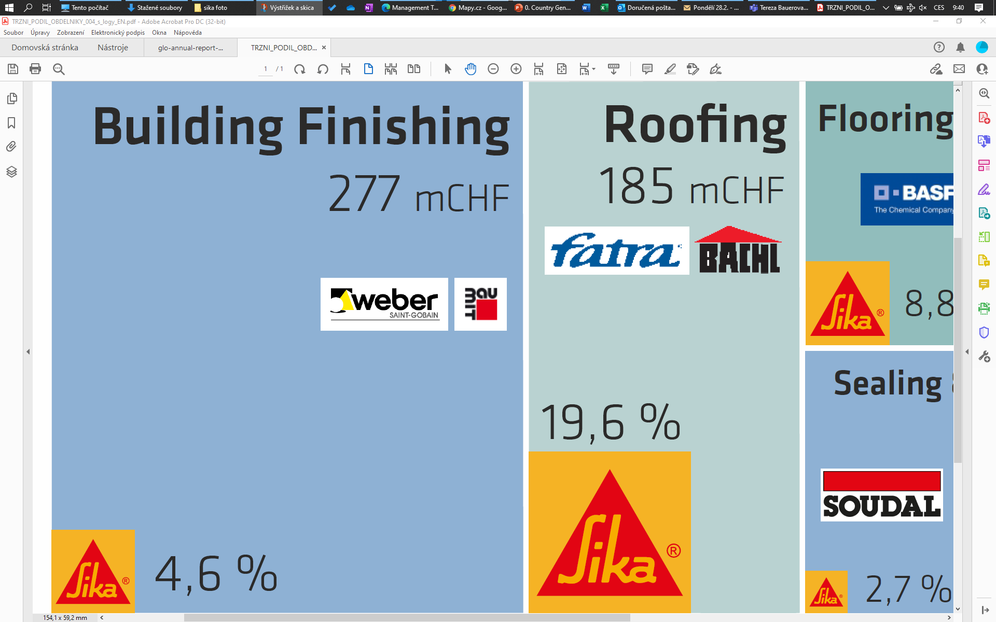
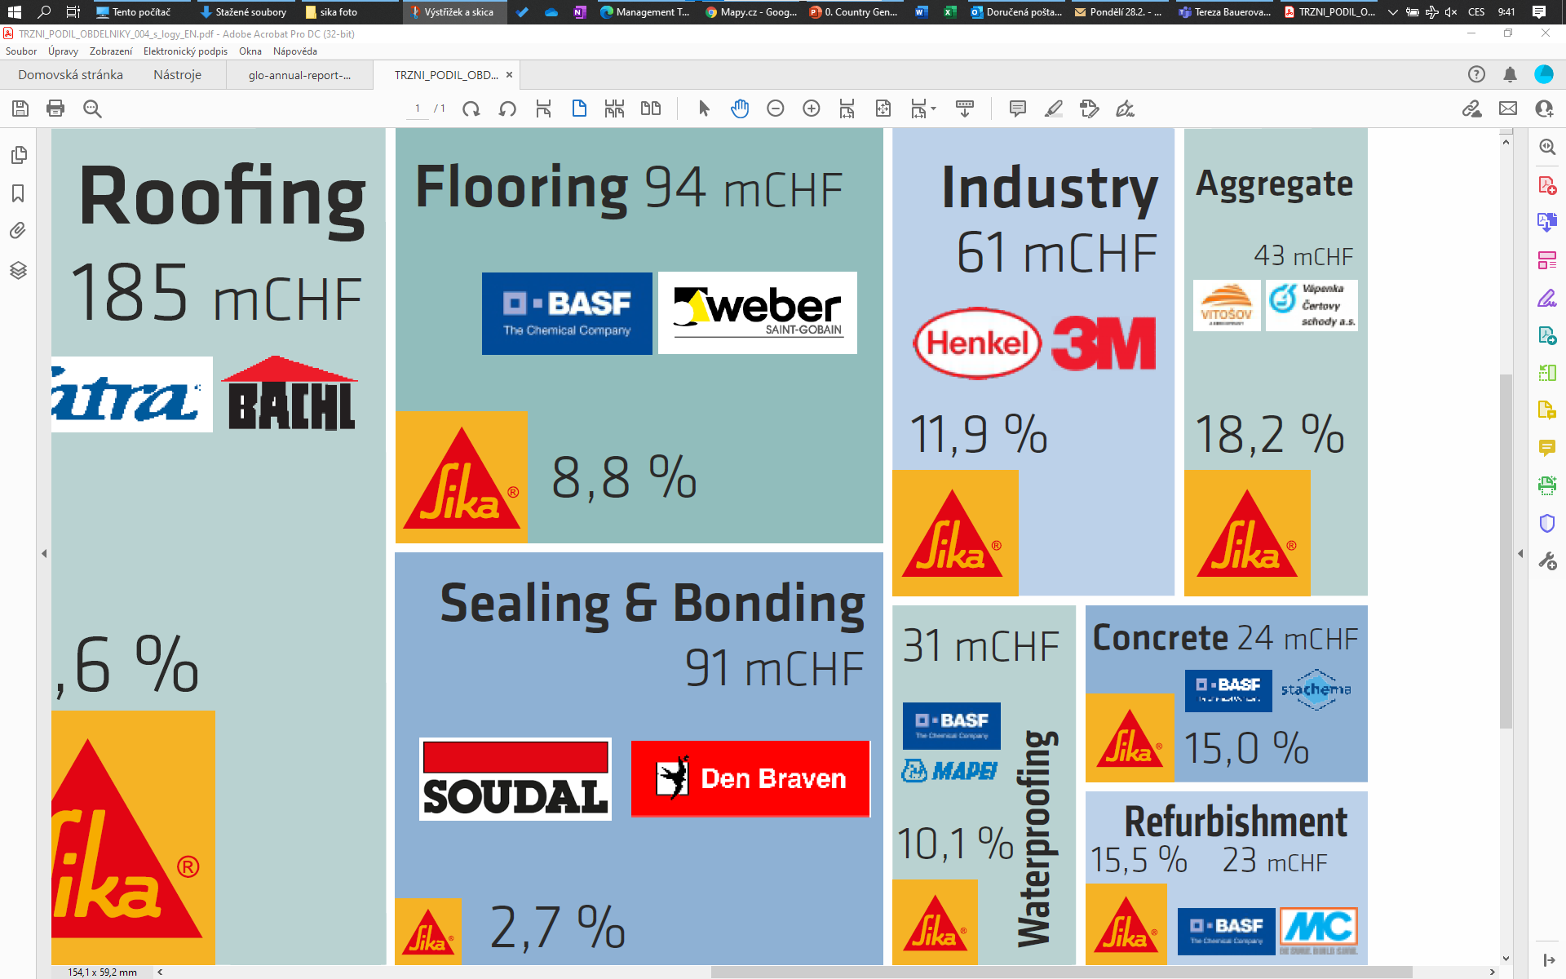
Market Potential Calculation Methodologies
Consultancy Project | Market Potential Analysis | Definition & Objectives
Vertical
Horizontal

Slide 9
Market Potential Vertical Methodologies
Consultancy Project | Market Potential Analysis | Definition & Objectives
Customer based
Calculation of the market potential based on the definition of the single customer’s product basket and potential followed up with multiplication by the number of customers with the similar characteristics
Top Down
Bottom Up
Calculation of the market potential based on the statistics of the selected industrial sector value or volume and data-based estimation of its share relevant to the chosen products or services
Statistics based

Slide 10
Market Potential Horizontal Methodology
Consultancy Project | Market Potential Analysis | Definition & Objectives
Competitors based
Calculation of the market potential based on the sum of all relevant sales of all the relevant competitors, which are present in the selected market.
Calculation of the market potential based on the statistics of the selected industrial sector value or volume and data-based estimation of its share relevant to the chosen products or services
Statistics based
Horizontal

Slide 11
Market Potential Analysis
Vertical – Top Down
By Jakub Čech & Andrej Šišolák
Notes:
Note: Please after inserting your picture, “Right Click” on the picture and “Send it to Back” to get the “Gradient” effect.

Slide 12


Top-Down Calculation Process
Consultancy Project | Market Potential Analysis | Vertical – Top Down
High Level Data
Segmentation
Sample
Calculation
Collect all possible macroeconomic data that could show the chosen market's total value or volume
Define the relevant market segments and split the total market value into them
Analyze the potential for the sample group of the most typical applications or usages of the company's products or services in each segment.
Set up a percentage share of the sample group's calculated potential and total market value. Apply the same coefficient for the whole segment. Sum up figures from all segments to get full market potential.
01
02
03
04

Slide 13
Market Potential Sika CZ Case Study
Consultancy Project | Market Potential Analysis | Vertical – Top Down
CZ Macroeconomic Environment:
CZ Construction Activity By Project Segments:
Key Macroeconomic Indicators |  | 2015 |  | 2016 |  | 2017 |  | 2018 |  | 2019 |  | 2020 | 2021
GDP (nominal) (bn. CHF) |  | 194 |  | 202 |  | 215 |  | 227 |  | 242 |  | 236 | 247
Population (mn) |  | 10,538 |  | 10,554 |  | 10,579 |  | 10,610 |  | 10,650 |  | 10,694 | 10,702
GDP per capita (TCHF) |  | 17,829 |  | 18,575 |  | 20,636 |  | 23,415 |  | 23,494 |  | 22,912 | 23,980
GDP (real) growth (%) |  | 5,4 |  | 2,5 |  | 5,2 |  | 3,2 |  | 2,3 |  | -6,1 | 3,3
Unemployment rate (%) |  | 5,1 |  | 4,0 |  | 2,9 |  | 2,2 |  | 2,0 |  | 2,6 | 3,5
Inflation rate |  | 0,3 |  | 0,7 |  | 2,5 |  | 2,1 |  | 2,8 |  | 3,2 | 3,8
CZK|CHF (pavg) |  | 24,9 |  | 25,1 |  | 21,9 |  | 22,9 |  | 23,3 |  | 24,3 | 23,7
CZK|EUR (pavg) |  | 27,3 |  | 27,0 |  | 26,3 |  | 25,6 |  | 25,7 |  | 26,4 | 25,1
Year | Construction work "S" total | in it
 |  | in the CR | in it |  |  |  |  |  |  | Abroad
 |  |  | New construction, reconstruction and upgrade | in it |  |  |  |  | Repairs and maintenance
 |  |  |  | Residential buildings | Non-residential buildings not designed for production | neNon-residential buildings designed for production | Civil engineering works | Water management works
2014 | 428 276 | 417 013 | 302 575 | 46 344 | 59 811 | 60 615 | 130 563 | 5 242 | 114 438 | 11 263
2015 | 459 051 | 446 104 | 326 340 | 51 603 | 56 185 | 62 155 | 151 693 | 4 704 | 119 764 | 12 947
2016 | 424 609 | 410 719 | 292 297 | 57 574 | 42 645 | 71 171 | 117 927 | 2 980 | 118 422 | 13 890
2017 p) | 453 431 | 437 542 | 313 900 | 59 966 | 48 379 | 87 817 | 114 768 | 2 970 | 123 642 | 15 889
CZ Construction Activity By Company Size:
CZ Construction Activity By Region:
566 mld
279 mld
287 mil

Slide 14
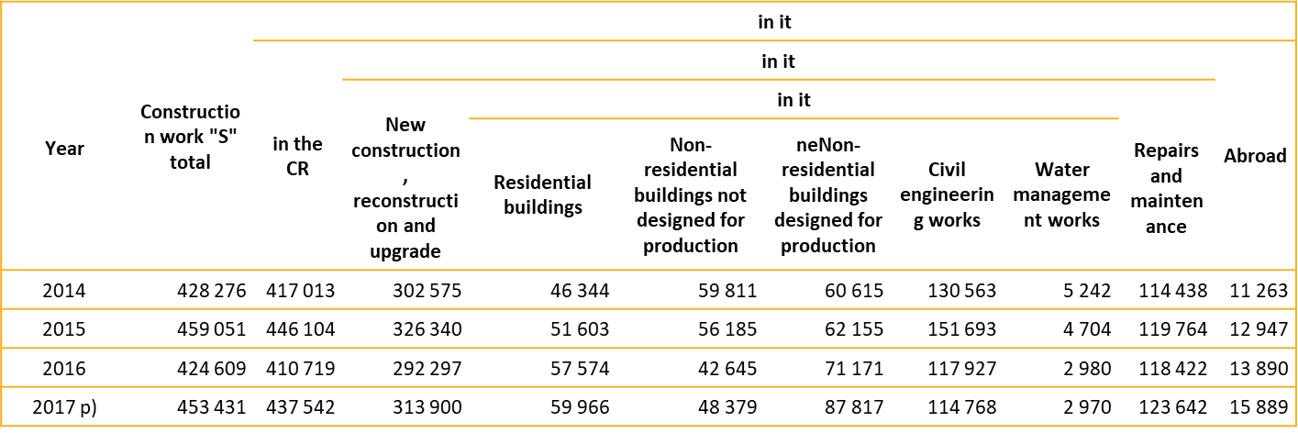
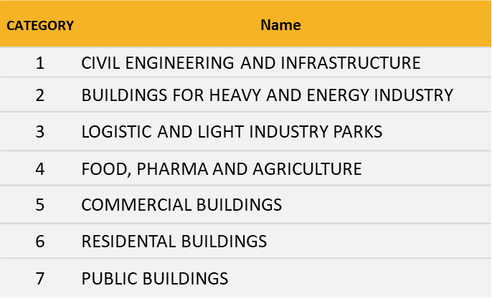




Market Potential Sika CZ Case Study
Consultancy Project | Market Potential Analysis | Vertical - Top Down
CZ Construction Activity By Project Segments:

Slide 15
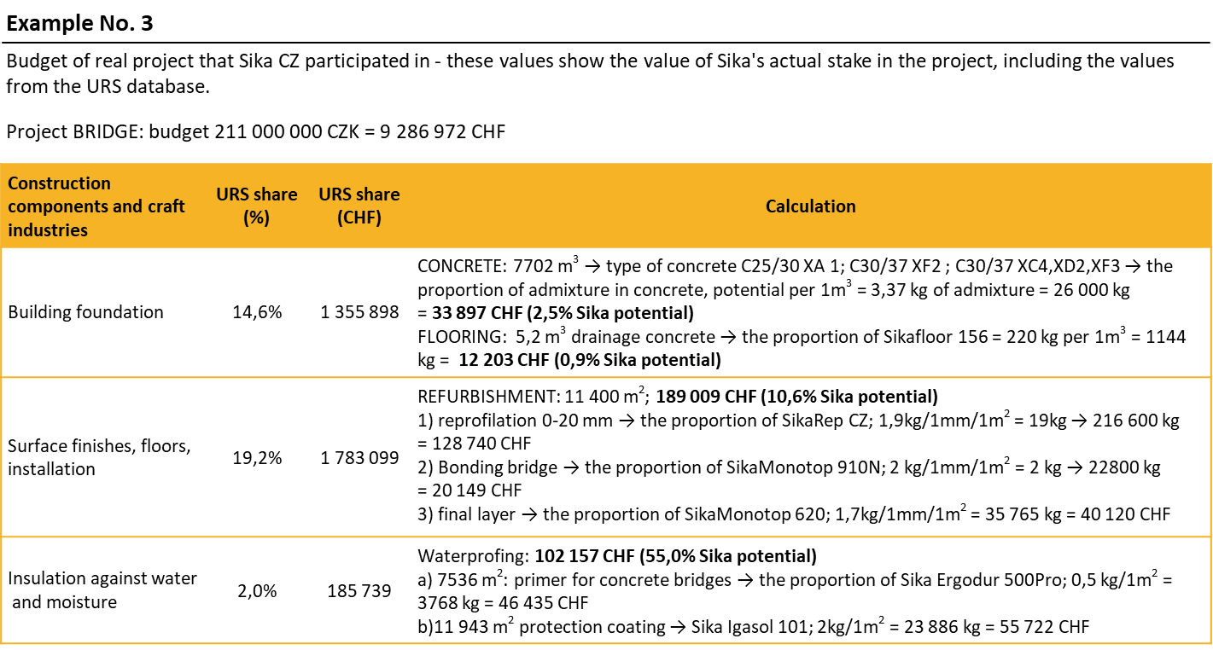
Market Potential Sika CZ Case Study
Consultancy Project | Market Potential Analysis | Vertical – Top Down
Bill of materials:

Slide 16
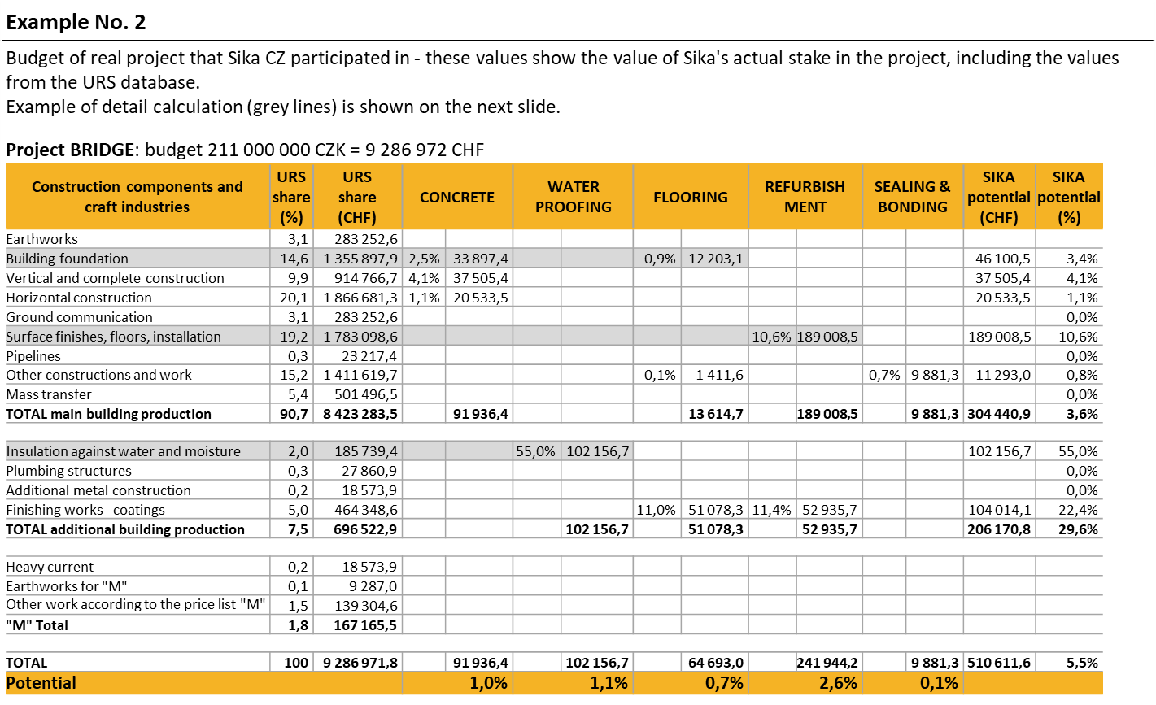
Market Potential Sika CZ Case Study
Consultancy Project | Market Potential Analysis | Vertical – Top Down
Bill of materials:

Slide 17
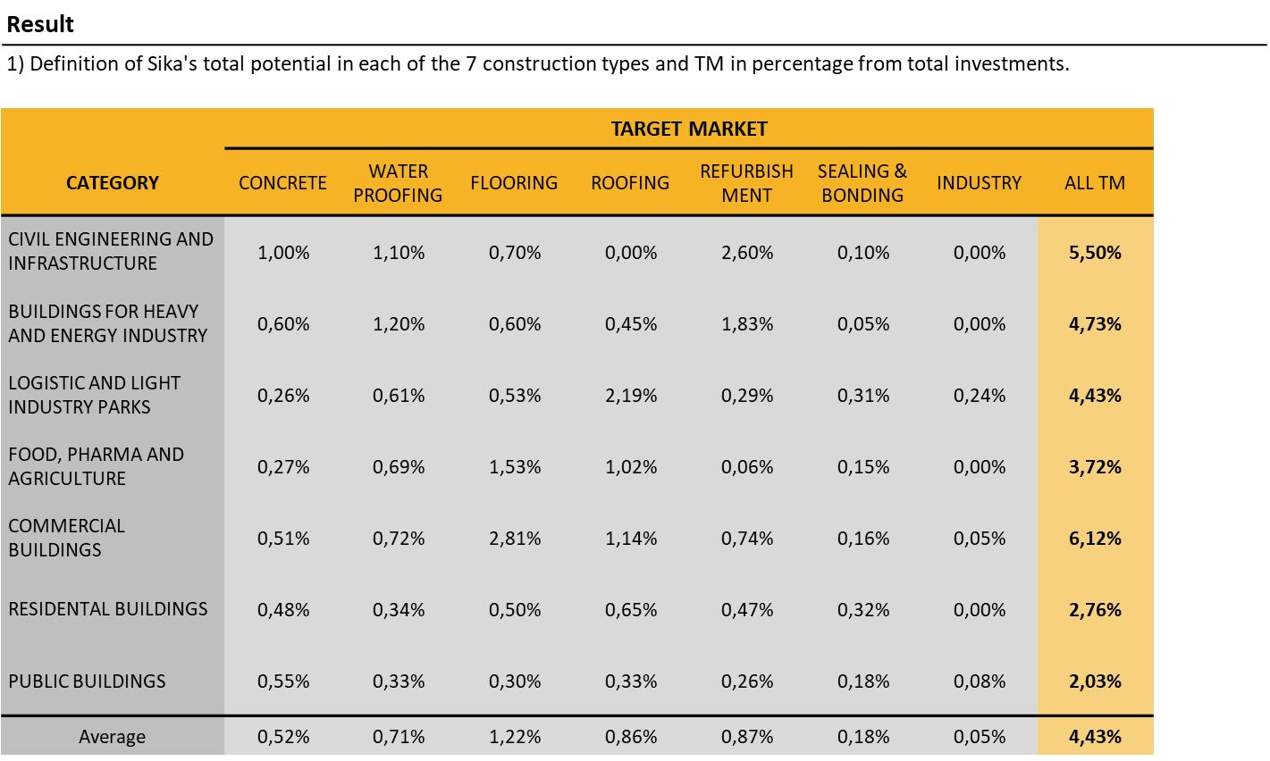
Market Potential Sika CZ Case Study
Consultancy Project | Market Potential Analysis | Vertical – Top Down
Sika potential in % of total investment:

Slide 18
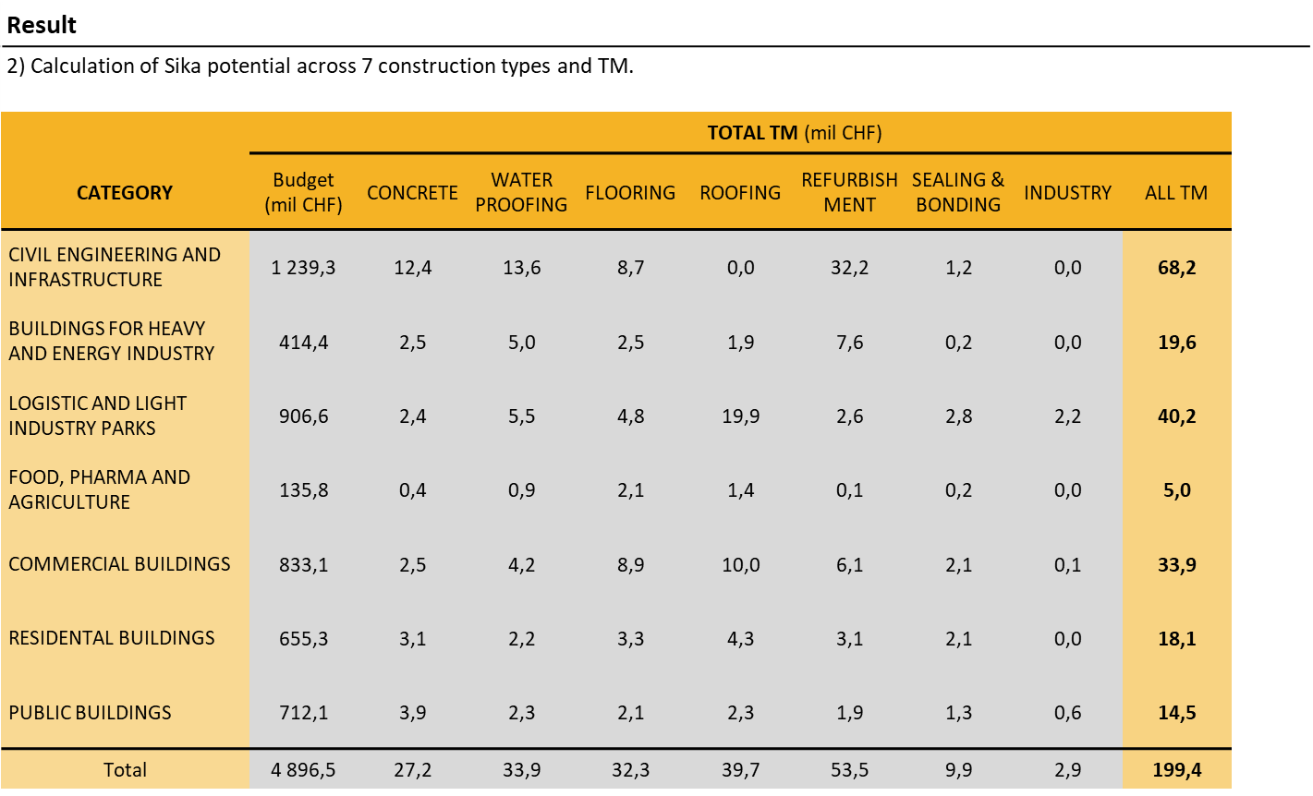
Market Potential Sika CZ Case Study
Consultancy Project | Market Potential Analysis | Vertical – Top Down
Sika potential in different types of buildings:

Slide 19
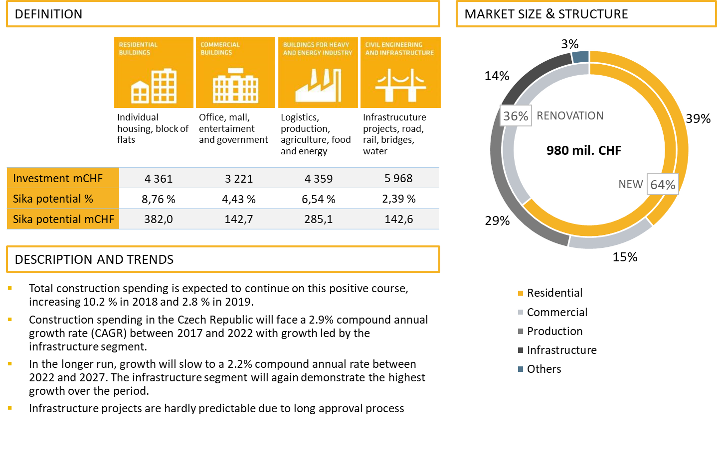
Market Potential Sika CZ Case Study
Consultancy Project | Market Potential Analysis | Vertical – Top Down
Relevant Sika potential:

Slide 20
Market Potential Analysis
Vertical – Bottom Up
By Jakub Čech & Andrej Šišolák
Notes:
Note: Please after inserting your picture, “Right Click” on the picture and “Send it to Back” to get the “Gradient” effect.

Slide 21


Bottom Up Calculation Process
Consultancy Project | Market Potential Analysis | Vertical – Bottom Up
Segmentation
Product basket
Calculation
Aggregation
Split all potential customers to the segments based on the defined criteria. Main goal is to associate the customers based on their characteristics or behavior on the market
Define the typical product basket for the customer segments based on customer analysis
Calculate your potential based on the product mix and potential sales to the customers in each segment. As a percentage of the total customer turnover or total spending in the segment
Apply the calculation in each segment to all existing customers. This leads to a potential sales per segment. Put all segments together to get the relevant potential for your company on the market
01
02
03
04

Slide 22
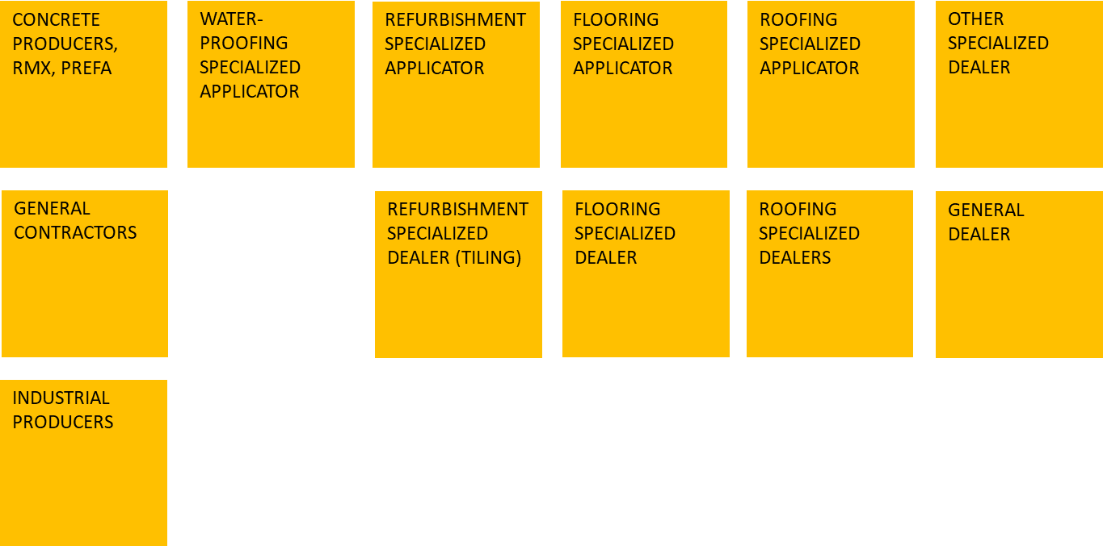
Market Potential Sika CZ Case Study
Consultancy Project | Market Potential Analysis | Vertical – Bottom Up
Customer segmentation – segment definition:

Slide 23
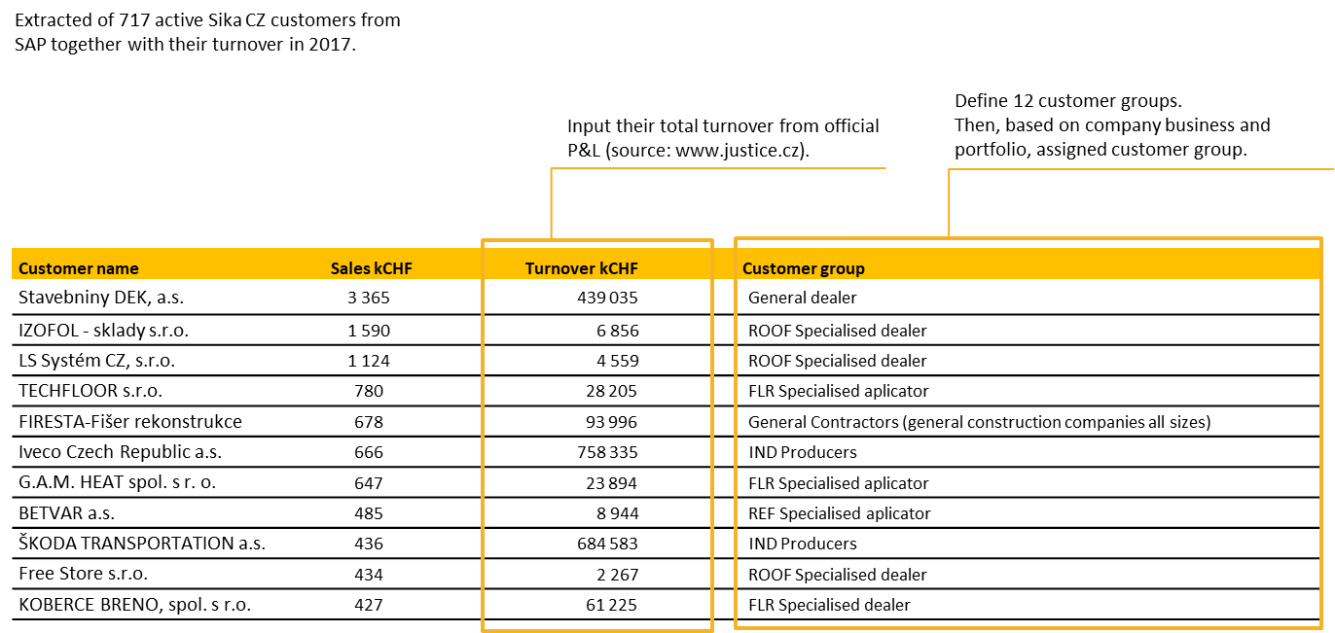
Market Potential Sika CZ Case Study
Consultancy Project | Market Potential Analysis | Vertical – Bottom Up
Customer segmentation:

Slide 24
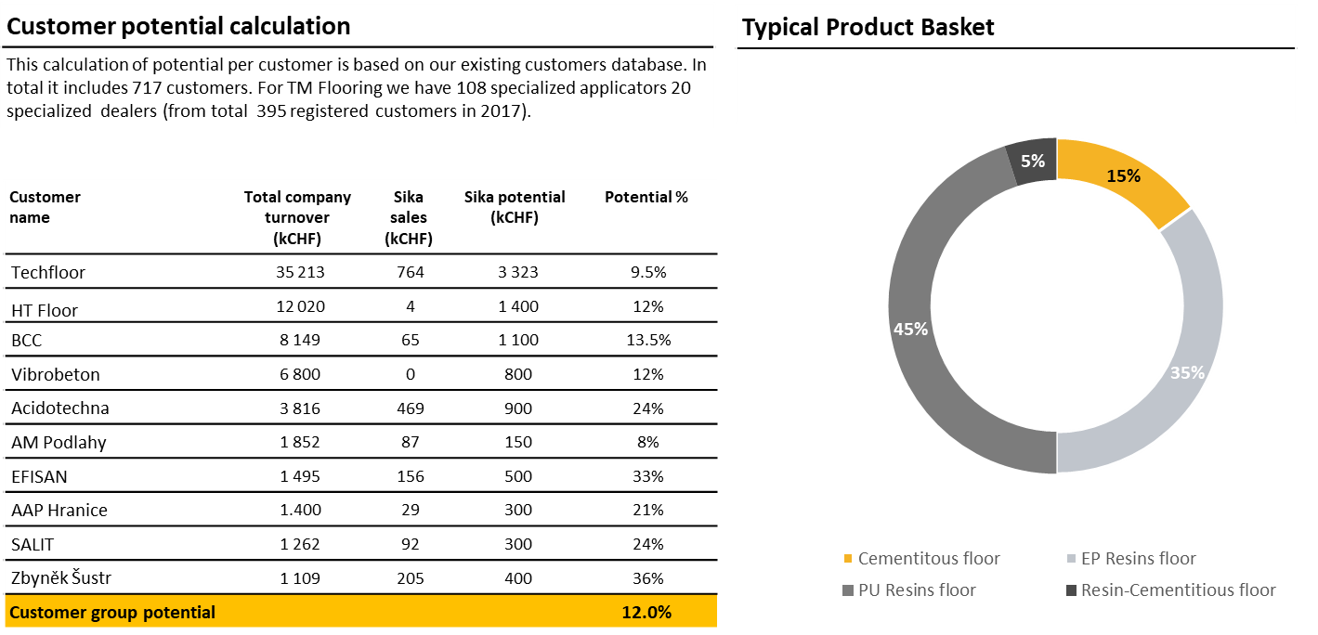
Market Potential Sika CZ Case Study
Consultancy Project | Market Potential Analysis | Vertical – Bottom Up
Product basket:

Slide 25
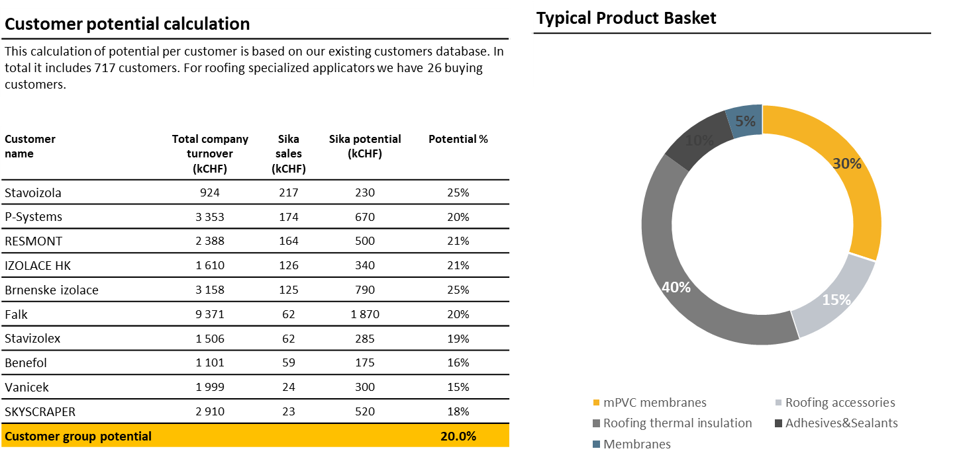
Market Potential Sika CZ Case Study
Consultancy Project | Market Potential Analysis | Vertical – Bottom Up
Product basket:

Slide 26
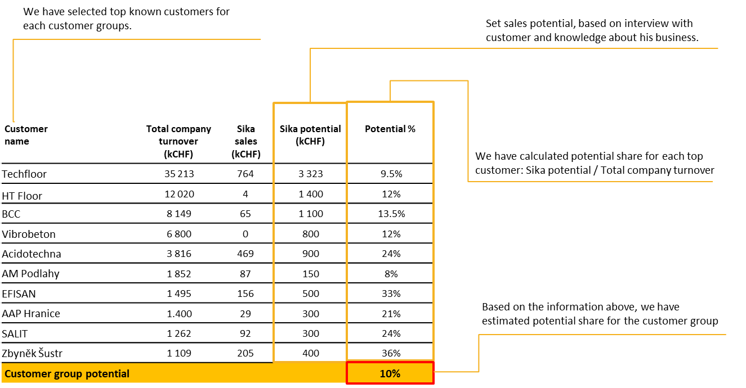
Market Potential Sika CZ Case Study
Consultancy Project | Market Potential Analysis | Vertical – Bottom Up
Potential calculation:

Slide 27
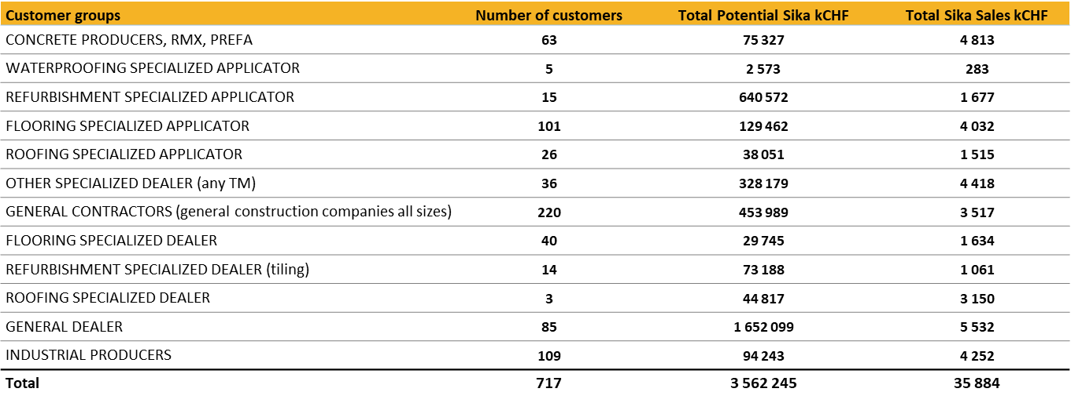
Market Potential Sika CZ Case Study
Consultancy Project | Market Potential Analysis | Vertical – Bottom Up
Potential calculation:

Slide 28
Market Potential Analysis
Horizontal
By Jakub Čech & Andrej Šišolák
Notes:
Note: Please after inserting your picture, “Right Click” on the picture and “Send it to Back” to get the “Gradient” effect.

Slide 29


Horizontal Calculation Process
Consultancy Project | Market Potential Analysis | Horizontal
List
Segmentation
Calculation
Aggregation
Make a list of all relevant competitors which are active in all the chosen market segments and find their official sales figures in the trade register or annual reports
Based on the annual reports or information from the customers, split the total sales of each competitor into the selected market segments
Calculate market potential for each selected market segment by aggregating the competitors’ sales allocated in each of them
Sum up the potential of the individual segments into the total market potential.
01
02
03
04

Slide 30
Market Potential Sika CZ Case Study
Consultancy Project | Market Potential Analysis | Horizontal
Hard facts | Competitors’ list:

Slide 31
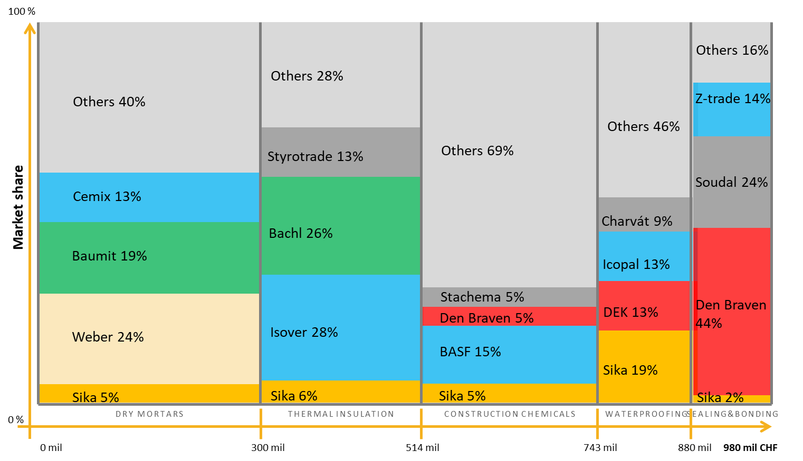
Market Potential Sika CZ Case Study
Consultancy Project | Market Potential Analysis | Horizontal
Allocation of the sales into the segments:

Slide 32
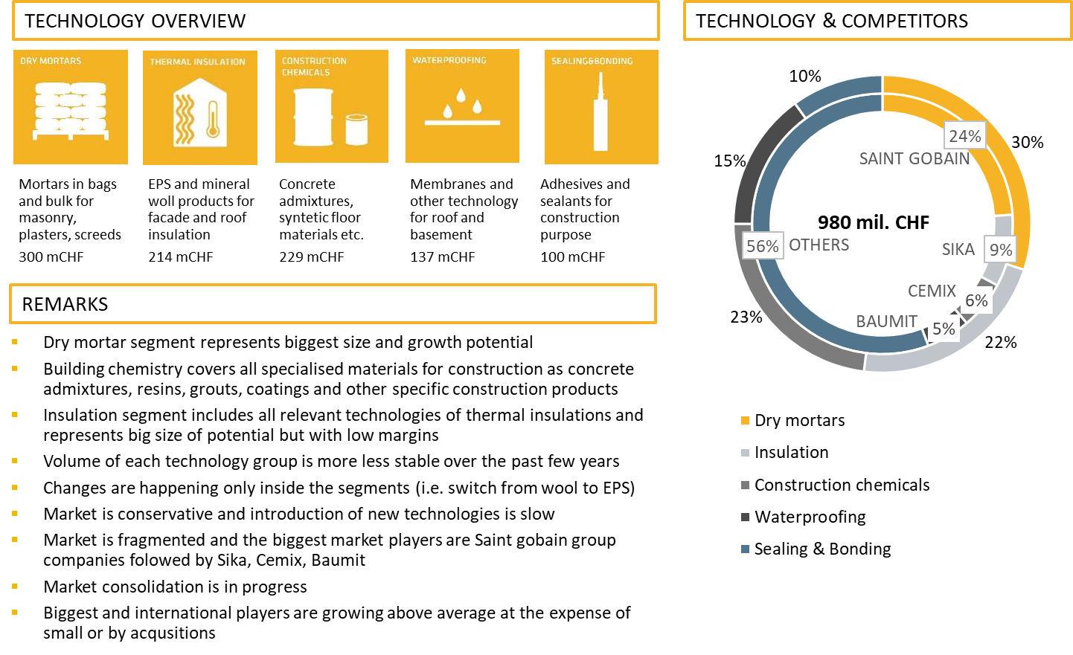
Market Potential Sika CZ Case Study
Consultancy Project | Market Potential Analysis | Horizontal
Total market potential:

Slide 33
Market Potential Analysis
Summary
By Jakub Čech & Andrej Šišolák
Notes:
Note: Please after inserting your picture, “Right Click” on the picture and “Send it to Back” to get the “Gradient” effect.

Slide 34



Summary Of Market Potential Calculation
Consultancy Project | Market Potential Analysis | Summary
Top Down
Bottom Up
Horizontal
Total value of market potential calculated based on the statistic methodology
Total value of market potential calculated based on customer’ product basket methodology
Total value of market potential calculated based on competitors methodology

Slide 35
Thank You
For Your Watching
Jakub & Andrej

