Slide 1
Economic Order Quantity-basics
Ing.Jaromír Skorkovský,CSc.
Department of corporate economy

Slide 2
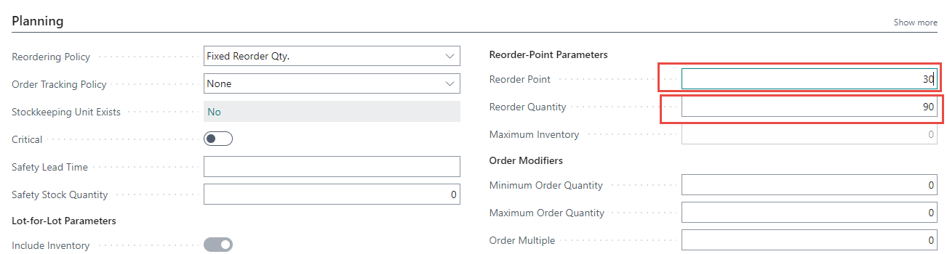
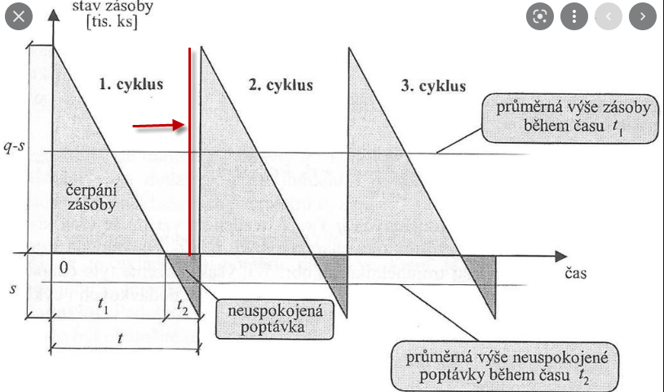
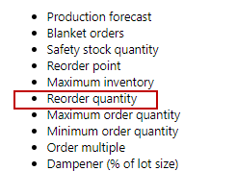
Item card
?

Slide 3

EOQ 1 (ENG-CZ)
EOQ = Economic Order Quantity and limitation of this model (omezení)
EQO = Deterministic model – jde o deterministický model
Variables used to derive EOQ basic formula (see slide EOQ5)
  Ch = Cost to hold one unit inventory for a year – náklad na skladování položky za jeden rok
  Cp = Cost to place a single order – náklad spojený s vyřízení jedné objednávky
  A = Demand for the year – požadavky za celý rok
  Q = Quantity of orders – počet objednávek
The economic order quantity (EOQ) is the order quantity that minimizes total holding and ordering costs for the year. Even if all the assumptions don’t hold exactly, the EOQ gives us a good indication of whether or not current order quantities are reasonable – má to vazbu na využívání sešitu požadavků v NAV
Total Relevant Cost (TRC)
  why relevant ? ->because they are affected by order quantity
TRC= Yearly Holding Cost + Yearly Ordering Cost
Average inventory carrying cost –>see EOQ4 slide

Slide 4
EOQ 2
What is the EOQ Model?
Cost Minimizing Order Quantity (Q)
Assumptions=prerequisites (předpoklady):
  Single item only- hodnotí se vždy jedna skladová položka
  Relatively uniform (continuous) & known demand rate – relativně stálá poptávka
  Fixed item cost - fixní náklad spojený s pořízením zboží
  Fixed ordering and holding cost -fixní náklady na objednávání a skladování
  No stock shortage and Instantaneous shipment - nepočítá se s podtečením zásob pod nastavenou hodnotu a v případě požadavku se realizuje okamžitě dodávka
Constant Lead Time =LT (see slide EOQ3) - průběžná doba

Slide 5
EOQ 3
Q = Quantity
A
A
time
LT
LT-Lead time
Notice, that inventory never goes below zero; shortages do not exist !!

Slide 6
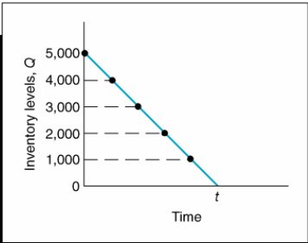


EOQ4 - Carrying cost (náklady na skladování)
Resource- Taylor- Wikipedia
Average inventory (carrying) cost = $\frac{Q}{2 }$
To verify this relationship, we can specify any number of points values of Q over the entire time period, t , and divide by the number of points. For example, if Q = 5,000, the six points designated from 5,000 to 0, as shown in shown figure, are summed and divided by 6:

Slide 7
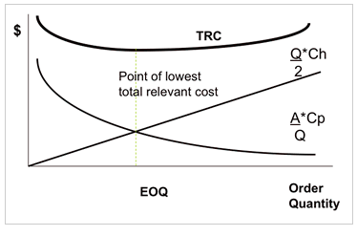
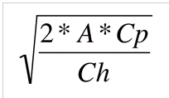
EOQ 5
EOQ
TRC=
To calculate derivative of TRC and put it to 0
dTRC/dQ=0=Ch/2+(A*Cp)/(Q*Q)-> Q=
Deriving the equation and fin extem
TRC=Total Relevant Cost

Slide 8

EOQ 6 – simpe example
EOQ
Pam runs a mail-order business for gym equipment. Annual demand for the TricoFlexers is 16,000 =A. The annual holding cost per unit is $2.50=Ch and the cost to place an order is $50=Cp. What is the economic order quantity?
  Ch = Cost to hold one unit inventory for a year
  Cp = Cost to place a single order
  A = Demand for the year
  Q = Quantity of orders

Slide 9
EOQ
Thanks for your attention

