Slide 1
Introduction to Busniess Central
(Customer Relationship Management)
Ing.J.Skorkovský,CSc.
MASARYK UNIVERSITY BRNO, Czech Republic
Faculty of economics and business administration
Department of corporate economy

Slide 2
CRM – Customer Relationship Management
PROs
  It enables us to keep track of all prospective customer (suspects and prospects)
  Improve sales and marketing service
  The company can promote the work it has done for its customers to approach prospects
CONs
  CRM software may not integrate well with other email and accounting systems
  Another disadvantage to a newly implemented CRM software is the learning curve.

Slide 3
CRM – Customer Relationship Management
Relationship management is a customer-oriented feature with service response based on customer input, one-to-one solutions to customers’ requirements, direct online communications with customer and customer service centers that help customers solve their issues.
Salesforce automation
  Sales promotion analysis
    Advertising
    Personal selling
    Direct marketing
    Public relations
  Automate tracking of a client’s account history
  Use of technology (ERP->MS Dynamics NAV)
Opportunity Management (see an extra picture related to so-called Business Rainbow)

Slide 4
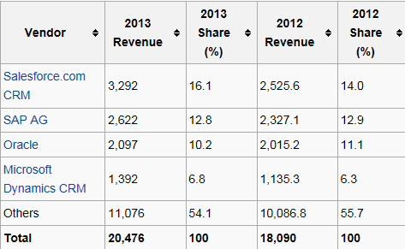

Market leaders (home study)
Although the table is somewhat old-fashioned, I can confirm that the importance of CRM is growing at an extreme pace
figures in millions of US dollars
Source:

Slide 5
Customer (Vendor)-Contact Cards
Customer card
Creation of Customer Card
Interactions
Interactions
Interactions
Contact card 1
Contact card 2
Contact card 3
Opportunity 1
Opportunity 2
Opportunity 3
Sales Cycle stages
Sales Cycle stages
Sales Cycle stages
Lost
Lost
WIN

Slide 6

Partially for MPH_AOPR - read frame only
Vendor
Statistic :
Costs/Revenue
Customer Ledger
Entries
Customer
Interaction
Log
Entries
Contact
Card
Salesperson
To-Do
Card
Profile (Contact properties)
(To-Do)
Assigned
activities
Statistics:
Interactions,
Sales Cycle stages,
Deal chances, Values,..
ABC (Pareto)
Analysis
Opportunity
Activity
code
Sales Cycle
Stages
Partial Activities
Interaction Log
Entries
Meeting /Telephone call
Stage number
Activity

Slide 7
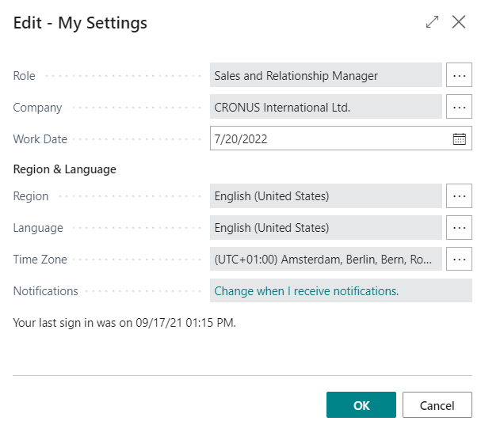
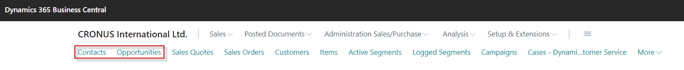

Slide 8
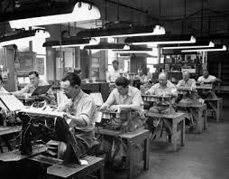
Contact cards
Contact card- company->Customer or Vendor
Contact card- person -> Customer or Vendor
Contact Character– profiles, technologies, market segment,...
Interactions (driven mostly by wizard) – telephones , meetings, presentations, business lunches
Business Opportunities (estimated close date and value of the deal, probability,.. )
Sales Cycles activities (stages)
Customer Card creation from Contact card using templates
Quotes assigned to Contact cards
Interaction log entries

Slide 9
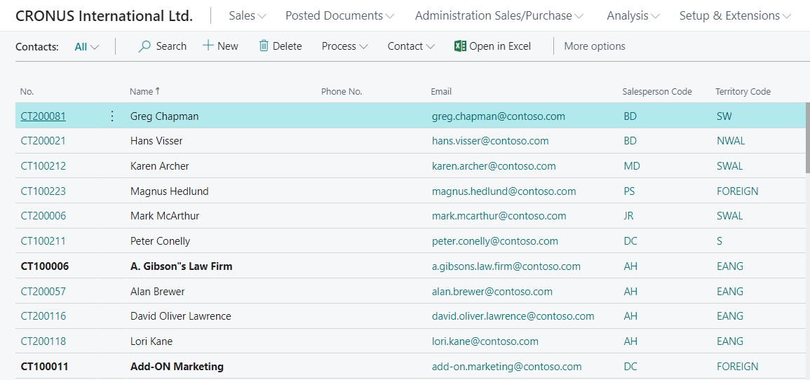
List of contact
OR
Customer->Related->Customer->Other->Contact
Searching window
Contact of selected Customer
List of all Contacts

Slide 10
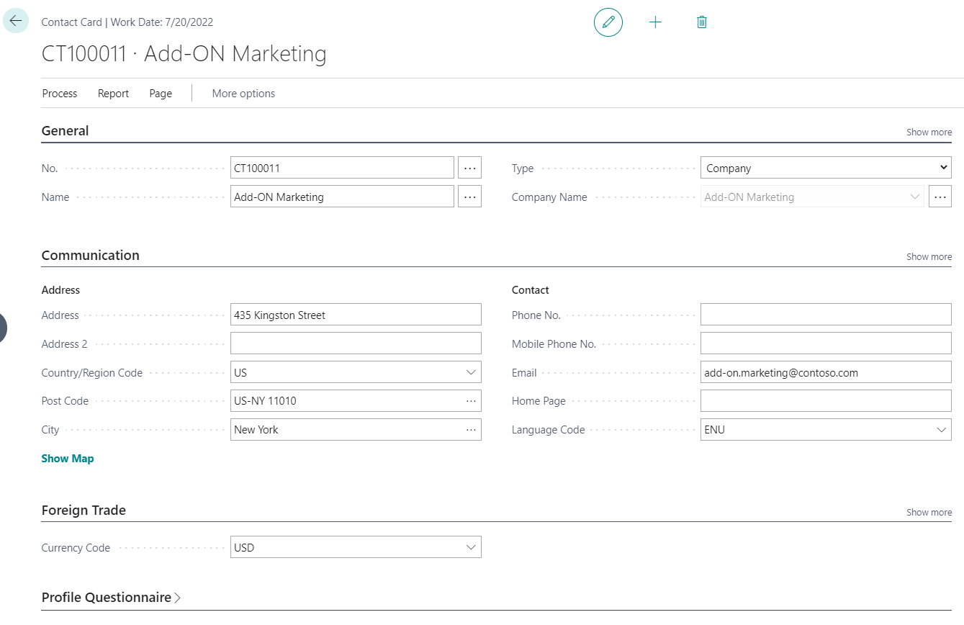
Contact card – company - (Header of the contact card)
Company Contact Card
Eric Clapton
Luciano Pavarotti
Paul McCartney
Contact persons type cards

Slide 11
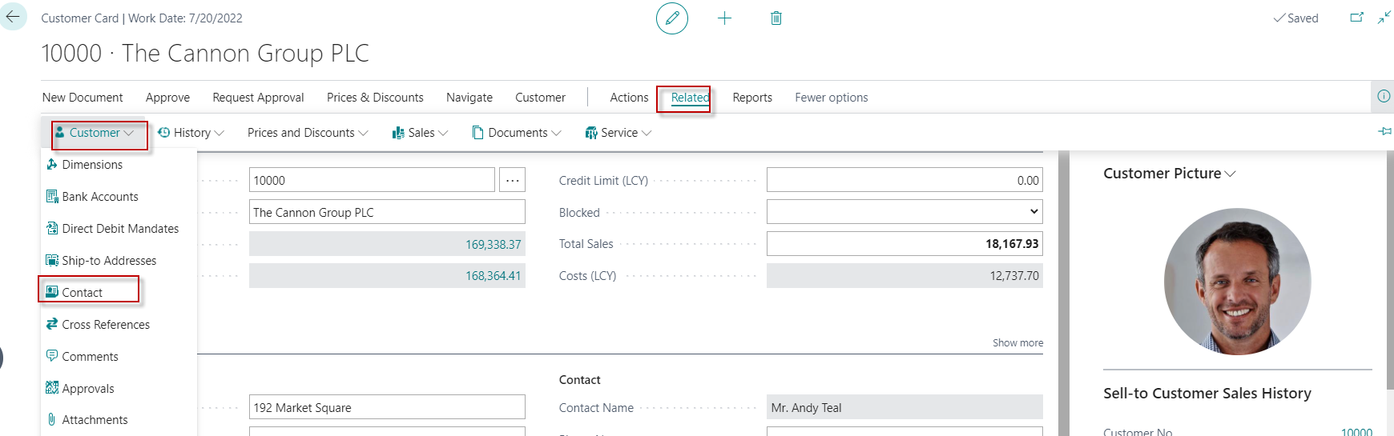
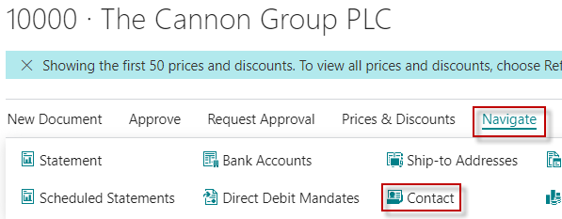
Customer card->Contact card (relationship)
Contact Card
Another option for accessing
contacts from the customer card

Slide 12
Try to find
Contact
CT000053 !!!!

Slide 13
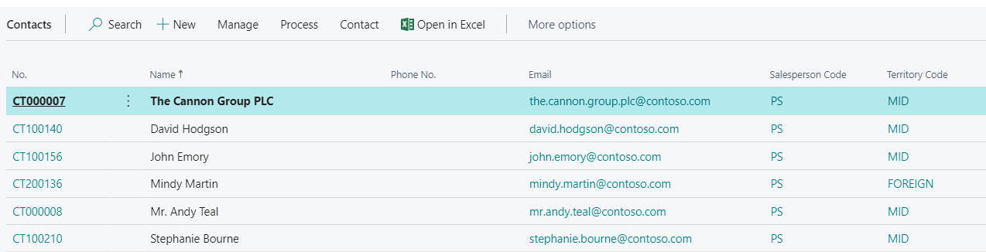
Contact cards
Person card
Company card
See next slide

Slide 14
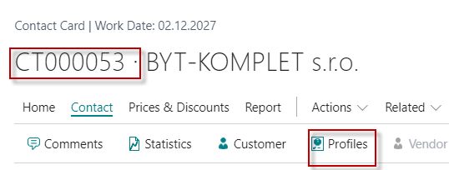
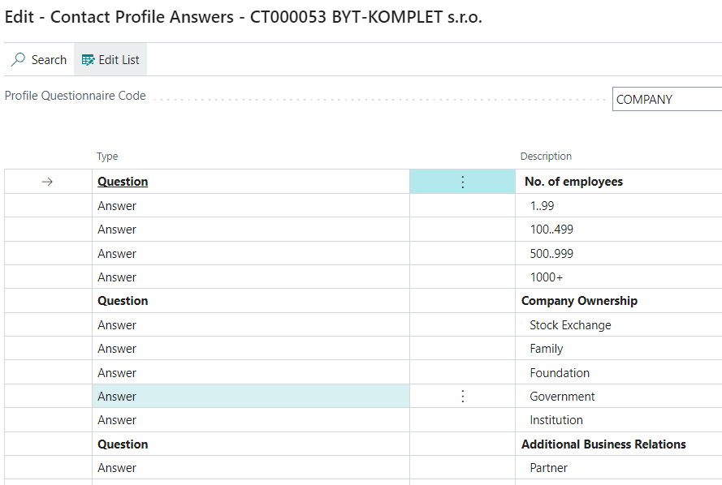
Contact Profile

Slide 15
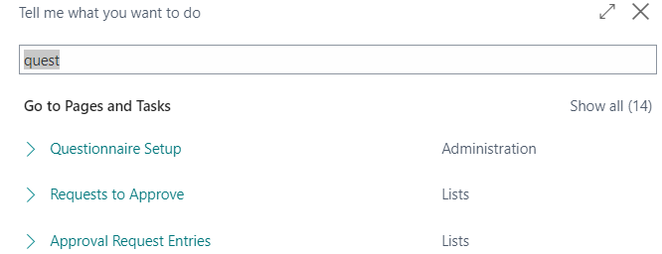
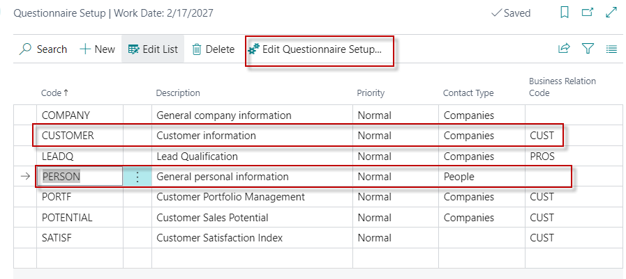
Questionnaire Setup (to create profiles) I

Slide 16
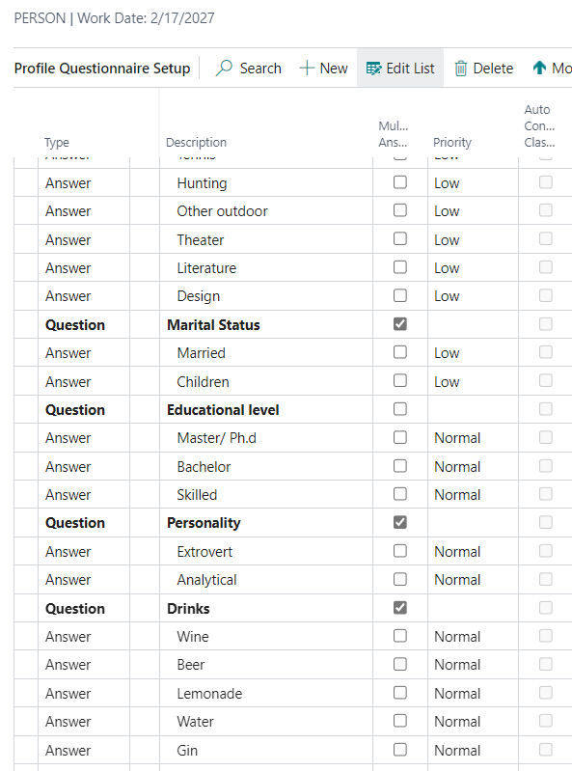
Questionnaire Setup II
You enter this in by yourself
(If asked)

Slide 17
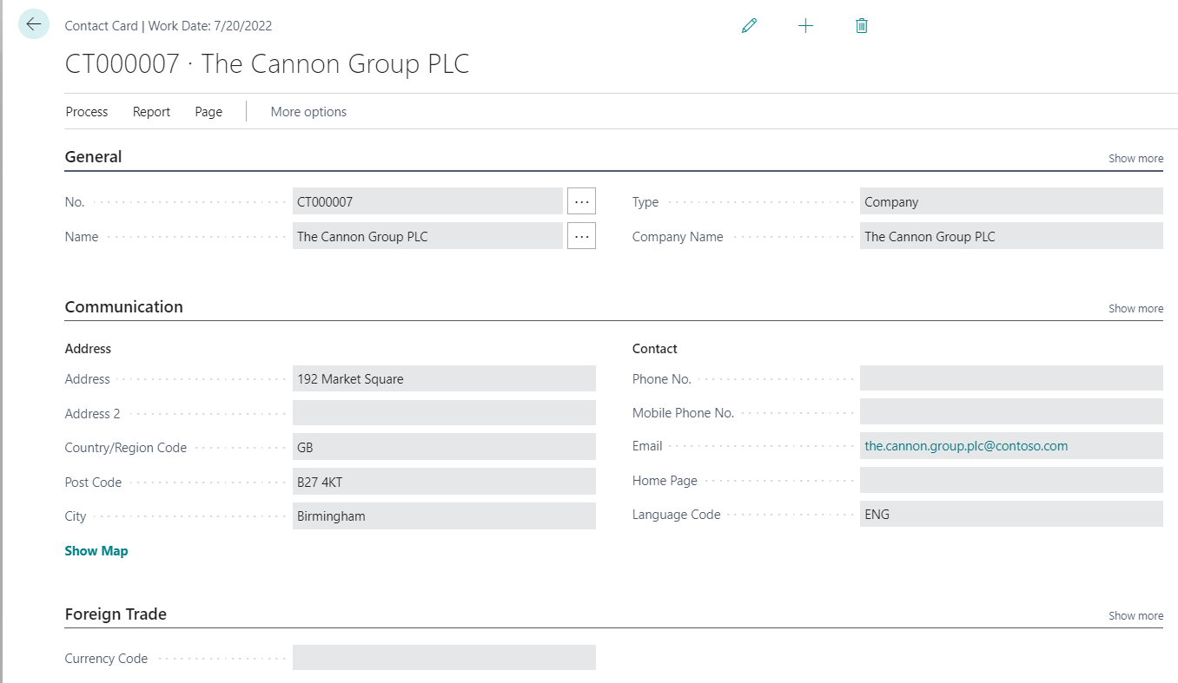
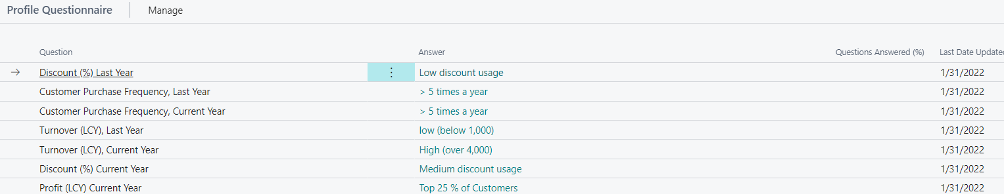
Contact Card (CC) – type=Company
Profile
How to edit and edit profile from one CC ->Related->Contact->Profiles

Slide 18
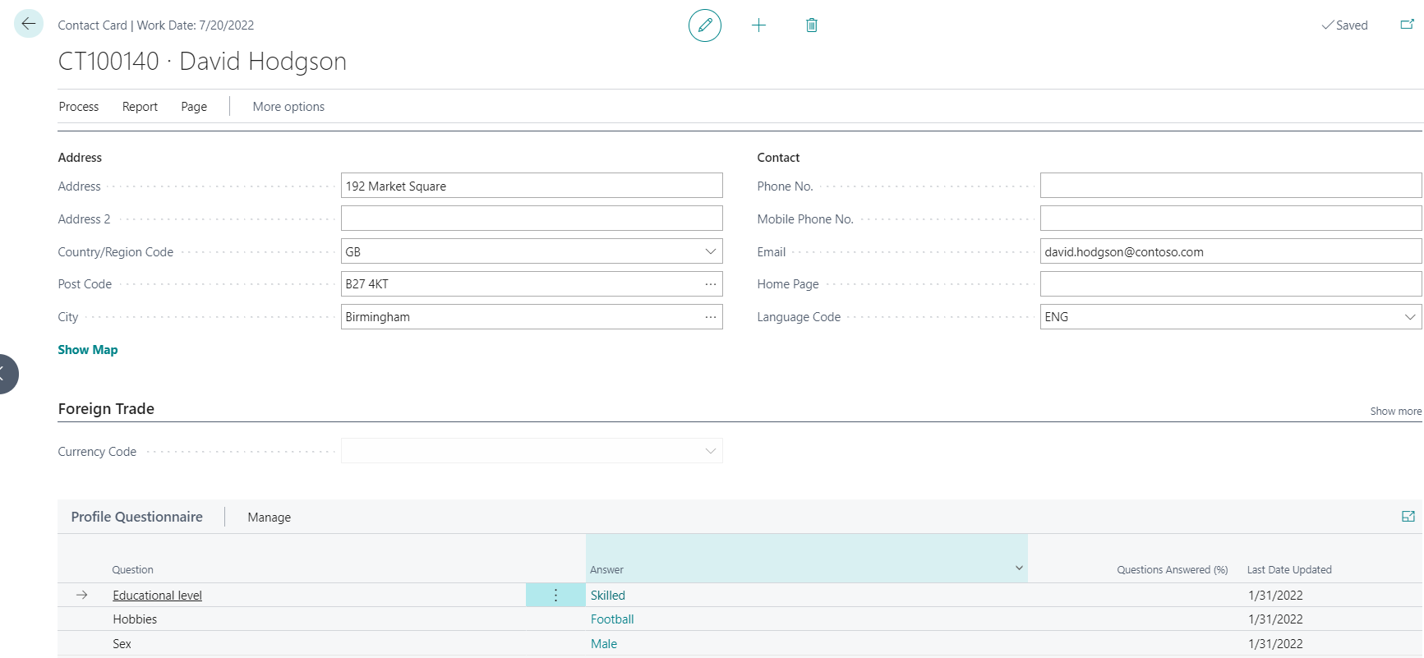
Contact Card- Person
Profile

Slide 19
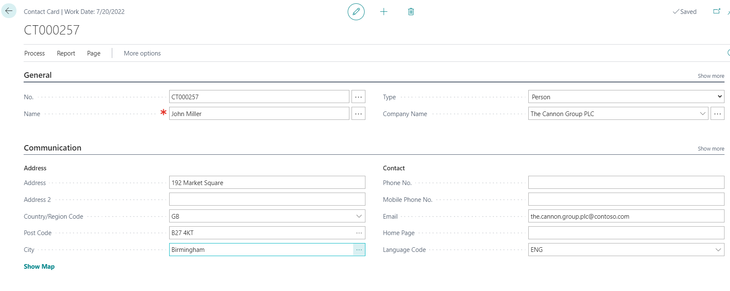
Contact Card- Company-new person
(created from Company card)
See profile settings

Slide 20
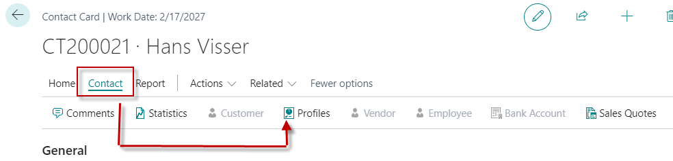
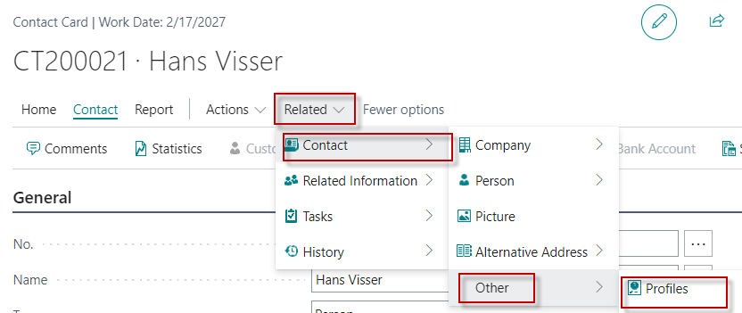
Two ways how to access profile of the Contact Card

Slide 21
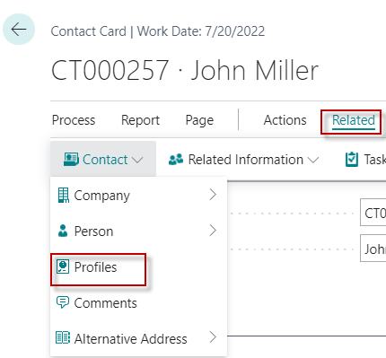
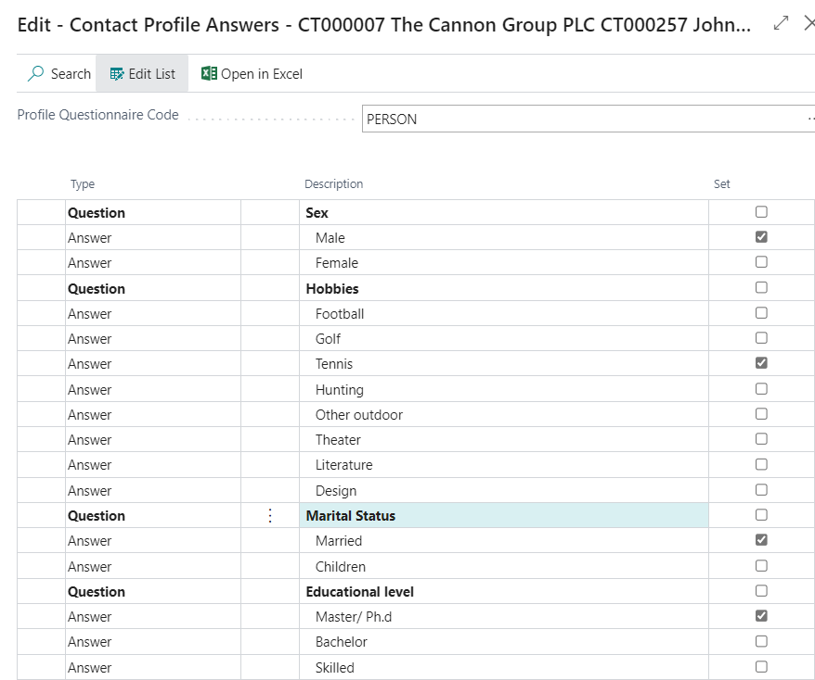
Contact Card- Company-new person – profile I

Slide 22
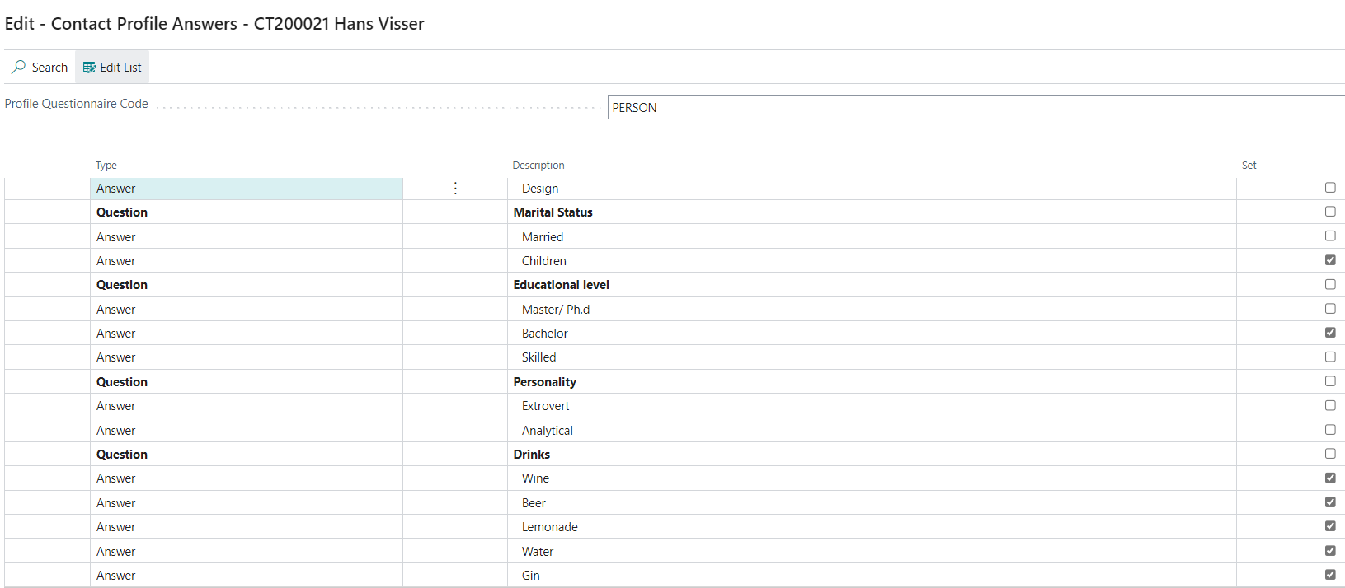
Contact Card- Company-new person – profile II

Slide 23
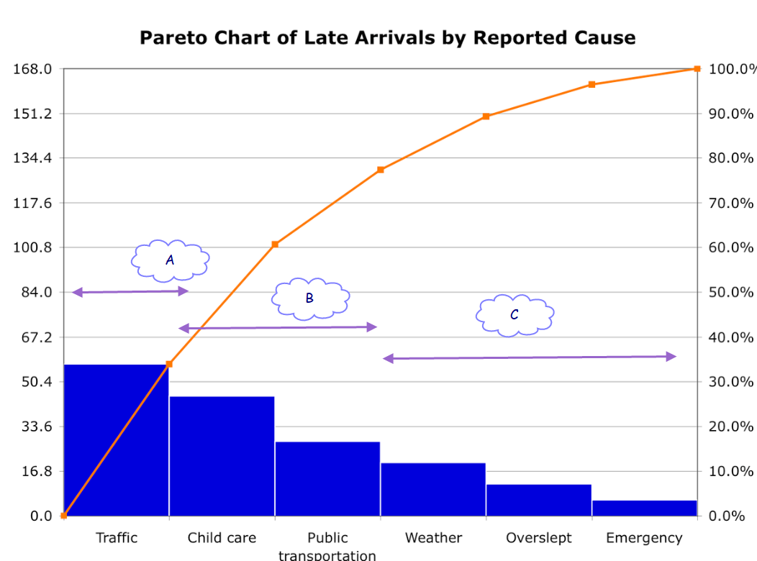
Pareto - as you know from your seminar papers

Slide 24
Pareto analysis creatrion explanantion
Customer 1
Customer Ledger Entry 1000
1800
Customer Ledger Entry 800
Sales from 1000 and above -> A
Contact 1
Profile - A
Customer 2
Customer Ledger Entry 90
160
Customer Ledger Entry 70
Sales from 100 to 999S -> B
Contact 2
Profile - B
Customer 3
Customer Ledger Entry 20
24
Customer Ledger Entry 4
Sales from 0 to 99 -> C
Contact 3
Profile - C

Slide 25
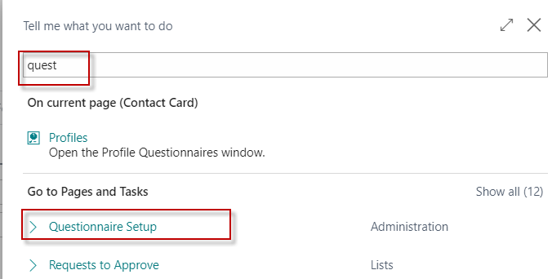
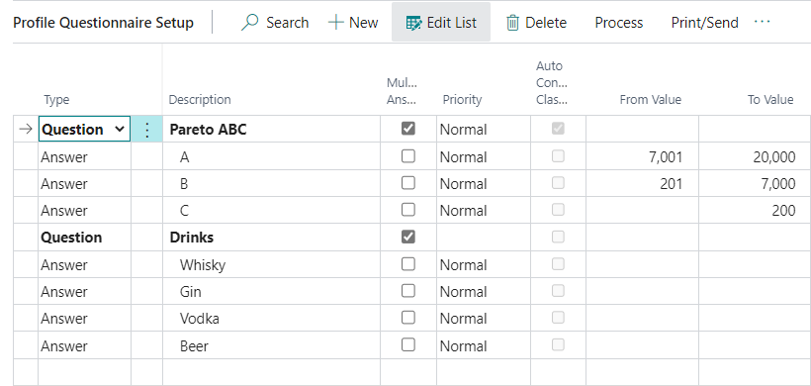
Questionaire modification-creation

Slide 26
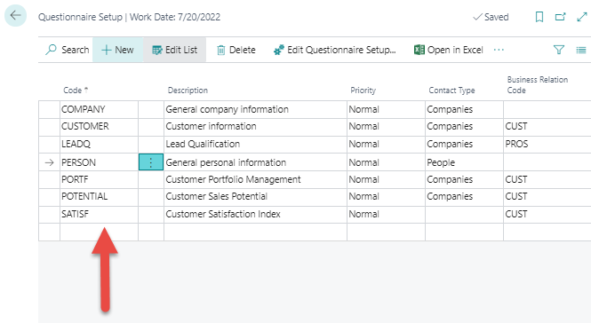
Pareto analysis-see extra example material
We create a new profile
named PARETO AOPR (this is only suggestion)

Slide 27
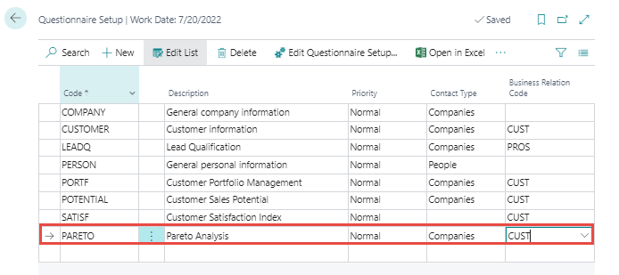

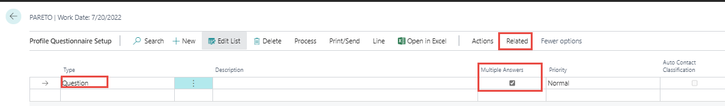
Pareto analysis –specification of questionnaire
Question
There will be either A, B or C

Slide 28
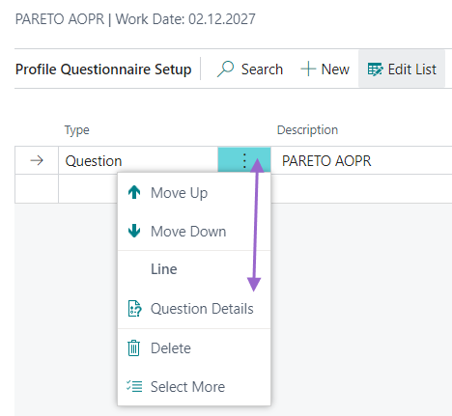
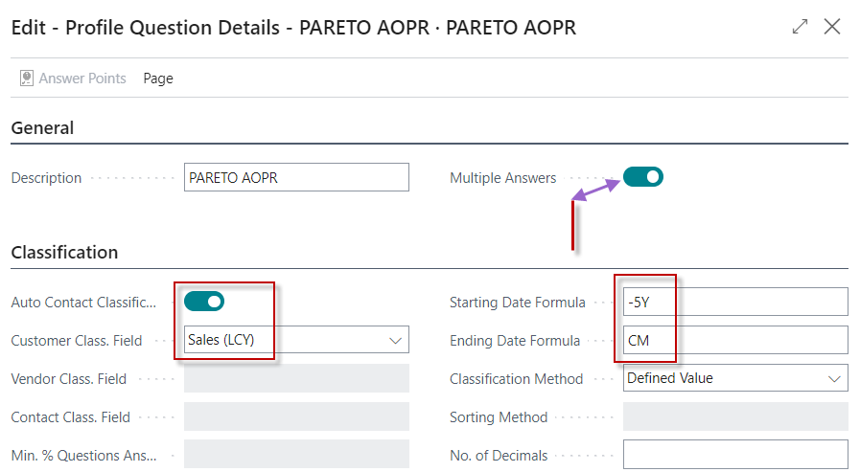
Question Details – 1st approach to access it

Slide 29
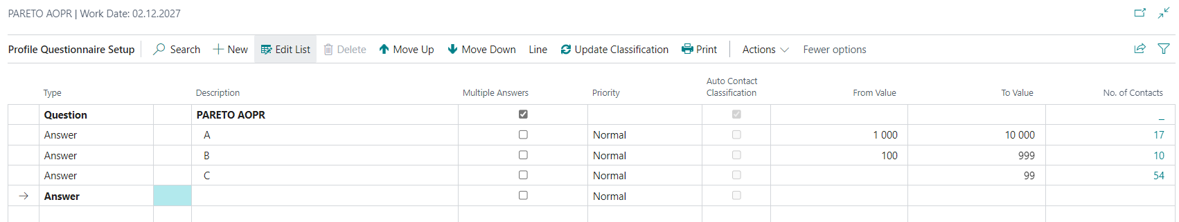
Answers setup - 1st approach and UPDATE Classification
UPDATE Classification

Slide 30
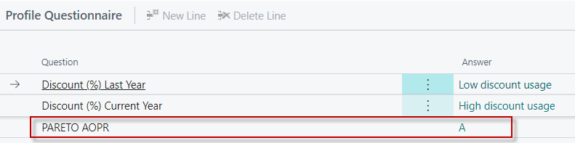
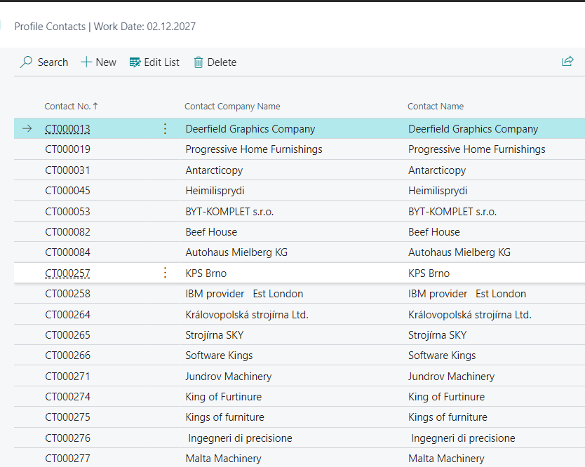
Questionaires after update link to Contact card

Slide 31
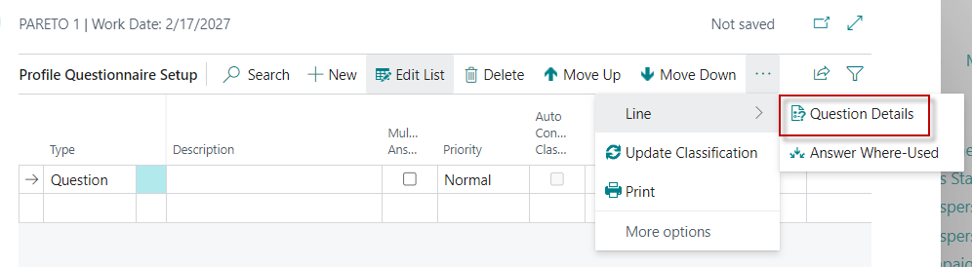
Pareto 2nd approch of Question Details specification
Next, you need to specify the Details of the question
that will then be automatically evaluated

Slide 32
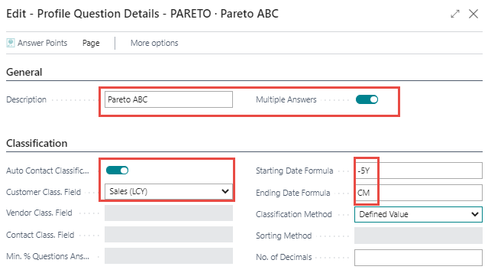
Pareto analysis –specification of questionnaire
We will analyze the sales amounts that are part of Customer Ledger Entries
five years backwards (-5Y) and end the analysis in the current month (CM)

Slide 33
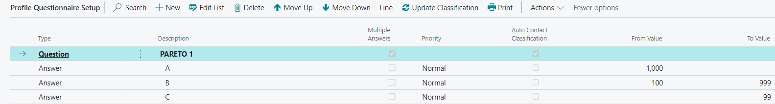
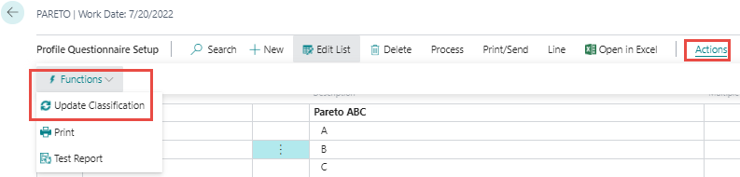
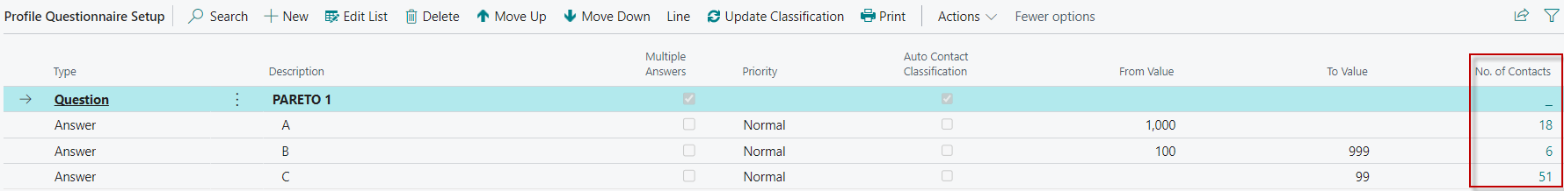
Pareto analysis –specification of questionnaire
Values of limits are entered manualy !!!!!!
Click

Slide 34
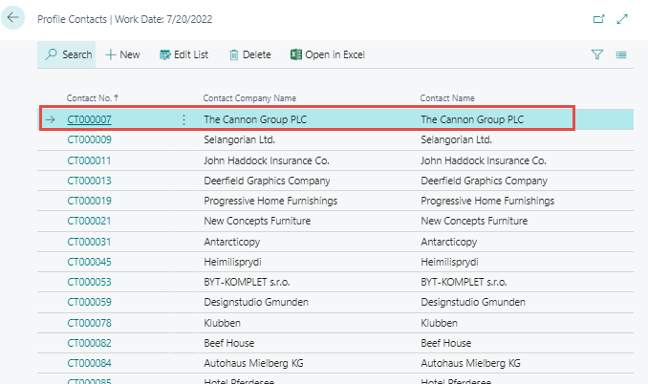
Pareto analysis – specification of questionnaire

Slide 35
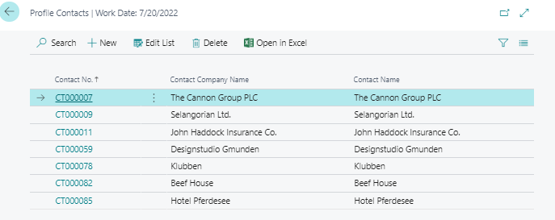
Pareto analysis –specification of questionnaire
Open contact card

Slide 36
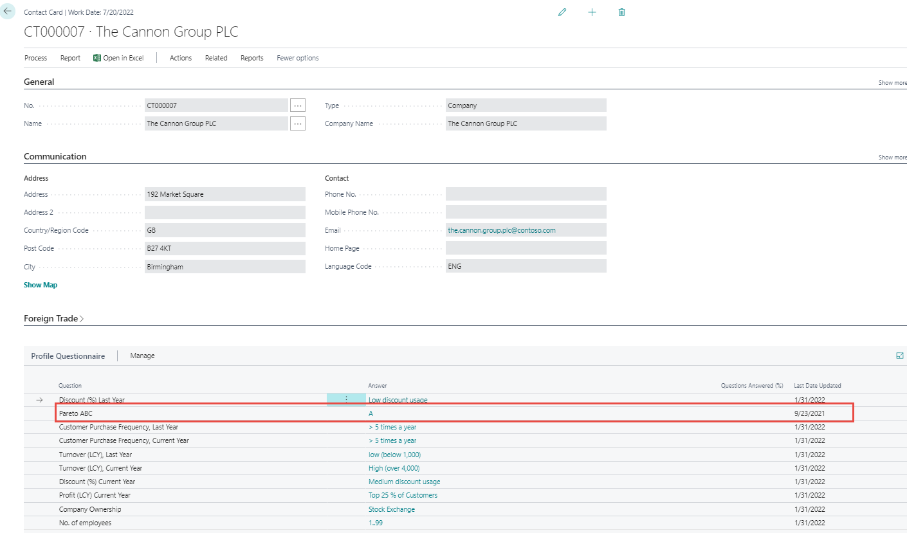
Pareto analysis – specification of questionnaire

Slide 37
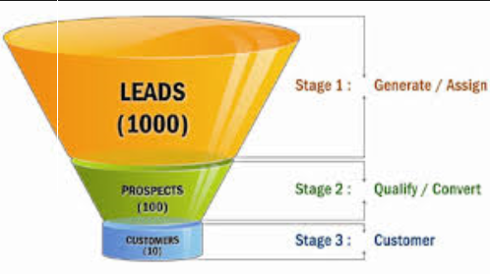
End of the section

Slide 38
Interactions

Slide 39
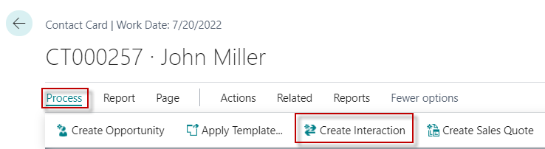
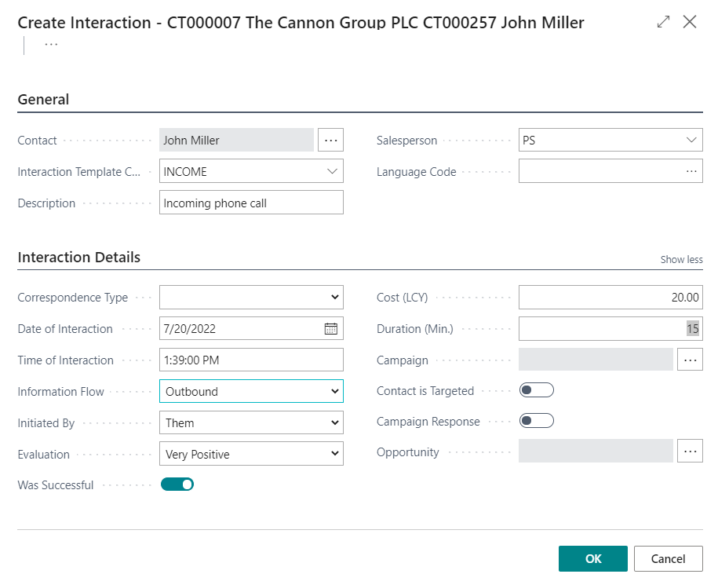
New interaction- use of wizard

Slide 40
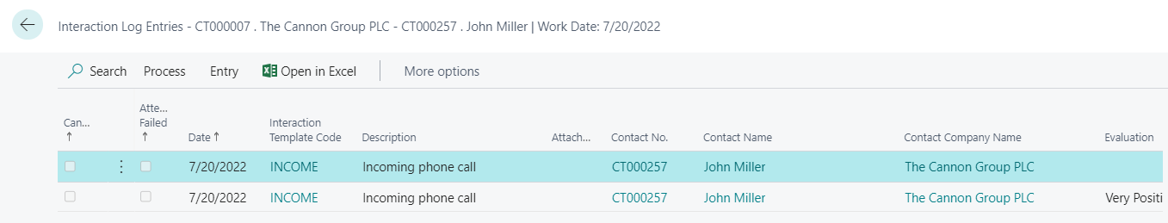
Interaction log entries

Slide 41
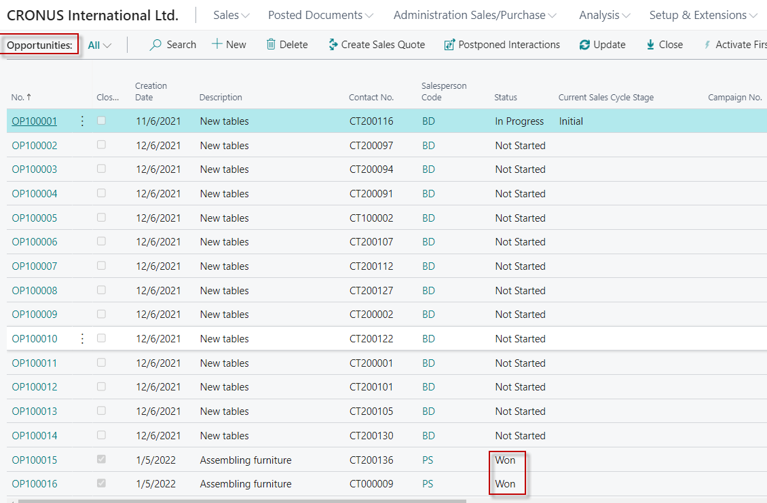
Another CRM area : Opportunity
From searching window

Slide 42
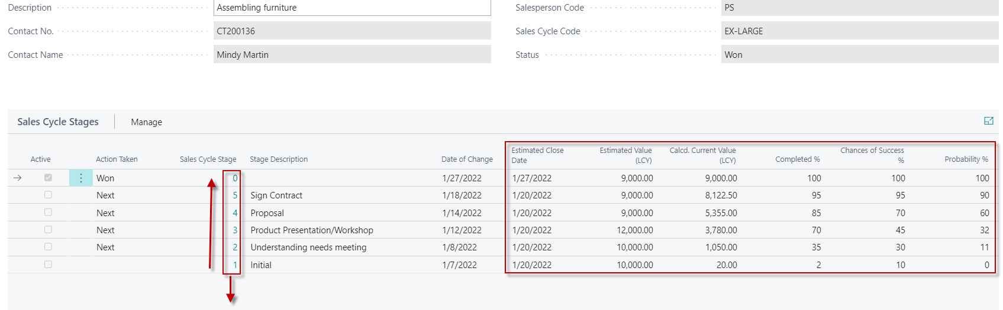
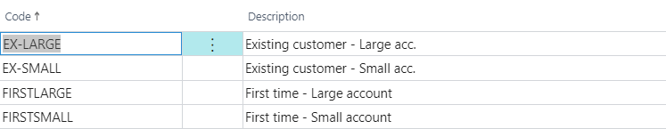
Opportunity structure
See next slide

Slide 43
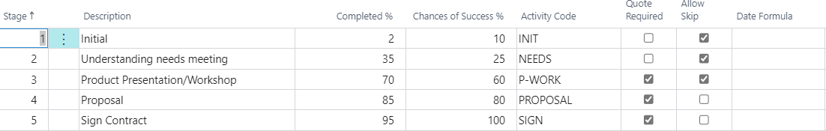
Sale Cycle Stages

Slide 44



Opportunity creation

Slide 45

Opportunity creation
Next stage is dependent on a new document creation

Slide 46


Opportunity creation- new stage

Slide 47

Opportunity creation – after Sales Quotation

Slide 48



Opportunity creation – after Sales Quotation
Next update

Slide 49


Opportunity creation – closing

Slide 50

Opportunity successfuly processed

Slide 51
New opportunites

Slide 52


Sales Cycles

Slide 53

New Opportunity

Slide 54

New opportunity –Sales Cycle 1st stage

Slide 55

Sales Cycles -1st Sales Cycle Stages an Update

Slide 56


Sales Cycles -2st Sales Cycle Stages an Update
Quotation Creation
Sales Quotation line
Activate
3rd SC stage

Slide 57

Sales Cycles -1st Sales Cycle Stages an Update

Slide 58


Sales Cycles -2st Sales Cycle Stages and next update
Calculations : Probabilities % = (80+70)/2=70, (50+40)/2=45
2nd stage : Calc current value 45000 = 100 000* 45 % = 45000
3rd stage : Calc current value = 64882/0,7=45417,
(where Estimated value is increased by 45% of the original calculated amount after rounding)
Activate
4rd stage

Slide 59

Opportuiny is closed as WON !!!

Slide 60
Personal profile
modificatoins

Slide 61


Personal profile creation (from Contact card OR Search window)

Slide 62

Personal profile creation
You have to EDIT Questionnaire ->

Slide 63

Personal profile creation

Slide 64

Personal profile creation
Click

Slide 65


Personal profile creation

Slide 66


Personal profile creation – back to setup

