Slide 1
Innovation Management
Block 1

Slide 2
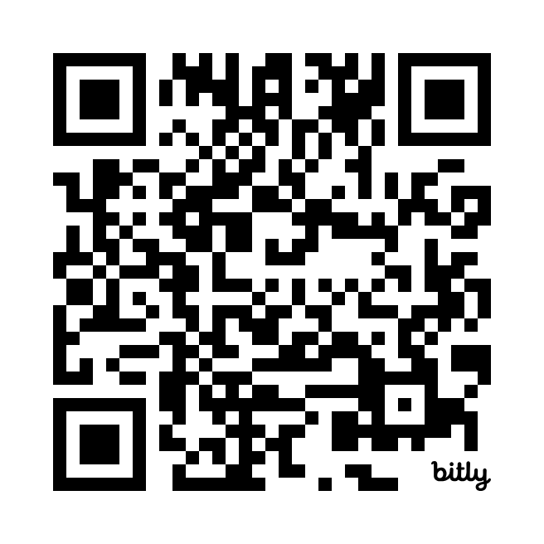
Teaching team
Michal Jirásek | Eva Švandová | Mariia Shkolnykova
Research, consulting, experience from:
www.linkedin.com/in/michal-jirasek/

Slide 3
Your assignment
Simulated project (a bit of role-play) in an international educational firm
In a team you will create an educational game product
Enhance and finalize a concept of a serious (board) game > protyping phase (incl. testing)
Create an educational package
Develop a business plan for the product

Slide 4
Your assignment
What you will learn/encounter:
Apply various innovation management tools
Manage an innovation project (balance creativity and execution + business)
Deal with problems appearing in innovation projects (deadlines, unclear instructions, etc.)
Cooperate in teams and coordinate diverse tasks (from game design, through creating a physical product, to marketing/entrepreneurship)
Design a teaching tool

Slide 5
Assignment motivation
Why this game (educational product):
Possible to get to the prototyping phase (and have a physical product)
Not starting with a blank page – problematic in previous year (a lot of time spent on the very basic game design)
Variety of areas to be covered (more likely to be relevant to your interests): game design, graphics/3D printing, teaching/training, project management, marketing, business/entrepreneurship
Flexibility in testing (relatively quick, diverse groups)
Could be used in a real classroom setting
Game: fun

Slide 6
Notes for the game and your work
Basic rules:
Your job is to learn, our job is to help you with that
Be pro-active and invest your time
All the restrictions/instructions serve to facilitate the process (but they could be modified where meaningful)
Find your place within the team (variety of the tasks), but also reflect on the whole experience
Have fun (while working hard)

Slide 7
Expectations

Slide 8
Please download and install the Slido app on all computers you use
What do you expect of the course? (positive)
ⓘ Start presenting to display the poll results on this slide.

Slide 9
Please download and install the Slido app on all computers you use
What do you expect of the course? (negative)
ⓘ Start presenting to display the poll results on this slide.

Slide 10
Teams and teambuilding

Slide 11
Teams and teambuilding
Create your Teams
Let‘s play a Marshmallow Challenge

Slide 12
About serious games

Slide 13
Serious games
Have a primary purpose beyond pure entertainment
Integrate game mechanics with educational content to engage users in meaningful learning experiences
Games enhance interest
Promote active learning (decision-making, solving problems)
Safe environment (compared to the real world)

Slide 14
Serious games

Slide 15
Examples of serious games

Slide 16
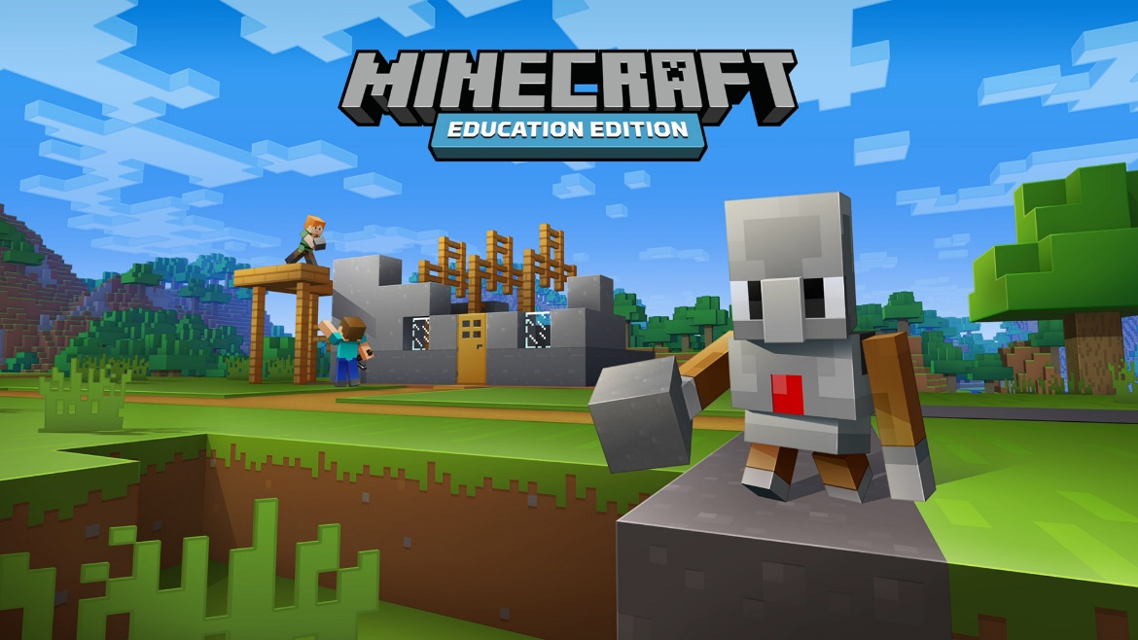
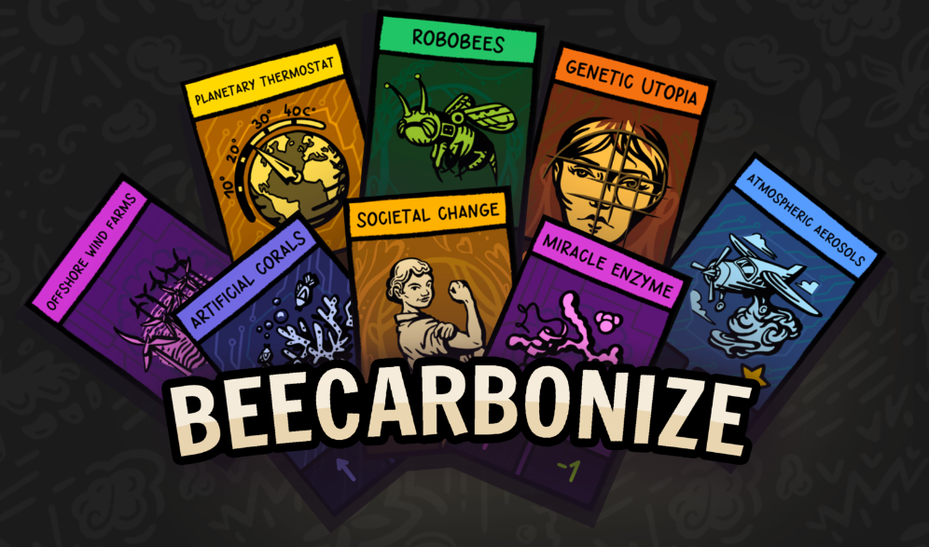
Examples of serious games
Charles Games

Slide 17
Examples of serious games
BGG: You are bird enthusiasts—researchers, bird watchers, ornithologists, and collectors—seeking to discover and attract the best birds to your network of wildlife preserves. Each bird extends a chain of powerful combinations in one of your habitats (actions). These habitats focus on several key aspects of growth:
Gain food tokens via custom dice in a birdfeeder dice tower
Lay eggs using egg miniatures in a variety of colors
Draw from hundreds of unique bird cards and play them

Slide 18
Beer Distribution Game
An example of a serious game

Slide 19
Beer Distribution Game
Simulates a beer supply chain
Four players per game – each representing a part of the supply chain
40 rounds (days)
Each round you choose how many units to order
The goal is to minimalize costs (unit in backlog 1 EUR/round, unit in inventory 0.5 EUR/round)
Zdroj: Pxfuel.com (CC)

Slide 21
Beer Distribution Game
Link: https://muni.cz/go/beer24 (choose your assigned gameplay)
Be patient with things happening (especially the more distant you are from the customer)
Do not coordinate the game with peers (emotional expressions allowed!)
Write only into green columns, look only at your sheet, do not change orders after confirming them

Slide 22
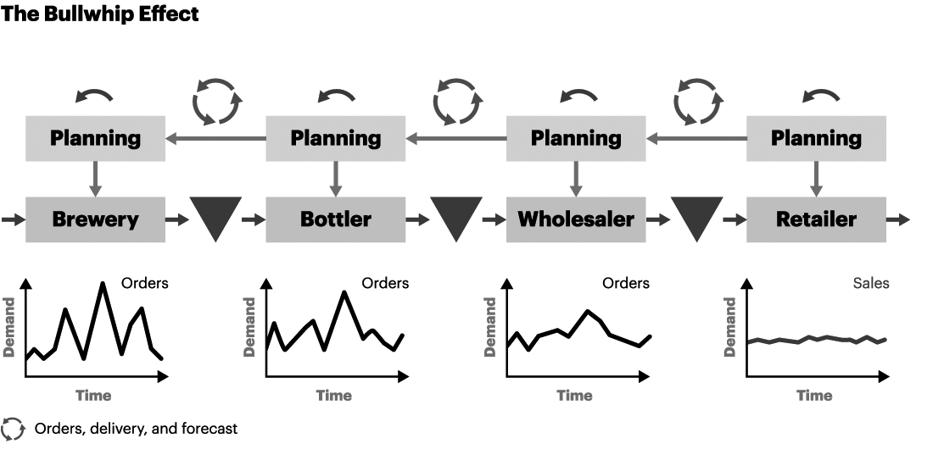
Beer Distribution Game
More in the course Logistics and Supply Chain Management
Example of emergent behavior – Bull-whip effect
Role of time delay

Slide 23
Educational package: Teaching note
You saw students‘ side of the game
Why it makes sense to provide additional materials to teachers?
Time: Takes a lot of your time to write, but saves a lot of time of others
Expertise: Not everyone is an expert on the topic
Experiences: Communicate what worked and what did not
Insight: Not all things (set-up, etc.) may be clear from the students‘ materials
Sales: Easier to sell! (because of the above)
…

Slide 24
Creating an educational package
Introduction – brief overview of the game, its purpose and target audience (players), learning objectives
Relevant concepts – outline concepts (theories and frameworks) integrated into the game
Connect the game, theoretical concepts and learning objectives – explain how these are linked
Provide guidance for student assessment (during and after the gameplay)
Include topics (questions and key points to address) for a debriefing session, highlight potential challenges and how to address them
Provide any tips for implementation (how to adjust the session, complementary materials or activities)

Slide 25
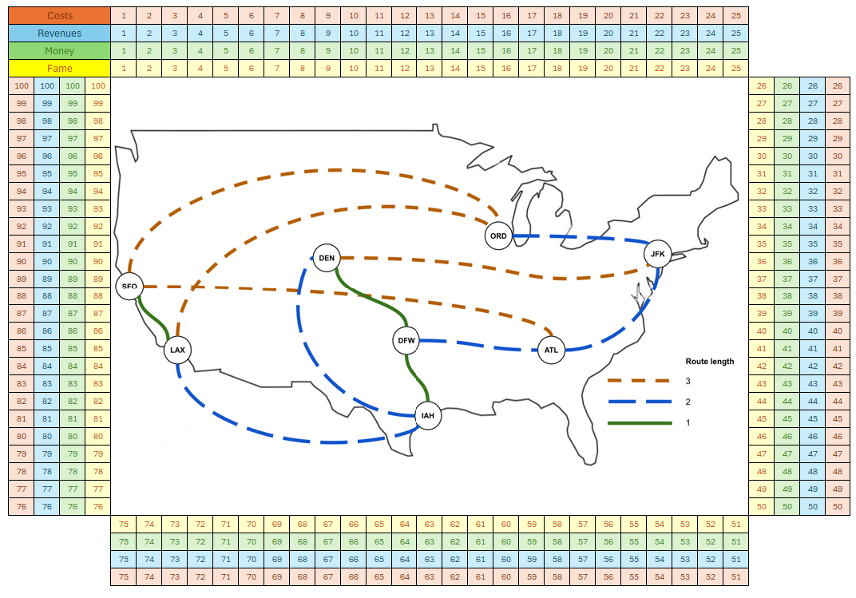
Sky Tycoons Game

Slide 26
Notes for the game and your work
The game you received is not perfect – possible inconsistencies, a lot of imbalances, only idea phase (no gameplay > physical problems)
Polish the basic rules, but also change them (you are not constrained in your changes)
Clarification of the existing rules possible (but it is your game)
All materials for the game (these are digital only) available for you
Possible to cover your expenses (print, game components) – discuss well ahead
Teaching ideas:
Business (Competitive) strategy – pricing, multi-market contact (retaliation), expansion strategies
Corporate strategy – alliances
Analytical vs intuitive approach to strategy
Financial management – performance measures, benefits and risks of debt

Slide 27
Design principles for serious games
Aligning Objectives
Clearly define the educational objectives (Bloom taxonomy) and ensure they are integrated into the game’s design.
The game’s mechanics and goals should support objectives, not distract from them.
Feedback
Provide immediate, constructive feedback to reinforce learning and correct mistakes.
Include an active debrief session.

Slide 28
Design principles for serious games
Context
A compelling narrative enhances engagement and make the educational content more relatable and memorable.
Contextualize the learning material within the game's story or setting to help students understand its relevance and application.
Balancing Challenge and Skill
Games should be challenging but not so difficult that they become frustrating.
The difficulty should scale with the player’s skill level to maintain engagement and promote learning progression.

Slide 29
Summary

Slide 30
Summary
The assignment
Taste of serious games (Marshmallow Challenge, Beer Distribution Game)
A bit of practice on presentations (and business)
Innovation process
Next steps

Slide 31
Please download and install the Slido app on all computers you use
Zpětná vazba k prvnímu bloku
ⓘ Start presenting to display the poll results on this slide.

