Slide 1

The Working Environment
Nathalie Houtzamer ; MCom; MBL

Slide 2

Who am I ?
Nathalie Houtzamer MCom; MBL
Lecturer
PHD candidate
Industry experience:
Training Management
Consultancy
Sales, Marketing and Operations

Slide 3

Working Environments Topics
Important Definitions
Why does the work environment matter
Strategies for effective working environments
Work environment models
Workplace Toxicity
Psychological Safety
Building a positive workplace culture

Slide 4

Yusuf and Metabolas (2012) define the workplace environment as comprising three sub-environments: the technical environment, which includes tools, equipment, and technological infrastructure; the human environment, encompassing peers, teams, and interactional dynamics; and the organizational environment, involving systems, procedures, values, and management-controlled practices.
THE WORK ENVIRONMENT
The “ Traditional” The office fun;
In groups discuss technical, human, and organizational elements ?
Notes:
THE OFFICE …Typical work environment as we know it right ? ?? Jokes aside !!
What are the Technical ? Human ?? Organisational ??

Slide 5
Important Definitions
Work Environment:
The work environment encompasses employees' physical, social, and psychological conditions. It includes workplace culture, physical space, interpersonal relationships, and organizational policies (Robbins & Judge, 2019).
Positive Work Environment: A positive work environment promotes employee well-being, productivity, and morale. Key aspects include supportive leadership, fair treatment, growth opportunities, and a culture of respect (Greenberg, 2018).
Safe Work Environment: A safe work environment ensures employees’ physical and psychological safety, aiming to minimize the risk of harm and promote psychological safety. This includes measures like compliance with health and safety regulations, clear policies against harassment, and fostering an inclusive culture (Griffin & Moorhead, 2017).

Slide 6



Please download and install the Slido app on all computers you use
Why do you think the work environment matters
ⓘ Start presenting to display the poll results on this slide.

Slide 7
Why does the work environment matter?
Employee Well-being and Productivity:
A positive work environment enhances employee well-being, leading to increased productivity and reduced absenteeism (Kelloway & Day, 2005).
Retention and Talent Attraction:
Supportive work environments are crucial for retaining employees and attracting top talent, as they foster job satisfaction and organizational commitment (Eisenberger et al., 2002).
Organizational Performance:
Healthy work environments contribute to better organizational performance by promoting collaboration, innovation, and efficiency (Danna & Griffin, 1999).
Mental Health and Reduced Stress:
Work environments that prioritize mental health support can significantly reduce employee stress levels, leading to better overall health and job satisfaction (Smith et al., 2021).
Adaptability and Resilience:
Organizations with flexible and supportive work environments are better equipped to adapt to changes and challenges, enhancing resilience and long-term success (Johnson & Brown, 2020).
Innovation and Creativity:
Environments that encourage open communication and psychological safety foster innovation and creativity among employees, driving competitive advantage (Williams & Davis, 2022).

Slide 8
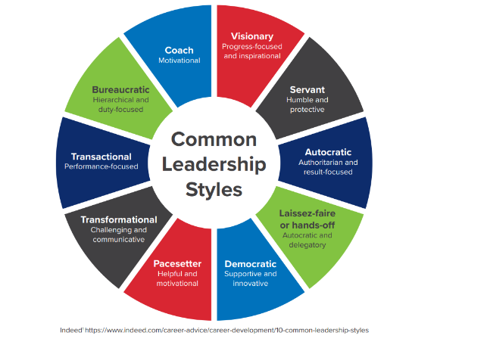
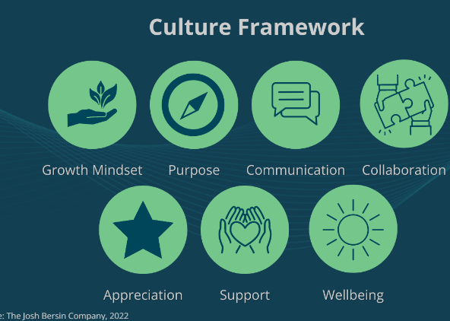
Strategies for Effective Working Environments
Leadership and Management Approaches:
  Adopting adaptive leadership styles to cater to diverse work settings.
  Building a culture of trust, transparency, and accountability.
Develop and foster a healthy workplace culture

Slide 9
Strategies for effective working environment
Mental Health Support Programs: Workplace initiatives aimed at providing resources and assistance for employees to maintain and improve mental well-being, such as counseling services, stress management workshops, and mental health days (American Psychological Association, 2020).
Boosts Productivity: Employees receiving mental health support exhibit higher productivity levels.
Reduces Absenteeism: Access to mental health resources leads to fewer sick days and lower absenteeism rates.
Enhances Employee Engagement: Supportive mental health programs foster a more engaged and committed workforce.
Work-Life Balance Policies: Policies designed to help employees achieve a healthy balance between work and personal life, typically including flexible hours, remote work options, and paid leave to reduce burnout and increase satisfaction (World Health Organization, 2020).
Improves Job Satisfaction: Flexible work arrangements contribute to higher job satisfaction among employees
Retains Talent: Companies offering work-life balance are more attractive to top talent and experience lower turnover rates.
Enhances Organizational Performance: Balanced work-life policies lead to better overall organizational performance.

Slide 10
Strategies for Effective Working Environments
Technology and Tools:
AI and Productivity: Organizations that adopt AI have shown a substantial productivity increase, with highly engaged companies reporting productivity rates as high as 72% (Tech.co, 2024).
Collaboration Tools: Firms using multiple collaboration tools (up to seven) report an 80% likelihood of high productivity, compared to 46% in those with limited tool usage (Tech. co, 2024).
Job Satisfaction with AI: 59% of employees report greater job satisfaction when using AI in the workplace (Tech.co, 2024).
Impact of Poor Collaboration: A significant 41% of workers have considered leaving due to poor collaboration tools and experiences (Zoom, 2024).
Collaboration Time: Office workers spend about 42% of their work hours on collaboration, underscoring the importance of effective tools (Zoom, 2024).
Unproductive Work Hours: Studies show that less than 60% of work hours are used productively, suggesting a need for enhanced technology and tools to improve efficiency (G2, 2024).

Slide 11
Working Environment Models
Traditional Office Model:
  Private, dedicated space leased long-term, often tailored to company needs.
  Focus on individual workspaces and designated meeting rooms.
  The business handles utilities, maintenance, and setup.
Remote Work Model:
    Refers to a work arrangement where employees perform their job duties outside the traditional office environment, typically from home or other locations, utilizing digital technologies to communicate and collaborate.
Advantages | Disadvantages
Boosts Productivity: Fewer office distractions. | Isolation: Less in-person interaction.
Cost Savings: Cuts commuting and work expenses. | Communication Gaps: Risk of misunderstandings.
Better Work-Life Balance: Flexible scheduling. | Blurs Boundaries: Harder to separate work from life.
Broader Talent Pool: Hire from anywhere. | Security Risks: Higher risk of data breaches.

Slide 12
Hybrid Work Model:
Hybrid Working
A blend of in-office and remote work, allows employees to split their time between both settings.
Variations:
  Office-first: Predominantly in-office with occasional remote work.
  Remote-first: Primarily remote with periodic office visits.
  Flexible: Employees choose their work location based on tasks and personal preferences.
Impact:
  Enhances work-life balance and job satisfaction.
  Requires robust communication tools and clear policies to function effectively.
Advantages | Disadvantages
Flexibility: Balances in-office and remote work. | Coordination Challenges: Hard to align schedules.
Employee Satisfaction: Supports diverse work preferences. | Resource Management: Office space may be underutilized.
Cost Savings: Reduces commuting and office expenses. | Unequal Access: Remote workers may feel left out.
Increased Productivity: Allows focused work and collaboration. | Security Concerns: Higher data security risks.

Slide 13

WORKING FROM HOME COVID FUN

Slide 14
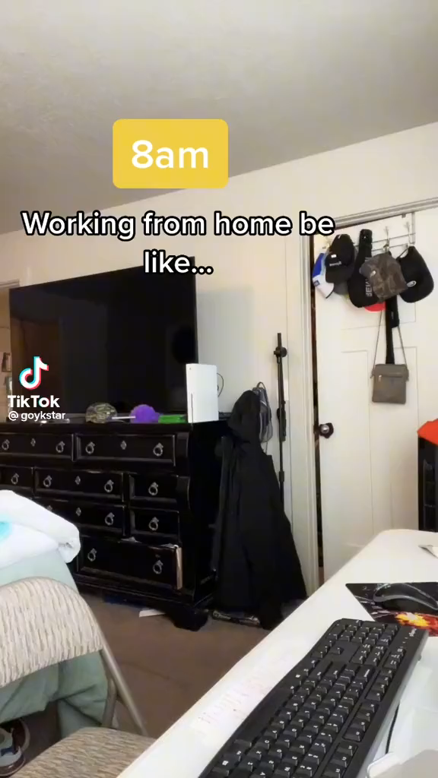
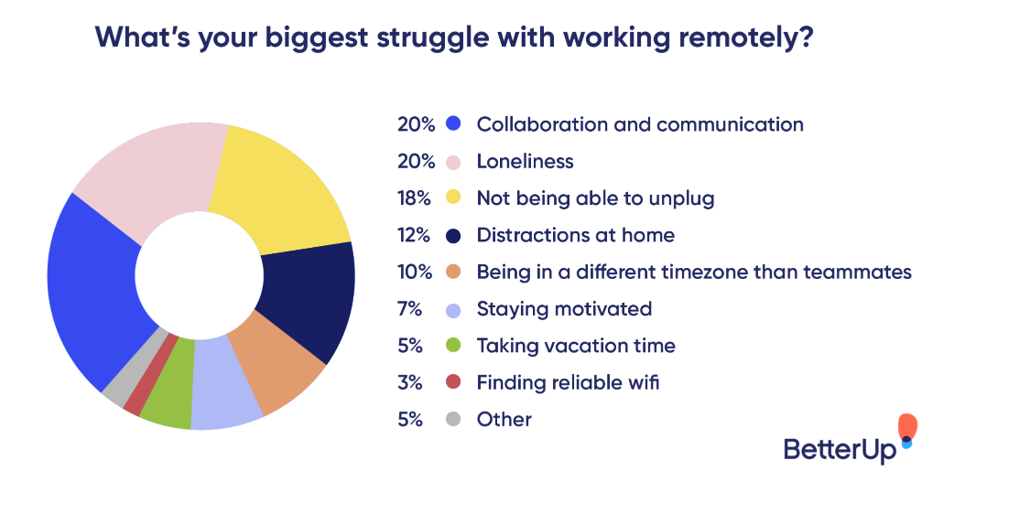
STRUGGLES OF REMOTE WORK

Slide 15
Best Practices in Implementing Working Environment Models
Developing Clear Policies:
  Establishing comprehensive guidelines for hybrid work arrangements.
  Communicating expectations regarding availability, performance, and communication.
Training and Development:
  Preparing managers to lead remote and hybrid teams effectively.
  Providing continuous learning opportunities to adapt to new technologies and workflows.
Monitoring and Evaluation:
  Utilizing productivity metrics to assess performance across different work settings.
  Collecting employee feedback regularly to identify areas for improvement.
Case Study:
https://www.youtube.com/watch?v=cl2k7-cdGRU

Slide 16
Workplace Toxicity Defined: A Dive Into The Data
Workplace toxicity refers to harmful conditions that directly impact employee mental health.
Recent findings from APA’s 2023 Work in America Survey shed light on the prevalence and consequences of workplace toxicity:
More than one in five (22%) workers experience harm to their mental health while on the job.
More than one in five (22%) of employees experienced harassment in the last year, up from 14% in 2022.
Women and LGBTQ+ individuals are particularly vulnerable, with 38% of women reporting sexual harassment and 38% of LGBTQ+ members facing physical, verbal, or sexual harassment. Fun example: toxic work environment Audio credits to @Sarai Marie Manager's tactic to instill fear and ma... | TikTok
Workplace toxicity takes on different shades across industries and job functions:
Customer service positions (31% of respondents) report higher verbal abuse rates compared to manual laborers (23%) and office workers (22%).
Manual laborers (12%) experience higher levels of organizational physical violence than office workers (5%) and customer service personnel (6%).
The survey also underscores the gravity of workplace discrimination and derogatory behaviors:
More than one in five (22%) employees witness discrimination in their workplace, and 15% have experienced it.
Over a quarter (28%) of workers have witnessed negative slights, insults, or jokes toward someone’s identity or background. Nearly (19%) have been the target behaviors.
Employees in toxic environments are three times more likely to experience harm to their mental health than those in healthy workplaces.
With 19% of workers reporting their workplace as toxic, the situation is far from reassuring.

Slide 17
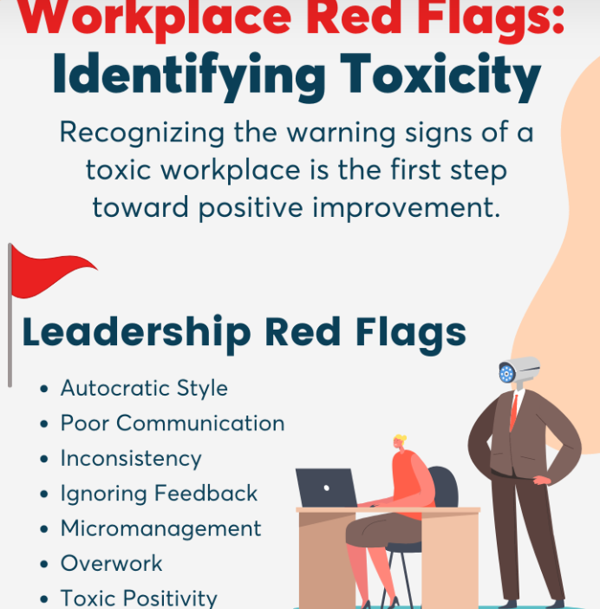
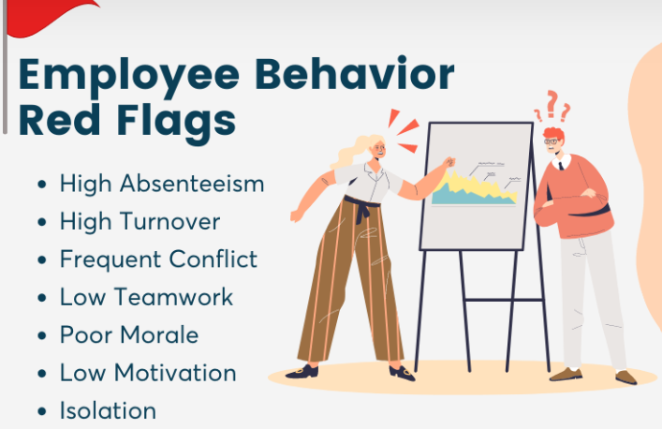
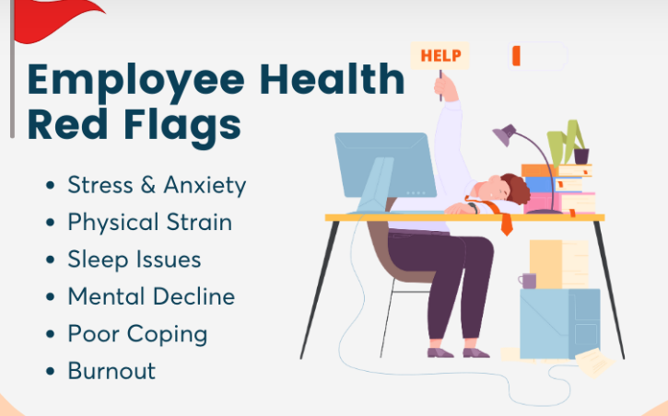
Toxic Working Environments
https://www.wellable.com

Slide 18
Psychological Safety
Definition:
  Psychological safety is “the belief that one can speak up without fear of negative consequences” (Edmondson, 2018).
Core Elements:
  Open communication, risk-taking, diverse perspectives
  Strong teamwork: Safe spaces allow teams to trust each other, support vulnerability, and collaborate freely (Deloitte Insights, 2020).
Benefits:
  Enhanced collaboration, creativity, and problem-solving (Deloitte Insights, 2020)
  Increased employee engagement and satisfaction
Fun example: toxic work environment Audio credits to @Sarai Marie Manager's tactic to instill fear and ma... | TikTok

Slide 19

MINDSET SHIFT: BALANCE IS THE WRONG ANALOGY
Simon Sinek
Notes:
This video is simply to make people understand that the world is shifting from the balance analogy

Slide 20
Building a Safe Workplace
1. Strong Leadership and Role Modeling
Leaders must align behaviors, communication, and decision-making to model a safe workplace culture.
Leadership should practice transparency, provide clear expectations, and prioritize empathy in their interactions.
Establish Clear Policies and Accountability
2. Open Communication Channels
Regular, transparent communication from leaders builds trust and a sense of security among employees.
Safe and anonymous channels for feedback allow employees to voice concerns without fear of retaliation.
3. Promote Diversity, Equity, and Inclusion (DEI)
DEI policies reduce workplace discrimination and foster a respectful and supportive environment.
Regular training and conscious recruitment practices encourage inclusivity and reduce unconscious bias.

Slide 21
HOW BURNOUT FEELS

Slide 22
Practical Initiatives to Support a Positive Workplace Culture
1. Implement Empathy and Boundaries Training for Managers
Empathy in leadership boosts morale, and training helps managers understand and address employee needs.
Encourage work-life boundaries to prevent burnout and foster mental health.
2. Safe Reporting Systems and Real-Time Feedback
Anonymous reporting systems help address toxic behaviors early and build trust.
Regular feedback mechanisms allow the organization to adapt to employee needs proactively.
3. Utilize Technology for Engagement and Transparency
Digital tools like company intranets foster open communication, celebrate achievements, and promote inclusivity.
Technology should support, not replace, empathetic leadership in creating a connected and transparent workplace.
These strategies empower organizations to proactively create a safe, productive, and supportive environment.

Slide 23
Thank you for your time and attention
Questions?

