Slide 1
Strategic Management
Lecture 2: External Analyses, Stakeholders
PESTEL, Porter‘s Five Forces, Stakeholders.
Ondrej Castek
castek@econ.muni.cz

Slide 2
Please join at slido.com

Slide 3
Lecture overview
Introduction
PESTEL
Five Forces
Stakeholders
Recap (KvIS)

Slide 4
Introduction

Slide 5
Learning outcomes
LO 3-1 Generate a PESTEL analysis to evaluate the impact of external factors on the firm.
LO 3-2 Differentiate the roles of firm effects and industry effects in determining firm performance.
LO 3-3 Apply Porter’s five competitive forces to explain the profit potential of different industries.
LO 3-4 Examine how competitive industry structure shapes rivalry among competitors.
LO 3-5 Describe the strategic role of complements in creating positive-sum co-opetition.
LO 3-6 Explain the five choices required for market entry.
LO 3-7 Appraise the role of industry dynamics and industry convergence in shaping the firm’s external environment.
LO 3-8 Generate a strategic group model to reveal performance differences between clusters of firms in the same industry.

Slide 6
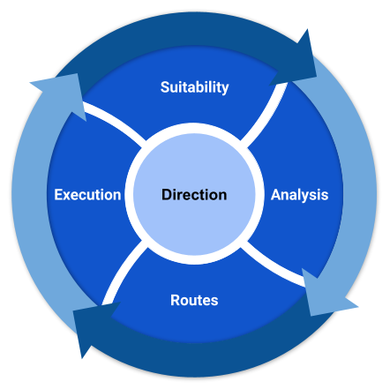
Introduction: Why external analysis
Notes:
Do not forget: Analysis = general/macro environment (PESTEL), task/micro/industry environment (Five forces), internal environment (not this lecture)
External analysis is crucial in strategic management for several reasons:
Identifying Opportunities and Threats: It helps organizations identify external opportunities they can capitalize on and threats they need to mitigate. This includes understanding market trends, economic conditions, and competitive dynamics.
Understanding the Competitive Landscape: By analyzing competitors, companies can understand their strengths and weaknesses, which helps in developing strategies to gain a competitive edge.
Adapting to Changes: The business environment is constantly changing due to technological advancements, regulatory changes, and shifts in consumer preferences. External analysis helps companies stay agile and adapt to these changes effectively.
Informed Decision-Making: It provides valuable insights that inform strategic decisions, ensuring they are based on a comprehensive understanding of the external environment.
Risk Management: By anticipating potential external risks, companies can develop strategies to manage or avoid them, thereby safeguarding their interests.
Benchmarking: It allows companies to benchmark their performance against industry standards and best practices, helping them identify areas for improvement.

Slide 7
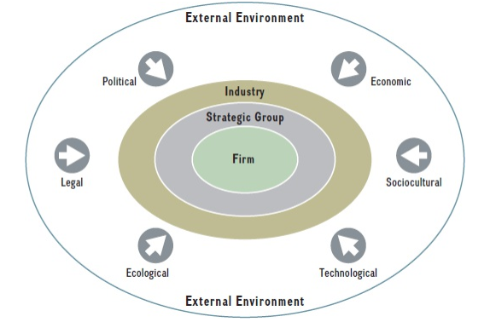
External environment
The external environment consists of all factors outside the firm that can affect its potential to gain and sustain a competitive advantage.
Notes:
Macro environment – firm‘s actions do not influence macro environment much.
Micro environment – firm‘s actions do influence micro environment a lot.
Internal environment – next week topic.

Slide 8
PESTEL External analysis of the macro environment

Slide 9
PESTEL
■ Political
■ Economic
■ Sociocultural
■ Technological
■ Ecological
■ Legal
...factors that might influence the firm.
A company needs to scan, monitor, and evaluate the important external factors and trends.
Notes:
To mitigate threats and leverage opportunities.

Slide 10
Political factors
Government Stability and Change of Leadership: A stable government can create a favorable business environment, while frequent changes in leadership can lead to uncertainty and affect business operations.
Government Policies: Policies related to taxation, trade, and industry regulations can significantly impact business strategies. For instance, favorable tax policies can encourage investment, while stringent regulations might increase operational costs.
Trade Tariffs and Trade Agreements: Tariffs can affect the cost of importing and exporting goods. Trade agreements like NAFTA or the EU can open up new markets or impose restrictions¹.
Tax Policies: Changes in corporate tax rates can influence business profitability and decisions on where to locate operations.
Regulations: Compliance with local, national, and international regulations can affect how businesses operate. This includes environmental regulations, labor laws, and health and safety standards¹.
Social Policies: Policies related to social welfare, healthcare, and education can impact the workforce and consumer base.
International Relations: Geopolitical tensions or strong diplomatic relations between countries can affect market access, supply chains, and overall business stability.

Slide 11
Political factors (examples)
The rise of short-term rental platforms like Airbnb and Booking.com has significantly impacted the housing market in the Canary Islands. These platforms have led to a substantial increase in property prices and rental rates, making it difficult for local residents to find affordable housing. For instance, in popular tourist areas like Tenerife and Gran Canaria, rental prices have surged by over 30% in the past five years. This increase is largely driven by property owners opting to rent out their homes to tourists at higher rates rather than to long-term residents, reducing the availability of long-term rental properties.
Moreover, the number of properties listed on short-term rental platforms has skyrocketed. In 2023, there were over 20,000 active Airbnb listings in the Canary Islands. This shift has not only inflated housing costs but also contributed to the displacement of local communities. Many residents have been forced to move to less desirable areas or even leave the islands altogether due to the lack of affordable housing options. The local government has been grappling with this issue, implementing regulations to limit the number of short-term rentals, but the impact on the housing market remains significant.

Slide 12
Political factors (examples)
BBC: Tens of thousands of people in Spain's Canary Islands have rallied against a model of mass tourism they say is overwhelming the Atlantic archipelago.

Slide 13
Economic factors
■ Economic growth rates.
■ Levels of employment.
■ Interest rates.
■ Price stability (inflation and deflation).
■ Currency exchange rates.

Slide 14
Economic factors (examples)
One example of a positive impact of an economic downturn can be seen in the discount retail industry. During economic recessions, consumers often become more price-sensitive and look for ways to save money. This shift in consumer behavior can lead to increased sales for discount retailers like Dollar General or Aldi.
For instance, during the 2008 financial crisis, Dollar General saw a significant increase in revenue, with sales rising by 10.5% in 2008 and continuing to grow in subsequent years. This growth was driven by consumers seeking more affordable options for everyday goods.

Slide 15
Economic factors (examples)
Additionally, economic downturns can force businesses to become more efficient and innovative. Companies may streamline operations, cut unnecessary costs, and focus on core competencies to survive the challenging economic environment. This can lead to long-term benefits, such as improved operational efficiency and a stronger competitive position once the economy recovers.
For example, during the 2008 recession, many companies in various industries adopted lean management practices, which helped them reduce waste and improve productivity, ultimately making them more resilient and competitive in the long run.

Slide 16
Economic factors (examples)
Netflix: During the 2008 financial crisis, Netflix saw a significant increase in subscribers as people opted for more affordable home entertainment options.
Amazon: Amazon thrived during the dot-com bubble burst and the 2008 recession by expanding its product offerings and focusing on customer satisfaction.
Dollar General: As mentioned earlier, Dollar General experienced growth during the 2008 recession as consumers turned to discount retailers for more affordable goods.
Lego: Despite the economic downturn in the early 2000s, Lego reinvented its product line and marketing strategy, leading to a resurgence in popularity and sales.
Groupon: Founded during the 2008 recession, Groupon capitalized on consumers’ desire for discounts and deals, quickly becoming a popular platform.
Mailchimp: This email marketing service grew significantly during the 2008 recession as businesses sought cost-effective ways to reach customers.
Citigroup: Despite the financial crisis, Citigroup managed to stabilize and grow by restructuring and focusing on core banking operations.
Hewlett-Packard (HP): Founded during the Great Depression, HP grew by focusing on innovation and quality, eventually becoming a leading technology company.
Microsoft: During the early 2000s recession, Microsoft continued to grow by expanding its software offerings and entering new markets.
Uber: Launched during the 2008 recession, Uber capitalized on the gig economy trend, providing flexible job opportunities and affordable transportation.

Slide 17
Sociocultural factors
Demographic Changes: Shifts in population demographics, such as aging populations or increasing birth rates, can affect market demand for certain products and services. For example, an aging population may increase demand for healthcare services and retirement homes.
Cultural Trends: Changes in cultural attitudes and lifestyles can impact consumer behavior. For instance, the growing trend towards health consciousness has led to increased demand for organic foods and fitness-related products.
Education Levels: The level of education in a population can influence the types of products and services that are in demand. Higher education levels often correlate with higher income levels and a greater demand for luxury goods and services.

Slide 18
Sociocultural factors
Social Attitudes: Social attitudes towards issues like sustainability and corporate social responsibility can affect business practices. Companies that are perceived as environmentally friendly or socially responsible may gain a competitive advantage.
Income Distribution: The distribution of wealth within a society can impact consumer spending patterns. In societies with a large middle class, there may be higher demand for mid-range products, whereas in societies with greater income inequality, there may be higher demand for both luxury and budget products.
Health Consciousness: Increasing awareness of health and wellness can drive demand for healthier food options, fitness products, and wellness services.
Work-Life Balance: Changing attitudes towards work-life balance can influence the demand for flexible working arrangements, remote work technologies, and leisure activities.

Slide 19
Sociocultural factors
Q: What is culture?

Slide 20
Please join at slido.com

Slide 21
Technological factors
Innovation and R&D: The pace of technological innovation and investment in research and development (R&D) can significantly impact industries. For example, companies in the tech sector, like Apple and Google, continuously invest in R&D to develop new products and stay ahead of competitors.
Automation and AI: The adoption of automation and artificial intelligence (AI) technologies can improve efficiency and reduce costs. For instance, manufacturing companies using robotics and AI for production processes can achieve higher productivity and lower labor costs.
Digital Transformation: The shift towards digital platforms and e-commerce has transformed how businesses operate. Retailers like Amazon have leveraged digital technologies to streamline operations, enhance customer experiences, and expand their market reach.

Slide 22
Technological factors
Cybersecurity: As businesses become more reliant on digital technologies, the importance of cybersecurity increases. Companies must invest in robust cybersecurity measures to protect sensitive data and maintain customer trust.
Big Data and Analytics: The use of big data and analytics allows businesses to gain insights into consumer behavior, optimize operations, and make data-driven decisions. For example, companies like Netflix use data analytics to personalize content recommendations and improve user engagement.
Sustainable Technologies: The development and adoption of sustainable technologies, such as renewable energy sources and eco-friendly products, can influence business strategies. Companies in the energy sector, like Tesla, are investing in sustainable technologies to meet regulatory requirements and consumer demand for green products.
Communication Technologies: Advances in communication technologies, such as 5G networks, enhance connectivity and enable new business models. Industries like telecommunications and media benefit from faster and more reliable communication infrastructure.

Slide 23
Technological factors (failure examples)
Kodak: Failed to adapt to the digital photography revolution, leading to a significant decline in its market share.
Blockbuster: Was outcompeted by Netflix and other streaming services, leading to its eventual bankruptcy.
Nokia: Dominated the mobile phone market but failed to keep up with the smartphone revolution, losing its leading position to Apple and Samsung.
BlackBerry: Once a leader in the smartphone market, it failed to innovate and keep up with touchscreen technology, leading to a sharp decline.
Yahoo: Struggled to compete with Google in the search engine market and failed to capitalize on its early lead in internet services.
Sears: Lost significant market share to online retailers like Amazon, leading to store closures and financial struggles.
Toys “R” Us: Failed to adapt to the rise of e-commerce and changing consumer preferences, resulting in bankruptcy.
MySpace: Was overtaken by Facebook due to its inability to innovate and improve user experience.
Borders: A major bookstore chain that failed to adapt to the rise of e-books and online retail, leading to its closure.
Polaroid: Known for its instant cameras, it struggled to compete with digital photography and eventually filed for bankruptcy.

Slide 24
Ecological factors
Climate Change: The impacts of climate change, such as rising temperatures, more frequent and severe weather events, and shifting precipitation patterns, can affect various industries. For example, agriculture, tourism, and insurance sectors are particularly vulnerable to these changes.
Environmental Regulations: Laws and regulations aimed at protecting the environment can influence business operations. This includes regulations on emissions, waste disposal, and the use of hazardous materials. Companies may need to invest in cleaner technologies or alter their processes to comply with these regulations.
Sustainability Initiatives: Increasing consumer demand for sustainable and eco-friendly products can drive businesses to adopt greener practices. This can include using renewable energy sources, reducing carbon footprints, and implementing sustainable supply chain practices.

Slide 25
Ecological factors
Energy Consumption: The availability and cost of energy can significantly impact businesses, especially those in energy-intensive industries. Companies may need to explore alternative energy sources or improve energy efficiency to manage costs and reduce environmental impact.
Waste Management: Effective waste management practices are crucial for businesses to minimize their environmental footprint. This includes recycling, reducing waste production, and ensuring safe disposal of hazardous materials.
Natural Disasters: The frequency and severity of natural disasters, such as hurricanes, floods, and earthquakes, can disrupt business operations and supply chains. Companies need to have contingency plans in place to mitigate these risks.
Pressure from NGOs: Non-governmental organizations (NGOs) and advocacy groups can influence business practices by raising awareness about environmental issues and advocating for more sustainable practices.

Slide 26
Ecological factors (failure examples)
BP: The Deepwater Horizon oil spill in 2010 caused significant environmental damage and led to massive financial losses and legal penalties for BP.
Pacific Gas and Electric Company (PG&E): Faced severe financial and legal repercussions due to wildfires in California, which were linked to their equipment.
ExxonMobil: Has faced numerous lawsuits and regulatory challenges due to its environmental impact and contribution to climate change.
Volkswagen: The emissions scandal, known as “Dieselgate,” resulted in significant financial penalties and damage to its reputation.
Monsanto (now part of Bayer): Faced numerous lawsuits and public backlash over the environmental and health impacts of its products, particularly glyphosate.
Shell: Has faced legal challenges and public protests over its oil drilling activities in environmentally sensitive areas.
Nestlé: Criticized for its water extraction practices, which have led to environmental degradation and water shortages in some regions.
Rio Tinto: Faced backlash and financial penalties for the destruction of a 46,000-year-old Aboriginal heritage site in Australia.
Duke Energy: Incurred significant costs and legal issues due to coal ash spills and contamination of water sources.
Chevron: Has faced long-standing legal battles and financial penalties over environmental damage in the Amazon rainforest.

Slide 27
Legal factors
Employment Laws: Regulations related to minimum wage, working hours, and employee rights can impact labor costs and operational practices. For example, changes in minimum wage laws can affect the profitability of labor-intensive industries.
Health and Safety Regulations: Laws ensuring workplace safety can require businesses to invest in safety equipment and training programs. Compliance with these regulations is crucial to avoid legal penalties and ensure employee well-being.
Consumer Protection Laws: These laws protect consumers from unfair business practices and ensure product safety. Companies must adhere to these regulations to avoid lawsuits and maintain customer trust.
Environmental Regulations: Laws aimed at protecting the environment can affect how businesses operate. This includes regulations on emissions, waste disposal, and the use of hazardous materials. Companies may need to invest in cleaner technologies or alter their processes to comply with these regulations.
Intellectual Property Laws: Protection of patents, trademarks, and copyrights is essential for businesses to safeguard their innovations and brand identity. Violations of intellectual property laws can lead to costly legal battles.

Slide 28
Legal factors
Antitrust Laws: These laws prevent monopolistic practices and promote fair competition. Companies must ensure their business practices do not violate antitrust regulations to avoid fines and legal challenges.
Licensing and Permits: Certain industries require specific licenses and permits to operate legally. Failure to obtain or renew these can result in business disruptions and legal issues.
Data Protection Laws: Regulations like the General Data Protection Regulation (GDPR) in the EU require businesses to protect personal data and ensure privacy. Non-compliance can lead to hefty fines and damage to reputation.
Trade Restrictions and Tariffs: Laws governing international trade, including tariffs and trade agreements, can impact the cost and availability of goods. Businesses involved in import/export must navigate these regulations carefully.
Fraud and Corruption Laws: Regulations aimed at preventing fraud and corruption require businesses to implement robust compliance programs. Violations can result in severe legal and financial consequences.

Slide 29
PESTEL HOW TO APPLY

Slide 30
PESTEL: Best practices for application
Use Up-to-Date Data: Ensure that the data you use is current and relevant. Outdated information can lead to inaccurate conclusions.
Prioritize Relevance: Focus on the factors most relevant to your business or industry. Not all elements of PESTEL will have the same impact on every organization.
Involve Diverse Perspectives: Engage a cross-functional team to gather insights. Different departments may have unique perspectives on how external factors affect the business.
Regular Updates: Conduct PESTEL analysis periodically. The external environment is dynamic, and regular updates can help you stay ahead of changes.
Integrate with Other Analyses: Use PESTEL in conjunction with other strategic tools like SWOT analysis. This can provide a more comprehensive view of your strategic position.

Slide 31
PESTEL: What to avoid
Overlooking Certain Factors: Avoid ignoring any of the PESTEL factors. Even if some seem less relevant, they can still have indirect impacts.
Relying Solely on Forecasts: While forecasts are useful, they should not be the only basis for your analysis. Prioritize factual data and historical trends.
Superficial Analysis: Avoid conducting a shallow analysis. Dive deep into each factor to understand its potential impact thoroughly.

Slide 32
PESTEL: Key points not to forget
Contextual Understanding: Always consider the broader context of each factor. For example, political changes in one country can have global repercussions.
Actionable Insights: Ensure that the findings from your PESTEL analysis lead to actionable strategies. The goal is to inform decision-making, not just to gather information.
Documentation and Communication: Document your findings clearly and communicate them effectively to all stakeholders. This ensures that everyone is on the same page and can act on the insights.

Slide 33
Porter‘s Five Forces External analysis of the micro environment

Slide 34
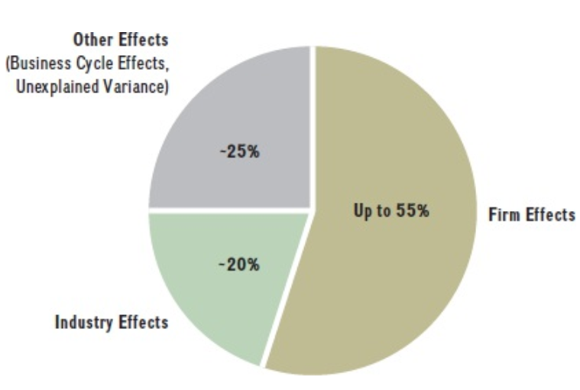
What explains firm performance
Notes:
Firm performance is determined primarily by two factors: industry and firm effects. Industry effects describe the underlying economic structure of the industry. They attribute firm performance to the industry in which the firm competes. The structure of an industry is determined by elements common to all industries, such as entry and exit barriers, number and size of companies, and types of products and services offered. Firm effects attribute firm performance directly to the actions strategic leaders take.

Slide 35
Industry
Same suppliers, same buyers.
Same cycle (same macro forces).
Same competition!
The question is, what is your strategic position?

Slide 36
Five competitive forces
„A framework that identifies five forces that determine the profit potential of an industry and shape a firm’s competitive strategy.“
broad view of competition
profit as a function of the five forces:
1. Threat of entry.
2. Power of suppliers.
3. Power of buyers.
4. Threat of substitutes.
5. Rivalry among existing competitors.

Slide 37
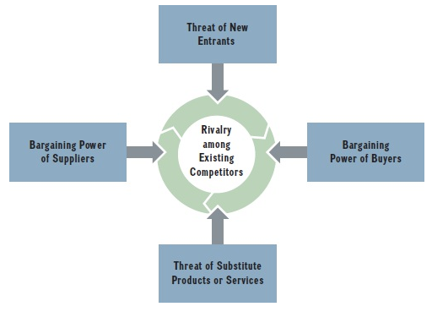
Porter‘s model of five competitive forces

Slide 38
Five forces: The threat of entry
A potential of new companies to enter the market.
Such entry would lower profitability in the industy.
Such threat forces the existing companies to spend extra money on building barriers.
Potential entry barriers:
■ Economies of scale.
■ Network effects.
■ Customer switching costs.
■ Capital requirements.
■ Advantages independent of size.
■ Government policy.
■ Credible threat of retaliation.

Slide 39
Five forces: The power of suppliers
Powerful suppliers, by raising costs and lowering quality or quantity, can significantly reduce the profitability of our business. This underscores the critical need to understand and manage the sources of supplier power, which can be:
■ The supplier’s industry is more concentrated than the industry it sells to.
■ Suppliers do not depend heavily on the industry for a large portion of their revenues.
■ Incumbent firms face significant switching costs when changing suppliers.
■ Suppliers offer products that are differentiated.
■ There are no readily available substitutes for the products or services that the suppliers offer.
■ Suppliers can credibly threaten to forward-integrate into the industry.

Slide 40
Five forces: The power of suppliers
Q: Which suppliers possess superior power today?

Slide 41
Five forces: The power of buyers
What increases buyers‘ power:
■ There are a few buyers and each buyer purchases large quantities relative to the size of a
single seller.
■ The industry’s products are standardized or undifferentiated commodities.
■ Buyers face low or no switching costs.
■ Buyers can credibly threaten to backwardly integrate into the industry.
What increases buyer‘s price sensitivity:
■ The buyer’s purchase represents a significant fraction of its cost structure or procurement
budget.
■ Buyers earn low profits or are strapped for cash.
■ The quality (cost) of the buyers’ products and services is not affected much by the quality (cost) of their inputs.

Slide 42
Five forces: The threat of substitutes
A substitute meets the same basic customer needs as the industry’s product but in a different way.
The threat of substitutes is high when
■ The substitute offers an attractive price-performance trade-off.
■ The buyers cost of switching to the substitute is low.
Q: Give me examples of substitutes.

Slide 43
Five forces: Rivalry among existing competitors
The intensity of competition: how fast and how large is the response to your own actions (price changes, quantity changes, communication campaings, new products...).
„The stronger the forces, the stronger the expected competitive intensity,
which in turn limits the industry’s profit potential“.

Slide 44
Five forces: Rivalry among existing competitors
Determined by the following factors:
■ Competitive industry structure.
■ Industry growth.
■ Strategic commitments.
■ Exit barriers

Slide 45
Five forces: Competitive industry structure
The structure of an industry is largely captured by
■ The number and size of its competitors.
■ The firm’s degree of pricing power.
■ The type of product or service (commodity or differentiated product).
■ The height of entry barriers.
The four main competitive industry structures are
1. Perfect competition
2. Monopolistic competition
3. Oligopoly
4. Monopoly

Slide 46
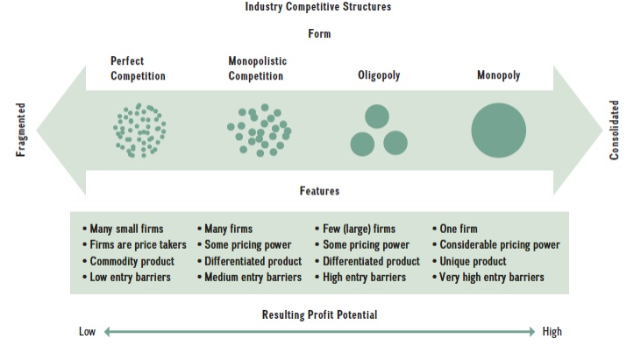
Five forces: Competitive industry structure

Slide 47
A sixth force: The complements What is co-opetition?

Slide 48
Sixth force: Complements and co-opetition
A complement is a product, service, or competency that adds value to the original product offering when the two are used in tandem.
Co-opetition is cooperation by competitors to achieve a strategic objective.

Slide 49
Sixth force: Co-opetition examples
Apple and Samsung: Despite being fierce competitors in the smartphone market, Apple and Samsung have collaborated extensively. Samsung has been a major supplier of components like screens and chips for Apple’s iPhones.
Ford and Toyota: These automotive giants worked together on hybrid technology. They collaborated to develop a hybrid system for light trucks and SUVs, combining their expertise to advance the technology more efficiently.
DHL and UPS: These logistics companies have partnered in certain regions to optimize delivery networks. By sharing resources and infrastructure, they can improve efficiency and service quality while still competing in other areas.
Co-opetition allows companies to leverage each other’s strengths while still maintaining their competitive edge.

Slide 50
Industry dynamics New entries, changing the competition landscape

Slide 51
Industry dynamics
New entrants: how do they decide? (see Exhibit 3.6 Entry choices in the Textbook)
Other industry dynamics:
Alliances, mergers, acquisitions
Split-ups (For example, DuPont recently announced plans to split into three separate companies, each focusing on different sectors: electronics, water solutions, and diversified industrial products)
Industry convergence

Slide 52
Industry convergence examples
Automotive and Energy Industries: The rise of electric vehicles (EVs) has led to significant convergence between the automotive and energy sectors. Companies like Tesla are not only car manufacturers but also major players in energy storage and solar power.
Healthcare and Biotechnology: The development of personalized medicine has brought together the healthcare and biotechnology industries. This convergence allows for tailored treatments based on individual genetic profiles, enhancing the effectiveness of medical interventions.
Agriculture and Biotechnology: The agricultural sector has increasingly integrated biotechnological advancements to improve crop yields and resistance to pests and diseases. Companies like Monsanto (now part of Bayer) have been at the forefront of developing genetically modified organisms (GMOs) to enhance agricultural productivity.
These examples illustrate how industry convergence can drive innovation and create new opportunities across different sectors

Slide 53
Strategic groups The within-industry differences

Slide 54
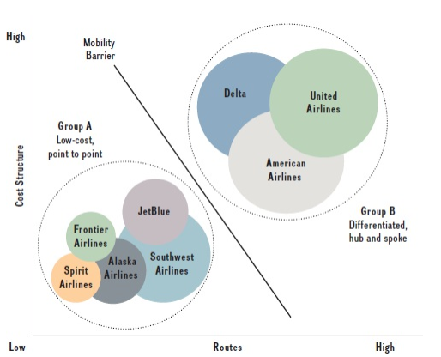
Strategic groups
Strategic group: „The set of companies that pursue a similar strategy within a specific industry“

Slide 55
Strategic groups: the map
How to create the strategic group map:
■ Identifying the most important strategic dimensions such as expenditures on research and development, technology, product differentiation, product and service offerings, cost structure, market segments, distribution channels, and customer service. These dimensions are strategic commitments based on managerial actions that are costly and difficult to reverse.
■ Choosing two key dimensions for the horizontal and vertical axes, which expose important differences among the competitors.
■ Graphing the firms in the strategic group, indicating each firm’s market share by the size of the bubble with which it is represented.

Slide 56
Strategic groups
■ Competitive rivalry is strongest between firms that are within the same strategic group.
■ The external environment affects strategic groups differently.
■ The five competitive forces affect strategic groups differently.
■ Some strategic groups are more profitable than others.

Slide 57
Porter‘s Five Forces HOW TO APPLY

Slide 58
How to apply the Five forces
Define the relevant industry.
Identify the key players in each of the five forces and attempt to group them into different categories.
Determine the underlying drivers of each force.
Assess the overall industry structure.

Slide 59
Stakeholders Stakeholder approach and stakeholder analysis

Slide 60
Stakeholder vs Shareholder approach
Shareholder approach
A business is an organization, which is supposed to create value for owners.
Stakeholder approach
A business is a place where interests of stakeholders meet – interests of those, who are involved in or affected by the business operations. The business is then supposed to create value not only for shareholders, but should be responsible for all stakeholders.

Slide 61
Who are stakeholders
Freeman and Reed, 1983
Wide:
can affect the achievement of an organization´s objectives or who is affected by the achievement of an organization´s objective.
Narrow:
on which the organization is dependent for its continued survival.

Slide 62
Who are stakeholders
Post, Preston, Sachs (2002)
Political groups
Regulatory auhorities
Supply chain associates
Investors: Shareowners and lenders
Joint Venture partners
Employees
Corporation
Customers and users
Local communities and citizens
Governments
Strategic alliances
Unions
Resource base
Industry structure
Social-political environment

Slide 63
Competitive behaviour
Company
Owners
Company
Company
Creditors
Employees
Management
Suppliers
Customers
Company
State
Company
Company

Slide 64
Stakeholder analysis
Set the goal of the analysis,
identify stakeholders,
analyze values and segment stakeholders,
analyze attributes,
analyze possible development of values and attributes,
draw a stakeholders map,
adopt corresponding measures,
analyze effects of these measures and act accordingly.

Slide 65
Let‘s wrap it up The KvIS is comming

Slide 66
KvIS
Summary of the lecture
Max 1 bonus point (3 questions, 1/3 point for the correct answer)
Remember to submit your answer a few seconds ahead (lag)

