Slide 1
Literature review assignment Discussion
Academic writing
Seminar 6

Slide 2
Features of academic writing (refreshing)

Slide 3
Presision
Project management is crucial for every business, and organizations always seek the best people management before starting or undertaking a project because it increases the project's effectiveness.
Project leaders must use certain behaviors for each talent in order for them to be entirely successful.
Avoid uncertain or general words (people, human, certain, issue)

Slide 4
Abbreviations
Define early and use them throughout the text
Project management is characterized for being a discipline constantly struggling with changes in the environment, aiming to be flexible enough to handle those changes end deliver the stablished outcomes. However, after the COVID-19 pandemic, the project management had to adapt beyond the previously known standards. The proposed work aims to describe how project management is dealing with the post-pandemic situation, which are the biggest challenges and what should be considered by PM (Project Management) professionals to be better prepared for the new conditions the pandemic brought to the world economy.

Slide 5
APA citations (problems)
The following sentence from the article mentioned by Carlos Rendón…..
Consequently, the pressure in competition, which some believe will occur due to rotation, could lead to more faulty audit work (Catanach et al. 1999).
Li et al also mentioned that the construction field saw an increase in productivity, time, and costs.
Authors concluded that deterioration in audit quality in a short tenure audit may be due to lack of competence or loss of independence (Knechel &Vanstraelen, 2007).
Ackermann and colleagues (2017) conducted an exploratory study to examine how consumers perceive the importance of taking care of their products.

Slide 6
APA citations (problems)
.. there have been relatively few studies focusing on consumer interest in information about product durability and repairability, as well as consumers' attitudes and beliefs regarding these aspects (Bigerna et al., 2021). Bigerna et al. (2021) conducted research…
Cooper's (2004) study examined consumer attitudes and behaviors related to the lifespan of household appliances.
This research develops a complete framework that connects social media advertising to purchasing decisions by analyzing essential elements that shape customer behaviour, such as convenience, time-saving features, security, information sources, and feedback Nobi et al. (2023).

Slide 7
APA citations (problems)
Martin and Iren's seminal work “Cohesion Policy and the Evolution of Regional Policy in Central and Eastern Europe” (2013) examines the extent to which internal regional financial policy has been subsumed in the Central Eastern European states.

Slide 8
Basic In-Text Citation Styles
Author | Parenthetical citation | Narrative citation
One author | (Luna, 2020) | Luna (2020)
One author with a quote | (Luna, 2020, p. 37) | Luna (2020) (p. 37)
Two authors | (Salas & D’Agostino, 2020) | Salas and D’Agostino (2020)
Three or more authors | (Martin et al., 2020) | Martin et al. (2020)
Group of authors | (OECD, 2020) | OECD (2020)
In parenthetical citations, use an ampersand (&) between names (Salas & D’Agostino, 2020)
In narrative citations, spell out the word “and” Salas and D’Agostino (2020)
Works with the same author and same date
(Judge & Kammeyer-Mueller, 2012a)
(Judge and Kammeyer-Mueller, 2012b)
If multiple authors within a single reference share the same surname
(Chen & Chen, 2019)

Slide 9
Academic writing is not…
Personal
Academic writing generally tries to avoid being too personal. Information about the author may come in at some points—for example in the acknowledgements or in a personal reflection—but for the most part the text should focus on the research itself.
Always avoid addressing the reader directly with the second-person pronoun “you.” Use the impersonal pronoun “one” or an alternate phrasing instead for generalizations:
As a teacher, you must treat your students fairly.
As a teacher, one must treat one’s students fairly.
Teachers must treat their students fairly.

Slide 10
The use of the first-person pronoun “I” is increasingly accepted in academic writing.
When you refer to yourself, it should be for good reason. You can position yourself and describe what you did during the research, but avoid arbitrarily inserting your personal thoughts and feelings:
Unacceptable
In my opinion…
I think that…
I like/dislike…
Acceptable
I conducted interviews with…
I argue that…
I hope to achieve…

Slide 11
Academic writing is not…
Long-winded
Many students think their writing isn’t academic unless it’s over-complicated and long-winded. This isn’t a good approach—instead, aim to be as concise and direct as possible.
If a term can be cut or replaced with a more straightforward one without affecting your meaning, it should be. Avoid redundant phrasings in your text, and try replacing phrasal verbs with their one-word equivalents where possible:
Interest in this phenomenon carried on in the year 2018.
Interest in this phenomenon continued in 2018.

Slide 12
Repetition is a part of academic writing— for example, summarizing earlier information in the conclusion—but it’s important to avoid unnecessary repetition. Make sure that none of your sentences are repeating a point you’ve already made in different words.

Slide 13
Improve wording
… a consumer trend signifies a significant change in …
The perspectives inside the organization are about which business processes must we master in order to please our shareholders and clients.
To better understand these effects, the author will explore influencers in three categories: celebrities, specialists, and fellow consumers.

Slide 14
Writing layout
Check for consistency of font style and size
Use template for writing
Keep up with word count
Use italics to emphasize the text

Slide 15
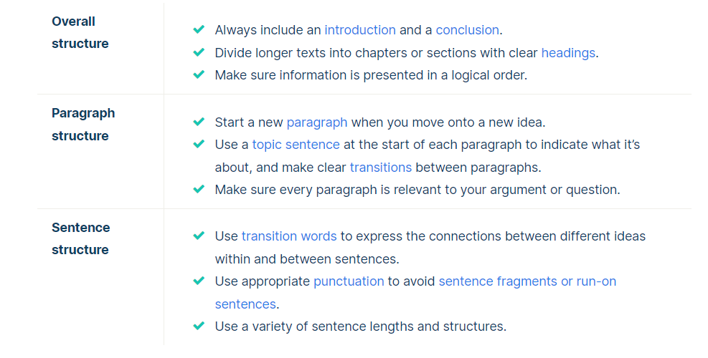
Structure

Slide 16
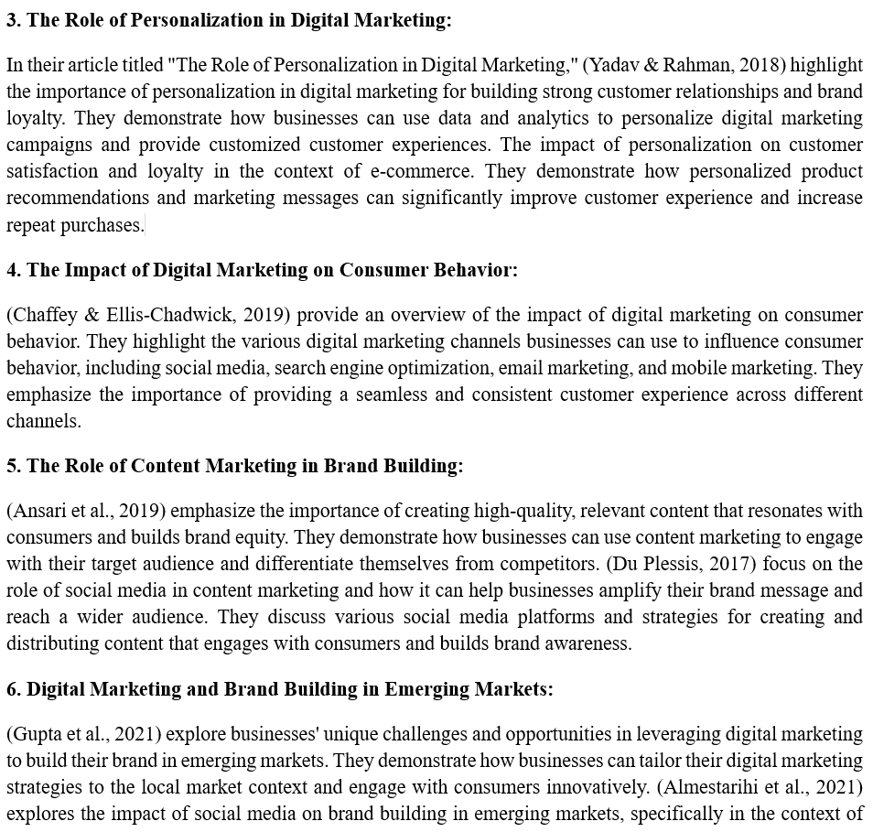

Slide 17
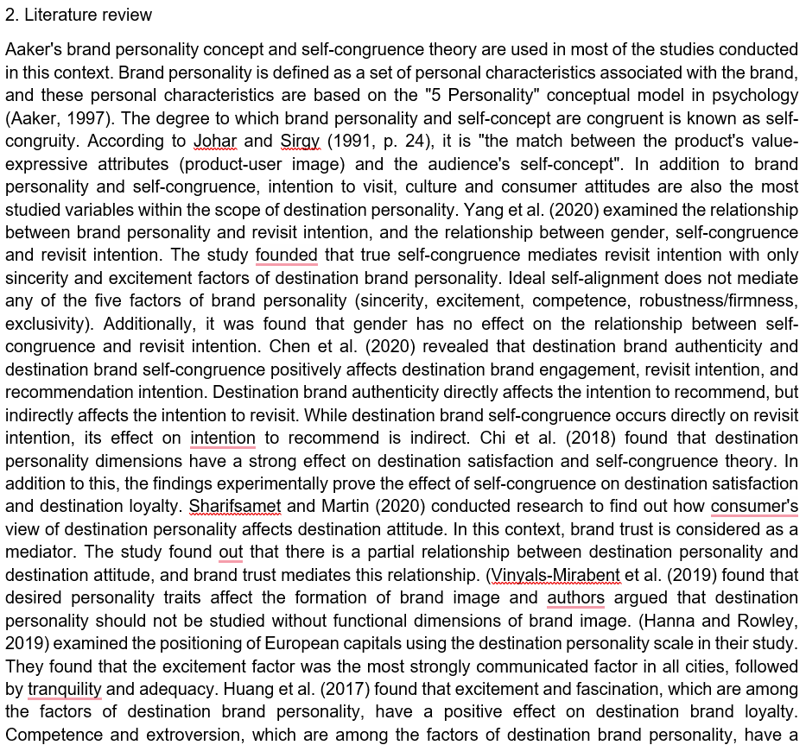

Slide 18
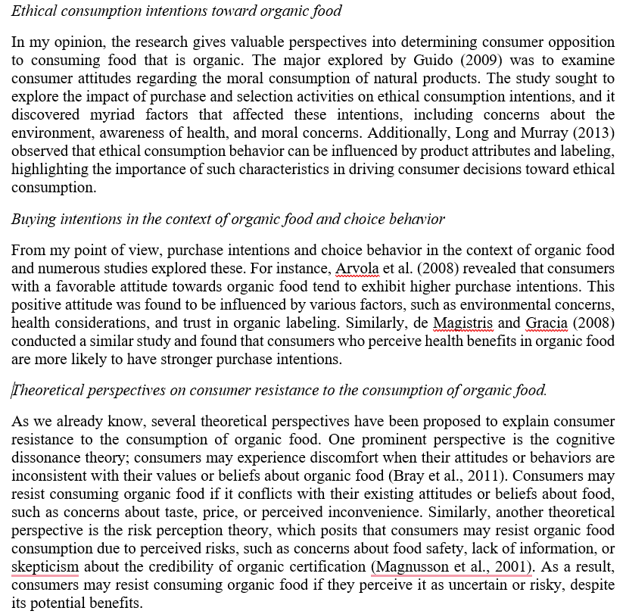

Slide 19
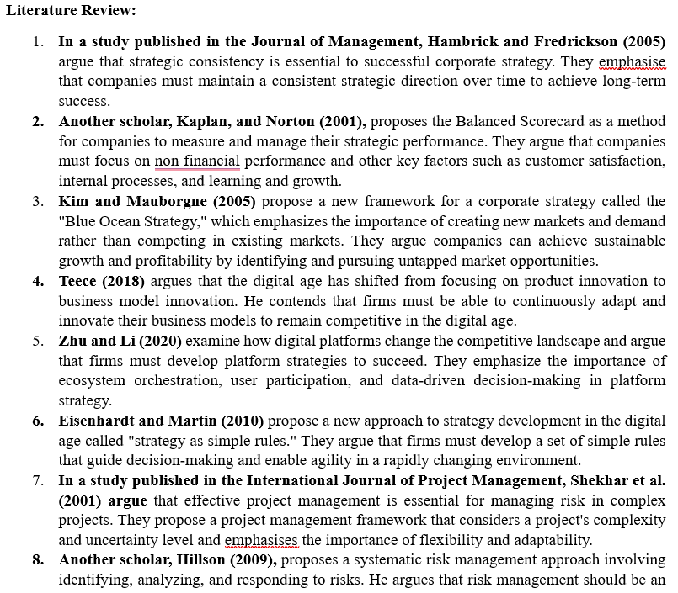
This is a shopping list not literature review

Slide 20
Connect sources
One of the most significant theoretical explanations for performance budgeting is that it can aid in the better allocation of public resources. Policymakers may guarantee that resources are allocated toward programs and initiatives that are most successful in attaining desired goals by tying budgeting to performance outcomes. This can lead to increased efficiency and effectiveness in government spending (Jones & Lynch, 2006).
There is evidence that performance budgeting improves budget outcomes. According to Poterba and Rueben (1999), states that used performance budgeting had better fiscal results, such as reduced deficits and improved credit ratings. Similarly, LaLumia and Lovell (2012) discovered that performance-based budgeting was connected with greater budgetary performance in US municipal governments.

Slide 21
Connect sources
Several strategies have been proposed to address the generational wealth gap. These strategies aim to increase intergenerational mobility, redistribute wealth, and improve access to opportunities for those from disadvantaged backgrounds. One approach to addressing the generational wealth gap is through policies aimed at increasing intergenerational mobility. This includes measures like improving access to education and affordable housing, which can help reduce the wealth gap by providing opportunities for those from low-income backgrounds (Chen & Corak, 2008). Another approach is through redistributive policies, such as progressive taxation and inheritance taxes, which can help redistribute wealth and reduce the concentration of wealth in older generations (Keister & Moller, 2000). These policies can help ensure greater economic and social equality by reducing the barriers to wealth accumulation faced by those from low-income backgrounds.

Slide 22
Topic sentence is important
The topic sentence is the first sentence of the paragraph.
Sometimes referred to as a focus sentence
Topic sentence helps organize the paragraph by summarizing the information in the paragraph.
Tips:
Identify the main point in your paragraph
Write a sentence that connects to your main idea with a what and a why. State what the topic is and why it matters.
Topic sentence gives readers something interesting to think
https://www.indeed.com/career-advice/career-development/how-to-write-a-topic-sentence

Slide 23
Topic sentence examples
An organization is like an organism whose flow of information is imperative for its functioning.
Fast fashion is readily available, inexpensively made part of fashion industry.
One of the primary causes of the generational wealth gap is differences in savings behavior between generations.
Dating apps have significantly changed the way people approach romantic relationships, driving a move toward online and mobile dating.

Slide 24
Avoid making strong claims
This literature review aims to provide a comprehensive overview of the current state of research …
I would conduct further research as mentioned to erase any doubts about partial moderating factors because just CSR in itself contains a broad spectrum of constructs.
In my opinion, the influence of COVID-19 on air transport is clear.
This literature review informs about all possible obstacles derived from wrong product consumption.

Slide 25
Suggestion: Do not bold or underline text.
The shift towards fully remote or hybrid work environments in recent years has brought employee engagement to the forefront as a critical area of study. Companies are increasingly focused on maintaining high productivity and engagement levels in virtual settings. Key strategies that have been proven effective in fostering employee engagement in remote work environments include organizational support, mental health initiatives, the adoption of appropriate technologies, and flexible work policies. These strategies are essential to addressing the challenges associated with remote work, such as communication barriers, social isolation, and work-life balance concerns.

Slide 26
Suggestion: Make text precise. Who uses technical analysis? Who are the experts? Who benefits from machine learning?
Technical analysis is a widely used technique in financial markets that involves studying historical prices and trading volume to forecast market trends and guide investment decision-making. Although technical analysis has been a reliable tool over the past decades, it has faced significant criticism for its limitations. The subjectivity of pattern recognition, and the inability to account for the complex nature of financial markets, have exposed researchers to exploring a tool to enhance these limitations. Many experts have introduced the integration of machine learning. Machine learning, which is a branch of artificial intelligence, is a tool that enables algorithms to learn from the data and improve over time. This artificial tool has shown significant potential to improve the efficiency and accuracy of technical analysis in predicting stock markets. This literature review entitles the importance and advantages of combining machine learning with technical analysis while discussing the challenges faced when performing this integration.

Slide 27
Suggestion: Think about topical sentence to open your idea. Use abbreviation properly.
1. Introduction:
It has impacted the way businesses interact with their target markets by providing small and medium enterprises with scalable and reasonably priced options for client outreach. Increasingly, SMEs-the category of business that traditionally has had limited access to mainstream advertising-are using a wide variety of digital marketing approaches to build better relationships with consumers

Slide 28
Suggestion: Think about topical sentence to open your idea. Refresh rules of academic writing.
Imai et al. (2019) build on this by suggesting that microfinance’s impact can be much greater when non-financial services are included. They argue that providing business training, mentoring, and other support helps borrowers better use their loans and gives them a higher chance of success. This makes sense because just having the money isn’t enough people also need the skills to manage it effectively. However, while this is an important insight, the study doesn’t provide many real-world examples of how MFIs can offer these additional services without putting too much strain on their resources. It’s a useful idea, but more practical guidance on how to make it work would have been helpful.

Slide 29
Suggestion: Think about topical sentence to open your idea. Use short sentences to make your text more dynamic. Focus on writing a good story.
Chen et al. (2021) examine deep learning, specifically the use of convolutional neural networks (CNNs), in detecting fraudulent insurance claims. CNNs can spot subtle patterns that might signal fraud, and the study shows they are impressively effective. However, Chen et al. raise a major concern: these models operate as “black boxes,” making decisions that are hard to explain. This lack of transparency is problematic because if claims are denied without clear reasoning, it could damage the trust between insurers and their customers. Their study suggests that, while deep learning models are powerful, they need to be made more understandable for the people affected by their decisions.

Slide 30
Suggestion: Think how to change the first sentence into a topical sentence
Lewis (2021) states that a key reason why LCCs succeed is their skill in shaping pricing strategies within their service types while influencing the entire airline industry. Southwest Airlines, a leader in the U.S. low-cost sector, offers a particularly insightful example of how LCCs shape market pricing. According to Ren (2020), Southwest's entry into a new market with nonstop flights consistently forces other airlines to reduce their prices, even on competing nonstop and connecting services. However, the effect is more pronounced when Southwest competes with nonstop flights, as passengers perceive nonstop services as a higher-quality option than connecting flights. This pricing strategy reflects the intricate link between ticket costs and the perceived service quality in the airline industry. Southwest’s ability to shape competitors’ pricing shows how LCCs use their streamlined, no-frills models to put competitive pressure on FSCs and other budget airlines.

Slide 31
Suggestion: Avoid using spoken language. Use short sentences to make your text more dynamic.
While previous research pertaining to the European railway market reforms focused primarily on observations from the mid-1990s up to the early 2010s (Mizutani, 2019), there are issues with this period. As said reforms were not evenly implemented over the course of nearly 20 years, their effects in a given country would not be comparable to another that was not on the same stage of implementation. Under these circumstances, data sets from the aforementioned period can be proven to be not ideal for the purposes of this particular study.

Slide 32
Suggestion: Topic sentence should be easy to understand. Use short sentences to make your text more dynamic.
Informal networking behaviors differ significantly across genders, often reinforcing structural inequalities. For example, Mengel (2020) explored how men and women form and utilize professional networks. His findings showed that men engage in homophilic networking, creating strong connections with same-gender peers. These networks are typically task-oriented, offering reciprocal benefits such as promotions and access to leadership opportunities. In contrast, women often establish smaller, relationally focused networks that prioritize social and emotional support over strategic resource exchange. While these networks provide personal encouragement, they often fail to deliver the professional advantages that men gain through broader, instrumental connections. Notably, Mengel’s study does not explore the long-term implications of these differences on career trajectories, leaving an important gap in understanding gendered networking outcomes.

Slide 33
Suggestion: Ensure proper citation using APA style. Direct citation requires page number. Use italics to emphasize text.
"The integration of AI into decision-making frameworks enhances operational efficiency and agility, but human oversight is indispensable for ensuring ethical alignment and transparency in strategic processes."- Shrestha et al. (2019) show that the need to balance the computational power of AI with the nuanced judgment and ethical oversight provided by human decision-makers. It serves as a foundation for discussing hybrid frameworks in strategic management. This is where AI supports data-driven insights while humans guide strategic and moral concerns. The concept of "strategic agility" enabled by AI is highlighted across multiple studies. Kaggwa et al. (2024) argue that AI's ability to assess real-time data facilitates firms to make quick and informed decisions.

Slide 34
Suggestion: Do not create paragraphs with 1-2 sentences.
… uncertainty is not factored in, clean energy stocks are unaffected by fluctuations in the US dollar. The results suggest that macroeconomic uncertainties mediate the link between the reserve currency and the volatility of these stocks.
According to Atz et al., (2023), “determining whether corporate sustainability and ESG investing strategies improve ﬁnancial performance can be confusing because studies diﬀer in what they analyze and how they address causal inference.’’ p-803
Conclusion
In summary, the existing literature presents a nuanced view of the impact of sustainability ETFs on investment portfolio profitability. While numerous studies

Slide 35
Suggestion: Using many synonyms may confuse reader. Explain differences between different terms.
The cultural nuances of emerging markets like India also play a significant role in shaping consumer preferences. Hofstede et al. (2019) highlight those societal values, such as collectivism and the need for social validation, often influence purchasing decisions in India. For Bata, understanding these cultural dimensions is crucial for designing personalized campaigns that resonate with local audiences. Marketing strategies that reflect the cultural and social diversity of India can help Bata strengthen its connection with consumers across regions and demographics.

Slide 36
References (Bibliography)
List of references is placed at the end of a work.
Each entry provides the author, date, title, and source of the work.
The reference allows readers to identify and retrieve the source.
Sources are listed in alphabetical order by the author last name.
You should have a reference entry for every source you cite.

Slide 37
I avoid informal terms and contractions.
I avoid second-person pronouns (“you”).
I avoid emotive or exaggerated language.
I avoid redundant words and phrases.
I avoid unnecessary jargon and define terms where needed.
I present information as precisely and accurately as possible.
I use appropriate transitions to show the connections between my ideas.
My text is logically organized using paragraphs.
Each paragraph is focused on a single idea, expressed in a clear topic sentence.
Every part of the text relates to my central thesis or research question.
I support my claims with evidence.
I use the appropriate verb tenses in each section.
I consistently use either UK or US English.
I format numbers consistently.
I cite my sources using a consistent citation style (APA style).

