Slide 1
Neutron Spectrometry
Jiří Cvachovec

Slide 2
Motivation
Neutron spectral flux density – “neutron spectrum” – “what energies are present and what is their proportion”
Applications:
  verification of functionality of nuclear reactors
  estimation of pressure vessel damage
  radiation protection
  radiotherapy
  estimation of biological effects
  nuclear weapons (mainly in the past)

Slide 3
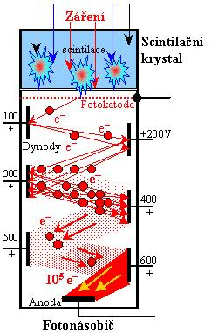
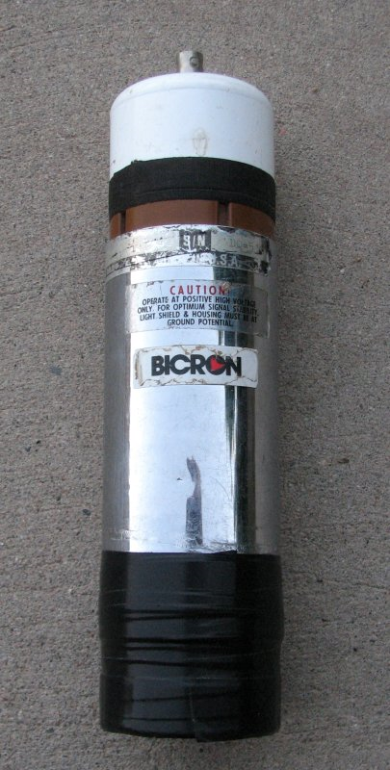
Scintillation Detector

Slide 4
Block Scheme

Slide 5
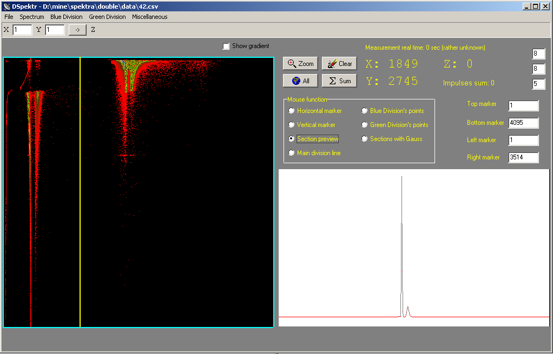
Neutron-Gamma Separation

Slide 6
The Unfolding Problem
ϕ(E_{n}) neutron energetic spectrum (this is what we want to measure)
z(E_{p}, E_{n}) detector response function (obtained by Monte Carlo simulation)
Z(E_{p}) measured proton spectrum (detector output)

Slide 7
Maximum Likelihood Estimation
Discrete form:
Assumption: neutron and proton spectra are random vectors with mutually independent, Poisson-distributed components
Likelihood function for f:
where
Algorithm:

Slide 8
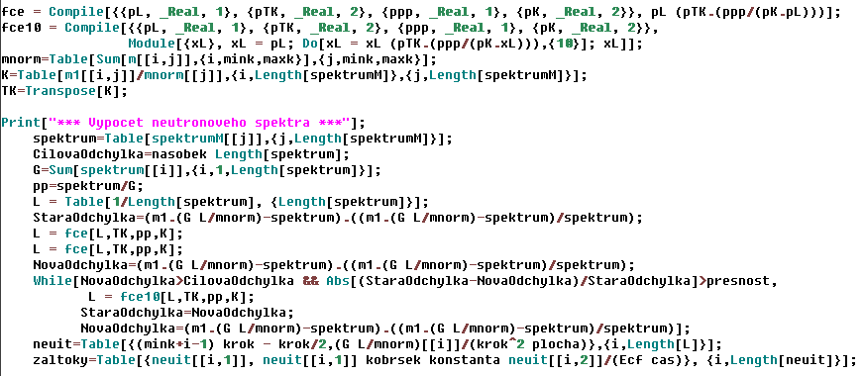
Mathematica Code

Slide 9
Detector Response Function
Obtained by Monte Carlo simulation
The interaction of the neutron with the detector is modeled.
What must be taken into account:
  detector geometry (cylinder)
  chemical composition (C, H, O, B, ...)
  different kinds of interactions (elastic and inelastic scattering, capture)
  library data (describe stochastic properties of interactions)
  user settings (energetic step, desired output format, etc.)

Slide 10
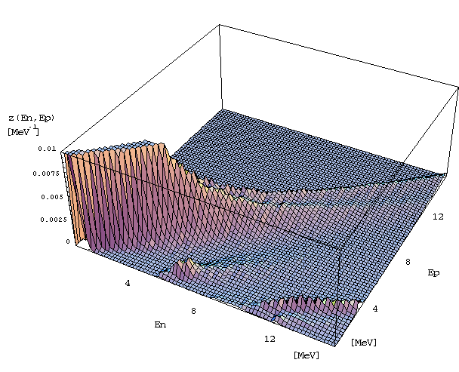
Sample Response Matrix

Slide 11
Verification of Results
Neutron line 13.9 MeV (stilbene Φ=1cm, H=1cm, coaxial impact)
Measured and calculated response E_{n}=5 MeV, perpendicular impact
Neutron spectrum from spontaneous fission of a ²⁵²Cf source
Neutron spectrum from a ²³⁹Pu-Be source

Slide 12
Further Work
In frame of TA ČR no. TA01011383
  replace analog part with digital equipment
  develop software for controlling and processing
  improve current methods
  incorporate new detectors
My main responsibility: software part
  neutron-gamma discrimination
  lead software development (evaluation procedures and response functions)
  increase level of automation
  improve propagation of uncertainties

Slide 13
Publications
Determination of AKR-2 beam and verification at iron and water arrangements
Košťál, Michal - Cvachovec, František - Cvachovec, Jiří - Ošmera, Bohumil - Hansen, Wolfgang. Annals of Nuclear Energy, Volume 38, Issue 1, 8 s. ISSN 0306-4549. 2011.
Maximum Likelihood Estimation of a Neutron Spectrum and Associated Uncertainties
Cvachovec, Jiří - Cvachovec, František. Advances in Military Technology, Brno : Univerzita obrany, Vol. 3, No. 2, 14 s. ISSN 1802-2308. 2008.
Neutron Response Function for BC-523A Scintillation Detector in the Energy Range 0.5 to 20 MeV
Cvachovec, Jiří - Cvachovec, František - Pošta, Severin - Ošmera, Bohumil. Journal of ASTM International, Vol. 5, No. 5, 4 s. ISSN 1546-962X. 2008.
Výpočet funkce odezvy pro detektory s dopovanými scintilátory (II)
Cvachovec, Jiří - Cvachovec, František - Pošta, Severin - Ošmera, Bohumil. ÚJV Řež, 2004. 12107-R,D.
Multiparameter multichannel analyser system for characterisation of mixed neutron-gamma field in the experimental reactor LR-0
Bureš, Zbyněk - Cvachovec, Jiří - Cvachovec, František - Čeleda, Pavel - Ošmera, Bohumil. In Reactor Dosimetry in the 21st Century: Proceedings of the 11th International Symposium on Reactor Dosimetry Brussels, Belgium 18 - 23 August 2002. Brussels : World Scientific Publishing Company, 2003. od s. 194-201, 8 s. ISBN 9812384480.
Anisotropy of light output in response function of stilbene detectors
Cvachovec, F. - Cvachovec, J. - Tajovský, P. Nuclear Instruments & Methods in Physics Research A, Elsevier Science Publishers, 476, 1-2, od s. 200-202. ISSN 0168-9002. 2002.

Slide 14
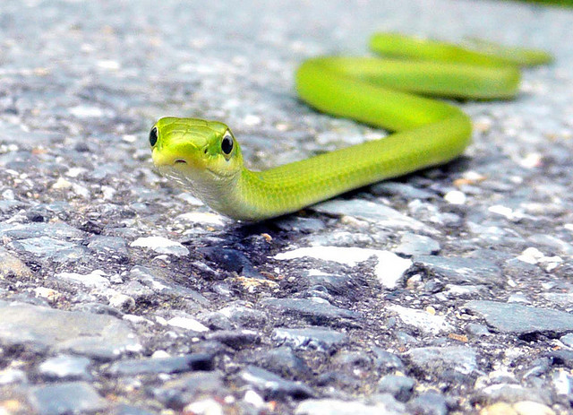
Q & A

