Slide 1
Website Classification
Mgr. Juraj Hreško`s thesis
7.2.2013
presented by Jaromír Navrátil

Slide 2
Synopsis
Task
Possible solutions
Solution
Rare classes
Possible improvements
Rewriting to C++

Slide 3
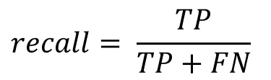
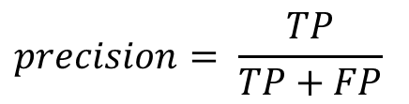
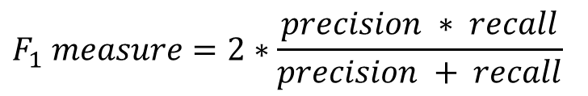
The Task
create application to classify czech websites
61 classes
multi-labeling (1-3 classes for each document)
real-time classification
be able to adjust the algorithm to maximize precision or recall
$$precision= \frac{TP}{TP+FP}$$
$$recall= \frac{TP}{TP+FN}$$
$$F_{1} measure=2∗\frac{precision ∗ recall}{precision + recall}$$

Slide 4
Classes
Occurrences Class
678 Insurance
1170 Job / Career
6003 Kids / Toys / Family
1059 Military / Guns
1974 Mobile Phones / Operators
11826 Music / Radio / Cinema / TV
3477 News / Magazines
54 Peer-to-peer
10002 Personal / Dating / Lifestyle
2049 Politics / Law
4077 Pornography
4227 Portals / Search Engines
90 Proxies
2475 Real Estate
6966 Regional
1803 Religious / Spirituality
6405 Sale / Auctions
6 Sects
48 Sex Education
42240 Shopping
288 Social Networks
14913 Sports
120 Streaming / Broadcasting
951 Swimwear / Intimate
384 Translation Services
24537 Travelling / Vacation
1788 Uploading / Downloading
816 Warez / Piracy
135 Web Based Mail
888 Web Hosting
1110 Money / Financial
Occurrences Class
3159 Advertisement
1281 Alcohol / Tobacco
2442 Arts
9756 Cars / Vehicles
1590 Banking
450 Brokers
27066 Building / Home
15045 Business
16998 Chats / Blogs / Forums
1068 Communications
72 Crime
11805 Education
2613 Entertainment
5553 Environment
1575 Erotic / Adult / Nudity
459 Extreme / Hate / Violence
13302 Fashion / Beauty
12708 Food / Restaurants
2298 Foundations / Charity / Social Services
135 Gambling
3090 Games
6108 Government
18 Hacking / Phishing / Fraud
9225 Health / Medicine
13794 Hobbies
2376 Humour / Cool
13995 IT / Hardware / Software
5163 IT Services / Internet
195 Illegal Drugs
90 Instant Messaging

Slide 5
Possible Approaches
Web structure mining - links
Web content mining - text, html, multimedia
Web usage mining - access logs
combining first two approaches would be ideal, but mining from structure is computationally difficult

Slide 6
Multi-label Classification
Algorithms from WEKA are not able to process multi-label data, thus we have to transform the problem or adapt the algorithm
Transforming the problem:
    choose one class for each example, forgetting others
    delete all examples with more than one class
    change every combination of classes into one new class
    use one classificator for each class
Categories | Occurence
0 | 0.41%
1 | 64.45%
2 | 31.75%
3 | 3.38%
4-6 | 0.01%

Slide 7
Components of Classifier
downloader
modeller
feature selection
machine learning
DB
URL
label
Downloader
content
Modeller
terms
Feature
Selection
model
class features list
Machine
Learning
knowledge representation
Classifier Rules

Slide 8
Downloader
download website using wget
get language coding (mostly Windows-1250, ISO 8859-2 or UTF-8)
transfer to UTF-8 using Enca

Slide 9
Modeller - source to vertical
transfer text to so-called vertical
delete HTML tags, scripts, parts of CSS, interpunction
divide words by spaces and convert them to lower-case
page source
vertical
<html>
<head>
<title>Interesting article.<title>
</head>
<body>
<h1>The article</h1>
This is the main part of the article.
</body>
</html>
word | Tag
interesting | title
article | title
the | h1
article | h1
this | none
is | none
the | none
main | none
part | none
of | none
article | none

Slide 10
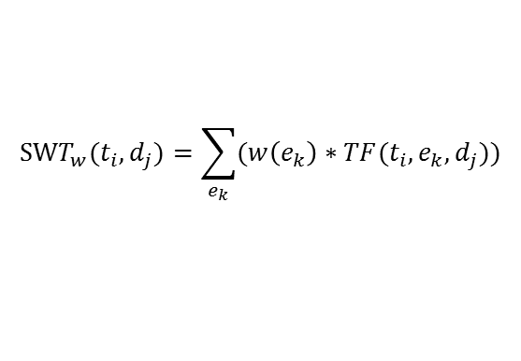
Modeller - vertical to vector
trasfer vertical into vector model using Structure-oriented Weighting Technique
delete words with high frequency across classes – not used
stemming (lemmatization) – not used
vertical
vector model
word | Tag
interesting | title
article | title
the | h1
article | h1
this | none
is | none
the | none
main | none
part | none
of | none
article | none
word | weight
article | 16
interesting | 10
the | 6
this | 1
is | 1
main | 1
part | 1
of | 1
article | 1
$$SWT_{w}(t_{i},d_{j})=\sum_{e_{k}}{(w\left(e_{k}\right)∗TF(t_{i},e_{k},d_{j}))}$$
e_{k} | title | h1 | h2 | h3 | none
w(e_{k}) | 10 | 5 | 3 | 2 | 1

Slide 11
Feature Selection
eliminate attributes with fewer than 50 ocurrences, lessening number of words in dictionary from 1 263 296 to 63 121
compute information gain for each term
choose 2000 best terms

Slide 12
Choosing Classifier
Category | Precision | Recall | F₁ Measure
Arts | 0.831 | 0.814 | 0.812
Entertainment | 0.793 | 0.768 | 0.763
Foundations | 0.811 | 0.792 | 0.789
Games | 0.787 | 0.768 | 0.765
HW-SW | 0.767 | 0.764 | 0.763
Mean | 0.798 | 0.781 | 0.778
choose 5 categories with average number of positive and negative examples
SVM - sigmoid
Category | Precision | Recall | F₁ Measure
Arts | 0.812 | 0.810 | 0.810
Entertainment | 0.767 | 0.766 | 0.766
Foundations | 0.766 | 0.764 | 0.764
Games | 0.814 | 0.811 | 0.811
HW-SW | 0.782 | 0.782 | 0.781
Mean | 0.788 | 0.787 | 0.786
SVM - linear
Category | Precision | Recall | F₁ Measure
Arts | 0.851 | 0.848 | 0.847
Entertainment | 0.817 | 0.815 | 0.815
Foundations | 0.821 | 0.821 | 0.821
Games | 0.851 | 0.851 | 0.851
HW-SW | 0.843 | 0.842 | 0.841
Mean | 0.837 | 0.835 | 0.835
Random forest
Category | Precision | Recall | F₁ Measure
Arts | 0.792 | 0.790 | 0.790
Entertainment | 0.762 | 0.759 | 0.758
Foundations | 0.761 | 0.758 | 0.758
Games | 0.798 | 0.797 | 0.796
HW-SW | 0.809 | 0.807 | 0.807
Mean | 0.784 | 0.782 | 0.782
J48
Category | Precision | Recall | F₁ Measure
Arts | 0.762 | 0.762 | 0.759
Entertainment | 0.765 | 0.761 | 0.760
Foundations | 0.742 | 0.742 | 0.741
Games | 0.763 | 0.744 | 0.740
HW-SW | 0.792 | 0.782 | 0.780
Mean | 0.765 | 0.758 | 0.756
Naive Bayes

Slide 13
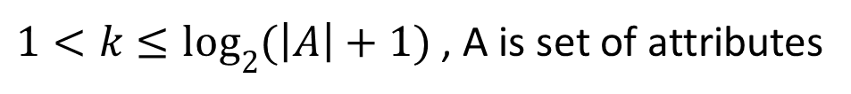

Random Forest
number of randomly selected attributes (constant $k$) was set to 50, as well as number of trees
rate Positive : Negative was set to 1:5 using meta classificator
$1<k≤\log_{2}{(\left|A\right|+1)}$ , A is set of attributes

Slide 14
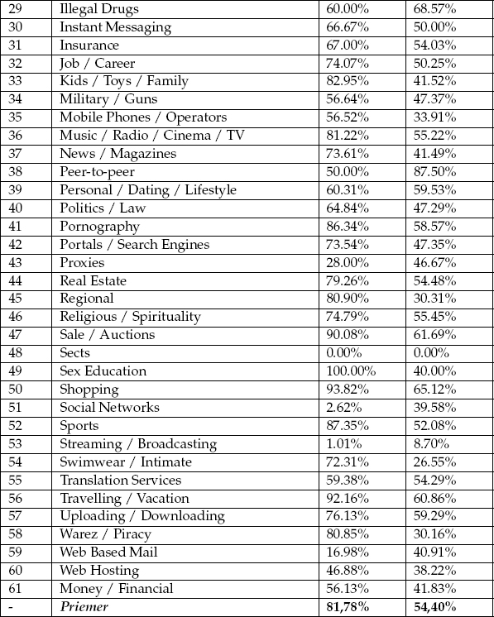
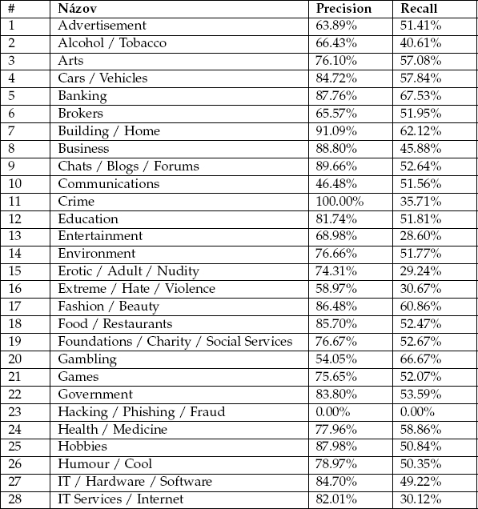
System Evaluation
cross-validation
  training : testing data set to 1:4
  precision 59.68%
second approach took each class as one problem

Slide 15
Complications
classes with very low number of positive examples
some pages stopped existing
system cannot handle HTTPS protocol, nor redirection
existing solution was very slow when it came to classifying multiple webpages

Slide 16
Rare Classes
task is to examine two classes with low occurence
Illegal Drugs (418 URLs)
  some pages do not exist anymore, are redirected or requires confirmation
  only 96 pages (23%) were classified correctly
Alcohol / Tobacco (5631 URLs)
  some websites caused utility wget to enter infinite loop
  2289 pages (41%) classified correctly
  category Shopping assigned many times, along with Social Networks

Slide 17
Rare Classes - data
classification of six thousand pages runned for about 18 hours (it would be much longer if SSD was not used)
Illegal Drugs (418 examples)
Alcohol / Tobacco (5631 examples)
Category | Times Assigned
Illegal Drugs | 96
Shopping | 56
Health / Medicine | 43
Social Networks | 39
Chats / Blogs / Forums | 19
Alcohol / Tobacco | 11
News / Magazines | 10
Streaming / Broadcasting | 10
other (classified < 10 times) | 122
empty pages | 59
Category | Times Assigned
Alcohol / Tobacco | 2289
Shopping | 648
Social Networks | 461
Food / Restaurants | 316
Health / Medicine | 203
Travelling / Vacacion | 167
Chats / Blogs / Forums | 105
Streaming / Broadcasting | 51
other (classified < 50 times) | 375
empty pages | 402

Slide 18
Possible Improvements
remove obstacles preventing downloading some pages, such as use of HTTPS, redirection, age prompt
relearn forests using verified data
use faster classifier or parallelize Random Forest
rewrite system from Python and Bash to C++
improve feature selection
Forest classifying rare class Sects
inkjet
inkjet
inkjet
< 4
>= 4
< 4
>= 4
< 4
>= 4
in class
not in class
in class
not in class
in class
not in class
...

Slide 19
Rewriting to C++
rapid increase of speed (now 42 examples per min., was 5.5)
somehow different results using same URLs
former solution (~1h 15min)
C++ version (9min 50s)
Category | Times Assigned
Illegal Drugs | 96
Shopping | 56
Health / Medicine | 43
Social Networks | 39
Chats / Blogs / Forums | 19
Alcohol / Tobacco | 11
News / Magazines | 10
Streaming / Broadcasting | 10
other (classified < 10 times) | 122
Category | Times Assigned
Social Networks | 128
Illegal Drugs | 81
Health / Medicine | 33
Shopping | 31
Chats / Blogs / Forums | 17
Alcohol / Tobacco | 9
Web Based Mail | 7
Streaming / Broadcasting | 7
other (classified < 7 times) | 58

Slide 20
Conclusion
rewriting system to C++ made it viable for real-time application
the main problem is preprocessing now
  downloading webpage takes most time
  using more pages from same domain could improve accuracy
  utility wget enters infinite loop on some sites
classifier itself could be improved as well
  independent list of attributes for each class
  another algorithm can be tried (e.g. Bayesian classifier)
dividing program into parts operating independently would slightly improve speed

Slide 21
Sources
Thesis of Mgr. Juraj Hreško, Masaryk University, Faculty of Informatics, Brno, 2012
http://weka.wikispaces.com/
http://www.ide.bth.se/~hgr/Papers/cuda-rf_mcc10_v1.0_crc.pdf
http://www.cplusplus.com/

