Slide 1
HTML5
and related standards
Petr Kunc

Slide 2
Contents
History
HTML5
CSS3
JavaScript (Pavel Smolka)
And more (if we have time)

Slide 3
History
1991 – HTML: 18 tags
Direction towards SGML application
<font>, <marquee>, <blink>
Arrival of DHTML: (late 90s)
http://www.angelfire.com/super/badwebs/
XHTML (is dead)
HTML5

Slide 4
XHTML
Strict rules
Should solve inconsistency of handling errors
XML advantages (interoperability, automatization, portability, extensibility)
BUT nobody really needed it...
Quirk modes!

Slide 5
XHTML2 and HTML5
Even more strict
Slow changes
WHATWG – for developers

Slide 6
XHTML vs HTML5
<!DOCTYPE html PUBLIC "-//W3C//DTD XHTML 1.0 Strict//EN" "http://www.w3.org/TR/xhtml1/DTD/xhtml1-strict.dtd">
<html xmlns="http://www.w3.org/1999/xhtml">
<head>
<meta http-equiv="Content-Type" content="text/html; charset=utf-8" />
<title>Title of the document</title>
</head>
<body>
<p>The content of the document.</p>
</body>
</html>

Slide 7
XHTML vs HTML5
<!DOCTYPE html>
<tiTLe>Title of the document</TitlE>
<meta charset=utf-8>
<p>The content of the document.

Slide 8
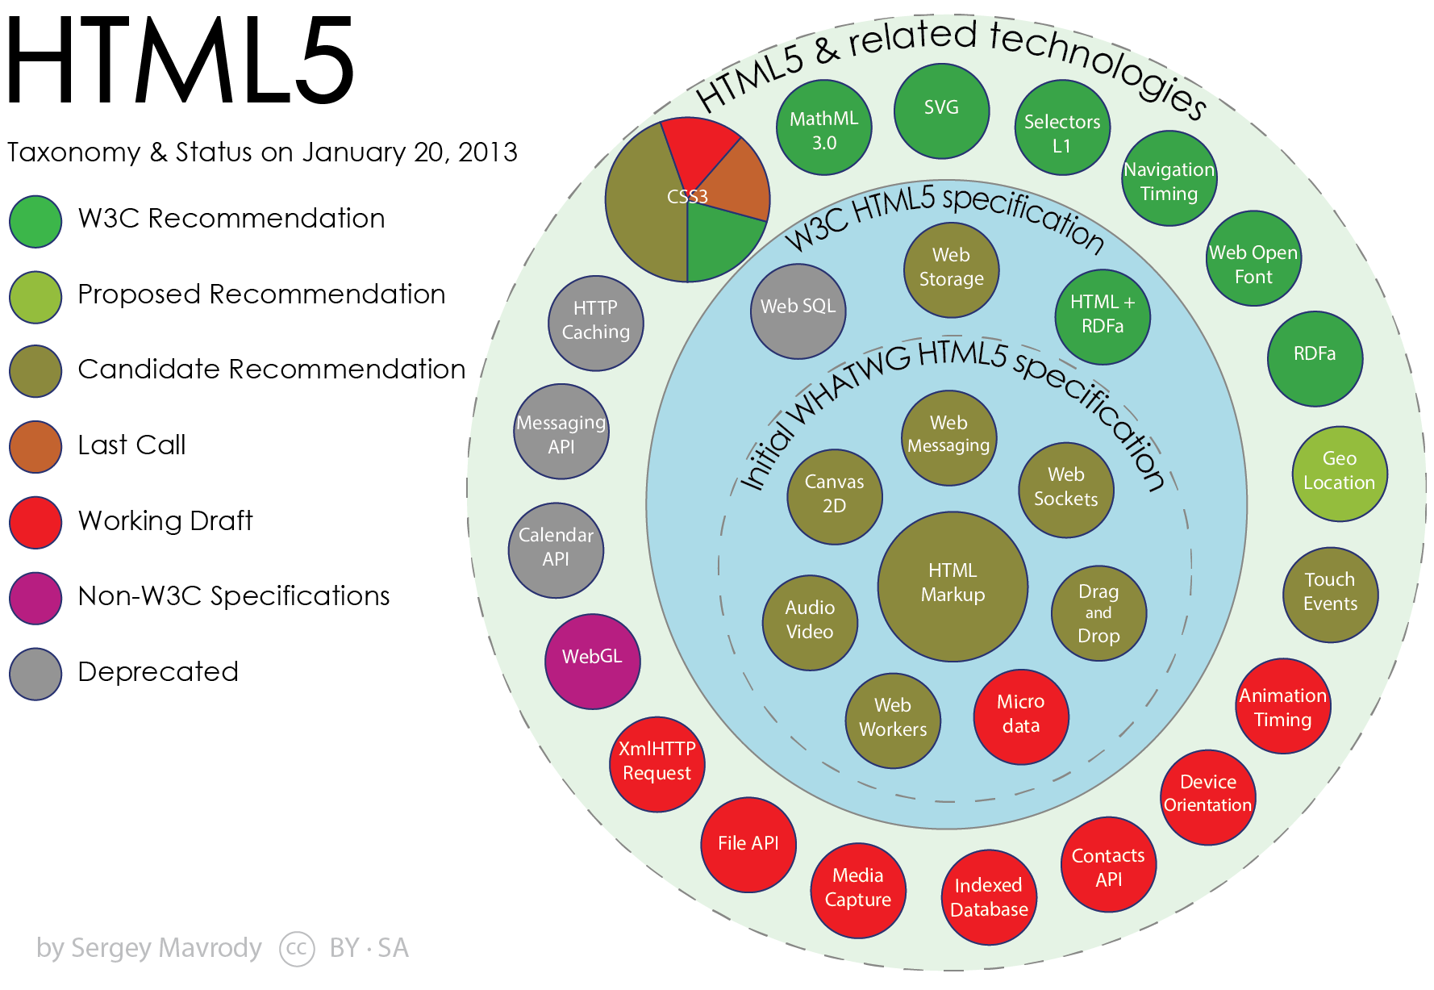

Slide 9
Browser support
http://caniuse.com
Fallbacks
Modernizr
Polyfills

Slide 10
Semantic tags
<div>, <span>
<article>, <section>, <nav>, <header>, <footer>, …
<figure>, <mark>
<time>, <date>
<output>

Slide 11
Other semantics
ARIA (roles)
RDFa
Microformats
Snippets
Inline SVGs!

Slide 12
Forms
Placeholders
Autofocus, Required
Pattern
Spellcheck, autocomplete, …
New types (email, url, tel, number, color, range, date, time, datalist) – great for mobiles
contentEditable

Slide 13
Audio and Video
Problems with formats
Flash fallbacks

Slide 14
Canvas
http://wolf3d.atw.hu
Game APIs
Collisions, …
Maybe next time ;)

Slide 15
CSS
Triumvirate of web apps (HTML, CSS, JS)
CSS – presentation
CSS 2.1 – too long
CSS 3 – modules (50, 4 core)
Inline
page does not have to look the same!

Slide 16
Horror of prefixes
-webkit-transform: rotate(1deg)//Safari+Chrome
-moz-transform: rotate(1deg)// FF 3.5-15
-ms-transform: rotate(1deg)// IE 9+
-o-transform: rotate(1deg)//Opera 10.5-12
transform: rotate(1deg)// FF 16+, O >12

Slide 17
Media queries
Linkage to type (screen, print)
Max-width, Max-screen-width
@media (min-width: 400px) and (…) {
  Styles
}

Slide 18
Web Fonts
Format problems (ttf, otf, woff, svg, …)
@font-face

Slide 19
Formatting boxes
Examples:
  Ellipsis
  Columns
  Opacity
  Corners
  Gradients
  Shadows
  Reflection
  Multiple backgrounds
  Borders
  Box model
  Transitions
  Transforms
  Animating

