Slide 1
Towards systems architecture for building operation analysis in large-scale environments
Adam Kučera

Slide 2
Introduction & Motivation – Facility Management systems
Problem – BMS data analysis
Methods & Areas of research
Results
Conclusions

Slide 3
Introduction
Facility management systems

Slide 4
Facility management
According to IFMA (International Facility management association): „a profession that encompasses multiple disciplines to ensure functionality of the built environment by integrating people, place, process and technology“
FM ensures tasks, which are not part of organization‘s „core business“

Slide 5
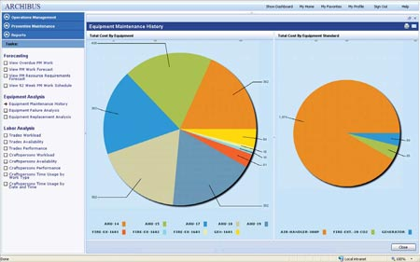
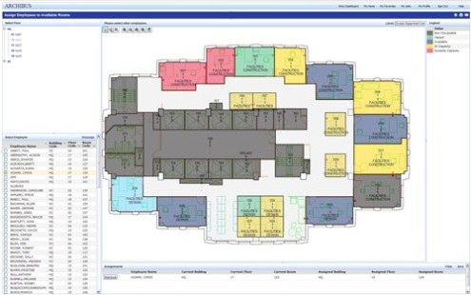
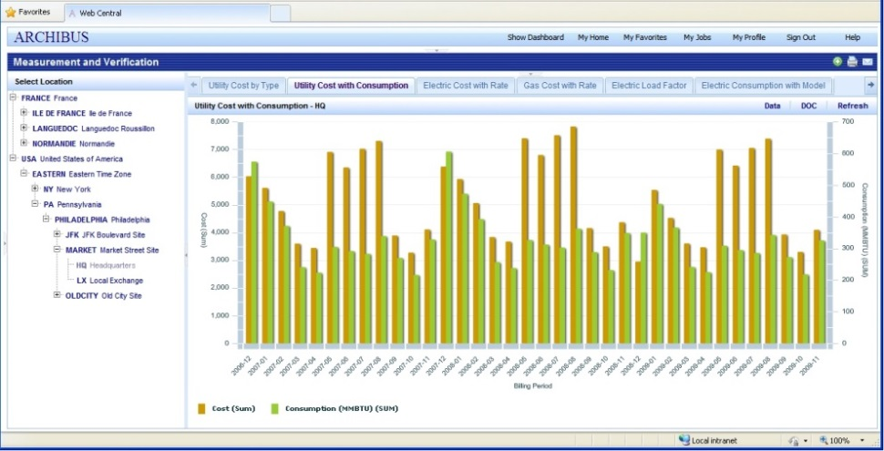
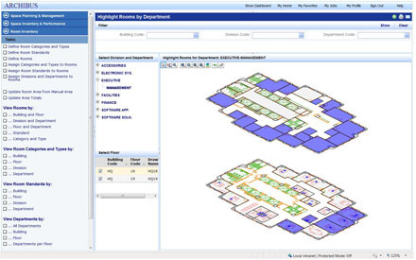
CAFM(Computer-Aided Facility Management)
CAFM software supports:
  Space management
  Maintenance
  Energy management
Provides advanced analytical tools

Slide 6
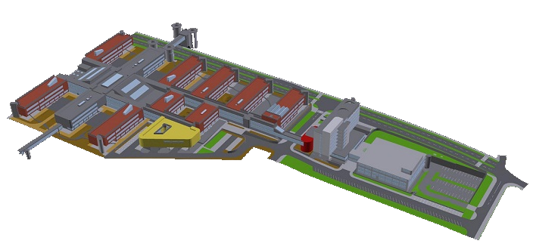
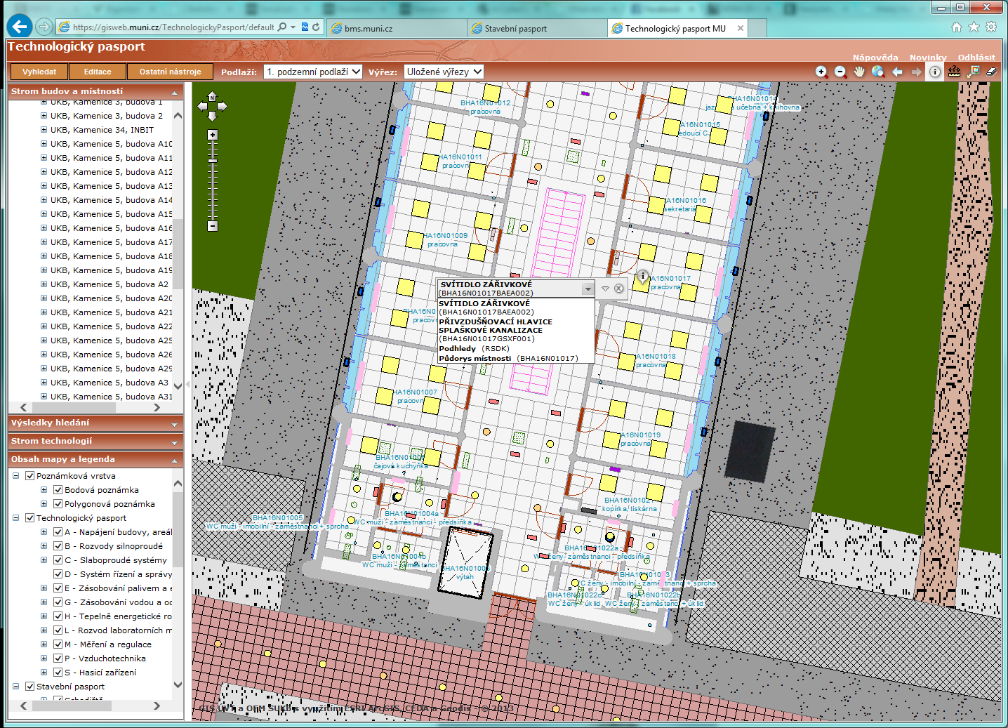
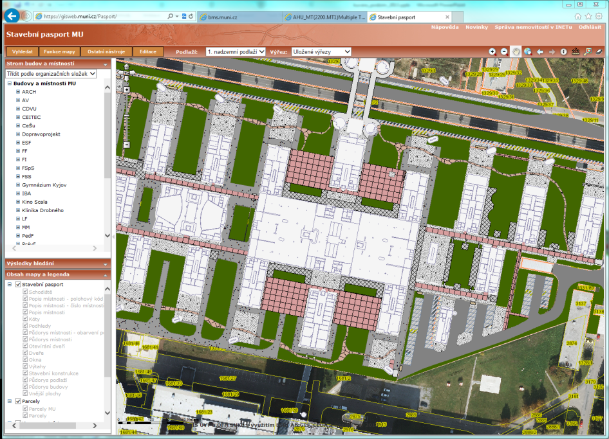
BIM (Building Infrastructure Modelling)
Database of building constructions and devices

Slide 7
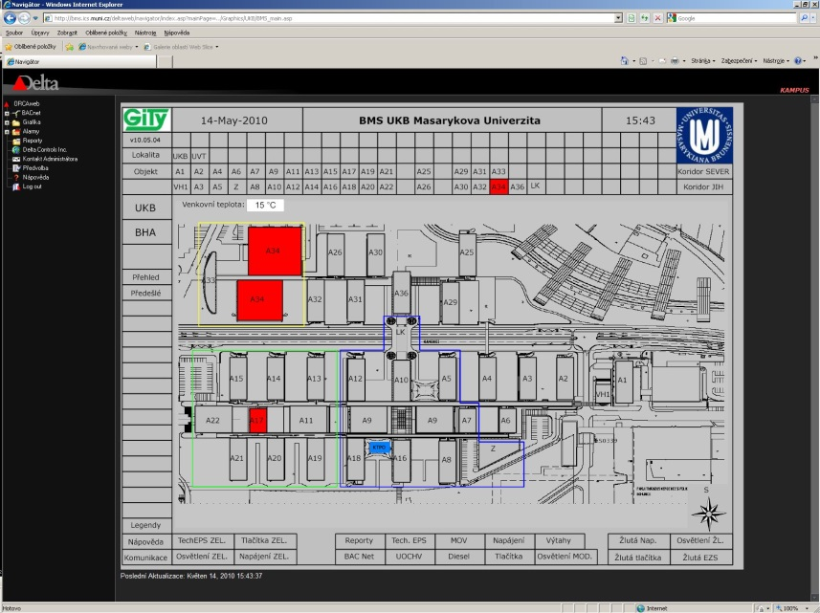
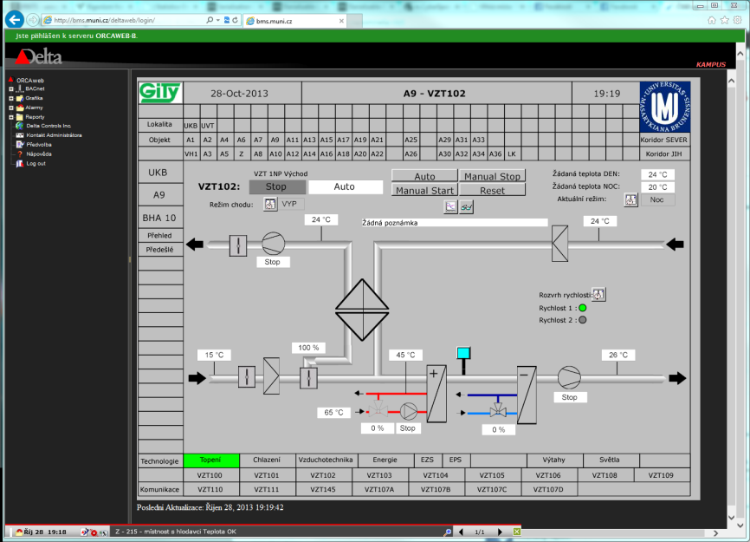
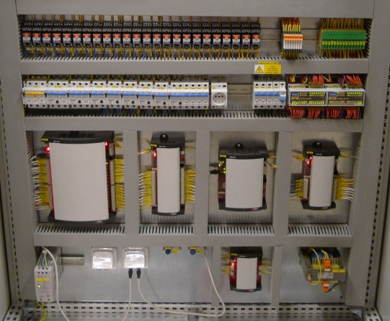
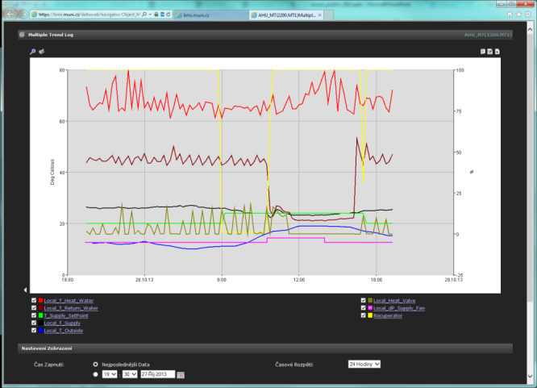
BMS (Building management system)
Monitors and controls building automation systems
MU has large BMS (40 buildings, 1000 devices,...)

Slide 8
Motivation
Facility manager should be able to query the BMS system in similar manner to those examples:
  Show me which rooms on the second floor of A11 building had running AC units during last 8 weekends.
  Tomorrow morning, I want to receive report about electricity consumption in 5 minute intervals for those 4 buildings during this night.
  I want to know which devices influence temperature in office of Mr./Mrs. XY.
  For all buildings at University Campus, compare electricity consumption per square meter.

Slide 9
Problem
Issues od building operation analysis

Slide 10
Issues of BMS
Inaccessible data
Missing semantics
Inflexible built-in analytical features
=>
Advanced analytical tools are unavailable for large-scale environments
Integration of BMS, BIM and CAFM does not exist

Slide 11
Two types of users
BMS contain precise and detailed data about building operation
Those data are not easily accessible
Two kinds of people:
  Knows how to analyze data but can‘t get them (Facility managers)
  Knows how to get the data but can‘t analyze them (BMS operators)

Slide 12
Methods & Areas of research
Steps towards flexible and efficient analysis

Slide 13
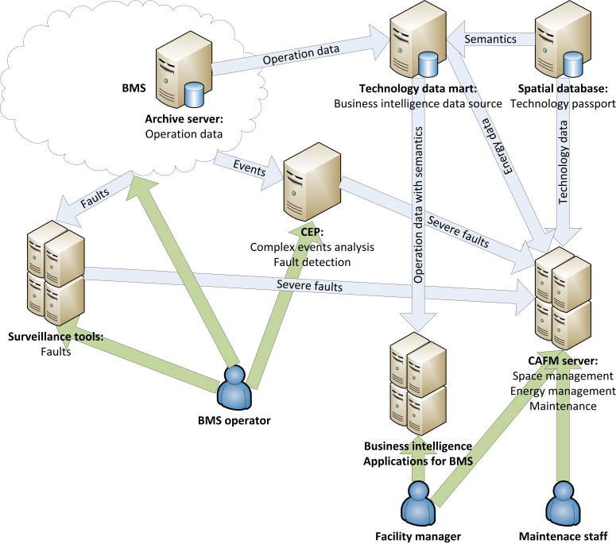
Methods and areas of research
Systems architecture
Exposing the BMS data
BMS data semantics
BMS specific operators
Query typology
Query definition
Visualization of results

Slide 14
Results
Existing applications & tools, Work in progress

Slide 15
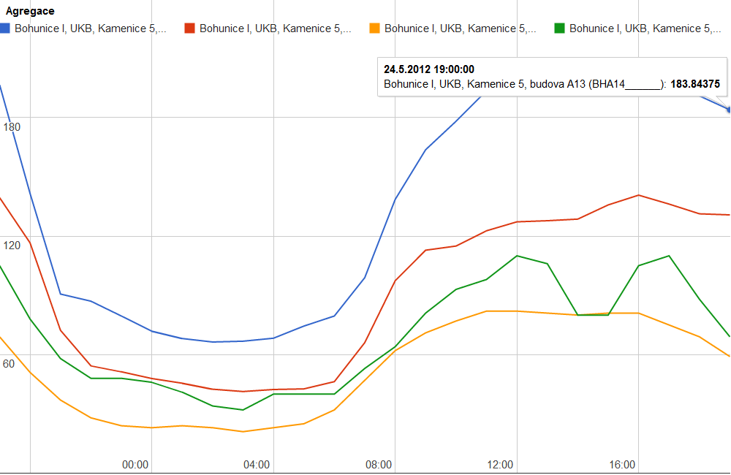
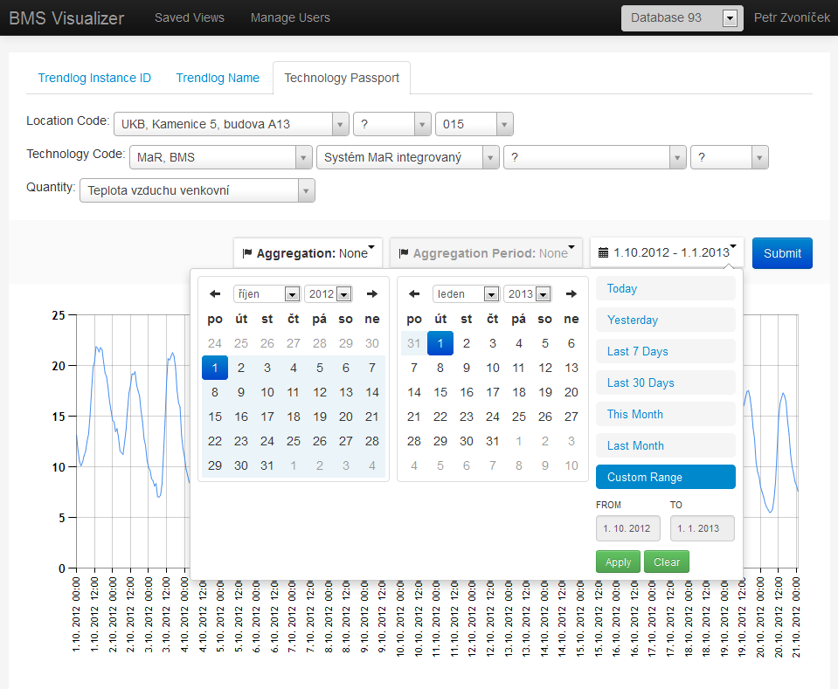
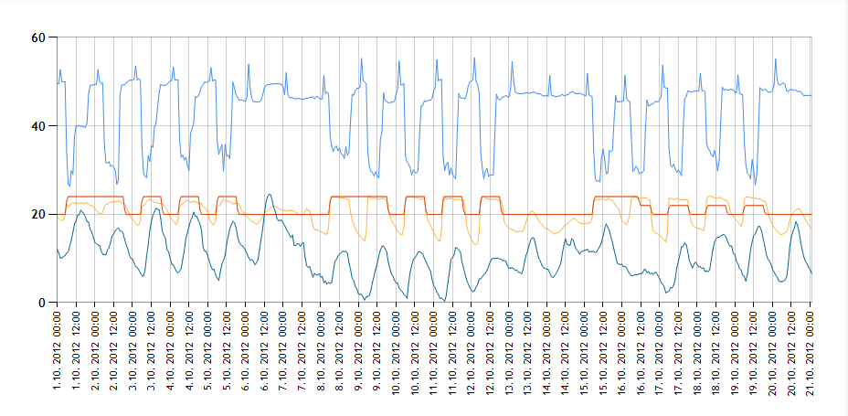
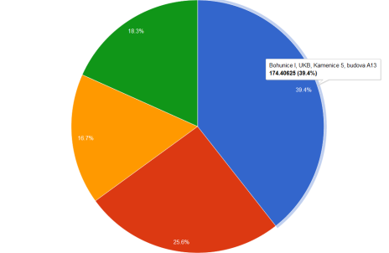
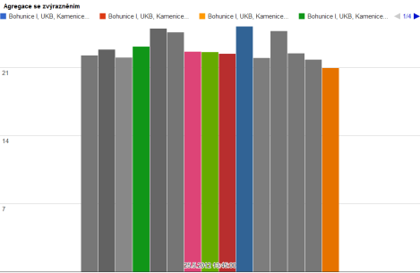
Results
Exposing data
  Technology data mart
  BMS API
Integrating BMS&BIM
  Ontology repository
Analysis & UI
  CEP engine
  Archive data browser
  Machine learning methods
Notes:
Tools are made without the support of ontology – repeating problems lead us to its development

Slide 16
Conclusions
Benefits of proposed solution

Slide 17
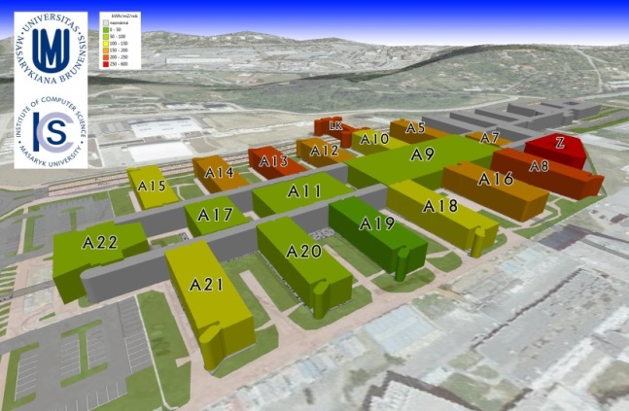
Conclusion
The main goal:
  Platform/Architecture for FM data processing
Developers will focus on:
  Analytical methods
  Convenient user interfaces
Facility managers will be provided with:
  Direct querying of the BMS
  Flexible reports
  Advanced analytical tools
  Incorporation of BMS data into CAFM
Notes:
Platform contains APIS, OLAP, ontology repository, guidlines for querying
Development of new applications will be reduced to fornt-end and analytical features (machine learning,...)
Not many people understands all areas - BMS, GIS, AI
Incorporation of BMS data into decission support tools provided by CAFM

Slide 18
Thank You for your attention.
Questions?

